Slide 1
Query by Singing and Humming System
LIN CHIAO WEI
2015/12/02

Slide 2
QBSH
Retrieve a song when forgetting the names of singer and song.
Extracting information from the humming input, comparing with database, and ranking by similarity.
Include three main part:
Onset detection
Pitch estimation
Melody matching

Slide 3
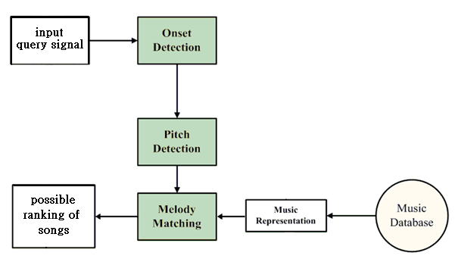
system diagram

Slide 4
Onset detection
- Magnitude Method
- Short-term Energy Method
- Surf Method
- Envelope Match Filter
Pitch estimation
- Autocorrelation Function
- Average Magnitude Difference Function
- Harmonic Product Spectrum
- Proposed Method
Melody matching
- Hidden Markov Model
- Dynamic Programming
- Linear Scaling

Slide 5
Onset detection
- Magnitude Method
- Short-term Energy Method
- Surf Method
- Envelope Match Filter
Pitch estimation
- Autocorrelation Function
- Average Magnitude Difference Function
- Harmonic Product Spectrum
- Proposed Method
Melody matching
- Hidden Markov Model
- Dynamic Programming
- Linear Scaling

Slide 6
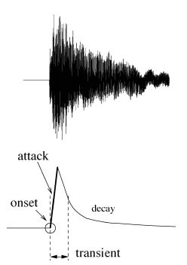
Onset
Onset refers to the beginning of a sound or music
note.
Capture the sudden changes of volume in music
signal.
[1] J. P. Bello, L. Daudet, S. Abdallah et al., “A tutorial on onset detection in music signals,” Speech and Audio Processing, IEEE Transactions on, vol. 13, no. 5, pp. 1035-1047, 2005.

Slide 7
Magnitude Method
Use volume as feature.
Steps:
Find envelope amplitude:
$$A_{k}=max\left(LPF\{x\left[n\right]\} | kn_{0}≤n≤(k+1)n_{0}\right)$$
(2) Magnitude difference:
$D_{k}=A_{k}−A_{k−1}$
(3) If $D_{k}>threshold$, $kn_{0}$ is recognized as the location of onset.
Disadvantage: highly effected by the background noise and the chosen threshold value
Notes:
difference over the threshold value, it means that there is a sudden, sufficient energy growth, which is exactly the position of onset.

Slide 8
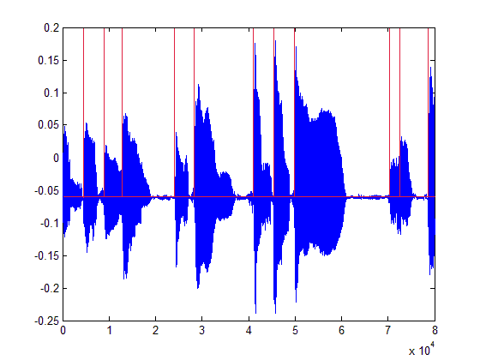
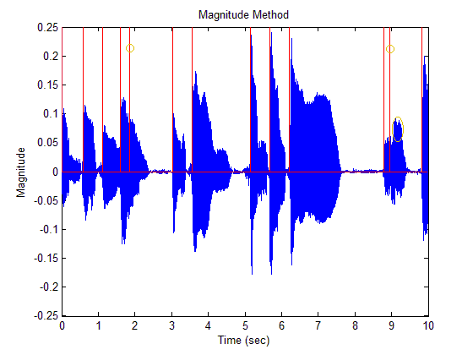
Magnitude Method
Notes:
difference over the threshold value, it means that there is a sudden, sufficient energy growth, which is exactly the position of onset.

Slide 9
Short-term Energy Method
Use energy as feature.
Disadvantage: sensitive to noise and the chosen threshold value
Two ways to implement.

Slide 10
Short-term Energy Method (1)
Type 1: similar to magnitude method.
Steps:
$E_{k}=\sum_{n=kn_{0}}^{\left(k+1\right)n_{0}−1}{x^{2}[n]}$
(2) $D_{k}=E_{k}−E_{k−1}$
(3) If $D_{k}>threshold$, $kn_{0}$ is recognized as the location of onset.

Slide 11
Short-term Energy Method (2)
Type 2: transfer to binary sequence.
Steps:
(1) $E_{k}=\sum_{n=kn_{0}}^{\left(k+1\right)n_{0}−1}{x^{2}[n]}$
(2)$D_{k}=\left\{\begin{aligned}1, if E_{k}>threshold \\ 0, if E_{k}≤threshold\end{aligned}\right.$
(3) For each continuous 1-sequences, set the first one as onset and the
last one as offset.
0 | 0 | 1 | 1 | 1 | 0 | 0 | 1 | 1 | 1 | 1 | 0
↑onset
↑offset
↑onset
↑offset
Notes:
假設二個note之間一定有silence

Slide 12
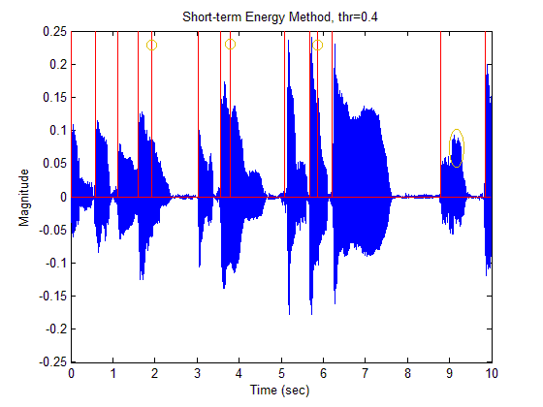
Short-term Energy Method

Slide 13
Surf Method
Use the slope of envelope to detect onsets.
Disadvantage: require more computation time.
[2] S. Pauws, "CubyHum: a fully operational" query by humming" system.“, ISMIR, pp. 187-196, 2002

Slide 14
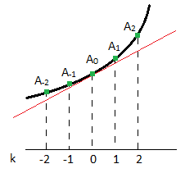
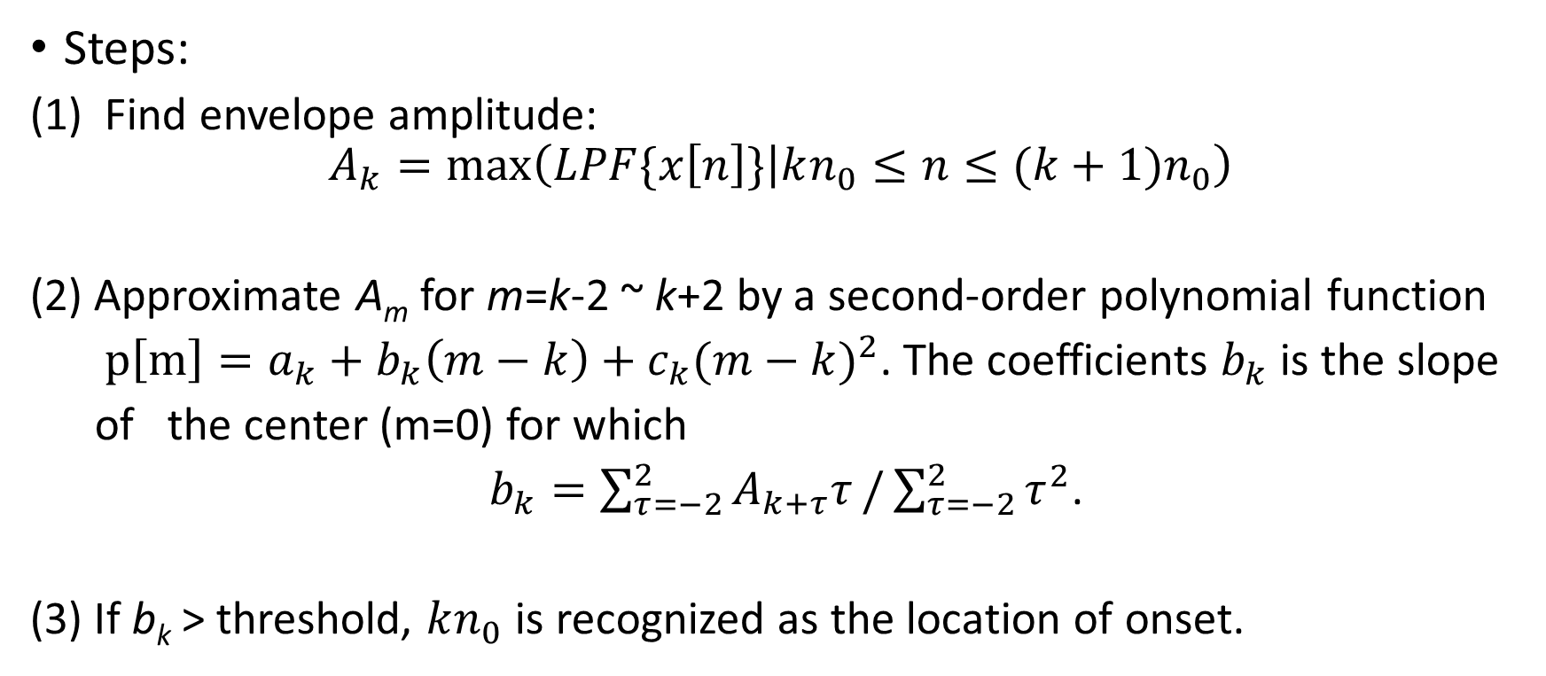
Surf Method
Steps:
Find envelope amplitude:
$$A_{k}=max\left(LPF\{x\left[n\right]\} | kn_{0}≤n≤(k+1)n_{0}\right)$$
(2) Approximate A_{m} for m=k-2 ~ k+2 by a second-order polynomial function
$p\left[m\right]=a_{k}+b_{k}\left(m−k\right)+c_{k}{(m−k)}^{2}$. The coefficients $b_{k}$ is the slope
of the center (m=0) for which
$b_{k}=\sum_{τ=−2}^{2}{A_{k+τ}τ}/\sum_{τ=−2}^{2}{τ^{2}}$.
(3) If b_{k} > threshold, $kn_{0}$ is recognized as the location of onset.

Slide 15
Surf Method

Slide 16
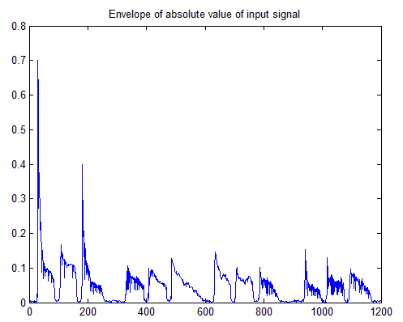
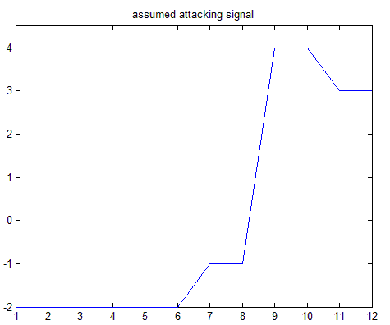
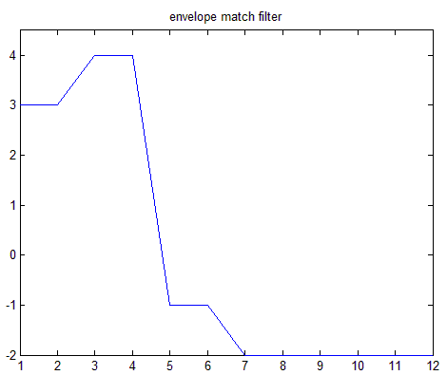
Envelope Match Filter

Slide 17
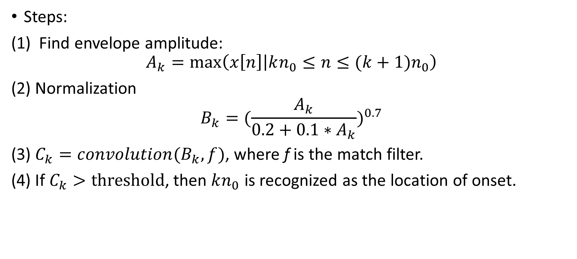
Envelope Match Filter
Steps:
Find envelope amplitude:
$$A_{k}=max\left(x\left[n\right] | kn_{0}≤n≤(k+1)n_{0}\right)$$
(2) Normalization
$$B_{k}={(\frac{A_{k}}{0.2+0.1∗A_{k}})}^{0.7}$$
(3) $C_{k}=convolution(B_{k},f)$, where f is the match filter.
(4) If $C_{k}>threshold$, then $kn_{0}$ is recognized as the location of onset.
Notes:
B: normalize 不是onset部份的波動也會放大→ ^0.7
Auto-correlation= f* conj(f(-t))

Slide 18
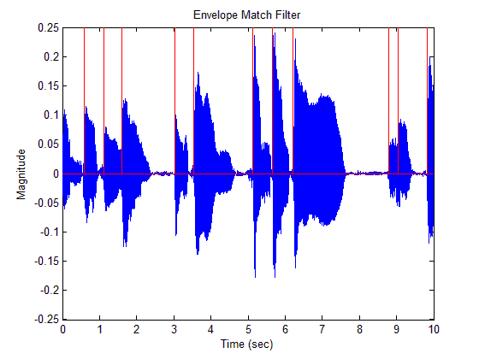
Envelope Match Filter
Notes:
B: normalize 不是onset部份的波動也會放大→ ^0.7

Slide 19
Onset detection
- Magnitude Method
- Short-term Energy Method
- Surf Method
- Envelope Match Filter
Pitch estimation
- Autocorrelation Function
- Average Magnitude Difference Function
- Harmonic Product Spectrum
- Proposed Method
Melody matching
- Hidden Markov Model
- Dynamic Programming
- Linear Scaling

Slide 20
Pitch extraction
Estimate the fundamental frequency of each note.
Sound produced by humming are along with harmonics which interrupt the estimation of fundamental frequency.

Slide 21
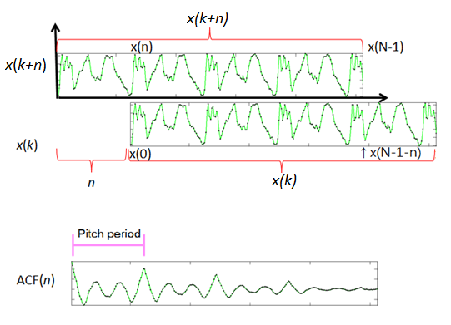
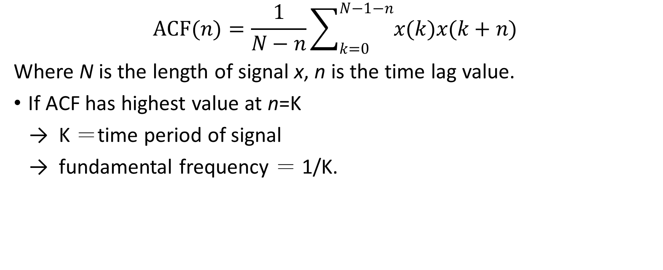
Autocorrelation Function
$$ACF(n)=\frac{1}{N−n}\sum_{k=0}^{N−1−n}{x(k)x(k+n)}$$
Where N is the length of signal x, n is the time lag value.
If ACF has highest value at n=K
→ K ＝time period of signal
→ fundamental frequency ＝ 1/K.
[4] J.-S. R. Jang, “Audio signal processing and recognition,” Information on http://www. cs. nthu. edu. tw/~ jang, 2011.
Notes:
Inner product of overlap part

Slide 22
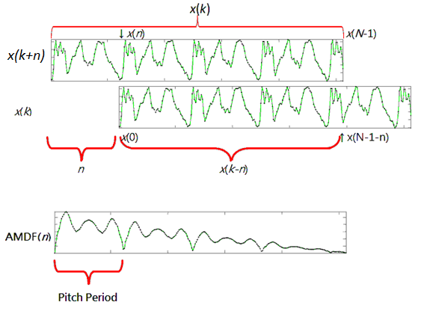
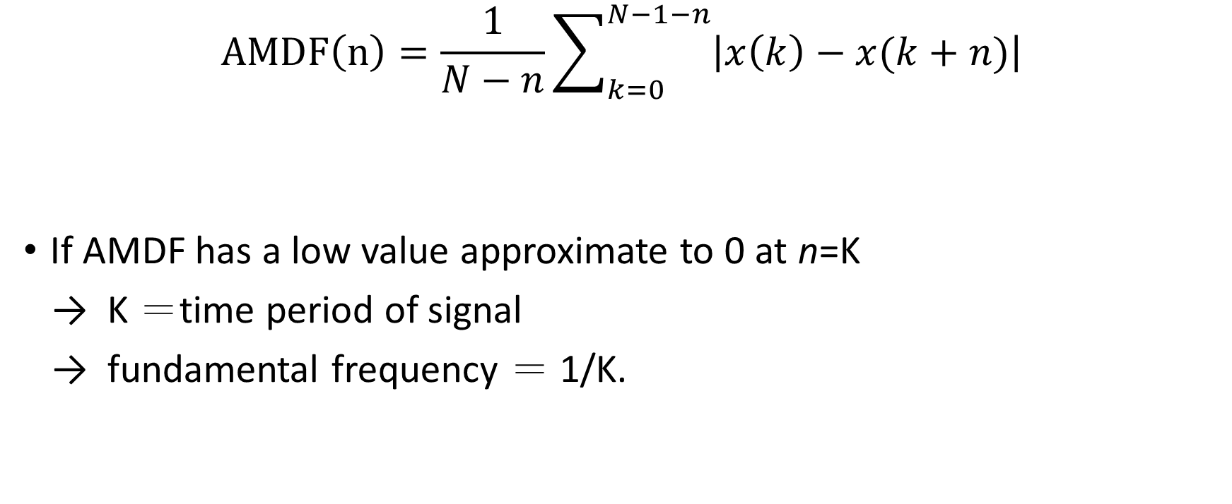
Average Magnitude Difference Function
$$AMDF\left(n\right)=\frac{1}{N−n}\sum_{k=0}^{N−1−n}{\left|x\left(k\right)−x(k+n)\right|}$$
If AMDF has a low value approximate to 0 at n=K
→ K ＝time period of signal
→ fundamental frequency ＝ 1/K.
[4] J.-S. R. Jang, “Audio signal processing and recognition,” Information on http://www. cs. nthu. edu. tw/~ jang, 2011.
Notes:
max(amdf)-amdf-max(amdf)*linspace(0,1,length(amdf))‘
抓max

Slide 23
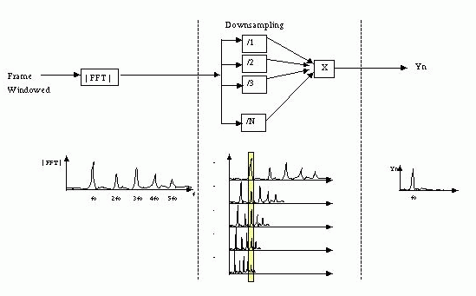
Harmonic Product Spectrum
pitch extraction method in the frequency domain
[4] J.-S. R. Jang, “Audio signal processing and recognition,” Information on http://www. cs. nthu. edu. tw/~ jang, 2011.

Slide 24
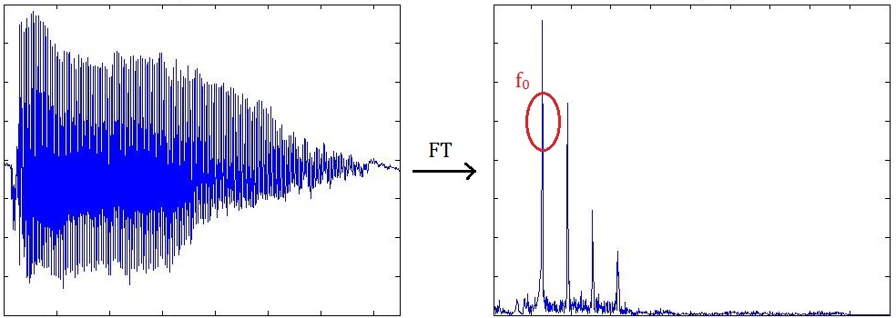
Proposed method
Frequency domain method
Get top 3 peaks at f₁, f₂, f₃. Fundamental frequency=min(f₁, f₂, f₃).

Slide 25
Onset detection
- Magnitude Method
- Short-term Energy Method
- Surf Method
- Envelope Match Filter
Pitch estimation
- Autocorrelation Function
- Average Magnitude Difference Function
- Harmonic Product Spectrum
- Proposed Method
Melody matching
- Hidden Markov Model
- Dynamic Programming
- Linear Scaling

Slide 26
Melody Matching
Transfer the pitch sequence extracted into MIDI number.
Compare the numeral sequence of sung input with those in database.
Notes:
Difficulty: sing at wrong key, sing too many or too few notes or sing from any part of the song

Slide 27
Dynamic Programming
A method to find an optimum solution to a multi-stage decision problem.
Use in DNA sequence matching.
Alignment matrix constructed by query sequence Q and target sequence T
$$AlignScore\left(i,j\right)=max\left\{\begin{aligned}&\left.AlignScore\left(i−1,j−1\right)+matchScore(q_{i},t_{j}\right) \\ &AlignScore\left(i−1,j\right)−1 \\ &AlignScore\left(i,j−1\right)−1\end{aligned}\right.$$
$$matchScore\left(q_{i},t_{j}\right)=\left\{\begin{aligned}&2, if q_{i}=t_{j} \\ &−2, otherwise\end{aligned}\right.$$
Notes:
As long as solution can be refine recursively
DNA {A,T,C,G}

Slide 28
Dynamic Programming
$$AlignScore\left(i,j\right)=max\left\{\begin{aligned}&\left.AlignScore\left(i−1,j−1\right)+matchScore(q_{i},t_{j}\right) \\ &AlignScore\left(i−1,j\right)−1 \\ &AlignScore\left(i,j−1\right)−1\end{aligned}\right.$$
$$matchScore\left(q_{i},t_{j}\right)=\left\{\begin{aligned}&2, if q_{i}=t_{j} \\ &−2, otherwise\end{aligned}\right.$$
Target Query |  | G | A | B | B
 | 0 | -1 | -2 | -3 | -4
G | -1 | 2 | 1 | 0 | -1
D | -2 | 1 | 0 | -1 | -2
A | -3 | 0 | 3 | 2 | -1
C | -4 | -1 | 2 | 1 | 0
B | -5 | -2 | 1 | 4 | 3
$$AlignScore\left(i,j\right)=max\left\{\begin{aligned}&\left.1+matchScore(q_{i},t_{j}\right) =3 \\ &0−1 =−1 \\ &0−1 =−1\end{aligned}\right.$$
Notes:
Trace back

Slide 29
Dynamic Programming
Target Query |  | G | A | B | B
 | 0 | -1 | -2 | -3 | -4
G | -1 | 2 | 1 | 0 | -1
D | -2 | 1 | 0 | -1 | -2
A | -3 | 0 | 3 | 2 | -1
C | -4 | -1 | 2 | 1 | 0
B | -5 | -2 | 1 | 4 | 3
route | 1 | 2 | 3 | 4
Target | G - AB - B | G - A - BB | G - ABB | G - A - B B
Query | GDA - CB | GDAC - B | GDACB | G D A C B -

Slide 30
Markov Model
Markov model: a probability transition model
Three basic elements:
(1)A set of states$S=\{s_{1}, s_{2},…, s_{N}\}$
(2)A set of transition probabilities T
(3)A initial probability distribution π
from to | α | β | γ | ω
α
β | 1 | 0.5
γ |  | 0.5
ω |  |  | 1 | 1

Slide 31
Hidden Markov Model
Hidden Markov model: an extended version of Markov Model.
Each state is a probability function.
RGBGGBBGRRR……
[8] Fundamentals of Speech Signal Processing, http://speech.ee.ntu.edu.tw/DSP2015Autumn/

Slide 32
Hidden Markov Model for melody matching
No zero-probability transition exists.
→ Give the observations not occur a minimal probability $P_{m}$
From To | α | β | γ | ω | τ
α | 0.05 | 0.05 | 0.05 | 0.05 | 0.05
β | 1 | 0.5 | 0.05 | 0.05 | 0.05
γ | 0.05 | 0.5 | 0.05 | 0.05 | 0.05
ω | 0.05 | 0.05 | 1 | 1 | 0.05
τ | 0.05 | 0.05 | 0.05 | 0.05 | 0.05
From To | α | β | γ | ω | τ
α | 0.0425 | 0.0434 | 0.0425 | 0.0425 | 0.2
β | 0.8333 | 0.4348 | 0.0425 | 0.0425 | 0.2
γ | 0.0425 | 0.4348 | 0.0425 | 0.0425 | 0.2
ω | 0.0425 | 0.0434 | 0.8333 | 0.8333 | 0.2
τ | 0.0425 | 0.0434 | 0.0425 | 0.0425 | 0.2
τ

Slide 33
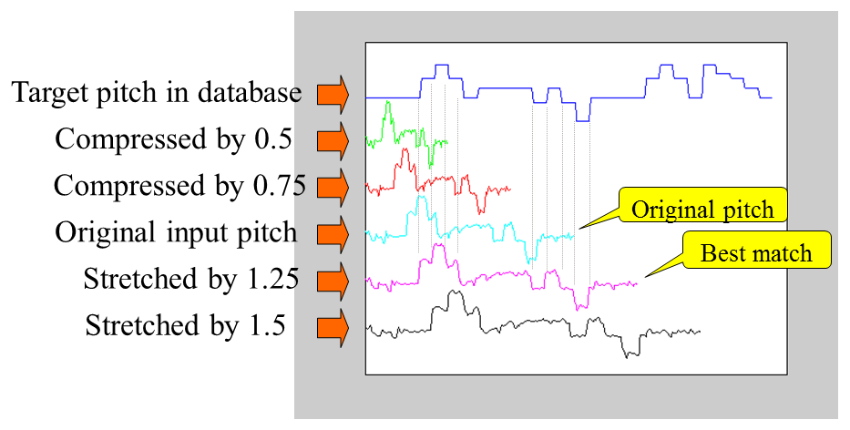
Linear Scaling
A straightforward frame-based method.
3 factors: scaling factor, scaling-factor bounds and resolution.
[4] J.-S. R. Jang, “Audio signal processing and recognition,” Information on http://www. cs. nthu. edu. tw/~ jang, 2011.

Slide 34
Conclusion
Query-By-Singing and Humming system makes people search their desired songs by content-based method.
Some onset detection methods: magnitude method, surf method, and envelope match filter.
Pitch detection method: autocorrelation function, average magnitude difference function, harmonic product spectrum and our proposed method.
Melody matching: dynamic programming, hidden-Markov model and linear scaling.
Notes:
Onset: 98% TP rate

Slide 35
Reference
[1] J. P. Bello, L. Daudet, S. Abdallah et al., “A tutorial on onset detection in music signals,” Speech and Audio Processing, IEEE Transactions on, vol. 13, no. 5, pp. 1035-1047, 2005.
[2]S. Pauws, "CubyHum: a fully operational" query by humming" system.“, ISMIR, pp. 187-196, 2002
[3] J.-J. Ding, C.-J. Tseng, C.-M. Hu et al., "Improved onset detection algorithm based on fractional power envelope match filter." pp. 709-713.
[4] J.-S. R. Jang, “Audio signal processing and recognition,” Information on http://www. cs. nthu. edu. tw/~ jang, 2011.
[5] X.-D. Mei, J. Pan, and S.-h. Sun, "Efficient algorithms for speech pitch estimation." pp. 421-424.

Slide 36
Reference
[6] M. J. Ross, H. L. Shaffer, A. Cohen et al., “Average magnitude difference function pitch extractor,” Acoustics, Speech and Signal Processing, IEEE Transactions on, vol. 22, no. 5, pp. 353-362, 1974.
[7] M. R. Schroeder, “Period Histogram and Product Spectrum: New Methods for Fundamental‐Frequency Measurement,” The Journal of the Acoustical Society of America, vol. 43, no. 4, pp. 829-834, 1968.
[8] Fundamentals of Speech Signal Processing, http://speech.ee.ntu.edu.tw/DSP2015Autumn/
[9] R. Bellman, “Dynamic programming and Lagrange multipliers,” Proceedings of the National Academy of Sciences of the United States of America, vol. 42, no. 10, pp. 767, 1956.
[10] L. R. Rabiner, “A tutorial on hidden Markov models and selected applications in speech recognition,” Proceedings of the IEEE, vol. 77, no. 2, pp. 257-286, 1989.

