Slide 1
Morphing
WU PO-HUNG

Slide 2
Morphing
http://www.youtube.com/watch?v=wZurRt0TidI

Slide 3
Outline
Introduction
Warping
  Forward Mapping
  Inverse Mapping
  Resample
Cross Dissolve
Mesh-Based Warping

Slide 4
Introduction
What is morphing?
Morphing – derived from the word metamorphosis.
Metamorphosis means to change shape, appearance or form.

Slide 5
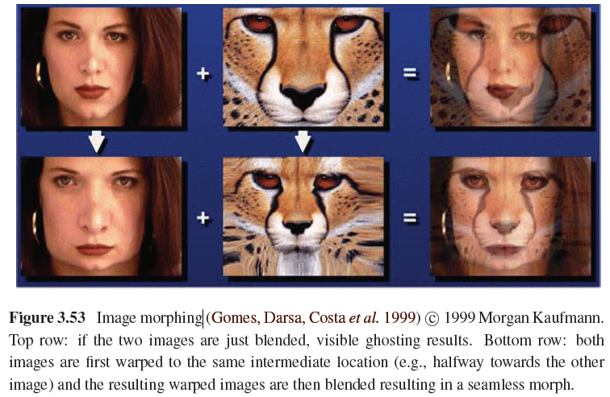
Example

Slide 6
Introduction
The morphing process consists of :
1) Warping two images so that they have the same “shape’’.
2) Cross dissolving the resulting images .

Slide 7
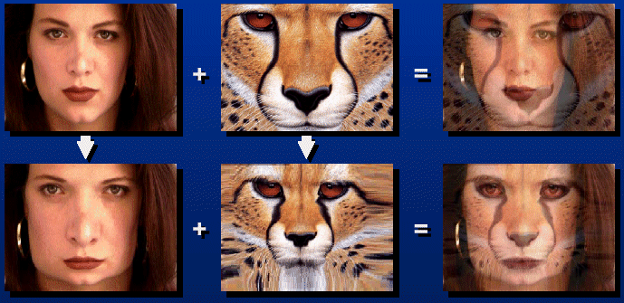
Introduction
Morphing = Object Averaging
The aim is to find “an average” between two objects
  Not an average of two images of objects…
  …but an image of the average object!
  How can we make a smooth transition in time?
    Do a “weighted average” over time t

Slide 8
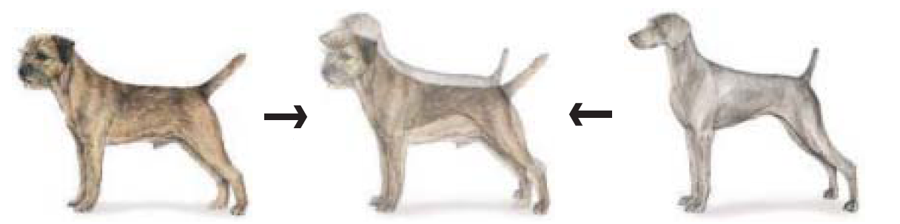
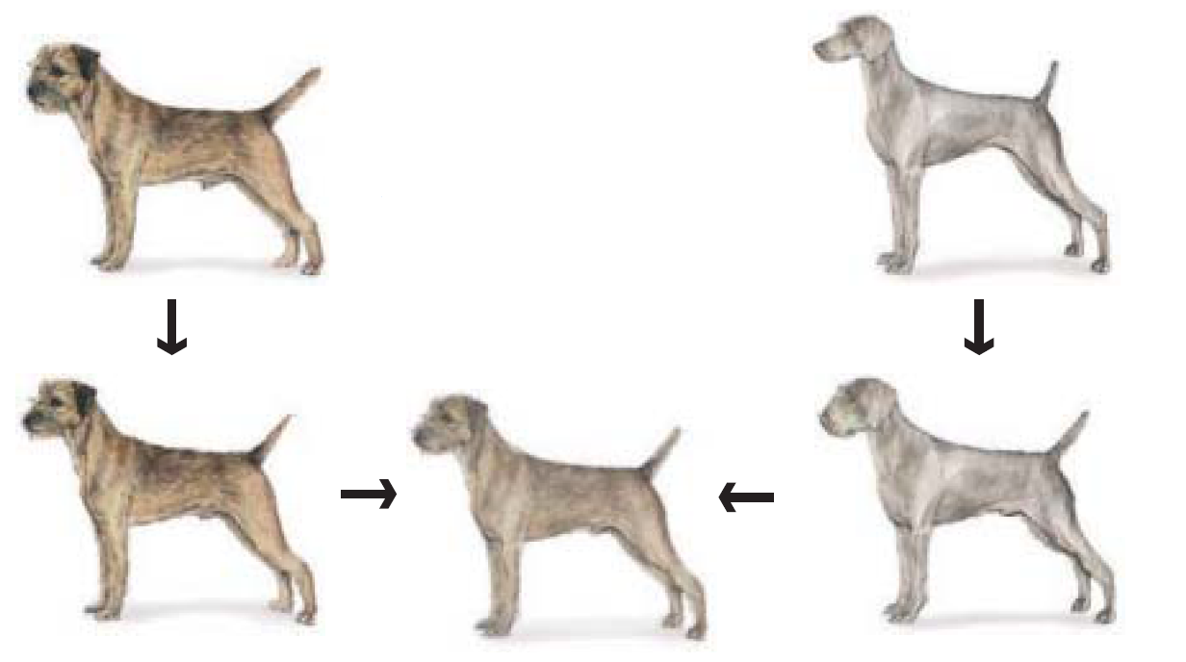
Introduction

Slide 9


WARPING
Warping an image means : apply a given deformation to it.
T(x,y)
y
y’
x
x’
f(x,y)
g(x’,y’)

Slide 10
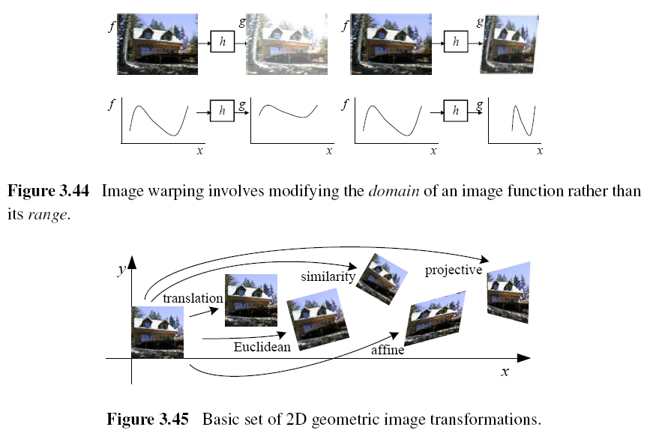
WARPING

Slide 11
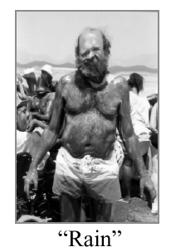
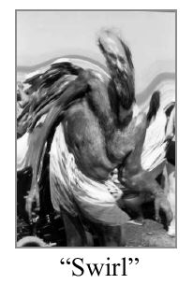
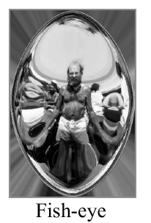
WARPING

Slide 12
WARPING
Two ways to warp an image:
→ Forward mapping.
→ Reverse mapping.

Slide 13
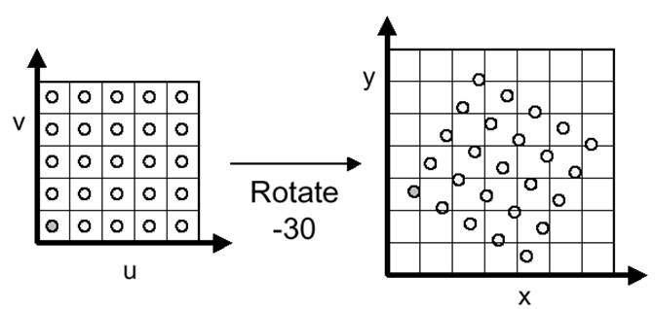
WARPING
Forward mapping
  Some destination pixels may not be covered
  Many source pixels can map to the same

Slide 14
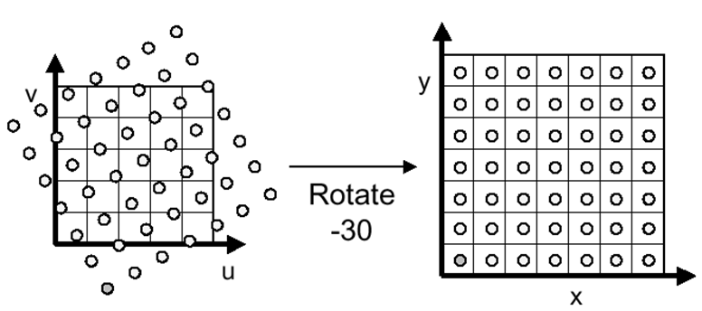
WARPING
Inverse mapping
  Must resample source
  May oversample, but much simpler!
  However, it requires an invertible warp function—not always possible

Slide 15
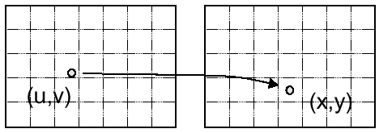
Resample
Evaluate source image at arbitrary (u, v)
  (u, v) does not usually have integer coordinates
Source Image
Destination Image

Slide 16
Resample
Some kinds of resampling
  Point resampling
  Triangle filter
  Gaussian filter
  Bilinear interpolation

Slide 17
Resample
  Point resampling

Slide 18
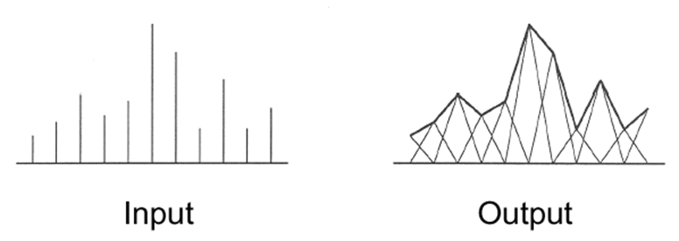
Resample
  Triangle filter
    Convolve with triangle filter

Slide 19
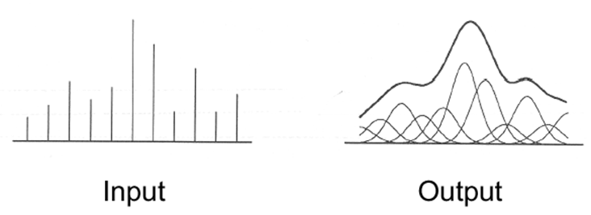
Resample
  Gaussian filter
  Convolve with Gaussian filter

Slide 20
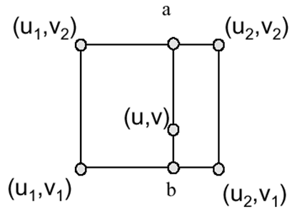
Resample
  Bilinear interpolation

Slide 21
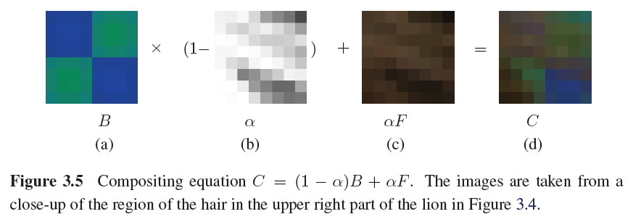
Cross Dissolve
Blend images
blend(i, j) = (1-t)src(i, j) + tdst(i, j) (0 ≤ t ≤ 1)

Slide 22
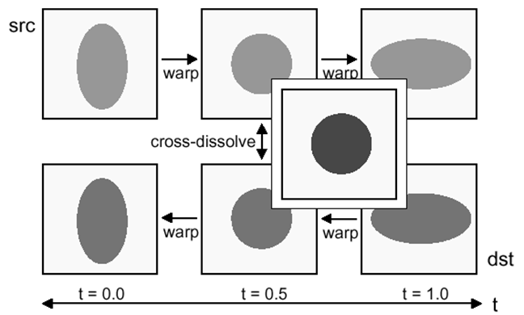
Morphing
Combines warping and cross-dissolving

Slide 23
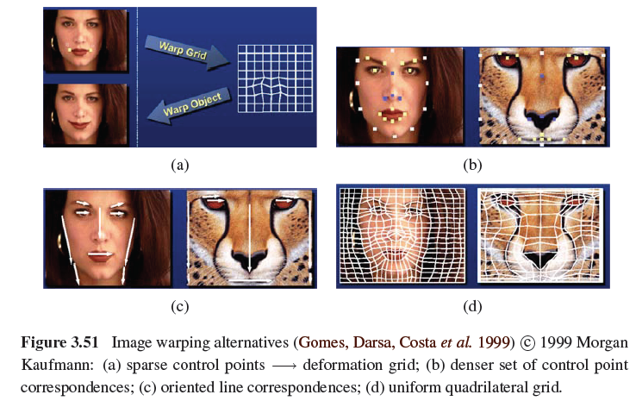
Mesh-Based Warping

Slide 24
Mesh-Based Warping

Slide 25
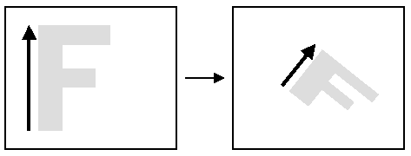
Warping with One Line Pair
What happens to the ‘F’?

Slide 26
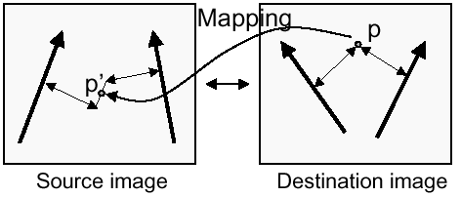
Warping with Multiple Line Pairs
Use weighted combination of points defined by each pair of corresponding lines
p’ is a weighted average

Slide 27
Thank you.

