Slide 1
High dynamic range imaging
Notes:
Basics for cameras
Some things you might want to know when you shoot pictures
First time, not well-organized yet
Scribe
Assignments
Slides available before Thursday

Slide 2
Camera pipeline
12 bits
8 bits

Slide 3
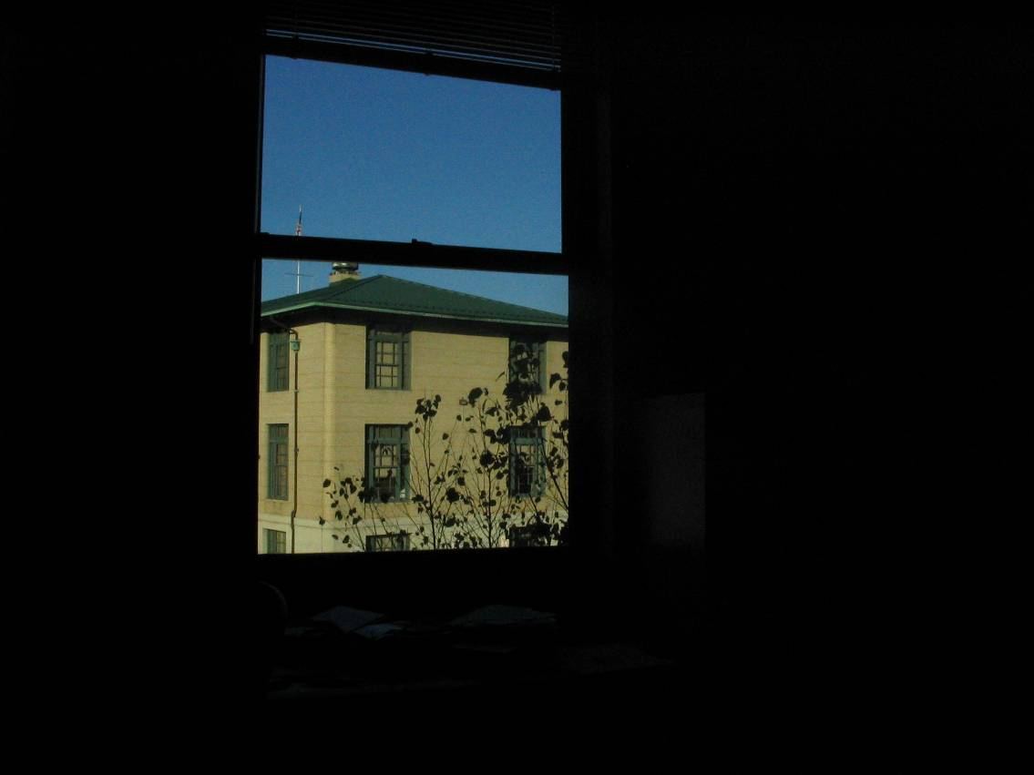
Short exposure
10⁻⁶
10⁶
dynamic range
Real world
radiance
10⁻⁶
10⁶
Picture
intensity
^{Pixel value 0 to 255}

Slide 4
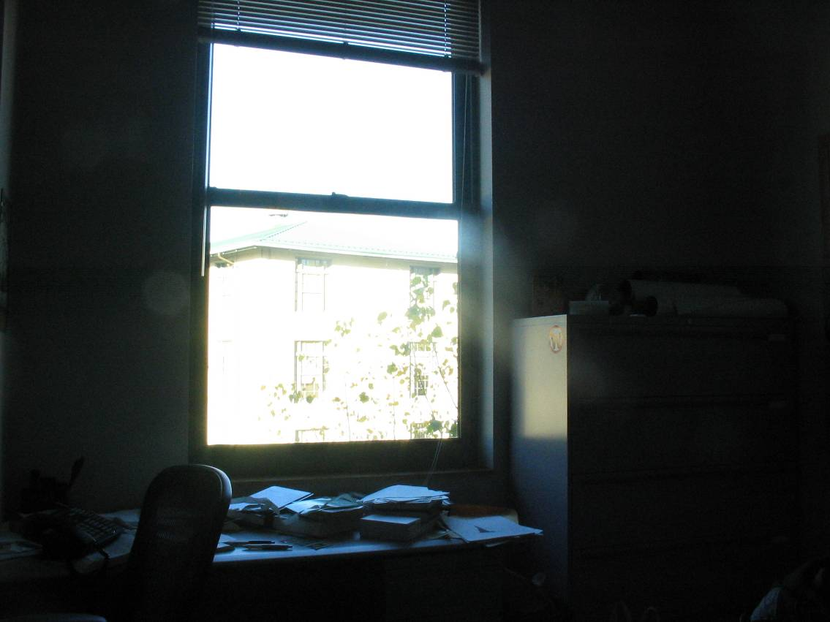
Long exposure
10⁻⁶
10⁶
dynamic range
Real world
radiance
10⁻⁶
10⁶
Picture
intensity
^{Pixel value 0 to 255}

Slide 5
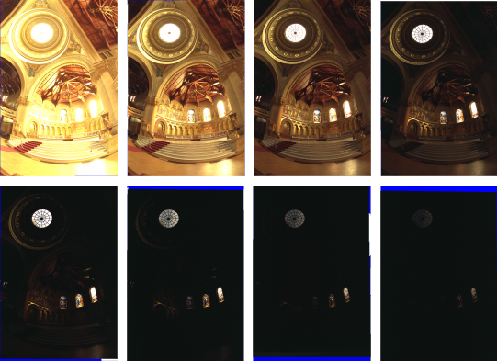
Varying shutter speeds

Slide 6
Recovering High Dynamic Range Radiance Maps from Photographs
Paul E. Debevec Jitendra Malik
SIGGRAPH 1997
Notes:
Basics for cameras
Some things you might want to know when you shoot pictures
First time, not well-organized yet
Scribe
Assignments
Slides available before Thursday

Slide 7
Recovering response curve
12 bits
8 bits

Slide 8
Recovering response curve
Image series
• 2
• 2
• 2
• 2
• 2
• 3
• 3
• 3
• 3
• 3
• 1
• 1
• 1
• 1
• 1
Δt = 2 sec
Δt = 1 sec
Δt = 1/2 sec
Δt = 1/4 sec
Δt = 1/8 sec
255
0
Notes:
10

Slide 9
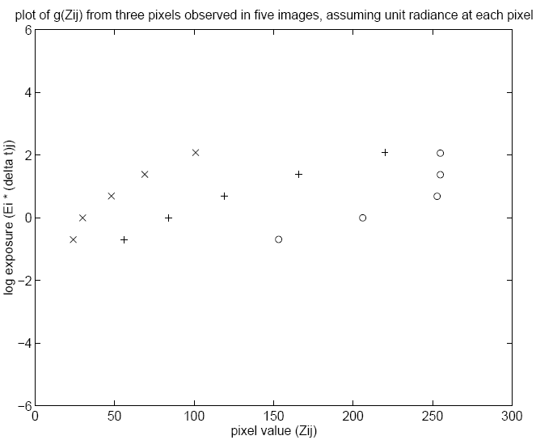
Idea behind the math
ln2

Slide 10
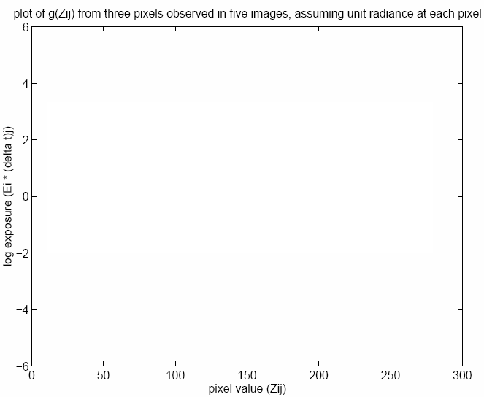
Idea behind the math
Each line for a scene point.
The offset is essentially
determined by the
unknown E_{i}

Slide 11
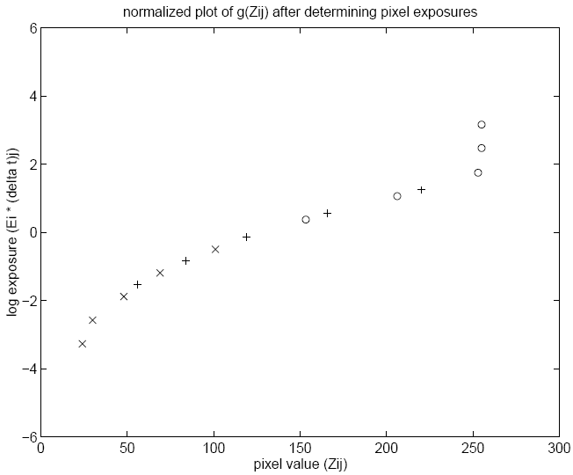
Idea behind the math
Note that there is a shift
that we can’t recover

Slide 12
Math for recovering response curve
Notes:
g’(z)=g(z+0.5)-g(z-0.5)
g’’(z)=g’(z+0.5)-g’(z-0.5)
=[g(z+1)-g(z)]-[g(z)-g(z-1)]
=g(z+1)-2g(z)+g(z-1)
g(z+1) - 2*g(z) + g(z-1) 用 Tylor 展開式展完相消就變 g''(z)
255+N variables
N*P equations

Slide 13
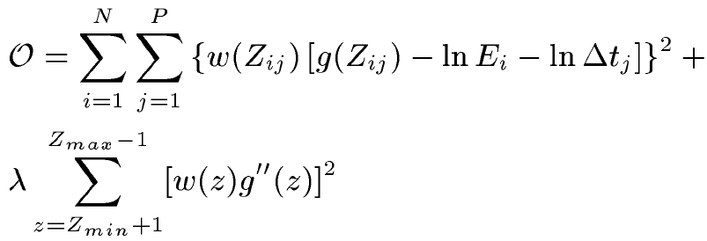
Recovering response curve
The solution can be only up to a scale, add a constraint
Add a hat weighting function

Slide 14
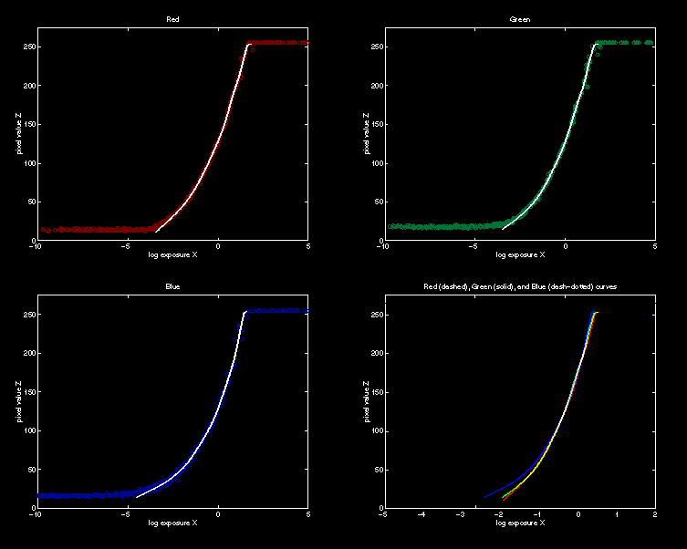
Recovered response function

Slide 15
Constructing HDR radiance map
combine pixels to reduce noise and obtain a more reliable estimation

Slide 16
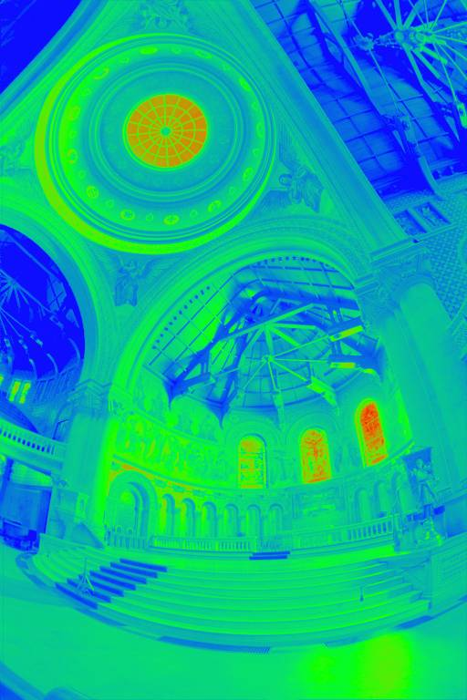
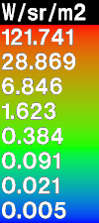
Reconstructed radiance map

Slide 17
Gradient Domain High Dynamic Range Compression
Raanan Fattal Dani Lischinski Michael Werman
SIGGRAPH 2002

Slide 18
The method in 1D
log
derivative
attenuate
exp
integrate

Slide 19
The method in 2D
Given: a log-luminance image H(x,y)
Compute an attenuation map
Compute an attenuated gradient field G:
Problem: G may not be integrable!
Notes:
Now let’s review the process in 2D.
Given a 2D log-luminance image H, we compute an attenuation map phi based on the magnitudes of the gradients in H. We’ll see how to construct this map later on.
Then we attenuate the gradient field by multiplying it with the map phi, and we get a new vector field G.
So now, just like in 1D we would like to reconstruct an image by integrating G. But, in the 2D case there is a problem: the modified vector field G is generally not integrable!

Slide 20
Solution
Look for image I with gradient closest to G in the least squares sense.
I minimizes the integral:
Poisson
equation
Notes:
The way we chose to overcome this problem is by searching for an image I, whose gradient field is closest to our field G, in the least squares sense.
This is done by minimizing the following integral taken over the entire image. The functional F inside the integral simply measures the L2 distance between the gradient field of I and the vector field G.

Slide 21
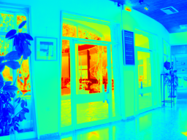
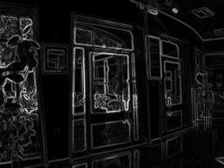
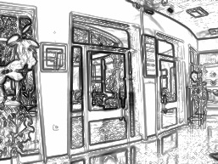
Attenuation
log(Luminance)
gradient magnitude
attenuation map
Notes:
We do this by computing a (Gaussian) pyramid of our luminance image.
For each level in the pyramid we compute its own gradient magnitude map.
And based on the gradient magnitudes we compute an attenuation map for each level. These map contain a factor between 0 and 1 at each pixel. Small gradients correspond to factors around 1, and high gradients correspond to smaller factors: the higher the gradient, the smaller its factor.
Now we have one such attenuation map for each pyramid level, but we would like to perform the attenuation at the original image resolution, so we will now combine them into a single map at the finest resolution level.

Slide 22
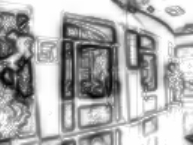
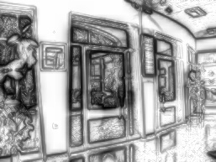
Multiscale gradient attenuation
interpolate
X
=
interpolate
X
=
Notes:
This is done in a coarse-to-fine manner: we interpolate each attenuation map to the next level (click),
There we multiply it with the map already computed for that level to get an accumulated attenuation map (click),
And then we repeat this again and again until we reach the full resolution level.

Slide 23
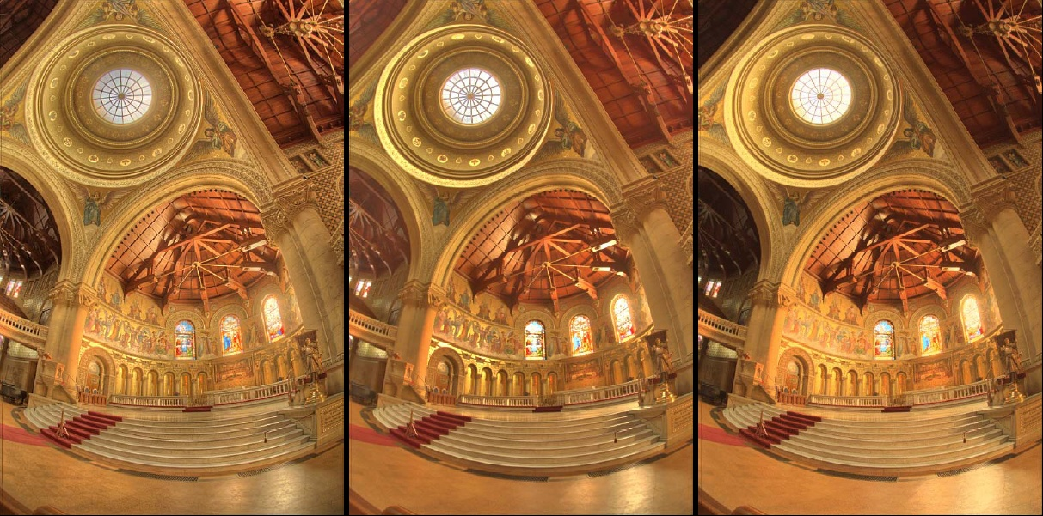
Informal comparison
Gradient domain [Fattal et al.]
Bilateral [Durand et al.]
Photographic [Reinhard et al.]

Slide 24
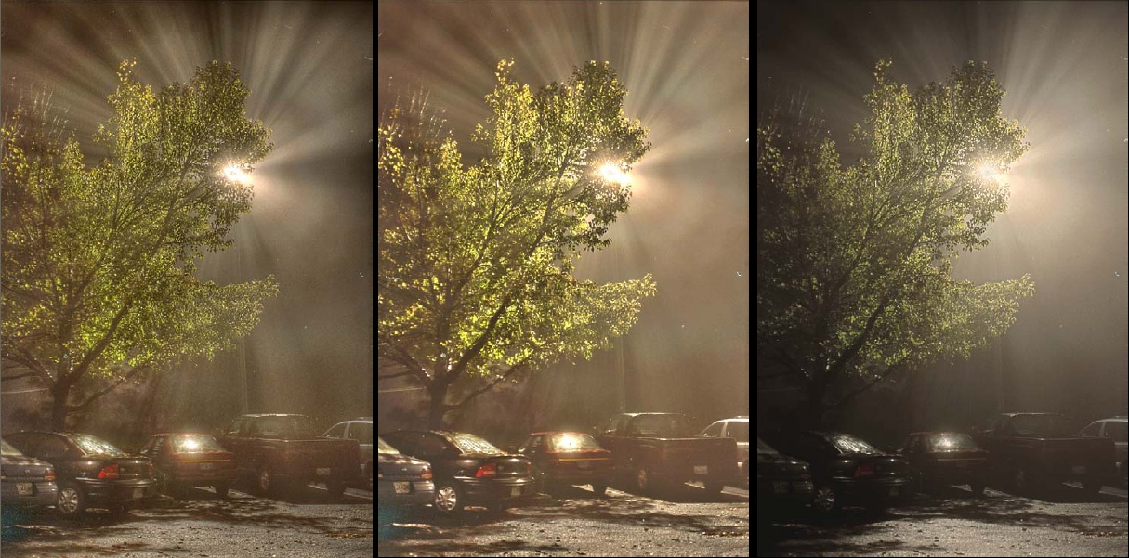
Informal comparison
Gradient domain [Fattal et al.]
Bilateral [Durand et al.]
Photographic [Reinhard et al.]

Slide 25
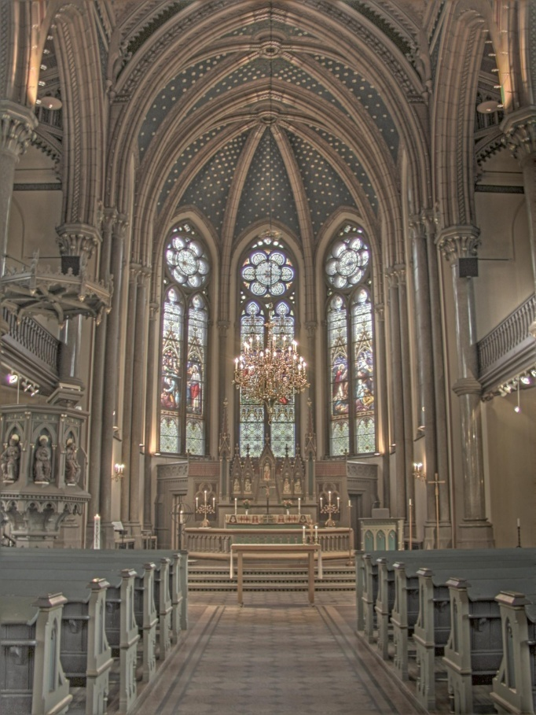
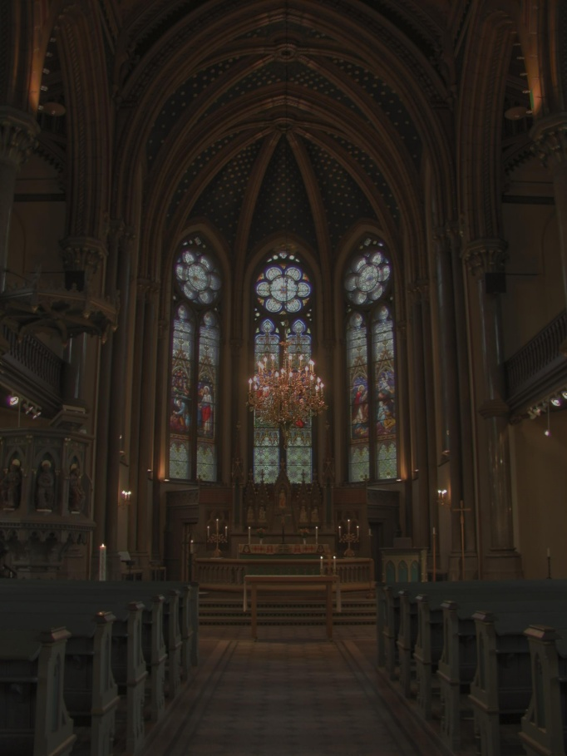
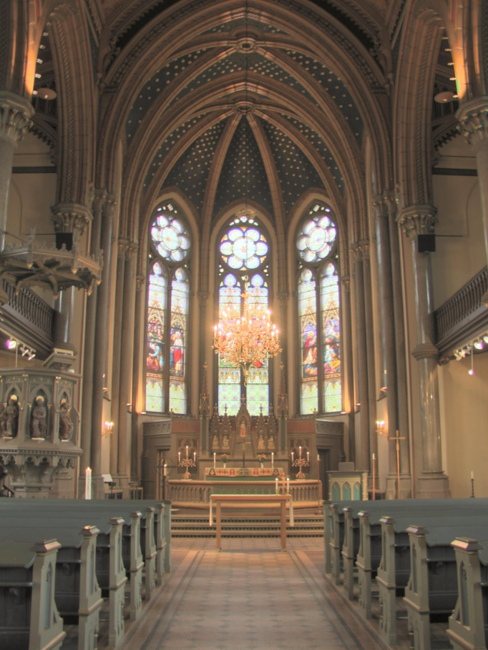
Informal comparison
Gradient domain [Fattal et al.]
Bilateral [Durand et al.]
Photographic [Reinhard et al.]

Slide 26
Local Laplacian Filters : Edge-aware Image Processing with a Laplacian Pyramid
Sylvain Paris Samuel W. Hasinoff Jan Kautz
SIGGRAPH 2011

Slide 27
Background on Gaussian Pyramids
Resolution halved at each level using Gaussian kernel
level 3
(residual)
level 2
level 1
level 0

Slide 28
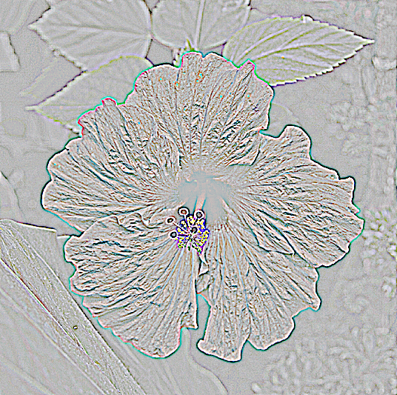
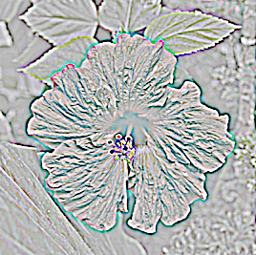
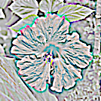
Background on Laplacian Pyramids
Difference between adjacent Gaussian levels
level 3
(residual)
level 2
level 1
level 0

Slide 29
Intuition for 1D Edge
=
+
+
Input signal
Discontinuity
Texture
Smooth
Decomposition for the sake of analysis only
We do not compute it in practice
Notes:
And finally, a smooth component, that describes smooth tonal variation

Slide 30
Intuition for 1D Edge
=
+
+
Input signal
Discontinuity
Texture
Smooth
Does not contribute to Lap. pyramid
at that scale (d²/dx²=0)
Notes:
For the rest of our analysis we ignore the smooth component.
We can do this because it has zero 2nd derivatives, so it doesn't contribute to any coefficients at this scale

Slide 31
Ideal Texture Increase
Discontinuity
Texture
Keep unchanged
Amplify
Notes:
As an example, let's consider the application of detail enhancement, which corresponds to increasing the texture.
In terms of our decomposition, ideally … we would hold the discontinuity unchanged … and amplify the texture component

Slide 32
Our Texture Increase
σ
σ
σ
σ
Input signal
Local nonlinearity
“Locally good” version
user-defined parameter σ defines texture vs. edges
Notes:
In our approach, we consider each coefficient separately – and in particular let's take a look at the coefficient corresponding to the circled pixel. By applying a nonlinearity that's specific to that coefficient, we get a processed version of the input that has the desired local properties
Here, the circled coefficient is on the left side of the discontinuity, its local result only affects the left side. … The coefficients on the right get processed too, but they have their own local results.
For texture increase, we use an S-shaped curve, where the S is centered at the value of the circled coefficient. This S has a limited range, defined by a user parameter, that distinguishes fine-scale texture (which gets enhanced) from larger discontinuities (which are unaffected). We can also visualize this on the input signal to see how only some coefficients affect the result.

Slide 33
Our Texture Increase
=
+
+
“Locally good”
Only left side is affected
Discontinuity
Unaffected
☺
Texture
Left side is ok,
right side is not
😐
Smooth
Does not contribute to Lap. pyramid
at that scale (d²/dx²=0)
Notes:
Let’s look at the locally-good result In terms of our decomposition.
The step edge, as desired, is unaffected,
For the texture component, only the left side has been processed – but intuitively, that’s okay.

Slide 34
Discussion
Negligible because collocated with discontinuity
Negligible because Gaussian kernel ≈ 0
=
+
+
“Locally good”
Only left side is affected
Discontinuity
Unaffected
☺
Texture
Left side is ok,
right side is not
😐
Smooth
Does not contribute to Lap. pyramid
at that scale (d²/dx²=0)
Good approximation
to ideal case overall ☺
(formal treatment in paper)
Notes:
The takeaway message is that overall, the locally-good result is a good approximation to the ideal case.
In the paper, we have a more formal version of this analysis.

Slide 35
Texture Manipulation Input
Notes:
I’ll start by showing some results of our method for texture manipulation
Here’s a sample input image

Slide 36
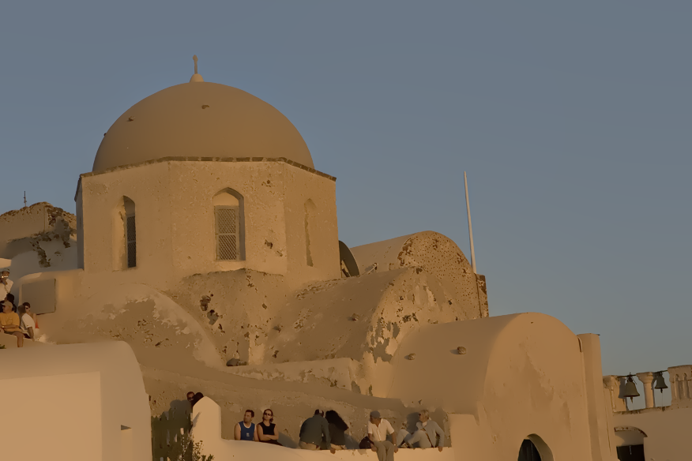
Texture Manipulation Decrease
Notes:
Here’s our result for decreasing the texture. It shows clean edge-preserving blur, without bleeding artifacts. You can see that important edges are preserved over different scales, maintaining detail over both the architecture and the people in the scene.
(the banding artifacts in sky are due to the projector)

Slide 37
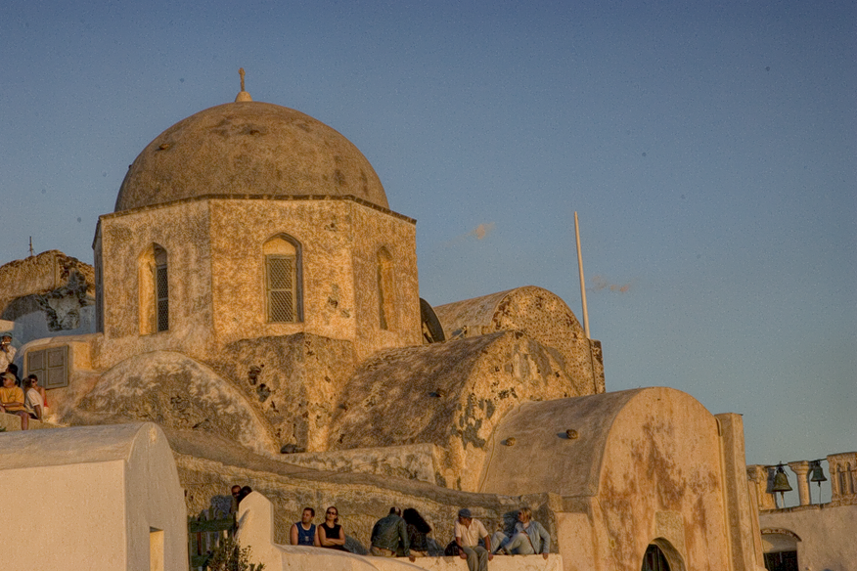
Texture Manipulation Small Increase
Notes:
Here’s out result for increasing texture, amplifying detail, again with no visible artifacts.
And we can push this even further.

Slide 38
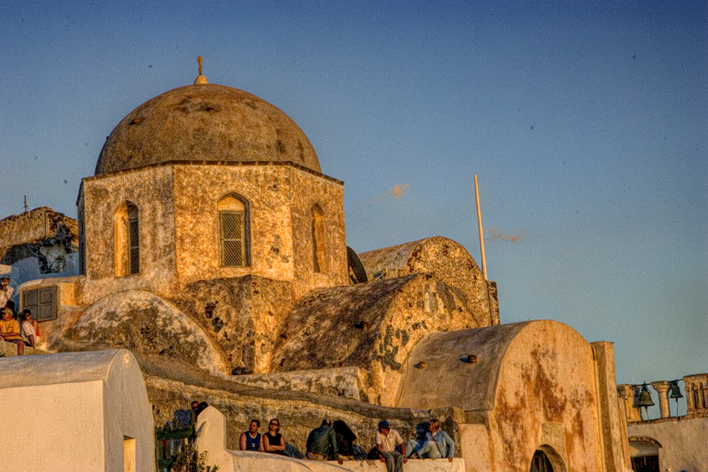
Texture Manipulation Large Increase
Notes:
Where our method really shines is for very strong detail enhancement.
Our method is robust enough to support very strong enhancement like this, without artifacts.

Slide 39
Texture Manipulation Input
Notes:
For reference, here’s the original input image.

Slide 40
Texture Manipulation Large Increase
Notes:
And again, here’s our strong texture enhancement result.

