Slide 1
Introduction to Light field camera
Speaker : 莊士昌

Slide 2
1. What is light field?

Slide 3
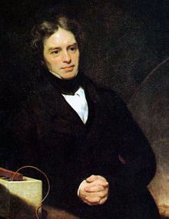
1. What is light field?

Slide 5
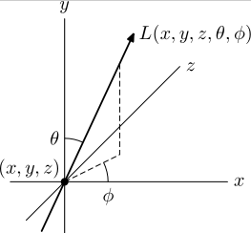
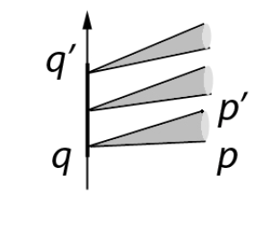
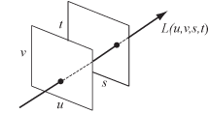
1. What is light field?
5-D plenoptic function 4-D plenoptic function

Slide 6
2. The Differences between Plenoptic camera &Conventional camera

Slide 7
2. The Differences …

Slide 8
2. The Differences …

Slide 9
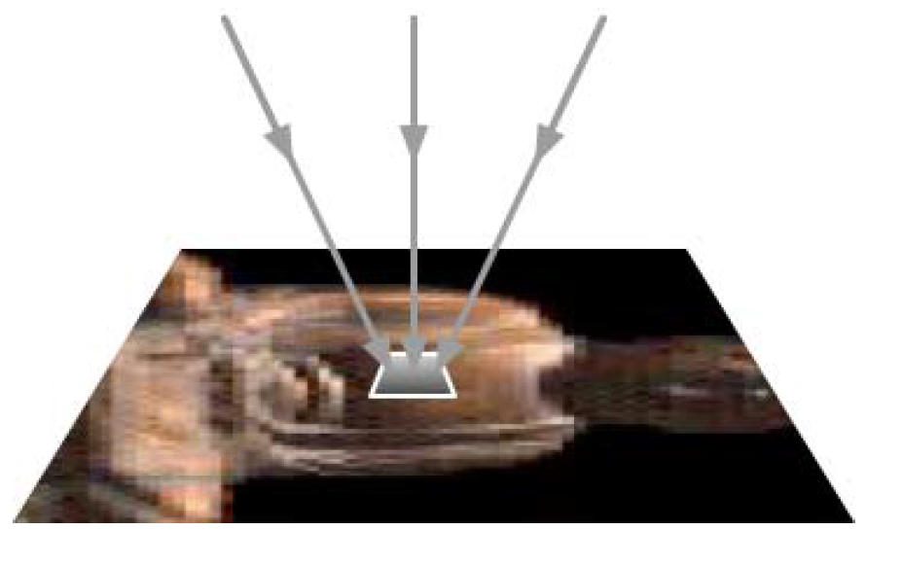
Sensor array

Slide 10
2.The Differences…

Slide 11
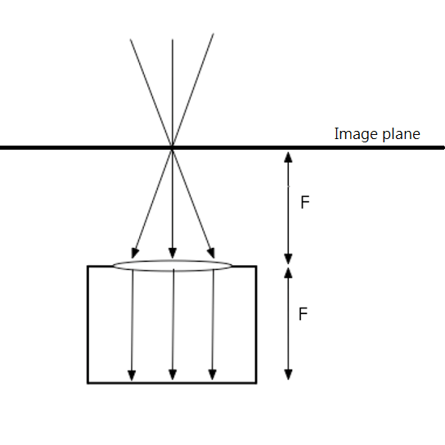
2.The Differences…

Slide 12
3. Light field model

Slide 13
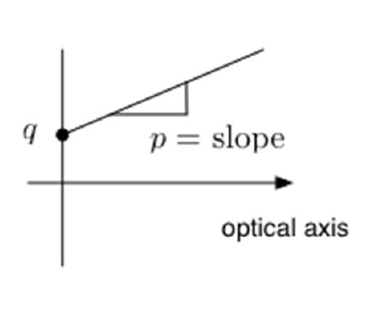
4-D light field model

Slide 14
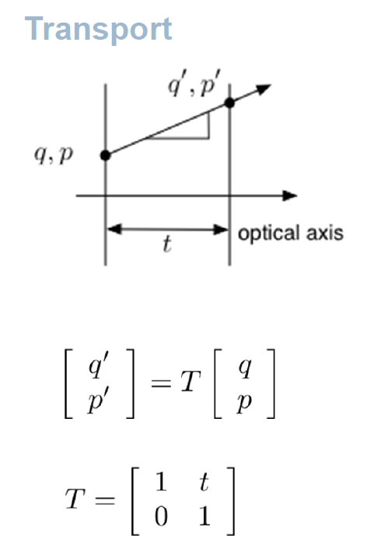
Two Primary Optical Transforms

Slide 15
2F camera

Slide 16
Plenoptic 1.0(Lippman)

Slide 17
Conservation of volume

Slide 18
Plenoptic 1.0(Lippman)

Slide 19
Rendering

Slide 20
Rendering

Slide 21
Rendering(Different viewpoints)

Slide 22
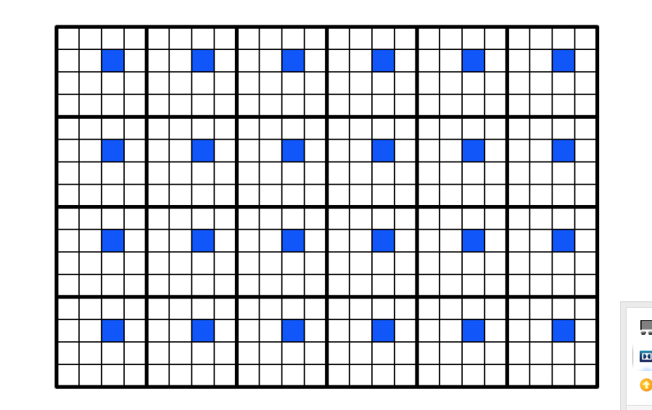
Rendering(Different viewpoints)

Slide 23
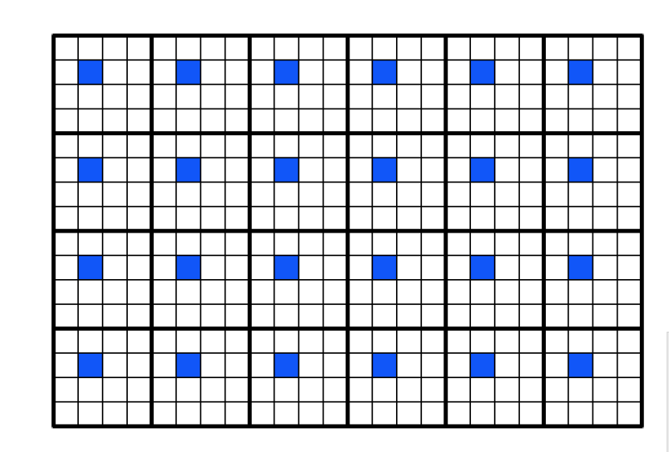
Rendering(Different viewpoints)

Slide 25
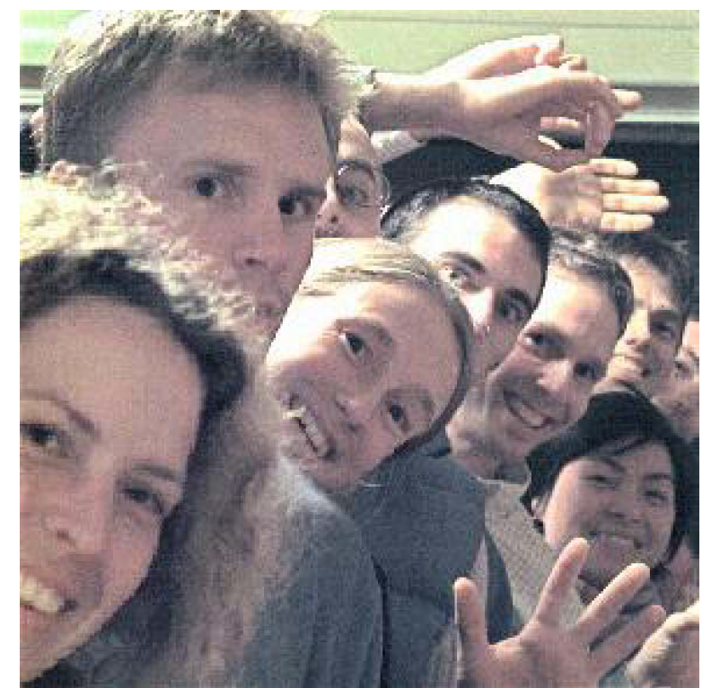

Slide 26
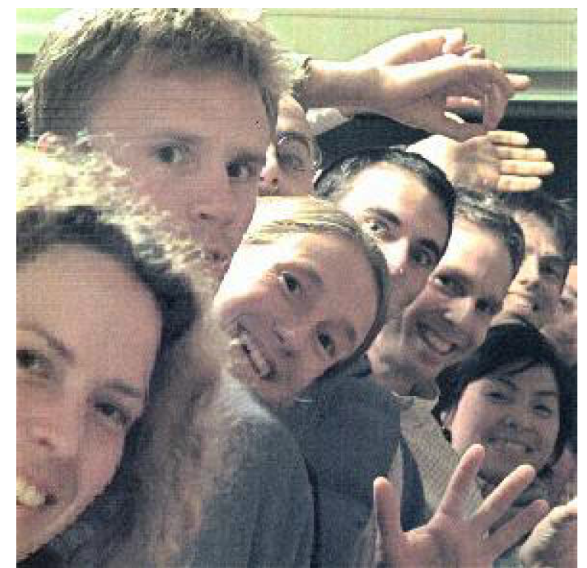

Slide 27
Refousing

Slide 28
Refousing

Slide 31
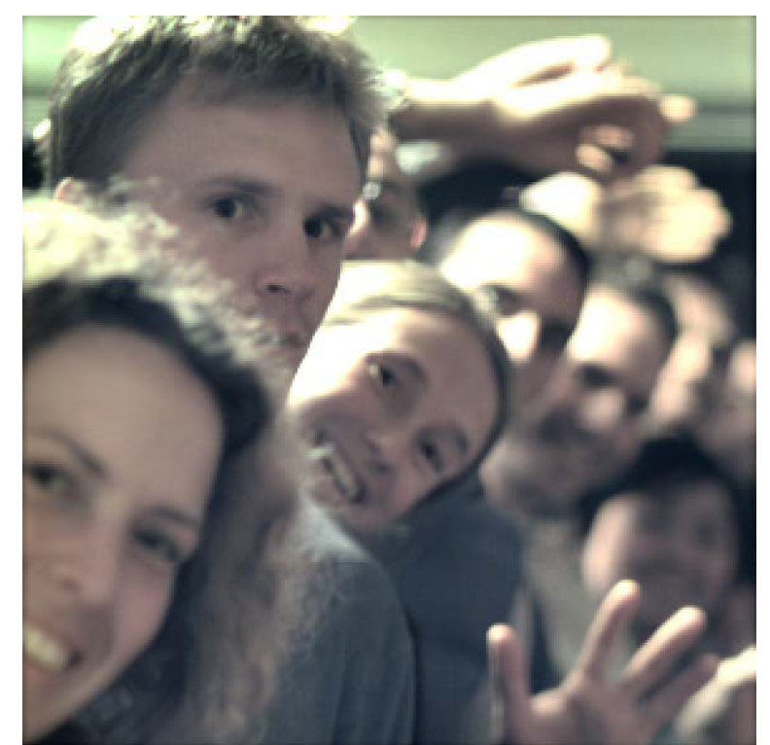

Slide 32
Fourier Slice Refocusing

Slide 33
Fourier Slice Refocusing

Slide 34
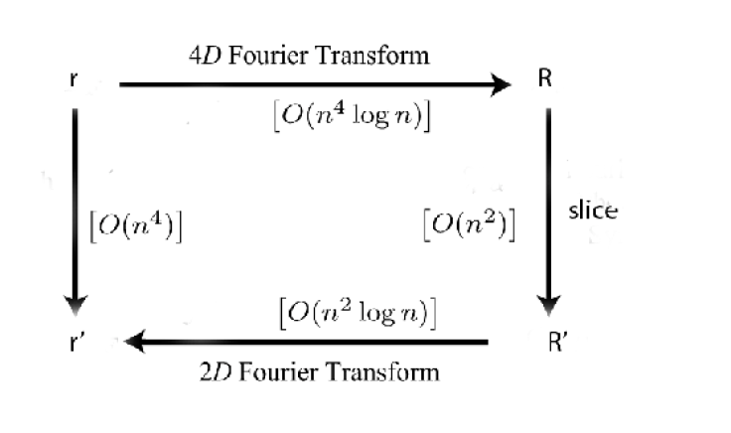
Fourier Slice Refocusing

Slide 35
Fourier Slice Refocusing

Slide 36
Fourier Slice Refocusing

Slide 37
Fourier Slice Refocusing

Slide 38
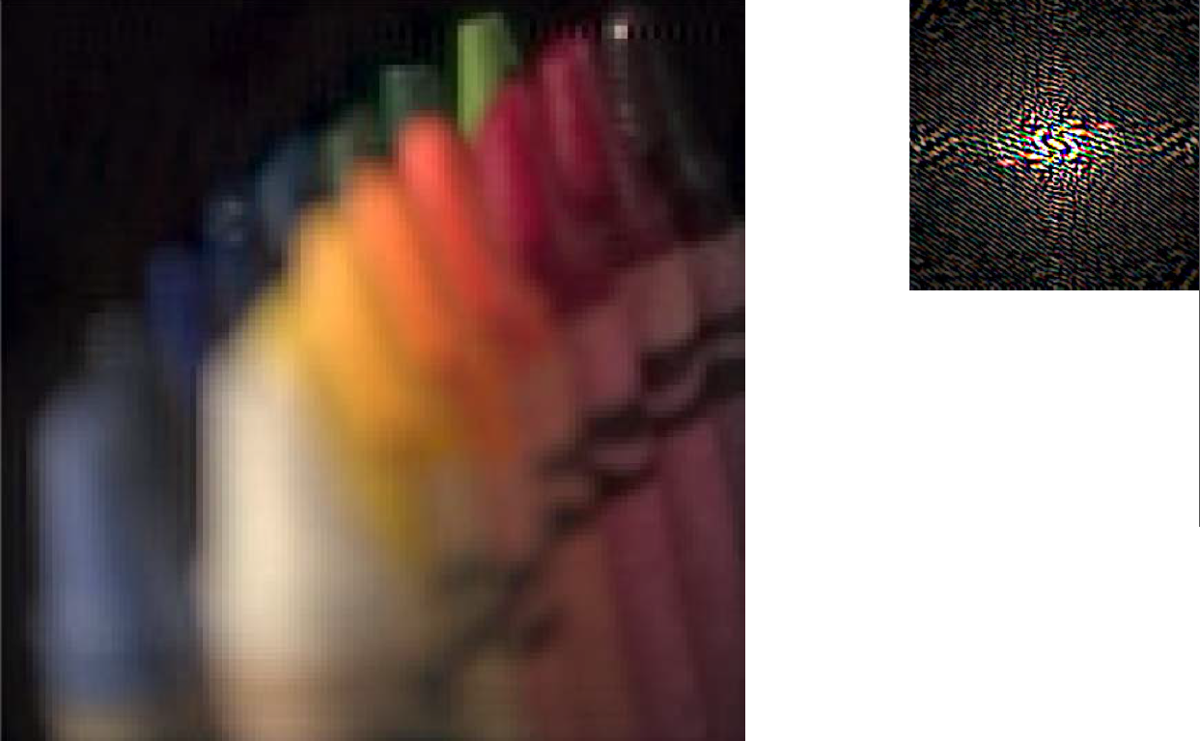
Fourier Slice Refocusing

Slide 39
Plenoptic 2.0

Slide 40
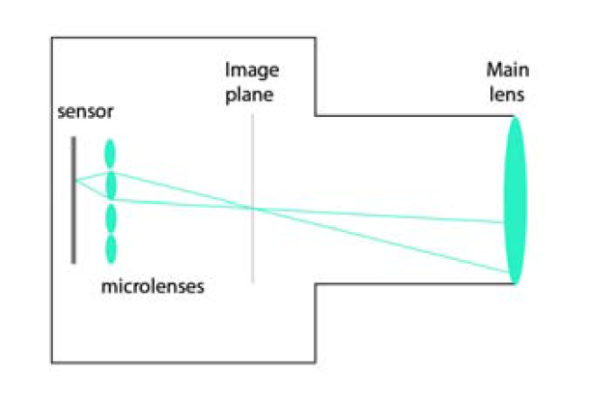
Plenoptic 2.0

Slide 41
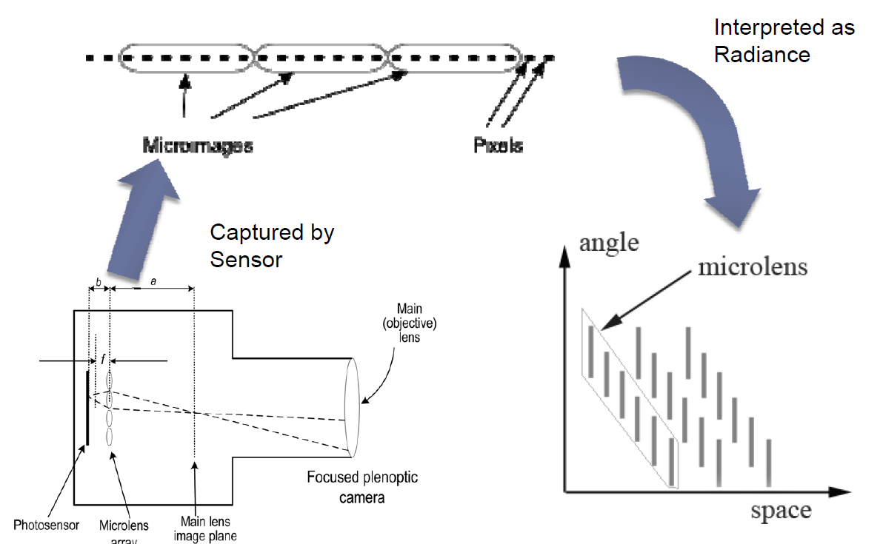
Plenoptic 2.0

Slide 42
Rendering

Slide 43
Rendering

Slide 44
Rendering(Different viewpoints)

Slide 45
Rendering(Different viewpoints)

Slide 48
Refocusing

Slide 49
Refocusing

Slide 50
Thank you for your attention!

Slide 51
Appendix A.

