Slide 1
Convolutional Neural Network
2015/10/02
陳柏任

Slide 2
Outline
Neural Networks
Convolutional Neural Networks
Some famous CNN structure
Applications
Toolkit
Conclusion
Reference

Slide 3
Outline
Neural Networks
Convolutional Neural Networks
Some famous CNN structure
Applications
Toolkit
Conclusion
Reference

Slide 4
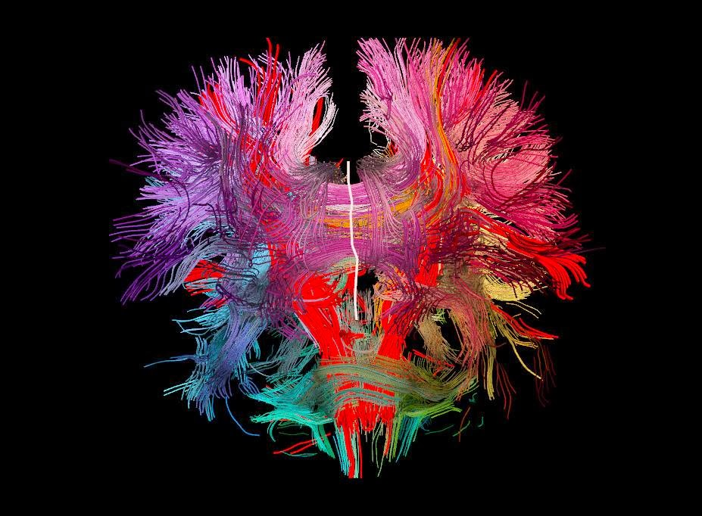
Our brain [1]

Slide 5
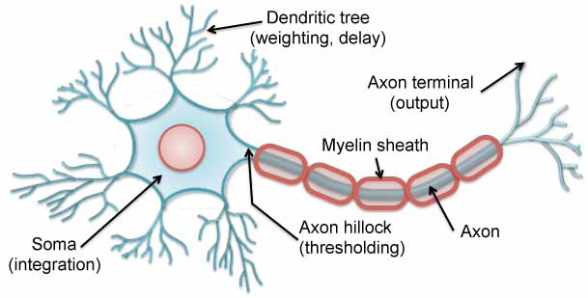
Neuron [2]

Slide 6
Neuron [2]

Slide 7
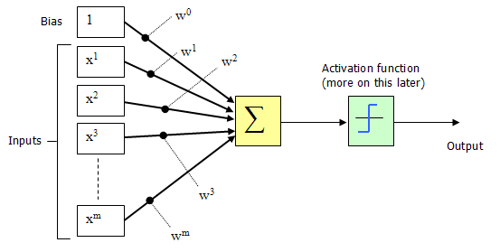
Neuron
Bias
Activation function
Inputs
Output
Neuron in Neural Networks [3]

Slide 8
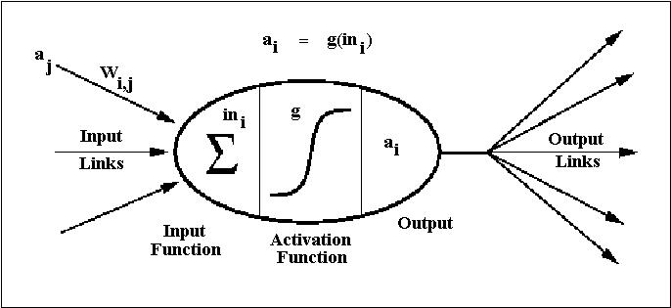
Neuron in Neural Networks
is a activation function.
are weights.
are inputs.
w₀ is the weight of bias.
y is the output.
Image of neuron in NN [7]

Slide 9
Difference Between Biology and Engineering
Activation function
Bias

Slide 10
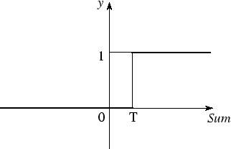
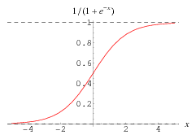
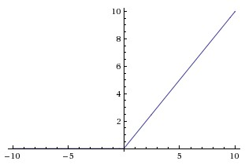
Activation Function
Because threshold function is not continuous, we can not apply some mathematical calculation on it.
We often use sigmoid function, tanh function, ReLU function and so on. These functions are differentiable.
Threshold function [4]
Sigmoid function [13]
ReLU function [14]

Slide 11
Why should we need to add the bias term?

Slide 12
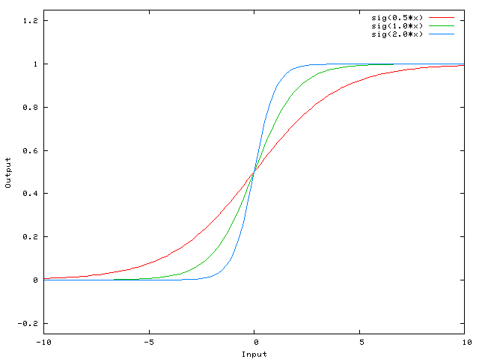
Without Bias Term
Without Bias Term [5]

Slide 13
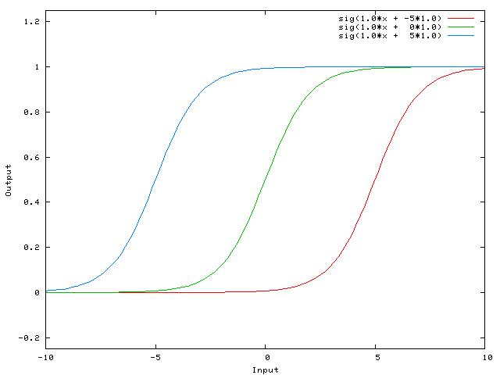
With Bias Term
With Bias Term [5]

Slide 14
Neural Networks (NNs)
Proposed in 1950s
NNs are a family of machine learning models.

Slide 15
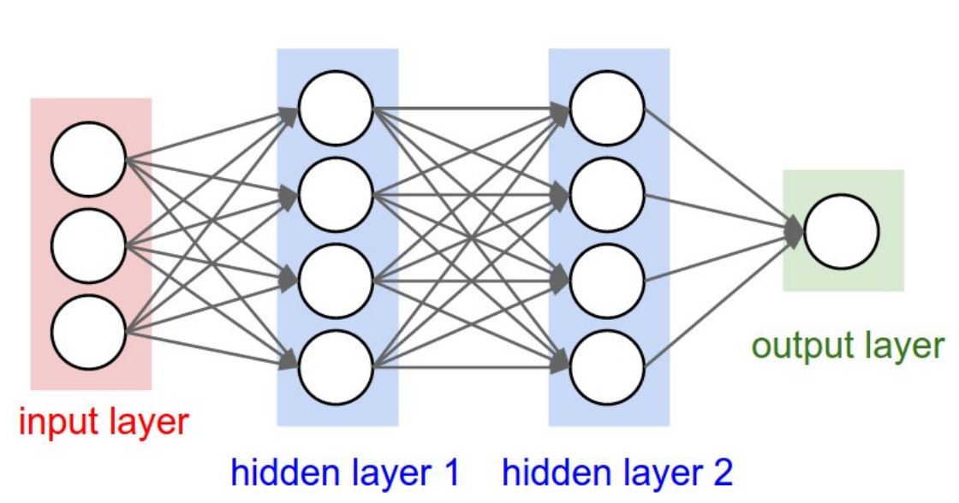
Neural Networks [6]

Slide 16
Neural Networks
Feed forward (No recurrences)
Fully-connected between layers
No connections between neurons in the layer

Slide 17
Cost Function
j is the neuron index in the output layer.
is the data ground-truth of j-th neuron in the output layer.
is the output of j-th neuron in the output layer.

Slide 18
Training
We need to learn the weights in the NN.
We use Stochastic Gradient Descent (SGD) and Back-propagation
SGD:
We use to find the best weights.
Back-propagation:
Update the weights from the last layer to the first layer

Slide 19
Outline
Neural Networks
Convolutional Neural Networks
Some famous CNN structure
Applications
Toolkit
Conclusion
Reference

Slide 20
Recall: Neural Networks
Neural Networks [6]

Slide 21
Convolutional Neural Networks (CNNs)
Input layer
Hidden layer
Hidden layer
Output layer

Slide 22
Convolutional Neural Networks (CNNs)
Compared with NNs, CNNs are 3 dimensional.
For example, a 512x512 RGB image is 512 height, 512 width and 3 depth.
Height
Width
Depth (Channel)

Slide 23
When Input is a image…
The information of image is the pixel.
For example, a 512x512 RGB image has 512x512x3 = 786432
information.
There are 786432 inputs and 786432 weights in the next layer per neuron.

Slide 24
Convolutional Neural Networks (CNNs)
Input layer
Hidden layer

Slide 25
What should we do?
The features of image are usually local.
We can reduce the fully-connected network to locally-connected network.
For example, if we set window size 5 …

Slide 26
Convolutional Neural Networks (CNNs)
Input layer
Hidden layer

Slide 27
What should we do?
The features of image are usually local.
We can reduce the fully-connected network to locally-connected network.
For example, if we set window size 5, we only need 5x5x3 = 75 weights per neuron.
The connectivity is
Local in space (height and width)
Full in depth (all 3 RGB channels)

Slide 28
Replication at the same area
Input layer
Hidden layer

Slide 29
Replication at the same area
Input layer
Hidden layer

Slide 30
Stride
Stride: How many pixels we move the window in one time.
For example
Inputs: 10x10
Window size: 5
Stride: 1

Slide 31
Stride
Stride: How many pixels we move the window in one time.
For example
Inputs: 10x10
Window size: 5
Stride: 1

Slide 32
Stride
Stride: How many pixels we move the window in one time.
For example
Inputs: 10x10
Window size: 5
Stride: 1

Slide 33
Stride
Stride: How many pixels we move the window in one time.
For example
Inputs: 10x10
Window size: 5
Stride: 1

Slide 34
Stride
Stride: How many pixels we move the window in one time.
For example
Inputs: 10x10
Window size: 5
Stride: 1
We get 6x6 outputs.

Slide 35
Stride
Stride: How many pixels we move the window in one time.
For example
Inputs: 10x10
Window size: 5
Stride: 1
We get 6x6 outputs.
The outputs size:
N
W

Slide 36
Replication at the same area with stride 1
Input layer
Hidden layer

Slide 37
What about stride 2?
Stride: How many pixels we move the window in one time.
For example
Inputs: 10x10
Window size: 5
Stride: 2

Slide 38
What about stride 2?
Stride: How many pixels we move the window in one time.
For example
Inputs: 10x10
Window size: 5
Stride: 2
Output size:

Slide 39
What about stride 2?
Stride: How many pixels we move the window in one time.
For example
Inputs: 10x10
Window size: 5
Stride: 2
Output size:
Cannot

Slide 40
There are some problem in stride …
The output size is smaller than input size.

Slide 41
Solution to the problem of stride
Padding!
That means we add value in the border of the image.
We often add 0 in the border.

Slide 42
Zero Pad
0 | 0 | 0 | 0 | 0 | 0 | 0 | 0 | 0 | 0 | 0 | 0 | 0 | 0
0 | 0 | 0 | 0 | 0 | 0 | 0 | 0 | 0 | 0 | 0 | 0 | 0 | 0
0 | 0 |  |  |  |  |  |  |  |  |  |  | 0 | 0
0 | 0 |  |  |  |  |  |  |  |  |  |  | 0 | 0
0 | 0 |  |  |  |  |  |  |  |  |  |  | 0 | 0
0 | 0 |  |  |  |  |  |  |  |  |  |  | 0 | 0
0 | 0 |  |  |  |  |  |  |  |  |  |  | 0 | 0
0 | 0 |  |  |  |  |  |  |  |  |  |  | 0 | 0
0 | 0 |  |  |  |  |  |  |  |  |  |  | 0 | 0
0 | 0 |  |  |  |  |  |  |  |  |  |  | 0 | 0
0 | 0 |  |  |  |  |  |  |  |  |  |  | 0 | 0
0 | 0 |  |  |  |  |  |  |  |  |  |  | 0 | 0
0 | 0 | 0 | 0 | 0 | 0 | 0 | 0 | 0 | 0 | 0 | 0 | 0 | 0
0 | 0 | 0 | 0 | 0 | 0 | 0 | 0 | 0 | 0 | 0 | 0 | 0 | 0
For example
Inputs: 10x10
Window size: 5
Stride: 1
Pad: 2 ( )

Slide 43
Zero Pad
0 | 0 | 0 | 0 | 0 | 0 | 0 | 0 | 0 | 0 | 0 | 0 | 0 | 0
0 | 0 | 0 | 0 | 0 | 0 | 0 | 0 | 0 | 0 | 0 | 0 | 0 | 0
0 | 0 |  |  |  |  |  |  |  |  |  |  | 0 | 0
0 | 0 |  |  |  |  |  |  |  |  |  |  | 0 | 0
0 | 0 |  |  |  |  |  |  |  |  |  |  | 0 | 0
0 | 0 |  |  |  |  |  |  |  |  |  |  | 0 | 0
0 | 0 |  |  |  |  |  |  |  |  |  |  | 0 | 0
0 | 0 |  |  |  |  |  |  |  |  |  |  | 0 | 0
0 | 0 |  |  |  |  |  |  |  |  |  |  | 0 | 0
0 | 0 |  |  |  |  |  |  |  |  |  |  | 0 | 0
0 | 0 |  |  |  |  |  |  |  |  |  |  | 0 | 0
0 | 0 |  |  |  |  |  |  |  |  |  |  | 0 | 0
0 | 0 | 0 | 0 | 0 | 0 | 0 | 0 | 0 | 0 | 0 | 0 | 0 | 0
0 | 0 | 0 | 0 | 0 | 0 | 0 | 0 | 0 | 0 | 0 | 0 | 0 | 0
For example
Inputs: 10x10
Window size: 5
Stride: 1
Pad: 2
Output size: 10x10 (remain the same)

Slide 44
Padding
We can keep the output size by padding.
Besides, we can avoid the border information “washing out”.

Slide 45
Recall the example with stride 1 and pad 2
Input layer
Hidden layer

Slide 46
There are still too many weights!
Despite we locally-connected the layer, there are still too many weights.
In the example described above, there are 512x512x5 neurons in the next layer, we have 75x512x512x5=98 million weights.
More neurons the next layer has, more weights we need to train.

Slide 47
There are still too many weights!
Despite we locally-connected the layer, there are still too many weights.
In the example described above, there are 512x512x5 neurons in the next layer, we have 75x512x512x5=98 million weights.
More neurons the next layer has, more weights we need to train.
→ MAIN IDEA: Not learn the same thing between different neurons!

Slide 48
Parameter sharing
We share parameter in the same depth.
Input layer
Hidden layer

Slide 49
Parameter sharing
We share parameter in the same depth.
Now we only have 75x5=375 weights.

Slide 50
Two Main Idea in CNNs
Local connected
Parameter sharing
Cause that is like we apply convolution on the image, we call this neural network CNN.
We call these layers “convolution layers”.
What we learn can be considered as the convolution filters.

Slide 51
Other layers in the CNNs
Pool layer
Fully-connected layer

Slide 52
Pool layers
The convolution layers often followed by pool layers in CNNs.
It can reduce the weights and will not lose too much information.
We often use max operation to do pooling.
1 | 2 | 5 | 6
3 | 4 | 2 | 8
3 | 4 | 4 | 2
1 | 5 | 6 | 3
Max pooling
4 | 8
5 | 6
Single depth slice

Slide 53
Window Size and Stride in pool layers
The window size is the pooling range.
The stride is how much pixel the window move.
For this example, window size = stride = 2.
1 | 2 | 5 | 6
3 | 4 | 2 | 8
3 | 4 | 4 | 2
1 | 5 | 6 | 3
Max pooling
4 | 8
5 | 6
Single depth slice

Slide 54
Window Size and Stride in pool layers
There are two types of the pool layers.
If window size = stride, this is traditional pooling.
If window size > stride, this is overlapping pooling.
The larger window size and stride will be very destructive.

Slide 55
Fully-connected layer
This layer is the same as the layer in the traditional NNs.
We often use this type of layers in the end of the CNNs.

Slide 56
Notice
There are still many weights in CNNs cause of the large depth, big image size and deep CNN structure.
→ Training is very time-consuming.
→ We need more training data or some other techniques to avoid overfitting.

Slide 57
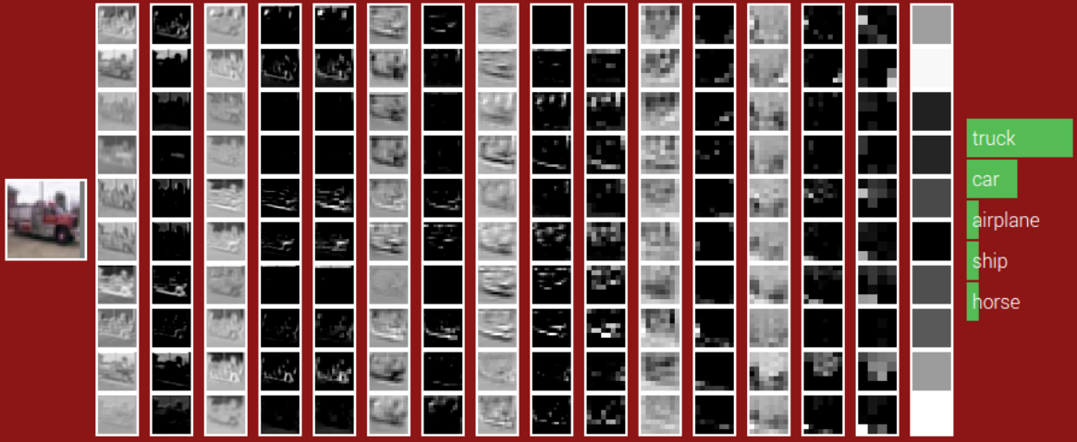
POOL
POOL
POOL
ReLU
ReLU
ReLU
ReLU
ReLU
ReLU
CONV
CONV
CONV
CONV
CONV
CONV
Fully-connected
32x32
Weights:
280
910
910
910
910
910
1600
Size:
16x16
8x8
4x4

Slide 58
Outline
Neural Networks
Convolutional Neural Networks
Some famous CNN structure
Applications
Toolkit
Conclusion
Reference

Slide 59
LeNet-5 [8]
(LeCun, 1998) [8]

Slide 60
AlexNet [9]
(Alex, 1998) [9]

Slide 61
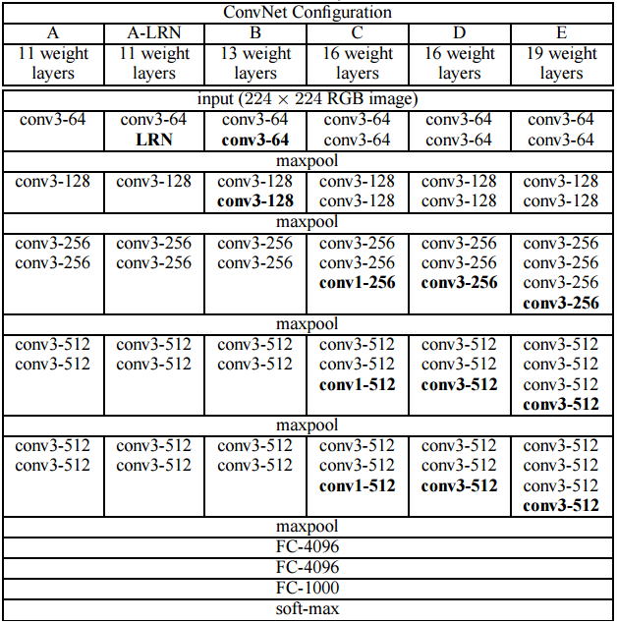
VGGNet [12]

Slide 62
Outline
Neural Networks
Convolutional Neural Networks
Some famous CNN structure
Applications
Toolkit
Conclusion
Reference

Slide 63
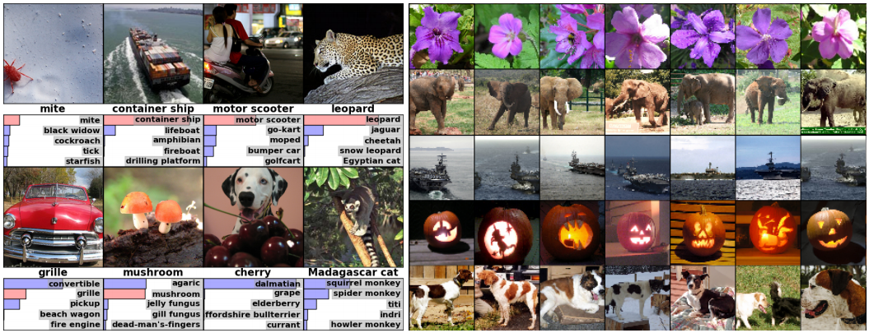
Object classification [9]

Slide 64
Human Pose Estimation [10]

Slide 65
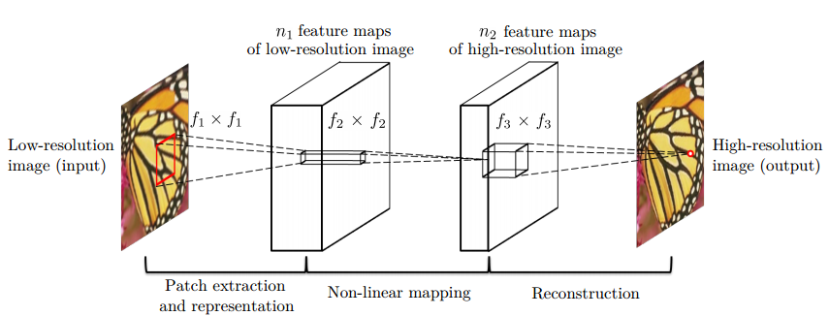
Super Resolution [11]

Slide 66
Outline
Neural Networks
Convolutional Neural Networks
Some famous CNN structure
Applications
Toolkit
Conclusion
Reference

Slide 67
Caffe
Developed by the University of California.
Operating system: Linux
Coding environment: Python
Can use NVIDIA CUDA GPU machine to speed up.

Slide 68
Outline
Neural Networks
Convolutional Neural Networks
Some famous CNN structure
Applications
Toolkit
Conclusion
Reference

Slide 69
Conclusion
The CNNs are based on locally-connected and parameter sharing.
Though we can get good performance by using CNNs, there are two things we need to notice, time-consuming and overfitting.
Sometimes we use pretrained models instead of training a new structure.

Slide 70
Outline
Neural Networks
Convolutional Neural Networks
Some famous CNN structure
Applications
Toolkit
Conclusion
Reference

Slide 71
Reference
Image
[1] http://4.bp.blogspot.com/-l9lUkjLHuhg/UppKPZ-FC-I/AAAAAAAABwU/W3DGUFCmUGY/s1600/brain-neural-map.jpg
[2] http://wave.engr.uga.edu/images/neuron.jpg
[3] http://www.codeproject.com/KB/recipes/NeuralNetwork_1/NN2.png
[4] http://wwwold.ece.utep.edu/research/webfuzzy/docs/kk-thesis/kk-thesis-html/img17.gif
[5] http://stackoverflow.com/questions/2480650/role-of-bias-in-neural-networks
[6] http://vision.stanford.edu/teaching/cs231n/slides/lecture7.pdf
[7] http://www.cs.nott.ac.uk/~pszgxk/courses/g5aiai/006neuralnetworks /images/actfn001.jpg
[13] http://mathworld.wolfram.com/SigmoidFunction.html
[14] http://cs231n.github.io/assets/nn1/relu.jpeg

Slide 72
Reference
Paper
[8] LeCun, Y., Bottou, L., Bengio, Y., & Haffner, P. (1998). Gradient-based learning applied to document recognition. Proceedings of the IEEE, 86(11), 2278-2324.
[9] Krizhevsky, Alex, Ilya Sutskever, and Geoffrey E. Hinton. "Imagenet classification with deep convolutional neural networks." Advances in neural information processing systems. 2012.
[10] Toshev, Alexander, and Christian Szegedy. "Deeppose: Human pose estimation via deep neural networks." Computer Vision and Pattern Recognition (CVPR), 2014 IEEE Conference on. IEEE, 2014.
[11] Dong, C., Loy, C. C., He, K., & Tang, X. (2014). Image Super-Resolution Using Deep Convolutional Networks. arXiv preprint arXiv:1501.00092.
[12] Simonyan, Karen, and Andrew Zisserman. "Very deep convolutional networks for large-scale image recognition." arXiv preprint arXiv:1409.1556 (2014).

