Slide 1

Recent Developments on Data Compression
Date: 2016/12/27
Instructor: Jian-Jiun Ding
Name: I-Hsiang Wang

Slide 2

Table of Contents
Brief intro. to data compression
Type of sources
  Text
  Image
  Audio
  Video
  DNA sequence

Slide 3
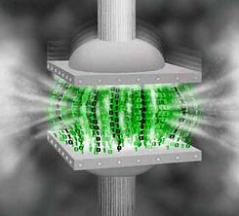
1. Brief intro. to Data Compression
Img src: http://img.viralpatel.net/2010/06/oracle-data-compress.jpg

Slide 4

Brief intro. to Data Compression
Fig.1 General block diagram of data compression

Slide 5
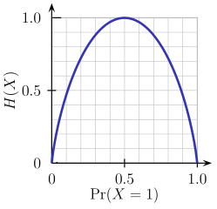

Brief intro. to Data Compression
For a given sequence of X, we can measure its entropy

Slide 6
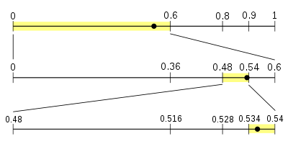
Brief intro. to Data Compression
Entropy coding
  Such as arithmetic code, Huffman code, Golomb code …
For a given X, arithmetic code can easily approach its entropy.
Simply put, arithmetic code codes the input symbol based on its probability.

Slide 7

Brief intro. to Data Compression
Trade-off between complexity and performance
(computation time/hardware ↔ compression ratio)
http://missingcloud.com/gif/GoodCheapFast_MissingCloud_.gif

Slide 8
2. Type of sources
  Text
  Image
  Audio
  Video
  Music
  DNA sequence

Slide 9

a). Text
Winzip…etc.
Examples:
LZ family: LZ77, LZW, ROLZ, LZP… a lot of variations
PPM: Prediction by Partial Matching
SR: Symbol Ranking
BWT: Burrows Wheeler Transform
ST: Sort Transform
DMC: Dynamic Markov Coding
CM: Context Mixing
Best algorithm?: https://www.quora.com/What-is-the-best-text-compression-algorithm
Further reading: http://mattmahoney.net/dc/dce.html
http://mattmahoney.net/dc/text.html

Slide 10

b). Image
Examples:
JPEG variants
SPIHT
GIF, BMP, TIFF … etc.
Intra-frame coding of video codecs
………………………
SVD(?)
DWT
Block-based
DCT
Full-image

Slide 11




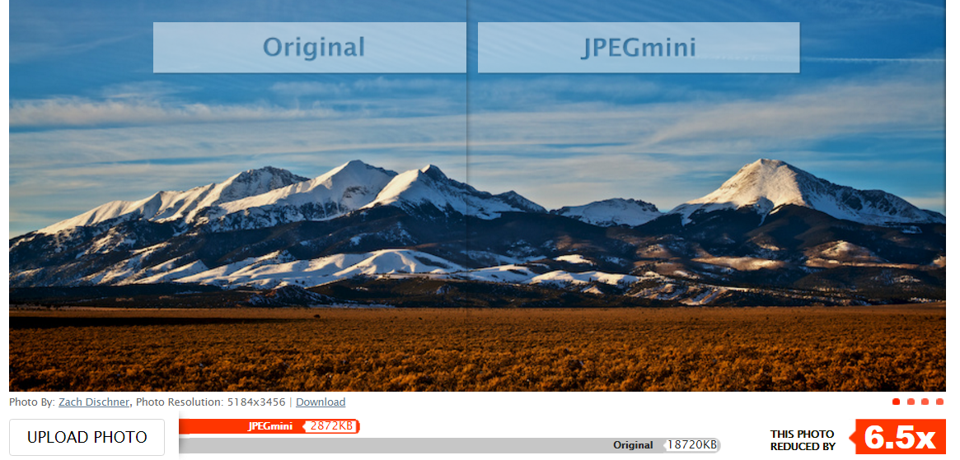
b). Image
Dropbox: Lepton
JPEGmini
-22%
Lepton
Lepton

Slide 12

c). Audio
Common formats:
MP3
AAC
OGG
WMA
FLAC
ALAC
Further reading: https://www.xaprb.com/blog/2016/02/21/best-itunes-mp3-format/
http://www.makeuseof.com/tag/audio-file-format-right-needs/

Slide 13

d). Video
H.264 family:
  Lots of variation
  Most widely used nowadays
VP9
  Open source
  Developed by Google

Slide 14
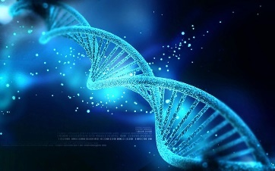
e). DNA sequence
Still an ongoing research field
Most prominent one:
ERGC(Efficient Referential Genome Compression)
Further reading: Comment-on-ERGC-an-efficient-referential-genome
Img src: http://www.livescience.com/images/i/000/068/518/original/dna-strand.jpeg?interpolation=lanczos-none&downsize=*:1000

Slide 15

Thank You

