Slide 1
Object Detection
DISP Lab
2023/05/30 Group Meeting
顏勁賢

Slide 2
Outline
Introduction of Object Detection
HOG + SVM
YOLO
Reference

Slide 3
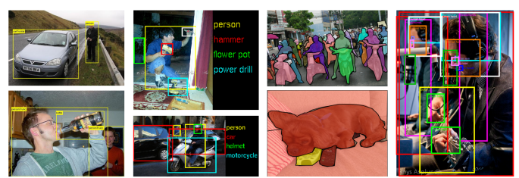
Introduction of Object Detection
What is Object Detection?
[1] Zhengxia Zou , Keyan Chen, Zhenwei Shi, Yuhong Guo, and Jieping Ye. “Object Detection in 20 Years: A Survey”

Slide 4
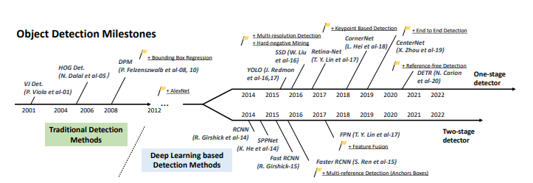
Introduction of Object Detection
[1] Zhengxia Zou , Keyan Chen, Zhenwei Shi, Yuhong Guo, and Jieping Ye. “Object Detection in 20 Years: A Survey”

Slide 5
HOG + SVM
Overview of feature extraction and object detection
[2] N. Dalal and B. Triggs. “Histograms of oriented gradients for human detection” 2005 IEEE Computer Society Conference on Computer Vision and Pattern Recognition (CVPR'05)

Slide 6
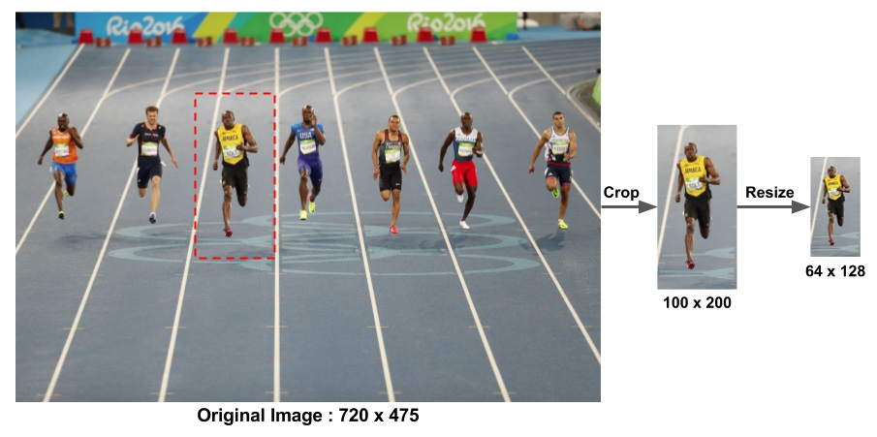
HOG + SVM
Preprocessing
[4] Satya Mallick. Histogram of Oriented Gradients explained using OpenCV

Slide 7
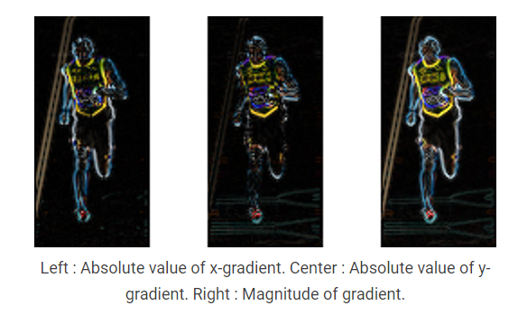
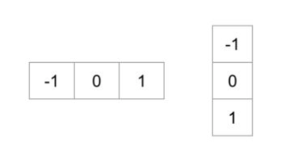
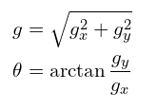
HOG + SVM
Gradient Computation
[4] Satya Mallick. Histogram of Oriented Gradients explained using OpenCV

Slide 8
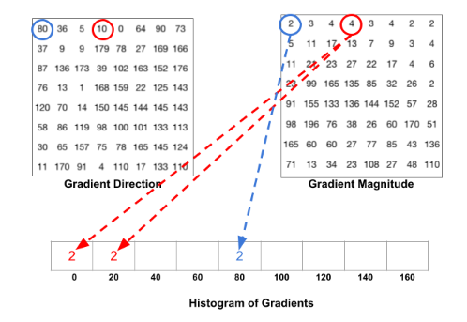
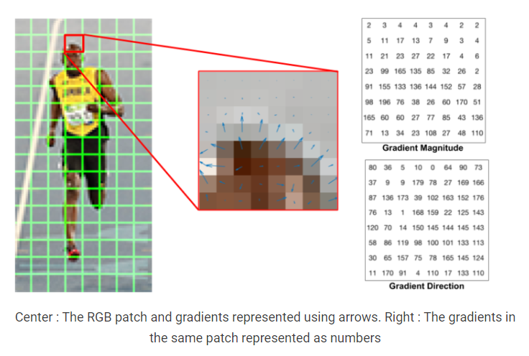
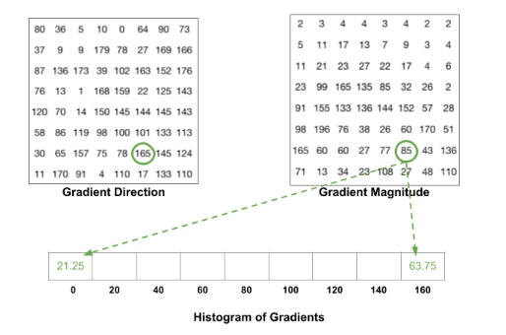
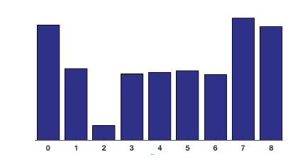
HOG + SVM
Histogram of Gradients
[4] Satya Mallick. Histogram of Oriented Gradients explained using OpenCV

Slide 9
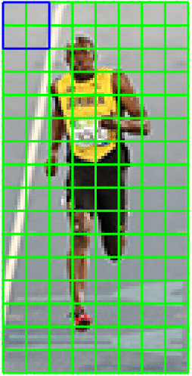
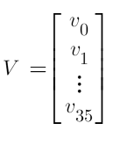
HOG + SVM
16×16 Block Normalization
[4] Satya Mallick. Histogram of Oriented Gradients explained using OpenCV

Slide 10
YOLO
One Stage and Two Stage
[5] Tommy Huang. 深度學習: 物件偵測上的模型結構變化

Slide 11
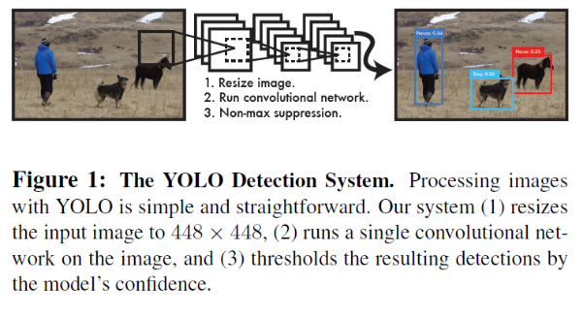
YOLO
The YOLO Detection System
Resizes the input image to 448 x 448
Runs a single convolutional network on the image
Thresholds the resulting detections by the model’s confidence
[6] Joseph Redmon, Santosh Divvala, Ross Girshick, Ali Farhadi. “You Only Look Once: Unified, Real-Time Object Detection”

Slide 12
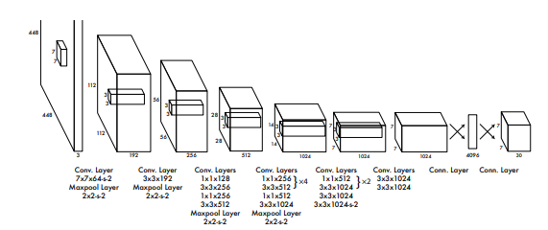
YOLO
The Architecture
[6] Joseph Redmon, Santosh Divvala, Ross Girshick, Ali Farhadi. “You Only Look Once: Unified, Real-Time Object Detection”

Slide 13
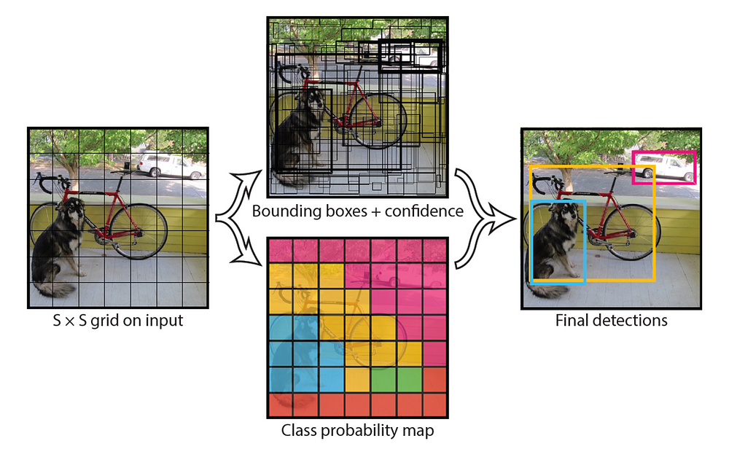
YOLO
Unified Detection
[6] Joseph Redmon, Santosh Divvala, Ross Girshick, Ali Farhadi. “You Only Look Once: Unified, Real-Time Object Detection”
[8] C.C.Lo. YOLO — You Only Look Once 介紹 Medium

Slide 14
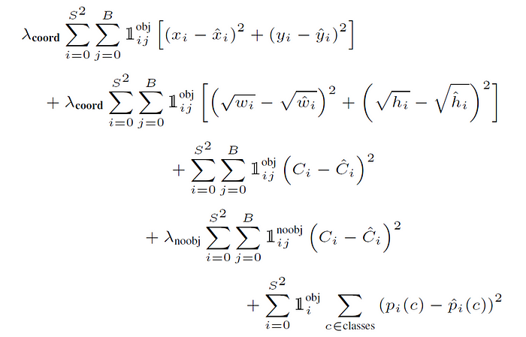
YOLO
Pretrain first 20 convolutional layers on the ImageNet 1000-class competition dataset.
Top-5 Accuracy 88%
Loss Function (Sum-Squared Error)
[6] Joseph Redmon, Santosh Divvala, Ross Girshick, Ali Farhadi. “You Only Look Once: Unified, Real-Time Object Detection”

Slide 15
YOLO
Limitations of YOLO
Hard to detect small object
Number of Class

Slide 16
Reference
[1] Zhengxia Zou , Keyan Chen, Zhenwei Shi, Yuhong Guo, and Jieping Ye. “Object Detection in 20 Years: A Survey” arXiv:1905.05055[cs.CV]
[2] N. Dalal and B. Triggs. “Histograms of oriented gradients for human detection” 2005 IEEE Computer Society Conference on Computer Vision and Pattern Recognition (CVPR’05)
[3] Jeremy Pai. Object Detection — HOG + SVM. Medium
[4] Satya Mallick. Histogram of Oriented Gradients explained using OpenCV
[5] Tommy Huang. 深度學習: 物件偵測上的模型結構變化 Medium
[6] Joseph Redmon, Santosh Divvala, Ross Girshick, Ali Farhadi. “You Only Look Once: Unified, Real-Time Object Detection” arXiv:1506.02640 [cs.CV]
[7] Tommy Huang. 深度學習-物件偵測:You Only Look Once (YOLO) Medium
[8] C.C.Lo. YOLO — You Only Look Once 介紹 Medium

Slide 17
Thanks for Listening!

