Slide 1
Active Contours “Snake” Segmentation
報告者: 許宸睿

Slide 2
Outlines
Introduction of Snakes
Details of Snakes
Geometric Active Contours
Deep Snakes

Slide 3
Outlines
Introduction of Snakes
Principles of Snakes
Geometric Active Contours
Deep Snakes

Slide 4
Introduction of Snakes
A framework for delineating an object outline from 2D image.
Widely used in applications like object tracking, shape recognition, segmentation, stereo matching, etc.
Depending on interaction with users or other high level image understanding process.

Slide 5
Introduction
Imagine using a rubber band to circle an object.

Slide 6
Introduction
Examples
Video.1: How Active Contour Do
Ref: https://youtu.be/SdqBNFx-uNc

Slide 7
Outlines
Introduction of Snakes
Principles of Snakes
Geometric Active Contours
Deep Snakes

Slide 8
Principles of Snakes
An energy-minimizing spline guided by external constraint forces and influenced by image forces that pull it toward features.
let curves: $C\left(p\right)={\left[x\left(p\right),y\left(p\right)\right]}^{T}, 0≤p≤1$
$E\left(C\right)=E_{ext}\left(C\right)+E_{int}\left(C\right)$
To minimize E(C) to obtain the contour

Slide 9
Internal Energy
$E\left(C\right)=E_{ext}\left(C\right)+E_{int}\left(C\right)$
$E_{int}\left(C\right)= \int_{0}^{1}{w_{1}\left(p\right){\left|\left|C_{p}\right|\right|}^{2}+w_{2}\left(p\right){\left|\left|C_{pp}\right|\right|}^{2}dp }$
$C_{p}=\frac{∂C}{∂p}, C_{pp}=\frac{∂^{2}C}{∂p^{2}}$
$w_{1} controls tension, w_{2} controls rigidity.$

Slide 10
External Energy
$E\left(C\right)=E_{ext}\left(C\right)+E_{int}\left(C\right)$
$E_{ext}\left(C\right)= \int_{0}^{1}{P\left(C\left(p\right)\right)dp }$
P is for image energy, aka some functions of the features of the image. Line, edge, texture features are available.
For example: $P\left(x,y\right)=c\left|\left|▽G_{σ}∗I\left(x,y\right)\right|\right|$
c is a chosen constant.

Slide 11
Int and Ext Energy
Fig.1: Active contour with only int or ext energy
Ref: http://www.bcamath.org/documentos_public/courses/course_day3.pdf

Slide 12
Minimizing E
Gradient Descent
$E\left(C\right)=E_{ext}\left(C\right)+E_{int}\left(C\right)$
$E^{∗}\left(C(p)\right)=E_{ext}^{∗}\left(C(p)\right)+E_{int}^{∗}\left(C\left(p\right)\right)$
→ $∇E^{∗}\left(C\left(p\right)\right)=∇E_{ext}^{∗}\left(C\left(p\right)\right)+∇E_{int}^{∗}\left(C\left(p\right)\right)$
$∇E_{int}^{∗}=w_{1}\frac{∂^{2}C}{∂s^{2}}+w_{2}\frac{∂^{4}C}{∂s^{4}}, s is arc length.$

Slide 13
Algorithm
1. Initialize the contour
2. While True
3. Compute the external and internal energy
4. Update the contour
5. If $ΔE≤theshold:$
6. break
7. End if
8. End while

Slide 14
Pros and Cons
Advantages:
Flexibility: complex shapes and non-uniform background
Customizable: with different energy function, it could be customized to specified field.
Disadvantages
Initial contour: snakes don’t see the object boundaries unless it get very close to it
Proper parameters for choosing $w_{1}, w_{2}$
Difficulties with occlusions

Slide 15
Variant of Snake: Balloon Model
Snake is shrinking the contour to find out the object.
Balloon is expanding inside the object to match the contour.
The contour is inside the object at first, so which is less influenced by initial contour.
$F_{ext}=−∇E_{ext}$
$F_{balloon}=k_{1}\hat{n}\left(p\right)+k\frac{F_{ext}}{|\left|F_{ext}\right||}$
F_int
F_inflat
F_ext

Slide 16
Outlines
Introduction of Snakes
Principles of Snakes
Geometric Active Contours
Deep Snakes

Slide 17
Geometric Active Contours(GAC)
Applying Euclidean curve shortening to snakes.
More robust to noise and occlusions in the image, handling objects with complex shapes and topologies.
Could promote to 3D image segmentation

Slide 18
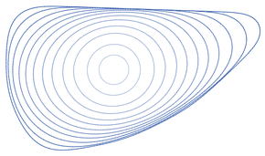
Euclidean curve shortening
A process that modifies a smooth curve in the Euclidean plane.
Moving its points perpendicular to the curve at a speed according to curvature.
From geometric heat equation
$$\frac{∂C}{∂t}=κ \vec{N}$$
Fig.2: Euclidean curve
More Details of proof: https://ieeexplore.ieee.org/stamp/stamp.jsp?tp=&arnumber=563665
Fig: https://en.wikipedia.org/wiki/Curve-shortening_flow

Slide 19
Level Set Representations
The curve C(p,t) is represented by the zero level set of a smooth and Lipschitz continuous function:
$$\{C\left(t\right)∈R^{2}:Ψ\left(C, t\right)=0\}$$
Take partial with t, then get
$$∇Ψ\left(C,t\right)C_{t}+Ψ_{t}\left(C,t\right)=0$$
And for zero level, the following relation holds:
$$\frac{∇Ψ}{\left|\left|∇Ψ\right|\right|}=−\vec{N}$$
We can get curvature with $\frac{∂C}{∂t}=κ \vec{N}$:
$$κ=div(\frac{∇Ψ}{\left|\left|∇Ψ\right|\right|})$$

Slide 20
Level set function
By applying curvature $κ=div\left(\frac{∇Ψ}{\left|\left|∇Ψ\right|\right|}\right)$
and equation $∇Ψ\left(C,t\right)C_{t}+Ψ_{t}\left(C,t\right)=0$,
we get the level set function:
$$\frac{∂Ψ}{∂t}=\left|\left|∇Ψ\right|\right| div\left(\frac{∇Ψ}{\left|\left|∇Ψ\right|\right|}\right)$$
Applying stop term $φ\left(x,y\right)$, and inflation term v.
$$\frac{∂Ψ}{∂t}=φ\left(x,y\right)\left|\left|∇Ψ\right|\right| div\left(\frac{∇Ψ}{\left|\left|∇Ψ\right|\right|}+v\right)$$
$φ\left(x,y\right)=\frac{1}{1+{\left|\left|∇G_{σ}∗I\right|\right|}^{n} }$ for example

Slide 21
Modifying Level Set Function
Changing the ordinary Euclidean arc-length function:
$$ds=\left|\left|C_{p}\right|\right|dp={\left(x_{p}^{2}+y_{p}^{2}\right)}^{\frac{1}{2}}dp$$
to $ds_{φ}=φds={\left(x_{p}^{2}+y_{p}^{2}\right)}^{\frac{1}{2}}φdp$
Then, the partial derivative of C with t is
$$\frac{∂C}{∂t}=\left(φκ−∇φ⋅\vec{N}\right)\vec{N}$$
The level set function is then become:
$$\frac{∂Ψ}{∂t}=φ\left|\left|∇Ψ\right|\right| div\left(\frac{∇Ψ}{\left|\left|∇Ψ\right|\right|}+v\right)+∇φ⋅∇Ψ$$
where v is constant inflation term.

Slide 22
Promoting to 3D
Let $S:\left[0,1\right]×\left[0, 1\right]→R^{3}$, with coordinates(u, v)
Set $S_{u}=\frac{∂S}{∂u}$, $S_{v}=\frac{∂S}{∂v}$, then
$$dS={\left({\left|\left|S_{u}\right|\right|}^{2}{\left|\left|S_{v}\right|\right|}^{2}−{(S}_{u}⋅S_{v}\right)}^{\frac{1}{2}})dudv$$
$$\frac{∂S}{∂t}=H\vec{N}$$
where H is $\frac{1}{2}(κ_{1}+κ_{2})$
Applying H with similar steps which $κ$ does in planes.

Slide 23
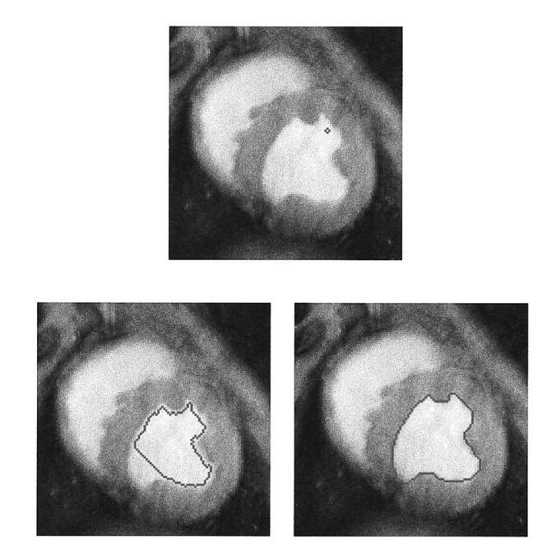
Experiments
45 iters, bubbles
60 iters, bubbles
Ref: https://ieeexplore.ieee.org/stamp/stamp.jsp?tp=&arnumber=563665

Slide 24
Experiments
Two bubbles merging
Ref: https://ieeexplore.ieee.org/stamp/stamp.jsp?tp=&arnumber=563665

Slide 25
Experiments
Three bubbles merging in noisy image
Ref: https://ieeexplore.ieee.org/stamp/stamp.jsp?tp=&arnumber=563665

Slide 26
Pros and Cons
Advantages
Robust to noise and occlusions
Able to handle complex shapes, like non-convex objects
Could extend to 3D and higher dimensional images
Disadvantages
Suffer from local minima and may fail to converge to the correct object boundary if initial contour is too far from the object.
Expensive to compute
Require expert knowledge

Slide 27
Outlines
Introduction of Snakes
Principles of Snakes
Geometric Active Contours
Deep Snakes

Slide 28
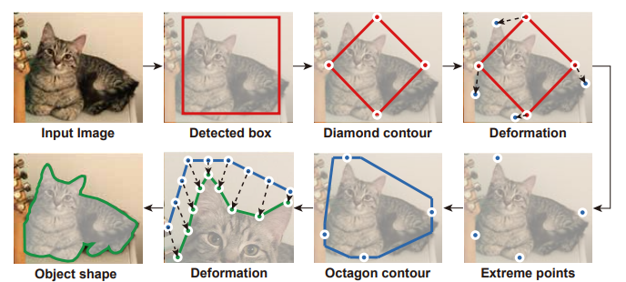
Deep Snake
A snake based deep learning model.
Energy function is from training.
Ref: https://arxiv.org/pdf/2001.01629.pdf

Slide 29
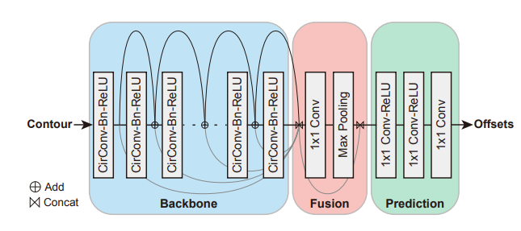
Structure
High Level Structure
Deep Snake
Object
Detector
Deep
Snake
image
contour
Off set of contour
Ref: https://arxiv.org/pdf/2001.01629.pdf

Slide 30
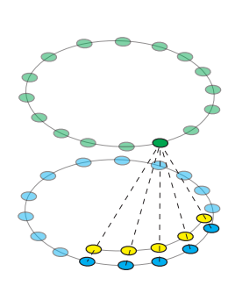
Circular Convolution
Since snakes is built with n nodes, it could use 1d convolution to calculate each nodes.
And head and tail are linked together, so circular convolution is introduced.
Ref: https://arxiv.org/pdf/2001.01629.pdf

Slide 31
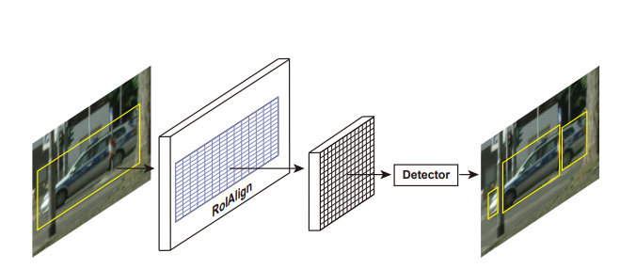
Multi-componet Detection
Perform RoIAlign to obtain the feature map and detect the component boxes.
Ref: https://arxiv.org/pdf/2001.01629.pdf

Slide 32
Implementation Details
Loss function of extreme point deformation
Loss function for iterative contour deformation

Slide 33
Experiment
Ref: https://arxiv.org/pdf/2001.01629.pdf

Slide 34
Experiments
Ref: https://arxiv.org/pdf/2001.01629.pdf

Slide 35
Takeaway
Snakes is a good framework for obtaining objects’ contour.
Flexibility to various shapes, customizable to specified field
GAC is robust to noise and occlusion.
Results of snake depend to initial contour a lot.
Deep Snake solves the problem by learning the energy function.

Slide 36
Thanks for Listening

Slide 37
Reference
https://homepages.inf.ed.ac.uk/rbf/CVonline/LOCAL_COPIES/MORSE/iu.pdf
https://ieeexplore.ieee.org/stamp/stamp.jsp?tp=&arnumber=1716641
https://ieeexplore.ieee.org/stamp/stamp.jsp?tp=&arnumber=563665
https://arxiv.org/pdf/2001.01629.pdf
https://www.analyticsvidhya.com/blog/2021/09/active-contours-a-method-for-image-segmentation-in-computer-vision/

