Slide 1
Adversarial Attacks
Speaker: Rong Zhang
Advisor: Jian-Jiun Ding
2023/11/7

Slide 2
Outline
Introduction
Theory
Methodology
Experimental results
Conclusion

Slide 3
Introduction (1/3)
Adversarial Attack is a topic that first being introduced in 2018, by Aleksander Madry in ICML 2018 [A].
Adversarial Attack investigates Robustness and Fault tolerance rate of a model, including but not limited to machine learning.
Adversarial Attack is a defensive topic that aims to optimize models, on the contrary, Adversarial Examples is an offensive topic that tries to sabotage or malfunction models.
[A] Madry, A., Makelov, A., Schmidt, L., Tsipras, D., & Vladu, A. (2018). Towards deep learning models resistant to adversarial attacks. International Conferences on Machine Learning.

Slide 4
Introduction (2/3)
Adversarial Attack is to generate certain Adversarial Examples.
Adversarial Examples means modified data that will misclassify ML models but remain visual realistic. [1]
[1] Ian Goodfellow, Jonathon Shlens, and Christian Szegedy. Explaining and harnessing adversarial examples. In International Conference on Learning Representations, 2015.

Slide 5
Introduction (3/3)
Multiple attack methods such as Deep-Fool have been experimented and recognized as effective. [2]
That is, design a robust model to prevent upcoming unknown attack is gradually valued as important topic.
In this work, we have several novelties listed below.
Multiple generators by Reinforcement learning
Various attack qualities to increase performance
Predictions from unknown attack
[2] Chao-Wei Xiao, Bo Li, Jun-Yan Zhu, Warren He, Ming-Yan Liu, and Dawn Song, “Generating Adversarial Examples with Adversarial Networks”, 27th International Joint Conference on Artificial Intelligence and the 23rd European Conference on Artificial Intelligence(IJCAI-ECAI-18), Stockholm, Sweden, 2018.

Slide 6
Outline
Introduction
Theory
Methodology
Experimental results
Conclusion

Slide 7
Theory (1/3)
In order to achieve the goal of generating examples, we have target function:
$$ρ\left(θ\right)=E_{x,y\sim D}[\max_{δ∈S}{L(θ,x+δ,y)]} as the risk function, where θ∈R^{ρ}$$
$$is model parameters, D is underlying data distribution, and δ∈R^{S} are$$
$$vectors from the perturbution set S.$$
By minimizing $ρ$, we can create a model with the least risk of learning data distributions with perturbation or noises.

Slide 8
Theory (2/3)
In practice, $D$ is usually inaccessible, which we cannot directly obtain risk function $ρ$.
However, we can approximate risk function$ρ$ by finding minimum of$φ$:
$$φ\left(θ\right)=\max_{δ∈S}{L(θ,x+δ,y)}.$$
$φ$ is a function with locally continuous and differentiable where:
$$\frac{dφ}{dθ}=\sup_{δ∈S(θ)}{∇_{θ}L(θ,x+δ,y)}.$$

Slide 9
Theory (3/3)
In order to prove the optimization of the risk function:
$$If ε∈S is a non−zero maximizer of φ, then the gradient −∇_{θ}L is$$
$$a descent of φ.$$
By applying inner product optimizer $<.>$, we have perturbation with descent learning:
$\frac{dφ}{dθ}=\left\langle ∇_{θ}L\left(θ,x+δ,y\right),∇_{θ}L\left(θ,x+ε,y\right)\right\rangle ≥$
$$\left\langle ∇_{θ}L\left(θ,x+ε,y\right),∇_{θ}L\left(θ,x+ε,y\right)\right\rangle .$$

Slide 10
Outline
Introduction
Theory
Methodology
Approach
Structure
Attack method
Model optimization
Experimental results
Conclusion

Slide 11
Approach (1/2)
Attack (Training)
$$f_{target}(f_{threat}(X))≠Y$$
X
Threat
Target
Y
Design Goal
Control(3rd party models)
Defend (Testing)
$$f_{target}:X_{threat}=Y$$
X
Threat
Target
Y
Control(existing methods)
Design Goal

Slide 12
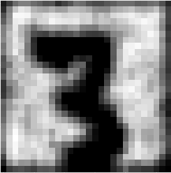
Approach (2/2)
Ian Goodfellow et al. have experimented and recognized the GAN is an effective method.[3]
The input does not limit to certain labels since the generator and discriminator are two distinguish networks.
Below shows reconstruction of attack samples (right) and original image (left).
[3] Ian Goodfellow, Jean PougetAbadie, Mehdi Mirza, Bing Xu, David Warde-Farley, Sherjil Ozair, Aaron Courville, and Yoshua Bengio. Generative adversarial nets. In NIPS, pages 2672–2680, 2014.

Slide 13
Structure (1/2)
Multi-generator robust detection
Training(Ideal)
Testing(Ideal)
Input
Attack
Gen
Target
Labels
For Robustness detection
Step
Robust
Poisoned Input
Attack
Gen
RW
Labels
From existing black-boxes
Expect to be correct labels

Slide 14
Structure (2/2)
Training framework
We apply a modified GANs to generate attack inputs to train threat and target model.
Real
Threat
GAN_loss
Prediction
Input
Attack
Gen
RW
Step
Robust
Target
Adv_loss

Slide 15
Attack method
The current effective attack methods are Fast Gradient Sign Method (FGSM) and Deep-Fool.
We apply the method above and Deep-Fool to examine the model performance, which is measured by F-score.

Slide 16
Model optimization (1/3)
Generator
In practice, the data distribution $D$ is unknown. We can predict the distribution by applying random walks with neural networks with perturbations $S$.
$$Assume x∈R^{D} is outcome of D,we have:$$
$$P_{v|h}(x)=σ(W_{v}P_{v,δ∈S}(x+δ)+b_{v}),$$
$$P_{h|v}(x)=σ(W_{h}P_{h,δ∈S}(x+δ)+b_{h}),$$
$$where W is layer of visible and hidden nodes of networks,$$
$$then if δ is a maximizer of risk,\min_{δ∈S,ε∈S(y)}{L\left(x+δ,x+ε\right)} is a descent method to find the optimal distribution set S.$$
That is, we have generator function $f_{G}\left(x,δ\right)=P_{v,h}(x,x+δ)$.

Slide 17
Model optimization (2/3)
Discriminator
Given data distribution $D$, for $x,y∈R^{D}$, we have: $f_{T}\left(x\right)=x+α\operatorname{sgn}\left(∇_{x}L\left(x,y\right)\right).$
$If x^{(t+1)}=$ $f_{T}\left(x^{\left(t\right)}\right) is a maximizer of L\left(x^{\left(t\right)},y\right), then {sgn⁡(∇}_{x^{\left(t\right)}}L\left(x^{\left(t\right)},y\right)) is a descent method.$
This method is called projected gradient descent (PGD):
$$x^{\left(t+1\right)}=\prod_{x∈D+S,y∈D}{x^{(t)}+α⁡{sgn⁡(∇}_{x^{\left(t\right)}}L\left(x^{\left(t\right)},y\right))}.$$

Slide 18
Model optimization (3/3)
Generator loss
$$L_{G}=E_{x}\log{f_{T}\left(x\right)+}E_{x}\log{(1−f_{T}\left(f_{G}\left(x\right)+x\right))}$$
Discriminator loss
$$L_{D}=E_{x}l_{f}\left(f_{G}\left(x\right)+x, t\right), l denotes loss function.$$
Quality loss
$$L_{Q}=E_{x}\max_{k}{\sum_{k∈Row(x)}{f_{G}\left(x\right)−}x}$$

Slide 19
Outline
Introduction
Theory
Methodology
Experimental results
Dataset
Attack quality
Result
Trade-off between Distortion and Accuracy
Applicable defense
Conclusion

Slide 20
Dataset
We use MNIST [7] in this experiment. This dataset contains 70,000 hand-writing digits of 60,000 for training and 10,000 for testing.
In this section, the training set will be used as prediction of distortion.
And testing set will be used as external black-box attack, which is originally unknown.
[7] Yann LeCun and Corrina Cortes. The MNIST database of handwritten digits. 1998.

Slide 21
Attack quality (1/2)
We apply quality of attack predictions as a distortion to train our model.
Different quality of inputs can increase the robustness of target model.
Small
L-distance
Large

Slide 22
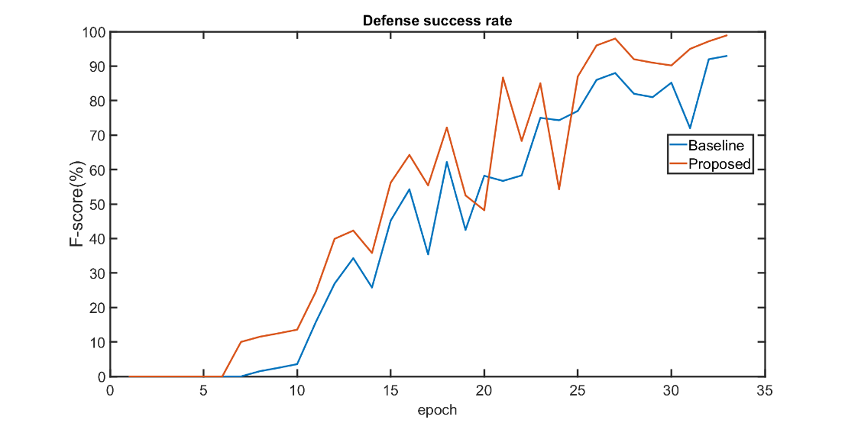
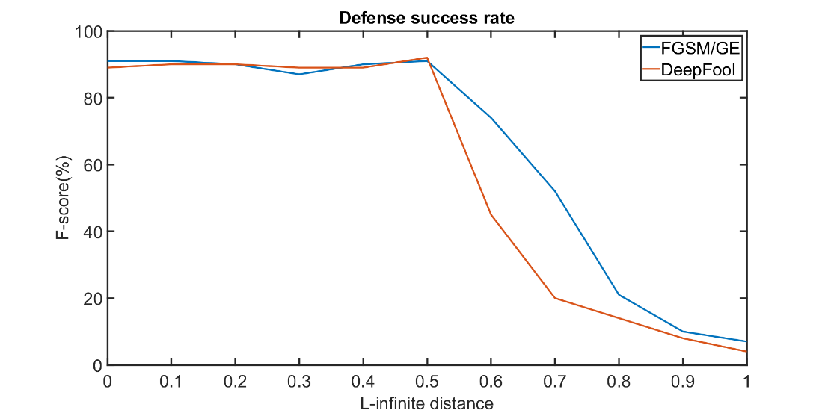
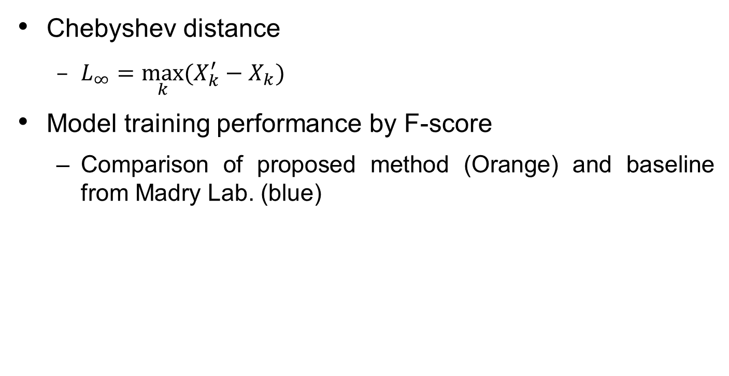
Attack quality (2/2)
Chebyshev distance
$L_{∞}=\max_{k}{(X_{k}^{′}−X_{k})}$
Model training performance by F-score
Comparison of proposed method (Orange) and baseline from Madry Lab. (blue)

Slide 23
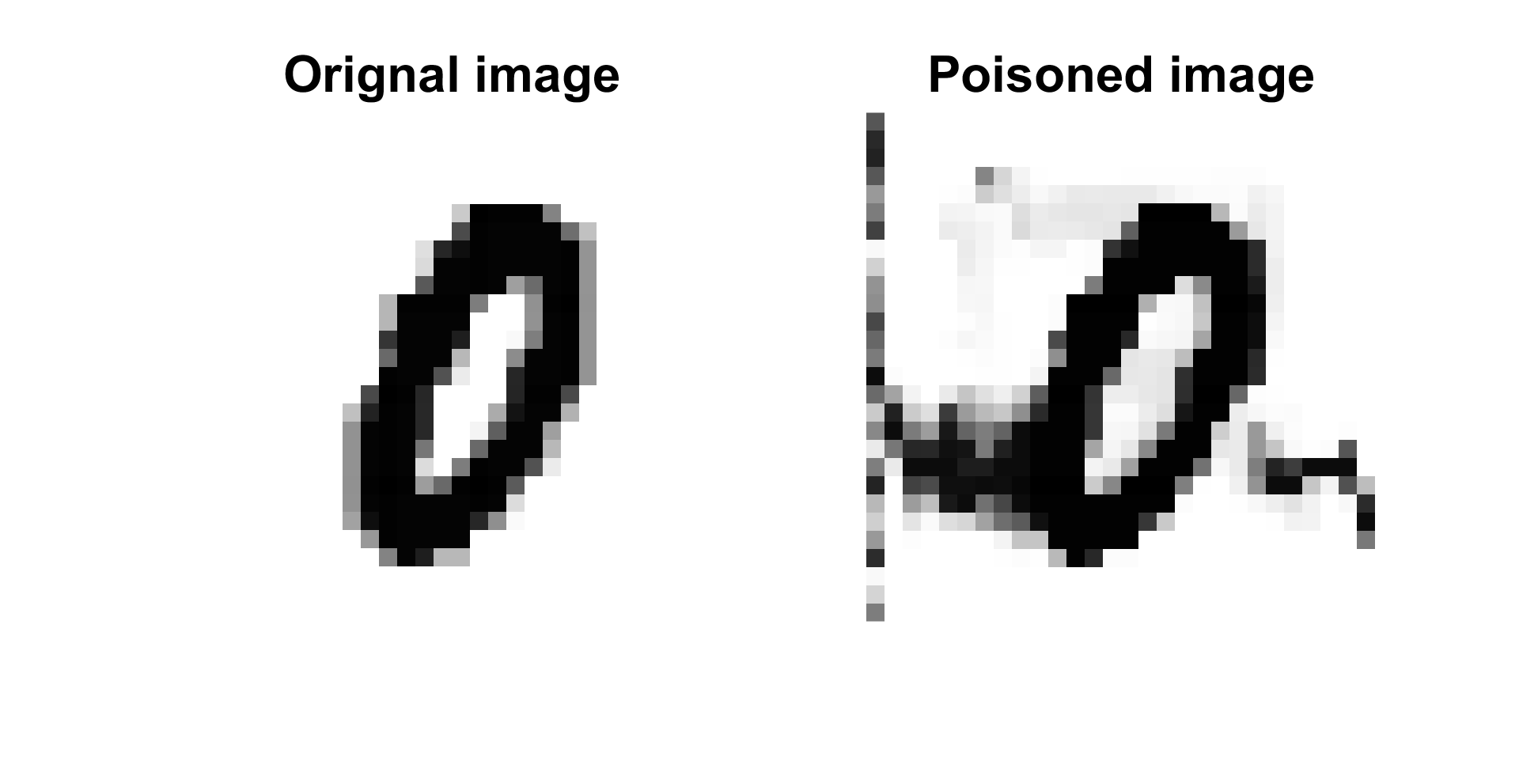
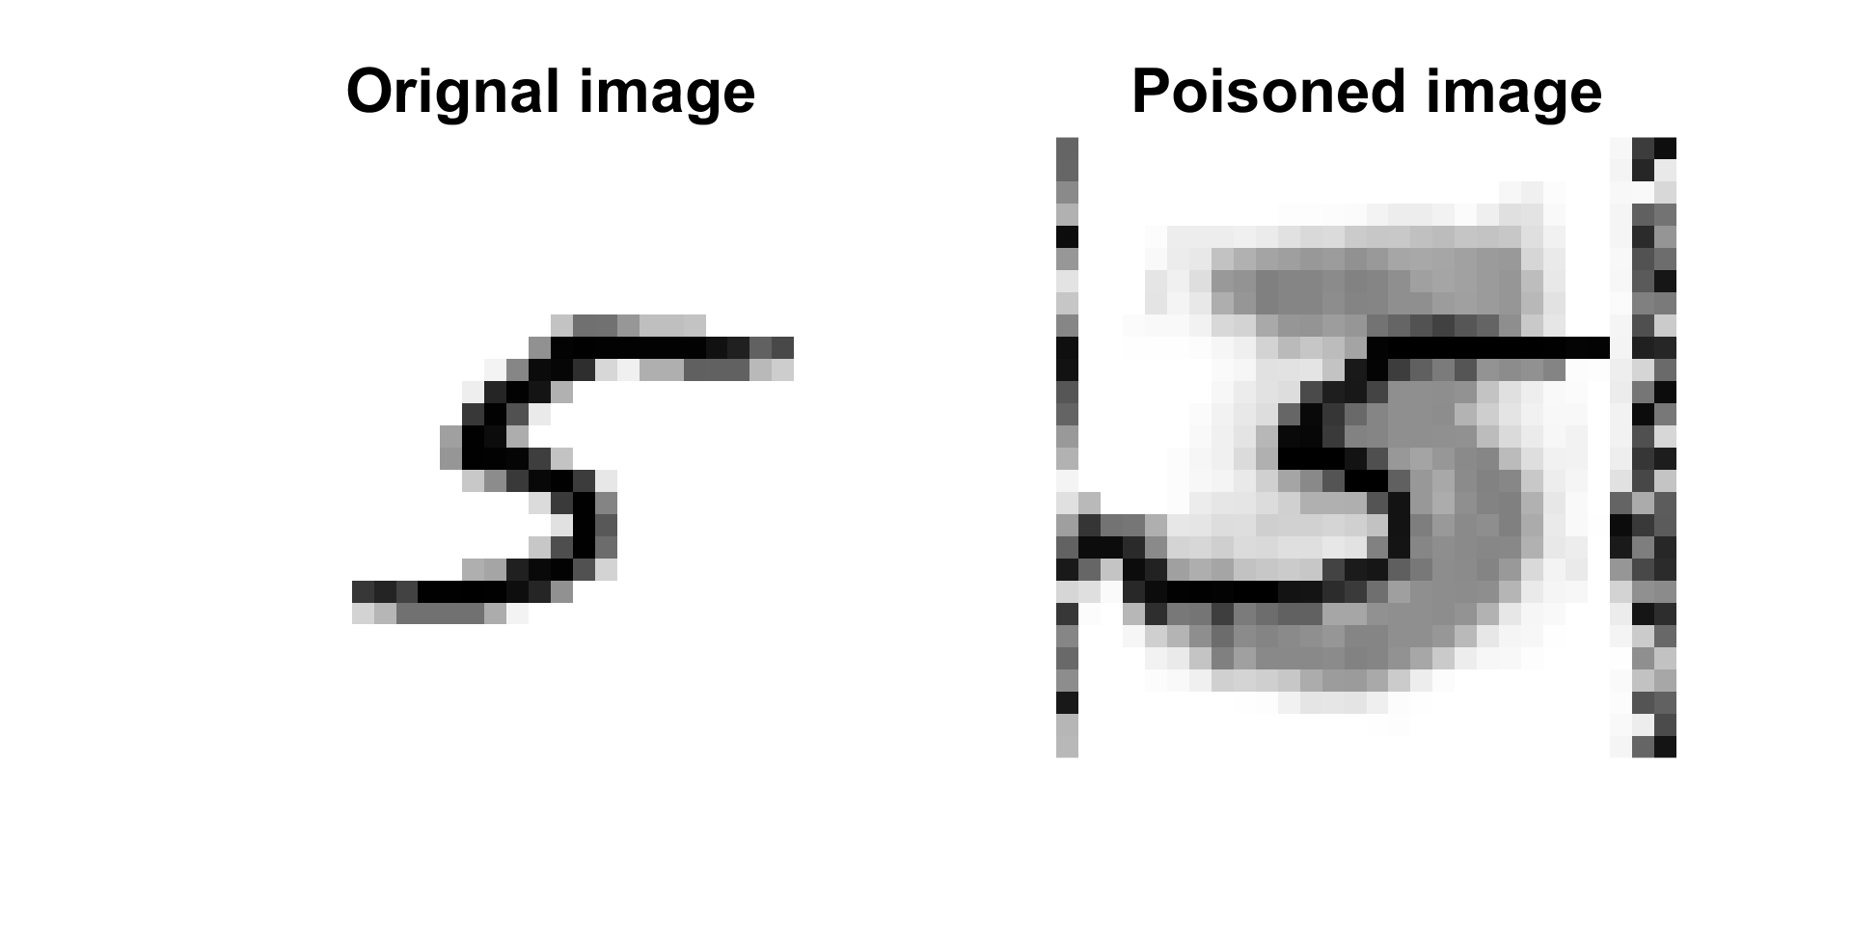
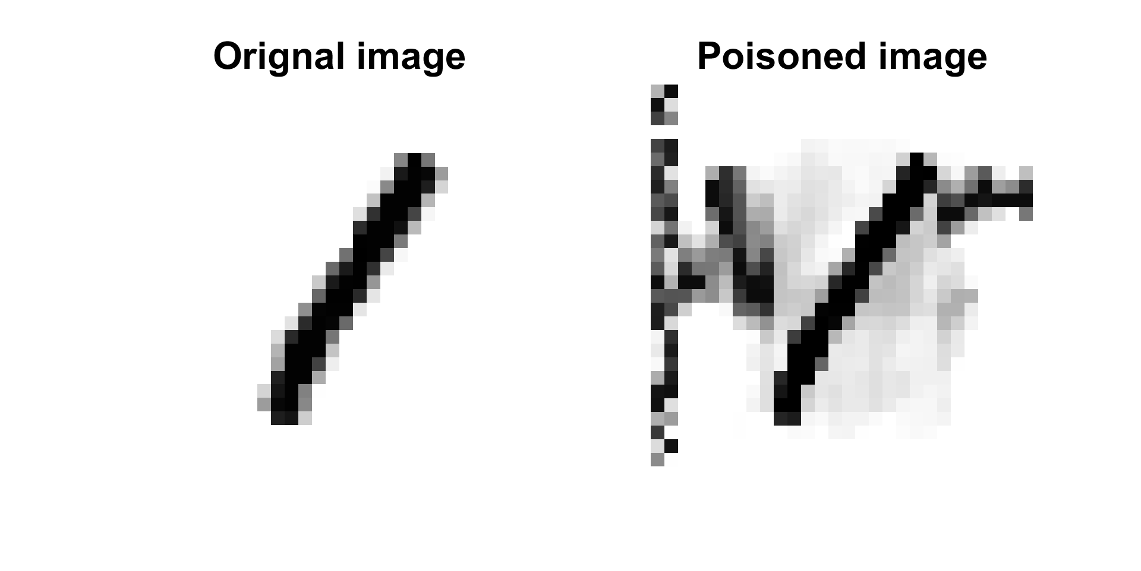
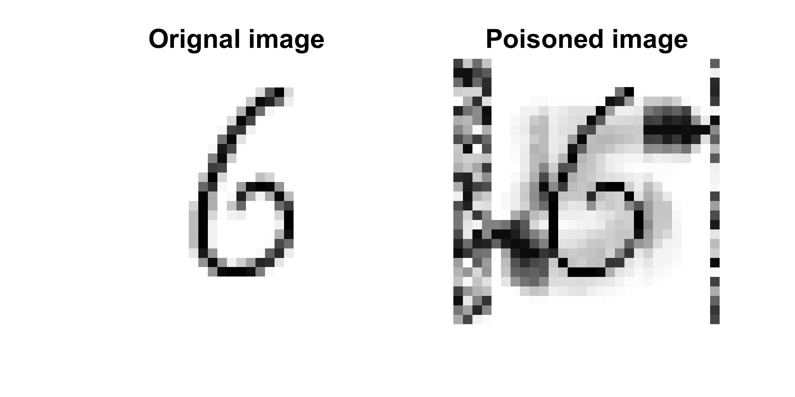
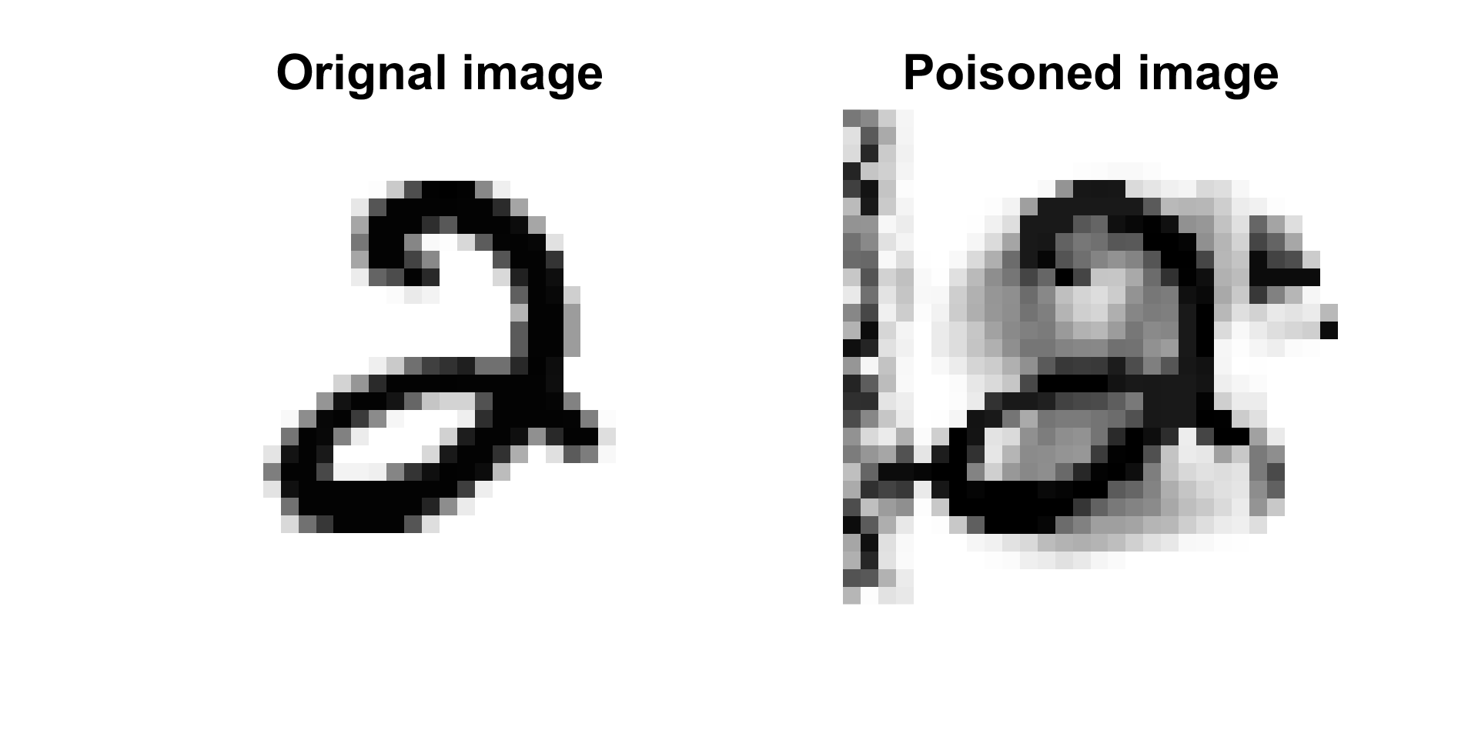
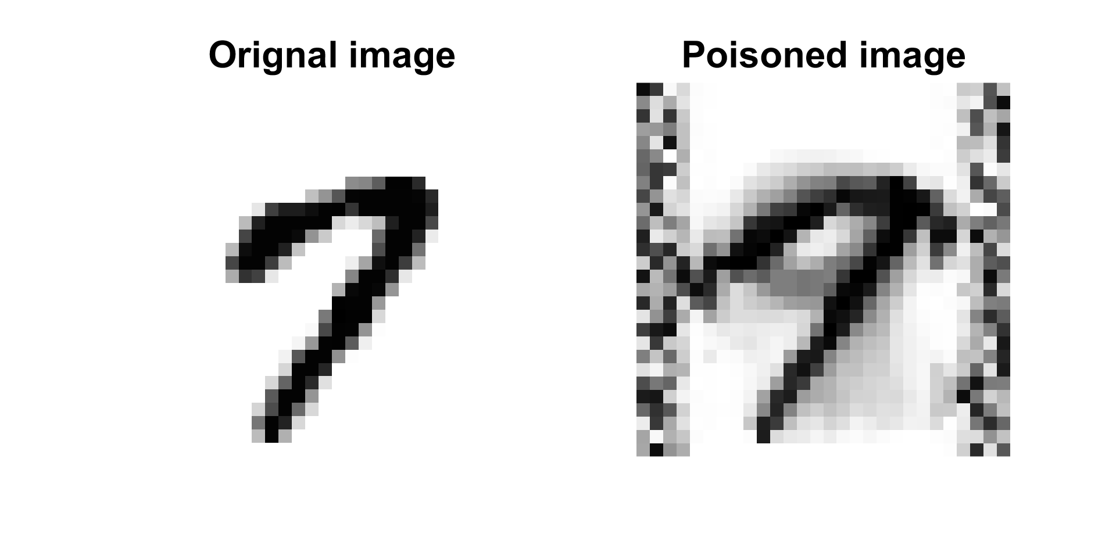
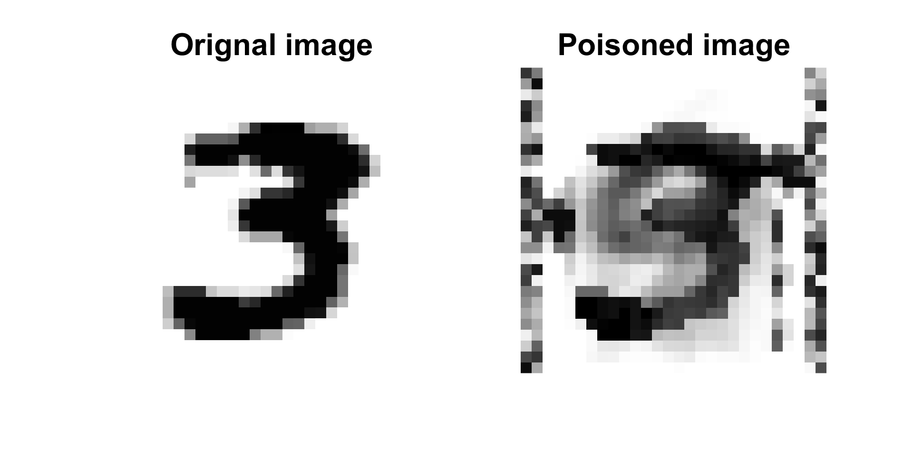
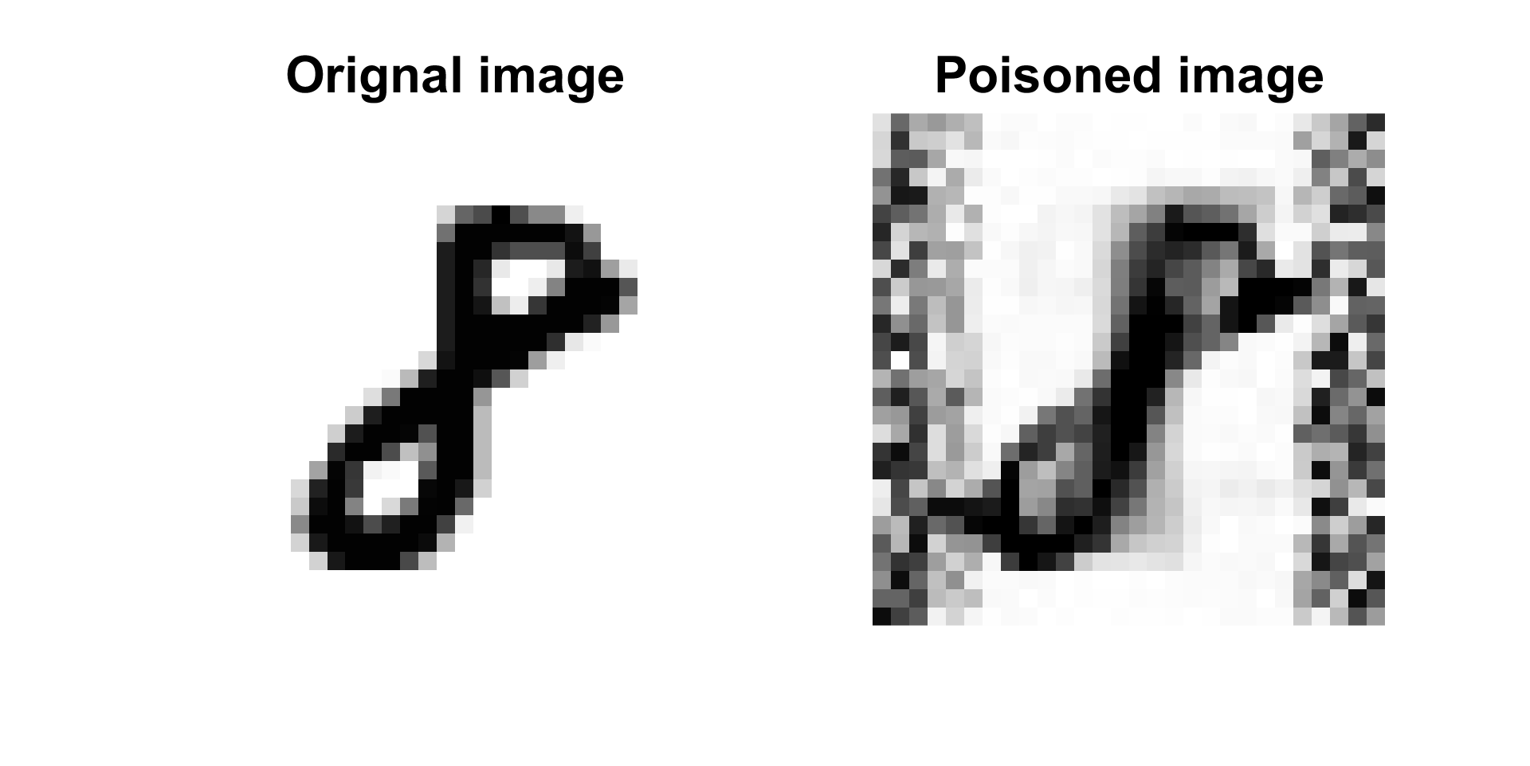
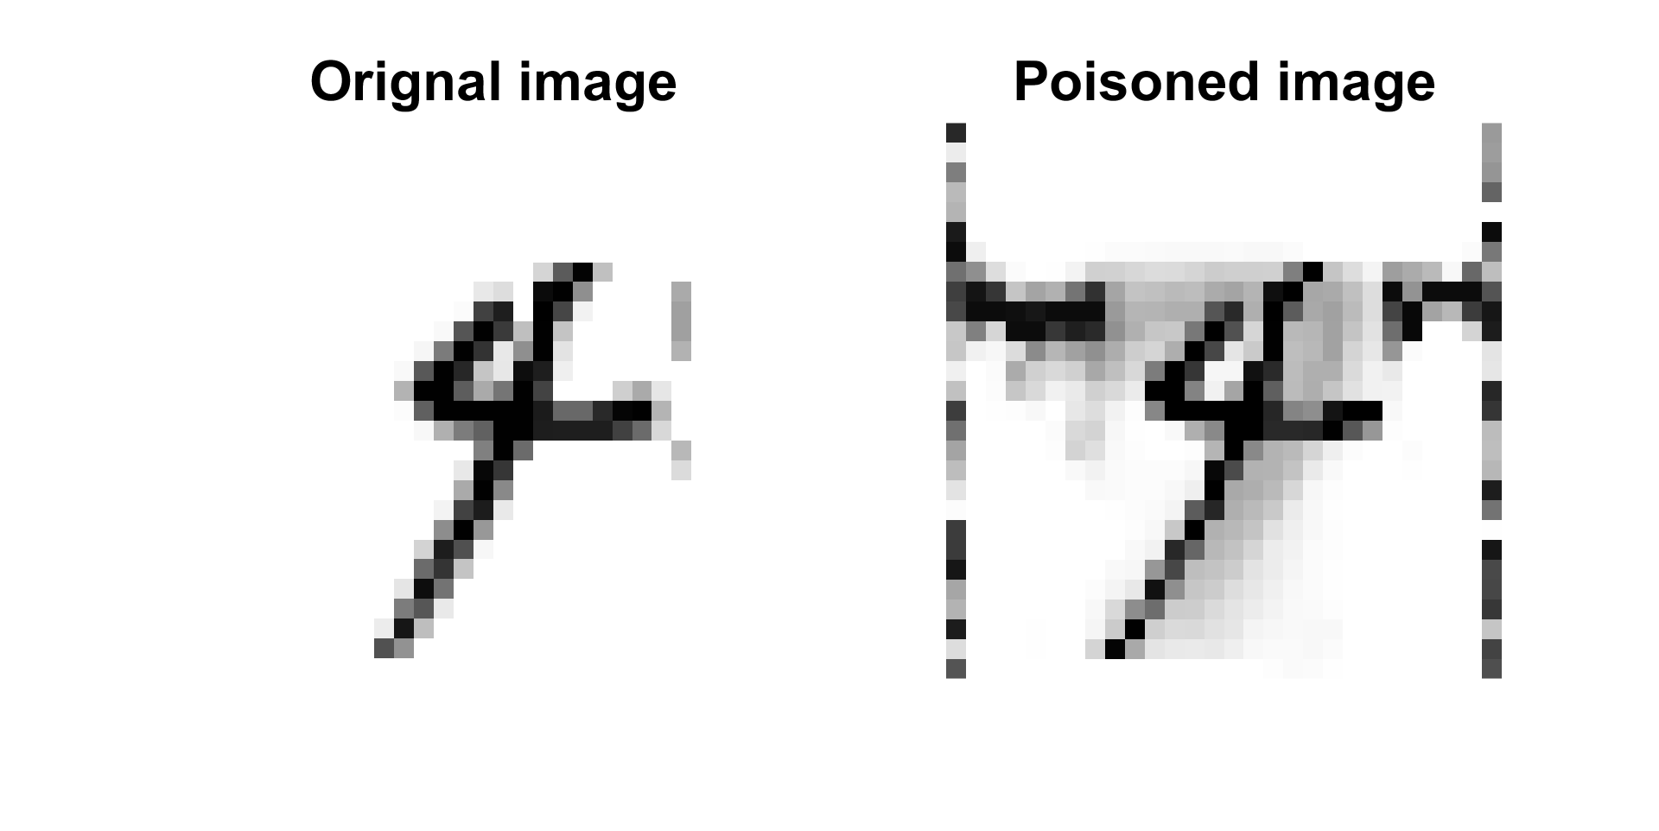
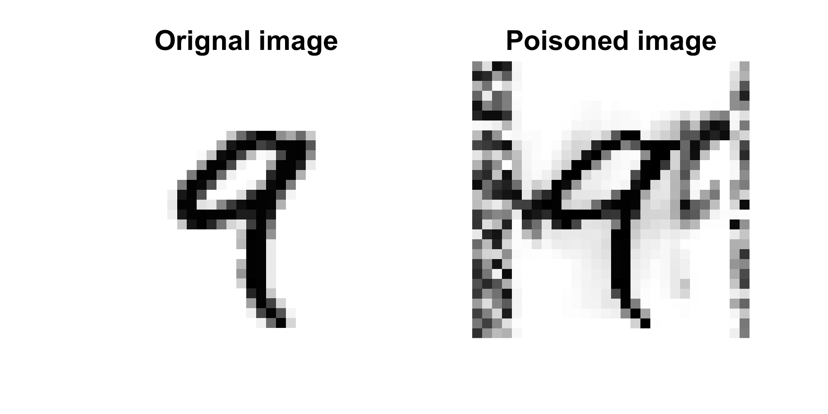
Result of model outputs (1/2)
Original
Poisoned
Original
Poisoned
The digits with perturbation toleration (L-infinite) less than 0.6.
That is, the robustness of models is tested.

Slide 24
Result of overall performance (2/2)
The following table shows the Maximum distance/Accuracy of each models under different attack methods.
 | CNN | Madry lab.[8] | Binary ABS[9] | Proposed
Clean | 99.1 | 98.8 | 99 | 98
FGSM /GE | 0.1/21 | 0.47/89 | 0.49/85 | 0.54/91
DeepFool / GE | 0.09/0 | 0.53/90 | 0.46/78 | 0.55/89
All Attacks | 0.95/10.5 | 0.5/89.5 | 0.475/81.5 | 0.545/90
[8] Aleksander Madry, Aleksandar Makelov, Ludwig Schmidt, Dimitris Tsipras and Adrian Vladu, “Towards Deep Learning Models Resistant to Adversarial Attacks”, International Conference on Learning Representations, 2018.
[9] Lukas Schott, Jonas Rauber, Matthias Bethge and Wieland Brendel, “TOWARDS THE FIRST ADVERSARIALLY ROBUST NEURAL NETWORK MODEL ON MNIST”, International Conference on Learning Representations, 2019.

Slide 25
Trade-off
Trade-off between distortion and robustness
Image is more identical but less robust (left) and vice versa (right).
We aim to find the optimal quality.
Identical
Visual Realistic
Unidentified
Low
Robustness
High

Slide 26
Applicable defense
Vehicle registration plate
Model | CNN | OCR | Proposed
Acc. (MNIST) | 0 | 12 | 90
Acc. (Vehicle number) | 5 | 20 | 90
As the results from CNN and Optical Character Recognition(OCR), it is clear that the robustness of the models is not enough to handle certain adversarial attack.
[10] Muhammad Tahir Qadri, Muhammad Asif, “AUTOMATIC NUMBER PLATE RECOGNITION SYSTEM FOR VEHICLE
IDENTIFICATION USING OPTICAL CHARACTER RECOGNITION”, In International Conference on Education Technology and Computer, 2009.

Slide 27
Outline
Introduction
Theory
Methodology
Experimental results
Conclusion

Slide 28
Conclusion
The robustness of model in this experiment is comparably strong to deal with unknown attack.
This study shows the attack perturbation can be intentionally made as imperceptible noises, that is, design a robust model is necessary.
The security of current machine learning, including but not limited to conventional methods like OCR.

Slide 29
Thanks for the listening.

