Slide 1
An Introduction to
Time-Frequency Analysis
Advisor : Jian-Jiun Ding, Ph. D.
Presenter : Ke-Jie Liao
Taiwan ROC
Taipei
National Taiwan University
GICE
DISP Lab
MD531

Slide 2
Outline
Introduction
STFT
  Rectangular STFT
  Gabor Transform
Wigner Distribution Function
Motions on the Time-Frequency Distribution
  FRFT
  LCT
Applications on Time-Frequency Analysis
  Signal Decomposition and Filter Design
  Sampling Theory
  Modulation and Multiplexing

Slide 3
Introduction
Frequency?
  Another way to consider things.
Frequency related applications
  FDM
  Sampling
  Filter design , etc ….

Slide 4
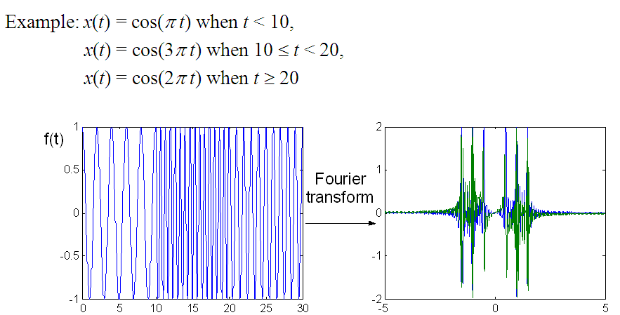
Introduction
Conventional Fourier transform
  1-D
  Totally losing time information
  Suitable for analyzing stationary signal
  ,i.e. frequency does not vary with time.
[1]

Slide 5
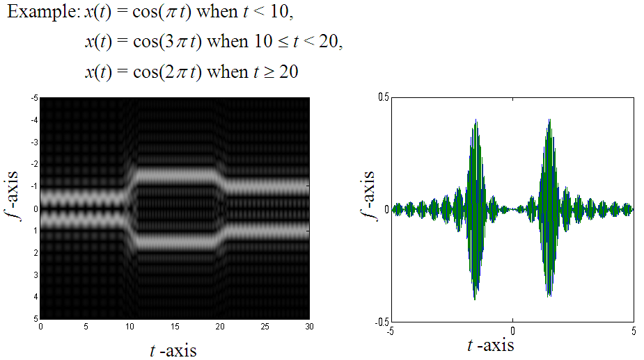
Introduction
Time-frequency analysis
  Mostly originated form FT
  Implemented using FFT
[1]

Slide 6
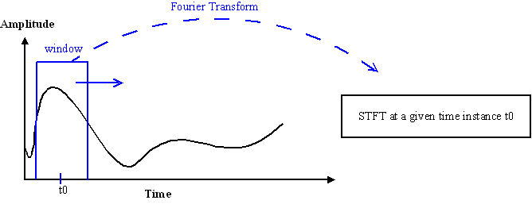
Short Time Fourier Transform
Modification of Fourier Transform
  Sliding window, mask function, weighting function
Mathematical expression
  Reversing Shifting FT
w(t)

Slide 7
Short Time Fourier Transform
Requirements of the mask function
  w(t) is an even function. i.e. w(t)=w(-t).
  max(w(t))=w(0),w(t₁) w(t₂) if |t₁|<|t₂|.
  when |t| is large.
An example of window functions
t
Window width K

Slide 8
Short Time Fourier Transform
Requirements of the mask function
  w(t) is an even function. i.e. w(t)=w(-t).
  max(w(t))=w(0),w(t₁) w(t₂) if |t₁|<|t₂|.
  when |t| is large.
An illustration of evenness of mask functions
Mask
Signal
t0

Slide 9
Short Time Fourier Transform
Effect of window width K
  Controlling the time resolution and freq. resolution.
Small K
  Better time resolution, but worse in freq. resolution
Large K
  Better freq. resolution, but worse in time resolution

Slide 10
Short Time Fourier Transform
The time-freq. area of STFTs are fixed
f
More details in time
f
More details in freq.
K decreases
t
t

Slide 11
Rectangular STFT
1
Rectangle as the mask function
  Uniform weighting
Definition
  Forward
  Inverse
    where
2B

Slide 12
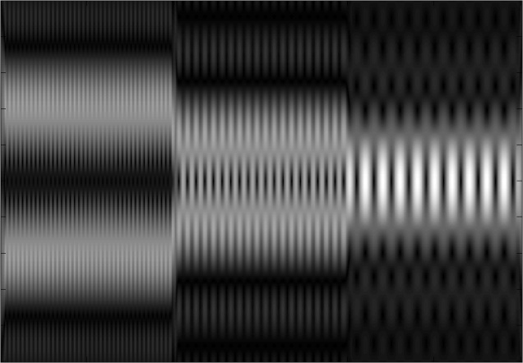
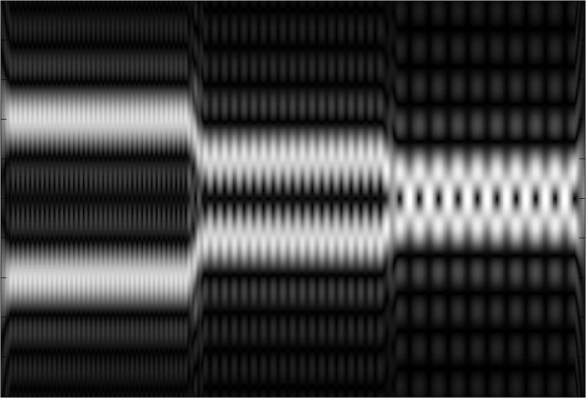
Rectangular STFT
Examples of Rectangular STFTs
f
f
B=0.25
B=0.5
2
2
1
1
0
0
30
t
t
0
10
20
0
10
20
30

Slide 13
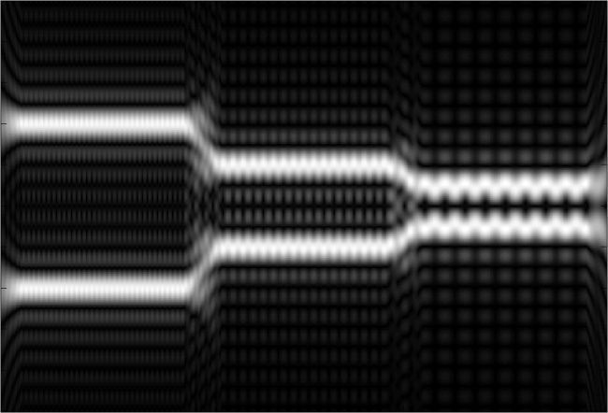
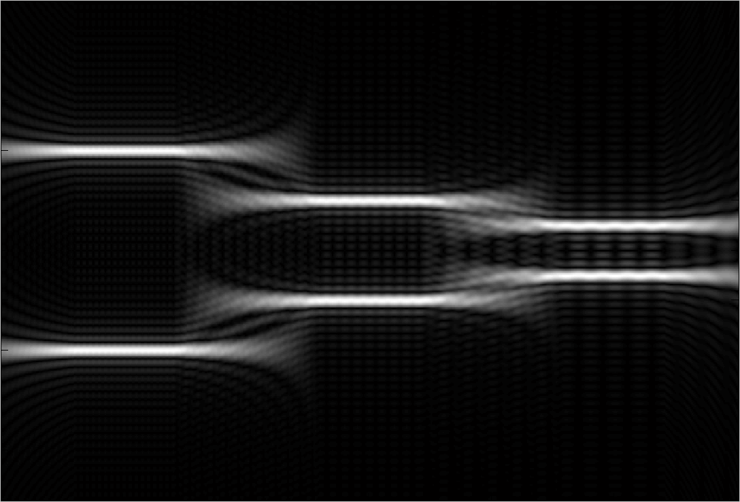
Rectangular STFT
Examples of Rectangular STFTs
f
f
B=1
B=3
2
2
1
1
0
0
t
t
0
10
20
30
0
10
20
30

Slide 14
Rectangular STFT
Properties of rec-STFTs
  Linearity
  Shifting
  Modulation

Slide 15
Rectangular STFT
Properties of rec-STFTs
  Integration
  Power integration
  Energy sum

Slide 16
Gabor Transform
Gaussian as the mask function
Mathematical expression
  Since
  where
GT’s time-freq area is the minimal against other STFTs!

Slide 17
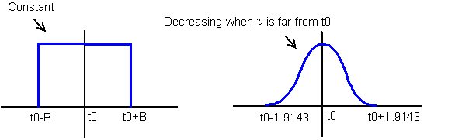
Gabor Transform
Compared with rec-STFTs
  Window differences
  Resolution – The GT has better clarity
  Complexity
Discontinuity
Weighting differences

Slide 18
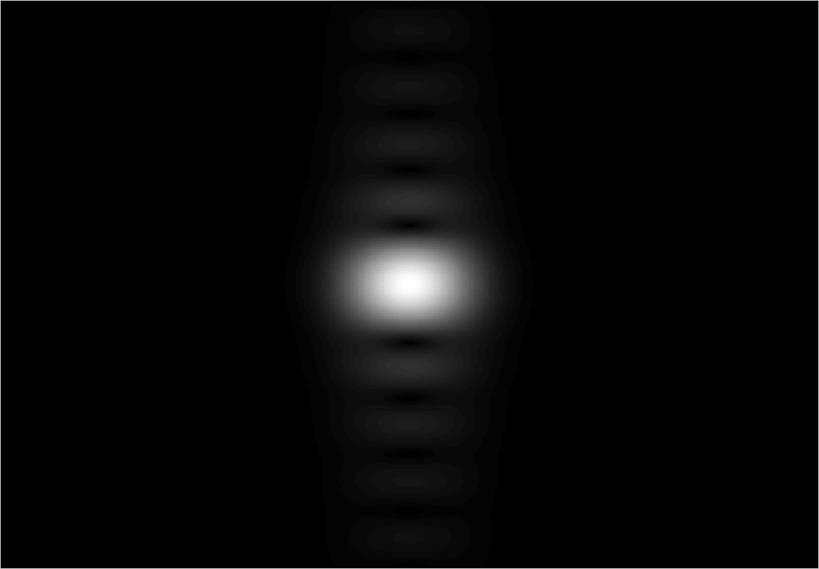
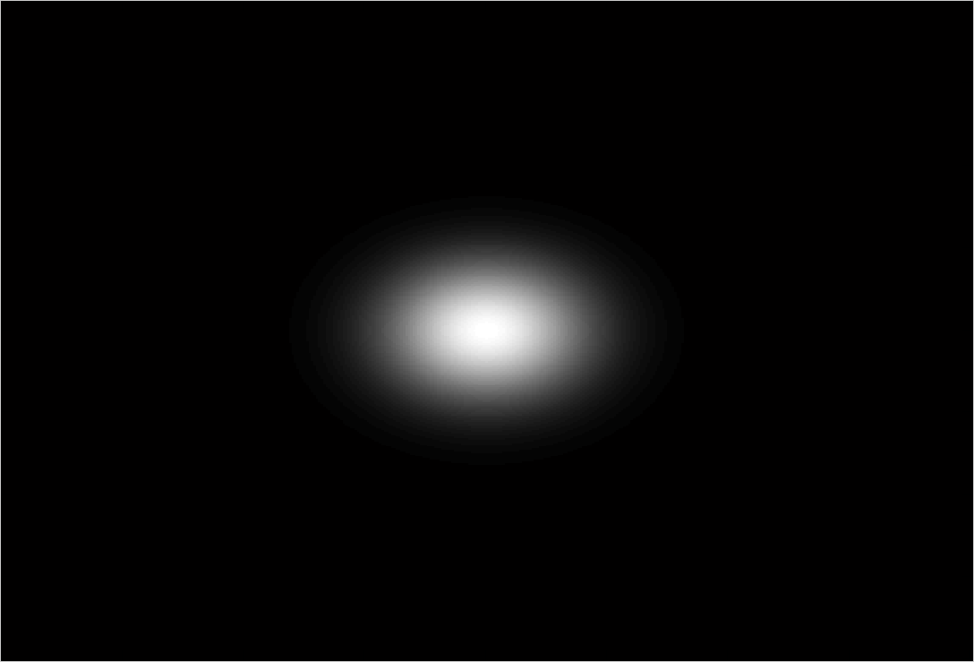
Gabor Transform
Compared with rec-STFTs
  Resolution – GT has better clarity
Example of
Better resolution!
f
f
The rec-STFT
The GT
0
0
t
t
0
0

Slide 19
Gabor Transform
Compared with the rec-STFTs
  Window differences
  Resolution – GT has better clarity
Example of
GT’s area is minimal!
High freq. due to discon.
f
The rec-STFT
The GT
0
0
t
t
0
0

Slide 20
Gabor Transform
Properties of the GT
  Linearity
  Shifting
  Modulation
Same as the rec-STFT!

Slide 21
Gabor Transform
Properties of the GT
  Integration
  Power integration
  Energy sum
  Power decayed
K=1-> recover original signal

Slide 22
Gabor Transform
Gaussian function centered at origin
Generalization of the GT
  Definition

Slide 23
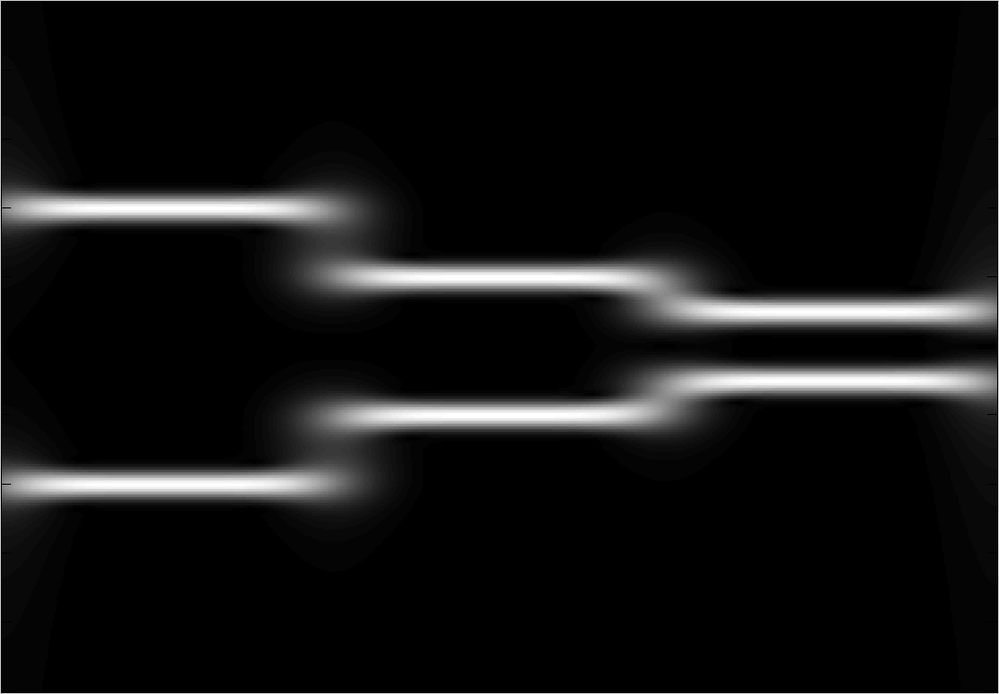
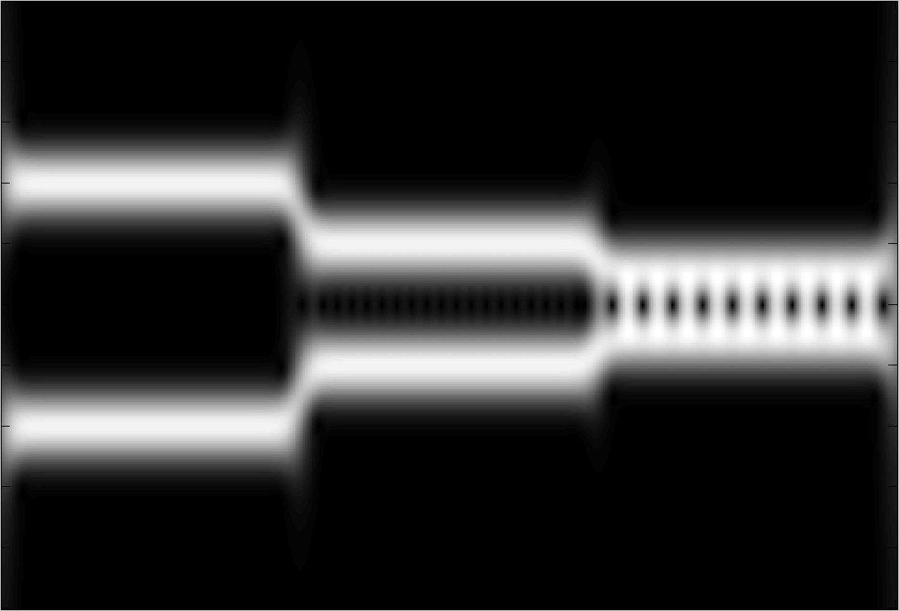
Gabor Transform
plays the same role as K,B.(window width)
  increases -> window width decreases
  decreases -> window width increases
Examples : Synthesized cosine wave
f
f
2
2
1
1
0
0
t
t
0
10
20
30
0
10
20
30

Slide 24
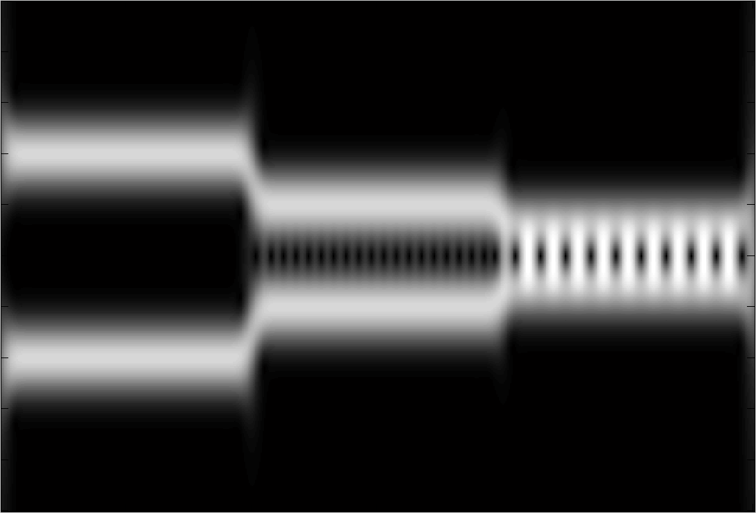
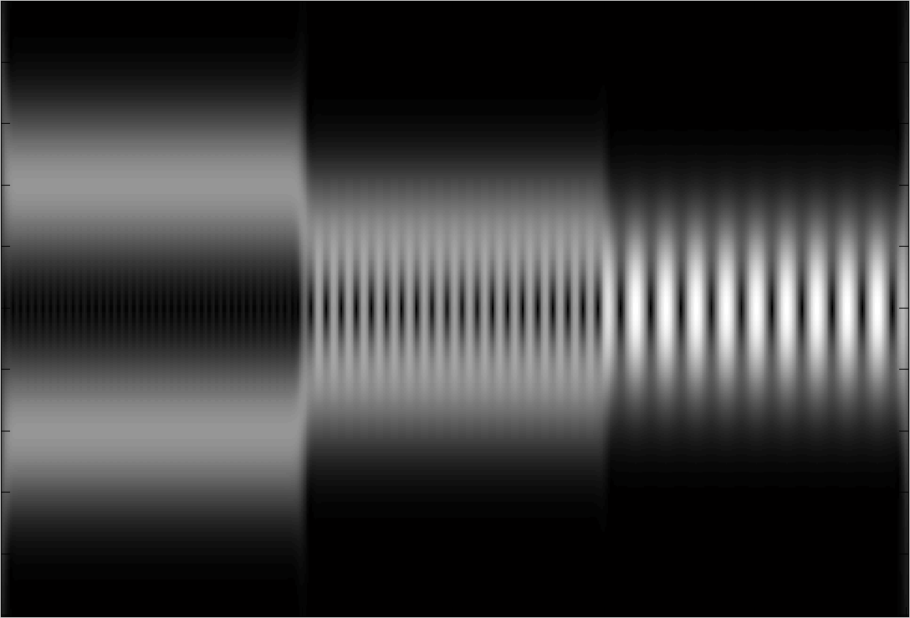
Gabor Transform
plays the same role as K,B.(window width)
  increases -> window width decreases
  decreases -> window width increases
Examples : Synthesized cosine wave
f
f
2
2
1
1
0
0
t
t
0
10
20
30
0
10
20
30

Slide 25
Wigner Distribution Function
Definition
  Auto correlated -> FT
  Good mathematical properties
Autocorrelation
  Higher clarity than GTs
  But also introduce cross term problem!

Slide 26
Wigner Distribution Function
Cross term problem
  WDFs are not linear operations.
Cross term!
n(n-1) cross term!!

Slide 27
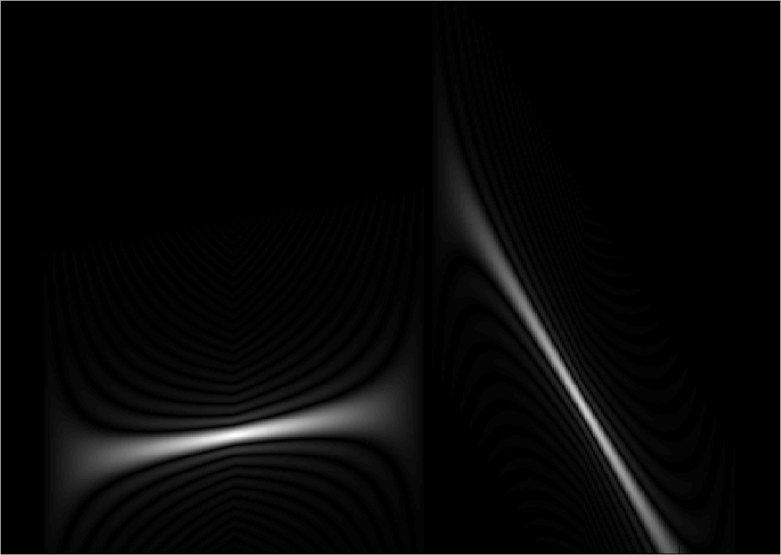
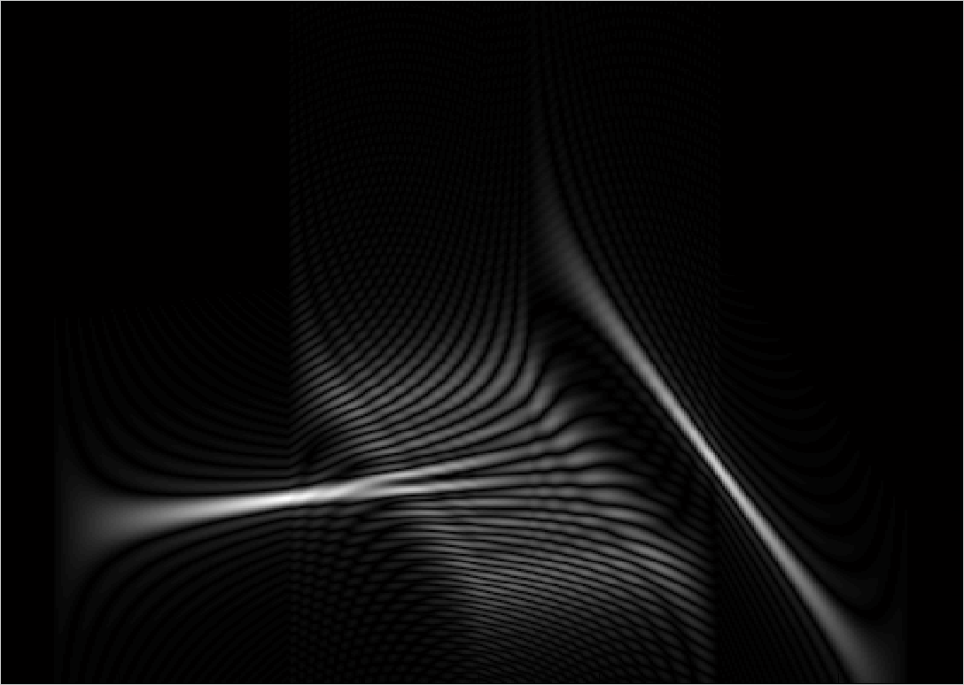
Wigner Distribution Function
An example of cross term problem
f
f
Without cross term
With cross term
0
0
t
t
0
0

Slide 28
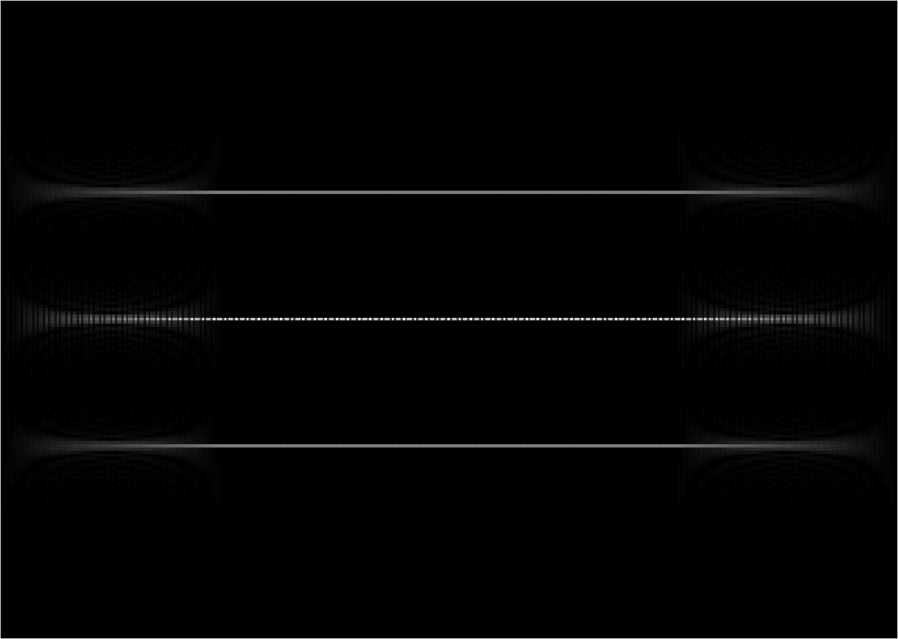
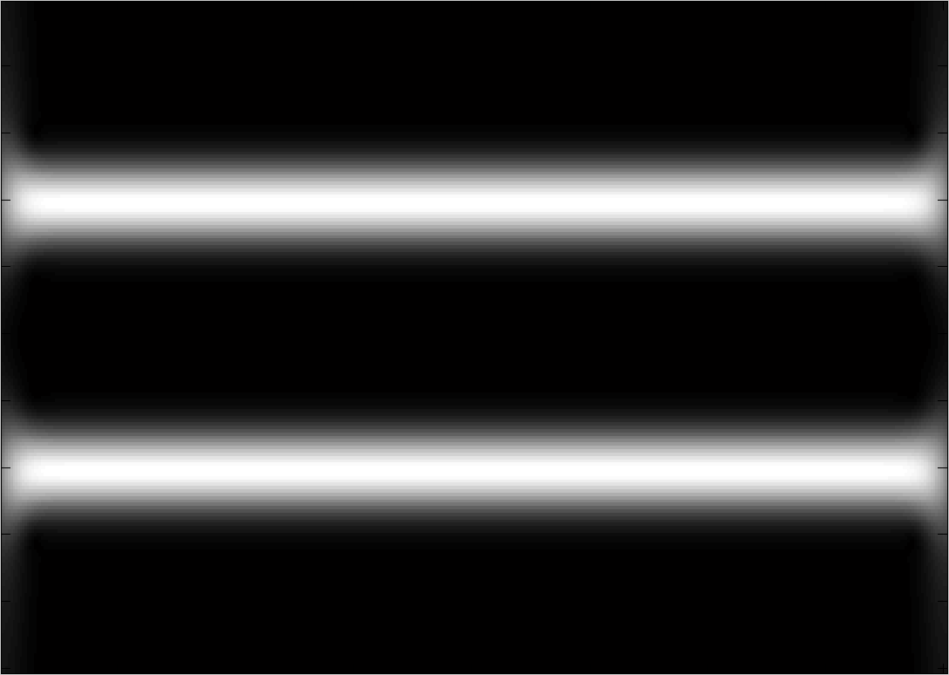
Wigner Distribution Function
Compared with the GT
  Higher clarity
  Higher complexity
An example
f
f
WDF
GT
0
0
t
t
0
0

Slide 29
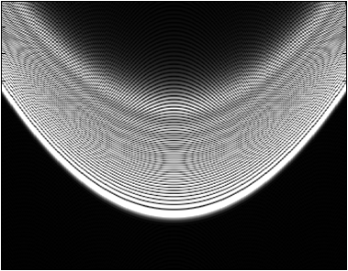
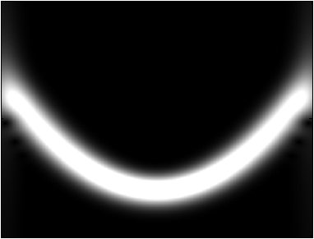
Wigner Distribution Function
But clarity is not always better than GT
  Due to cross term problem
  Functions with phase degree higher than 2
f
f
WDF
GT
Indistinguishable!!
0
0
t
t
[1]
0
0

Slide 30
Wigner Distribution Function
Properties of WDFs
  Shifting
  Modulation
  Energy property

Slide 31
Wigner Distribution Function
Properties of WDFs
  Recovery property
  is real
  Energy property
  Region property
  Multiplication
  Convolution
  Correlation
  Moment
  Mean condition frequency and mean condition time

Slide 32
Motions on the Time-Frequency Distribution
Operations on the time-frequency domain
  Horizontal Shifting (Shifting on along the time axis)
  Vertical Shifting (Shifting on along the freq. axis)
f
t
f
t

Slide 33
Motions on the Time-Frequency Distribution
Operations on the time-frequency domain
  Dilation
  Case 1 : a>1
  Case 2 : a<1

Slide 34
Motions on the Time-Frequency Distribution
Operations on the time-frequency domain
  Shearing - Moving the side of signal on one direction
  Case 1 :
  Case 2 :
f
a>0
Moving this side
t
a>0
f
Moving this side
t

Slide 35
Motions on the Time-Frequency Distribution
Rotations on the time-frequency domain
  Clockwise 90 degrees – Using FTs
f
Clockwise rotation 90
t

Slide 36
Motions on the Time-Frequency Distribution
Rotations on the time-frequency domain
  Generalized rotation with any angles – Using WDFs or GTs via the FRFT
  Definition of the FRFT
  Additive property

Slide 37
Motions on the Time-Frequency Distribution
Rotations on the time-frequency domain
  [Theorem]
  The fractional Fourier transform (FRFT) with angle φ is equivalent to the clockwise rotation operation with angle φ for the WDF or GT.
Old
New
New
Old
Counterclockwise rotation matrix
Clockwise rotation matrix

Slide 38
Motions on the Time-Frequency Distribution
Rotations on the time-frequency domain
  [Theorem]
  The fractional Fourier transform (FRFT) with angle φ is equivalent to the clockwise rotation operation with angle φ for the WDF or GT.
Examples (Via GTs)
[1]

Slide 39
Motions on the Time-Frequency Distribution
Rotations on the time-frequency domain
  [Theorem]
  The fractional Fourier transform (FRFT) with angle φ is equivalent to the clockwise rotation operation with angle φ for the WDF or GT.
Examples (Via GTs)
[1]

Slide 40
Motions on the Time-Frequency Distribution
Twisting operations on the time-frequency domain
  LCT s
Old
New
Inverse exist since ad-bc=1
f
The area is unchanged
f
LCT
t
t

Slide 41
Applications on Time-Frequency Analysis
Signal Decomposition and Filter Design
  A signal has several components - > separable in time
  -> separable in freq.
  -> separable in time-freq.
Horizontal cut off line on the t-f domain
f
t
f
t
Vertical cut off line on the t-f domain

Slide 42
Applications on Time-Frequency Analysis
Signal Decomposition and Filter Design
  An example
f
Signals
Noise
t
Rotation -> filtering in the FRFT domain

Slide 43
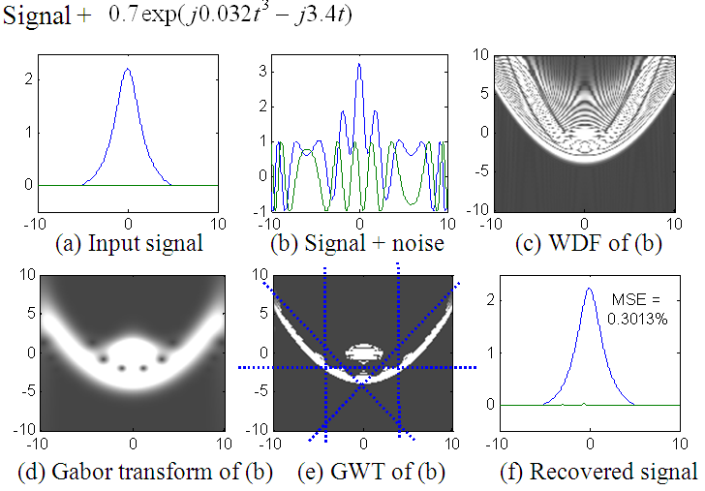
Applications on Time-Frequency Analysis
Signal Decomposition and Filter Design
  An example
The area in the t-f domain isn’t finite!
[1]

Slide 44
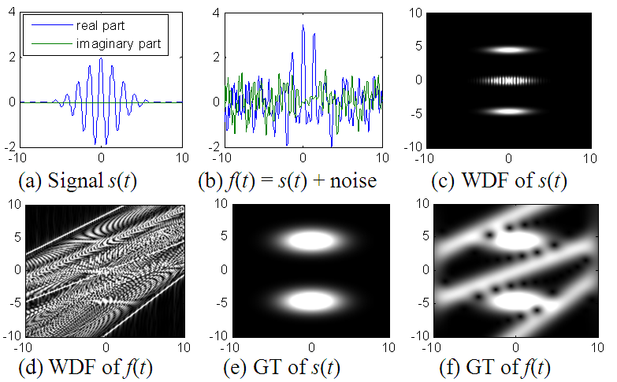
Applications on Time-Frequency Analysis
Signal Decomposition and Filter Design
  An example
[1]

Slide 45
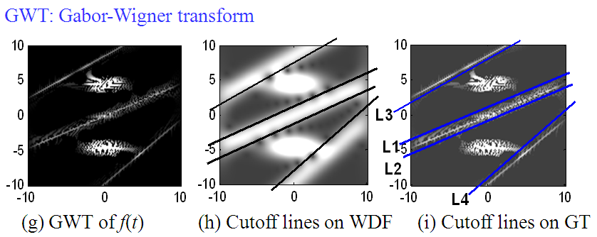
Applications on Time-Frequency Analysis
Signal Decomposition and Filter Design
  An example
[1]

Slide 46
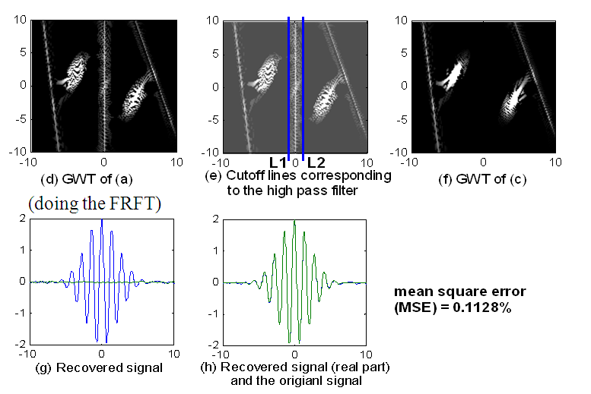
Applications on Time-Frequency Analysis
Signal Decomposition and Filter Design
  An example
The area in the t-f domain isn’t finite!
[1]

Slide 47
Applications on Time-Frequency Analysis
Sampling Theory
  Nyquist theorem : , B
  Adaptive sampling
[1]

Slide 48
Conclusions and Future work
Comparison among STFT,GT,WDF
Time-frequency analysis apply to image processing?
 | rec-STFT | GT | WDF
Complexity | ㊣㊣㊣ | ㊣㊣ | ㊣
Clarity | ㊣ | ㊣㊣ | ㊣㊣㊣
勝!
勝!

Slide 49
References
[1] Jian-Jiun Ding, Time frequency analysis and wavelet transform class note, the Department of Electrical Engineering, National Taiwan University (NTU), Taipei, Taiwan, 2007.
[2] S. C. Pei and J. J. Ding, ”Relations between Gabor transforms and fractional Fourier transforms and their applications for signal processing”, IEEE Trans. Signal Processing, vol.55,no. 10,pp.4839-4850.
[3] S. Qian and D. Chen, Joint Time-Frequency Analysis: Methods and Applications, Prentice-Hall, 1996.
[4] D. Gabor, ”Theory of communication”, J. Inst. Elec. Eng., vol. 93, pp.429-457, Nov. 1946.
[5] L. B. Almeida, ”The fractional Fourier transform and time-frequency representations, ”IEEE Trans. Signal Processing, vol. 42,no. 11, pp. 3084-3091, Nov. 1994.
[6] K. B. Wolf, “Integral Transforms in Science and Engineering,” Ch. 9: Canonical transforms, New York, Plenum Press, 1979.

Slide 50
References
[7] X. G. Xia, “On bandlimited signals with fractional Fourier transform,” IEEE Signal Processing Letters, vol. 3, no. 3, pp. 72-74, March 1996.
[8] L. Cohen, Time-Frequency Analysis, Prentice-Hall, New York, 1995.
[9] T. A. C. M. Classen and W. F. G. Mecklenbrauker, “The Wigner distribution−a tool for time-frequency signal analysis; Part I,” Philips J. Res., vol. 35, pp. 217-250, 1980.

