Slide 1
Applications of the Transformer to the field of computer vision
November 8 , 2022
Professor: Jian-Jiun Ding
Presenter: Cyun-Bo Wang

Slide 2
Overview
Intro of the Transformer
From NLP to CV
Intro of several designs

Slide 3
Encoder-Decoder Structure
Self-attention
mechanism
Intro of the
Transformer

Slide 4
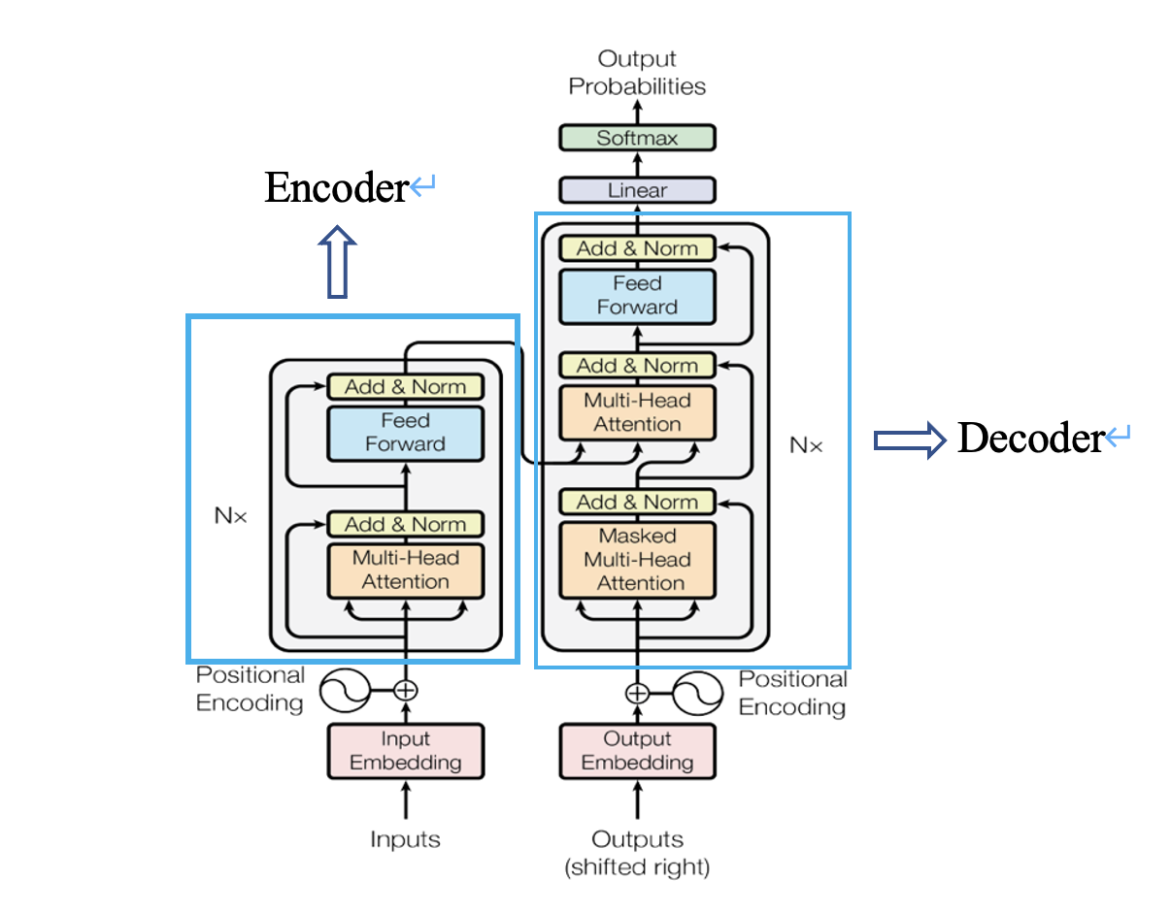
Encoder-Decoder
Structure
Encoder-Decoder Structure [1]

Slide 5
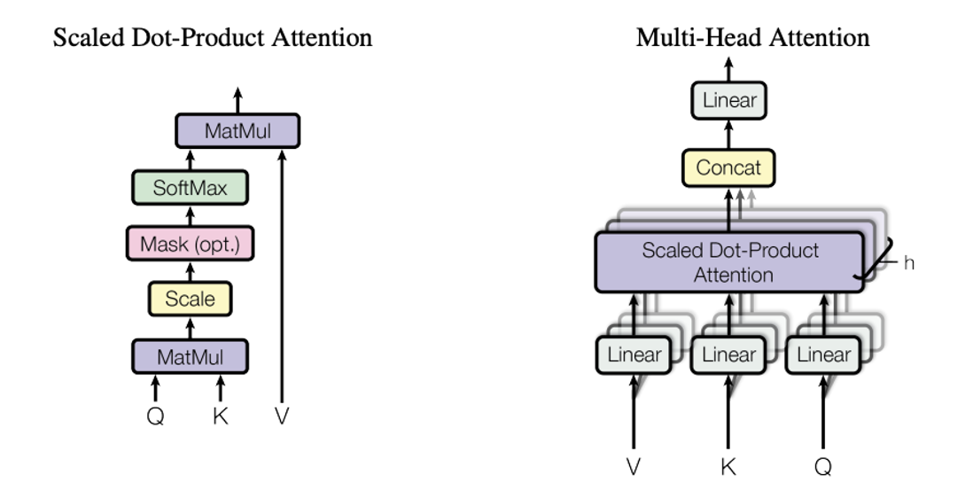
Self-Attention Mechanism
Self-attention [1]
Multi-head self-attention [1]

Slide 6
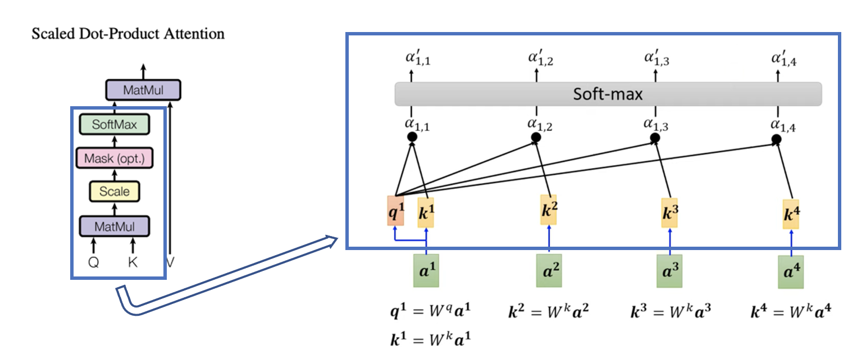
Self-Attention Mechanism
Details of Self-attention. [1] and [2]

Slide 7
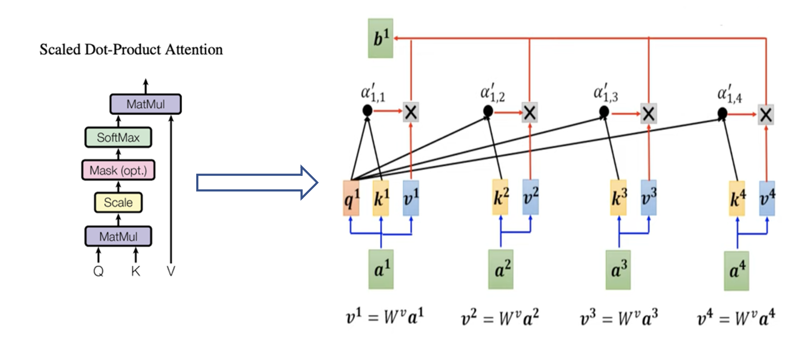
Self-Attention Mechanism
Details of Self-attention. [1] and [2]

Slide 8
Self-Attention Mechanism
Details of Self-attention. [1] and [2]

Slide 9
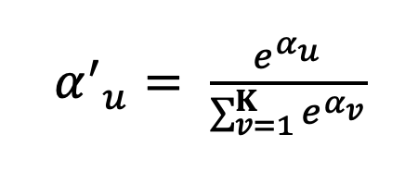
Self-Attention
Mechanism
Self-attention formula [1]

Slide 10
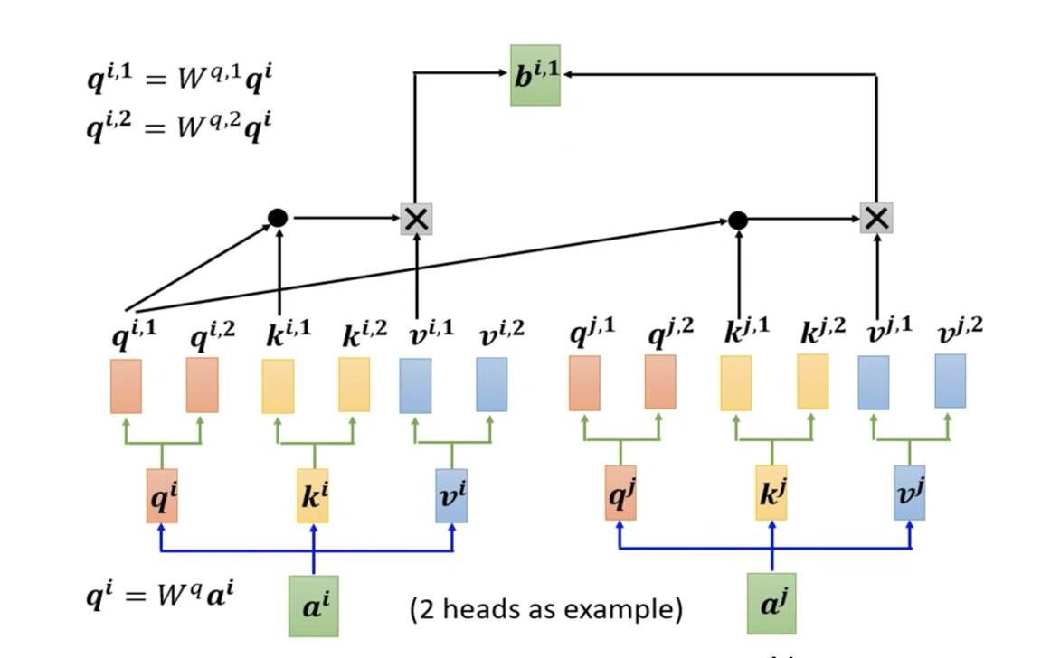
Self-Attention Mechanism
Multi-head
Details of multi-head self-attention. [2]

Slide 11
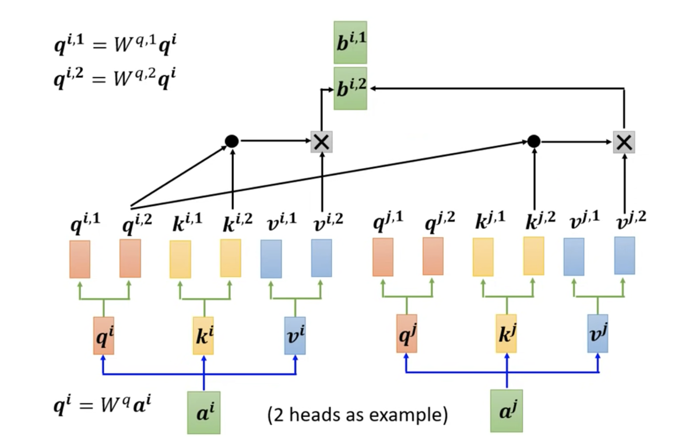
Self-Attention Mechanism
Multi-head
Details of multi-head self-attention. [2]

Slide 12
Self-Attention Mechanism
Multi-head
Details of multi-head self-attention. [2]

Slide 13
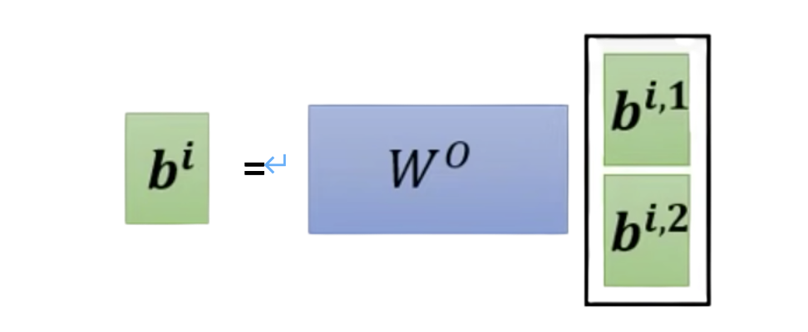
Self-Attention
Mechanism
Details of multi-head self-attention. [2]

Slide 14
From NLP to CV

Slide 15
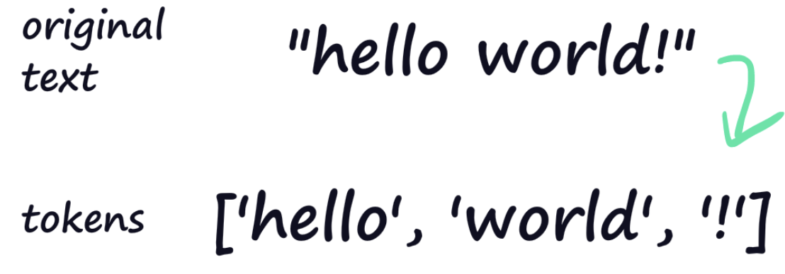
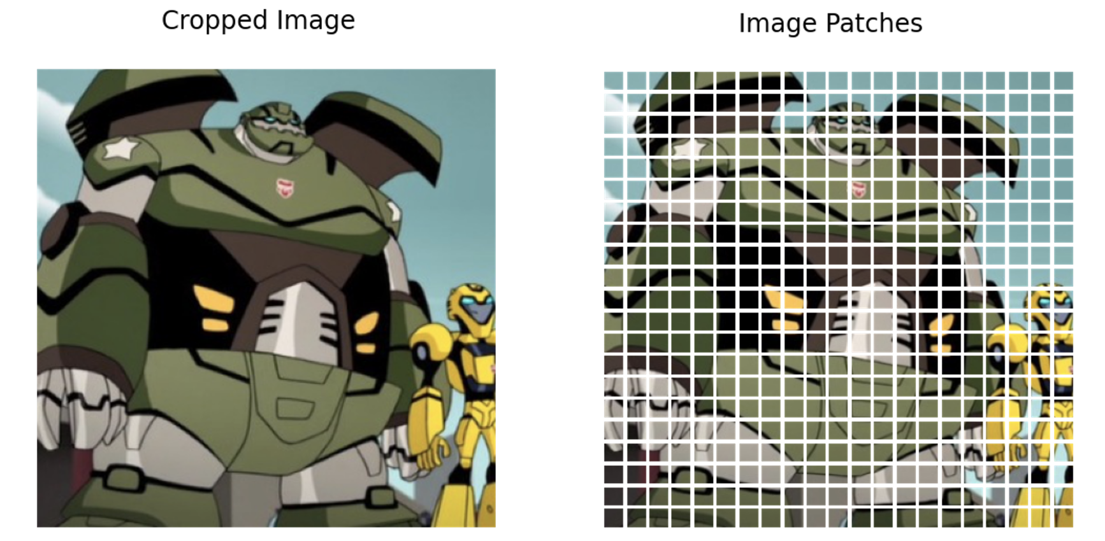
token: word
token: image patch
NLP CV
Words [3]
Image Patches [4]

Slide 16
Vision Transformer
Swin Transformer
Intro of
several designs
BEIT

Slide 17
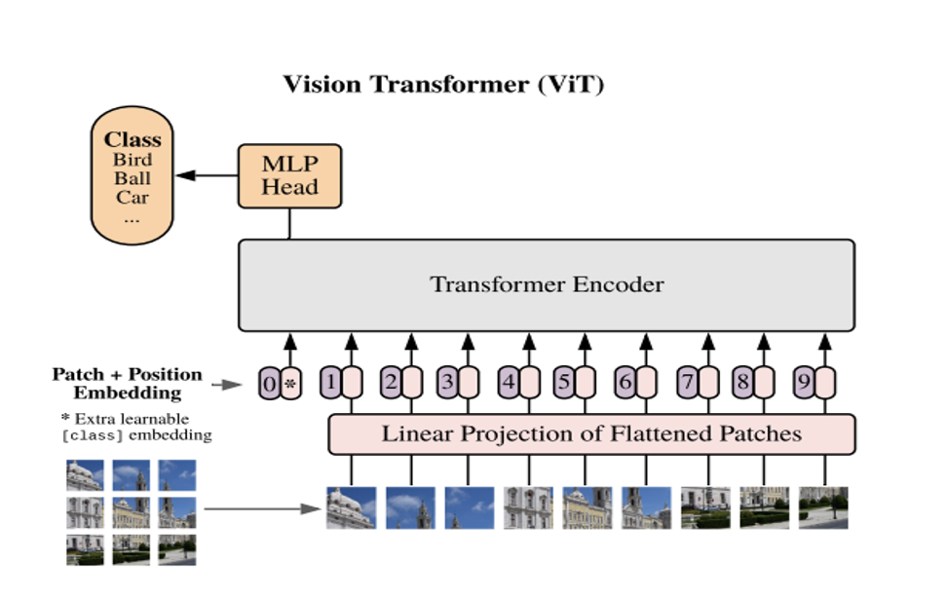
Intro of several designs
Vision Transformer (ViT)
Structure of the Vision Transformer. [5]

Slide 18
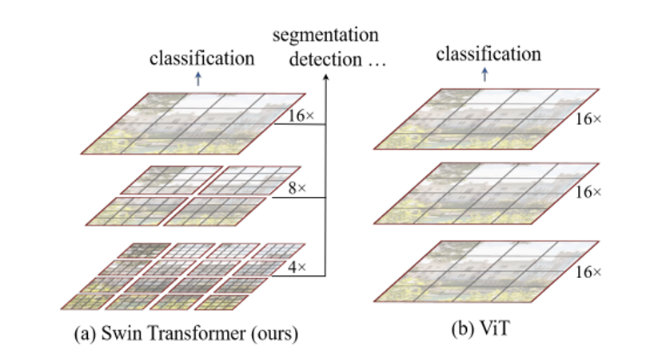
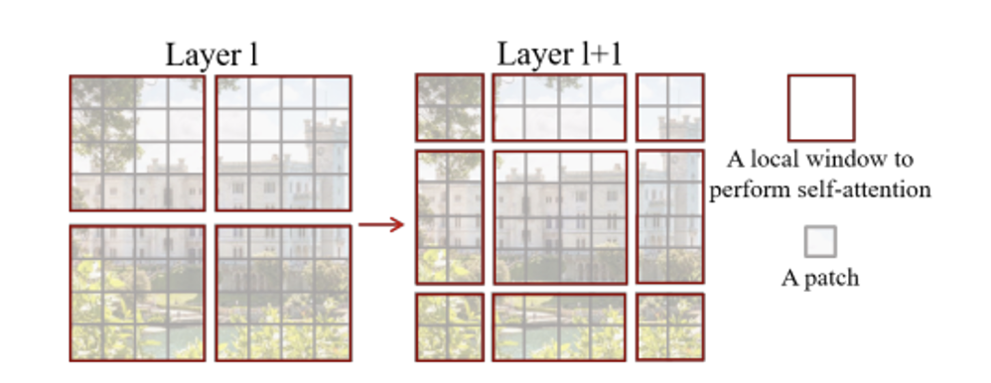
Intro of several designs
Swin Transformer
(𝛼) Multi-scale (𝛽) Local-window self-attention
(𝛾) Shifted-window operation
Elaborate designs of the Swin Transformer. [6]

Slide 19
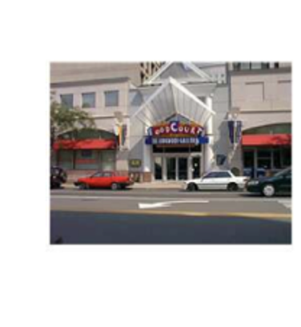
Intro of several designs
Swin Transformer
W
Global Self - Attention (The vanilla Transformer):
Quadratic to N 𝚯(N²)
H
Window Self - Attention (Swin Transformer)
Linear to N 𝚯(N)
N (HW/P²) patches
(In this example: 16 patches)
Computational complexity analysis for ViT and Swin Transformer.
The image is quoted from [7].

Slide 20
Intro of several designs
Swin Transformer
(𝛼) The architecture of the Swin Transformer (Swin - T)
(𝛽) Swin Transformer block
Structure of the Swin Transformer. [6]

Slide 21
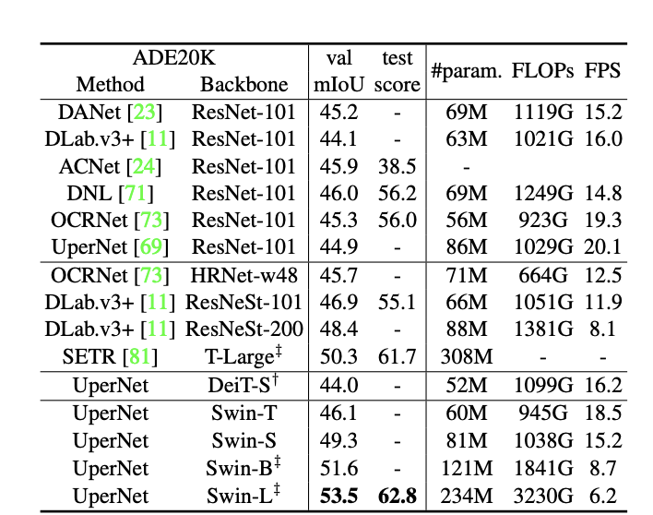
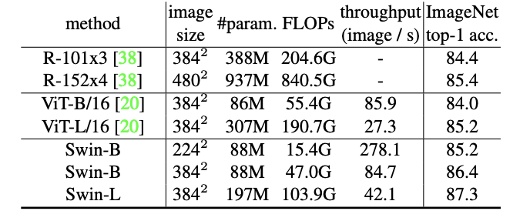
Intro of several designs
Swin Transformer
(𝛼) Image classification
(𝛽) Semantic segmentation
Performance of the Swin Transformer. [6]

Slide 22
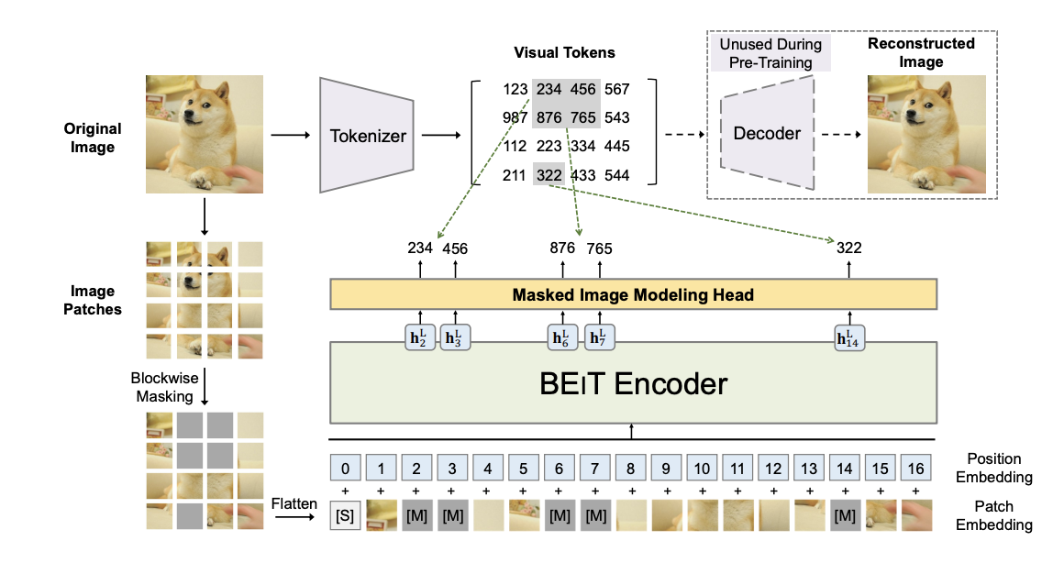
Intro of several designs
BEIT (Bidirectional Encoder representation from Image Transformers)
Structure of the BEIT. [8]

Slide 23
Reference
[1] VASWANI, Ashish, et al. Attention is all you need. Advances in neural information processing systems, 2017, 30.
[2]https://speech.ee.ntu.edu.tw/~hylee/ml/ml2021-course-data/self_v7.pdf
[3]https://towardsdatascience.com/why-are-there-so-many-tokenization-methods-for-transformers-a340e493b3a8
[4]https://gowrishankar.info/blog/transformers-everywhere-patch-encoding-technique-for-vision-transformersvit-explained/
[5] DOSOVITSKIY, Alexey, et al. An image is worth 16x16 words: Transformers for image recognition at scale. arXiv preprint arXiv:2010.11929, 2020.
[6] LIU, Ze, et al. Swin transformer: Hierarchical vision transformer using shifted windows. In: Proceedings of the IEEE/CVF International Conference on Computer Vision. 2021. p. 10012-10022.
[7] ZHANG, Hang, et al. Context encoding for semantic segmentation. In: Proceedings of the IEEE conference on Computer Vision and Pattern Recognition. 2018. p. 7151-7160.
[8] BAO, Hangbo; DONG, Li; WEI, Furu. Beit: Bert pre-training of image transformers. arXiv preprint arXiv:2106.08254, 2021.

Slide 24
Thanks for listening!

