Slide 1
Estimation
Rong Zhang
Advisor: Jian-Juan Ding

Slide 2
Outline
Introduction
Theoretical methods and Simulations
Applicable methods and Simulations
Conclusion

Slide 3
Introduction
Dealing with prior knowledge in Probability Theory and Stochastic Processes is different from implementation, which is empirical knowledge.

Slide 4
Outline
Introduction
Theoretical methods and Simulations
Sufficient Statistics
Uniformly Minimal Variance Unbiased Estimator
Applicable methods and Simulations
Conclusion

Slide 5
Sufficient Statistics (1/4)
Theorem. Let $X$ be distributed according to $P_{θ}∈𝒫$, and let $T$ be sufficient for $𝒫$, then $T$ consists of two independent function with likelihood observation $L$: $$L\left(θ | x\right)=g\left(T\left(x\right) | θ\right)h\left(x\right).$$
Proof. Since the information according to parameters $θ$ is only related to $T(X)$, and $h(x)$ only consists the information related to sample space $X$, thus the likelihood observations only relies on parameter function $g$.
Lehmann, E. L., & Casella, G. (2006). Theory of point estimation. Springer Science & Business Media.

Slide 6
Sufficient Statistics (2/4)
A simple example of sufficiency is certain distribution, we will take Exponential distribution and Rayleigh distribution as examples.
$$f_{X}\left(x\right)={λe}^{−λx},x≥0,$$
$$Then for liklihood function L and mean estimator T:$$
$$T=\sum_{i=1}^{n}{X_{i}},where X_{i} is i.i.d. samples,$$
$$L\left(θ | x\right)=g\left(λ | θ\right)h\left(x\right),$$
$$Now we have g\left(λ | θ\right)=λ for mean estimation, then h only relies$$
$$on sample space X, which is trial numbers of sampling.$$
$$That is, L\left(θ | x\right)=λn,prove that T is a sufficient statistic by λ.$$
Lehmann, E. L., & Casella, G. (2006). Theory of point estimation. Springer Science & Business Media.

Slide 7
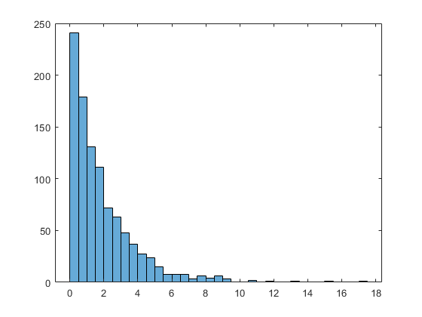
Sufficient Statistics (3/4)
For Exponential distribution, we have:
$$T=\sum_{i=1}^{n}{X_{i}}$$
Then the samples sum estimator $T$ contains all information from parameter $λ$ and no other estimators can provide additional.
That is, we can design an estimator for $λ$:
$$\hat{λ}=\frac{T}{n}.$$
Table: Sufficient Estimation of an Exponential distribution.
Estimator | $$μ/σ$$
$$\hat{λ}=\frac{T}{n}$$ | 2.002/0.003
Fig: Samples of an exponential distribution.
Lehmann, E. L., & Casella, G. (2006). Theory of point estimation. Springer Science & Business Media.

Slide 8
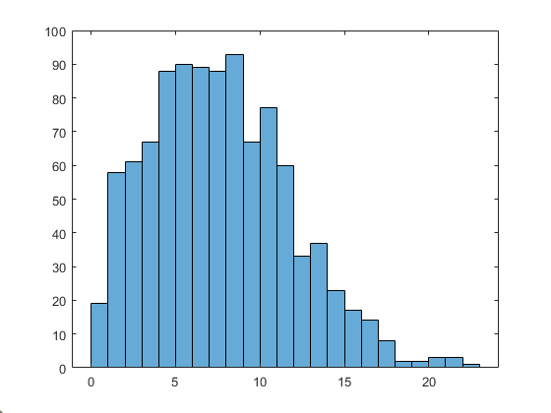
Sufficient Statistics (4/4)
For Rayleigh distribution, we have sufficient statistics $T$:
$$T=\sum_{i=1}^{n}{X_{i}^{2}},$$
Based on Maximum Likelihood Estimation, the scaling parameter $σ$ can be estimated as:
$$\hat{σ}=\sqrt{\frac{T}{2n}}.$$
Table: Sufficient Estimation of a Rayleigh distribution.
Estimator | $$μ/σ$$
$$\hat{σ}=\sqrt{\frac{T}{2n}}$$ | 6.018/0.021
Fig: Samples from Rayleigh distribution.
Lehmann, E. L., & Casella, G. (2006). Theory of point estimation. Springer Science & Business Media.

Slide 9
UMVUE (1/5)
Uniformly Minimal Variance Unbiased Estimator is a type of estimator in parameter estimation which consists several properties:
The estimator is unbiased: $𝔼\left[δ\right]=μ$.
The estimation reaches Lower bound of information.
The estimator has minimal variance for all parameters: $𝕍\left[δ\right]≤𝕍[δ^{′}]$.
UMVUE can provide “the most accurate” estimation to represent sample spaces such as:
Expected Value
Variance
Skewness (Sometimes)
Kurtosis (Sometimes)
Lehmann, E. L., & Casella, G. (2006). Theory of point estimation. Springer Science & Business Media.

Slide 10
UMVUE (2/5)
Theorem. Let $X$ be distributed according to $P_{θ}∈𝒫$, and let $T$ be sufficient for estimating $δ_{θ}$, then for every other estimator $δ_{θ}^{′}$,$𝕍\left[δ_{θ}\right]≤𝕍\left[δ_{θ}^{′}\right]$.
Proof. Skip.
Lehmann, E. L., & Casella, G. (2006). Theory of point estimation. Springer Science & Business Media.

Slide 11
UMVUE (3/5)
For demonstration, we first prove unbiasedness of two estimators:
Unbiasedness: $$μ→\overline{X}=\frac{1}{n}\left(X_{1}+…+X_{n}\right),$$ $$𝔼\left[\overline{X}\right]=𝔼\left[\frac{1}{n}\left(X_{1}+…+X_{n}\right)\right]=\frac{1}{n}𝔼\left[\left(X_{1}+…+X_{n}\right)\right]→μ.$$ $$σ^{2}→Var\left(X\right)=\frac{1}{n−1}\sum_{i=1}^{n}{{\left(X_{i}−\overline{X}\right)}^{2}},$$ $$𝔼\left[Var\left(X\right)\right]=𝔼\left[\frac{1}{n−1}\sum_{i=1}^{n}{{\left(X_{i}−\overline{X}\right)}^{2}}\right]=\frac{1}{n−1}\left[n\left(σ^{2}+μ^{2}\right)−n\left(\frac{σ^{2}}{n}+μ^{2}\right)\right]=\frac{nσ^{2}−σ^{2}}{n−1}→σ^{2}.$$
$$μ=𝔼\left[X\right]=\int_{−∞}^{∞}{xf_{X}\left(x\right)dx}.$$
$$σ^{2}=𝔼\left[X^{2}\right]−{(𝔼\left[X\right])}^{2}.$$
Lehmann, E. L., & Casella, G. (2006). Theory of point estimation. Springer Science & Business Media.

Slide 12
UMVUE (4/5)
For demonstration, we use Normal distribution $X\sim 𝒩(μ,σ^{2})$:
Information Lower bound: The information of parameters can be estimated by maximizing likelihood, $$I\left(μ\right)=𝔼\left[{\left(\frac{∂\ln{f_{𝒩}(x;μ,}σ^{2})}{∂μ}\right)}^{2}\right]=𝔼\left[{\left(\frac{X−μ}{σ^{2}}\right)}^{2}\right]=\frac{1}{σ^{2}},$$ $$σ_{μ}^{2}=\frac{σ^{2}}{n}≥\frac{1}{nI\left(μ\right)},$$ $$I\left(σ^{2}\right)=𝔼\left[{\left(\frac{∂^{2}\ln{f_{𝒩}(x;μ,}σ^{2})}{∂{(σ^{2})}^{2}}\right)}^{2}\right]=\frac{1}{2σ^{4}},$$ $$Var\left[σ^{2}\right]=\frac{2σ^{4}}{n−1}≥\frac{1}{nI\left(σ^{2}\right)}=\frac{2σ^{4}}{n}.$$
Lehmann, E. L., & Casella, G. (2006). Theory of point estimation. Springer Science & Business Media.

Slide 13
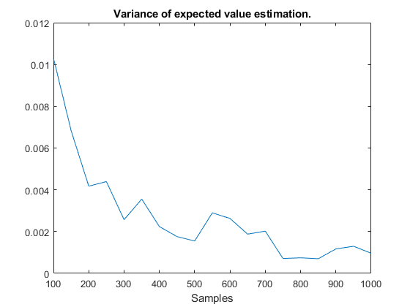
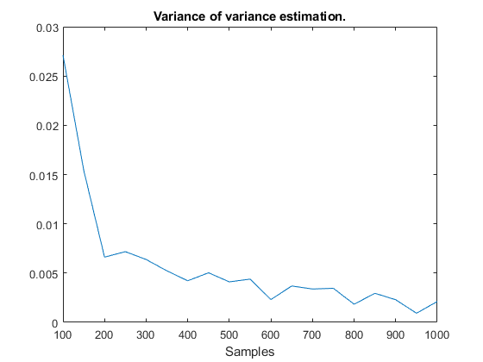
UMVUE (5/5)
The results show that mean $μ$ and variance $σ^{2}$ not only are accurate but also no other estimators can provide more accurate estimations.
Lehmann, E. L., & Casella, G. (2006). Theory of point estimation. Springer Science & Business Media.

Slide 14
Outline
Introduction
Theoretical methods and Simulations
Applicable methods and Simulations
Markov-Chain-Monte-Carlo
Importance Sampling
Reparameterization
Variational Inference
Conclusion

Slide 15
Markov-Chain-Monte-Carlo
Note that Markov-Chain-Monte-Carlo (MCMC) is not a certain method, it’s a characteristic of a process that follows Markov’s Chain properties, where the current sampling only depends on previous one.
A classic method that applies MCMC is Gibbs-sampling, where we can observe target distribution by obtaining it’s conditional distributions.
Note that this is different from Bayes estimator where we set a prior knowledge to obtain our targets.
Andrieu, C., & Thoms, J. (2008). A tutorial on adaptive MCMC. Statistics and computing, 18, 343-373.

Slide 16
Gibbs-Sampling (1/2)
This method is applied on those Joint distributions with difficult sampling, where:
$$x_{i}\sim X_{1},…X_{i−1}|X_{i},…$$
The advantage is we only need to know the conditional probability of a joint distribution $X$, with enough iterations we can obtain an accurate sampling of $X$.
Due to its Markov Chain property, the sample $x_{i}$ only relies on current conditional probability, which simplifies the sampling process.
Casella, G., & George, E. I. (1992). Explaining the Gibbs sampler. The American Statistician, 46(3), 167-174.

Slide 17
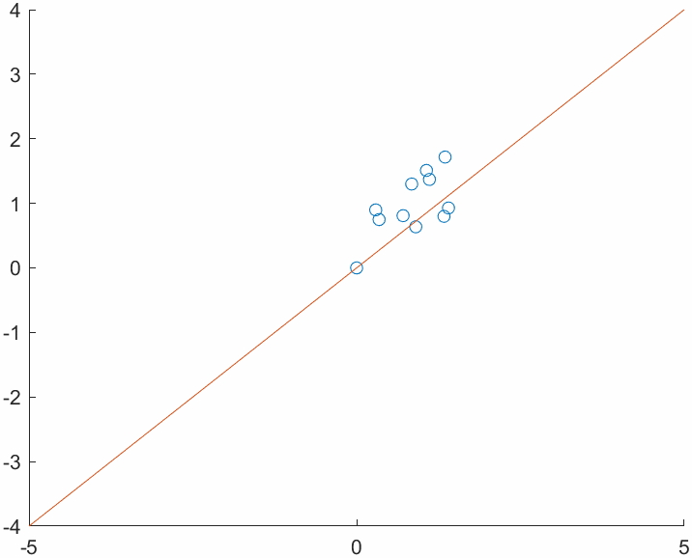
Gibbs-Sampling (2/2)
For a joint distribution $X,Y$, we have:
$$μ_{Y|X}=0.8x,σ_{Y|X}=0.6,μ_{X|Y}=0.8y,σ_{X|Y}=0.6,$$
Then for Gibbs-Sampler, we have:
$$x_{i}\sim 𝒩\left(μ_{X|Y},σ_{X|Y}^{2}\right),y_{i}\sim 𝒩\left(μ_{Y|X},σ_{Y|X}^{2}\right),$$
In this case, we are sampling from a bivariate normal distribution:
$$f_{X,Y}\left(x,y\right)=\frac{1}{2π\sqrt{ (1−ρ^{2})σ_{X}^{2}σ_{Y}^{2}}}e^{−\frac{1}{2\left(1−ρ^{2}\right)}[{\left(\frac{x−μ_{X}}{σ_{X}}\right)}^{2}+2ρ\left(\frac{x−μ_{X}}{σ_{X}}\right)\left(\frac{y−μ_{Y}}{σ_{Y}}\right)+{\left(\frac{y−μ_{Y}}{σ_{Y}}\right)}^{2}]}.$$
Fig: Gibbs-Sampling of a bivariate normal distribution.
Casella, G., & George, E. I. (1992). Explaining the Gibbs sampler. The American Statistician, 46(3), 167-174.

Slide 18
Importance Sampling (1/4)
Importance Sampling is an effective method of measuring events that are closed to “almost never”.
Monte-Carlo can estimate every events with large enough observations, however, if an event “almost never” happens, then applying Monte-Carlo may be inefficient.
Importance Sampling applies weights with a “comparably easier” sampling to estimate events from original sampling.
Neal, R. M. (2001). Annealed importance sampling. Statistics and computing, 11, 125-139.

Slide 19
Importance Sampling (2/4)
To estimate an event $S$ with Monte-Carlo, we have:
$$𝔼\left[\operatorname{Pr}\left(S\right)\right]=\frac{1}{n}\sum_{i=1}^{n}{I_{S}(s_{i})},$$
However, directly obtaining the event $S$ may not be easy due to $I_{S}(s_{i})$ may never happen, that is, sampling from an easier event and applying weights for importance is effective.
$$𝔼\left[\operatorname{Pr}\left(S\right)\right]=𝔼\left[\operatorname{Pr}\left(S\right)\frac{\operatorname{Pr}\left(S^{′}\right)}{\operatorname{Pr}\left(S^{′}\right)}\right]=𝔼\left[\frac{f_{S}\left(s\right)}{f_{S^{′}}\left(s\right)}\operatorname{Pr}\left(S^{′}\right)\right]=𝔼\left[w\operatorname{Pr}\left(S^{′}\right)\right],$$
Neal, R. M. (2001). Annealed importance sampling. Statistics and computing, 11, 125-139.

Slide 20
Importance Sampling (3/4)
To demonstrate this, we can estimate an event $S$ from sampling normal distribution $X\sim 𝒩(0,1)$, where $Pr(S)=Pr⁡(X≥3)$, the probability of $X≥3$ is unlikely to happen which has $0.135\%$.
That is, applying Monte-Carlo to sample $X≥3$ from $X\sim 𝒩(0,1)$ may take significantly large numbers of observations to acquire accurate estimations.
We can apply a sampling from $𝒩(3,1)$, which samples $X≥3$ are more likely to happen, then:
$$s=\frac{f_{μ=0}(s^{′})}{f_{μ=3}(s^{′})}s^{′},$$
Neal, R. M. (2001). Annealed importance sampling. Statistics and computing, 11, 125-139.

Slide 21
Importance Sampling (4/4)
Iterations | 500 | 1000 | 2000 | 5000
Importance | 0.144 | 0.137 | 0.137 | 0.135
Monte-Carlo | 0 | 0 | 0.8 | 0.148
Neal, R. M. (2001). Annealed importance sampling. Statistics and computing, 11, 125-139.

Slide 22
Reparameterization (1/7)
Reparameterization is a technique for simplifying sampling process, which is not easy to obtain properties such as gradient.
Randomness is a powerful tool to represent uncertainties, however, it’s not suitable for optimizing and regression tasks.
To resolve this issue, a “decisive” approach for representing sampling is developed for problems such as optimization.
Salimans, T., & Kingma, D. P. (2016). Weight normalization: A simple reparameterization to accelerate training of deep neural networks. Advances in neural information processing systems, 29.

Slide 23
Reparameterization (2/7)
The table shows how to reparameterize certain sampling:
Samples | Reparameterization
$$Z\sim 𝒩(μ,σ^{2})$$ | $$z=μ+σε,ε\sim 𝒩\left(0,1\right).$$
$$Z\sim Exp(λ)$$ | $$z=−\frac{\ln{1−u}}{λ},u\sim U\left(0,1\right).$$
$$Z\sim U(a,b)$$ | $$z=a+\left(b−a\right)u,u\sim U\left(0,1\right).$$
$$Z\sim L(μ,s)$$ | $$z=μ+s\ln{\frac{u}{1−u}},u\sim U\left(0,1\right).$$
$$Z\sim Β(α,β)$$ | $$z=\frac{x}{x+y},x,y\sim Γ\left(α,β\right).$$
$$Z\sim Rayleigh(σ)$$ | $$z=σ\sqrt{−2\ln{1−u}},u\sim U\left(0,1\right).$$
$$Z\sim χ^{2}(k)$$ | $$z=\sum_{i=1}^{k}{ε_{i},}ε_{i}\sim 𝒩\left(0,1\right),i=1,…,k.$$

Slide 24
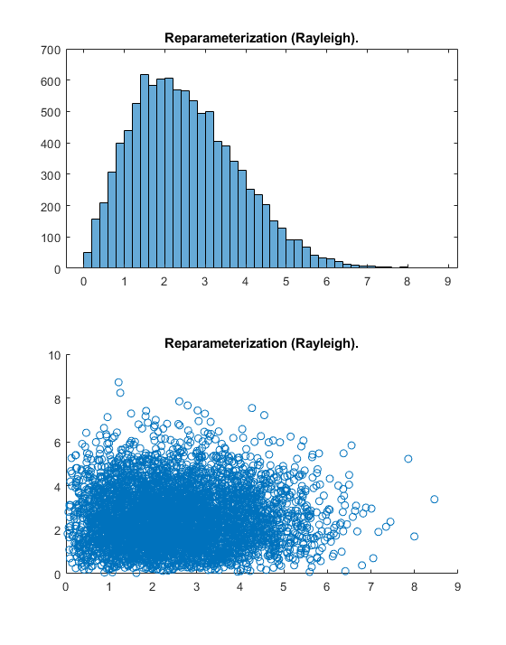
Reparameterization (3/7)
$$z=σ\sqrt{−2\ln{1−u}},u\sim U\left(0,1\right).$$
$$z=μ+σε,ε\sim 𝒩\left(0,1\right).$$
Salimans, T., & Kingma, D. P. (2016). Weight normalization: A simple reparameterization to accelerate training of deep neural networks. Advances in neural information processing systems, 29.

Slide 25
Reparameterization (4/7)
$Z\sim 𝒩\left(μ,σ^{2}\right)→z=μ+σε,$
$$\frac{∂Z}{∂μ}=1,\frac{∂Z}{∂σ}=ε,ε\sim 𝒩\left(0,1\right).$$
$Z\sim Rayleigh\left(σ\right)→z=σ\sqrt{−2\ln{(1−u)}},$
$$\frac{∂Z}{∂σ}=\sqrt{−2\ln{(1−u)}},u\sim U\left(0,1\right).$$
Salimans, T., & Kingma, D. P. (2016). Weight normalization: A simple reparameterization to accelerate training of deep neural networks. Advances in neural information processing systems, 29.

Slide 26
Reparameterization (5/7)
Suppose we have a destination $\left(d_{x},d_{y}\right)$, and we want to optimize a $n$ step random walk process where:
$$X_{i}\sim 𝒩\left(μ_{x,i},σ_{x,i}^{2}\right),Y_{i}\sim 𝒩\left(μ_{y,i},σ_{y,i}^{2}\right).$$
The evaluation is:
$$L={\left(d_{x}−\sum_{i=1}^{n}{X_{i}}\right)}^{2}+{\left(d_{y}−\sum_{i=1}^{n}{Y_{i}}\right)}^{2},$$
Salimans, T., & Kingma, D. P. (2016). Weight normalization: A simple reparameterization to accelerate training of deep neural networks. Advances in neural information processing systems, 29.

Slide 27
Reparameterization (6/7)
To optimize this, we can use gradient descent:
$$μ←μ−η\frac{dL}{dμ},σ←σ−η\frac{dL}{dσ},$$
The gradient of sampling $Z$ based on parameter $μ$ and $σ$ is:
$$\frac{dZ}{dμ}=1,\frac{∂Z}{∂σ}=ε,ε\sim 𝒩\left(0,1\right),$$
Then we have final gradient of $L$ by chain rule:
$$\frac{dL}{dμ}=\frac{dL}{dZ}\frac{dZ}{dμ}=2\left(d_{z}−\sum_{i=1}^{n}{Z_{i}}\right),\frac{dL}{dσ}=\frac{dL}{dZ}\frac{dZ}{dσ}=2\left(d_{z}−\sum_{i=1}^{n}{Z_{i}}\right)ε.$$
Salimans, T., & Kingma, D. P. (2016). Weight normalization: A simple reparameterization to accelerate training of deep neural networks. Advances in neural information processing systems, 29.

Slide 28
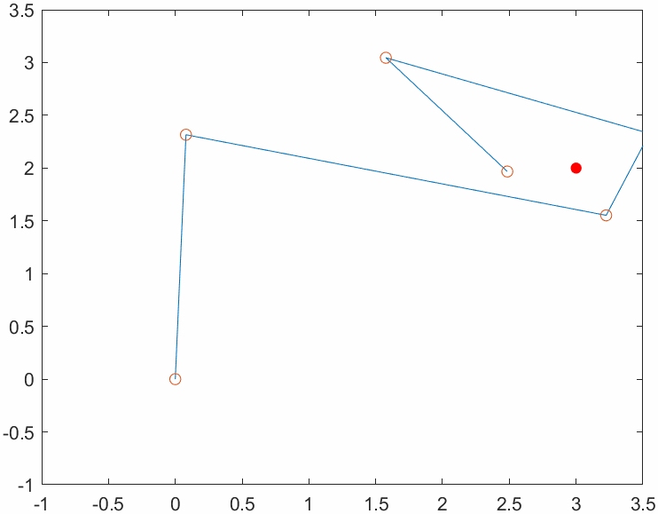
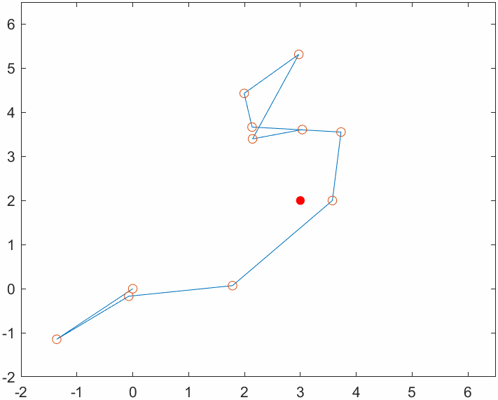
Reparameterization (7/7)
Based on the equations, we can construct the model:
Salimans, T., & Kingma, D. P. (2016). Weight normalization: A simple reparameterization to accelerate training of deep neural networks. Advances in neural information processing systems, 29.

Slide 29
Variational Inference (1/4)
Variational Inference is a common technique of approximating optimization or estimation by converging randomness.
The classic example of Variational Inference is Bayesian model, which uses prior knowledge to predict empirical knowledge.
The advanced example is Variational Auto-Encoder (VAE) in machine learning, which approaches target distribution by certain losses.
This method nowadays usually combines with Reparameterization due to the convenience of representing randomness.
Blei, D. M., Kucukelbir, A., & McAuliffe, J. D. (2017). Variational inference: A review for statisticians. Journal of the American statistical Association, 112(518), 859-877.

Slide 30
Variational Inference (2/4)
One example of Variational Inference is KL-divergence, which measures the difference between two distributions, this KPI is commonly used in several models.
$$D(P|\left|Q\right)=\sum{P\left(x\right)\ln{\frac{P\left(x\right)}{Q\left(x\right)}}},$$
To further simplify this, we can assume both $P$ and $Q$ are Normal:
$$D(P|\left|Q\right)=\ln{\frac{σ_{Q}}{σ_{P}}}+\frac{σ_{P}^{2}+{\left(μ_{P}−μ_{Q}\right)}^{2}}{2σ_{Q}^{2}}−\frac{1}{2}.$$
Kingma, D. P., Salimans, T., & Welling, M. (2015). Variational dropout and the local reparameterization trick. Advances in neural information processing systems, 28.

Slide 31
Variational Inference (3/4)
In practice, KL-divergence $D$ is:
$$D(P|\left|Q\right)=\frac{1}{2}\sum{\left(σ_{P}^{2}+μ_{P}^{2}−1−\ln{σ_{P}^{2}}\right)},$$
Which we can easily obtain the derivatives of empirical knowledge $P$:
$$\frac{∂}{∂μ_{P}}D=μ_{P},\frac{∂}{∂σ_{P}^{2}}D=\frac{1}{2}\left(1−\frac{1}{σ_{P}^{2}}\right).$$
Kingma, D. P., Salimans, T., & Welling, M. (2015). Variational dropout and the local reparameterization trick. Advances in neural information processing systems, 28.

Slide 32
Variational Inference (4/4)
Kingma, D. P., Salimans, T., & Welling, M. (2015). Variational dropout and the local reparameterization trick. Advances in neural information processing systems, 28.

Slide 33
Outline
Introduction
Theoretical methods and Simulations
Applicable methods and Simulations
Conclusion

Slide 34
Conclusion
Estimation is an effective method to measure and describe randomness, due to we usually lack of understanding of natural effects, design a model to represent uncertainties is crucial.
Unless you’re dealing with quantum, which randomness is its characteristic.

Slide 35
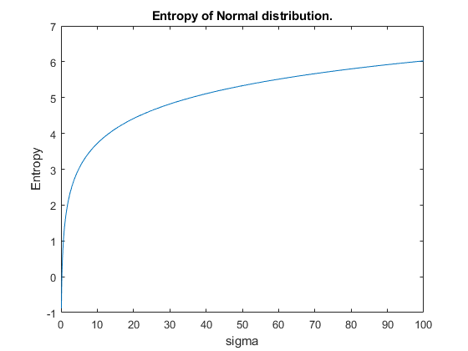
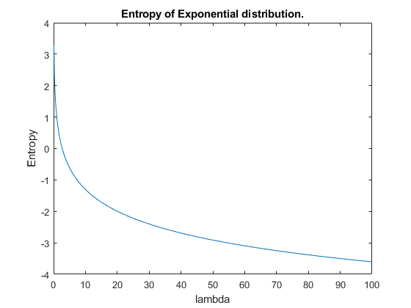
Some interesting facts
Why we always use Normal distribution $𝒩(μ,σ^{2})$ to describe unknown randomness such as noises in communication systems?
Distribution | Entropy
$$𝒩(0,1)$$ | 1.42
$$Exp(1)$$ | 1
$$U(−\sqrt{3},\sqrt{3})$$ | 1.24
Consider Information entropy of a random variable $X$, which samples from Normal distribution $𝒩(μ,σ^{2})$, $H\left(X\right)=𝔼\left[−\ln{X}\right],$
$$H\left(X\right)=𝔼\left[−\ln{\frac{1}{σ\sqrt{2π}}}+\frac{{\left(X−μ\right)}^{2}}{{2σ}^{2}}\right]=\frac{1}{2}\ln{2πeσ^{2}},$$
$$H\left(Y\right)=𝔼\left[−\ln{λ}+λY\right]=1−\ln{λ},$$
Lin, J. (1991). Divergence measures based on the Shannon entropy. IEEE Transactions on Information theory, 37(1), 145-151.

Slide 36
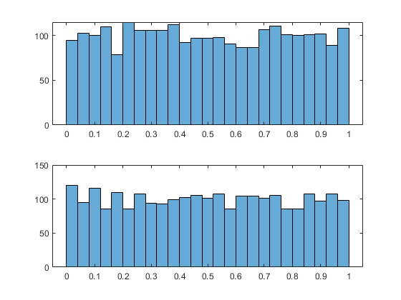
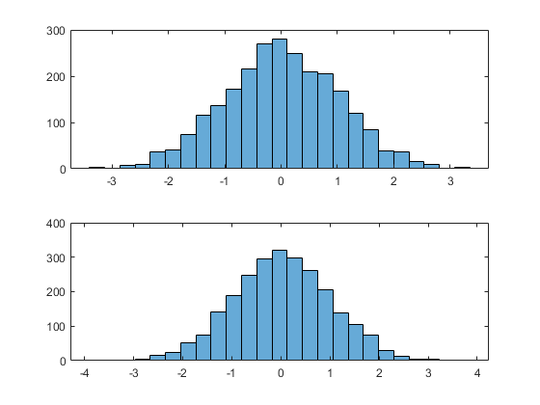
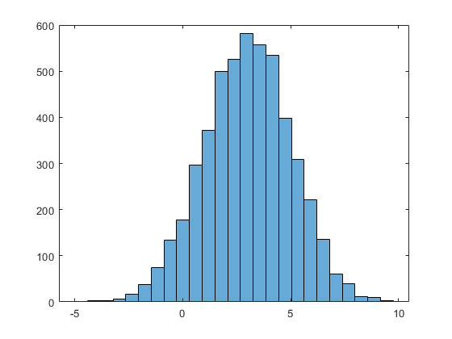
Some interesting facts
How we implement sampling from continuous distribution? Like Normal distribution $𝒩(μ,σ^{2})$?
$$1. u_{1},u_{2}\sim U\left(0,1\right),$$
$2. z_{1}=\sqrt{−2\ln{u_{1}}}cos⁡(2πu_{2}$), $z_{1}=\sqrt{−2\ln{u_{1}}}sin⁡(2πu_{2}$),
$3. x_{1}=μ+σz_{1}$, $x_{2}=μ+σz_{2}$.
$2. z_{1}=\sqrt{−2\ln{u_{1}}}cos⁡(2πu_{2}$), $z_{1}=\sqrt{−2\ln{u_{1}}}sin⁡(2πu_{2}$),
Lee, D. U., Villasenor, J. D., Luk, W., & Leong, P. H. W. (2006). A hardware Gaussian noise generator using the Box-Muller method and its error analysis. IEEE transactions on computers, 55(6), 659-671.

