Slide 1
Introduction of Fractional Fourier Transform (FRFT)
Speaker: Chia-Hao Tsai
Research Advisor: Jian-Jiun Ding
Digital Image and Signal Processing Lab
Graduate Institute of Communication Engineering
National Taiwan University

Slide 2
Outlines
Introduction of Fractional Fourier Transform (FRFT)
Introduction of Linear Canonical Transform (LCT)
Introduction of Two-Dimensional Affine Generalized Fractional Fourier Transform (2-D AGFFT)
Relations between Wigner Distribution Function (WDF), Gabor Transform (GT), and FRFT

Slide 3
Outlines (cont.)
Implementation Algorithm of FRFT /LCT
Closed Form Discrete FRFT/LCT
Advantages of FRFT/LCT contrast with FT
Optics Analysis and Optical Implementation of the FRFT/LCT
Conclusion and future works
References

Slide 4
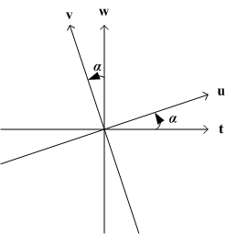
Introduction of Fractional Fourier Transform (FRFT)
The FRFT: a rotation in time-frequency plane.
: a operator
Properties of
- =I: zero rotation
- : FT operator
- : time-reverse operator
- : inverse FT operator
- =I: 2π rotation
- : additivity
(I: identity operator)

Slide 5
Introduction of FRFT (cont.)
Definition of FRFT:
( : Kernel of FRFT)

Slide 6
Introduction of FRFT (cont.)
When : identity
When : FT
When α isn’t equal to a multiple of , the FRFT is equivalent to doing times of the FT.
-when doing the FT 0.4 times.
-when doing the FT 0.5 times.
-when doing the FT 2/3 times.

Slide 7
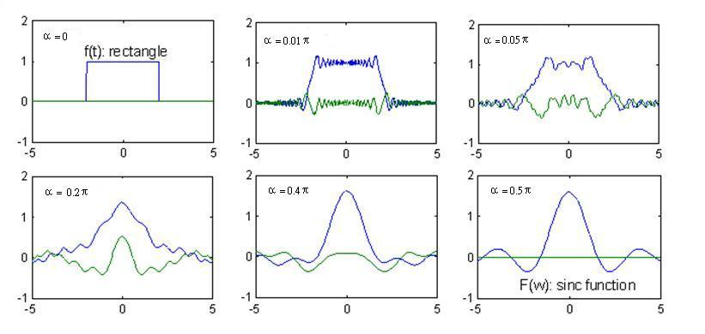
Introduction of FRFT (cont.)
An Example for the FRFT of a rectangle
(Blue line: real part, green line: imaginary part)

Slide 8
Introduction of Linear Canonical Transform (LCT)
The LCT is more general than the FRFT. The FRFT has one free parameter (α), but the LCT has four parameters (a, b, c, d) to adjust the signal.
The LCT can use some specific value to change into the FRFT.

Slide 9
Introduction of LCT (cont.)
Definition of LCT:
with the constraint ad – bc = 1

Slide 10
Introduction of LCT (cont.)
Additivity property:
where
Reversibility property:

Slide 11
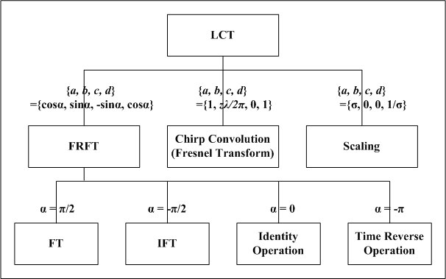
Introduction of LCT (cont.)

Slide 12
Fractional / Canonical Convolution and Correlation
FT for convolution:
FT for correlation :

Slide 13
Fractional / Canonical Convolution and Correlation (cont.)
Fractional convolution (FRCV):
Fractional correlation (FRCR) :
type1:
type2:

Slide 14
Fractional / Canonical Convolution and Correlation (cont.)
Canonical convolution (CCV):
Canonical correlation (CCR) :
type1:
type2:

Slide 15
Introduction of Two-Dimensional Affine Generalized Fractional Fourier Transform (2-D AGFFT)
The 2-D AGFFT that it can be regarded as generalization of 2-D FT, 2-D FRFT, and 2-D LCT.
Definition of 2-D AGFFT:
where , , ,
, and

Slide 16
Introduction of 2-D AGFFT (cont.)
where
,
Reversibility property:

Slide 17
Introduction of 2-D AGFFT (cont.)
When
the 2-D AGFFT can become the 2-D unseparable FRFT which was introduced by Sahin et al.

Slide 18
Introduction of 2-D AGFFT (cont.)

Slide 19
2-D Affine Generalized Fractional Convolution/ Correlation
2-D Affine Generalized Fractional Convolution (2-D AGFCV):
-applications of 2-D AGFCV:
filter design, generalized Hilbert transform, and mask
2-D Affine Generalized Fractional Correlation (2-D AGFCR):
-applications of 2-D AGFCR: 2-D pattern recognition

Slide 20
Relation Between FRFT and Wigner Distribution Function (WDF)
Definition of WDF:
The property of the WDF:
-high clarity
-with cross-term problem

Slide 21
Relation Between FRFT and WDF (cont.)
Why does the WDF have a cross-term problem?
Ans: autocorrelation-term
of the WDF is existed
If , its WDF will become

Slide 22
Relation Between FRFT and WDF (cont.)
Clockwise-Rotation Relation:
The FRFT with parameter α is equivalent to the clockwise-rotation operation with angle α for WDF.

Slide 23
Relation Between FRFT and Gabor Transforms (GT)
Definition of GT:
The property of the GT:
-with clarity problem
-avoid cross-term problem
-cost less computation time

Slide 24
Relation Between FRFT and GT (cont.)
Why can the GT avoid the cross-term problem?
Ans: the GT no have the autocorrelation-term
If , its GT will become

Slide 25
Relation Between FRFT and GT (cont.)
Clockwise-Rotation Relation:
The FRFT with parameter α is equivalent to the clockwise-rotation operation with angle α for GT.

Slide 26
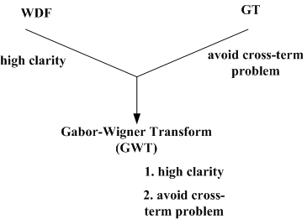
Relations Between FRFT, WDF, and GT

Slide 27
Relations Between FRFT, WDF, and GT (cont.)
Definition of GWT:
Clockwise-Rotation Relation:
Ex1: if then
Ex2: if then

Slide 28
Implementation Algorithm of FRFT/LCT
Two methods to implement FRFT/LCT:
- Chirp Convolution Method
- DFT-Like Method
To implement the FT, we need to use multiplications.

Slide 29
Implementation Algorithm of FRFT/LCT (cont.)
Chirp Convolution Method:
For LCT, we sample t-axis and u-axis as and ,
then the continuous LCT becomes
chirp multiplication
chirp convolution

Slide 30
Implementation Algorithm of FRFT/LCT (cont.)
To implement the LCT, we need to use 2 chirp multiplications and 1 chirp convolution.
To implement 1 chirp convolution, we need to use requires 2 DFTs.
Complexity:
2P (2 chirp multiplications) + (2 DFTs)
(P = 2M+1 = the number of sampling points)

Slide 31
Implementation Algorithm of FRFT/LCT (cont.)
This is 2 times of complexity of FT.
To implement the LCT directly, we need to use multiplications.
So, we use Chirp Convolution Method to implement the LCT that it can improve the efficiency of the LCT.
For FRFT, its complexity is the same as LCT.

Slide 32
Implementation Algorithm of FRFT/LCT (cont.)
DFT-Like Method:
(chirp multi.) (FT) (scaling) (chirp multi.)
Step.1: chirp multi.
Step.2: scaling
Step.3: FT
Step.4: chirp multi.

Slide 33
Implementation Algorithm of FRFT/LCT (cont.)
We can implement the LCT:
where
To implement the LCT, we need to use 2 M-points multiplication operations and 1 DFT.
(P = 2M+1 = the number of sampling points)

Slide 34
Implementation Algorithm of FRFT/LCT (cont.)
Complexity:
2P (2 multiplication operations) + (1 DFT)
This is only half of the complexity of Chirp Convolution Method.

Slide 35
Implementation Algorithm of FRFT/LCT (cont.)
When using Chirp Convolution Method, the sampling interval is free to choose, but it needs to use 2 DFTs.
When using the DFT-like Method, although it has some constraint for the sampling intervals, but we only need 1 DFT to implement the LCT.

Slide 36
Closed Form Discrete FRFT/LCT
DFRFT/DLCT of type 1:
applied to digital implementing of the continuous FRFT
DFRFT/DLCT of type 2:
applied to the practical applications about digital signal processing

Slide 37
Closed Form Discrete FRFT/LCT (cont.)
Definition of DFRFT of type 1:
when α ∈ 2Dπ+(0, π), D is integer (sinα > 0)
when α ∈ 2Dπ+(−π, 0), D is integer (sinα < 0)
with the constraint and
(2N+1, 2M+1 are the number of points in the time, frequency domain)

Slide 38
Closed Form Discrete FRFT/LCT (cont.)
when and D are integer, because we can’t find proper choice for Δu and Δt that can’t use as above.
, when α = 2Dπ
, when α = (2D+1)π
The DFRFT of type 1 is efficient to calculate and implement.

Slide 39
Closed Form Discrete FRFT/LCT (cont.)
Complexity:
2P (2 chirp multiplications)+ (1 FFT)
But it doesn’t match the continuous FRFT, and lacks many of the characteristics of the continuous FRFT.

Slide 40
Closed Form Discrete FRFT/LCT (cont.)
Definition of DLCT of type 1:
(b>0)
(b<0)
with the constraint

Slide 41
Closed Form Discrete FRFT/LCT (cont.)
When b = 0, we can’t also find proper choice for Δu and Δt that can’t use as above.
(b=0, d is integer)
(b=0, d isn’t integer)
where R= (2M+1)⋅(2N+1) and

Slide 42
Closed Form Discrete FRFT/LCT (cont.)
Definition of DLCT of type 2:
From DLCT of type 1, we let p = (d/b)⋅Δu², q = (a/b)⋅Δt²
where M ≥ N
(2N+1, 2M+1 are the number of points in the time, frequency domain), s is prime to M

Slide 43
Closed Form Discrete FRFT/LCT (cont.)
By setting p = q and s = ±1, we can define the DFRFT from the DLCT and get the formula of DFRFT of type 2.
Definition of DFRFT of type 2:
where M ≥ N
Complexity of DFRFT/DLCT of type 2 is the same as complexity of DFRFT/DLCT of type 1.

Slide 44
Advantages of FRFT/LCT contrast with FT
The FRFT/LCT are more general and flexible than the FT.
The FRFT/LCT can be applied to partial differential equations (order n > 2). If we choice appropriate parameter α, then the equation can be reduced order to n-1.
The FT only deal with the stationary signals, we can use the FRFT/LCT to deal with time-varying signals.

Slide 45
Advantages of FRFT/LCT contrast with FT (cont.)
Using the FRFT/LCT to design the filters, it can reduce the NMSE. Besides, using the FRFT/LCT, many noises can be filtered out that the FT can’t remove in optical system, microwave system, radar system, and acoustics.
In encryption, because the FRFT/LCT have more parameter than the FT, it’s safer in using the FRFT/LCT than in using the FT.

Slide 46
Advantages of FRFT/LCT contrast with FT (cont.)
In signal synthesis, using the transformed domain of the FRFT/LCT to analyze some signal is easier than using the time domain or frequency domain to analyze signals.
In multiplexing, we can use multiplexing in fractional domain for super-resolution and encryption.

Slide 47
Applications of FRFT/LCT

Slide 48
Use FRFT/LCT to Represent Optical Components
Propagation through the cylinder lens with focus length f:
Propagation through the free space (Fresnel Transform) with length z:

Slide 49
Implementation FRFT/LCT by Optical Systems
Case1:
Free space
Cylinder lens
Cylinder lens
The implementing of LCT (b≠0) with 2 cylinder lenses and 1 free space.

Slide 50
Implementation FRFT/LCT by Optical Systems (cont.)
{a, b, c, d} = {cosα, sinα, -sinα, cosα}

Slide 51
Implementation FRFT/LCT by Optical Systems (cont.)
Case2:
Free space
Cylinder lens
Free space
The implementing of LCT (c ≠ 0) with 1 cylinder lenses and 2 free space.

Slide 52
Implementation FRFT/LCT by Optical Systems (cont.)
{a, b, c, d} = {cosα, sinα, -sinα, cosα}

Slide 53
Implementation FRFT/LCT by Optical Systems (cont.)
If we want to have shorter length in the optical implementation of LCT, then case1 is preferred.
If we want to retrench the number of lenses we use, or avoid placing the lenses contacting to the input and output, then case2 is preferred.

Slide 54
Conclusion and future works
FRFT/LCT are more general and flexible than the FT. Then, We hope to find other applications of FRFT/LCT.
Can we find more general functions?
Then, we let the functions use in other applications.

Slide 55
References
[1] V. Namias, “The fractional order Fourier transform and its application to quantum mechanics,” J. Inst. Maths. Applics., vol. 25, pp. 241-265, 1980.
[2] A. C. McBride and F. H. Kerr, “On Namias’ fractional Fourier transforms,” IMA J. Appl. Math., vol. 39, pp. 159-175, 1987.
[3] S. C. Pei, C. C. Tseng, and M. H. Yeh, “Discrete fractional Hartley and Fourier transform,” IEEE Trans. Circuits Syst., II: Analog and Digital Signal Processing, vol. 45, no. 6, pp. 665-675, June 1998.
[4] B. Santhanam and J. H. McClellan, “The DRFT—A rotation in time frequency space,” in Proc. ICASSP, May 1995, pp. 921–924.
[5] J. H. McClellan and T. W. Parks, “Eigenvalue and eigenvector decomposition of the discrete Fourier transform,” IEEE Trans. Audio Electroacoust., vol. AU-20, pp. 66–74, Mar. 1972.
[6] B. W. Dickinson and K. Steiglitz, “Eigenvectors and functions of the discrete Fourier transform,” IEEE Trans. Acoust., Speech, Signal Processing, vol. ASSP-30, pp. 25–31, Feb. 1982.
[7] H. M. Ozaktas, B. Barshan, D. Mendlovic, L. Onural, “Convolution, filtering, and multiplexing in fractional Fourier domains and their rotation to chirp and wavelet transform,” J. Opt. Soc. Am. A, vol. 11, no. 2, pp. 547-559, Feb. 1994.

Slide 56
References (cont.)
[8] Zayed, “A convolution and product theorem for the fractional Fourier transform,” IEEE Signal Processing Letters, vol. 5, no. 4, pp. 101-103, Apr. 1998.
[9] A. W. Lohmann, “Image rotation, Wigner rotation, and the fractional Fourier transform,” J. Opt. Soc. Amer. A, vol. 10, no. 10, pp.2181–2186, Oct. 1993.
[10] D. A. Mustard, “The fractional Fourier transform and the Wigner distribution,”J. Australia Math. Soc. B, vol. 38, pt. 2, pp. 209–219, Oct.1996.
[11] S. C. Pei and J. J. Ding, “Relations between the fractional operations and the Wigner distribution, ambiguity function,” IEEE Trans. Signal Process., vol. 49, no. 8, pp. 1638–1655, Aug. 2001.
[12] H. M. Ozaktas, B. Barshan, D. Mendlovic, and L. Onural, “Convolution, filtering, and multiplexing in fractional Fourier domains and their rotation to chirp and wavelet transform,” J. Opt. Soc. Amer. A, vol. 11, no. 2, pp. 547–559, Feb. 1994
[13] A. Sahin, M. A. Kutay, and H. M. Ozaktas, ‘Nonseparable two-dimensional fractional Fourier transform`, Appl. Opt., vol. 37, no. 23, p 5444-5453, Aug 1998.
[14] S. C. Pei, and J. J. Ding “Two-Dimensional affine generalized fractional Fourier transform,” IEEE Trans. Signal Processing, Vol.49, No. 4, April 2001.

