Slide 1
GAN vs DPM
Presenter : 盧德晏
Advisor : 丁建均 教授
Date : 04/25, 2023

Slide 2
Outline
Generative Adversary Network (GAN)
Ian Pouget-Abadie, Jean Mirza, Mehdi Xu, Bing Warde-Farley, David Ozair
, Sherjil Courville, Aaron Bengio, and Yoshua. ”Generative adversarial nets,”
proceedings of NIPS, 2014. pp. 2672–2680.
Yang Wang, “A mathematical introduction to generative adversarial nets,” arXiv: 2009.00169 (2020)
Diffusion Probabilistic Models (DPM)
Jonathan Ho, Ajay Jain, and Pieter Abbeel, “Denoising diffusion probabilistic models,” arXiv Preprint arxiv:2006.11239 (2020)
Alex Nichol & Prafulla Dhariwal. “Improved denoising diffusion probabilistic models,” arXiv Preprint arxiv:2102.09672 (2021)
Prafula Dhariwal & Alex Nichol. “Diffusion Models Beat GANs on Image Synthesis., arXiv Preprint arxiv:2105.05233 (2021)
Rombach & Blattmann, et al. “High-Resolution Image Synthesis with Latent Diffusion Models,“ CVPR, 2022.

Slide 3
Generative Adversary Network (GAN)

Slide 4
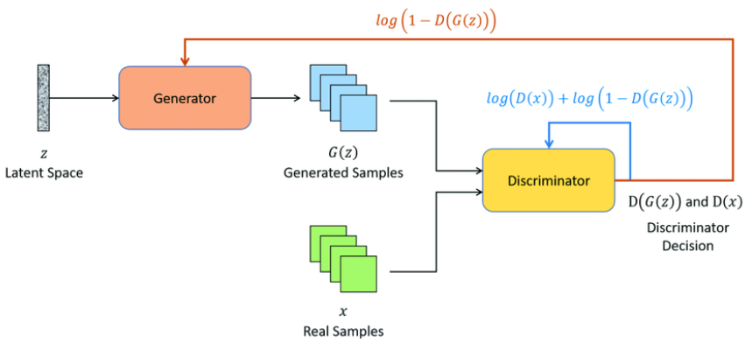
Generative Adversary Network (GAN)
Generative Adversary Network (GAN):

Slide 5
Generative Adversary Network
Notation:
$x∈ℝ^{d}$: Real data
$z∈ℝ^{d}$: Latent vector
$G(z)∈ℝ^{d}$: Faked data
$D\left(x\right)∈ℝ$: Discriminator evaluation of real data
$D\left(G\left(z\right)\right)∈ℝ$: Discriminator evaluation of faked data
$Error\left(a,b\right)∈ℝ$: Error between $a$ and $b$
1 : True ; 0 : False
Discriminator:
Loss function : $L_{D}=Error\left(D\left(x\right),1\right)+Error\left(D\left(G\left(z\right)\right),0\right)$
Generator:
Loss function : $L_{G}=Error\left(D\left(G\left(z\right)\right),1\right)$

Slide 6
Generative Adversary Network
Cross Entropy:
$p\left(x\right), q\left(x\right)$ are probability distribution
$H\left(p,q\right)={𝔼 }_{x\sim p\left(x\right)}\left[−\log\left(q\left(x\right)\right)\right]=−\sum_{x∈𝒳}{p\left(x\right)\log\left(q\left(x\right)\right)}$
Binary Cross Entropy:
$y, \hat{y} ∈0, 1$
Label: $y$ ; Estimation: $\hat{y}$
$H\left(y,\hat{y}\right)=−\sum{ylog\left(\hat{y}\right)+\left(1−y\right)\log\left(1−\hat{y}\right)}$
Loss function of discriminator:
$L_{D}=H\left(1,D\left(x\right)\right)+H\left(0,D\left(G\left(z\right)\right)\right)$
$L_{D}=−\sum_{x∈𝒳,z∈𝒵}{log\left(D\left(x\right)\right)+\log\left(1−D\left(G\left(z\right)\right)\right)}$
Loss function of generator:
$L_{G}=H\left(1,D\left(G\left(z\right)\right)\right)$
$L_{G}=−\sum_{x∈𝒳,z∈𝒵}{log\left(D\left(G\left(z\right)\right)\right)}$

Slide 7
Generative Adversary Network
Another representations for optimization:
Discriminator:
$\min_{D}{L_{D}}=\min_{D}{−\sum_{x∈𝒳,z∈𝒵}{log\left(D\left(x\right)\right)+\log\left(1−D\left(G\left(z\right)\right)\right)}}$
$\max_{D}\left(log\left(D\left(x\right)\right)+\log\left(1−D\left(G\left(z\right)\right)\right)\right)$
Combine generator with discriminator:
$\min_{G}{\max_{D}\left(log\left(D\left(x\right)\right)+\log\left(1−D\left(G\left(z\right)\right)\right)\right)}$
Define a value function:
$V\left(G,D\right)={𝔼 }_{x\sim p_{data}}\left[\log\left(D\left(x\right)\right)\right]+{𝔼 }_{z\sim p_{z}}\left[\log\left(1−D\left(G\left(z\right)\right)\right)\right]$
$\min_{G}{\max_{D}{V\left(G,D\right)}}$

Slide 8
Generative Adversary Network
Training discriminator:
$\max_{D}{V\left(G,D\right)}$
$V\left(G,D\right)={𝔼 }_{x\sim p_{data}}\left[\log\left(D\left(x\right)\right)\right]+{𝔼 }_{z\sim p_{z}}\left[\log\left(1−D\left(G\left(z\right)\right)\right)\right]$
$={𝔼 }_{x\sim p_{data}}\left[\log\left(D\left(x\right)\right)\right]+{𝔼 }_{y\sim p_{g}}\left[\log\left(1−D\left(y\right)\right)\right]$
$=\int{p_{data}\left(x\right)\log\left(D\left(x\right)\right)+p_{g}\left(x\right)\log\left(1−D\left(x\right)\right)dx}$
By partial derivative :
$\frac{∂V\left(G,D\right)}{∂D}=\frac{p_{data}\left(x\right)}{D\left(x\right)}−\frac{p_{g}\left(x\right)}{1−D\left(x\right)}=0$ → $D^{∗}\left(x\right)=\frac{p_{data}\left(x\right)}{p_{data}\left(x\right)+p_{g}\left(x\right)}$
$D^{∗}\left(x\right)=\frac{p_{data}\left(x\right)}{p_{data}\left(x\right)+p_{g}\left(x\right)}=\left\{\begin{aligned}1, x∈real data \\ &0, x∈faked data G\left(z\right)\end{aligned}\right.$
(1)
(2)
(3)
(4)
(5)

Slide 9
Generative Adversary Network
Log-sum inequality :
$\sum_{i=1}^{n}{a_{i}\log\left(\frac{a_{i}}{b_{i}}\right)≥\left(\sum_{i=1}^{n}{a_{i}}\right)\log\left(\frac{\sum_{i=1}^{n}{a_{i}}}{\sum_{i=1}^{n}{b_{i}}}\right)}$
Jensen’s inequality :
If $f$ is a concave function, then $f\left(𝔼\left[X\right]\right)≥𝔼\left[f\left(X\right)\right]$
Kullback-Leibler divergence $D_{KL}\left(p||q\right)$
Definition : $D_{KL}\left(p||q\right)=\sum_{x∈𝒳}{p\left(x\right)\log\left(\frac{p\left(x\right)}{q\left(x\right)}\right)}$
Non-negativity : $D_{KL}\left(p||q\right)≥0$
Convexity :$D_{KL}\left(λp_{1}+\left(1−λ\right)p_{2}||λq_{1}+\left(1−λ\right)q_{2}\right)≤λD_{KL}\left(p_{1}||q_{1}\right)+\left(1−λ\right)D_{KL}\left(p_{2}||q_{2}\right), 0≤λ≤1$
Non-symmetry : $D_{KL}\left(p||q\right)≠D_{KL}\left(q||p\right)$
Jensen–Shannon divergence $D_{JS}\left(p||q\right)$
Definition : $D_{JS}\left(p||q\right)=\frac{1}{2}D_{KL}\left(p||r\right)+\frac{1}{2}D_{KL}\left(q||r\right)$ , where $r=\frac{p+q}{2}$
Bound : $0≤D_{JS}\left(p||q\right)≤\log_{b}\left(2\right)$ , where $b$ is the base of logarithm
Convex function
Symmetry : $D_{JS}\left(p||q\right)=D_{JS}\left(q||p\right)$

Slide 10
Generative Adversary Network
Training generator:
$\min_{G}{V\left(G,D^{∗}\right)}$
$V\left(G,D^{∗}\right)={𝔼 }_{x\sim p_{data}}\left[\log\left(D^{∗}\left(x\right)\right)\right]+{𝔼 }_{x\sim p_{g}}\left[\log\left(1−D^{∗}\left(x\right)\right)\right]$
$={𝔼 }_{x\sim p_{data}}\left[\log\left(\frac{p_{data}\left(x\right)}{p_{data}\left(x\right)+p_{g}\left(x\right)}\right)\right]+{𝔼 }_{x\sim p_{g}}\left[\log\left(\frac{p_{g}\left(x\right)}{p_{data}\left(x\right)+p_{g}\left(x\right)}\right)\right]$
$=−log4+{𝔼 }_{x\sim p_{data}}\left[\log\left(p_{data}\left(x\right)\right)−\log\left(\frac{p_{data}\left(x\right)+p_{g}\left(x\right)}{2}\right)\right]$
$+{𝔼 }_{x\sim p_{data}}\left[\log\left(p_{g}\left(x\right)\right)−\log\left(\frac{p_{data}\left(x\right)+p_{g}\left(x\right)}{2}\right)\right]$
$=−log4+D_{KL}\left(p_{data}\left(x\right)||\frac{p_{data}\left(x\right)+p_{g}\left(x\right)}{2}\right)+D_{KL}\left(p_{g}\left(x\right)||\frac{p_{data}\left(x\right)+p_{g}\left(x\right)}{2}\right)$
$=−log4+2D_{JS}\left(p_{data}\left(x\right)||p_{g}\left(x\right)\right)≥−log4$
(1)
(2)
(3)
(4)
(5)
Bound : $0≤D_{JS}\left(p||q\right)≤\log_{b}\left(2\right)$ , where $b$ is the base of logarithm

Slide 11
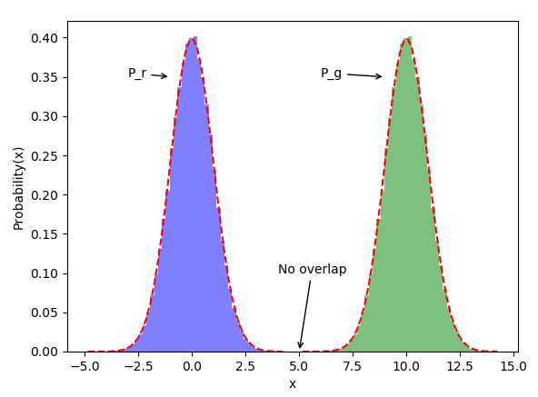
Generative Adversary Network
Some limitations for GAN :
Vanishing gradient issue due to which the generator training might fail
Model collapse where the generator might repeatedly create the same output
Failure to converge due to which the discriminator feedback can get less meaningful to the generator thus impacting its quality
$$p\left(x\right)$$
$$q\left(x\right)$$
Why do the gradient of GAN vanish during the training ?
Jensen–Shannon divergence $D_{JS}\left(p||q\right)$
Definition : $D_{JS}\left(p||q\right)=\frac{1}{2}D_{KL}\left(p||r\right)+\frac{1}{2}D_{KL}\left(q||r\right)$ , where $r=\frac{p+q}{2}$
$D_{JS}\left(p||q\right)=\frac{1}{2}\sum{p\left(x\right)\log\left(\frac{p\left(x\right)}{p\left(x\right)+q\left(x\right)}\right)}+\frac{1}{2}\sum{q\left(x\right)\log\left(\frac{q\left(x\right)}{p\left(x\right)+q\left(x\right)}\right)}+log2$
When $x≥5$, $p\left(x\right)≈0$ : $D_{JS}\left(p||q\right)=log2$
When $x<5$, $q\left(x\right)≈0$ : $D_{JS}\left(p||q\right)=log2$
→ $∀x∈ℝ,D_{JS}\left(p||q\right)=log2=const.$ → $∇D_{JS}\left(p||q\right)=0$
Vanishing gradient
Notes:
具体原因可以解释如下：GAN采用的是对抗训练的方式，G的梯度更新来自D，所以G生成的好不好，得看D怎么说。具体就是G生成一个样本，交给D去评判，D会输出生成的假样本是真样本的概率（0-1），相当于告诉G生成的样本有多大的真实性，G就会根据这个反馈不断改善自己，提高D输出的概率值。但是如果某一次G生成的样本可能并不是很真实，但是D给出了正确的评价，或者是G生成的结果中一些特征得到了D的认可，这时候G就会认为我输出的正确的，那么接下来我就这样输出肯定D还会给出比较高的评价，实际上G生成的并不怎么样，但是他们两个就这样自我欺骗下去了，导致最终生成结果缺失一些信息，特征不全。
———————————————

Slide 12
Diffusion Probabilistic Models (DPM)

Slide 13
Diffusion Probabilistic Models
Diffusion Probabilistic Models (DPM):
Noise
Noise
Noise
Noise
$$q\left(x_{0}\right)$$
Forward diffusion
$$⋯⋯$$
$${x }_{0}$$
$${x }_{1}$$
$${x }_{2}$$
$$z$$
$$⋯⋯$$
Reverse diffusion
$$p\left(x_{0}\right)$$
denoise
denoise
denoise
denoise

Slide 14
Diffusion Probabilistic Models
Forward diffusion : add noise to the image
Distribution of the
noised images
Output
Mean $μ_{t}$
Variance $Σ_{t}$
$$q\left(x_{t}|x_{t−1}\right)=𝒩\left( x_{t} ; \sqrt{1−β_{t}}x_{t−1} , β_{t}I \right)$$
Notations:
t : time step (from 0 to T)
$x_{0}$ : a data sampled from the real data distribution $q\left(x\right)$ (i.e. $x_{0}\sim q\left(x\right)$)
$β_{t}$ : variance schedule ($0≤β_{t}≤1$, and $β_{0}=small number$, $β_{T}=large number$)
$I$ : Identity matrix

Slide 15
Diffusion Probabilistic Models
Closed-Form Formula :
$x_{t}=\sqrt{\overline{α_{t}}}x_{0}+\sqrt{1−\overline{α_{t}}}ε$
$ε\sim 𝒩\left(0,I\right)$
$α_{t}=1−β_{t}$
$\overline{α_{t}}=\prod_{i=1}^{t}{α_{i}}$
Reparameterization trick :
If $z={\left[z_{1},z_{2},…,z_{D}\right]}^{T}$ and i.i.d., then $Cov\left(z_{i},z_{j}\right)=0 , ∀i≠j$
If $z\sim 𝒩\left(μ,σ^{2}I\right)$ , then $z=μ+σε$ , where $ε\sim 𝒩\left(0,I\right)$
Mean vector : $μ_{z}=𝔼\left[z\right]=𝔼\left[μ+σε\right]=μ+σ𝔼\left[ε\right]=μ$
Variance matrix: $Var\left(z\right)=Var\left(μ+σε\right)=σ^{2}I$

Slide 16
Diffusion Probabilistic Models
$q\left(x_{t}|x_{t−1}\right)=𝒩\left( x_{t} ; \sqrt{1−β_{t}}x_{t−1} , β_{t}I \right)$
$x_{t}=\sqrt{1−β_{t}}x_{t−1}+\sqrt{β_{t}}ε_{t−1}$
$=\sqrt{α_{t}}x_{t−1}+\sqrt{1−α_{t}}ε_{t−1}$
$=\sqrt{α_{t}}\left(\sqrt{α_{t−1}}x_{t−2}+\sqrt{1−α_{t−1}}ε_{t−2}\right)+\sqrt{1−α_{t}}ε_{t−1}$
$=\sqrt{α_{t}α_{t−1}}x_{t−2}+\sqrt{α_{t}\left(1−α_{t−1}\right)}ε_{t−2}+\sqrt{1−α_{t}}ε_{t−1}$
$=\sqrt{α_{t}α_{t−1}}x_{t−2}+\sqrt{1−α_{t}α_{t−1}}\overline{ε_{t−2}}$
$=…$
$=\sqrt{α_{t}α_{t−1}…α_{1}}x_{0}+\sqrt{1−α_{t}α_{t−1}…α_{1}}ε$
$=\sqrt{\overline{α_{t}}}x_{0}+\sqrt{1−\overline{α_{t}}}ε$
(1)
(2)
(3)
(4)
(5)
(6)
(7)
All the ε are i.i.d. (independent and identically distributed) standard normal random variables
$ε_{0},ε_{1},…,ε_{t−1}\sim 𝒩\left(0,I\right)$
$\overline{ε_{0}}$, $\overline{ε_{1}},…,\overline{ε_{t−1}}\sim 𝒩\left(0,I\right)$
$ε\sim 𝒩\left(0,I\right)$
$α_{t}=1−β_{t}$
$\overline{α_{t}}=\prod_{i=1}^{t}{α_{i}}$

Slide 17
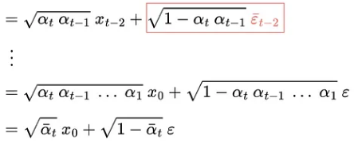
Diffusion Probabilistic Models
$$x_{t}=\sqrt{\overline{α_{t}}}x_{0}+\sqrt{1−\overline{α_{t}}}ε$$

Slide 18
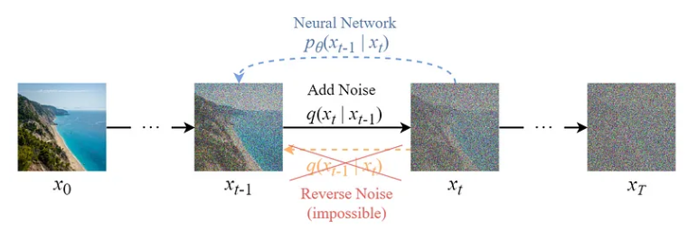
Diffusion Probabilistic Models
Reverse diffusion : remove noise from the image
Target distribution : $q\left(x_{t−1}|x_{t}\right)=𝒩\left( x_{t−1} ; {\tilde{μ}}_{t}\left(x_{t},x_{0}\right), {\tilde{β}}_{t}I \right)$
Approximated distribution : $p_{θ}\left(x_{t−1}|x_{t}\right)=𝒩\left( x_{t−1} ; μ_{θ}\left(x_{t},t\right), Σ_{θ}\left(x_{t},t\right)\right)$
$θ$ : Learnable parameters by neural network

Slide 19
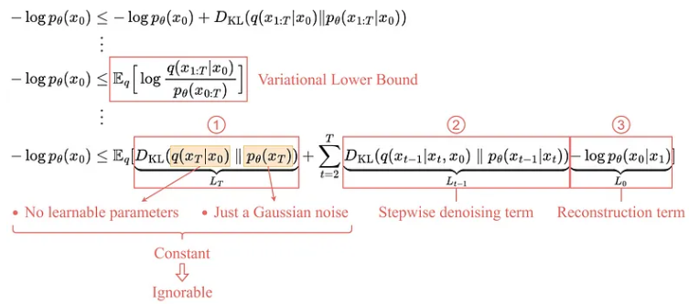
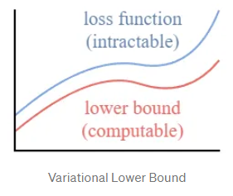
Diffusion Probabilistic Models
Loss function : Negative Log-Likelihood
$L=−\log\left(p_{θ}\left(x_{0}\right)\right)$
$p_{θ}\left(x_{0}\right)$ depends on $x_{1}$, $x_{2}$, …, $x_{T}$ ; therefore, it is intractable
Instead of optimizing the intractable loss function itself, we can optimize the Variational Lower Bound.
$\text{Non}\text{−}\text{negativity}\text{ : }D_{KL}\left(p||q\right)≥0$

Slide 20
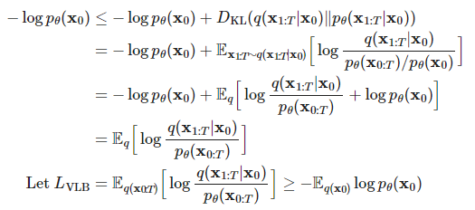
Diffusion Probabilistic Models
Prove for the VLB of the loss function :
Loss function : Negative Log-Likelihood
$L=−\log\left(p_{θ}\left(x_{0}\right)\right)$
$p_{θ}\left(x_{0}\right)$ depends on $x_{1}$, $x_{2}$, …, $x_{T}$ ; therefore, it is intractable
Instead of optimizing the intractable loss function itself, we can optimize the Variational Lower Bound (VLB).
$\text{Non}\text{−}\text{negativity}\text{ : }D_{KL}\left(p||q\right)≥0$
$$L=$$

Slide 21
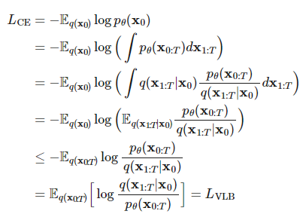
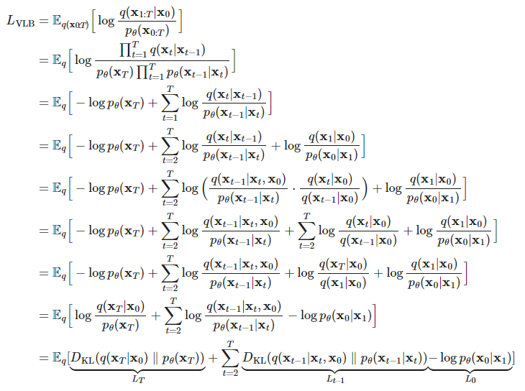
Diffusion Probabilistic Models
Instead of optimizing the intractable loss function itself, we can optimize the Variational Lower Bound (VLB).
Jensen’s inequality

Slide 22
Diffusion Probabilistic Models
Loss function:
$L=𝔼_{q}\left[D_{KL}\left(q\left(x_{T}|x_{0}\right)||p_{θ}\left(x_{T}\right)\right)+\sum_{t=2}^{T}{D_{KL}\left(q\left(x_{t−1}|x_{t},x_{0}\right)||p_{θ}\left(x_{t−1}|x_{t}\right)\right)−\log\left(p_{θ}\left(x_{0}|x_{1}\right)\right)}\right]$
$=𝔼_{q}\left[L_{T}+\sum_{t=2}^{T}{L_{t−1}+L_{0}}\right]$
Constant term $: L_{T}=D_{KL}\left(q\left(x_{T}|x_{0}\right)||p_{θ}\left(x_{T}\right)\right)$
Since $q$ has no learnable parameters and $p_{θ}\left(x_{T}\right)$ is just a Gaussian noise probability, this term will be a constant during training and thus can be ignored.
${\text{Stepwise} \text{denoising} \text{term} : L}_{t−1}=D_{KL}\left(q\left(x_{t−1}|x_{t},x_{0}\right)||p_{θ}\left(x_{t−1}|x_{t}\right)\right), ∀t=2,3,…,T$
This term compares the target denoising step $q$ and the approximated denoising step $p_{θ}$
Reconstruction term : $L_{0}=−\log\left(p_{θ}\left(x_{0}|x_{1}\right)\right)$
This is the reconstruction loss of the last denoising step and it can be ignored during training for the following reasons
It can be approximated using the same neural network in $L_{t−1}$.
Ignoring it makes the sample quality better and makes it simpler to implement.

Slide 23
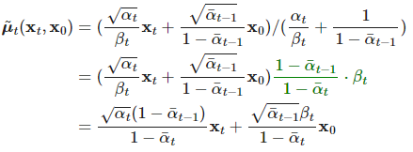
Diffusion Probabilistic Models
${\text{Stepwise} \text{denoising} \text{term} : L}_{t−1}=D_{KL}\left(q\left(x_{t−1}|x_{t},x_{0}\right)||p_{θ}\left(x_{t−1}|x_{t}\right)\right), ∀t=2,3,…,T$
$Target distribution: q\left(x_{t−1}|x_{t},x_{0}\right)=𝒩\left( x_{t−1} ; {\tilde{μ}}_{t}\left(x_{t},x_{0}\right), {\tilde{β}}_{t}I \right)$
Use Bayes’ rule, we have
Bayes’ rule :
$P\left(A|B\right)P\left(B\right)=P\left(B | A\right)P\left(A\right)$
Variance :
$\exp\left(−\frac{1}{2σ^{2}}{\left(x−μ\right)}^{2}\right)=\exp\left(−\frac{1}{2}\left(\frac{1}{σ^{2}}x^{2}−\frac{2μ}{σ^{2}}x+\frac{μ^{2}}{σ^{2}}\right)\right)$
$α_{t}=1−β_{t}$
$\overline{α_{t}}=\prod_{i=1}^{t}{α_{i}}$
$x_{t}=\sqrt{\overline{α_{t}}}x_{0}+\sqrt{1−\overline{α_{t}}}ε_{t}$ → $x_{0}=\frac{1}{\sqrt{\overline{α_{t}}}}\left(x_{t}−\sqrt{1−\overline{α_{t}}}ε_{t}\right)$
Mean :

Slide 24
Diffusion Probabilistic Models
Apply $x_{t}=\sqrt{\overline{α_{t}}}x_{0}+\sqrt{1−\overline{α_{t}}}ε_{t}$ → $x_{0}=\frac{1}{\sqrt{\overline{α_{t}}}}\left(x_{t}−\sqrt{1−\overline{α_{t}}}ε_{t}\right)$ into the mean
Objective : Approximate $p_{θ}\left(x_{t−1}|x_{t}\right)$ as close as the target $q\left(x_{t−1}|x_{t}\right)$
Variance :
Mean :
We can obtain : ${\tilde{μ}}_{t}\left(x_{t}\right)=\frac{1}{\sqrt{α_{t}}}\left(x_{t}−{\frac{1−α_{t}}{\sqrt{1−\overline{α_{t}}}}ε}_{t}\right)$
Setting learning mean : $μ_{θ}\left(x_{t},t\right)=\frac{1}{\sqrt{α_{t}}}\left(x_{t}−\frac{1−α_{t}}{\sqrt{1−\overline{α_{t}}}}ε_{θ}\left(x_{t},t\right)\right)$
learning variance : $Σ_{θ}\left(x_{t},t\right)={\tilde{β}}_{t}I=\frac{1−{\overline{α}}_{t−1}}{1−{\overline{α}}_{t}}$ $β_{t}$
Target distribution : $q\left(x_{t−1}|x_{t}\right)=𝒩\left( x_{t−1} ; {\tilde{μ}}_{t}\left(x_{t},x_{0}\right), {\tilde{β}}_{t}I \right)$
Approximated distribution : $p_{θ}\left(x_{t−1}|x_{t}\right)=𝒩\left( x_{t−1} ; μ_{θ}\left(x_{t},t\right), Σ_{θ}\left(x_{t},t\right)\right)$
$θ$ : Learnable parameters by neural network

Slide 25
Diffusion Probabilistic Models
The comparison between the target mean and the approximated mean can be done using a mean squared error (MSE):
Target distribution : $q\left(x_{t−1}|x_{t}\right)=𝒩\left( x_{t−1} ; {\tilde{μ}}_{t}\left(x_{t},x_{0}\right), {\tilde{β}}_{t}I \right)$
Approximated distribution : $p_{θ}\left(x_{t−1}|x_{t}\right)=𝒩\left( x_{t−1} ; μ_{θ}\left(x_{t},t\right), Σ_{θ}\left(x_{t},t\right)\right)$
Learning mean : $μ_{θ}\left(x_{t},t\right)=\frac{1}{\sqrt{α_{t}}}\left(x_{t}−\frac{1−α_{t}}{\sqrt{1−\overline{α_{t}}}}ε_{θ}\left(x_{t},t\right)\right)$
Learning variance : $Σ_{θ}\left(x_{t},t\right)={\tilde{β}}_{t}I=\frac{1−{\overline{α}}_{t−1}}{1−{\overline{α}}_{t}}$ $β_{t}$
$$x_{t}=\sqrt{\overline{α_{t}}}x_{0}+\sqrt{1−\overline{α_{t}}}ε_{t}$$

Slide 26
Diffusion Probabilistic Models
Simplified loss function $L_{t}^{simple}$:
$$x_{t}=\sqrt{\overline{α_{t}}}x_{0}+\sqrt{1−\overline{α_{t}}}ε_{t}$$

Slide 27
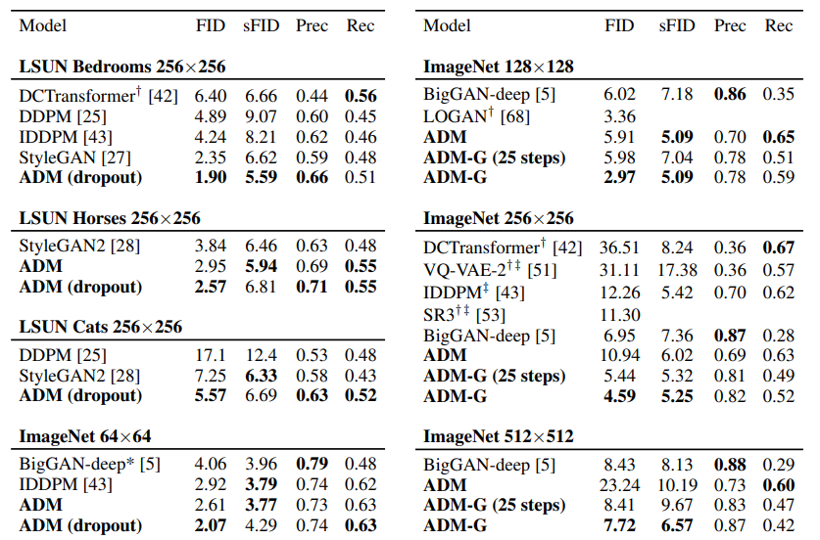
Diffusion Probabilistic Models
DPM application : image, audio , denoising, higher resolution image, but higher computation
$FID\left(x,g\right)={\left\|μ_{x}−μ_{g}\right\|}_{2}^{2}+Tr\left(Σ_{x}+Σ_{g}−2{\left(Σ_{x}Σ_{g}\right)}^{0.5}\right)$
$sFID$ : consider spatial features with FID

Slide 28
Thanks for Listening

