Slide 1
Graph cut
Chien-chi Chen

Slide 2
Outline
Introduction
  Interactive segmentation
  Related work
Graph cut
  Concept of graph cut
  Hard and smooth constrains
  Min cut/Max flow
Extensive of Graph cut
  Grab cut
  Paint Selection
Unsupervise graph cut
Conclusion
Reference

Slide 3
Outline
Introduction
  Demo
  Related work
Graph cut
  Concept of grap hcut
  Hard and smooth constrains
  Min cut/Max flow
Extensive of Graph cut
  Grab cut
  Paint Selection
Unsupervise graph cut
Conclusion
Reference

Slide 4
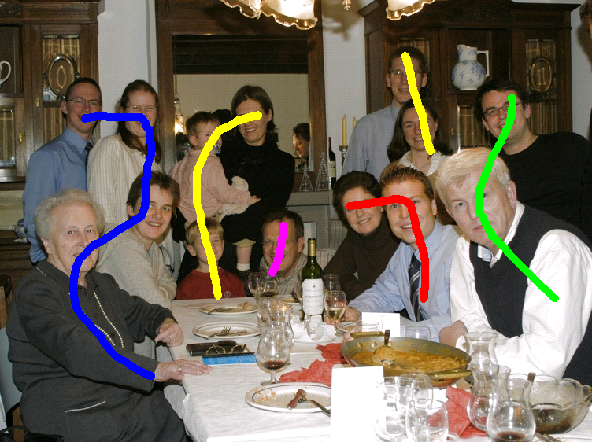
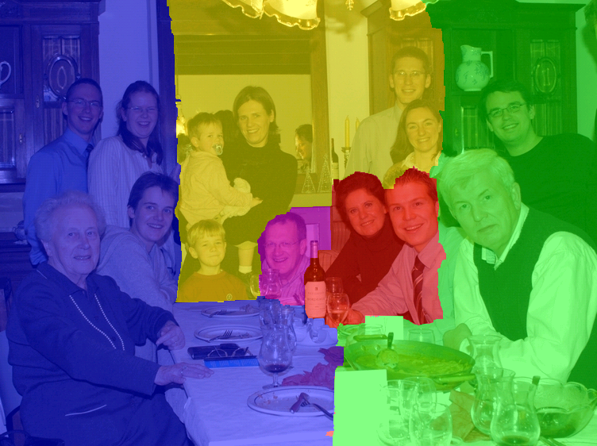
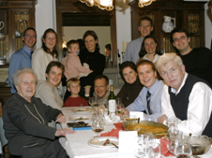
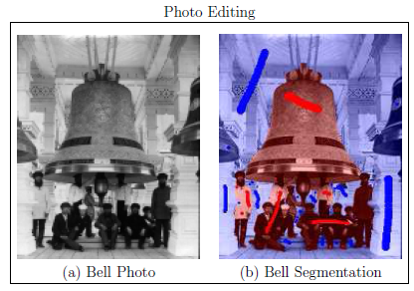
Interactive Segmentation

Slide 5
Related Work
Scribble-based selection
  Graph cut
Painting-based selection
  Paint Selection
  http://www.youtube.com/watch?v=qC5Y9W-E-po
Boundary-based selection
  Intelligent Scissor
  http://www.youtube.com/watch?v=3LDsh3vi5fg

Slide 6
Outline
Introduction
  Demo
  Related work
Graph cut
  Concept of graph cut
  Hard and smooth constrains
  Min cut/Max flow
Extensive of Graph cut
  Grab cut
  Paint Selection
Unsupervise graph cut
Conclusion
Reference

Slide 7
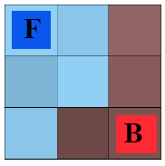
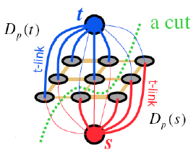
Concept of graph cut
Characteristic
  Interactive image segmentation using graph cut
  Binary label: foreground vs. background
Interactive
  User labels some pixels
Algorithm setting
  Hard constrains
  Smoothness constrains
Min cut/Max flow
  Energe minimization

Slide 8
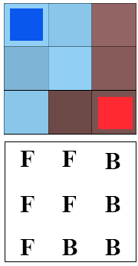
Labeling as a graph problem
Each pixel = node
Add two nodes F & B
Labeling: link each pixel to either F or B
Desired result

Slide 9
Data term
Put one edge between each pixel and F & G
Weight of edge = minus data term
  Don’t forget huge weight for hard constraints
  Careful with sign

Slide 10
Smoothness term
Add an edge between each neighbor pair
Weight = smoothness term

Slide 11
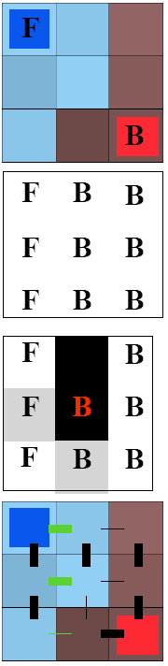
Energy function
Labeling: one value per pixel, F or B
Energy(labeling) = hard + smoothness
  Will be minimized
Hard: for each pixel
  Probability that this color belongs to F (resp. B)
Smoothness (aka regularization):
per neighboring pixel pair
  Penalty for having different label
  Penalty is downweighted if the two
  pixel colors are very different
One labeling
(ok, not best)
Data
Smoothness
Notes:
A為binary : obj or bkg

Slide 12
Min cut
Energy optimization equivalent to min cut
Cut: remove edges to disconnect F from B
Minimum: minimize sum of cut edge weight
http://www.cse.yorku.ca/~aaw/Wang/MaxFlowStart.htm

Slide 13
Outline
Introduction
  Demo
  Related work
Graph cut
  Concept of graph cut
  Hard and smooth constrains
  Min cut/Max flow
Extensive of Graph cut
  Grab cut
  Paint Selection
Unsupervise graph cut
Conclusion
Reference

Slide 14
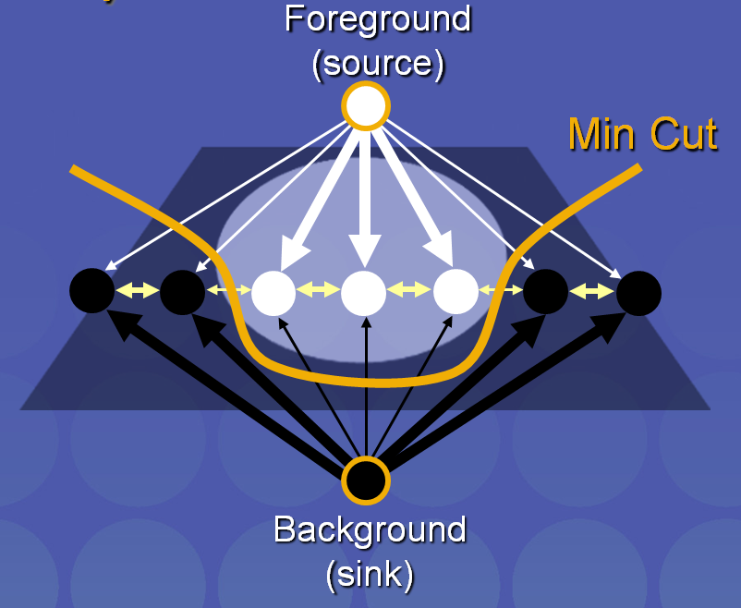
Extensive of Graph cut
Grab cut
E(φ,S,x, λ) = Ecol(φ,S,x) + Ecol(,S,x, λ)
:Gaussian mixture model
Image
Notes:
Gaussian mixture model : 用來建立foreground 和background的model

Slide 15
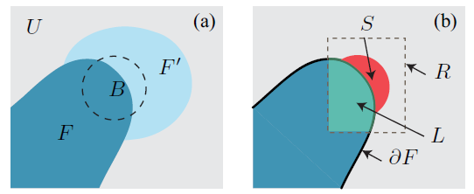
Extensive of Graph cut
Paint selection
B- user brush, F- existing selection
F’- new selection, U- background
R-dilated box, L- local foreground,
dF-frontal foreground

Slide 16
Extensive of Graph cut
E(X)=
Hard constrains
  Using L(local foreground) to build GMM
  Background model is randomly sampling a number (1200 points)from background to build GMM
Notes:
表示foreground 只有L，所偵測的區域只有S和Sb(hard background scribble)

Slide 17
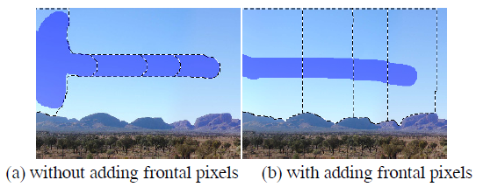
Extensive of Graph cut
Smoothness constrains
Adding frontal forground

Slide 18
Outline
Introduction
  Interactive segmentation
  Related work
Graph cut
  Concept of graph cut
  Hard and smooth constrains
  Min cut/Max flow
Extensive of Graph cut
  Grab cut
  Paint Selection
Unsupervise graph cut
Conclusion
Reference

Slide 19
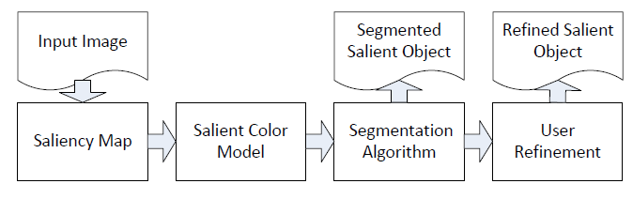
Unsupervise graph cut
Automatic object segmentation with salient color model
Saliency Map:

Slide 20
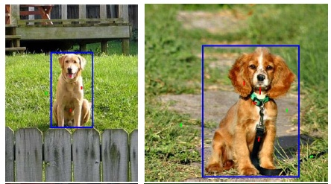
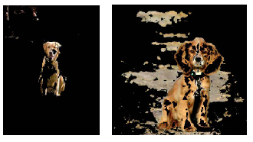
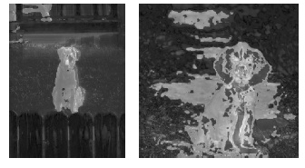
Unsupervise graph cut
Saliency map

Slide 21
Unsupervise graph cut
Segmentation
Hard constrains
  K-means is employed to model distribution

Slide 22
Unsupervise graph cut
Smoothness constrains

Slide 23
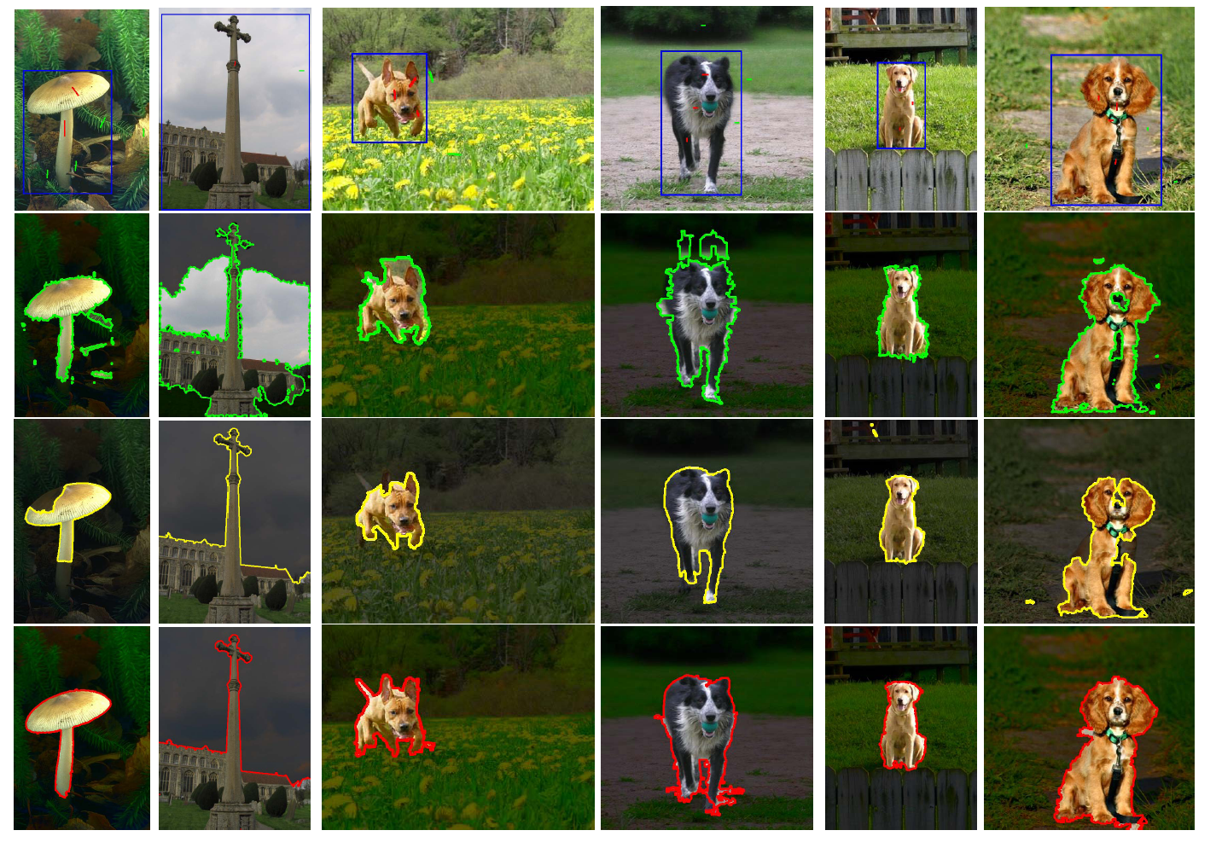

Slide 24
Outline
Introduction
  Interactive segmentation
  Related work
Graph cut
  Concept of graph cut
  Hard and smooth constrains
  Min cut/Max flow
Extensive of Graph cut
  Grab cut
  Paint Selection
Unsupervise graph cut
Conclusion
Reference

Slide 25
Conclusion
Interactive segmentation
Graph cut is fast, robust segmentation
It consider not only difference between source to node, but also link of node to node.

Slide 26
Reference
Lecture slide from Dr. Y.Y. Chuang.
Y. Boyjov, “An Experimental Comparison of Min-Cut/Max-Flow Algorithms for Energy Minimization in Vision”, PAMI 2002.
J. Liu, J. Sun, H.Y. Shum, ”Paint Selection”, sigraph 2007.
C.C. Kao, J.H. Lai, S.Y. Chien,“Automatic Object Segmentation With Salient Color Model”, IEEE 2011.

Slide 27
Q&A

