Slide 1
Introduction to MPEG-4 Part 10 (H.264/AVC) [1]

Slide 2
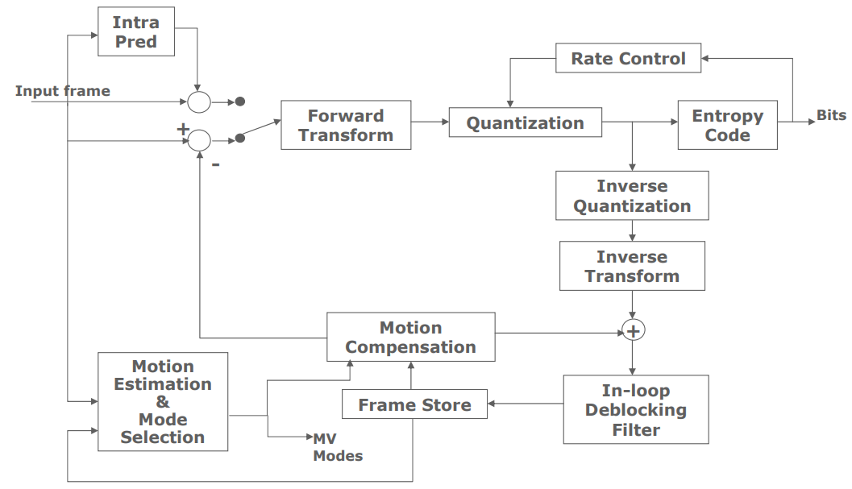
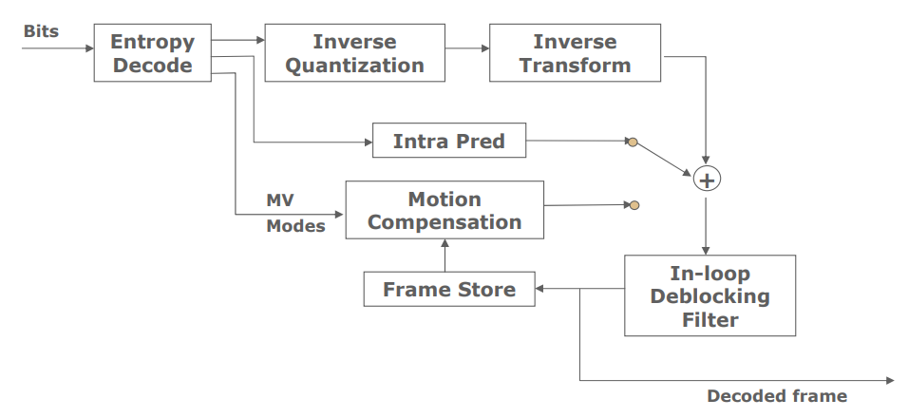
H.264 CODEC Flow [2]

Slide 3
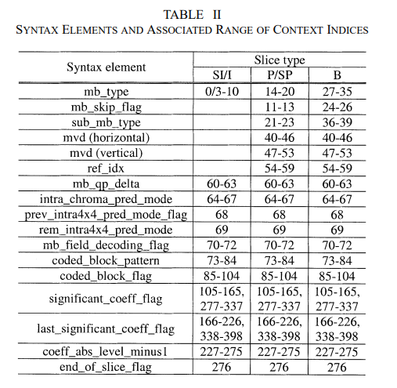
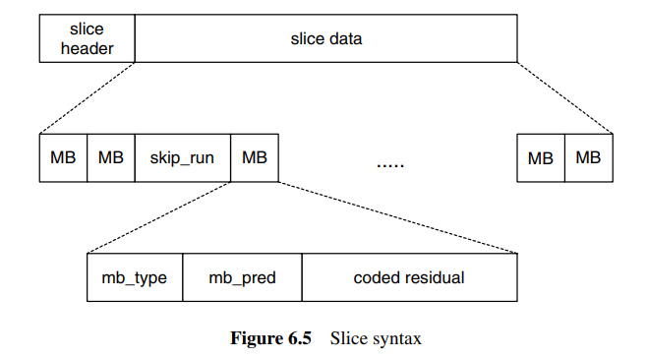
Slices And Macroblocks
Macroblocks (MBs) : 16x16 luma, 8x8 chroma
Macroblock partitions: 16x16, 16x8, 8x16, 8x8
Sub-macroblock: 8x8
Sub-macroblock partitions: 8x8, 8x4, 4x8, 4x4
Slices
I slice
Contain only I MBs
P slice
Contain I or P or skipped MBs
B slice
Contain I or B or skipped MBs
SI slice
SP slice
[3]

Slide 4
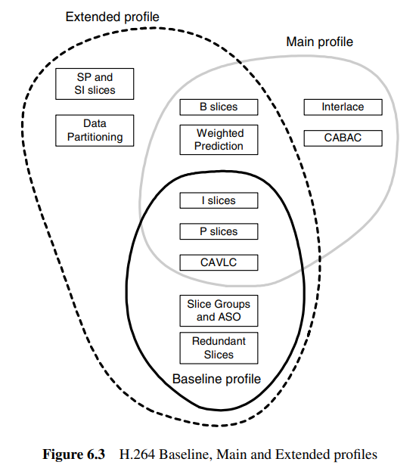
H.264 Profiles
The Baseline Profile
I / P slices, CAVLC
Video telephony, conferencing and wireless communication
The Main Profile
I /P /B slices, CABAC
Broadcast television, storage
The Extended Profile
SI / SP slices, CAVLC, error resilience
Streaming

Slide 5
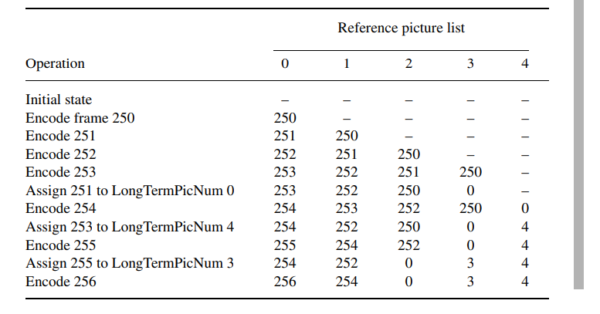
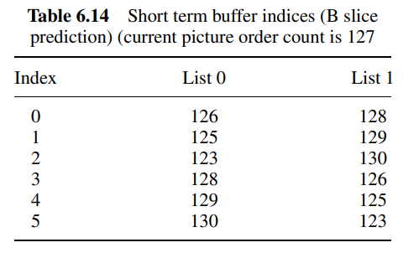
The Baseline Profile – Reference Picture Management
Two reference picture lists: 0 for P while 0 & 1 for B
List 0: closest past then closest future
List 1: closest future then closest past
Sliding window memory control
Short-term (default) and long-term
Compared with MPEG-Visual, more choices (16x2)
Flushed once receiving IDR (instantaneous decoder refresh) picture

Slide 6
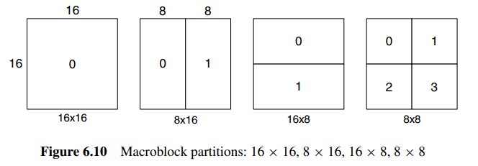
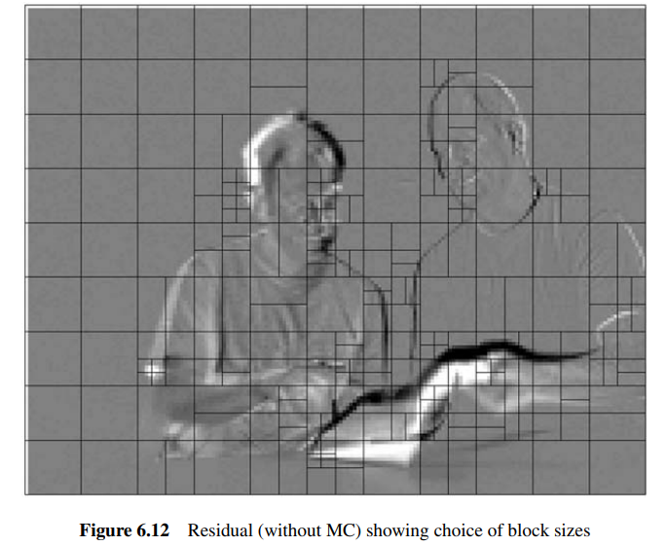
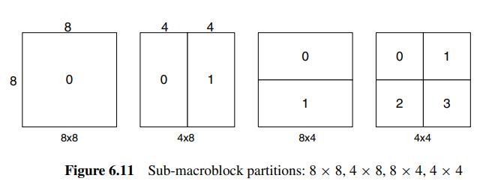
Inter Prediction – Partitioning
Tree structured motion compensation
Trade off

Slide 7
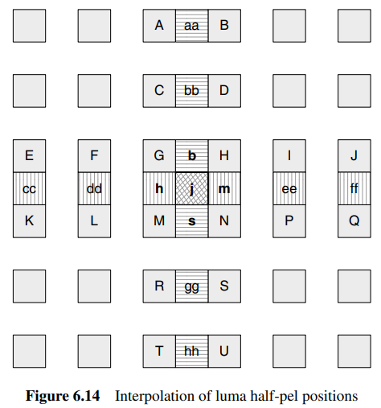
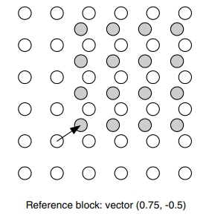
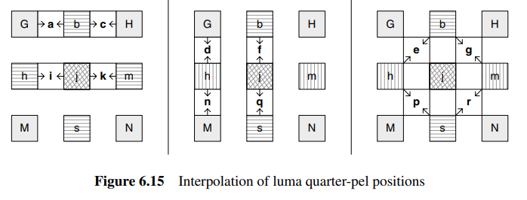
Inter Prediction – Interpolation
Motion vector accuracy
Quarter-sample resolution for luma
One-eighth-sample resolution for chroma
Interpolation
Six tap FIR (1, -5, 20, 20, -5, 1) / 32 (luma)
Mean value (luma)
Bilinear interpolation (chroma)

Slide 8
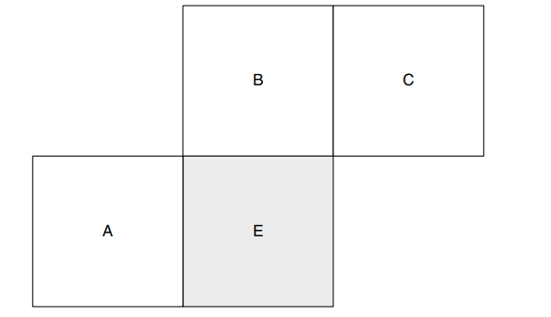
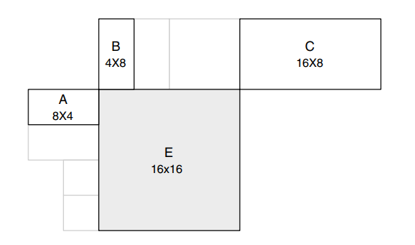
Inter Prediction – Motion Vector Compensation
Case 1: same size → DPCM
Case 2: arbitrary size → follow the rules shown below
Case 1
Case 2

Slide 9
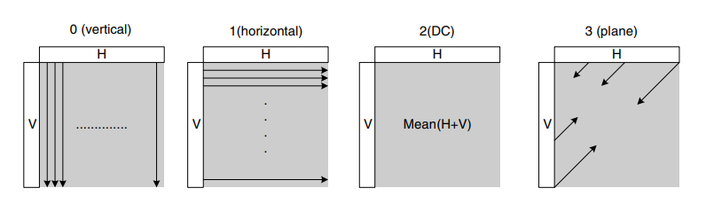
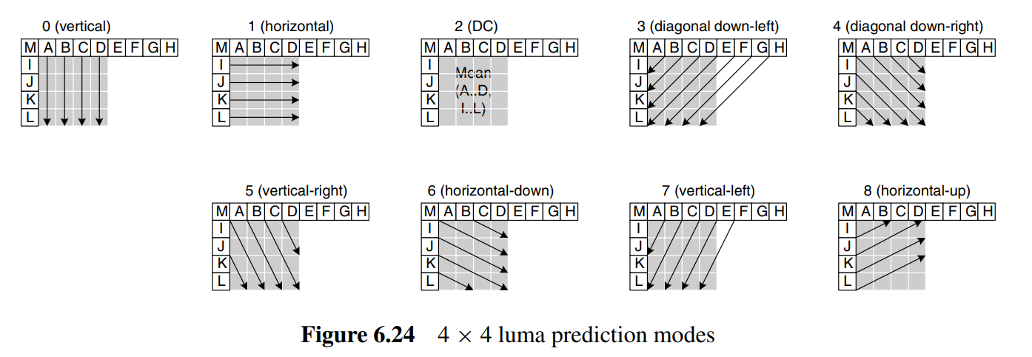
Intra Prediction – Prediction Mode
Luma prediction
4x4: 9 modes
16x16: 4 modes
Chroma prediction
8x8: similar to 16x16 luma except difference in mode index

Slide 10
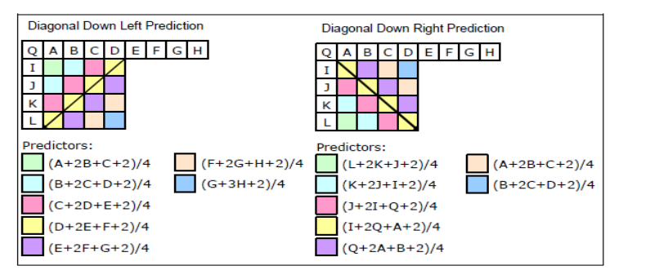
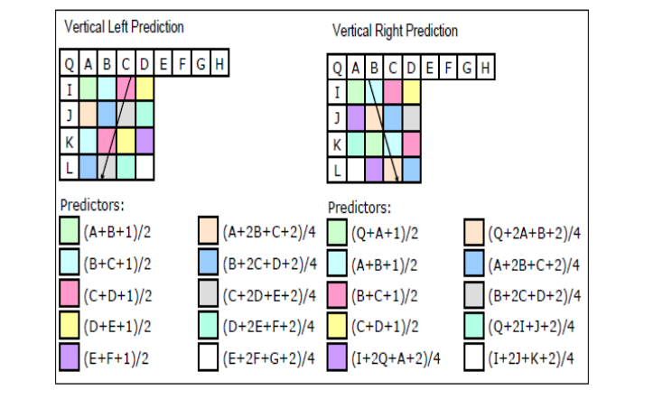
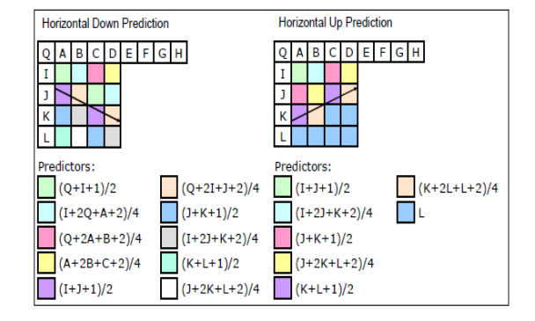
Intra Prediction – Prediction Mode Cont’d
Implementation of extrapolation in different modes [4]

Slide 11
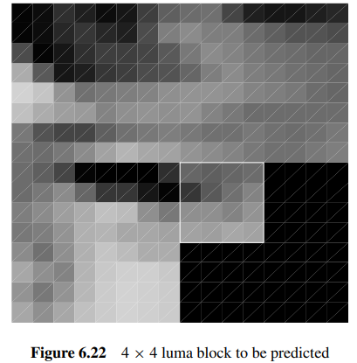
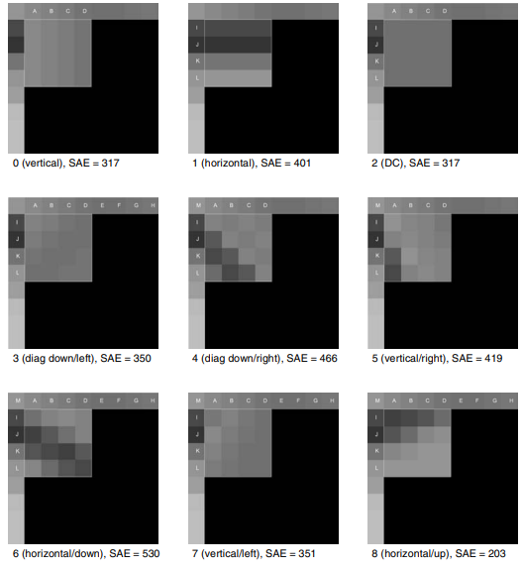
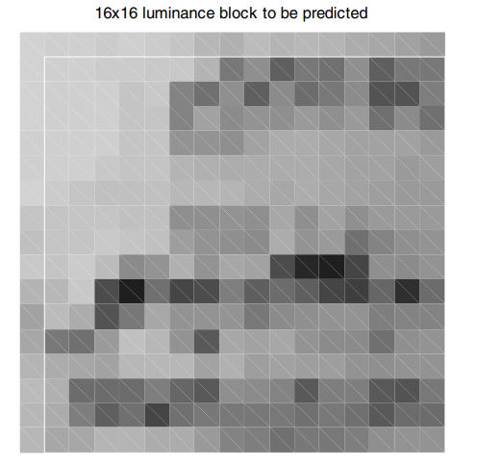
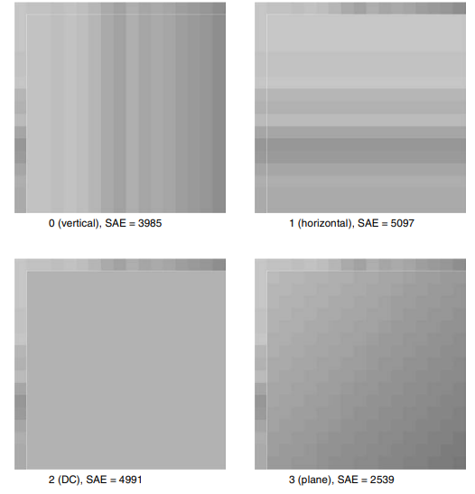
Intra Prediction – Prediction Mode Cont’d

Slide 12
Intra Prediction – Mode Prediction
Prediction mode need to be predicted as well
Most probable prediction mode $=\min\left(A,B\right)$
If either of neighboring blocks are not available, set as 2 (DC)
Two flags
prev_intra4×4_pred_mode
rem_intra4×4_pred_mode
If prev_intra4×4_pred_mode = 1
prediction mode = Most probable prediction
else if prev_intra4×4_pred_mode = 0 and rem_intra4×4_pred_mode < Most probable prediction
prediction mode = rem_intra4×4_pred_mode
else if prev_intra4×4_pred_mode = 0 and rem_intra4×4_pred_mode >= Most probable prediction
prediction mode = rem_intra4×4_pred_mode + 1

Slide 13
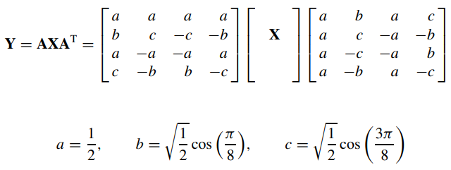
Intra Prediction – Residual Transform
DCT-based integer transform
Using only addition, subtraction and shift
Factorized
Where d = c / b = sqrt(2)
Simplify d as 0.5 and scale 2nd and 4th rows

Slide 14
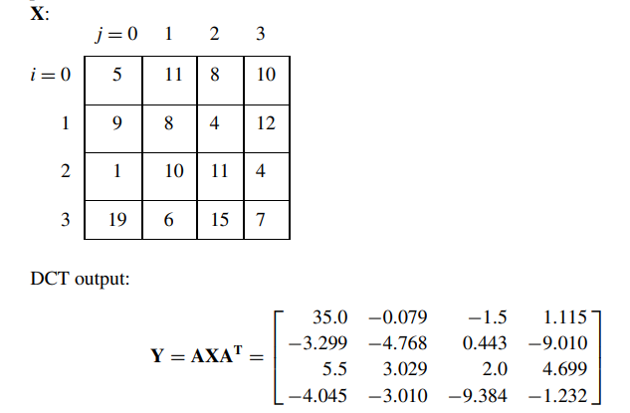
Intra Prediction – Residual Transform Cont’d
Example

Slide 15
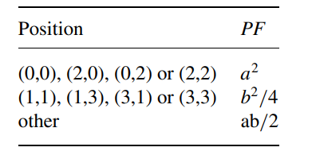
Intra Prediction – Quantization
QP = [0,51]
.
Qstep doubles when QP increases by 6
To further simplify , where and
Integer implementation: ,where f = $2^{qbits}/3$ for Intra and $2^{qbits}/6$ for Inter
Inverse: , where V = Qstep · PF · 64

Slide 16
Intra Prediction – DC Coefficient Transform
Perform Hadamard Transform to DC coefficients if predicted in 16x16
Luma: 4x4, Chroma: 2x2
Case: 4x4
Case: 2x2

Slide 17
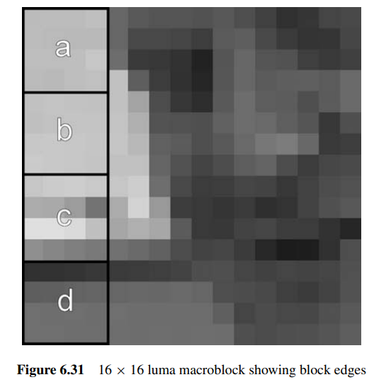
Deblocking Filter
In-loop filter
Boundary strength
Determined by whether p / q is intra / inter coded and is MB boundary or not
Is filtered only if
BS > 0
|p0 – q0| < α and |p1 – p0| < β and |q1 – q0| < β
α, β and QP are positively correlated
Post-filter
Not defined in CODEC
will be filtered
won’t be filtered

Slide 18
Entropy Coding
Parameters are encoded using Exp-Golomb codes
Except residual block data
Entropy_coding_mode
0 for CAVLC (baseline profile)
1 for CABAC (main profile)

Slide 19
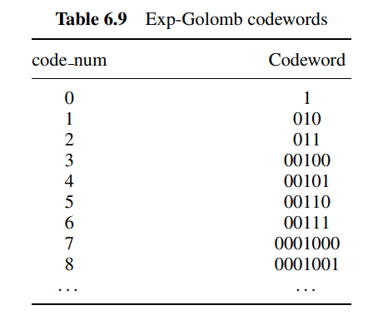
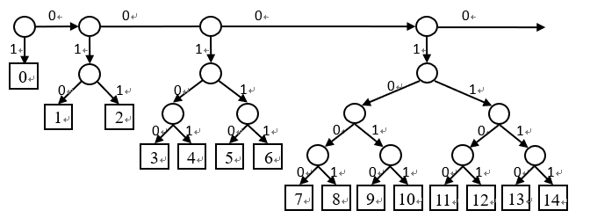
Entropy Coding – Exp-Golomb Coding
[M][1][INFO]
M = floor(log2[code_num + 1])
INFO = code_num + 1 – $2^{M}$
Decoding:

Slide 20
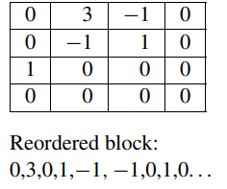
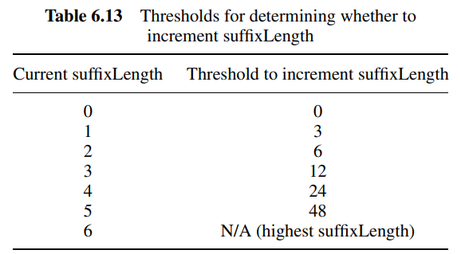
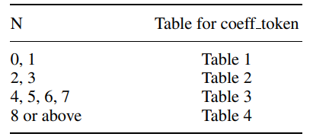
Entropy Coding – CAVLC
TotalCoeffs: number non-zero value
4 Tables determined by nC
nC = round ((nA + nB) / 2); = 0 if neither is available
Trailing ones: numbers of ones in reverse order, if $>$ 3, choose last 3
Levels: non-zero coefficients other than trailing ones
prefix + suffix
suffix length is adaptive
Total_zeros
Run_before
Levels
Trailing ones

Slide 21
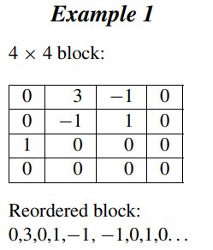
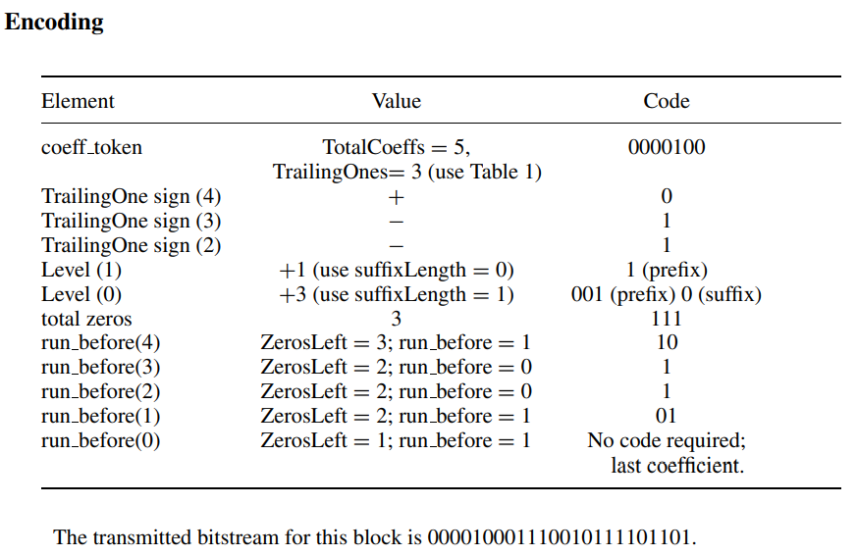
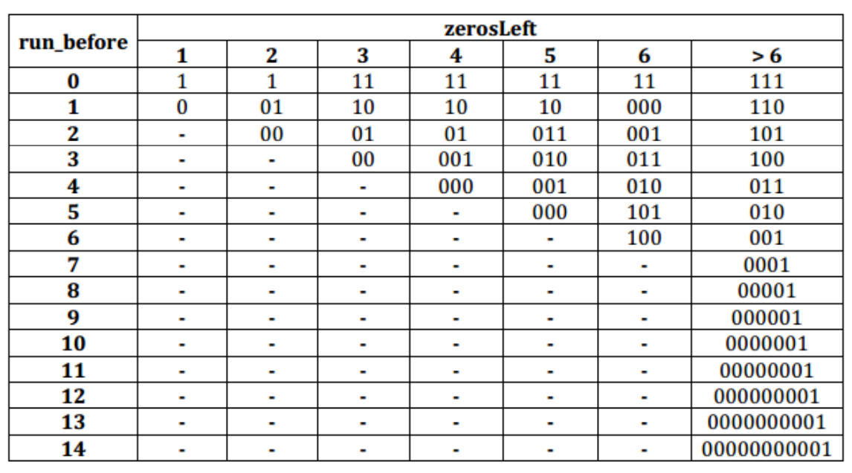
Entropy Coding – CAVLC Cont’d

Slide 22
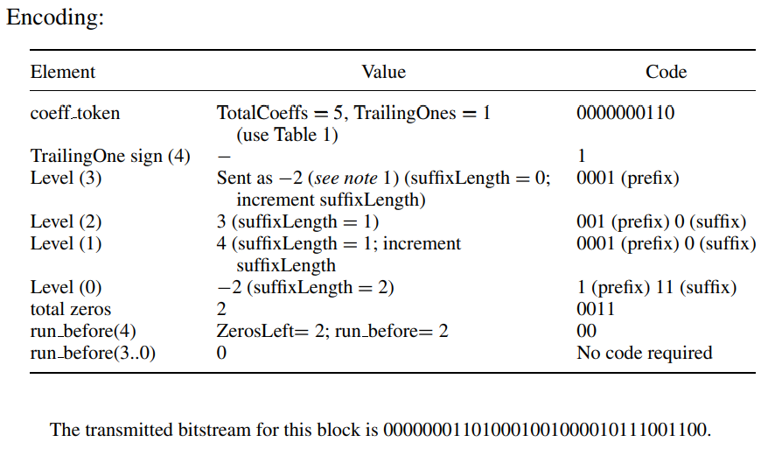
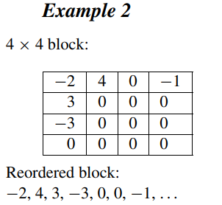
Entropy Coding – CAVLC Cont’d

Slide 23
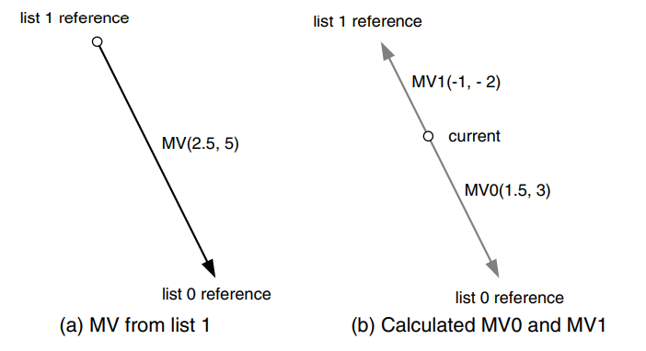
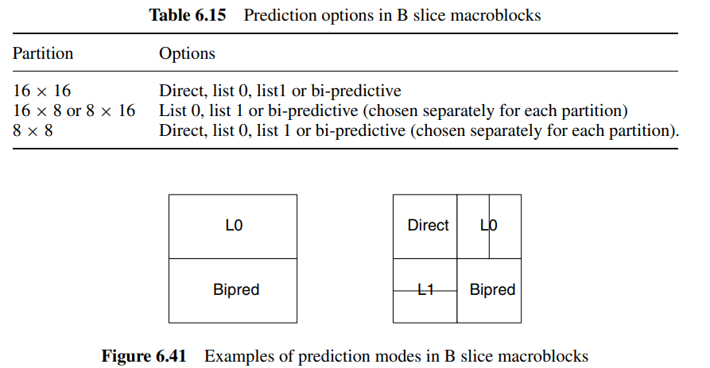
Main Profile – B slices
Buffer index are sent in Exp-Golomb Coding
i.e. closer picture order count requires shorter codes
Prediction mode
Bi-prediction mode
Direct mode (No MVs transmitted)
Temporal
spatial
temporal direct mode

Slide 24
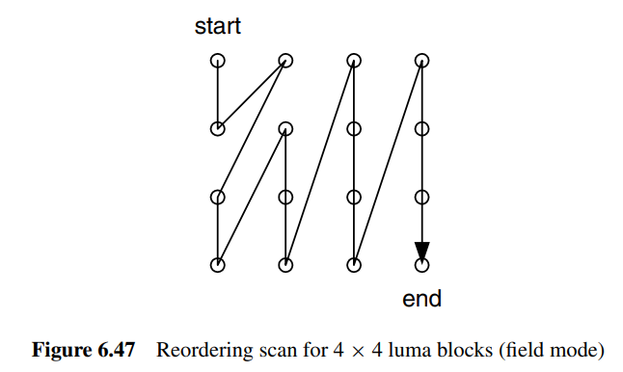
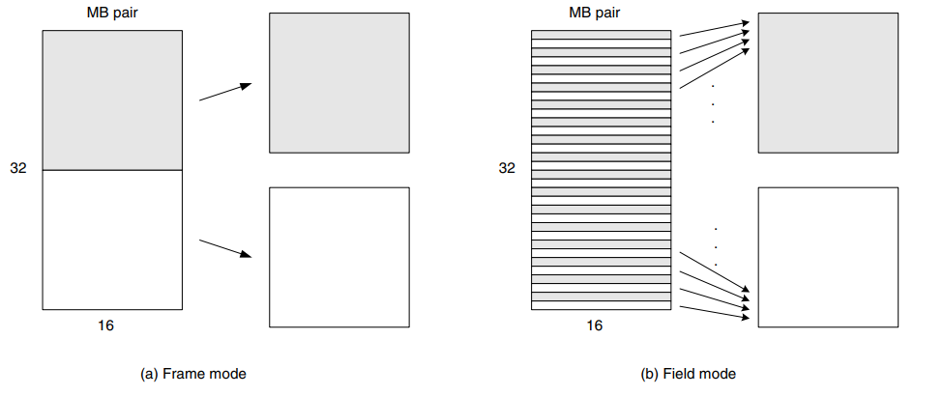
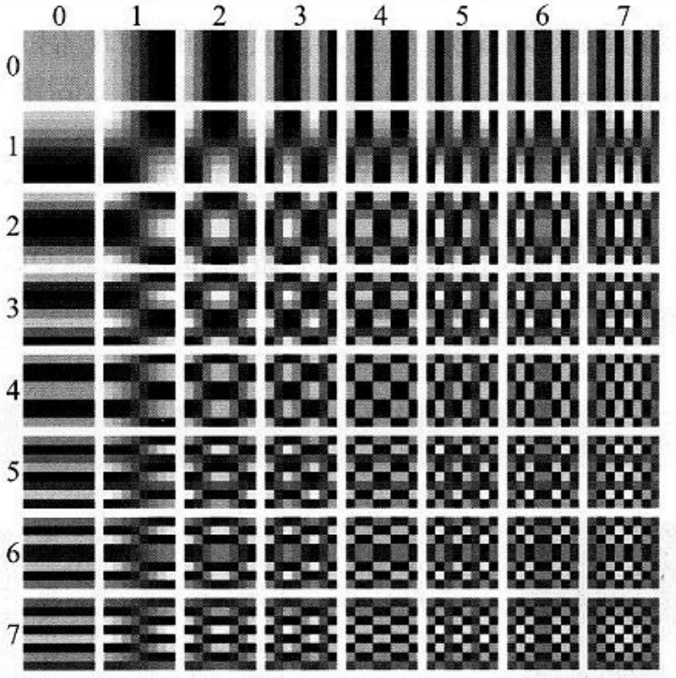
Main Profile – Interlace
Processed by 32x16 “macroblock pairs”
Alternative scan order
[5]

Slide 25
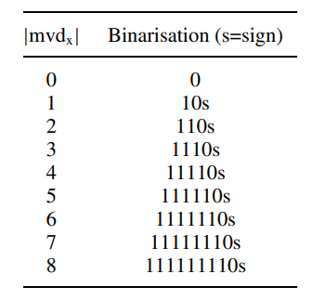
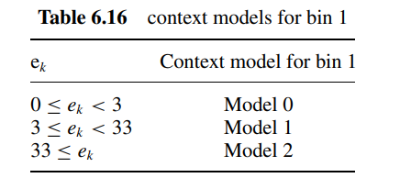
Main Profile – CABAC
Four binarization method
Unary code
Truncated unary code
kth-order Exp-Golomb code
Fixed-length code
Binarize with table when |mvdx| < 9; else use Exp-Golomb Coding
.
Scale down frequency if counts > threshold

Slide 26
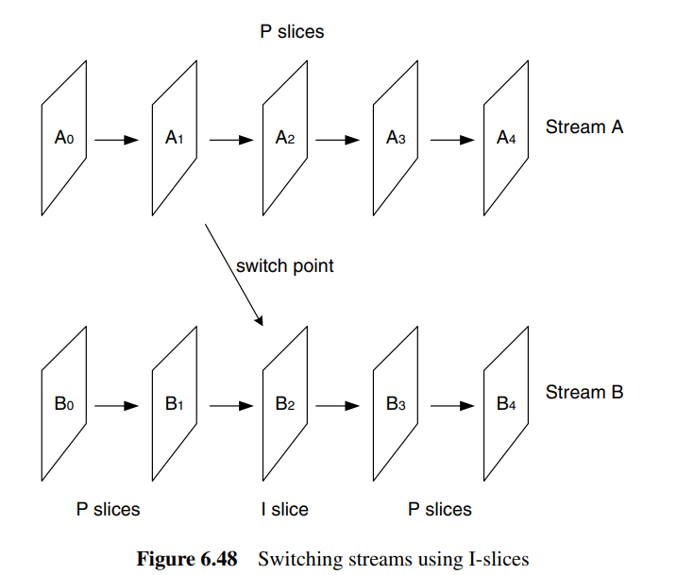
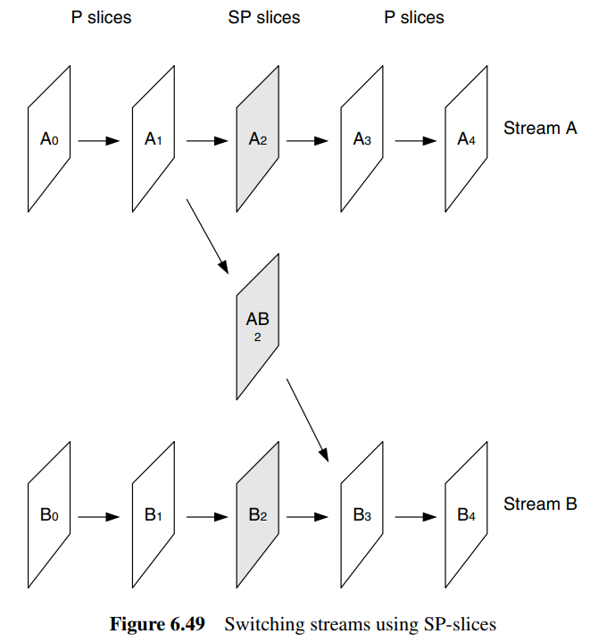
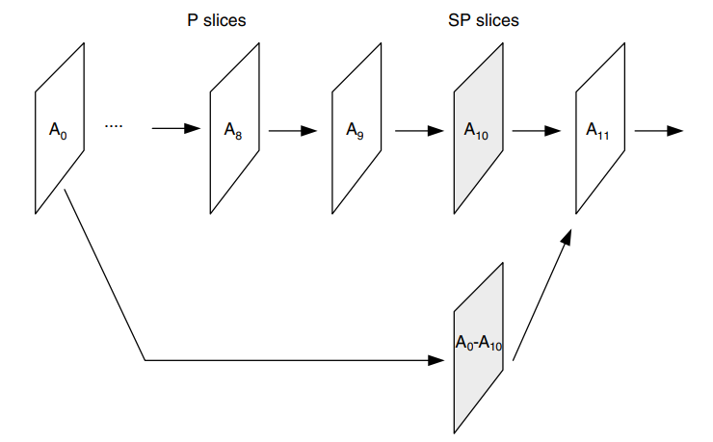
Extended Profile – SI/SP Slices
To switch between different bitrate
Fast-forward & rewind
SI can be used for different sequence

Slide 27
Error Resilience
Data partitioning
Slices / Slice groups
Arbitrary slice ordering
Flexible macroblock ordering
Redundant slices

Slide 28
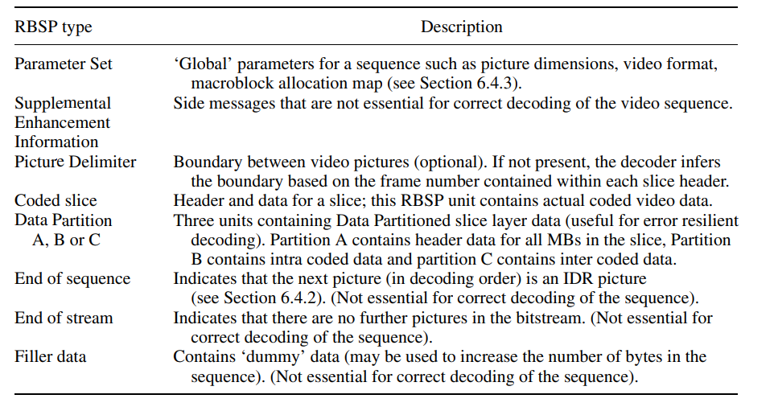
Data Transportation
Video Coding Layer (VCL)
Network Abstraction Layer (NAL)
Raw Byte Sequence Payload (RBSP) (NALU)
12 types

Slide 29
Extended Profile – Data Partitioning
Coded data is partitioned into 3 parts
A: slice header, MB header
B: residual data for intra
C: residual data for inter
Unequal protection

Slide 30
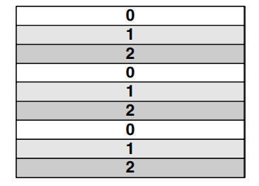
The Baseline Profile – Flexible Macroblock Ordering (FMO)
Aim to reduce error
Assign order other than the scan order (ASO)
7 types in total
6 types are defined
1 type left as user-defined
Interleaved
Dispersed
Foreground & Background

Slide 31
Conclusion
Variable block size for motion compensation
Quarter pel accuracy motion compensation
Enhanced temporal prediction
more choices on referencing frames and flexibility on ordering
In-loop deblocking filter
Spatial intra prediction
Efficient entropy coding
CAVLC, CABAC
Integer transform

Slide 32
Reference
[1] G., R.I.E. (2012) The H.264 Advanced Video Compression Standard. Chichester: Wiley.
[2] Sriram Sethuraman. Tutorial: The H.264 Advanced Video Compression Standard. Retrieved from https://www.ittiam.com/wp-content/uploads/2017/12/H.264_Advanced_video_compression_standard.pdf
[3] D. Marpe, H. Schwarz, and T. Wiegand, “Context-based adaptive binary arithmetic coding in the H.264/AVC video compression standard,” IEEE Transactions on Circuits and Systems for Video Technology, vol. 13, no. 7, pp. 620–636, Jul. 2003, doi: https://doi.org/10.1109/TCSVT.2003.815173.
[4] Anil Kumar C. “Intra Prediction Algorithm for Video Frames of H.264” Nat. Volatiles & Essent. Oils, 2021
[5] 酒井善則、吉田俊之 共著，白執善 編譯，“影像壓縮技術”，全華，2004。

