Slide 1
High Dynamic Range Imaging (HDRI)
MD531 Group Meeting 2022/12/06 吳悠嘉

Slide 2
Outline
Introduction
HDR Imaging
HDR on TVs

Slide 3
Outline
Introduction
HDR Imaging
HDR on TVs

Slide 4
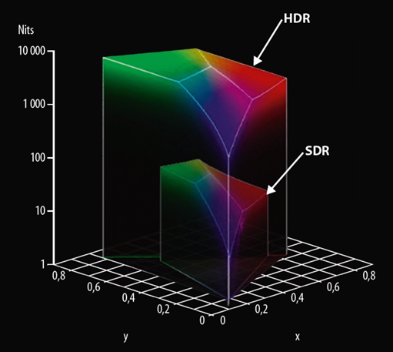
What is HDR?
HDR = High Dynamic Range
Dynamic Range: the ratio between the largest and smallest nonzero pixel values of an image
Objective: Make images as close as the true scenes seen from our eyes.
Eye can adapt radiance from ${10}^{−6}$ to ${10}^{6} {cd}/{m^{2}}$ . Picture intensity is only from 0 to 255.
[1]

Slide 5
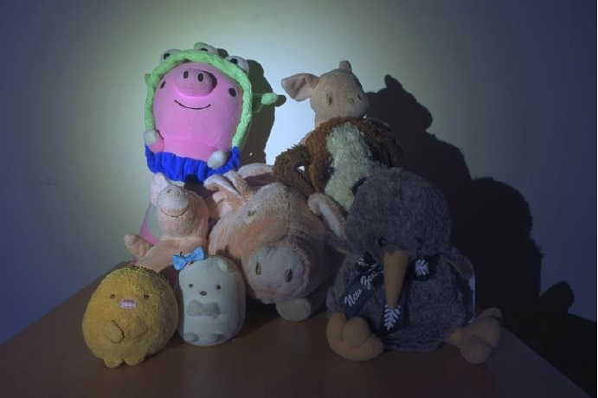
Example
Short exposure
The details of dark regions aren’t clear
Long exposure
Bright regions are too bright
HDR Image
Both bright and dark regions are clearer.

Slide 6
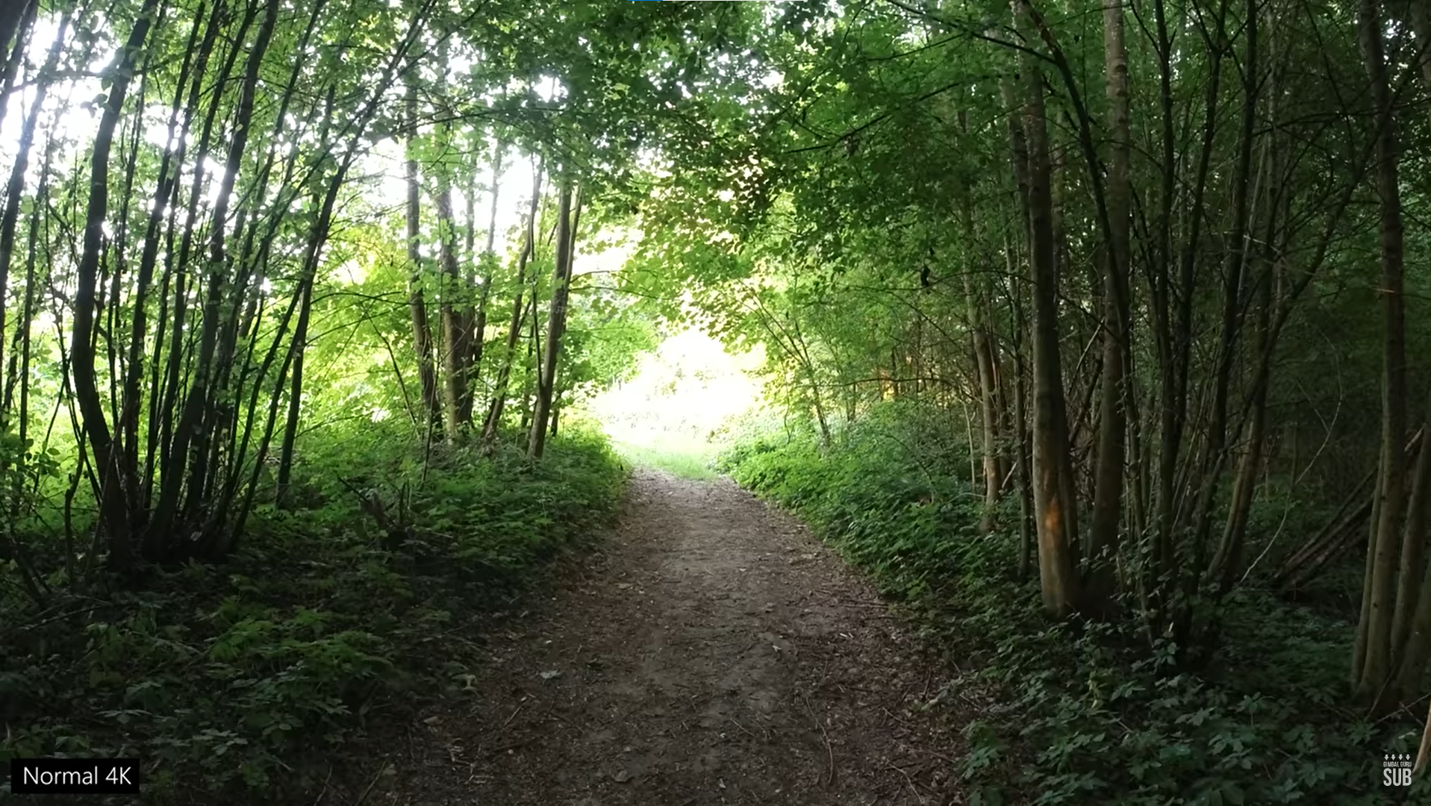
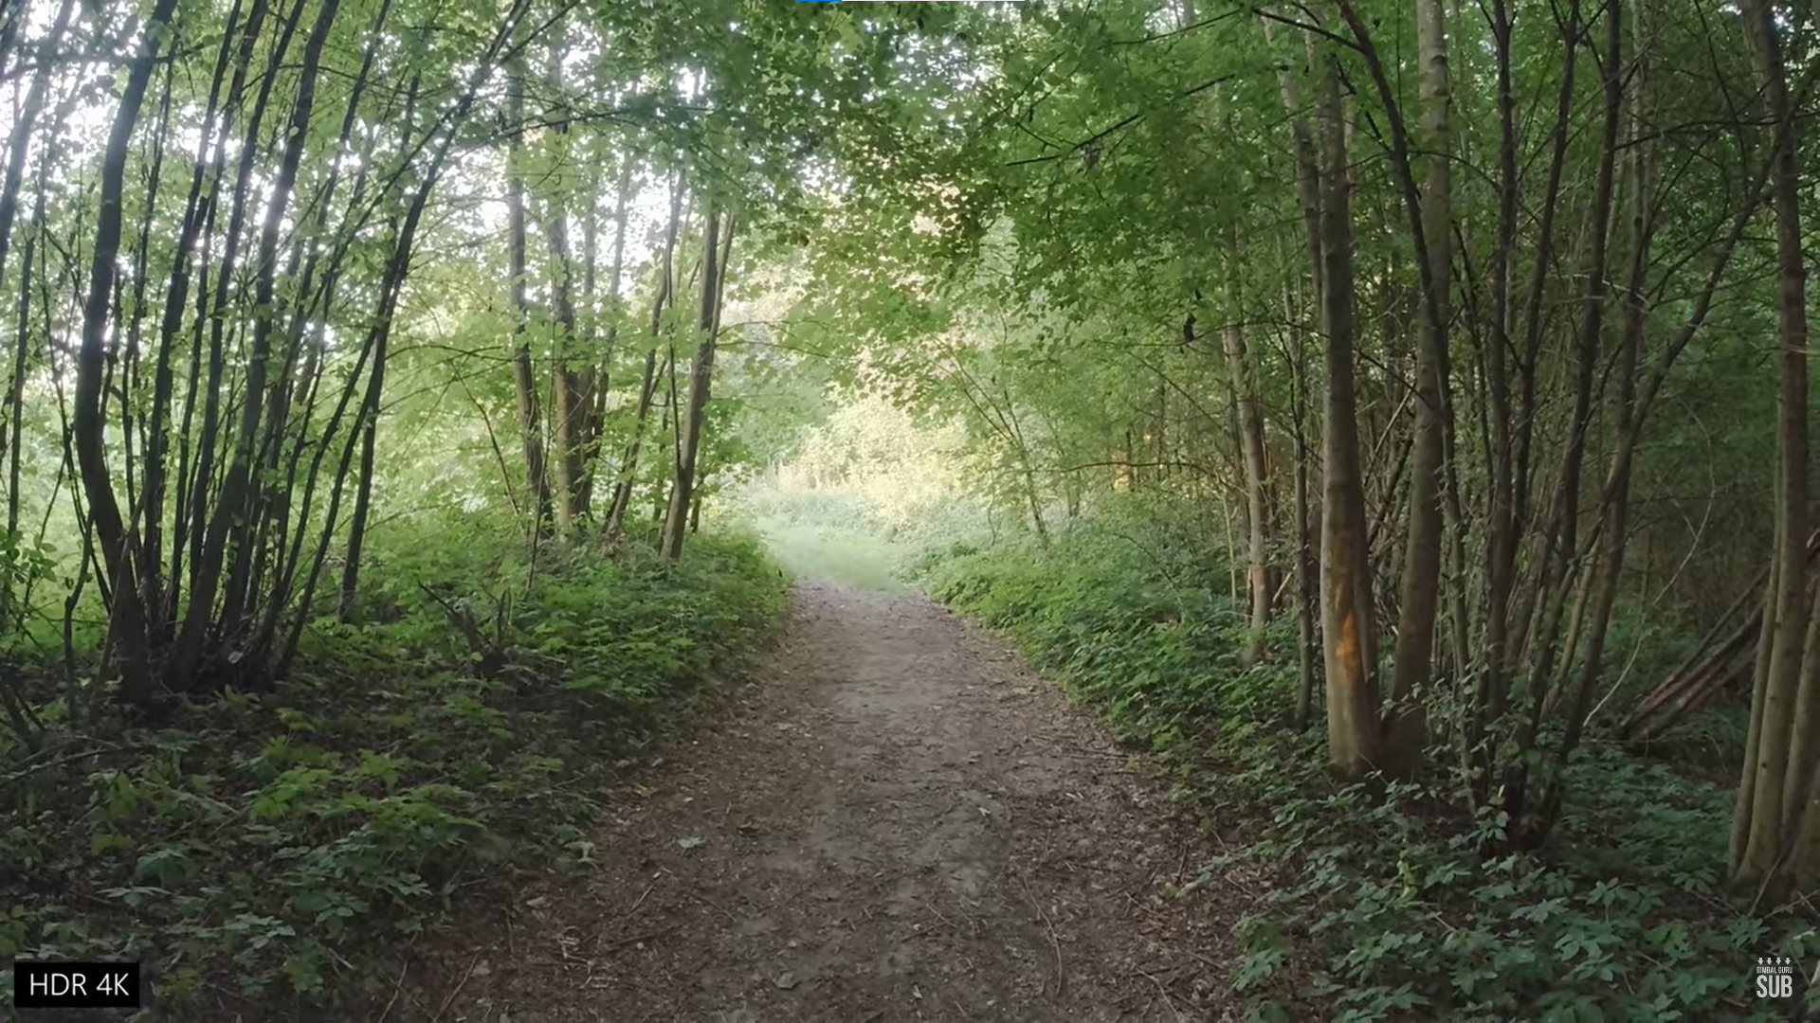
Example
[2]

Slide 7
Outline
Introduction
HDR Imaging
Typical Way for HDR Imaging
Deep Learning Method
HDR on TVs

Slide 8
Outline
Introduction
HDR Imaging
Typical Way for HDR Imaging
Deep Learning Method
HDR on TVs

Slide 9
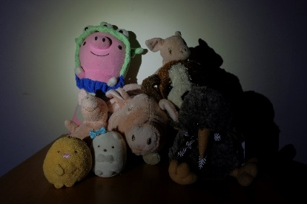
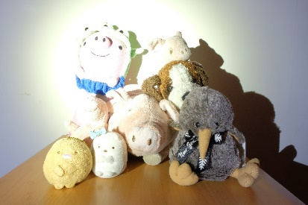
Flow for Typical HDR Imaging
Recovering High Dynamic Range Radiance Maps from Photographs [3]
Tone mapping
Input Images of different exposure
$$E$$
(irradiance)
8-bit
Output HDR image

Slide 10
Flow for Typical HDR Imaging
Recovering High Dynamic Range Radiance Maps from Photographs [3]
Tone mapping
Input Images of different exposure
$$E$$
(irradiance)
8-bit
Output HDR image

Slide 11
Recovering High Dynamic Range Radiance Maps from Photographs
Image Acquisition Pipeline
$$f$$
[3]
$$X=E∆t, where ∆t is exposure time$$
$$Z=f\left(X\right)=f\left(E∆t\right),$$
$$⇒X= f^{−1}\left(Z\right) ⇒E= \frac{f^{−1}\left(Z\right)}{∆t}$$
Known: $Z$, $∆t$
Unknown: $f$, $E$, $X$
The goal is to recover function $f.$
Then, we can get the irradiance $E$.
Notes:
Image Acquisition Pipeline shows how scene radiance becomes pixel values for both film and digital cameras

Slide 12
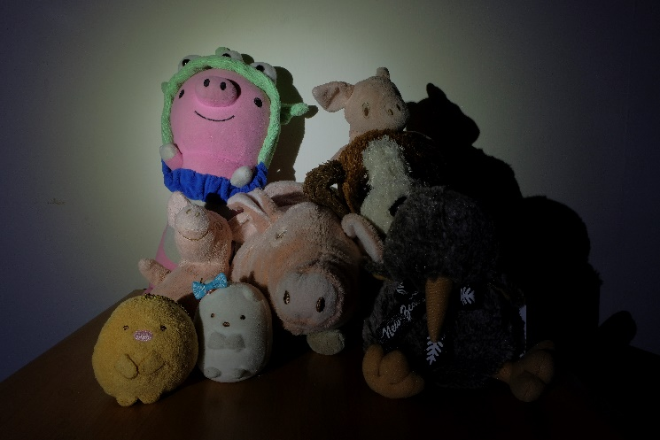
Recovering High Dynamic Range Radiance Maps from Photographs
$$Z_{31}$$
Choose some points on the pictures. For a sufficiently overdetermined system:
$$N\left(P−1\right)> Z_{max}−Z_{min} (=255)$$
$$P:\# of images, N:\# of chosen points$$
3
3
3
2
$$Z_{22}$$
2
2
1
1
1
$$∆t_{1}=0.125s$$
$$∆t_{2}=2s$$
$$∆t_{3}=30s$$
$$Z_{ij}=f(E_{i}∆t_{j})$$
$$f^{−1}\left(Z_{ij}\right)=E_{i}∆t_{j}$$
$$\ln{f^{−1}\left(Z_{ij}\right)= \ln{E_{i}}+\ln{∆t_{j}}}$$
$$g\left(Z_{ij}\right)= \ln{E_{i}}+\ln{∆t_{j}}$$
Objective Function:
$$𝒪= \sum_{i=1}^{N}{\sum_{j=1}^{P}{{[g\left(Z_{ij}\right)−\ln{E_{i}}−\ln{∆t_{j}}]}^{2}}}+ λ\sum_{z=Z_{min}+1}^{Z_{max}−1}{g^{′′}{(z)}^{2}}$$
$$g^{′′}\left(z\right)=g\left(z−1\right)−2g\left(z\right)+g(z+1)$$
$⇒$ Minimize the objective function $𝒪$
To ensure $g$ is smooth

Slide 13
Recovering High Dynamic Range Radiance Maps from Photographs
Add some constraints
The solution can be only up to a scale $g\left(Z_{mid}\right)=g(\frac{1}{2}\left(Z_{min}+Z_{max}\right))=0$
Add a hat weighting function for smoothness of $g(z)$ on extreme values
$w\left(z\right)=\left\{\begin{aligned}z−Z_{min} for z≤Z_{mid} \\ Z_{max}−z for z≥Z_{mid}\end{aligned}\right.$
$⇒$ The objective function $𝒪$becomes
$$𝒪= \sum_{i=1}^{N}{\sum_{j=1}^{P}{{\left\{w(Z_{ij})[g\left(Z_{ij}\right)−\ln{E_{i}}−\ln{∆t_{j}}]\right\}}^{2}}}+ λ\sum_{z=Z_{min}+1}^{Z_{max}−1}{{\left[w(z)g^{′′}(z)\right]}^{2}}$$

Slide 14
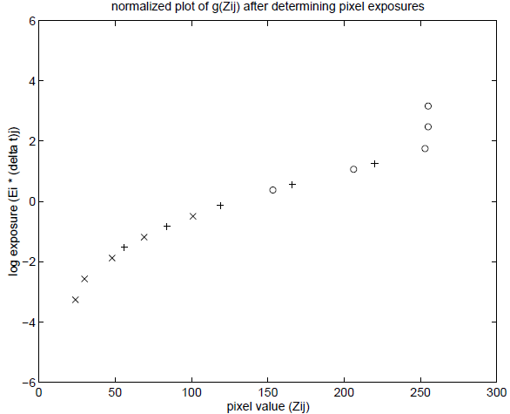
Recovering High Dynamic Range Radiance Maps from Photographs
Minimizing $𝒪$ is a linear least squares problem
$$𝒪= \sum_{i=1}^{N}{\sum_{j=1}^{P}{{\left\{w(Z_{ij})[g\left(Z_{ij}\right)−\ln{E_{i}}−\ln{∆t_{j}}]\right\}}^{2}}}+ λ\sum_{z=Z_{min}+1}^{Z_{max}−1}{{\left[w(z)g^{′′}(z)\right]}^{2}}$$
Solve by SVD
Let $g^{′′}\left(z\right)=0$
From $g\left(Z_{ij}\right)= \ln{E_{i}}+\ln{∆t_{j}}$,
$$\ln{E_{i}}=g\left(Z_{ij}\right)−\ln{∆t_{j}}$$
But for robustness
$$\ln{E_{i}}=\frac{\sum_{j=1}^{P}{w(Z_{ij})(g\left(Z_{ij}\right)−\ln{∆t_{j})}}}{\sum_{j=1}^{P}{w(Z_{ij})}}$$
$$g\left(Z_{ij}\right)= \ln{E_{i}}+\ln{∆t_{j}}$$
[3]

Slide 15
Flow for Typical HDR Imaging
Recovering High Dynamic Range Radiance Maps from Photographs
Tone mapping
Input Images of different exposure
$$E$$
(irradiance)
8-bit
Output HDR image

Slide 16
Tone Mapping（色調映射）
Although we recover the irradiance $E$, but the pixel value range of an image is still 0 to 255.
Tone mapping addresses the problem of strong contrast reduction from the scene radiance to the displayable range.
[2]

Slide 17
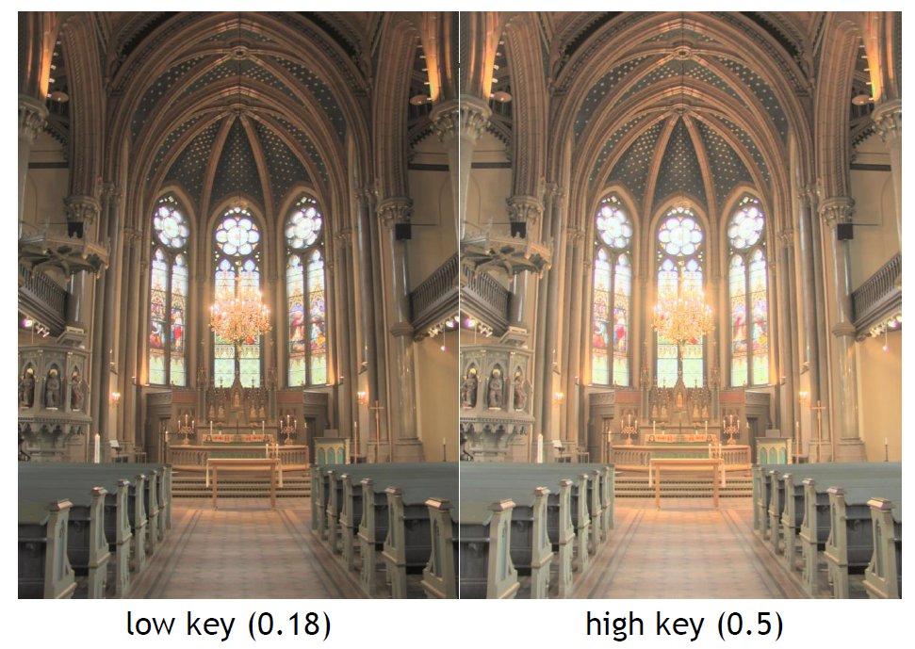
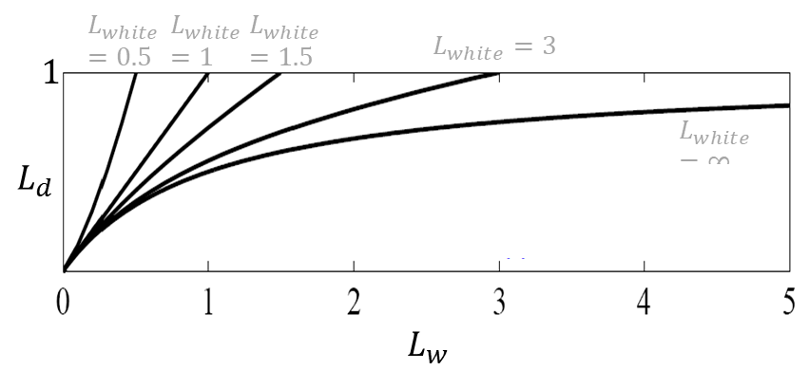
Common Methods of Tone Mapping
Global Operator
Every pixel is compressed by the same curve
$$L_{white}=∞$$
$$\overline{L_{w}}=exp\left(\frac{1}{N}\sum_{x,y}{\log\left(δ+L_{w}(x,y)\right)}\right)$$
$$L_{m}\left(x,y\right)=\frac{a}{\overline{L_{w}}}L_{w}(x,y)$$
$L_{w}$: input Luminance
$a$: User-specified key
$$L_{d}=\frac{L_{m}(x,y)\left(1+\frac{L_{m}(x,y)}{L_{white}^{2}(x,y)}\right)}{1+L_{m}(x,y)}$$
$L_{white}$: the smallest luminance to be mapped to 1
$$a$$
[4]

Slide 18
Common Methods of Tone Mapping
Local Operator
Every pixel is compressed according to luminance of surrounding areas.
Find largest surrounding area centered with $(x,y)$ without any sharp contrast
$$L_{s}^{blur}\left(x,y\right)=L_{m}\left(x,y\right)⊗G_{s}\left(x,y\right), s=1,…, N$$
$G_{s}\left(x,y\right)$ is a Gaussian kernel of a specific scale
$$V_{s}\left(x,y\right)=\frac{L_{s}^{blur}\left(x,y\right)−L_{s+1}^{blur}\left(x,y\right)}{c/{σ_{s}^{2}}+L_{s}^{blur}\left(x,y\right)}$$
Find $s_{max}$ to satisfy
$$\max_{s_{max}∈j}\left\{s_{max}\left|V_{s_{max}}\left(x,y\right)\right.<ε\right\}$$
Final display image:
$$L_{d}=\frac{L_{m}(x,y)}{1+L_{s_{max}}^{blur}\left(x,y\right)}$$
Notes:
尋找區域亮度以強化亮部壓縮的細節就是該論文重點

Slide 19
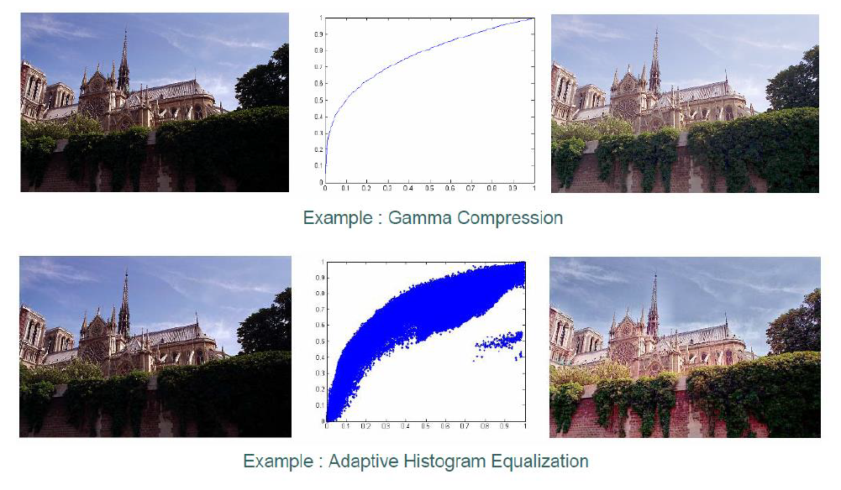
Global vs. Local
[4]

Slide 20
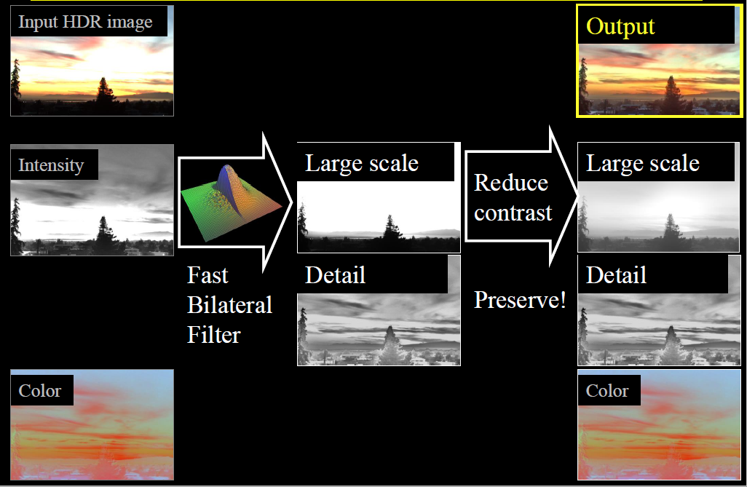
Common Methods of Tone Mapping
Fast Bilateral Filtering
[4]

Slide 21
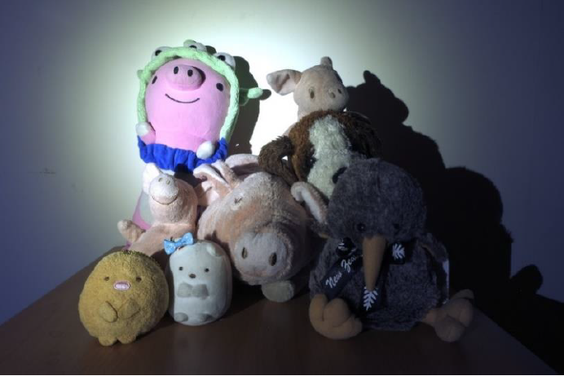
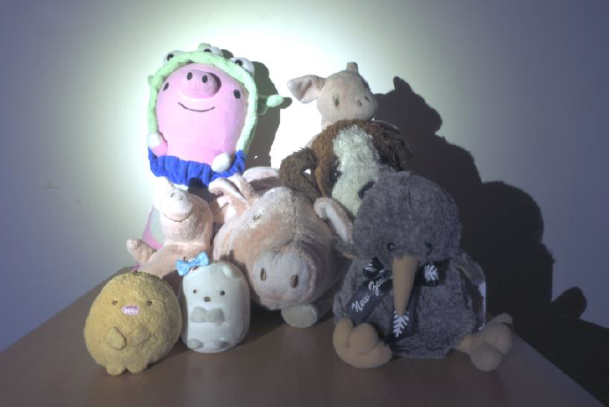
Some Results
Global Operator
Bilateral Filtering
(opencv)
OpenHDR
(convenient website)

Slide 22
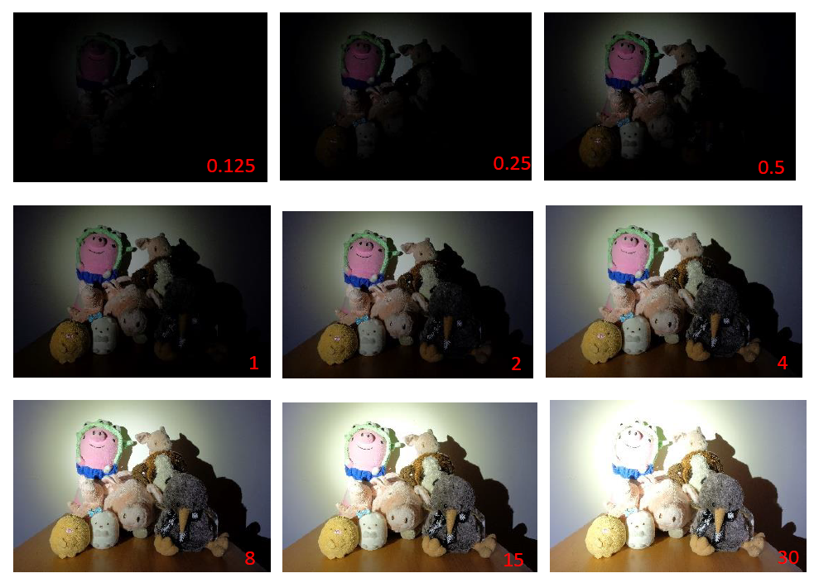
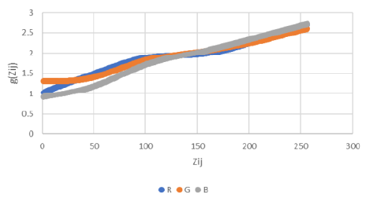
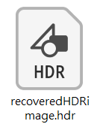
Review of the Overall Flow
Recovering High Dynamic Range Radiance Maps from Photographs
Tone mapping
Input Images of different exposure
Output HDR image
$$E$$
(irradiance)
8-bit
Recover the function $g\left(Z_{ij}\right)$ on RGB channels

Slide 23
Outline
Introduction
HDR Imaging
Typical Way for HDR Imaging
Deep Learning Methods
HDR on TVs

Slide 24
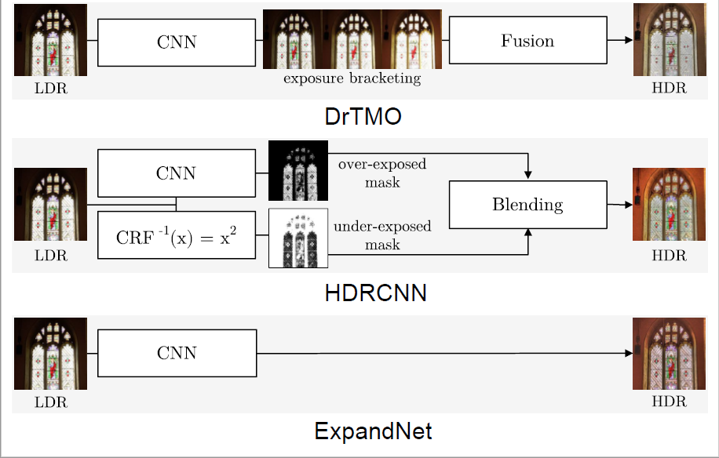
Some Deep Learning Methods
[4]

Slide 25
Outline
Introduction
HDR Imaging
HDR on TVs

Slide 26
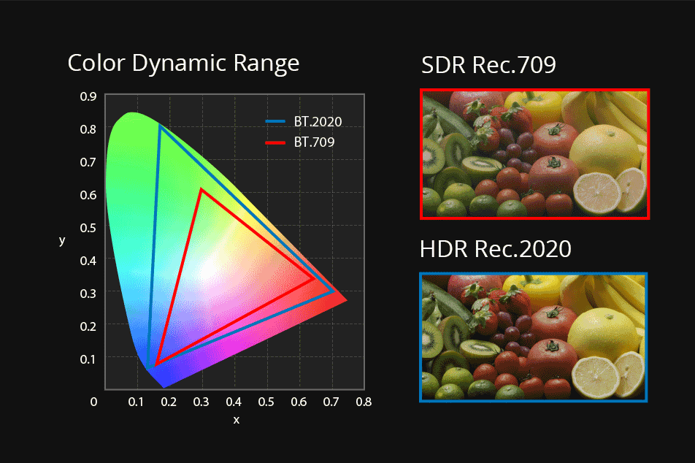
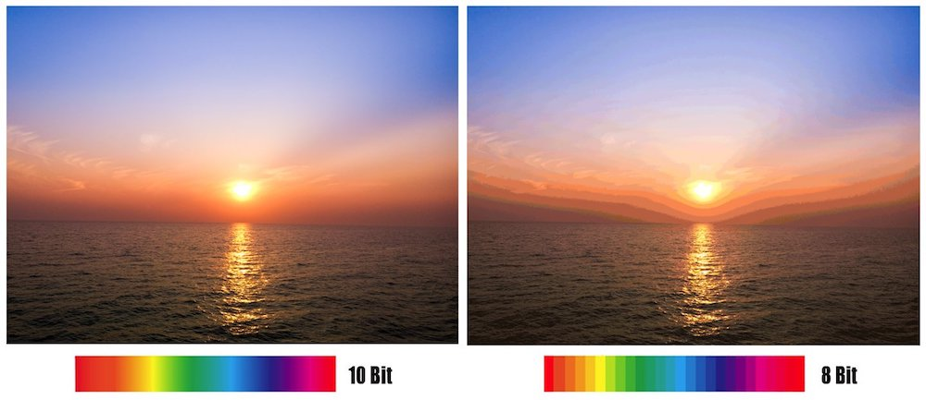
HDR on TVs
Color Gamut: BT.2020 (0.0005nit to 10000nits)
Bit Depth: 8 bits → 10 bits
Rise time
Luminance and white point accuracy
[5]
[6]
Notes:
https://proav.roland-china.com/products/v-600uhd/
https://jacksonlin.net/20180802-10bit-vs-8bit/
Bit depth 顯示器可顯示顏色數量

Slide 27
HDR Formats

Slide 28
HDR Formats
[7]
Notes:
https://www.aten.com/gb/en/aten-info/media-center/press-release/3553/

Slide 29
HDR10 vs. Dolby Vision
[8]

Slide 30
HDR Supports Status
[9]

Slide 31
Quick Review
Recovering High Dynamic Range Radiance Maps from Photographs
Common Methods for Tone Mapping (Global, Local, Bilateral Filtering)
HDR on TVs – Different HDR Formats

Slide 32
Thanks for Listening!

