Slide 1
Hadamard matrix
F05942067 華祥志

Slide 2
Outline
Hadamard matrix
Jacket matrix
Group theory
Cocycle & Coboundary
Order 12, 16

Slide 3

Hadamard matrix
H is a matrix of order n, n = 4, 8, 12, 16, …
$h_{ij}∈\left\{1,−1\right\}$
$HH^{T}=nI_{n}$
$\left(\begin{matrix}1 & 1 \\ 1 & −1\end{matrix}\right), \left(\begin{matrix}1 & 1 & 1 & 1 \\ 1 & −1 & 1 & −1 \\ 1 & 1 & −1 & −1 \\ 1 & −1 & −1 & 1\end{matrix}\right)$

Slide 4
Equivalence
$H_{1}≅H_{2} ⟺ H_{1}=PH_{2}Q$ for some {1, -1} permutation matrix P, Q

Slide 5

Jacket matrix
$A={\left[a_{ij}\right]}_{n×n}$
$A^{−1}=\frac{1}{n}{\left[\frac{1}{a_{ij}}\right]}^{T}$
$J=\left[\begin{matrix}1 & 1 & 1 & 1 \\ 1 & −x & x & −1 \\ 1 & x & −x & −1 \\ 1 & −1 & −1 & 1\end{matrix}\right], J^{−1}\left[\begin{matrix}1 & 1 & 1 & 1 \\ 1 & −\frac{1}{x} & \frac{1}{x} & −1 \\ 1 & \frac{1}{x} & −\frac{1}{x} & −1 \\ 1 & −1 & −1 & 1\end{matrix}\right]$
$\left[\begin{matrix}a & b & b & a \\ b & −c & c & −b \\ b & c & −c & −b \\ a & −b & −b & a\end{matrix}\right]$

Slide 6
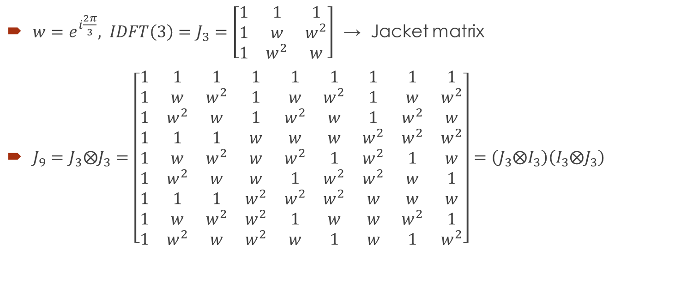
Jacket matrix
$w=e^{i\frac{2π}{3}}, IDFT\left(3\right)=J_{3}=\left[\begin{matrix}1 & 1 & 1 \\ 1 & w & w^{2} \\ 1 & w^{2} & w\end{matrix}\right]$ → Jacket matrix
$J_{9}=J_{3}⨂J_{3}=\left[\begin{matrix}1 & 1 & 1 & 1 & 1 & 1 & 1 & 1 & 1 \\ 1 & w & w^{2} & 1 & w & w^{2} & 1 & w & w^{2} \\ 1 & w^{2} & w & 1 & w^{2} & w & 1 & w^{2} & w \\ 1 & 1 & 1 & w & w & w & w^{2} & w^{2} & w^{2} \\ 1 & w & w^{2} & w & w^{2} & 1 & w^{2} & 1 & w \\ 1 & w^{2} & w & w & 1 & w^{2} & w^{2} & w & 1 \\ 1 & 1 & 1 & w^{2} & w^{2} & w^{2} & w & w & w \\ 1 & w & w^{2} & w^{2} & 1 & w & w & w^{2} & 1 \\ 1 & w^{2} & w & w^{2} & w & 1 & w & 1 & w^{2}\end{matrix}\right]=\left(J_{3}⨂I_{3}\right)\left(I_{3}⨂J_{3}\right)$

Slide 7
Group
(G, ‧ ) or (G, + ) is called a group, if
$a,b∈G⇒a⋅b$ $∈G$
$a,b,c∈G⇒\left(a⋅b\right)⋅c=a⋅\left(b⋅c\right)$
$∃1∈G, s.t. a⋅1=1⋅a=a$
$∀a∈G, ∃b∈G, s.t. a⋅b=b⋅a=1$
e.g. non-zero real numbers, non-singular matrices

Slide 8
Group
Cyclic group $\left(ℤ_{n},\text{+}\right)$
$ℤ_{n}=\left\{x | 0≤x≤n−1\right\}, x+y=\left(x+y\right)\left(mod n\right)$
$ℤ_{2}=\left\{0,1\right\}, 0+0=0, 0+1=1, 1+1=0$
Binary number with bitwise-XOR
$ℤ_{2}×ℤ_{2}×ℤ_{2}×…×ℤ_{2}×ℤ_{2}$, direct product
$\left(a,b,c\right)+\left(d,e,f\right)=\left(a+d,b+e,c+f\right)$

Slide 9

$$ℤ_{3}×ℤ_{3}$$
$G=ℤ_{3}×ℤ_{3}=\left\{\begin{aligned}g_{1}=\left(0,0\right),g_{2}=\left(0,1\right),g_{3}=\left(0,2\right),g_{4}=\left(1,0\right),g_{5}=\left(1,1\right), \\ g_{6}=\left(1,2\right),g_{7}=\left(2,0\right),g_{8}=\left(2,1\right),g_{9}=\left(2,2\right)\end{aligned}\right\}$
$j_{m,n}=w^{\left\langle g_{m},g_{n}\right\rangle }$
$j_{5,6}=w^{\left\langle g_{5},g_{6}\right\rangle }=w^{\left\langle \left(1,1\right),\left(1,2\right)\right\rangle }=w^{1+2}=w^{0}=1$

Slide 10

Cocycle
Finite group G
Finitely generated abelian group C
$ψ:G×G→C$
$ψ\left(a,b\right)ψ\left(ab,c\right)=ψ\left(a,bc\right)ψ\left(b,c\right), ∀a,b,c∈G$
$J=\left[ψ\left(g_{m},g_{n}\right)\right]$

Slide 11

Cocycle
$ψ:\left(ℤ_{3}×ℤ_{3}\right)×\left(ℤ_{3}×ℤ_{3}\right)→\left\{1,w,w^{2}\right\}$
$ψ\left(a,b\right)=w^{\left\langle a,b\right\rangle }$
Check: $ψ\left(a,b\right)ψ\left(a+b,c\right)=ψ\left(a,b+c\right)ψ\left(b,c\right)$
$w^{\left\langle a,b\right\rangle +\left\langle a+b,c\right\rangle }=w^{\left\langle a,b\right\rangle +\left\langle a,c\right\rangle +\left\langle b,c\right\rangle }=w^{\left\langle a,b+c\right\rangle +\left\langle b,c\right\rangle }$

Slide 12

Cocycle
The set of all cocycles with
$\left(ψ_{1}∙ψ_{2}\right)\left(a,b\right)=ψ_{1}\left(a,b\right)ψ_{2}\left(a,b\right)$
forms an abelian group $Z^{2}\left(G,C\right)$

Slide 13
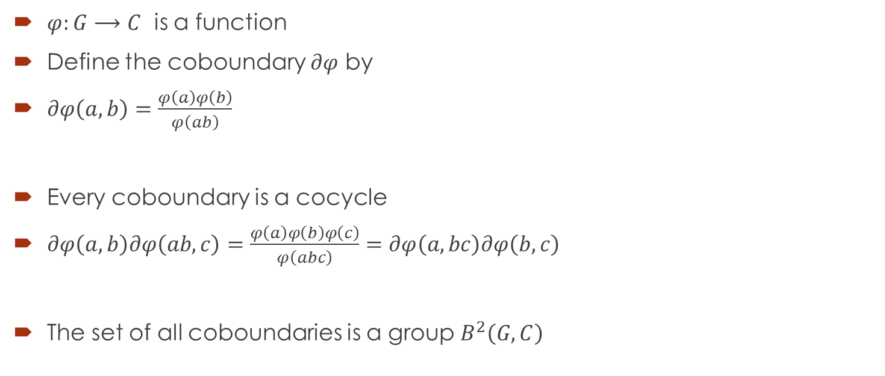
Coboundary
$φ:G⟶C$ is a function
Define the coboundary $∂φ$ by
$∂φ\left(a,b\right)=\frac{φ\left(a\right)φ\left(b\right)}{φ\left(ab\right)}$
Every coboundary is a cocycle
$∂φ\left(a,b\right)∂φ\left(ab,c\right)=\frac{φ\left(a\right)φ\left(b\right)φ\left(c\right)}{φ\left(abc\right)}=∂φ\left(a,bc\right)∂φ\left(b,c\right)$
The set of all coboundaries is a group $B^{2}\left(G,C\right)$

Slide 14

orthogonality
$\left\langle row a, row c\right\rangle$
$=\sum_{b∈G}{ψ\left(a,b\right)ψ\left(c,b\right)}$
$=\sum_{b∈G}{ψ\left(a,b\right)ψ\left(ca^{−1}⋅a,b\right)}$
$=\sum_{b∈G}{ψ\left(ca^{−1},a\right)ψ\left(ca^{−1},a⋅b\right)}$
$=ψ\left(ca^{−1},a\right)\sum_{b∈G}{ψ\left(1,ab\right)ψ\left(ca^{−1},ab\right)}$
$=ψ\left(ca^{−1},a\right)\sum_{d∈G}{ψ\left(1,d\right)ψ\left(ca^{−1},d\right)}$
$=±\left\langle row 1, row ca^{−1}\right\rangle$

Slide 15

Sylvester construction
$H_{2}=\left[\begin{matrix}1 & 1 \\ 1 & −1\end{matrix}\right]$
$H_{2^{n}}=H_{2^{n−1}}⊗H_{2}=H_{2}⊗H_{2}⊗…⊗H_{2}$
Cocyclic:
$ψ:{\left(ℤ_{2}\right)}^{n}×{\left(ℤ_{2}\right)}^{n}→\left\{1,−1\right\}$
$ψ\left(a,b\right)={\left(−1\right)}^{\left\langle a,b\right\rangle }$

Slide 16
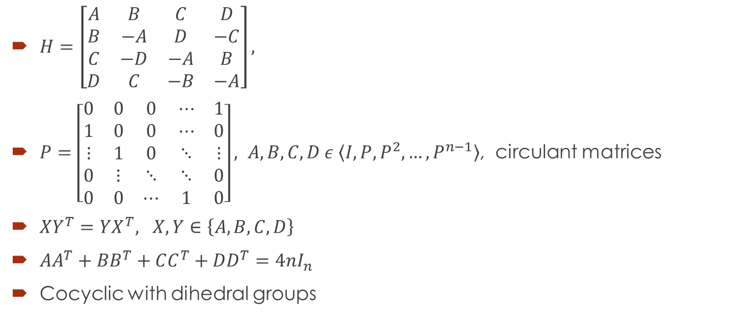
The Williamson construction
$H=\left[\begin{matrix}A & B & C & D \\ B & −A & D & −C \\ C & −D & −A & B \\ D & C & −B & −A\end{matrix}\right],$
$P=\left[\begin{matrix}0 & 0 & 0 & ⋯ & 1 \\ 1 & 0 & 0 & ⋯ & 0 \\ ⋮ & 1 & 0 & ⋱ & ⋮ \\ 0 & ⋮ & ⋱ & ⋱ & 0 \\ 0 & 0 & ⋯ & 1 & 0\end{matrix}\right], A,B,C,D ε \left\langle I,P,P^{2},…,P^{n−1}\right\rangle$, circulant matrices
$XY^{T}=YX^{T}, X,Y∈\left\{A,B,C,D\right\}$
$AA^{T}+BB^{T}+CC^{T}+DD^{T}=4nI_{n}$
Cocyclic with dihedral groups

Slide 17
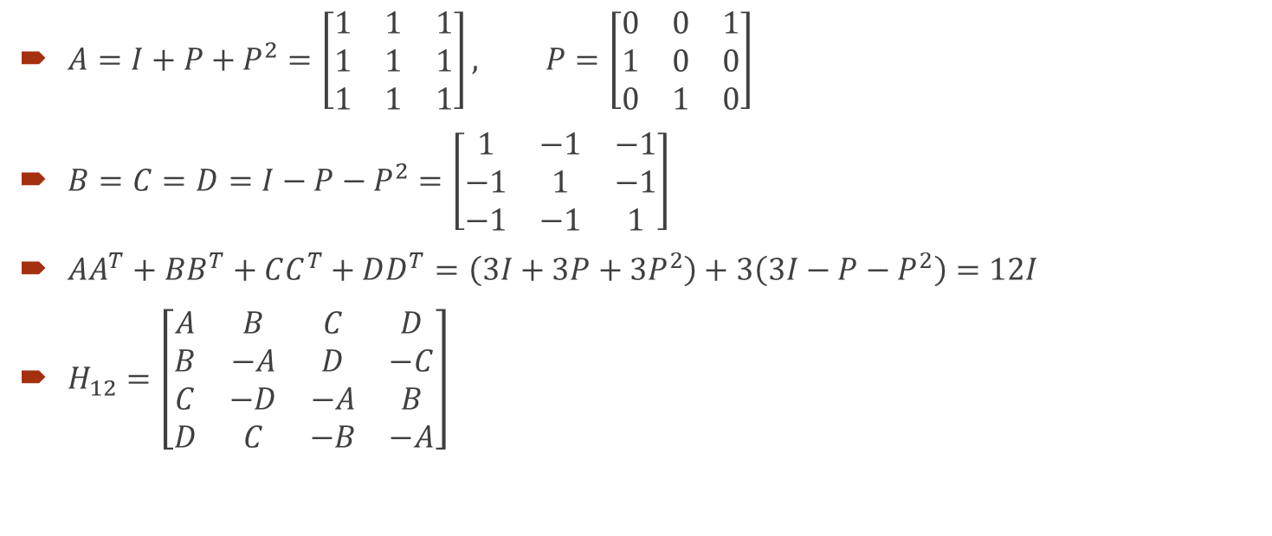
The Williamson construction
$A=I+P+P^{2}=\left[\begin{matrix}1 & 1 & 1 \\ 1 & 1 & 1 \\ 1 & 1 & 1\end{matrix}\right], P=\left[\begin{matrix}0 & 0 & 1 \\ 1 & 0 & 0 \\ 0 & 1 & 0\end{matrix}\right]$
$B=C=D=I−P−P^{2}=\left[\begin{matrix}1 & −1 & −1 \\ −1 & 1 & −1 \\ −1 & −1 & 1\end{matrix}\right]$
$AA^{T}+BB^{T}+CC^{T}+DD^{T}=\left(3I+3P+3P^{2}\right)+3\left(3I−P−P^{2}\right)=12I$
$H_{12}=\left[\begin{matrix}A & B & C & D \\ B & −A & D & −C \\ C & −D & −A & B \\ D & C & −B & −A\end{matrix}\right]$

Slide 18

Dihedral group $D_{2n}$
a: rotation 45°(counterclockwise)
b: reflection
$ab=ba^{7}≠ba$
$bab=a^{7}$
$D_{2n}=\left\langle a,b | a^{n}=b^{2}=1,bab=a^{−1}\right\rangle$
$1 a a^{2} a^{3} a^{4} a^{5} a^{6} a^{7}$
$b ba ba^{2} ba^{3} ba^{4} ba^{5} ba^{6} ba^{7}$

Slide 19
16x16 Hadamard matrix
5 equivalent 16x16 Hadamard matrices
all are cocyclic

Slide 20
Reference
[1] Chen, Zhu, et al. "Fast cocyclic Jacket transform based on DFT." Communications, 2008. ICC'08. IEEE International Conference on. IEEE, 2008.
[2] Álvarez Solano, Víctor, et al. "The homological reduction method for computing cocyclic Hadamard matrices." Journal of Symbolic Computation 44.5 (2009): 558-570.
[3] Horton, Jeffrey, Christos Koukouvinos, and Jennifer Seberry. "A search for Hadamard matrices constructed from Williamson matrices." (2002).
[4] Flannery, D. L. "Cocyclic Hadamard matrices and Hadamard groups are equivalent." Journal of Algebra 192.2 (1997): 749-779.
[5] Baliga, A., and K. J. Horadam. "Cocyclic Hadamard matrices over Zt x Z~." Australasian Journal of Combinatorics 51 (1995): 123-134.

Slide 21
Reference
[6] Álvarez, Víctor, et al. "An algorithm for computing cocyclic matrices developed over some semidirect products." International Symposium on Applied Algebra, Algebraic Algorithms, and Error-Correcting Codes. Springer, Berlin, Heidelberg, 2001.
[7] Horadam, Kathy J. "An introduction to cocyclic generalised Hadamard matrices." Discrete applied mathematics 102.1-2 (2000): 115-131.

