Slide 1
Hand Gesture Recognition
Speaker: 李奕承
Date:2019/2/15

Slide 2
Outline
1. Introduction
2. Related work in model selection
3. Collect data and do some experiment
4. Our proposed model
5. Reference

Slide 3
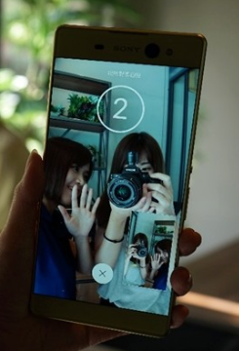
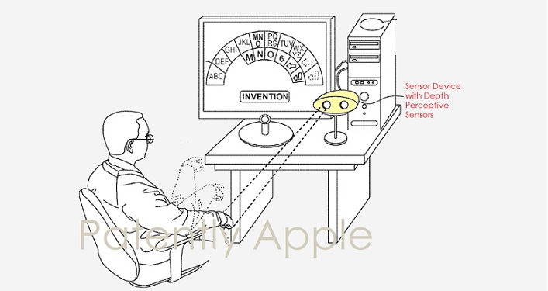
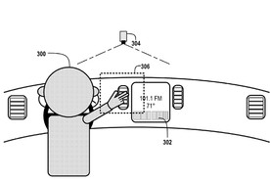
1.Introduction
1. Remote input in Apple's notebook through TrueDepth camera system
2. Touch-free Car control
3. Selfie hand gesture on the Sony Xperia XA Ultra
Notes:
https://technews.tw/2018/03/05/apple-patent-truedepth-remote-input/
https://agirls.aotter.net/post/50298
https://www.techbang.com/posts/15068-google-wants-to-develop-vehicles-with-gesture-control-sliding-his-hand-it-is-possible-to-switch-radio-stations-lifting-windows

Slide 4
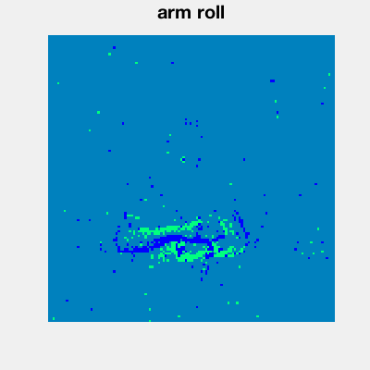
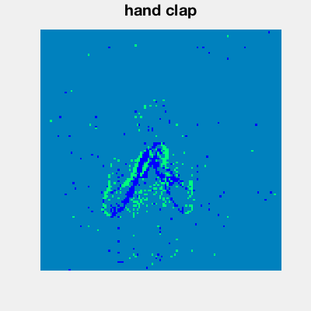
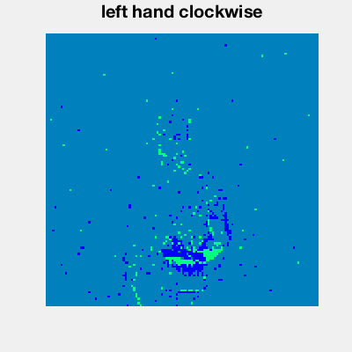
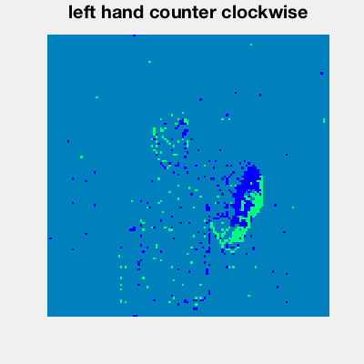
2.Related dataset
1. The 20BN-jester Dataset V1
2. IBM DVS128 Gesture Dataset (CVPR 2017)
Notes:
https://20bn.com/datasets/jester
A Low Power, Fully Event-Based Gesture Recognition System

Slide 5
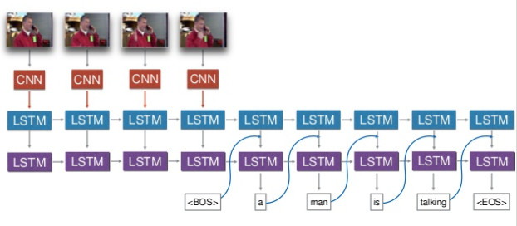
2.Related work in model selection
(a) Sequence to Sequence - Video to Text
Jeff Donahue(2015 CVPR)
Notes:
https://research.nvidia.com/sites/default/files/pubs/2015-06_Hand-Gesture-Recognition/CVPRW2015-3DCNN.pdf

Slide 6
2.Related work in model selection
(b) Hand Gesture Recognition with 3D Convolutional Neural Networks
Pavlo Molchanov, Shalini Gupta, Kihwan Kim, and Jan Kautz NVIDIA, Santa Clara, California, USA (2015 CVPR)
Notes:
https://research.nvidia.com/sites/default/files/pubs/2015-06_Hand-Gesture-Recognition/CVPRW2015-3DCNN.pdf

Slide 7
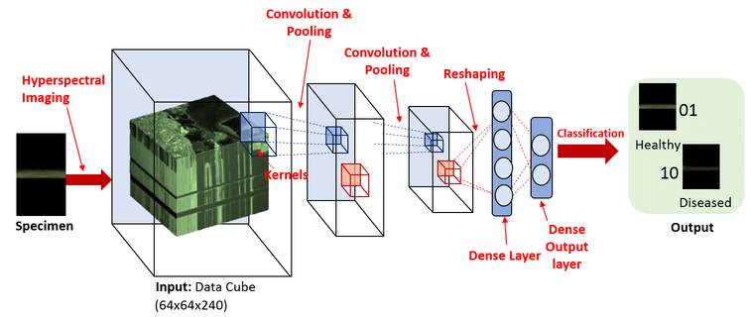
2.Related work in model selection
(b) Hand Gesture Recognition with 3D Convolutional Neural Networks
Pavlo Molchanov, Shalini Gupta, Kihwan Kim, and Jan Kautz NVIDIA, Santa Clara, California, USA (2015 CVPR)
Notes:
https://research.nvidia.com/sites/default/files/pubs/2015-06_Hand-Gesture-Recognition/CVPRW2015-3DCNN.pdf

Slide 8
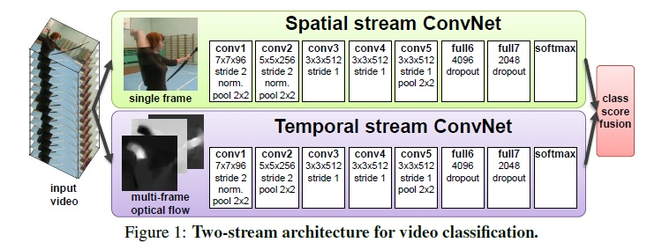
2.Related work in model selection
(c) Convolutional Two-Stream Network Fusion for Video Action Recognition
Christoph Feichtenhofer, Axel Pinz, and Andrew Zisserman(2016 CVPR)
Notes:
有些action的识别依赖单张图像就够，有些则必须依赖运动和时间特征
多张相邻帧的光流，对motion特征进行表示

Slide 9
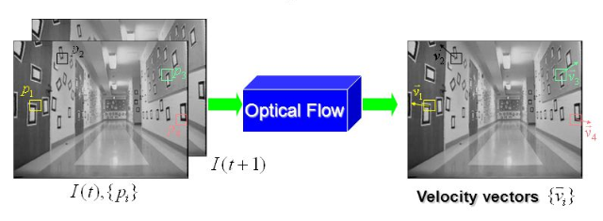
2.Related work in model selection
(c) Convolutional Two-Stream Network Fusion for Video Action Recognition
What is Optical flow?
Notes:
https://slideplayer.com/slide/5034827/16/images/5/What+is+Optical+Flow+Optical+Flow.jpg

Slide 10
2.Related work in model selection
(d) Quo Vadis, Action Recognition? A New Model and the Kinetics Dataset (CVPR 2017)
https://arxiv.org/pdf/1705.07750.pdf
Notes:
https://slideplayer.com/slide/5034827/16/images/5/What+is+Optical+Flow+Optical+Flow.jpg
CVPR deepmind

Slide 11
Thank you !!
Notes:
https://www.youtube.com/watch?v=vd0czNKL1DE&feature=youtu.be

