Slide 1
Introduction to Principle Component Analysis
葉明昌

Slide 2
Motivation
When I consider what to say at group meeting
Image processing on C/C++, PCA, part of my work, etc.
Search PCA on Google scholar and find a interesting result
And PCA is a frequently mentioned method
But what behind it?

Slide 3
Outline
Goal of PCA
Geometrical meaning of PCA
Some simple mathematical interpretation
Example of application
Focus on the part I used on my work

Slide 4
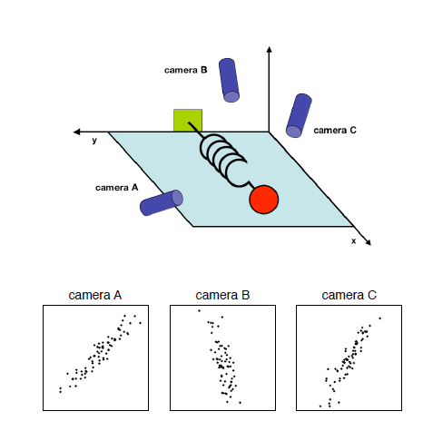
Goal
Given a data table(matrix) X, we want to
Reduce its dimension (Redundant dimension)
Find a principle component
e.g. the right scenario
Noisy spring oscillation
Three randomly put cameras
We can record 6 data for a single moment
Ax, Ay, Bx, By, Cx, Cy
Source:[1]

Slide 5
Framework
Ax, Ay, Bx, By, Cx, Cy → […]
A kind of “change of basis”
Can be rewrite as
$$PX=Y (1)$$
Here, X is an m*n data matrix
m=variables, n=samples
The m rows of P should be a set of new orthonormal basis

Slide 6
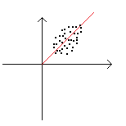
Framework
The right example can modeled as
$X_{example}=\left[\begin{matrix}x_{1} & x_{2} & … & x_{n} \\ y_{1} & y_{2} & … & y_{n}\end{matrix}\right]$
A new basis is
$P_{example}=\frac{1}{\sqrt{2}}\left[\begin{matrix}1 & 1 \\ 1 & −1\end{matrix}\right]$
We can discard one basis (1, -1)
And then the reduction of dimension is done

Slide 7
Covariance Matrix
Let $\overline{X}$ be a matrix that the mean of every variable is 0, e.g.
$${\overline{X}}_{example}=\left[\begin{matrix} (x_{1} & x_{2} & … & x_{n}) \\ (y_{1} & y_{2} & … & y_{n})\end{matrix}\right]−\left[\begin{matrix}\overline{x} \\ \overline{y}\end{matrix}\begin{matrix} … \\ …\end{matrix}\begin{matrix}\overline{ x} \\ \overline{ y}\end{matrix}\right]$$
Then the covariance of $i^{th}$ and $j^{th}$ variable is $\frac{1}{n}\sum_{k=1}^{n}{x_{ik}x_{jk}}$
Generalize…
$C_{\overline{X}}=\frac{1}{n}\overline{X}{\overline{X}}^{T}$
$C_{\overline{X}}$ is the covariance matrix of X
Value at $i^{th}$ row, $j^{th}$ column ($C_{{\overline{X}}_{ij}}$) means the covariance of $i^{th}$ and $j^{th}$ variable
What we want the transformed data table, i.e., Y, to be?

Slide 8
SNR & Redundancy
Assume $\overline{X}=Y_{1}+η_{1}=Y_{1}+Y_{2}+η_{2}=…$
$\sum{Y_{i}}$ is an approximated matrix and the rest is viewed as noise
The lower the noise is, the better the approximation becomes (more “principle”)
High SNR → Large variance for the signal
Note that variance of $i^{th}$ variable after some basis change is $C_{Y_{ii}}$
which is on diagonal (2)
When $|C_{Y_{ij}}|$ increase (i != j)
One variable is more predictable when given the other
So we need to minimize it, i.e., set it to 0 (uncorrelated) (3)
By (1) to (3), we can make a conclusion
PCA is to find a change of basis such that $C_{Y}$ is a diagonal matrix

Slide 9
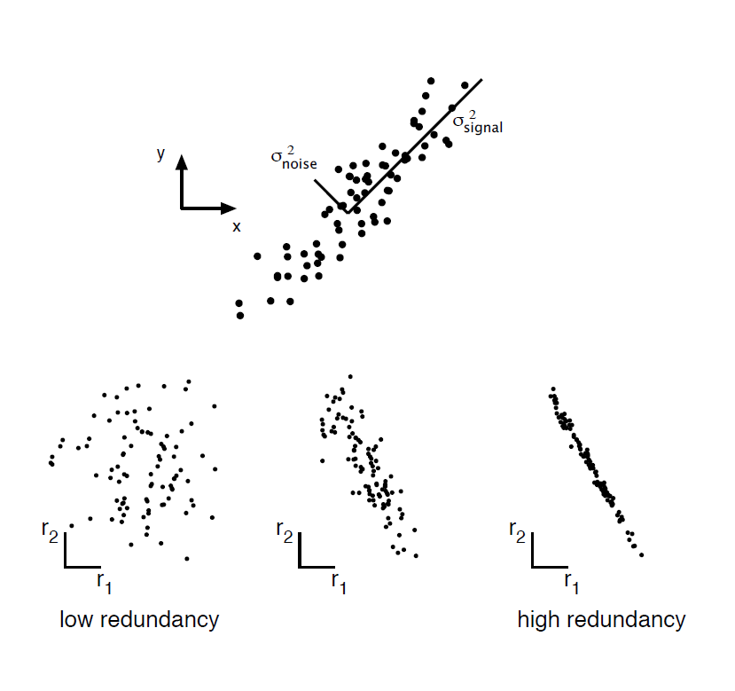
SNR & Redundancy
Scatter plot of data points.
Analogy to SNR
Extract two different variables of
each sample
Source:[1]

Slide 10
PCA by Eigenvalue Decomposition
$$Recall we set PX=Y$$
$$And diagonal C_{Y}=\frac{1}{n}YY^{T}=\frac{1}{n}PXX^{T}P^{T}=PC_{X}P^{T}$$
$$C_{X}=P^{T}C_{Y}P if P orthonormal$$
$$PCA can be performed by finding EVD of the covariance matrix$$
$$Back to PX=Y$$
$$Rows in P should be principle components\left(and eigenvectors\right)of X$$
$$Values ofC_{Y}are corresponding eigenvalue$$
For convenience, no “bar notation” here

Slide 11
PCA by SVD
Change X to be an n*m zero-mean data matrix
n still be number of samples, m still be number of variables
$$SVD: X=USV^{H}$$
Recall what is V’s property:
$$X^{H}X=VDV^{H}$$
$X^{H}X$ is the covariance matrix here
The same form as $C_{X}=P^{T}C_{Y}P$
So the columns of V should be PCs of X, and diag of D should be eigenvalues

Slide 12
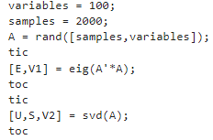

EVD vs SVD
When m large, generate covariance matrix takes enormous time
However, in some algorithm of SVD[3], $X^{H}X$ is not calculated directly
Experiment on Matlab is on next page
As number of variables increases, computation time of EVD sharply increases
Number of samples affect SVD more than EVD

Slide 13
EVD vs SVD
200 samples | EVD | SVD
100 variables | 1ms | 3ms
200 variables | 2ms | 4ms
500 variables | 12ms | 7ms
1k variables | 45ms | 15ms
2k variables | 280ms | 40ms
5k variables | 6.6s | 180ms
500 samples | EVD | SVD
100 variables | 1ms | 3ms
200 variables | 2ms | 7ms
500 variables | 12ms | 23ms
1k variables | 47ms | 40ms
2k variables | 300ms | 90ms
5k variables | 6.7s | 380ms
1k samples | EVD | SVD
100 variables | 1ms | 8ms
200 variables | 2ms | 15ms
500 variables | 12ms | 42ms
1k variables | 55ms | 130ms
2k variables | 310ms | 250ms
5k variables | 6.8s | 780ms
2k samples | EVD | SVD
100 variables | 1ms | 20ms
200 variables | 3ms | 40ms
500 variables | 17ms | 90ms
1k variables | 65ms | 250ms
2k variables | 390ms | 1s
5k variables | 7s | 2.3s

Slide 14
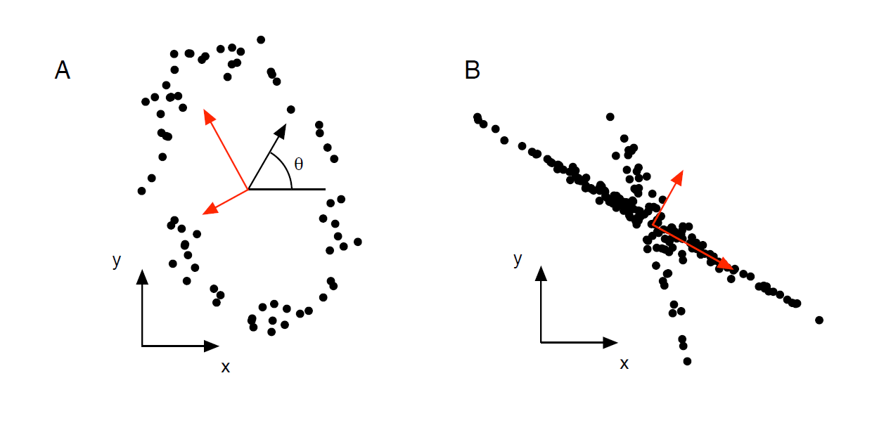
PCA’s Properties
Simply gives an analytic solution about the feature of data
No additional parameter
May not be the best method for like the following two cases
Source:[1]
However, if we want to find a match ellipse,
PCA can still be applied on case A

Slide 15
Application
Machine Learning
Extract feature
Reduce Dimension
Speed up the training process
Regression
Ellipse matching
Many topic using statistic
Find the hidden pattern

Slide 16
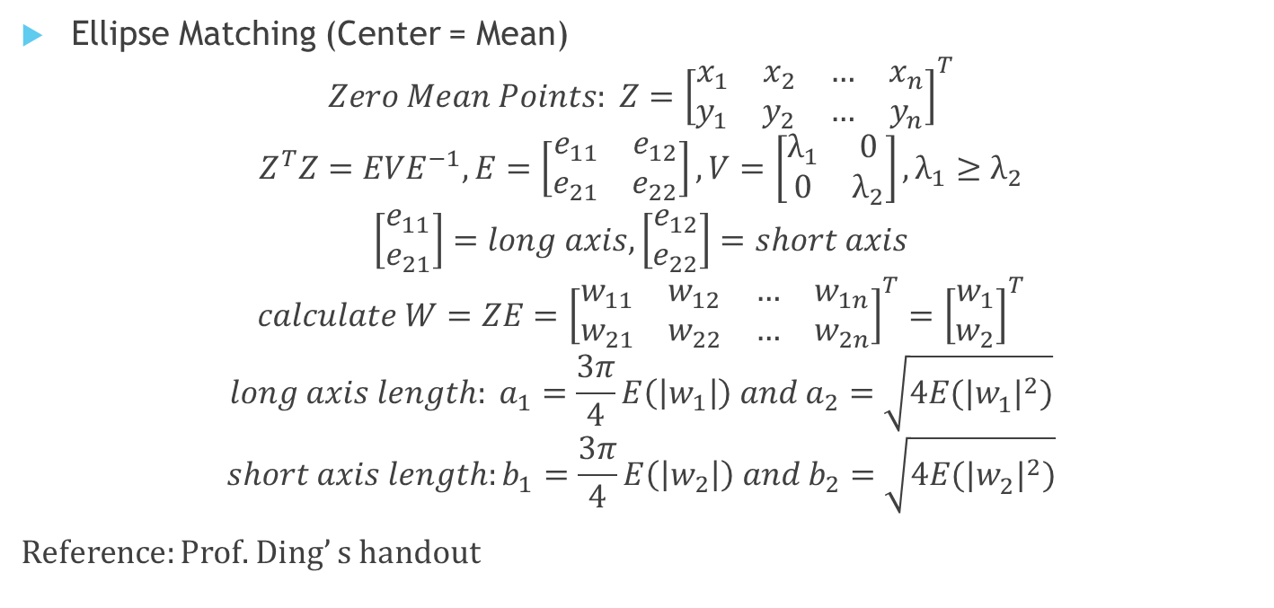
Example
Ellipse Matching (Center = Mean)
$$Zero Mean Points: Z={\left[\begin{matrix}x_{1} & x_{2} & … & x_{n} \\ y_{1} & y_{2} & … & y_{n}\end{matrix}\right]}^{T}$$
$$Z^{T}Z=EVE^{−1}, E=\left[\begin{matrix}e_{11} & e_{12} \\ e_{21} & e_{22}\end{matrix}\right], V=\left[\begin{matrix}λ_{1} & 0 \\ 0 & λ_{2}\end{matrix}\right],λ_{1}≥λ_{2}$$
$$\left[\begin{matrix}e_{11} \\ e_{21}\end{matrix}\right]=long axis,\left[\begin{matrix}e_{12} \\ e_{22}\end{matrix}\right]=short axis$$
$$calculate W=ZE={\left[\begin{matrix}w_{11} & w_{12} & … & w_{1n} \\ w_{21} & w_{22} & … & w_{2n}\end{matrix}\right]}^{T}={\left[\begin{matrix}w_{1} \\ w_{2}\end{matrix}\right]}^{T}$$
$$long axis length: a_{1}=\frac{3π}{4}E\left(\left|w_{1}\right|\right) and a_{2}=\sqrt{4E({|w_{1}^{ }|}^{2})}$$
$$short axis length:b_{1}=\frac{3π}{4}E\left(\left|w_{2}\right|\right) and b_{2}=\sqrt{4E({|w_{2}^{ }|}^{2})}$$
Reference: Prof. Ding’ s handout

Slide 17
Example
In eye tracking process:
“Two black part on the same altitude” is a strong feature
However, there may be rotation of face
Scenario: Given a tiled face, straighten it

Slide 18
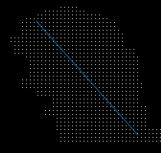
Example
Use some method to find face & part of neck
Sample the coordinates, and do PCA
Only two variables, so EVD is better
The principle axis is the long axis of the ellipse
Rotate according to the axis

Slide 19
Reference
[1] Jonathon Shlens, “A Tutorial on Principal Component Analysis”, arXiv: 1404.1100, April 2014
[2] Svante Wold, et al., “Principal component analysis”, Chemometrics and Intelligent Laboratory Systems, Volume 2, Issues 1–3, August 1987, Pages 37-52
[3] https://math.stackexchange.com/questions/2522793/can-we-do-svd-without-computing-eigenvector-decomposition

