Slide 1
Introduction of Fuzzy System and Application
學生: 林政均
指導教授: 丁建均 博士
2023.11.07

Slide 2
Introduction
Fuzzy logic is a method proposed by Professor Zadeh in 1965 to use mathematical models to describe linguistic fuzzy information. We can regard it as an extension of traditional set theory.
The advantage of fuzzification is that it can provide better generalization, error tolerance, and be more suitable for nonlinear systems applied in the real world.
The application fields of fuzzy logic include:
Control Engineering (intelligent control)
Signal Processing (image processing, speech recognition)
Quantitative Analysis
Expert System
Decision
Scheduling

Slide 3
Fuzzy Set
A classical set is a collection of distinct object. Let U be a universe of discourse. The characteristic function $μ_{A}$ of a crisp set A, in U takes its values in {0,1} and is defined as
$$μ_{A}\left(x\right)=\left\{\begin{aligned}1, if and only if x∈A \\ 0, if and only if x∉A\end{aligned}\right.$$
The boundary of set A is rigid and sharp and performs a two-class dichotomization (i.e., x $∈$ A or x $∉$ A), and the universe of discourse U is a crisp set.

Slide 4
Fuzzy Set
A fuzzy set, on the other hand, introduces vagueness by eliminating the sharp boundary that divides members from nonmembers in the group.
The transition between full membership and non-membership is gradual rather than abrupt.
A fuzzy set A in the universe of discourse U can be defined as a set of ordered pairs, $A=\left\{(x,μ_{A}(x)) | x∈U\right\}$ where $μ_{A}(·)$ is called the membership function (or characteristic function) of A, and $μ_{A}\left(x\right)$ is the grade (or degree) of membership of x in A, which indicates the degree that x belongs to A

Slide 5
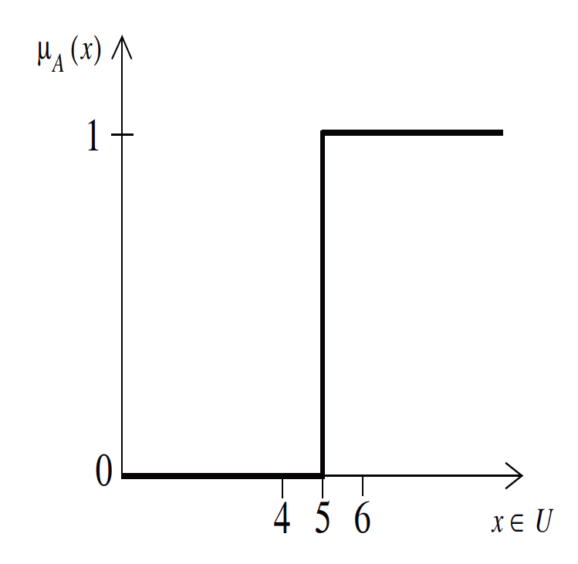
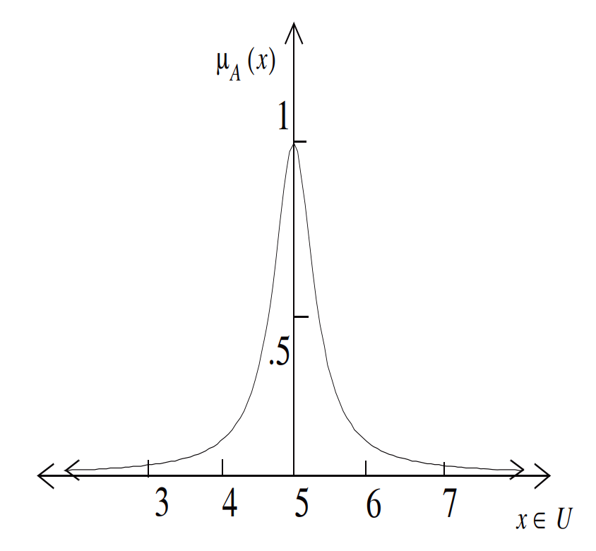
Fuzzy Set
Let U be the real line ℜ and let crisp set A represent “real numbers which are greater than 5.”
$$μ_{A}\left(x\right)=\left\{\begin{aligned} 1, x ≧5 \\ 0, x<5\end{aligned}\right.$$
$$A=\left\{(x,μ_{A}(x)) | x∈U\right\}$$
Reference: Chin-Teng Lin and C.S. George Lee, “Neural Fuzzy Systems: A Neuro-Fuzzy Synergism to Intelligent Systems”

Slide 6
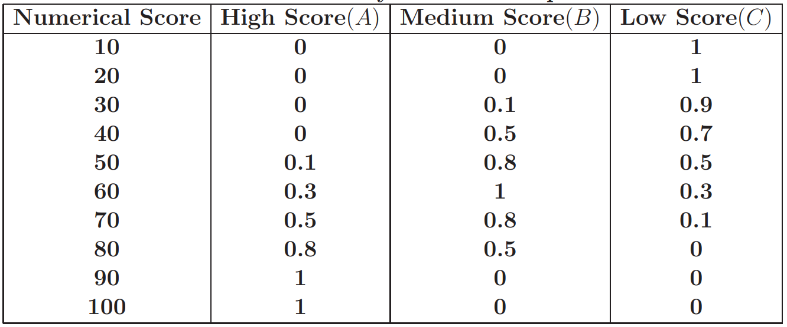
Fuzzy Set
Assume that in an examination, all the possible scores are U = { 10,20,..., 100}. Consider three fuzzy sets, A ≡ "High Score," B ≡ "Medium Score," and C ≡ "Low Score," whose membership functions are defined as
Reference: Chin-Teng Lin and C.S. George Lee, “Neural Fuzzy Systems: A Neuro-Fuzzy Synergism to Intelligent Systems”

Slide 7
Support of Fuzzy Set
The support of a fuzzy set A is the crisp set of all x $∈$ U such that $μ_{A}\left(x\right)>$0. That is,
$$Supp\left(A\right)=\left\{x∈U | μ_{A}\left(x\right)> \text{0}\right\}$$
Then we have
$Supp\left(A\right)=$ $Supp\left("High Score"\right)=\left\{50, 60, 70, 80, 90, 100\right\}$
$Supp\left(B\right)=$ $Supp\left("Medium Score"\right)=\left\{30, 40, 50, 60, 70, 80\right\}$
$Supp\left(C\right)=$ $Supp\left("Low Score"\right)=\left\{10, 20, 30, 40, 50, 60, 70\right\}$
Reference: Chin-Teng Lin and C.S. George Lee, “Neural Fuzzy Systems: A Neuro-Fuzzy Synergism to Intelligent Systems”

Slide 8
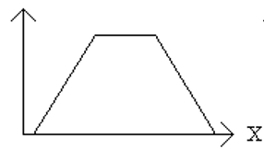
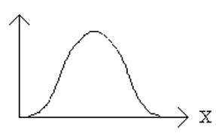
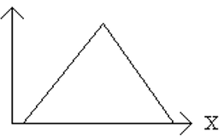
Membership Function
Triangular
Trapezoidal
Gaussian
Reference: Chin-Teng Lin and C.S. George Lee, “Neural Fuzzy Systems: A Neuro-Fuzzy Synergism to Intelligent Systems”

Slide 9
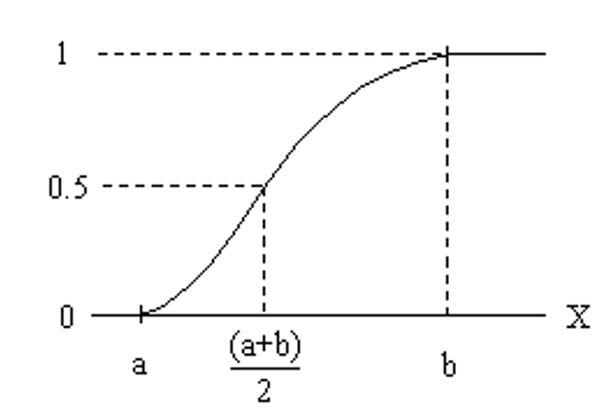
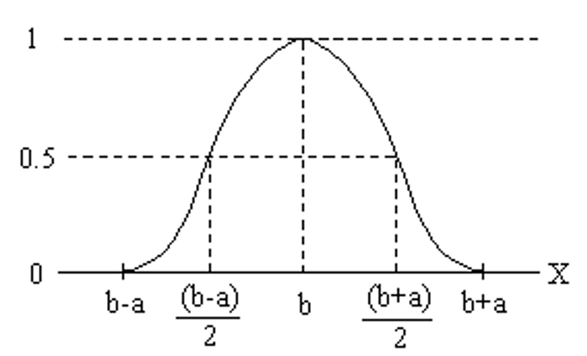
Membership Function
S-shaped
Pi-shaped
Reference: Chin-Teng Lin and C.S. George Lee, “Neural Fuzzy Systems: A Neuro-Fuzzy Synergism to Intelligent Systems”

Slide 10
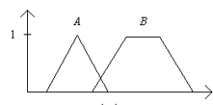
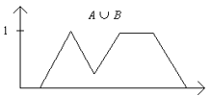
Set-theoretic Operations
Complement: When $μ_{A}\left(x\right)>$∈ [0, 1], the complement of A, denoted as $\overline{A}$ , is defined by its membership function as
$μ_{\overline{A}}\left(x\right)=1−μ_{A}\left(x\right)$, $∀x∈U$
Intersection: The intersection of fuzzy sets A and B is denoted as A ∩ B and is defined by
$μ_{A∩B}\left(x\right)=min [μ_{A}\left(x\right)$, $μ_{B}\left(x\right)]≡μ_{A}\left(x\right) \text{⋀} μ_{B}\left(x\right), ∀x∈U$
Union: The union of fuzzy sets A and B is denoted as A ∪ B and is defined by
$μ_{A∩B}\left(x\right)=max⁡[μ_{A}\left(x\right)$, $μ_{B}\left(x\right)]≡μ_{A}\left(x\right) \text{⋁} μ_{B}\left(x\right), ∀x∈U$
Fuzzy set A and B
The complement of A
The intersection of A and B
The union of A and B
Reference: Chin-Teng Lin and C.S. George Lee, “Neural Fuzzy Systems: A Neuro-Fuzzy Synergism to Intelligent Systems”

Slide 11
Set-theoretic Operations
Equality: A and B are equal if and only if
$$μ_{A}\left(x\right) \text{=} μ_{B}\left(x\right), ∀x∈U$$
Degree of Equality: To check the degree of equality of two fuzzy sets, we can use the similarly measure:
$$E\left(A, B\right)≡degree\left(A=B\right)=\frac{|A∩B|}{|A∪B|}$$
Subset: A is a subset of B, that is A ⊆B, if and only if
$$μ_{A}\left(x\right) ≦ μ_{B}\left(x\right), ∀x∈U$$
Proper Subset: If A ⊆ B and A ≠ B, then A is a proper subset of B, that is, A ⊂ B. Again, the definition of subset is crisp. To check the degree that A is a subset of B, we can use the subsethood measure:
$$S\left(A, B\right)≡degree\left(A\text{⊆}B\right)=\frac{|A∩B|}{|A|}$$

Slide 12
Fuzzy Logic
Linguistic Variable: A linguistic variable is a variable whose values are words or sentences in a natural or artificial language. E.g. temperature, speed, age, etc.
A linguistic variable is characterized by a quintuple (x, T(x), U, G, M) in which x is the name of the variable; T(x) is the term set of x; that is, the set of names of linguistic values of x with each value being a fuzzy variable defined on U; G is a syntactic rule for generating the names of values of x; and M is a semantic rule for associating with each value of x its meaning.

Slide 13
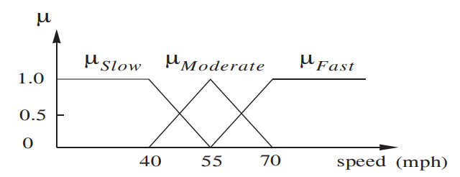
Fuzzy Logic
If speed is a linguistic variable with U = [0, 100], that is, x = “speed,” then its term set T(speed) could be
T(speed) = { very slow, slow, moderate, fast, ... }
The semantic rule M could be defined as
M(slow) = fuzzy set for “a speed below about 40 mph” with $μ_{slow}$
M(moderate) = fuzzy set for “a speed close to 50 mph” with $μ_{moderate}$
M(fast) = fuzzy set for “a speed above about 70 mph” with $μ_{fast}$
Reference: Chin-Teng Lin and C.S. George Lee, “Neural Fuzzy Systems: A Neuro-Fuzzy Synergism to Intelligent Systems”

Slide 14
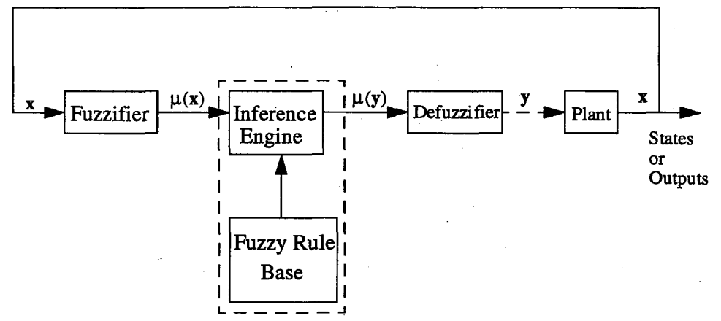
Fuzzy Logic Control Systems
The typical architecture of a FLC, which is comprised of four principal components: a fuzzifier, a fuzzy rule base, an inference engine, and a defuzzifier.
Reference: Chin-Teng Lin and C.S. George Lee, “Neural Fuzzy Systems: A Neuro-Fuzzy Synergism to Intelligent Systems”

Slide 15
Fuzzifier
A fuzzifier performs the function of fuzzification which is a subjective valuation to transform measurement data into valuation of a subjective value. Hence, it can be defined as a mapping from an observed input space to labels of fuzzy sets in a specified input universe of discourse
1. Fuzzy singleton
2. Gaussian membership function

Slide 16
Fuzzy Rule Base
Fuzzy rules are characterized by a collection of fuzzy IF-THEN rules in which the preconditions and consequents involve linguistic variables.
The most common types of fuzzy rules:
Linguistic Fuzzy Rule (Mamdani’s Fuzzy Model)
Functional Fuzzy Rule (Sugeno’s Fuzzy Model)
Tsukamoto’s Method
Linguistic Fuzzy Rule: Precondition：x is x₀ and y is y₀ Fuzzy rule 1：If x is A₁ and y is B₁ Then z is C₁ Fuzzy rule 2：If x is A₂ and y is B₂ Then z is C₂
Functional Fuzzy Rule: Precondition：x is x₀ and y is y₀ Fuzzy rule 1：If x is A₁ and y is B₁ Then z is f₁(x,y) Fuzzy rule 2：If x is A₂ and y is B₂ Then z is f₂(x,y)

Slide 17
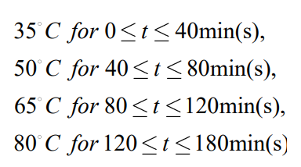
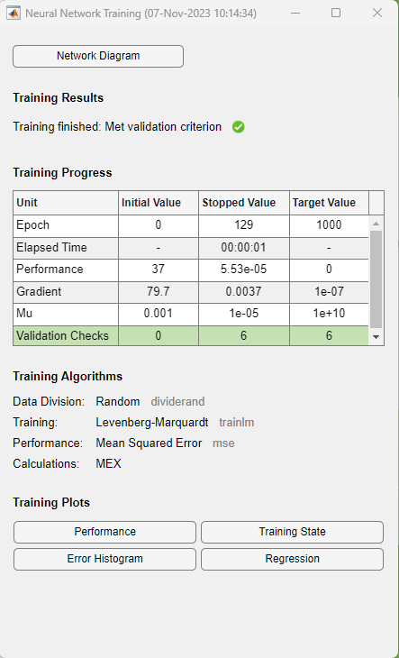
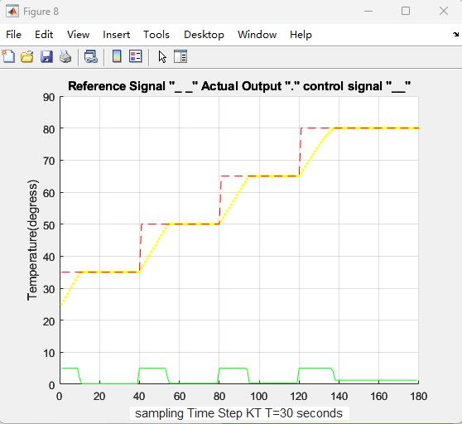
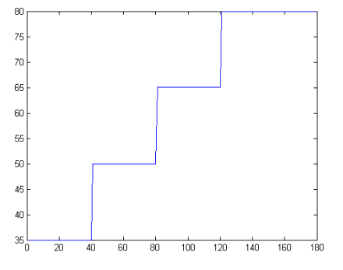
Application — water temperature control
The temperature from signal
Fuzzy Neural Network
Result

Slide 18
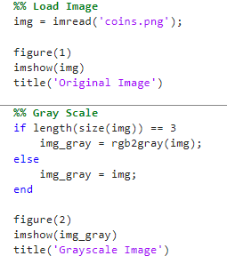
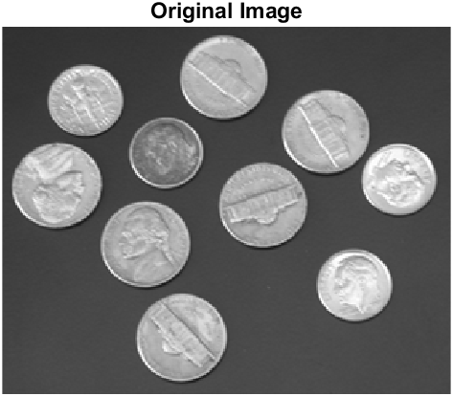
Application — edge detection
Load image and convert to grayscale image

Slide 19
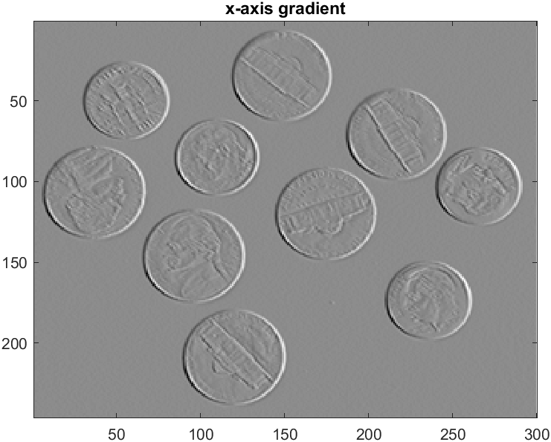
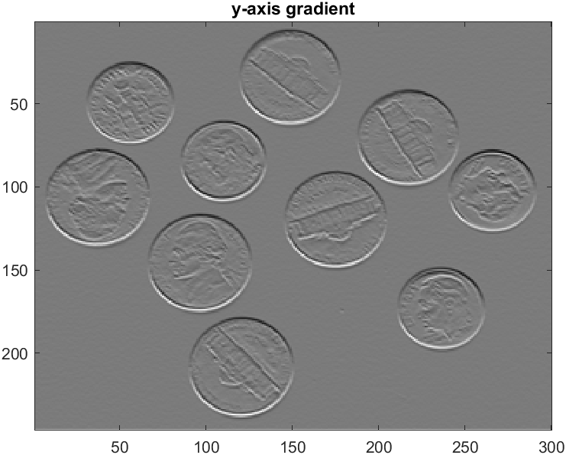
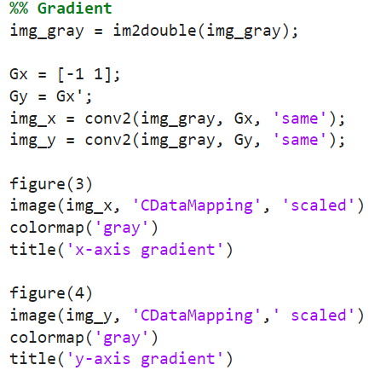
Application — edge detection
Obtain the vertical and horizontal gradient

Slide 20
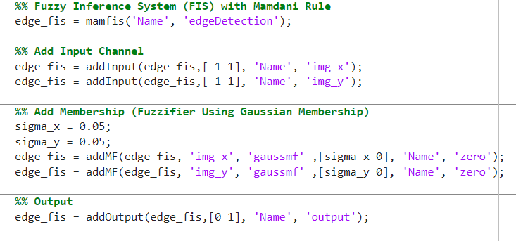
Application — edge detection
Fuzzifier

Slide 21
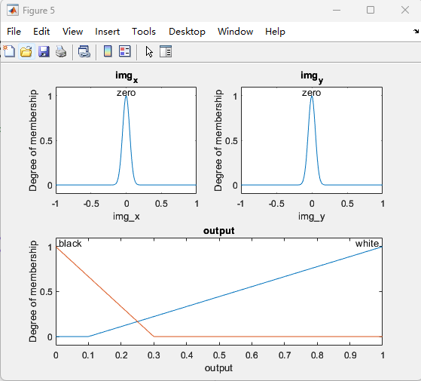
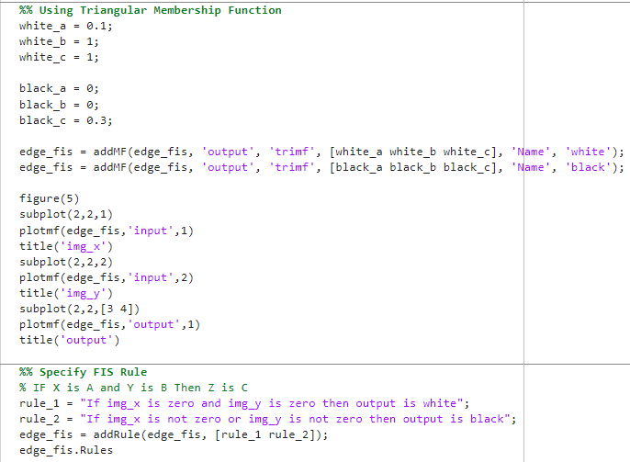
Application — edge detection
Fuzzy Rule Base

Slide 22
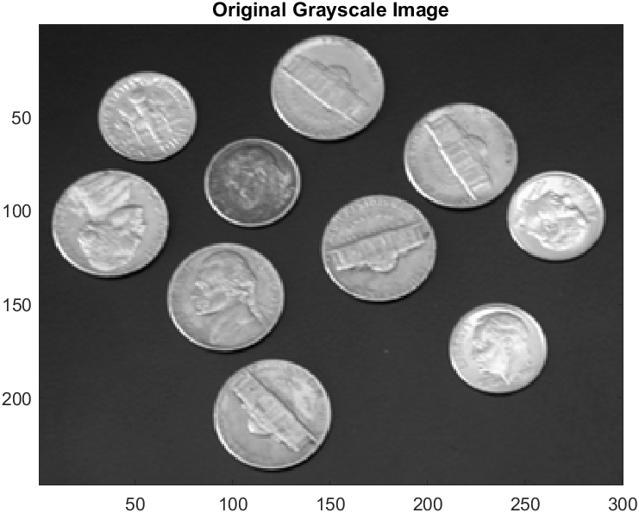
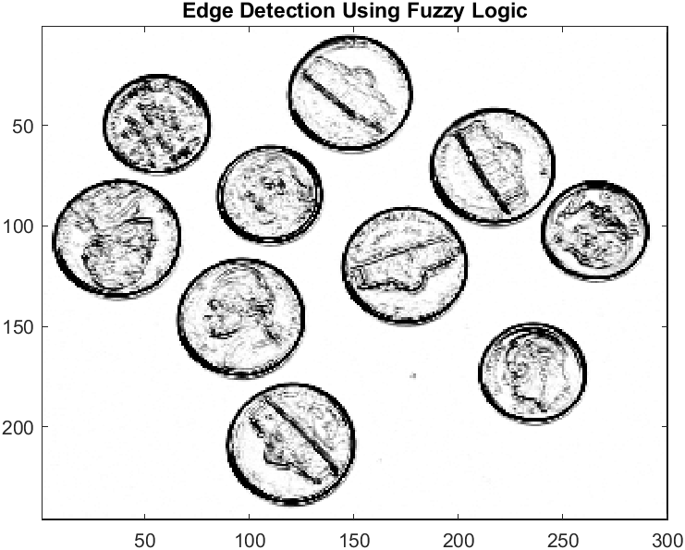
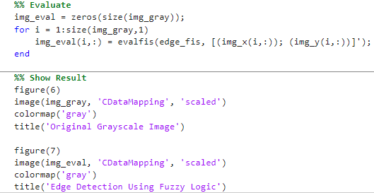
Application — edge detection
Defuzzifier

Slide 23
Reference:
[1] Chin-Teng Lin and C.S. George Lee, “Neural Fuzzy Systems: A Neuro-Fuzzy Synergism to Intelligent Systems”

