Slide 1
Unnatural L0 Representation for Natural Image Deblurring
Speaker: Wei-Sheng Lai
Date: 2013/04/26

Slide 2
Outline
Introduction
Related work
L0 Deblurring
Conclusion

Slide 3
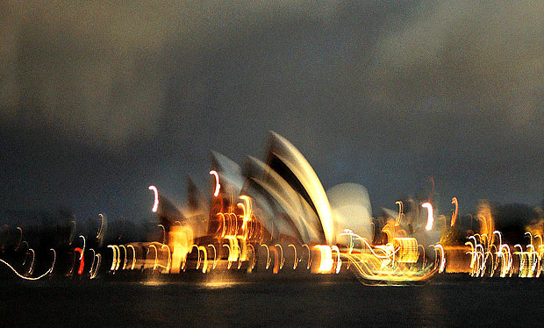
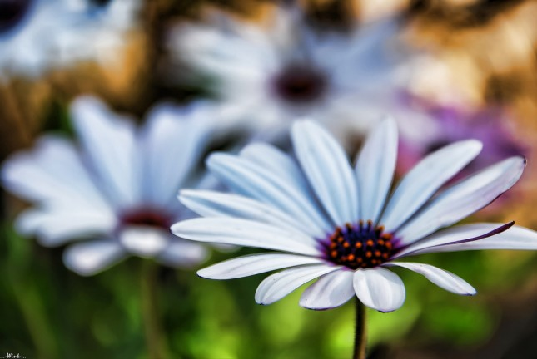
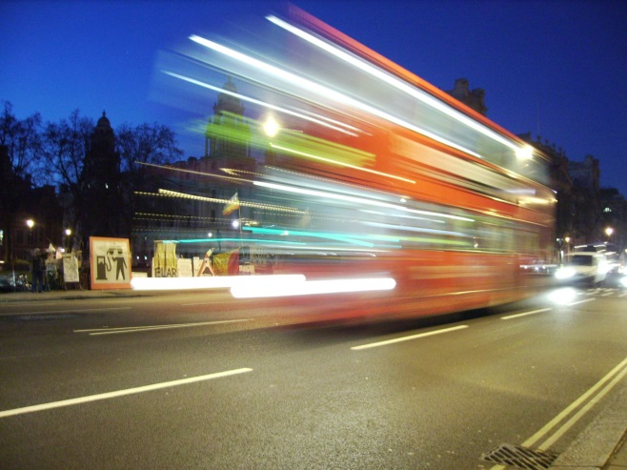
1. Introduction
Form of image blur :
Object motion
Camera Shake
Out of focus (defocus)
Blur model:
$$B=L⊗K+N$$
B: blurred(observed) image
L: latent(sharp) image
K: blur kernel
N: noise
$⨂$: convolution
Point Spread Function (PSF)

Slide 4
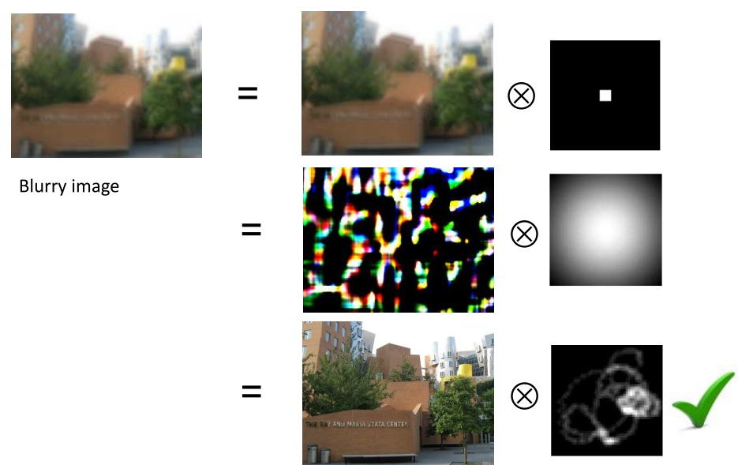
1. Introduction
Ill-posed problem:
observation (B) < unknown variables (L + K)

Slide 5
1. Introduction
Early method:
Richardson–Lucy deconvolution (RL) [1][2]
$$L^{t+1}=L^{t} .∗\left(\hat{ K} ⊗ \frac{B}{L^{t}⊗K}\right)$$
Wiener filter [3]
$$L(F)=B(F) .∗\left( \frac{K^{∗}(F)}{{\left|K\left(F\right)\right|}^{2}+{σ^{2}}/A}\right)$$
Both are known to be sensitive to noise.
$\hat{ K}$: flipped blur kernel
$σ$ : noise ratio
A : constant
[1] Richardson, William Hadley. "Bayesian-based iterative method of image restoration." JOSA 62.1 (1972): 55-59.
[2] Lucy, L. B. "An iterative technique for the rectification of observed distributions."The astronomical journal 79 (1974): 745.
[3] Wiener, Norbert. Extrapolation, interpolation, and smoothing of stationary time series: with engineering applications. Technology
Press of the Massachusetts Institute of Technology, 1950.

Slide 6
1. Introduction
Recent framework: Maximum-a-Posteriori (MAP)
$$\left(L^{∗}, K^{∗}\right)=arg\min_{L, K}{{ \left\|B−L⊗K\right\|}_{2}^{2}+ ρ_{L}\left(L\right)+ρ_{K}\left(K\right)}$$
$ρ_{L}\left(L\right)$ : prior of latent image
$ρ_{K}\left(K\right)$ : prior of kernel
Non-linear problem, iterative optimization :
$$L^{∗}=arg\min_{L}{{ \left\|B−L⊗K\right\|}_{2}^{2}+ ρ_{L}\left(L\right)}$$
$$K^{∗}=arg\min_{K}{{ \left\|B−L⊗K\right\|}_{2}^{2}+ ρ_{K}\left(K\right)}$$

Slide 7
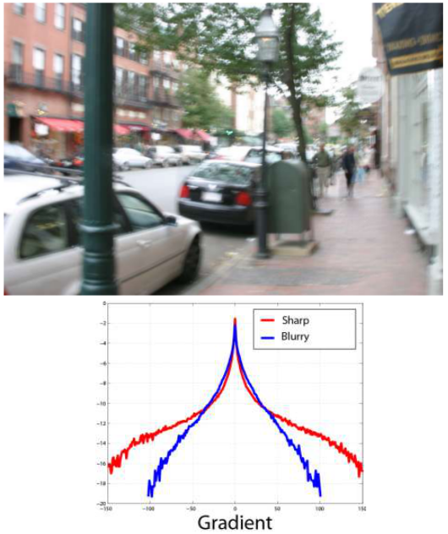
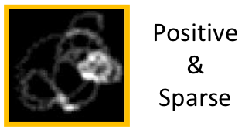
2. Related work
Fergus et al. Siggraph 2006 [4]
Heavy tails distribution of nature image gradient
Assume kernel prior as Gamma distribution
$$P\left(x | a, b\right)=\frac{x^{a}e^{−x/b}}{a!b^{a+1}}$$
[4] R. Fergus et al, “Removing camera shake from a single photograph,” Siggraph 2006

Slide 8
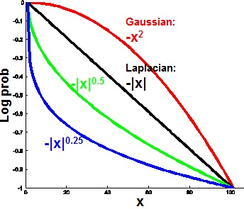
2. Related work
Prior (regularization) :
Gaussian prior (L2 regularization) [5]:
$${E(L)=\left\|B−L⊗K\right\|}_{2}^{2}+λ{ \left\|∇L\right\|}_{2}^{2}$$
TV-L1 prior [6]:
$${E(L)=\left\|B−L⊗K\right\|}_{2}^{2}+λ{\left\|∇L\right\|}_{1}^{}$$
Sparse prior [7]:
$${E(L)=\left\|B−L⊗K\right\|}_{2}^{2}+λ{\left|∇L\right|}^{α}$$
, $α≤1$
[5] S Cho et al, “Fast motion deblur,” Siggraph 2009
[6] Xu, Li, and Jiaya Jia. "Two-phase kernel estimation for robust motion deblurring." ECCV 2010.
[7] Levin, Anat, et al. "Image and depth from a conventional camera with a coded aperture." ACM TOG 2007

Slide 9
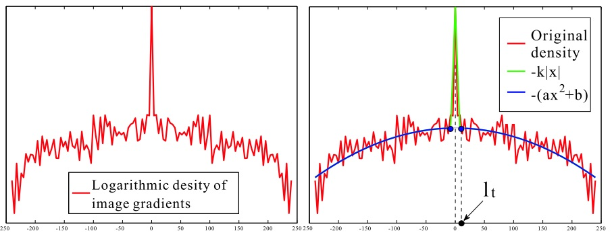
2. Related work
Q.Suan et al. Siggraph 2008 [8]
N and $∂N$ should follow the zero-mean Gaussian distribution
$$E\left(L\right)=\sum_{∂^{∗}}{{\left\|∂^{∗}B−∂^{∗}L⊗K\right\|}_{2}^{2}}+λ_{1}{\left\|ρ\left(∂_{x}L\right)+ρ\left(∂_{y}L\right)\right\|}_{1}$$
$$+{ λ}_{2}\left({\left\|∂_{x}L−∂_{x}B\right\|}_{2}^{2}+{\left\|∂_{y}L−∂_{y}B\right\|}_{2}^{2}\right)+ {\left\|K\right\|}_{1}$$
[8] Q. Shan et al, “High quality motion deblurring from a single image,” Siggraph 2008

Slide 10
2. Related work
Cho et al. Siggraph 2009 [5]
Accelerate the deblurring procedure by first estimating a predicted image and using L2 regularization
Kernel estimation :
$$E\left(K\right)=\sum_{∂^{∗}}{{\left\|∂^{∗}B−∂^{∗}P⊗K\right\|}_{2}^{2}}+β{\left\|K\right\|}_{2}^{2}$$
Image deconvolution:
$$E\left(L\right)=\sum_{∂^{∗}}{{\left\|∂^{∗}B−∂^{∗}L⊗K\right\|}_{2}^{2}}+λ{ \left\|∇L\right\|}_{2}^{2}$$
[5] S Cho et al, “Fast motion deblur,” Siggraph 2009

Slide 11
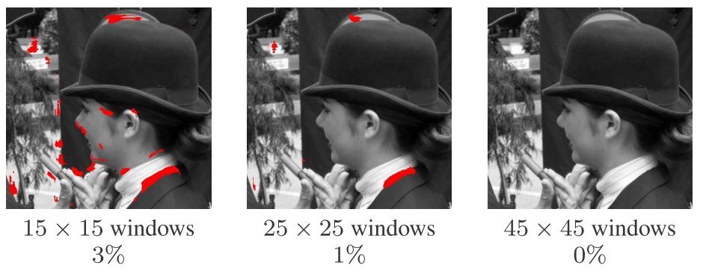
2. Related work
Anat Levin et al. CVPR 2009 [9] :
MAP x,k approach will favor blur image with delta kernel.
$$\left(L^{∗}, K^{∗}\right)=arg\min_{L, K}{{ \left\|B−L⊗K\right\|}_{2}^{2}+λ{ \left\|∇L\right\|}_{2}^{2}}$$
Estimate kernel K first, then use non-blind deconvolution to solve the latent image.
[9] Levin, Anat, et al. "Understanding and evaluating blind deconvolution algorithms." CVPR 2009.

Slide 12
Unnatural L0 Sparse Representation for Natural Image Deblurring

Slide 13
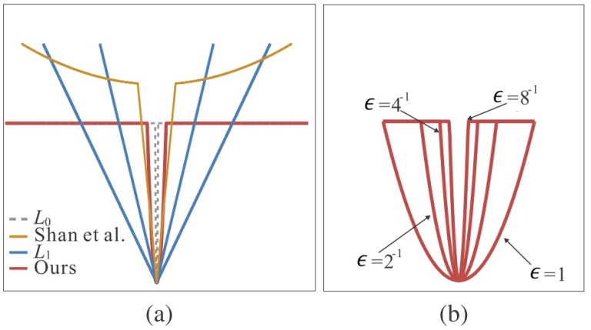
3. L0 Deblurring
Li Xu et al. CVPR 2013 [10]
Predict image with L0 optimization
L0-norm:
$$ρ\left(x\right)={\left\|x\right\|}^{0}= \left\{\begin{aligned}0, \left|x\right|=0 \\ &1, \left|x\right| ≠0\end{aligned}\right.$$
Approximate L0 sparsity function:
$$φ\left(∇_{∗}I\right)=\left\{\begin{aligned}\frac{1}{ε^{2}}{\left|∇_{∗}I\right|}^{2}, if \left|∇_{∗}I\right|≤ε \\ &1, otherwise\end{aligned}\right.$$
[10] Xu, Li, Shicheng Zheng, and Jiaya Jia. "Unnatural L0 Sparse Representation for Natural Image Deblurring.” CVPR 2013

Slide 14
3. L0 Deblurring
Main objective function:
$$\min\left\{{\left\|K⊗I−B\right\|}_{2}^{2}+λ \sum_{∗∈\{x, y\}}{φ_{0}\left(∂_{∗}I\right)}+γ{\left\|K\right\|}_{2}^{2}\right\}$$
where $φ_{0}\left(∂_{∗}I\right)=\sum_{i}{{φ(∂}_{∗}I_{i})}$, $φ\left(∇_{∗}I\right)=\left\{\begin{aligned}\frac{1}{ε^{2}}{\left|∇_{∗}I\right|}^{2}, if \left|∇_{∗}I\right|≤ε \\ &1, otherwise\end{aligned}\right.$
Iteratively solve:
$$I^{(t+1)}=arg\min_{I}\left\{{\left\|K^{(t)}⊗I−B\right\|}_{2}^{2}+λ \sum_{∗∈\{x, y\}}{φ_{0}\left(∂_{∗}I\right)}\right\}$$
$$K^{(t+1)}=arg\min_{K}\left\{{ \left\|K⊗I^{(t+1)}−B\right\|}_{2}^{2}+γ{\left\|K\right\|}_{2}^{2} \right\}$$
[10] Xu, Li, Shicheng Zheng, and Jiaya Jia. "Unnatural L0 Sparse Representation for Natural Image Deblurring.” CVPR 2013

Slide 15
3. L0 Deblurring
Solving
$$I^{(t+1)}=arg\min_{I}\left\{{\left\|K^{(t)}⊗I−B\right\|}_{2}^{2}+λ \sum_{∗∈\{x, y\}}{φ_{0}\left(∂_{∗}I\right)}\right\}$$
where $φ_{0}\left(∂_{∗}I\right)=\sum_{i}{{φ(∂}_{x}I_{i})}$ $, φ\left(∂_{∗}I\right)=\left\{\begin{aligned}\frac{1}{ε^{2}}{\left|∂_{∗}I\right|}^{2}, if \left|∂_{∗}I\right|≤ε \\ &1, otherwise\end{aligned}\right.$
Equivalent to solving
$$I^{(t+1)}=arg\min_{I, w}\left\{{\left\|K^{(t)}⊗I−B\right\|}_{2}^{2}+λ \sum_{∗∈\{x, y\}}{\sum_{i}{\left\{{\left\|w_{∗i}\right\|}^{0}+\frac{1}{ε^{2}}{\left(∂_{∗}I^{(t)}−w_{∗i}\right)}^{2}\right\}}}\right\}$$
$$w_{∗i}=\left\{\begin{aligned}0, if \left|∂_{∗}I\right|≤ε \\ &∂_{∗}I, otherwise\end{aligned}\right.$$
$$ε∈\{1, 2^{−1}, 4^{−1}, 8^{−1}\}$$
[10] Xu, Li, Shicheng Zheng, and Jiaya Jia. "Unnatural L0 Sparse Representation for Natural Image Deblurring.” CVPR 2013

Slide 16
3. L0 Deblurring
$$F\left(x\right)=\frac{\overline{F\left(B_{M}\right)} .∗F\left(Y\right)+λ/ε^{2}\left(\overline{F\left(∂_{x}\right)} .∗F\left(w_{x}\right)+\overline{F\left(∂_{y}\right)} .∗F\left(w_{y}\right)\right)}{\overline{F\left(B_{M}\right)} .∗F\left(B_{M}\right) + λ/ε^{2}F_{D}^{2}}$$
$$K^{(t+1)}=arg\min_{K}\left\{{ \left\|K⊗I^{(t+1)}−B\right\|}_{2}^{2}+γ{\left\|K\right\|}_{2}^{2} \right\}$$
$$k^{(t+1)}=F^{−1}\left(\frac{\overline{F(A_{M}^{(t+1)})} .∗F(y)}{{\left|F\left(A_{M}^{(t+1)}\right)\right|}^{2}+γ}\right)$$
$$k^{(t+1)}=k^{(t)}{\left(\frac{A_{R}^{T} y}{{(A}_{R}^{T}A_{R}^{}+γ)k^{\left(n\right)}}\right)}^{α}$$
[10] Xu, Li, Shicheng Zheng, and Jiaya Jia. "Unnatural L0 Sparse Representation for Natural Image Deblurring.” CVPR 2013

Slide 17
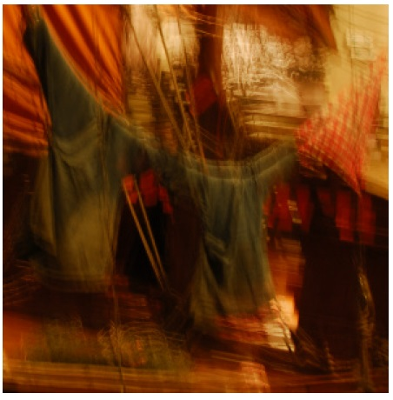
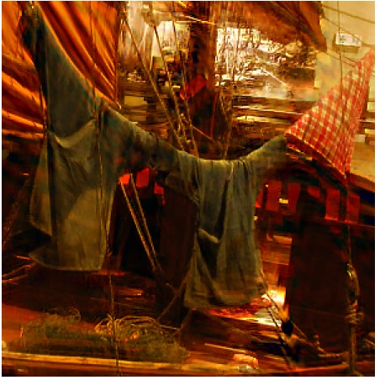
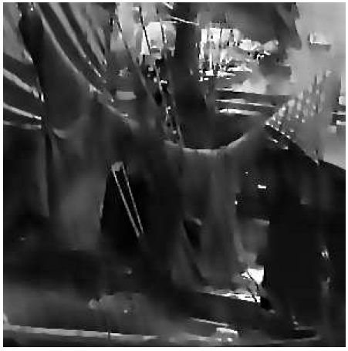
3. L0 Deblurring
Unnatural Representation
Fast Hyper-Laplacian deconvolution ($L^{0.5}$ norm) [11]
Input image
Deblurring result
L0 optimization
Predict map
kernel
[11] Krishnan, Dilip, and Rob Fergus. "Fast image deconvolution using hyper-Laplacian priors." ANIPS 2009

Slide 18
3. L0 Deblurring
Other results

Slide 19
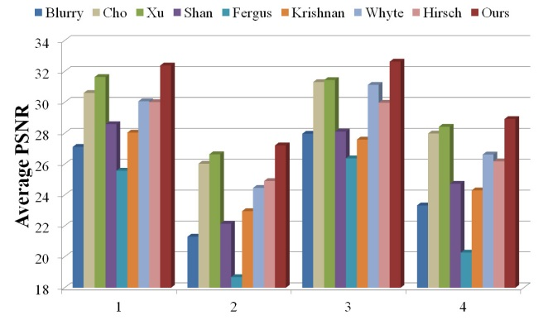
3. L0 Deblurring
Advantage of L0 deblurring:
Fast convergence
High quality

Slide 20
4. Conclusion
A naïve MAP x,k estimation will fail.
$$\left(L^{∗}, K^{∗}\right)=arg\min_{L, K}{{ \left\|B−L⊗K\right\|}_{2}^{2}+λ{ \left\|∇L\right\|}_{2}^{2}}$$
How to estimate correct kernel is important.
It is not as simple as what I have shown, there are many implementation details.

Slide 21
Thanks for Attention !

