Slide 1
MATLAB GUI with GUIDE
報告人：張捷勝

Slide 2
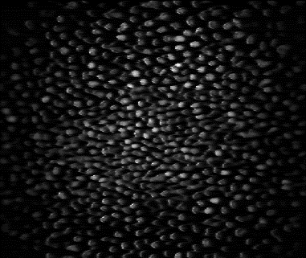
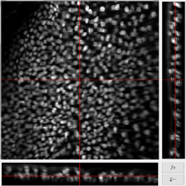
Why GUI (Graphical User Interfaces)?
User-friendly
Visualization
Convenient analysis tool
…
Threshold
α
β

Slide 3
An Example

Slide 4
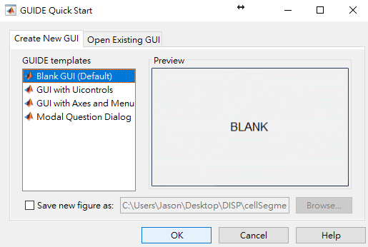
How to Start Your Own GUI ?

Slide 5
How to Start Your Own GUI ?

Slide 6
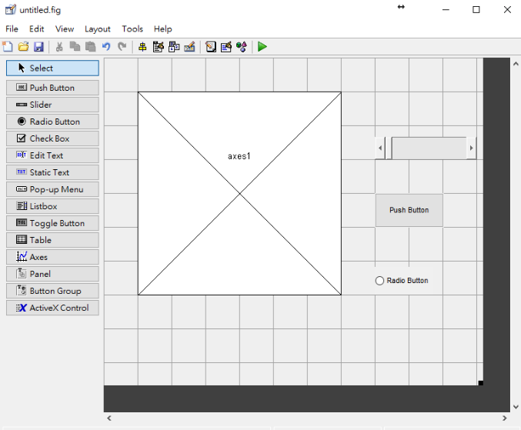
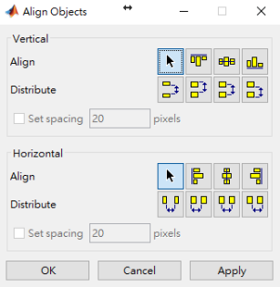
How to Start Your Own GUI ?

Slide 7
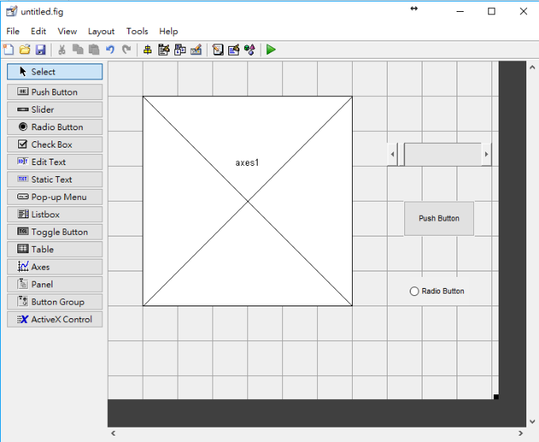
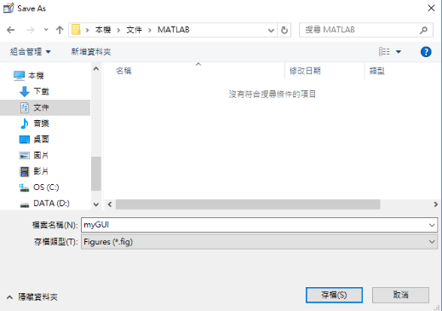
How to Start Your Own GUI ?

Slide 8
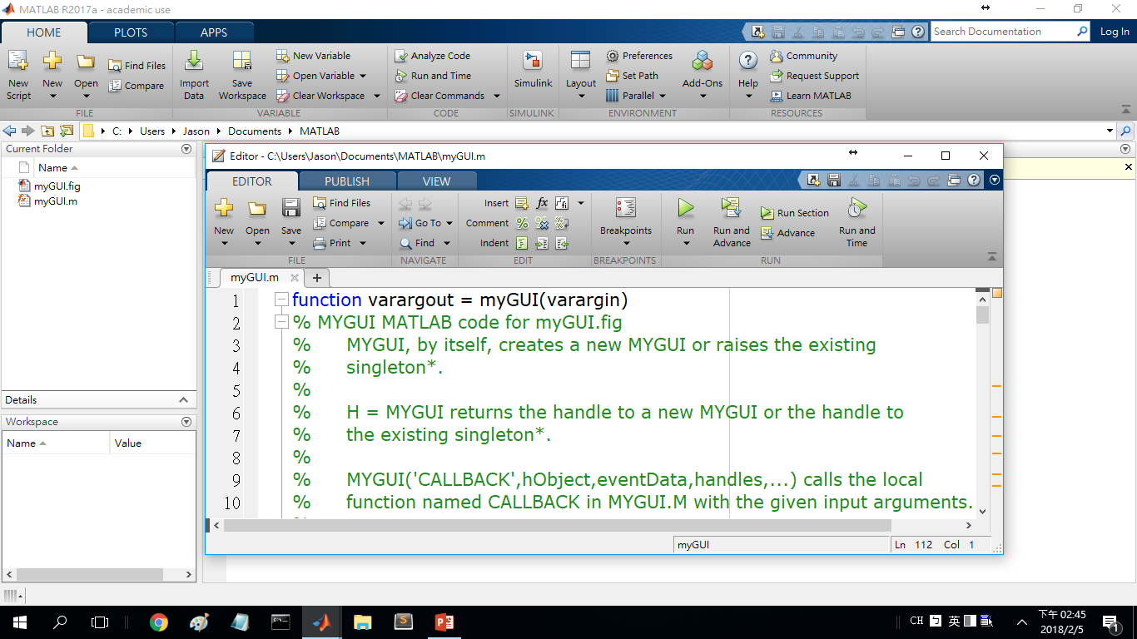
How to Start Your Own GUI ?

Slide 9
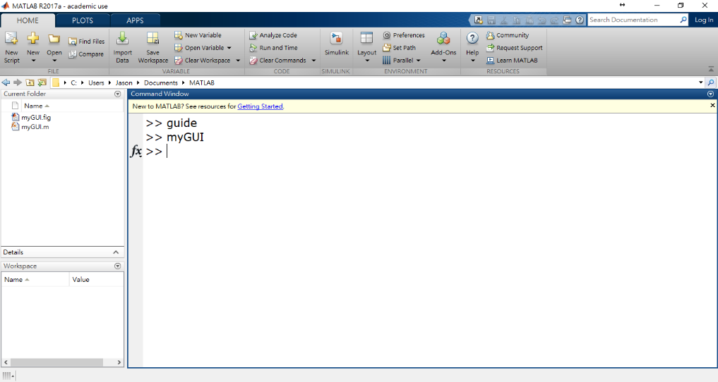
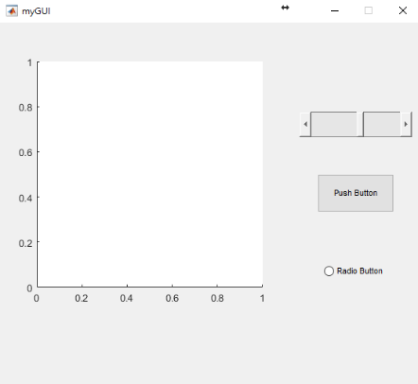
How to Start Your Own GUI ?
Unlike function calls,
command line returns to the next line.

Slide 10
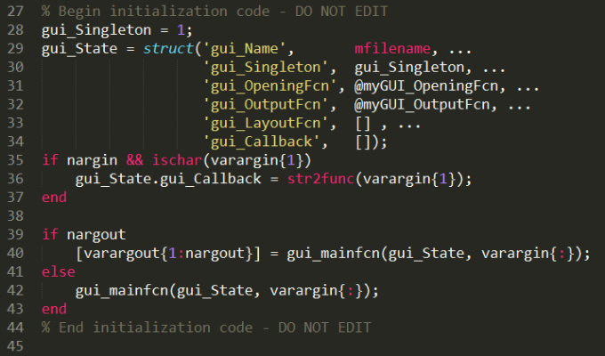
myGUI.m
Variable-length output/input argument list
EX: [out1, out2, out3] = myGUI( in1, in2, in3 );
There is no “end” at the end of every function

Slide 11
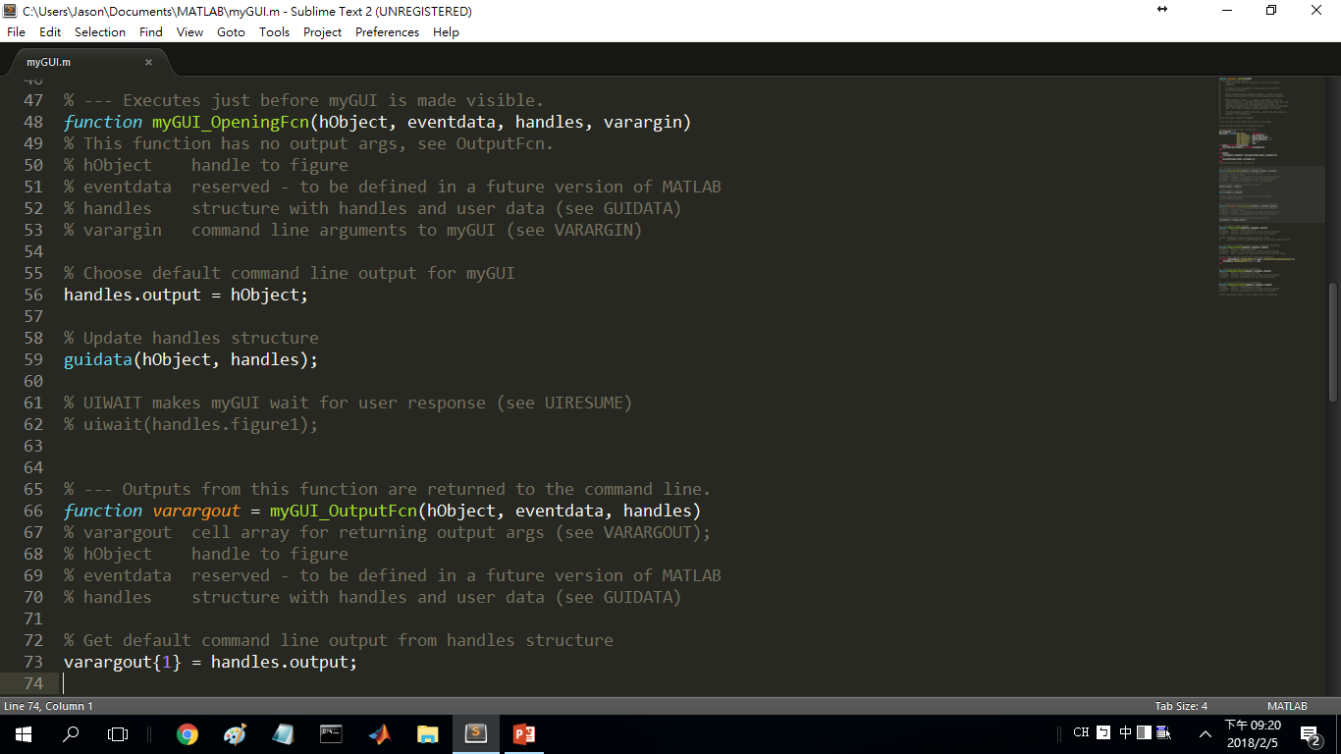
OpeningFcn & OutputFcn

Slide 12
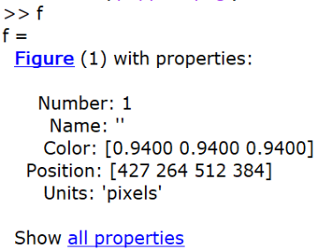
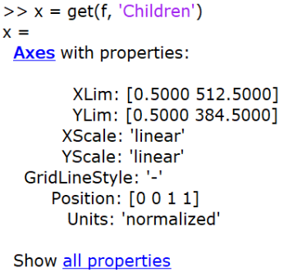
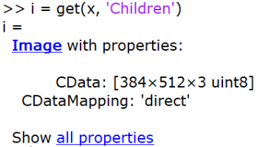
What is a handle?

Slide 13
OpeningFcn & OutputFcn
‘handles’ is stored with the object specified by ‘hObject’.

Slide 14
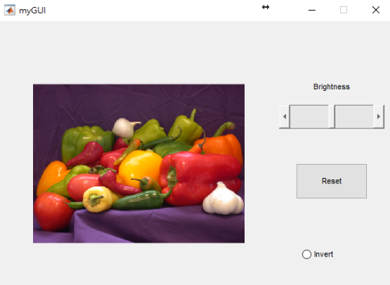
A Simple Example
Input file name of an image
Show the image on axes
Use slider to adjust brightness
Use radio button to invert the image
Use push button to reset to original image

Slide 15
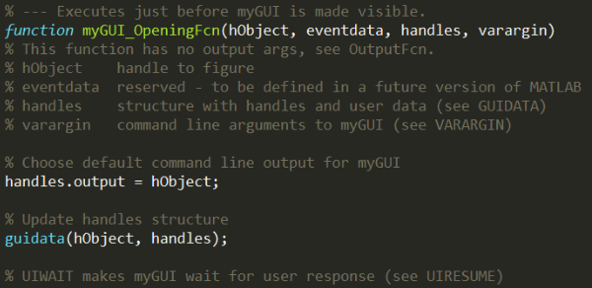
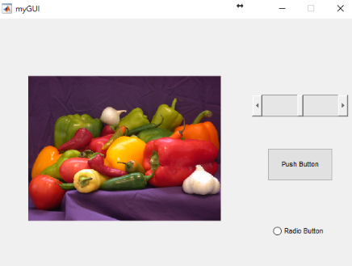
OpeningFcn
Figure
Axes
Image

Slide 16
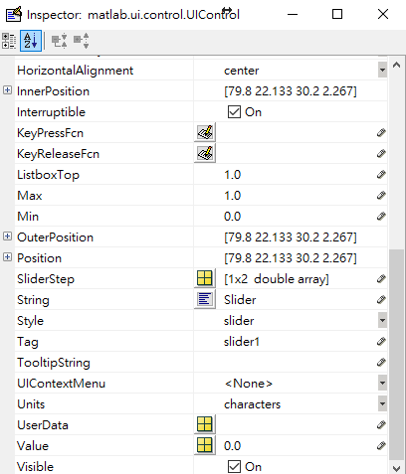
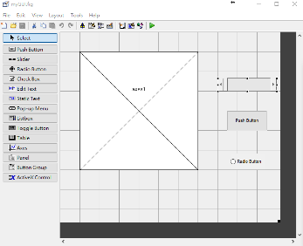
slider1_CreateFcn
or
Be careful when you change the ‘Tag’ property Saving ‘myGUI.fig’ will update your ‘myGUI.m’ file.

Slide 17
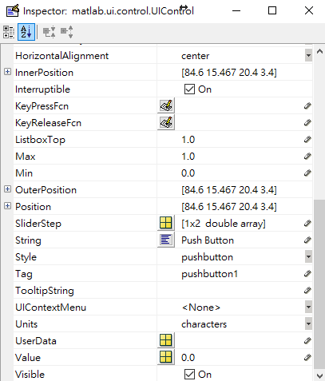
Change Button String
Reset

Slide 18
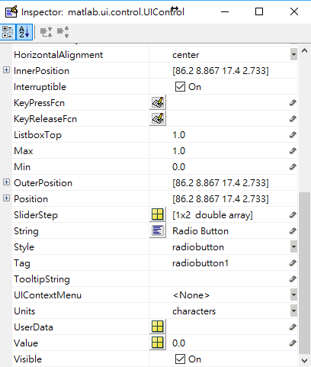
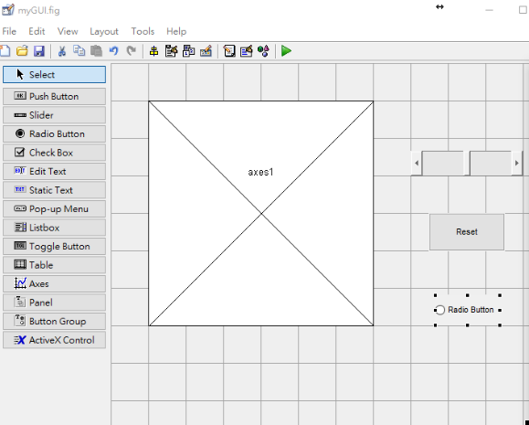
Change Button String
Invert

Slide 19
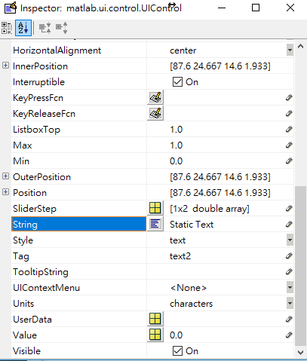
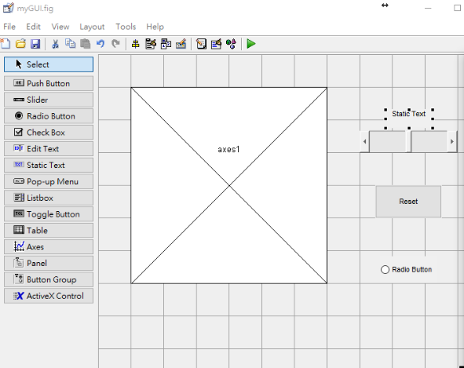
Change Button String
Brightness

Slide 20
slider1_Callback
Be sure to add this line if any variable stored in ‘handles’ is changed and need updating.
This function will be defined in a later slide. It updates the image on axes1 based on variables in ‘handles’.

Slide 21
radiobutton1_Callback

Slide 22
pushbutton1_Callback

Slide 23
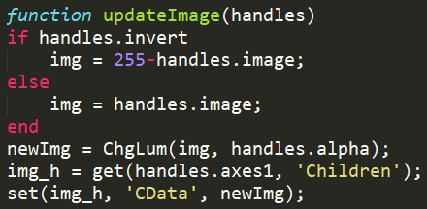
updateImage
Figure
Axes
Image
This function is defined in the next slide.
[
or
100 times slower

Slide 24
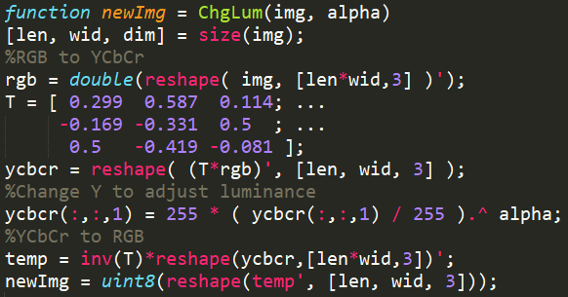
ChgLum (Adjust Brightness)

Slide 25
Advanced GUI Control - Listener
Allow brightness to change continuously as slider slides

Slide 26
Advanced GUI Control - Listener
Allow brightness to change continuously as slider slides

Slide 27
Advanced GUI Control - Mouse
ButtonDownFcn (property on Figure, Axes, and Image class)
WindowScrollWheelFcn (property on Figure class)

Slide 28
Advanced GUI Control - Mouse
Click on image to show cooridnates
Scroll mouse wheel to adjust slider

Slide 29
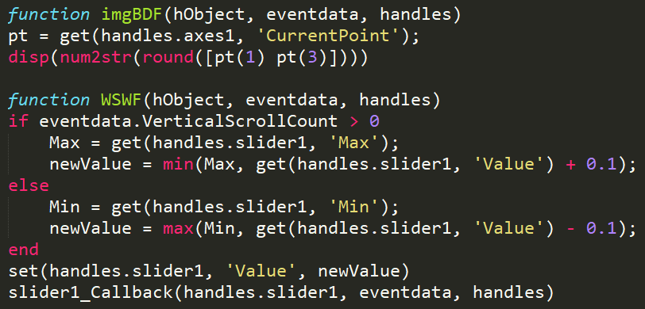
Advanced GUI Control - Mouse
Click on image to show cooridnates
Scroll mouse wheel to adjust slider

Slide 30
Reference
Tutorial video on MathWork
https://www.mathworks.com/videos/creating-a-gui-with-guide-68979.html

Slide 31
Any Question?

Slide 32
Thanks For Your Attention

