Slide 1
MPEG-4 Part 2 (MPEG-Visual)

Slide 2
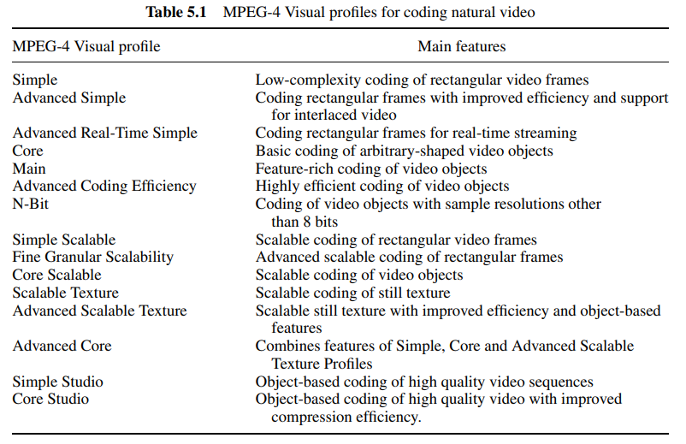
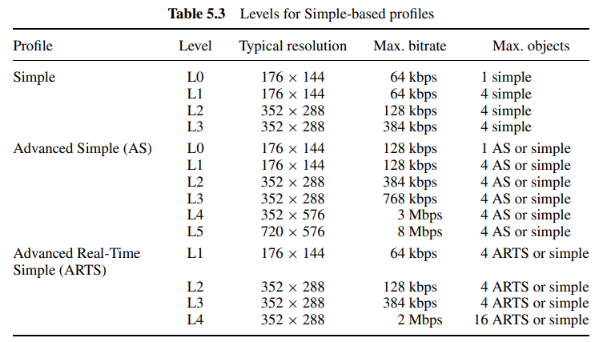
MPEG-Visual
Tools
Subset of coding functions that support specific features
Objects
Video elements
Profiles
Subset of coding tools
Levels
Define constraints on buffer memory

Slide 3
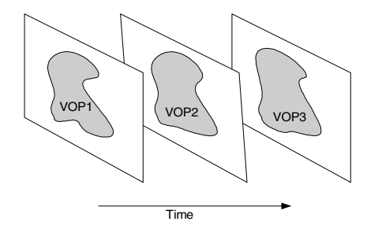
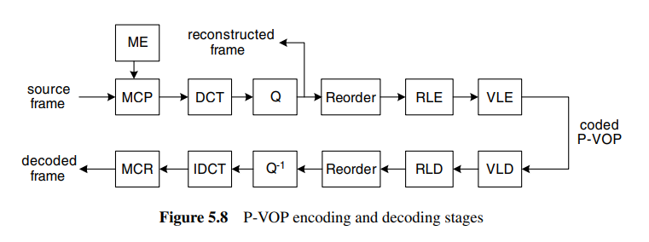
The Simple Profile
VOP (Video Object Plane)
I-VOP (Intra)
P-VOP (Inter)

Slide 4
I-VOP
DCT: 8x8
Quantization
Zig-zag scan
Last-Run-Level
Entropy Coding

Slide 5
Quantization
Only define inverse quantization
Method2 (H.263 Quantization) for simple profile
Method1 (MPEG-4 Quantization) for advanced simple profile

Slide 6
Quantization-Method 2
QP (step size) is in [1,31]
DC = DC_quantized × dc_scaler
For all short header (simple profile), Intra DC dc_scaler = 8
Else, refer to Table 5.4
For others transformed coefficients including AC and Inter DC,

Slide 7
P-VOP
Motion Compensation: 16x16 macroblock
Half pixel resolution
Each macroblock could either be coded in Inter-mode or Intra-mode
Inter-mode macroblock contains motion vector (differentially encoded) and coded residual coefficients of every 8x8 block

Slide 8
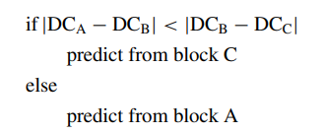
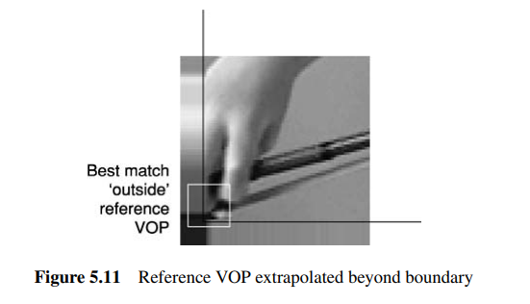
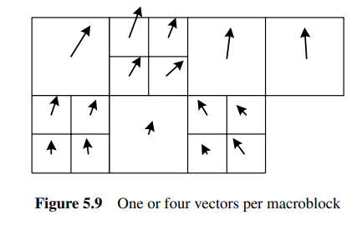
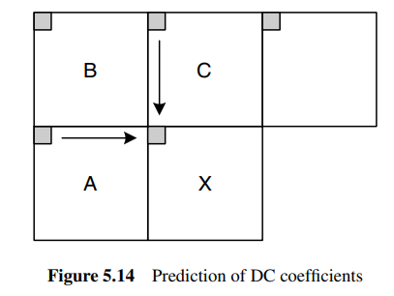
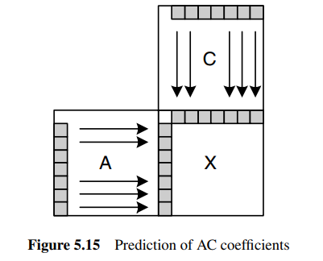
Coding Efficiency Tools
Four motion vectors in one macroblock
Unrestricted motion vectors
Intra prediction of DC and first row/column of AC (optional)

Slide 9
Transmission Efficiency Tools
Resynchronization marker
Data partitioning
e.g. coding mode, DC coefficient (intra), motion vector (inter) in first partition while AC and DC coefficient (inter) in second partition
Reversible VLCs

Slide 10
The Advanced Simple Profile
B-VOP
Forward prediction: from previous I/P VOPs
Backward prediction: from future I/P VOPs
Average of forward/backward prediction: from previous/future I/P VOPs
Quarter-pixel motion compensation

Slide 11
Quantization-Method 1
$W_{0}$ for intra and $W_{1}$ for inter

Slide 12
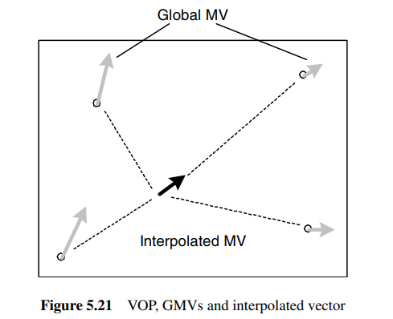
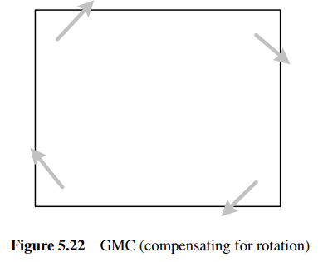
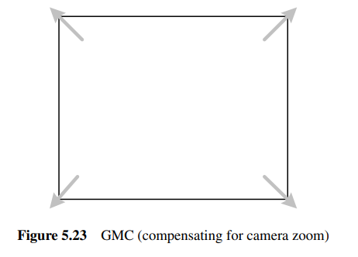
Global Motion Compensation (GMC)
Sends up to 4 GMVs for each VOP
MV is calculated by interpolation
Coded as S-VOP (S is for “sprite”, which will be mentioned later)

Slide 13
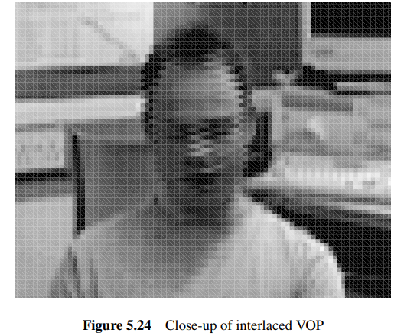
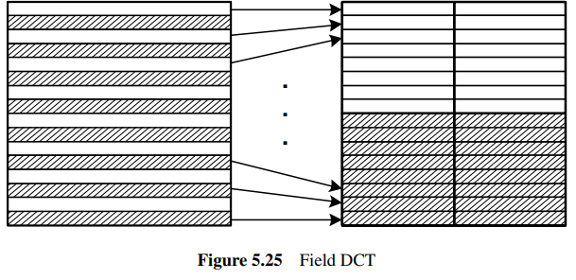
Interlace
Horizontal movements reduce correlation
Field/Frame DCT mode
16*8 motion compensation

Slide 14
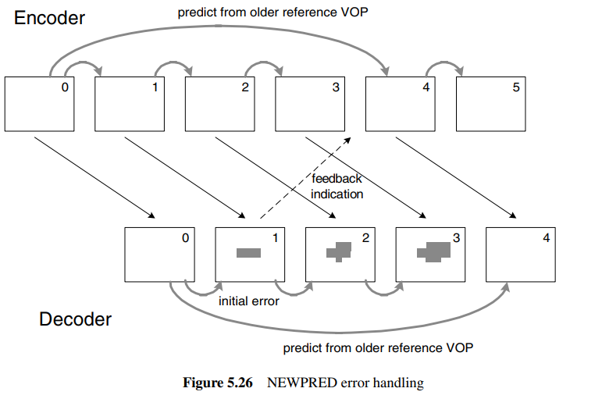
The Advanced Real Time Simple Profile
NEWPRED tool
Requires extra memory to store previous VOPs

Slide 15
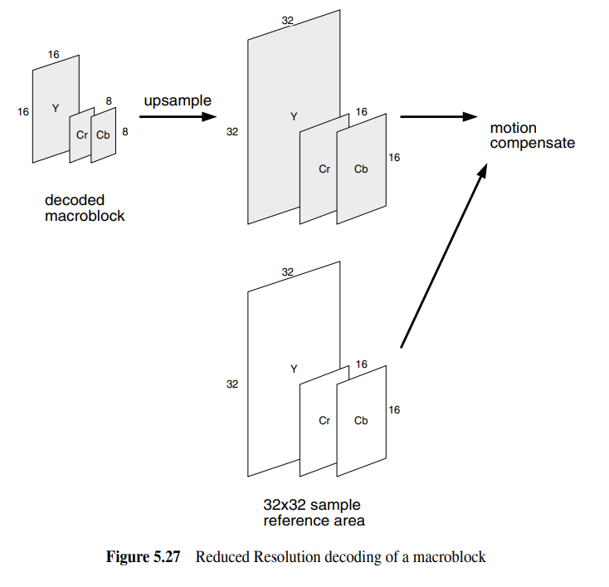
The Advanced Real Time Simple Profile Cont’d
Dynamic Resolution Conversion (DRC)
Limited bitrate channel
Half sampled both horizontally and vertically before encoding

Slide 16
Coding of Arbitrary Shaped Region (Core profile)
Binary shape coding
Motion compensation coding
Texture coding

Slide 17
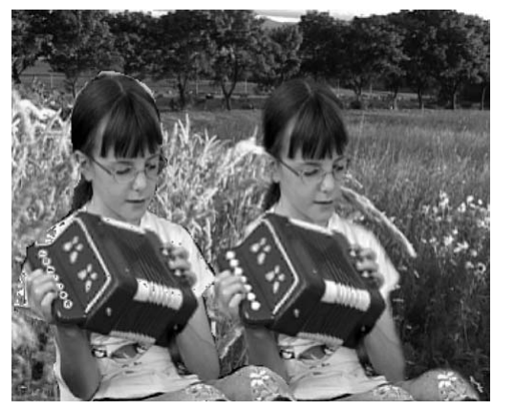
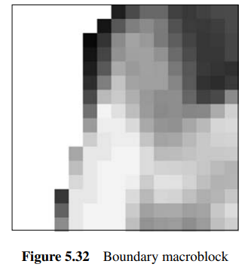
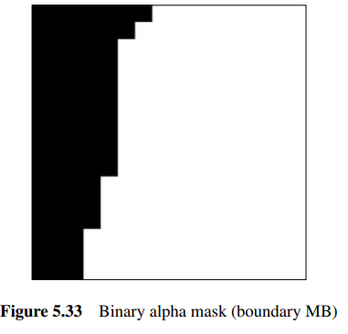
Binary Shaped Coding
Alpha blocks
Binary or grey scale
3 cases: transparent (outside), opaque (inside), boundary
Encoded by context-based arithmetic encoding

Slide 18
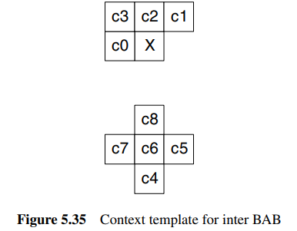
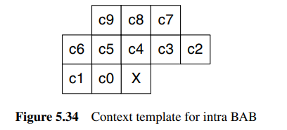
Binary Shaped Coding Cont’d
Intra: $c_{9}c_{8}c_{7}c_{6}c_{5}c_{4}c_{3}c_{2}c_{1}c_{0}$ as context
Set undefined pixels value as nearest neighbor inside the current BAB
Inter: $c_{8}c_{7}c_{6}c_{5}c_{4}c_{3}c_{2}c_{1}c_{0}$ as context
$c_{0}$ to $c_{3}$ in current VOP and $c_{4}$ to $c_{8}$ in reference VOP

Slide 19
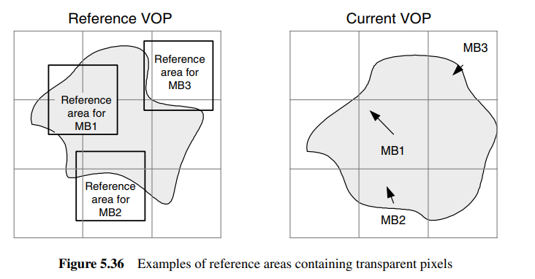
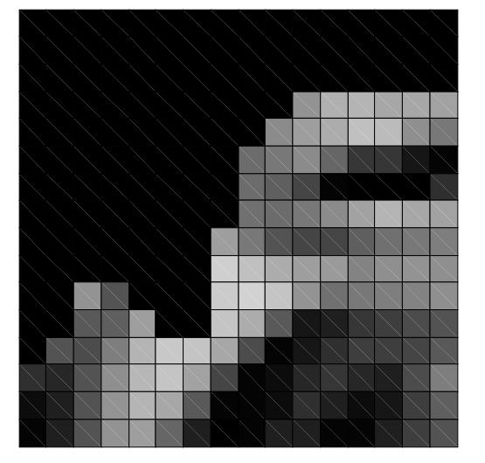
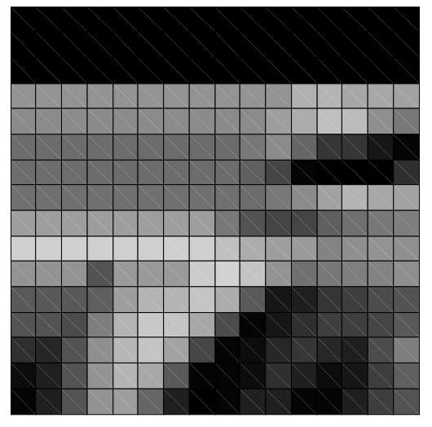
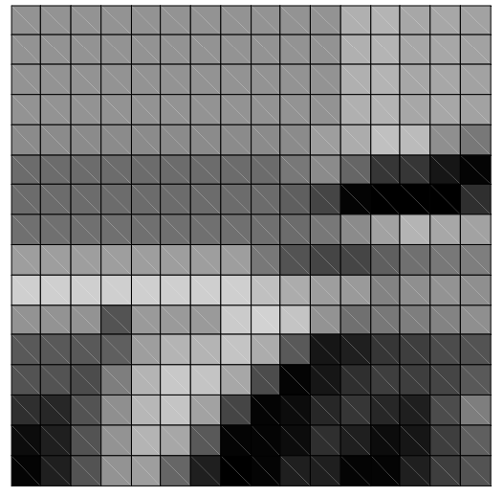
Motion Compensated Coding
Padding
Pad mean if both side have value
Padding order: boundary > transparent

Slide 20
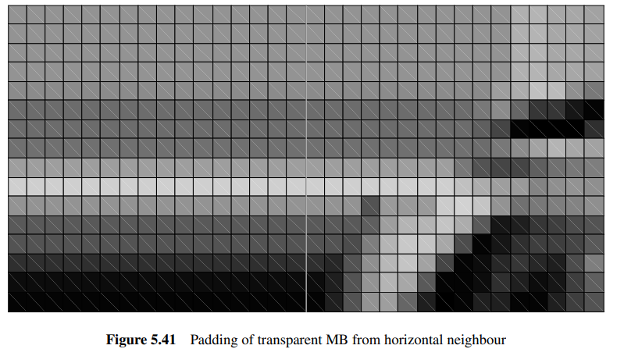
Motion Compensated Coding Cont’d
Transparent MB should be padded as well
If only one neighbor boundary MB
Horizontally or vertically extrapolation
If more than one neighbor boundary MB
Left > Top > Right > Bottom
If no neighbor boundary MB
Fill it with $2^{N−1}$, where N is bits per pixel

Slide 21
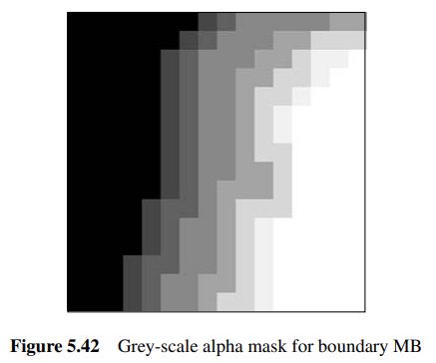
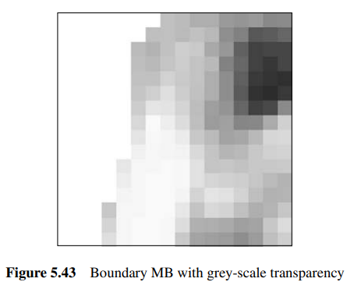
The Main Profile – Grey Shaped Coding
Grey scale alpha mask
Binary support mask (coded by CAE)
Grey scale alpha plane (coded by DCT)
Transparency information may not be identical

Slide 22
The Main Profile – Static Sprite Coding
S-VOPs (Static Sprite VOPs)
Two ways to transmit
Basic: sent entirely at the start
Low latency: updated piece by piece
Both methods contain up to 4 warping parameters
Low latency contain “sprite pieces”
Static-sprite-object
Static-sprite-update

Slide 23
The Advanced Coding Efficiency Profile – SADCT
Improve coding efficiency for boundary MBs

Slide 24
The N-bit Profile
Limited display
Support color depth from 4-12 bits

Slide 25
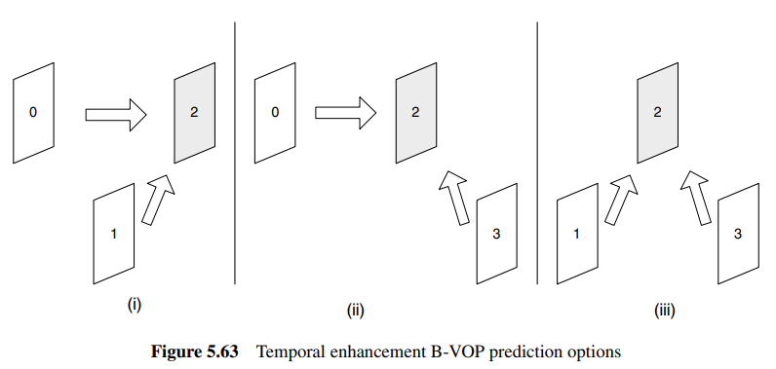
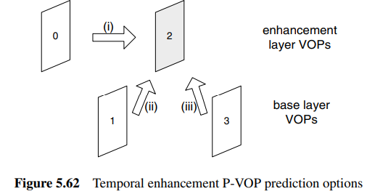
Scalable Video Coding
Spatial scalability
Base layer & Enhancement layer
Subsample input
Encode the reduced-resolution frame to form the base layer
Decode the base layer and up-sample to the original resolution
Subtract the full-resolution frame from this prediction frame
Encode the difference to form the enhancement layer
Temporal scalability

Slide 26
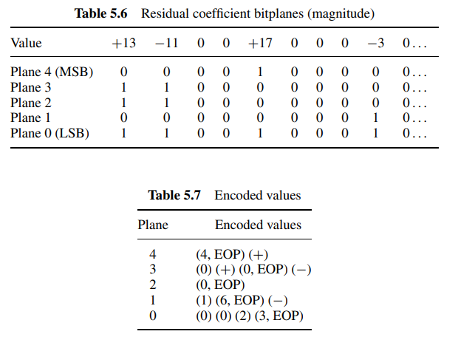
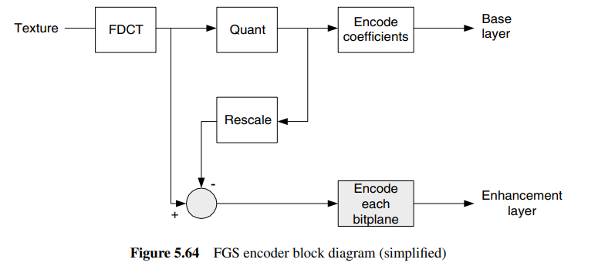
Fine Granular Scalability (FGS)

Slide 27
The Simple Studio Profile
Aim to encode video nearly-lossless
No temporal prediction (that is, only I-VOPs)

