Slide 1
Joint Face Detection and Alignment using Multi-task Cascaded Convolutional Networks

Slide 2
Introduction
Face detection and alignment are essential to many applications such as face recognition, facial expression recognition, age identification, and so on.
Automatically output the position for each face in the given image.

Slide 3
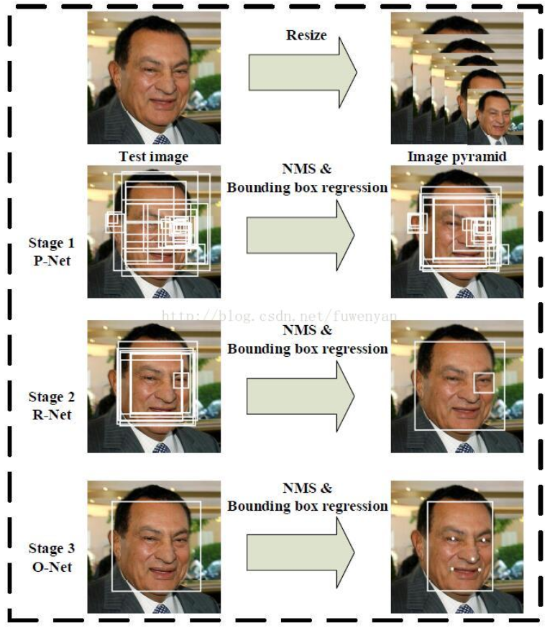
Cascaded framework that includes three-stage multi-task deep convolutional networks.
Fig1: flowchart

Slide 4
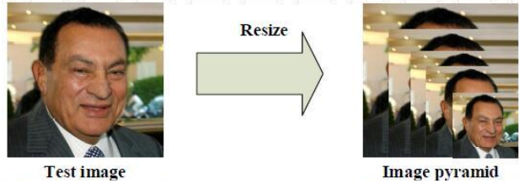
Given an image, we initially resize it to different scales to build an image pyramid

Slide 5
Stage1:Proposal Network(P-net)
Obtain the candidate facial windows and their bounding box regression vectors.

Slide 6
Stage1:Proposal Network(P-net)
Face classification

Slide 7
Stage1:Proposal Network(P-net)
Bounding box regression

Slide 8
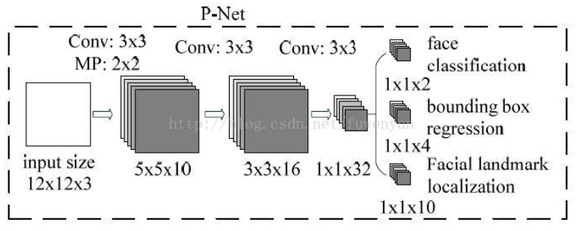
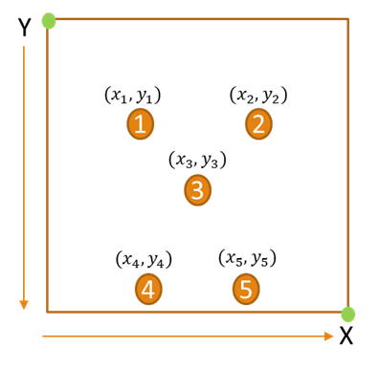
Stage1:Proposal Network(P-net)
Facial landmark location

Slide 9
P-net detection result
Candidates are calibrated based on the estimated bounding box regression vectors.
Employ non-maximum suppression (NMS) to merge highly overlapped candidates.

Slide 10
Stage2:Refinement Network(R-net)

Slide 11
R-net detection result
All candidates are fed to another CNN(R-Net),which further rejects a large number of false candidates, performs calibration with bounding box regression, and conducts NMS.

Slide 12
Stage3:Output Network (O-Net)
This stage is similar to the second stage, but in this stage we aim to identify face regions with more supervision.
The network will output five facial landmarks’ positions.

Slide 13
O-net detection result
The network will output five facial landmarks’ positions.

Slide 14
Flowchart

Slide 15
Training
Face classification: cross-entropy loss

Slide 16
Training
Bounding box regression: Euclidean loss

Slide 17
Training
Facial landmark localization: Euclidean loss

Slide 18
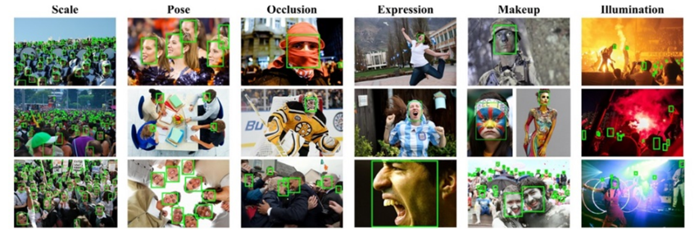
Training Data

Slide 19
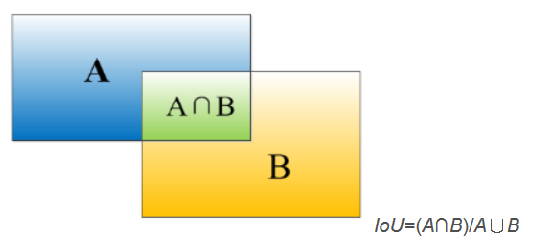
Experiments
Training Data
Negatives: Regions that the Intersection-over-Union (IoU) ratio less than 0.4 to any ground-truth faces
Positives: IoU above 0.65 to a ground truth face
Part faces: IoU between 0.4 and 0.65 to a ground truth face
Landmark faces: faces labeled 5 landmarks’ positions

Slide 20
Experiments
Training Data
Negatives and positives are used for face classification tasks
Positives and part faces are used for bounding box regression
landmark faces are used for facial landmark localization

Slide 21
Experiments

Slide 22
Oscar

Slide 23
Result

Slide 24
Conclusion
Framework adopts a cascaded structure with three stages of carefully designed deep convolutional networks that predict face and landmark location in a coarse-to-fine manner.
Given the cascade structure, proposed method can achieve very fast speed in joint face detection and alignment.

Slide 25
Reference
[1] Zhang, K., Zhang, Z., Li, Z., & Qiao, Y. (2016). Joint face detection and alignment using multitask cascaded convolutional networks. IEEE Signal Processing Letters, 23(10), 1499-1503.

