Slide 1
Matching Pursuits With Time-Frequency Dictionaries
Presenter : Chi-Lin Kuo
Advisor : Jian-Jiun Ding, Ph. D. Professor

Slide 2
Outlines
Introduction
Concepts of matching pursuit
Decomposition
Back projection
The choice function
The number of iteration
The convergence
Definition of atom
Energy density function
The Gabor dictionaries and the formulation for discrete implementation
Conclusion
Reference

Slide 3
Introduction

Slide 4
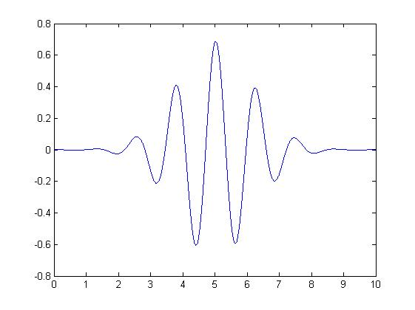
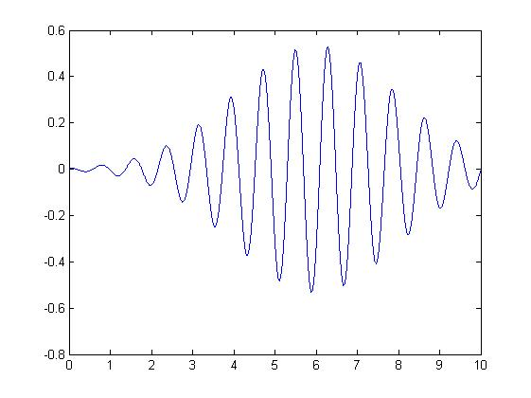
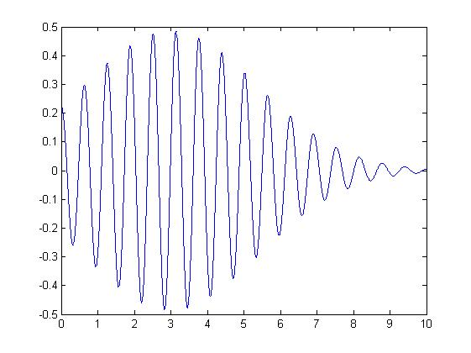
Introduction
$$s=3, u=5, ξ=5$$
$$s=5, u=6, ξ=8$$
$$s=6, u=3, ξ=10$$

Slide 5
Introduction
Matching pursuit is an iteration algorithm, that decomposed any signal into a linear expansion of waveforms that belong to a redundant dictionary of functions.
These waveforms are selected in order to best match the signal structures.
Although a matching pursuit is nonlinear, like an orthogonal expansion, it maintains an energy conservation which guaranties its convergence

Slide 6
Introduction
$\left\|f\right\|= \int_{−∞}^{∞}{{\left|f\left(t\right)\right|}^{2}dt< +∞}$
$<f,g> = \int_{−∞}^{∞}{f\left(t\right)\overline{g(t)} dt}$
H : Hilbert space
$Γ$ : index set of vectors
D : $\text{dictionary} \left\{ g_{γ}∈H \right| γ∈Γ \}$
$V$ : linear span of $D.$ $i.e. V={\left\{ \sum_{γ∈Γ}{c_{γ}g_{γ}}\right\}}_{c_{γ}∈R}$
$V$ is complete if and only if $V=H$.

Slide 7
Introduction
Two major dictionaries for the decomposition
1. Fourier transform dictionary --- atom:${ e}^{j2πft}$
2. Wavelet transform dictionary --- atom: $\frac{1}{\sqrt{s}}g\left(\frac{t−u}{s}\right)$ g is the mother wavelet
But they are in some sense not flexible enough

Slide 8
Decomposition
$f=〈f,g_{γ_{0}}〉g_{γ_{0}}+Rf$
$R^{m}f$ : the residual vector of $f$ after $m$ successive projections, $R^{0}f=f$
It is clear that the residue vector of f is orthogonal to $g_{γ_{0}}$
$\left|〈f,g_{γ_{0}}〉\right|≥α\sup_{γ∈Γ}\left|〈f,g_{γ}〉\right|$
$where α$ is an optimal factor that satisfies $0≤α≤1$.

Slide 9
Decomposition
A matching pursuit is an iterative algorithm
we are to select $g_{γ_{n}}$
$$R^{n}f=〈R^{n}f,g_{γ_{n}}〉g_{γ_{n}}+R^{n+1}f$$
such that
$$\left|〈R^{n}f,g_{γ_{n}}〉\right|≥α\sup_{γ∈Γ}\left|〈R^{n}f,g_{γ}〉\right|$$
$where α$ is an optimal factor that satisfies $0≤α≤1$.

Slide 10
Decomposition
$$f=〈R^{0}f,g_{γ_{0}}〉g_{γ_{0}}+R^{1}f \\ =〈R^{0}f,g_{γ_{0}}〉g_{γ_{0}}+〈R^{1}f,g_{γ_{1}}〉g_{γ_{1}}+R^{2}f \\ =… \\ =\sum_{n=0}^{m−1}{〈R^{n}f,g_{γ_{n}}〉g_{γ_{n}}}+R^{m}f$$
$${\left\|f\right\|}^{2}=\sum_{n=0}^{m−1}{{\left\|〈R^{n},g_{γ_{n}}〉\right\|}^{2}}+{\left\|R^{m}f\right\|}^{2}$$
$${\left\|g_{r_{n}}\right\|}^{2}=1$$

Slide 11
Decomposition
If the dictionary D is complete, for $f∈H$
$$f= \sum_{n=0}^{n=m−1}{<R^{n}f,g_{r_{n}}>}g_{r_{n}}$$
The vector $f$ is characterized by the sequence of two entries $\left(〈R^{n}f,g_{γ_{n}}〉,γ_{n}\right)$
This sequence is called the structure book
Two special cases
Smallest complete dictionary : basis
Largest complete dictionary : All vectors in H

Slide 12
Back - projection
$W$ be the orthogonal complement of $V$ in $H$
$P_{V}$ and $P_{W}$ be the projectors over $V$ and $W$
f $=\sum_{n=0}^{n=m−1}{〈R^{n}f,g_{γ_{n}}〉g_{γ_{n}}}+R^{m}f$
at the m^{th} iteration there are m vectors $(g_{γ_{n}}, n=0,…,m−1)$ already determined. Let $V_{m}$ be the subspace spanned by these vectors
$$P_{V_{m}}f=\sum_{n=0}^{n=m−1}{〈R^{n}f,g_{γ_{n}}〉g_{γ_{n}}}+P_{V_{m}}R^{m}f$$

Slide 13
Back - projection
$P_{V_{m}}f=\sum_{n=0}^{n=m−1}{〈R^{n}f,g_{γ_{n}}〉g_{γ_{n}}}+P_{V_{m}}R^{m}f$
$Approximation : f ≅ \sum_{n=0}^{n=m−1}{〈R^{n}f,g_{γ_{n}}〉g_{γ_{n}}}$
it may not be the best approximation , the reason is that in general $P_{V_{m}}\left(R^{m}f\right)≠0$.
i.e. ${ P}_{V_{m}}R^{m}f=\sum_{n=0}^{n=m−1}{x_{n}}g_{γ_{n}}$
Structure book : replace $〈R^{n},g_{γ_{n}}〉$ by $〈R^{n},g_{γ_{n}}〉+x_{n}$

Slide 14
Back - projection
To find $x_{i}$ we take an inner product with $g_{γ_{k}}$
$$〈P_{V_{m}}R^{m}f,g_{γ_{k}}〉=\sum_{n=0}^{m−1}{x_{n}}〈g_{γ_{n}},g_{γ_{k}}〉$$
the coefficients can be known by solving this linear system.
With back-projection, the error becomes
$${\left\|f\right\|}^{2}−{\left\|P_{V_{m}}f\right\|}^{2}={\left\|P_{W_{m}}f\right\|}^{2}={\left\|P_{W_{m}}R^{m}f\right\|}^{2}={\left\|R^{m}f\right\|}^{2}−{\left\|P_{V_{m}}R^{m}f\right\|}^{2}≤{\left\|R^{m}f\right\|}^{2}$$

Slide 15
The choice function
When the dictionary is very redundant, we can limit the space of search to a sub-dictionary. Let $Γ_{α}⊂Γ$
$$\sup_{γ∈Γ_{α}}\left|〈f,g_{γ}〉\right|≥α\sup_{γ∈Γ}\left|〈f,g_{γ}〉\right|$$
$where α$ is an optimal factor that satisfies $0≤α≤1$.
The size of $Γ_{α}$ can be much reduced from that of $Γ$ for most of the case. Then we defined the sub-dictionary $D_{α}$ by $\left\{g_{γ} | γ∈Γ_{α}\right\}$

Slide 16
The choice function
First search is in $D_{α}$.
$$〈R^{n}f,g_{\tilde{γ_{n}}}〉=\sup_{γ∈Γ_{∝}}\left|〈R^{n}f,g_{γ}〉\right|$$
Second search in a neighborhood of $g_{\tilde{γ_{n}}}$ with Newton method
find an element $g_{γ_{n}}$ where $\left|〈R^{n}f,g_{γ_{n}}〉\right|$ reaches a local maxima
$\left|〈R^{n}f,g_{γ_{n}}〉\right|≥\left|〈R^{n}f,g_{\tilde{γ_{n}}}〉\right|≥α\sup_{γ∈Γ}\left|〈f,g_{γ}〉\right|$
We compute the inner product with all $g_{γ}∈D_{α}$
$R^{n}f=〈R^{n}f,g_{γ_{n}}〉g_{γ_{n}}+R^{n+1}f$
$〈R^{n+1}f, g_{γ}〉=〈R^{n}f,g_{γ}〉−〈R^{n}f,g_{γ_{n}}〉〈g_{γ_{n}},g_{γ}〉$

Slide 17
The number of iteration
The number of iteration is determined by the precision we desire
If the desired precision is $ϵ$, the number of iteration is the minimum $p$ such that
$\left\|R^{p}f\right\|=\left\|f−\sum_{n=0}^{p−1}{〈R^{n}f,g_{γ_{n}}〉}\right\|≤ε\left\|f\right\|$
this is equivalent to
${\left\|f\right\|}^{2}−\sum_{n=0}^{p−1}{{\left|〈R^{n}f,g_{γ_{n}}〉\right|}^{2}}≤ε\left\|f\right\|$

Slide 18
The convergence
To realize the decay rate of the energy of residual vector $\left\|R^{n}f\right\|$,
we defined the correlation ratio of a function $f∈H$ with respect to $D$ by
$$λ\left(f\right)=\sup_{γ∈Γ}{\frac{\left|〈f,g_{γ}〉\right|}{\left\|f\right\|}}$$
$I\left(λ\right) :=\inf_{f∈H}{λ(f)}>0$.

Slide 19
The convergence
$\left|〈R^{n}f,g_{γ_{n}}〉\right|≥α\sup_{γ∈Γ}\left|〈R^{n}f,g_{γ}〉\right|=αλ\left(R^{n}f\right)‖R^{n}f‖$
${\left\|R^{n+1}f\right\|}^{2}={\left\|R^{n}f\right\|}^{2}−{\left|〈R^{n}f,g_{γ_{n}}〉\right|}^{2}$ $≤{\left\|R^{n}f\right\|}^{2}−α^{2}λ^{2}\left(R^{n}f\right){\left\|R^{n}f\right\|}^{2}$
$\left\|R^{n+1}f\right\|≤{‖R^{n}f‖\left(1−α^{2}λ^{2}\left(R^{n}f\right)\right)}^{1/2}$
$\left\|R^{m}f\right\|≤\left\|f\right\|\prod_{n=0}^{m−1}{{\left(1−α^{2}λ^{2}\left(R^{n}f\right)\right)}^{\frac{1}{2}}}$ $$≤\left\|f\right\|{\left(1−α^{2}I\left(λ\right)\right)}^{\frac{m}{2}}$$

Slide 20
Definition of atom
To carry out matching pursuit, dictionaries of time-frequency atoms are mostly considered
A general family of time-frequency atoms can be generated by scaling, translating and modulating a window function $g\left(t\right)∈$ H
1.$g\left(t\right)$is real, continuously differentiable
2.O( $\frac{1}{t^{2}+1}$ )
$3.\left\|g(t)\right\|=1$
4.The integral of $g(t)$ is nonzero
$5.g\left(0\right)≠0$

Slide 21
Definition of atom
Let $s>0$ be the scale, $ξ$ be the frequency modulating and $u$ be the translation in time. We define the vector $γ$ and index set $Γ$ by $γ=\left(s,u,ξ\right)∈R^{+}×R^{2}=Γ$. Then we define time-frequency atoms
$$g_{γ}\left(t\right)=\frac{1}{\sqrt{s}}g\left(\frac{t−u}{s}\right)e^{jξt}$$
which the factor $1/\sqrt{s}$ normalize the norm to be 1.
The family $D=\left\{g_{γ}\left(t\right)\right| γ∈Γ\}$ is extremely large. To represent efficiently function $f(t)$, we select a countable subset ${\{g}_{γ_{n}}\left(t\right)\left| n∈N\right\}$ with $γ_{n}=\left(s_{n},ξ_{n},u_{n}\right)$ so that
$$f\left(t\right)=\sum_{n=−∞}^{∞}{a_{n}g_{γ_{n}}(t)}$$

Slide 22
Definition of atom
When the real signal $f\left(t\right)$ is to be decomposed to real expansion, real time-frequency atoms must be used. It is defined as
$$g_{\left(γ,φ\right)}\left(t\right)=\frac{K_{\left(γ,φ\right)}}{\sqrt{s}}g\left(\frac{t−u}{s}\right)\cos\left(ξt+φ\right)$$
$K_{\left(γ,φ\right)}$ is a constant that normalized the norm of $g_{\left(γ,φ\right)}\left(t\right)$ to 1
The dictionary is thus defined by $D=\left\{g_{\left(γ,φ\right)}|γ∈Γ,φ∈\left[0, 2π\right)\right\}$
The matching pursuit with this dictionary is to decompose real $f\left(t\right)$ by
$$f\left(t\right)=\sum_{n=0}^{∞}{〈R^{n}f,g_{\left(γ_{n},φ_{n}\right)}〉g_{\left(γ_{n},φ_{n}\right)}\left(t\right)}$$
$$g_{\left(γ,φ\right)}\left(t\right)=\frac{K_{\left(γ,φ\right)}}{2}\left(e^{jφ}g_{γ}\left(t\right) +e^{−jφ}g_{γ−}\left(t\right) \right)$$
$γ=(s,u,ξ)$ and $γ^{−}=\left(s,u,−ξ\right)$

Slide 23
The energy density function
Wigner distribution function (WDF) of functions $f\left(t\right)$ and $g\left(t\right)$ is defined by
$$W_{f,h}\left(t,ω\right)=\int_{−∞}^{∞}{f\left(t+\frac{τ}{2}\right)h^{∗}\left(t−\frac{τ}{2}\right)}e^{−jωτ}dτ$$
And the Wigner distribution of $f(t)$ is $W_{f}\left(t,ω\right)=W_{f,f}\left(t,ω\right)$.
Since the time-frequency dictionary is complete for $f∈H$ we write
$$f=\sum_{n=0}^{∞}{〈R^{n}f,g_{γ_{n}}〉g_{γ_{n}}}$$
The WDF of it is
$$W_{f}\left(t,ω\right)=\sum_{n=0}^{∞}{{\left|〈R^{n}f,g_{γ_{n}}〉\right|}^{2}W_{g_{γ_{n}}}\left(t,ω\right)}+\sum_{n=0}^{∞}{\sum_{\begin{aligned}m=0 \\ m≠n\end{aligned}}^{∞}{〈R^{n}f,g_{γ_{n}}〉}{〈R^{m}f,g_{γ_{n}}〉}^{∗}W_{g_{γ_{n}},g_{γ_{m}}}}\left(t,ω\right)$$

Slide 24
The energy density function
$W_{g_{γ}}\left(t,ω\right)=\frac{1}{2π}\int_{−∞}^{∞}{\frac{1}{\sqrt{s}}g\left(\frac{t+\frac{τ}{2}−u}{s}\right)e^{jξ\left(t+\frac{τ}{2}\right)}\frac{1}{\sqrt{s}}g^{∗}\left(\frac{t−\frac{τ}{2}−u}{s}\right)e^{−jξ\left(t−\frac{τ}{2}\right)}e^{−jωτ}dτ}$ $=\frac{1}{2π}\int_{−∞}^{∞}{\frac{1}{s}g\left(\frac{t−u}{s}+\frac{τ}{2s}\right)g^{∗}\left(\frac{t−u}{s}−\frac{τ}{2s}\right)e^{−j\left(ω−ξ\right)τ}} dτ$ $=\frac{1}{2π}\int_{−∞}^{∞}{g\left(\frac{t−u}{s}+\frac{τ^{′}}{2}\right)g^{∗}\left(\frac{t−u}{s}−\frac{τ^{′}}{2}\right)e^{−jS\left(ω−ξ\right)τ^{′}}} dτ^{′}$ $=W_{g}\left(\frac{t−u}{s},s\left(ω−ξ\right)\right)$
$E_{f}\left(t,ω\right)∶=\sum_{n=0}^{∞}{{\left|〈R^{n}f,g_{γ_{n}}〉\right|}^{2}W_{g_{γ_{n}}}\left(t,ω\right)}$

Slide 25
The energy density function
$E_{f}\left(t,ω\right)∶=\sum_{n=0}^{∞}{{\left|〈R^{n}f,g_{γ_{n}}〉\right|}^{2}W_{g_{γ_{n}}}\left(t,ω\right)}$
$E_{f}\left(t,ω\right)=\sum_{n=0}^{∞}{{\left|〈R^{n}f,g_{γ_{n}}〉\right|}^{2}W_{g}\left(\frac{t−u_{n}}{s_{n}},s_{n}\left(ω−ξ_{n}\right)\right)}$
For real decomposition
$$E_{f}\left(t,ω\right)=\sum_{n=0}^{∞}{{\frac{1}{2}\left|〈R^{n}f,g_{\left(γ_{n},φ_{n}\right)}〉\right|}^{2}\left[W_{g_{\left(γ_{n},φ_{n}\right)}}\left(t,ω\right)+W_{g_{\left(γ_{n}−,φ_{n}\right)}}\left(t,ω\right)\right]} \\ =\frac{1}{2}\sum_{n=0}^{∞}{{\left|〈R^{n}f,g_{\left(γ_{n},φ_{n}\right)}〉\right|}^{2}\left[W_{g}\left(\frac{t−u_{n}}{s_{n}},s_{n}\left(ω−ξ_{n}\right)\right)+W_{g}\left(\frac{t−u_{n}}{s_{n}},s_{n}\left(ω+ξ_{n}\right)\right)\right]}$$

Slide 26
The Gabor dictionaries and the formulation for discrete implementation
$g\left(t\right)$ is a Gaussian window defined as $g\left(t\right)=2^{1/4}e^{−πt^{2}}$
$g_{γ}\left(t\right)$ are called Gabor functions
$W_{g}\left(t,ω\right)=2e^{−2π\left(t^{2}+{\left(\frac{ω}{2π}\right)}^{2}\right)}$

Slide 27
The Gabor dictionaries and the formulation for discrete implementation
The number of samples in the input signal be $N$
The scale $s$ can only vary between $1$ and $N$
The input signal and the Gaussian windows are expanded to be periodic with period $N$
The step size of time is 1 and that of frequency is $2π/N$
So the vector index is in the form $γ=\left(s,p,2πk/N\right)$ with $s∈\left(1,N\right)$, $p,k∈Z$, $0≤p<N$ and $0≤k<N$.
The Hilbert space $H$ is defined as the space of discrete signals of period $N$, which has dimension $N$.

Slide 28
The Gabor dictionaries and the formulation for discrete implementation
$g_{s}\left(n\right)=\frac{K_{s}}{\sqrt{s}}\sum_{l=−∞}^{∞}{g\left(\frac{n−lN}{s}\right)}$
$K_{s}$ normalize the norm of $g_{s}$ to unity
$g_{γ}\left(n\right)=g_{s}\left(n−p\right)e^{j\left(\frac{2πk}{N}\right)n}$
For real decomposition with $φ∈\left[0, 2π\right)$
$g_{\left(γ,φ\right)}\left(n\right)=K_{\left(γ,φ\right)}g_{s}\left(n−p\right)\cos\left(\frac{2πk}{N}n+φ\right)$
$K_{\left(γ,φ\right)}$ normalize the norm to unity.

Slide 29
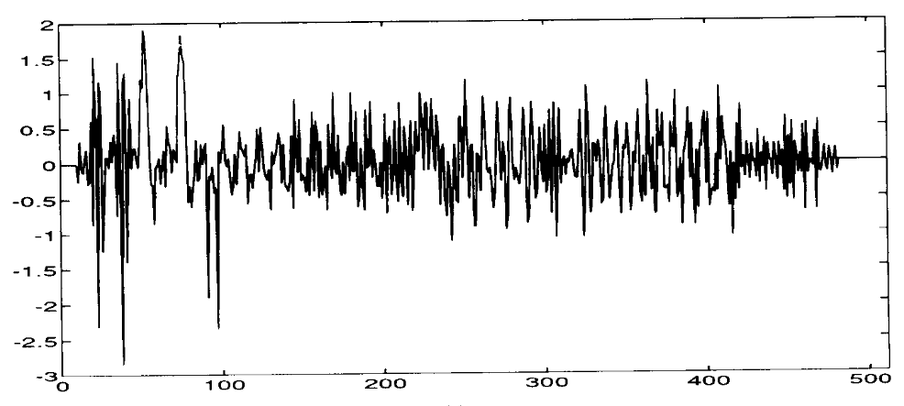
The Gabor dictionaries and the formulation for discrete implementation
A signal of 512 samples was built by adding chirp functions, truncated sinusoidal waves and waveforms of different time-frequency localizations
Figure.1: The testing waveform [1]

Slide 30
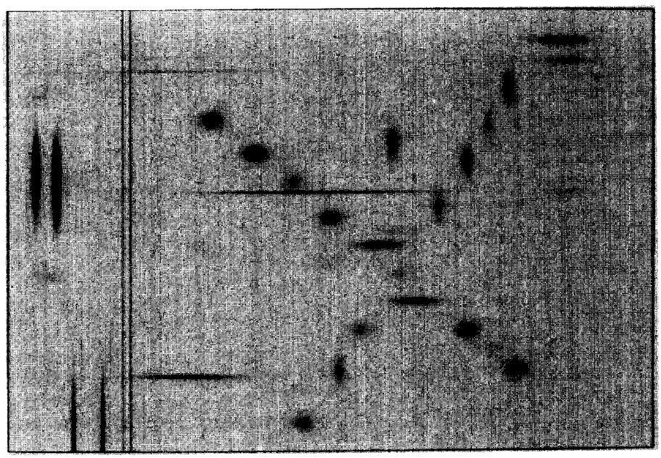
The Gabor dictionaries and the formulation for discrete implementation
Figure.2: Time-frequency energy distribution of the signal in Figure.1 [1]

Slide 31
Conclusion
Matching pursuit is a flexible decomposition algorithm that adaptively matches the so-called the coherent structures of a signal
A general class of the dictionary is the set of time-frequency atoms, characterized by the scale, the time shift and the frequency modulation.
With the use of such atoms, the signature of a signal can be captured so that we can express the signal by an expansion of much fewer elementary waveforms.
The matching pursuit requires a double search process for getting time-frequency components, so the complexity may be too high for some applications.
We can see that in the future, to find optimal dictionaries and to reduce the computational complexity are two critical issue in the development of this approach.

Slide 32
Conclusion
The matching pursuit algorithm
Input: signal f(t), dictionary D, threshold ε
Initialization: $R^{0}f←f(t)$ , $n ←0$
Obtain the subset $Γ_{α}$ and the subdictionary $D_{α}$
Iteration:
Repeat
Compute the inner product of $R^{n}f and each g_{γ}∈D_{α}$
Find locally optimal $g_{γ_{n}}$ by choice function
Compute ${<g}_{γ_{n}},$ $g_{γ}$> to get ${<R}^{n}f,g_{γ}>$
Record optimal inner product and index set
Until $\left\|R^{n}f\right\|<ε$
Output: structure book ($<R^{n}f,g_{γ_{n}}>,γ_{n}$)

Slide 33
Appendix – new atoms
Gabor atomic dictionary
$$g_{γ}\left(t\right)=\frac{1}{\sqrt{s}}g(\frac{t−u}{s})e^{iξt}$$
Chirplet atomic dictionary [2]
$$g_{γ}\left(t\right)=\frac{1}{\sqrt{s}}g(\frac{t−u}{s})e^{i(ξt+\frac{1}{2}ct^{2}+φ)}$$
Advanced chirplet atomic dictionary [3]
$$g_{γ}\left(t\right)=\frac{1}{\sqrt{s}}g(\frac{t−u}{s})e^{i(ξt+\frac{1}{2}ct^{2}+\frac{1}{3}rt^{3}+φ)}$$
Sinusoidal chirplet atomic dictionary [3]
$$g_{γ}\left(t\right)=\frac{1}{\sqrt{s}}g(\frac{t−u}{s})e^{i(ξt+\frac{1}{2}ct^{2}+\frac{1}{2}sinωt+φ)}$$

Slide 34
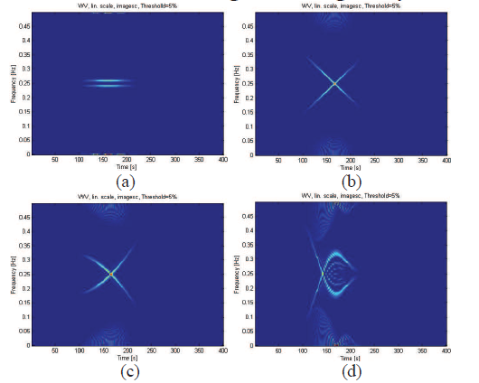
Appendix - the WVD of atoms
Figure.3:
(a) Gabor atom (b) Chirplet atom
(c) Advanced chirplet atom (d) sinusoidal chirplet atom [3]

Slide 35
Reference
[1] S.G. Mallat, and Z. Zhang, “Matching pursuit with time-frequency dictionaries,” IEEE Trans. Signal Processing,vol.41,no. 12,pp. 3397-3415, Dec. 1993
[2] A. Bultan, “A four-parameter atomic decomposition of chirplets,” IEEE Trans. Signal Processing, vol. 47, no. 3,pp. 731 -745, March 1999.
[3] Y Zhou, X Wang, Y Tian, and D Zhou, “A novel time-frequency atomic dictionary for radar intra-pulse modulation signal sparse representation,” Microwave Conference (APMC), 2015 Asia-Pacific
[4] H Zou, Q Dai, R Wang, and Y Li , “Parametric TFR via windowed exponential frequency modulated atoms,” IEEE Trans. Signal Processing, vol. 8, no. 5,pp. 140 - 142, May 2001.

