Slide 1
Model Compression
NTU DISP Lab Group Meeting
2024/01/02
電信碩二 顏勁賢

Slide 2
Outline
Pruning
Model Design
Knowledge Distillation
Parameter Quantization

Slide 3
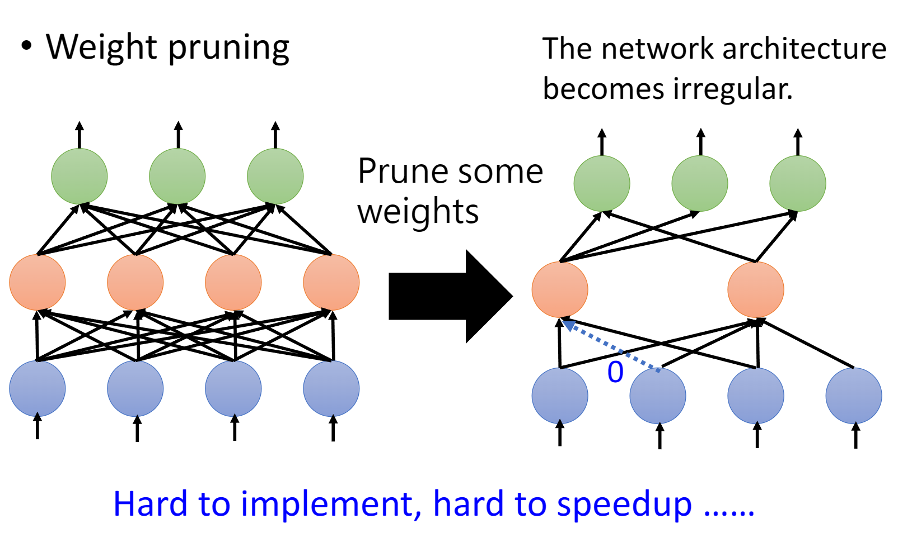
Pruning
Weight Pruning
Reference: https://speech.ee.ntu.edu.tw/~hylee/ml/2023-spring.php, Network Compression

Slide 4
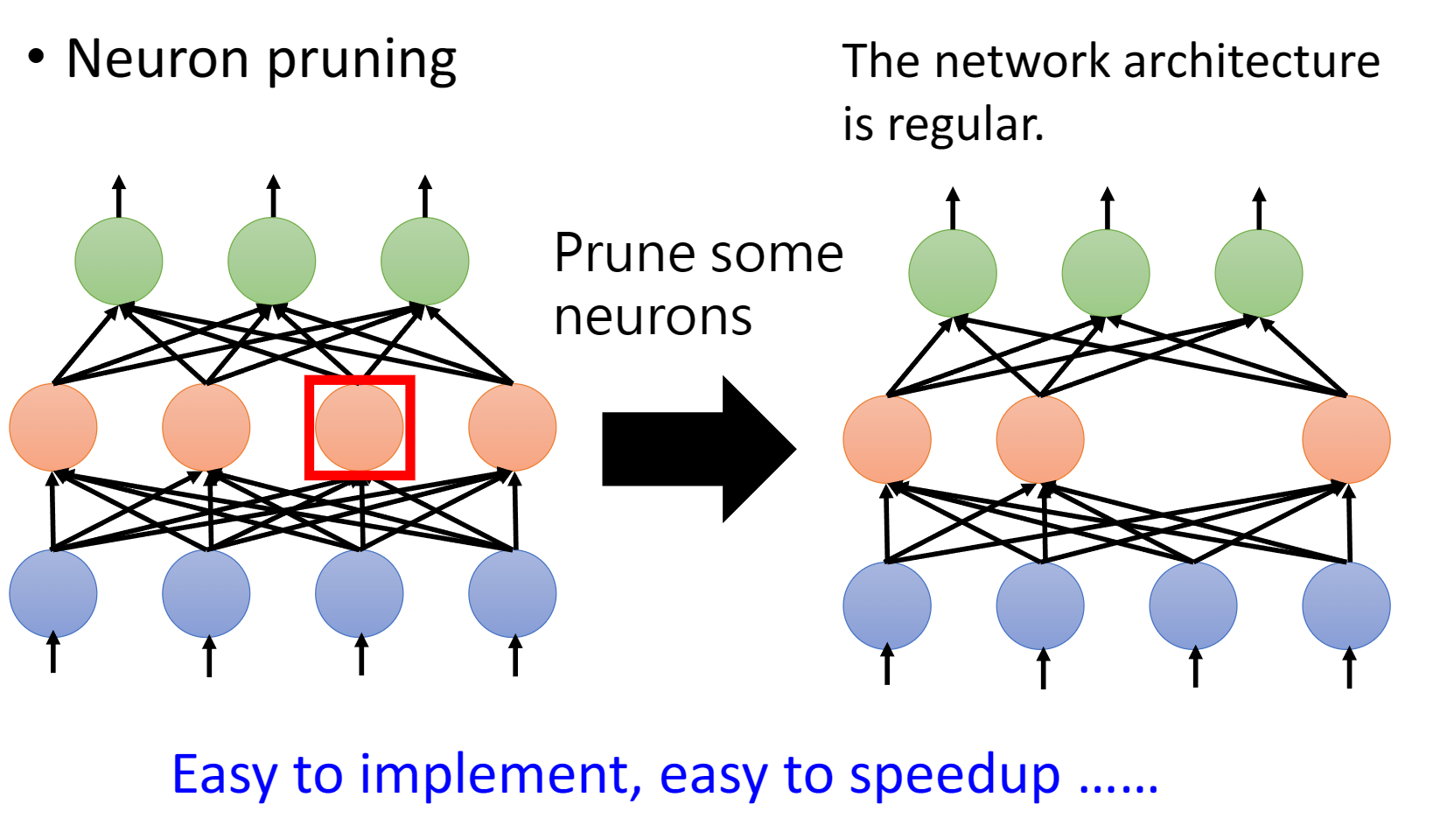
Pruning
Neuron Pruning
Reference: https://speech.ee.ntu.edu.tw/~hylee/ml/2023-spring.php, Network Compression

Slide 5
Model Design
SqueezeNet
MobileNet
ShuffleNet

Slide 6
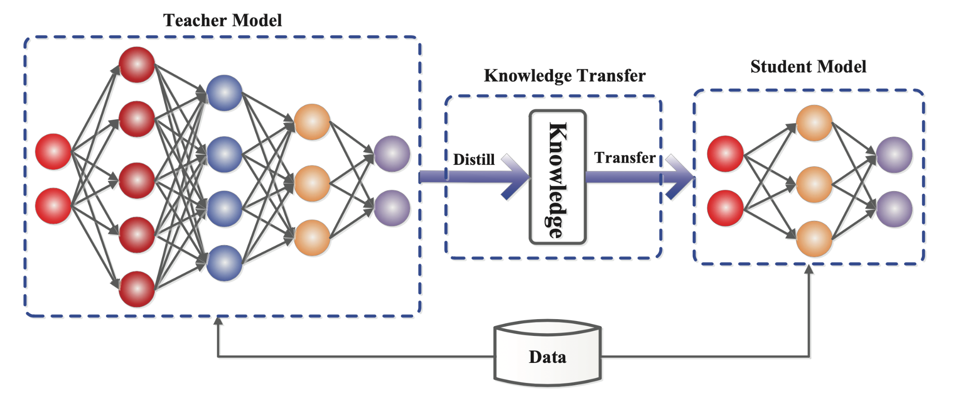
Knowledge Distillation
Reference: arXiv:2006.05525

Slide 7
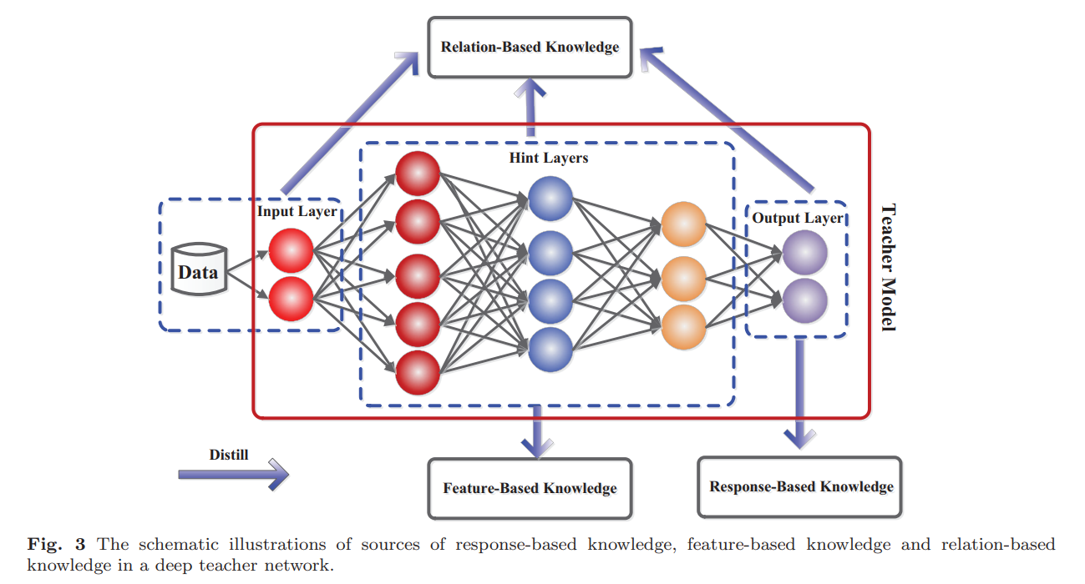
Knowledge Distillation
Response-Based
Feature-Based
Relation-Based
Reference: arXiv:2006.05525

Slide 8
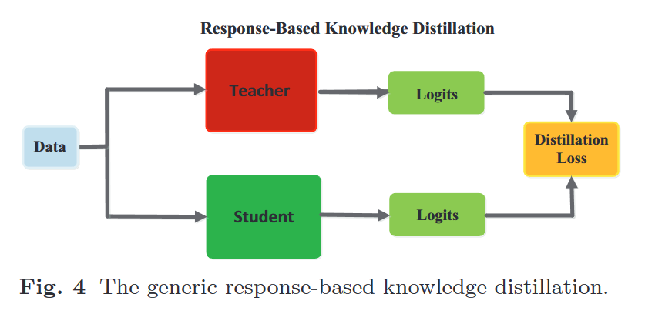
Knowledge Distillation
Response-Based
Feature-Based
Relation-Based
Reference: arXiv:2006.05525

Slide 9
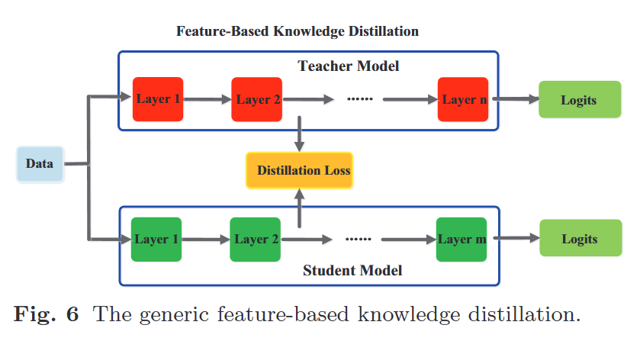
Knowledge Distillation
Response-Based
Feature-Based
Relation-Based
Reference: arXiv:2006.05525

Slide 10
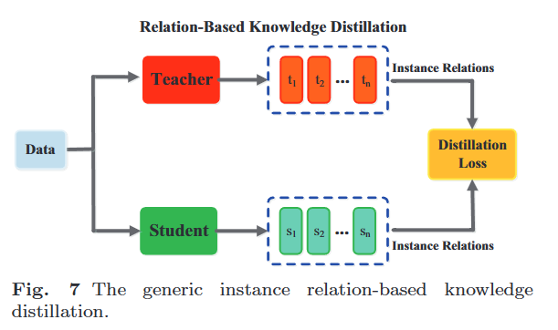
Knowledge Distillation
Response-Based
Feature-Based
Relation-Based
Reference: arXiv:2006.05525

Slide 11
Parameter Quantization
FP32
4 bytes
112.34567
INT8
1 byte
123
Quantization-aware training
Post-training Quantization

Slide 12
Parameter Quantization
FLOAT to INT4
Reference: https://chih-sheng-huang821.medium.com/ai%E6%A8%A1%E5%9E%8B%E5%A3%93%E7%B8%AE%E6%8A%80%E8%A1%93-%E9%87%8F%E5%8C%96-quantization-966505128365

Slide 13
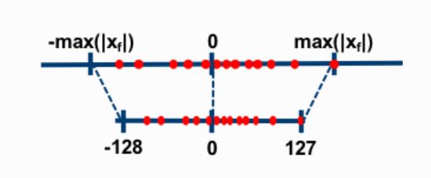
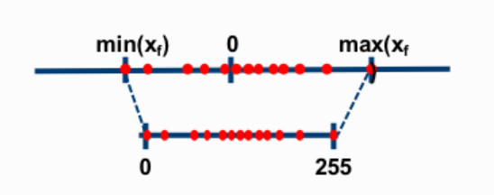
Parameter Quantization
Symmetric
INT4: 0, 1, 2, …, 15
Asymmetric
INT4: -8, -6, …, 0, 1, …, 7
Reference: https://intellabs.github.io/distiller/algo_quantization.html

Slide 14
Symmetric Quantization
Step 1, Find maximum value
Step 2, Compute scale factor
Step 3, Quantization
De-quantization
Reference: https://chih-sheng-huang821.medium.com/ai%E6%A8%A1%E5%9E%8B%E5%A3%93%E7%B8%AE%E6%8A%80%E8%A1%93-%E9%87%8F%E5%8C%96-quantization-966505128365

Slide 15
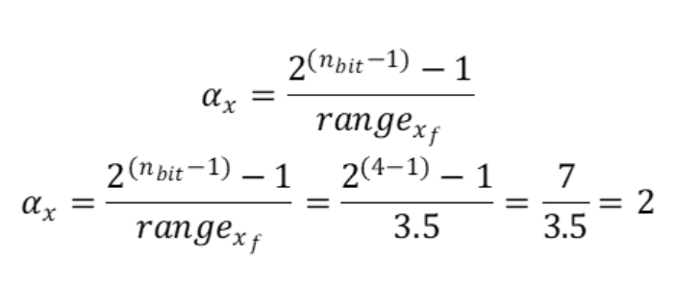
Symmetric Quantization
Step 1, Find maximum value
Step 2, Compute scale factor
Step 3, Quantization
De-quantization
Reference: https://chih-sheng-huang821.medium.com/ai%E6%A8%A1%E5%9E%8B%E5%A3%93%E7%B8%AE%E6%8A%80%E8%A1%93-%E9%87%8F%E5%8C%96-quantization-966505128365

Slide 16
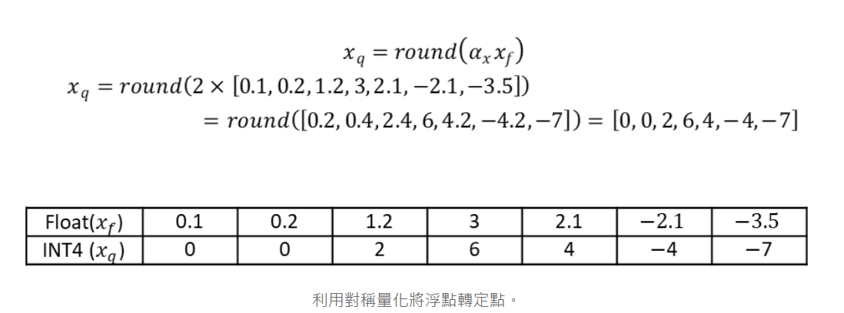
Symmetric Quantization
Step 1, Find maximum value
Step 2, Compute scale factor
Step 3, Quantization
De-quantization
Reference: https://chih-sheng-huang821.medium.com/ai%E6%A8%A1%E5%9E%8B%E5%A3%93%E7%B8%AE%E6%8A%80%E8%A1%93-%E9%87%8F%E5%8C%96-quantization-966505128365

Slide 17
Symmetric Quantization
Step 1, Find maximum value
Step 2, Compute scale factor
Step 3, Quantization
De-quantization
Reference: https://chih-sheng-huang821.medium.com/ai%E6%A8%A1%E5%9E%8B%E5%A3%93%E7%B8%AE%E6%8A%80%E8%A1%93-%E9%87%8F%E5%8C%96-quantization-966505128365

Slide 18
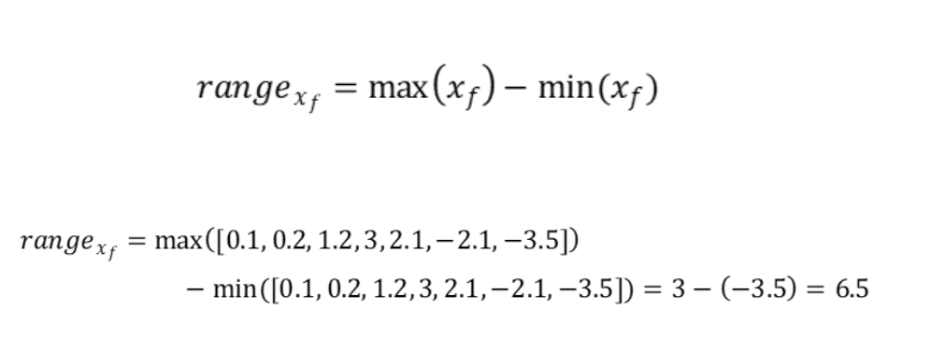
Asymmetric Quantization
Step 1, Find maximum value
Step 2, Compute scale factor
Step 3, Compute zero-point
Step 4, Quantization
De-quantization
Reference: https://chih-sheng-huang821.medium.com/ai%E6%A8%A1%E5%9E%8B%E5%A3%93%E7%B8%AE%E6%8A%80%E8%A1%93-%E9%87%8F%E5%8C%96-quantization-966505128365

Slide 19
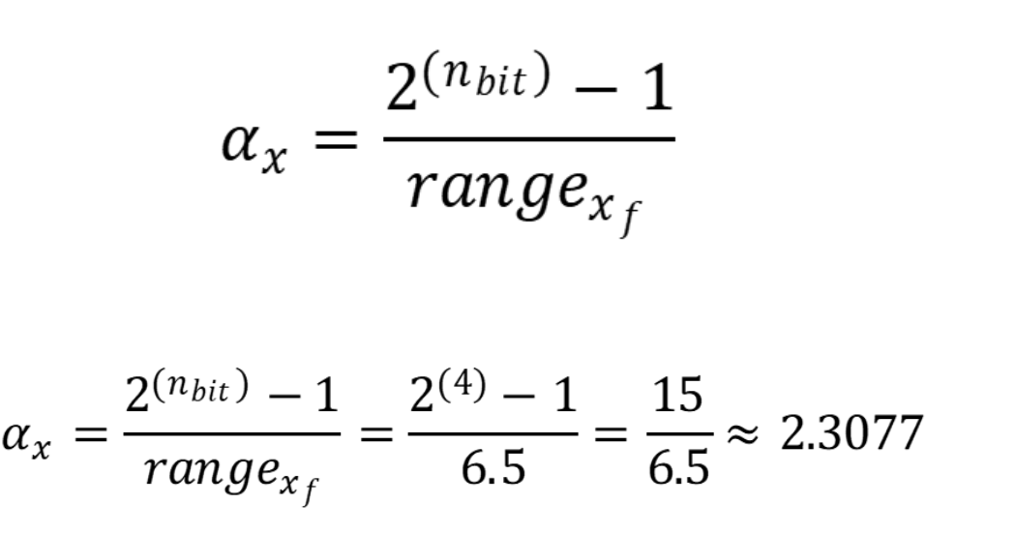
Asymmetric Quantization
Step 1, Find maximum value
Step 2, Compute scale factor
Step 3, Compute zero-point
Step 4, Quantization
De-quantization
Reference: https://chih-sheng-huang821.medium.com/ai%E6%A8%A1%E5%9E%8B%E5%A3%93%E7%B8%AE%E6%8A%80%E8%A1%93-%E9%87%8F%E5%8C%96-quantization-966505128365

Slide 20
Asymmetric Quantization
Step 1, Find maximum value
Step 2, Compute scale factor
Step 3, Compute zero-point
Step 4, Quantization
De-quantization
Reference: https://chih-sheng-huang821.medium.com/ai%E6%A8%A1%E5%9E%8B%E5%A3%93%E7%B8%AE%E6%8A%80%E8%A1%93-%E9%87%8F%E5%8C%96-quantization-966505128365

Slide 21
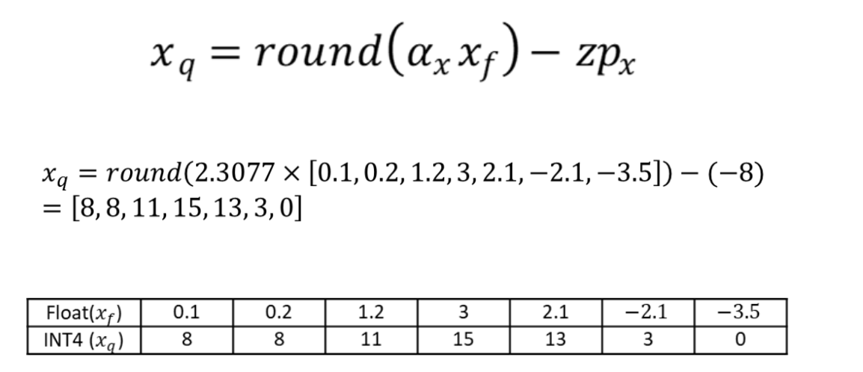
Asymmetric Quantization
Step 1, Find maximum value
Step 2, Compute scale factor
Step 3, Compute zero-point
Step 4, Quantization
De-quantization
Reference: https://chih-sheng-huang821.medium.com/ai%E6%A8%A1%E5%9E%8B%E5%A3%93%E7%B8%AE%E6%8A%80%E8%A1%93-%E9%87%8F%E5%8C%96-quantization-966505128365

Slide 22
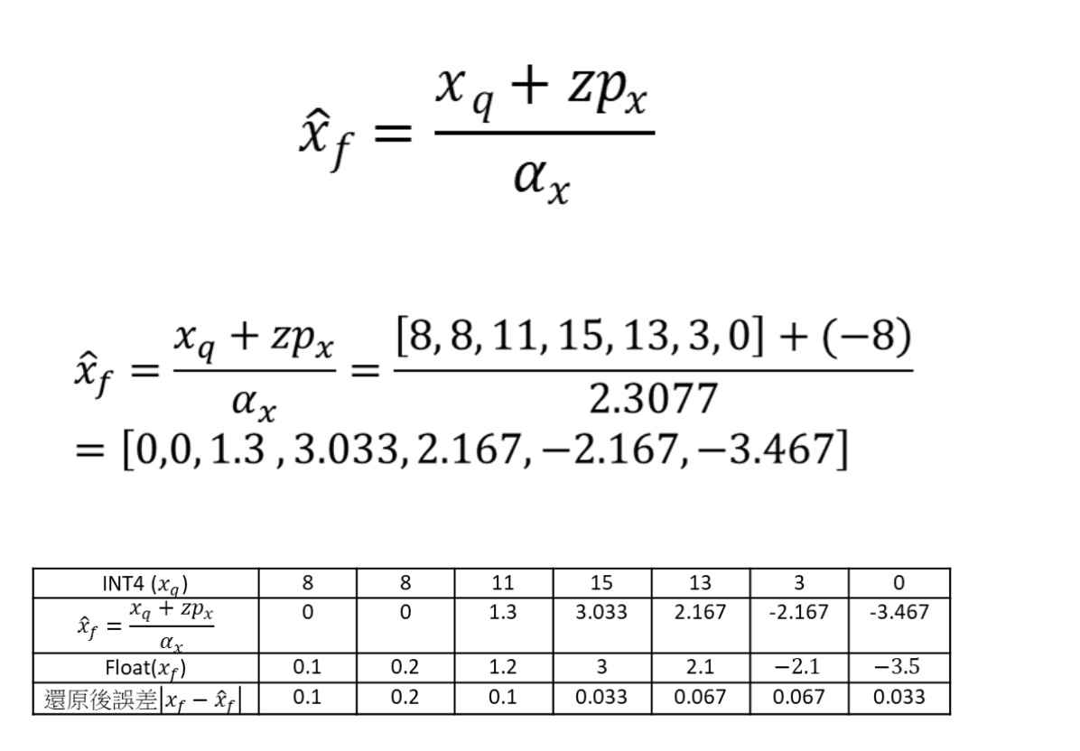
Asymmetric Quantization
Step 1, Find maximum value
Step 2, Compute scale factor
Step 3, Compute zero-point
Step 4, Quantization
De-quantization
Reference: https://chih-sheng-huang821.medium.com/ai%E6%A8%A1%E5%9E%8B%E5%A3%93%E7%B8%AE%E6%8A%80%E8%A1%93-%E9%87%8F%E5%8C%96-quantization-966505128365

Slide 23
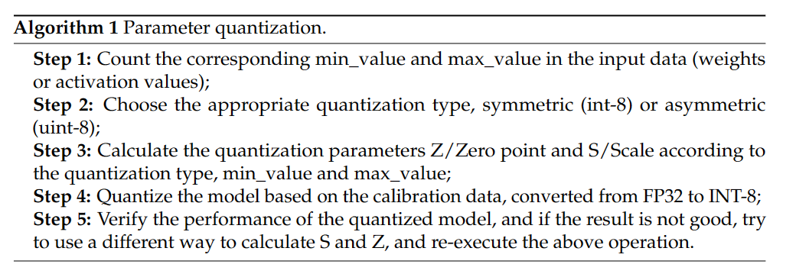
Quantization
Less storage overhead and bandwidth requirements
Lower power consumption
Faster calculation speed
Reference: https://www.mdpi.com/2073-431X/12/3/60

Slide 24
Reference
[1] Lee, H. (2023). MACHINE LEARNING 2023 SPRING. https://speech.ee.ntu.edu.tw/~hylee/ml/2023-spring.php
[2] Huang, T. (2022, September 4). AI模型壓縮技術-量化(Quantization). Medium. https://chih-sheng-huang821.medium.com/ai%E6%A8%A1%E5%9E%8B%E5%A3%93%E7%B8%AE%E6%8A%80%E8%A1%93-%E9%87%8F%E5%8C%96-quantization-966505128365
[3] Guo, J., Yu, B., Maybank, S. J., & Tao, D. (2021, May 20). Knowledge Distillation: A Survey. Arxiv. https://arxiv.org/abs/2006.05525
[4] Li, Z., Li, H., & Meng, L. (2023, March 12). Model Compression for Deep Neural Networks: A Survey. MDPI. https://www.mdpi.com/2073-431X/12/3/60
Reference: https://www.mdpi.com/2073-431X/12/3/60

