Slide 1
SPECTRAL NORMALIZATION FOR GENERATIVE ADVERSARIAL NETWORKS
Speaker:華祥志

Slide 2
Outline
Introduction of GAN
Spectral Normalization
Results on CIFAR-10 and STL-10
Conclusion

Slide 3
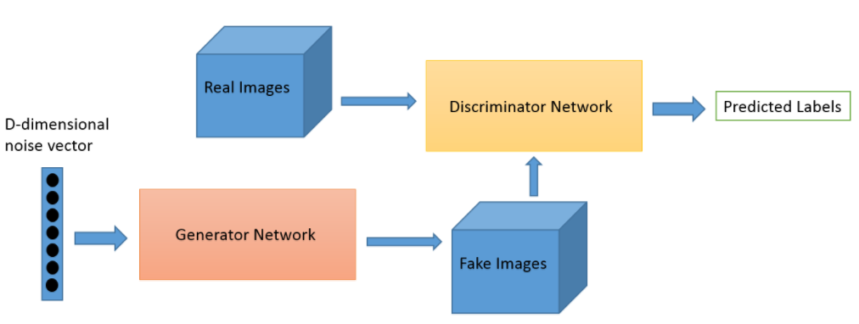
Generative Adversarial Network (GAN)

Slide 4
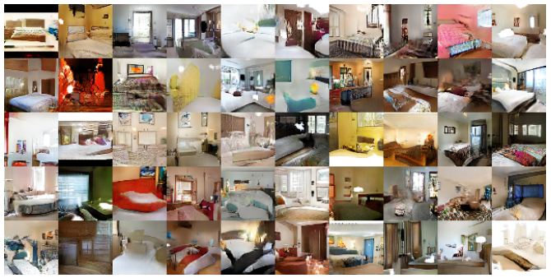
Generative Adversarial Network (GAN)
Generated bedrooms

Slide 5
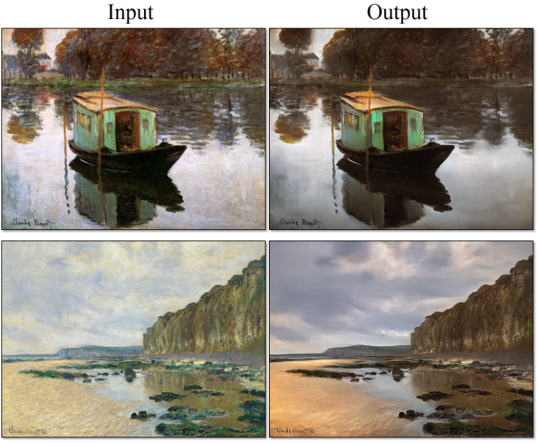
Generative Adversarial Network (GAN)
Style Transfer

Slide 6
Disadvantages
Non-convergence:
the model parameters oscillate, destabilize and never converge
Mode collapse:
the generator collapses which produces limited varieties of samples
Diminished gradient:
the discriminator gets too successful that the generator gradient
vanishes and learns nothing
Unbalance between the generator and discriminator causing overfitting
Highly sensitive to the hyperparameter selections.

Slide 7
Notations
Discriminator network
x : input image
, learning parameters set
a_{k} : element-wise non-linear activation function
Final output of the discriminator

Slide 8
Objective function
The standard formulation of GANs =
Usually
x is real image, x’ is fake image

Slide 9
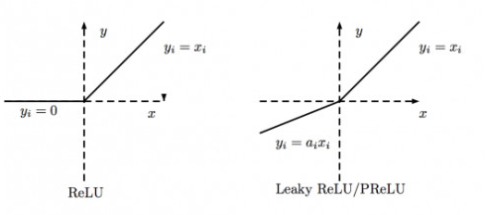
Lipschitz continuous
, for any x, x’
= the smallest possible value M
f = ReLU, leaky ReLU

Slide 10
Spectral norm
For matrix A, spectral norm
which is equivalent to the largest singular value of A
Each layer
Linear layer

Slide 11
Spectral norm
are all equal to 1, (e.g. leaky ReLU)
Upper bound on

Slide 12
Spectral Normalization (SN)
Normalizes the spectral norm of the weight matrix W
is bounded from above by 1
Use power method to produce the first left and right singular vectors
Approximate the spectral norm by

Slide 13
Gradient

Slide 14
Algorithm with spectral normalization

Slide 15
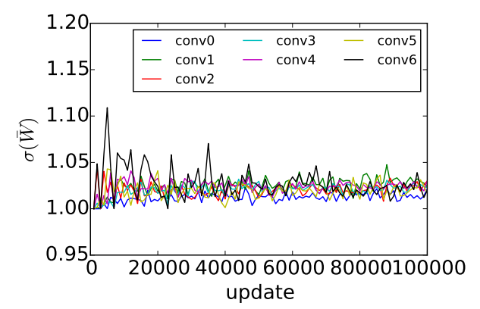
Accuracy
Spectral norms of all 7 convolutional layers in the standard CNN during course of the training on CIFAR-10

Slide 16
Results on CIFAR-10 and STL-10
Weight clipping (WC)
WGAN-GP
Batch normalization (BN)
Layer normalization (LN)
Weight normalization (WN)
Orthonormal regularization
SN-GAN

Slide 17
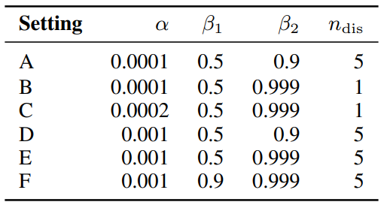
Results on CIFAR-10 and STL-10
Hyper-parameter settings
: learning rate
: first, second order momentum
(Adam Optimizer)
: number of updates of the discriminator
per one update of the generator

Slide 18
Inception Score
Image Quality & Image Diversity
higher is better

Slide 19
Frechet Inception Distance (FID)
are the mean and covariance matrix
lower is better

Slide 20
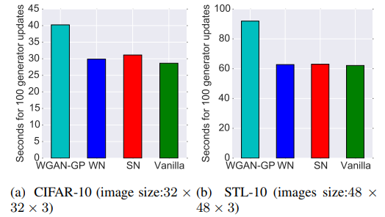
Training time
Computational time for 100 updates

Slide 21
Conclusion
Spectral normalization (SN) as a stabilizer of training of GANs.
The generated examples are more diverse than the conventional weight normalization and achieve better or comparative inception scores relative to previous studies.
The method imposes global regularization on the discriminator as opposed to local regularization introduced by WGAN-GP, and can possibly used in combinations.

Slide 22
Reference
[1] Miyato, Takeru, et al. "Spectral normalization for generative adversarial networks." arXiv preprint arXiv:1802.05957 (2018).
[2] Goodfellow, Ian, et al. "Generative adversarial nets." Advances in neural information processing systems. 2014.
[3] Gulrajani, Ishaan, et al. "Improved training of wasserstein gans." Advances in neural information processing systems. 2017.
[4] Warde-Farley, David, and Yoshua Bengio. "Improving generative adversarial networks with denoising feature matching." (2016).
[5] Radford, Alec, Luke Metz, and Soumith Chintala. "Unsupervised representation learning with deep convolutional generative adversarial networks." arXiv preprint arXiv:1511.06434 (2015).

