Slide 1
Singular Value Decomposition on solving Least Square optimization and Implementation
陳宏毅

Slide 2
Outline
Introduction
Theorems and Algorithms
  Singular Value Decomposition
  S.V.D on Least Square Optimization
  Applications of Least Square Optimization
Simulation Results
Conclusion
Reference

Slide 3
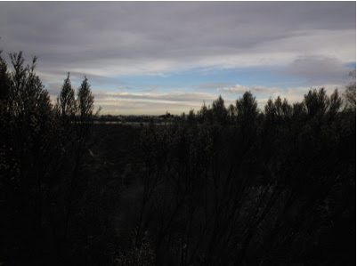
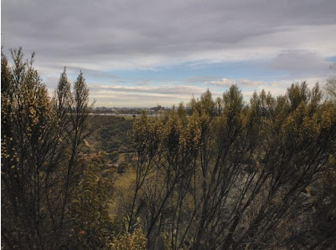
Introduction
  Singular Value Decomposition could solving data fitting and Least Square Optimization problem
  High Dynamic Range (H.D.R) Image Processing
  Edge-Preserving Filtering based on Local Extrema
(a) HDR processing
(b) Edge preserving
Notes:
HDR: 將多張曝光不同的照片疊加處理成一張保有細節、又更明亮的圖像
過度曝光處能增高彩度(天空)，低度曝光處能增加輪廓,細節。
Edge Preserving: 讓圖像上的Texture變的平滑但保留Structure Edges
讓處理後的圖形仍保有大致的結構

Slide 4
Outline
Introduction
Theorems and Algorithms
  Singular Value Decomposition
  S.V.D on Least Square Optimization
  Applications of Least Square Optimization
    Debevec’s HDR imaging
    Edge-Preserving Filtering based on Local Extrema
    Several Edge-preserving Filtering Methods Comparisonms
Simulation Results
Conclusion
Reference

Slide 5
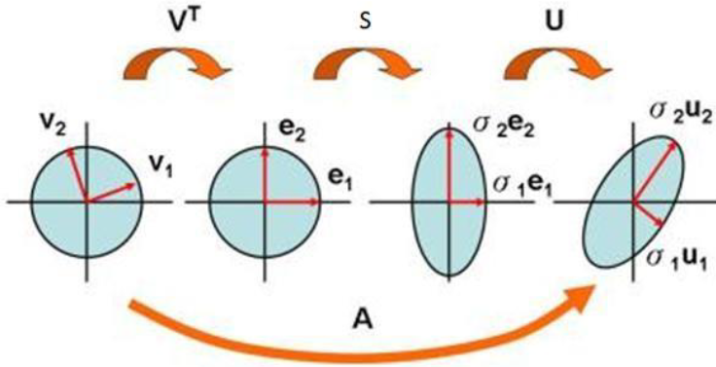
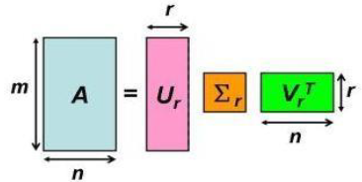
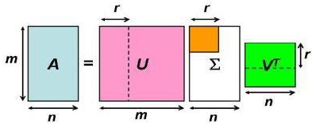

Singular Value Decomposition (S.V.D)
Given an $m×n$matrix $A$of rank $r$, $A=U S{ V}^{T}$
  columns of $U$ are called the left singular vectors
  columns of $V$ are called the right singular vectors
  $S$ only has values on its diagonal that are singular values
An transformation between the basis of row space and column space
(b) Rotation:${ V}^{T}$ , Retraction/Extension: $S$ , Rotation: $U$
(a) Data Compression
Notes:
(1) columns of $U$ are called the left singular vectors ，他是矩陣A的column space的 orthogonal basis
(2) columns of $V$are called the right singular vectors ，他是矩陣A的row space的 orthogonal basis
(3) 中間的S則是一個對角矩陣，而他們的值都是奇異值(Singular values)

Slide 6

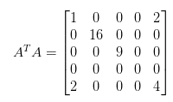

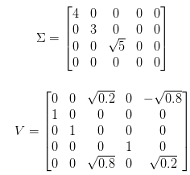

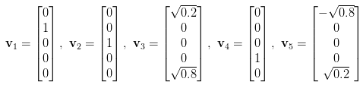
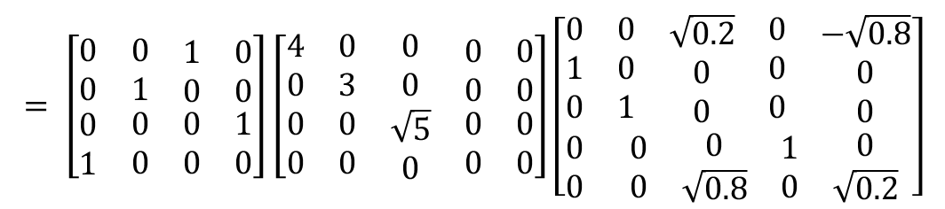
Singular Value Decomposition (S.V.D)
$$= \left[\begin{matrix}0 & 0 & \begin{matrix}1 & 0\end{matrix} \\ 0 & 1 & \begin{matrix}0 & 0\end{matrix} \\ \begin{matrix}0 \\ 1\end{matrix} & \begin{matrix}0 \\ 0\end{matrix} & \begin{matrix}\begin{matrix}0 & 1\end{matrix} \\ \begin{matrix}0 & 0\end{matrix}\end{matrix}\end{matrix}\right]\left[\begin{matrix}\begin{matrix}4 & 0 & 0 \\ 0 & 3 & 0 \\ \begin{matrix}0 \\ 0\end{matrix} & \begin{matrix}0 \\ 0\end{matrix} & \begin{matrix}\sqrt{5} \\ 0\end{matrix}\end{matrix} & \begin{matrix}\begin{matrix}0 \\ 0 \\ \begin{matrix}0 \\ 0\end{matrix}\end{matrix} & \begin{matrix}0 \\ 0 \\ \begin{matrix}0 \\ 0\end{matrix}\end{matrix}\end{matrix}\end{matrix}\right]\left[\begin{matrix}\begin{matrix}0 \\ 1 \\ 0\end{matrix} & \begin{matrix}\begin{matrix}0 \\ 0 \\ 1\end{matrix} & \begin{matrix}\sqrt{0.2} \\ 0 \\ 0\end{matrix} & \begin{matrix}\begin{matrix}0 \\ 0 \\ 0\end{matrix} & \begin{matrix}−\sqrt{0.8} \\ 0 \\ 0\end{matrix}\end{matrix}\end{matrix} \\ \begin{matrix}0 \\ 0\end{matrix} & \begin{matrix}\begin{matrix}0 \\ 0\end{matrix} & \begin{matrix}0 \\ \sqrt{0.8}\end{matrix} & \begin{matrix}\begin{matrix}1 \\ 0\end{matrix} & \begin{matrix}0 \\ \sqrt{0.2}\end{matrix}\end{matrix}\end{matrix}\end{matrix}\right]$$
Step 1:
Step 4:
Step 2:
Step 3:

Slide 7
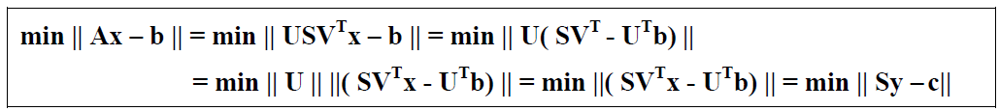
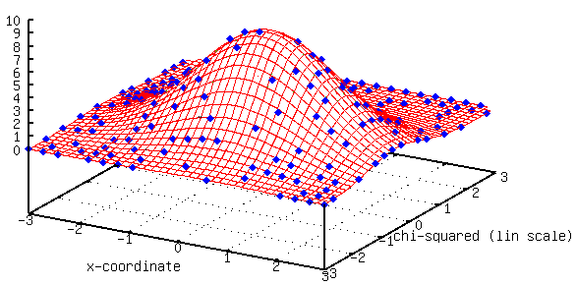

S.V.D on Least Square Optimization
Given that: $y=V^{T}x, c=U^{T}b.\left\|U\right\|=1$
With $S$ is an diagonal matrix, $y=S^{+}c, x=VS^{+}U^{T}b$

Slide 8
Outline
Introduction
Theorems and Algorithms
  Singular Value Decomposition
  S.V.D on Least Square Optimization
  Applications of Least Square Optimization
    Debevec’s HDR imaging
    Edge-Preserving Filtering based on Local Extrema
    Several Edge-preserving Filtering Methods Comparisonms
Simulation Results
Conclusion
Reference

Slide 9
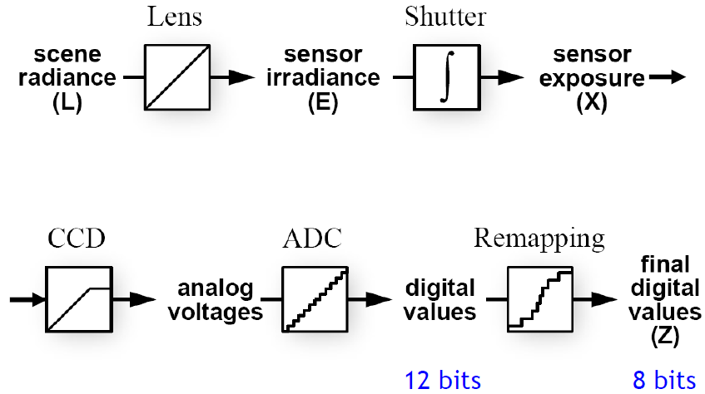

Debevec’s HDR imaging
Camera pipeline
$$Z_{ij}=f(X)=f(E_{i}∙∆t_{j})$$
Notes:
Traditional camera can’t capture the full spectral content and dynamic range like the HDR image.
In order to solve this problem, we have to do some post-processing via reconstructing the camera response curve
from multiple exposures, thus we reconstruct the radiance map (E).

Slide 10
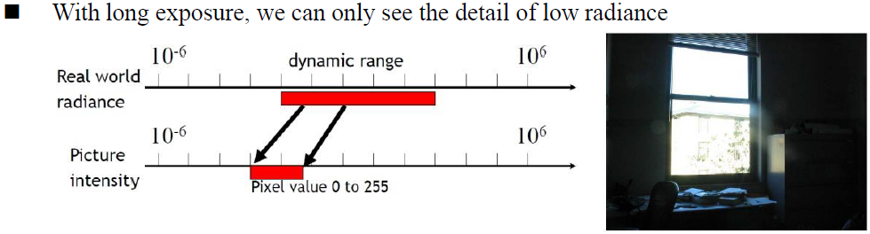
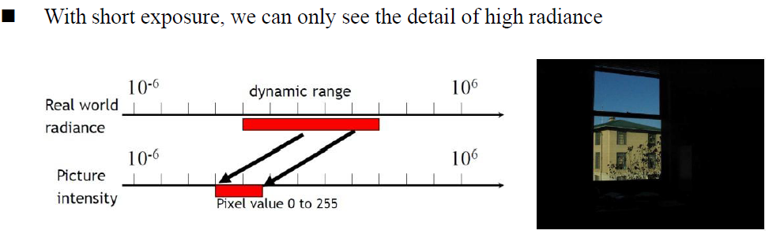
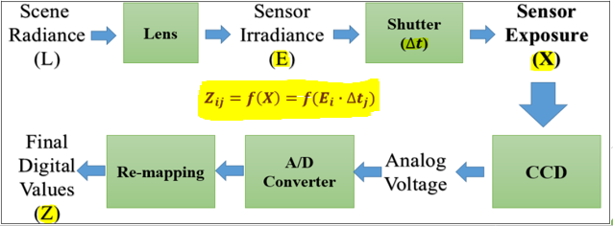

Debevec’s HDR imaging

Slide 11
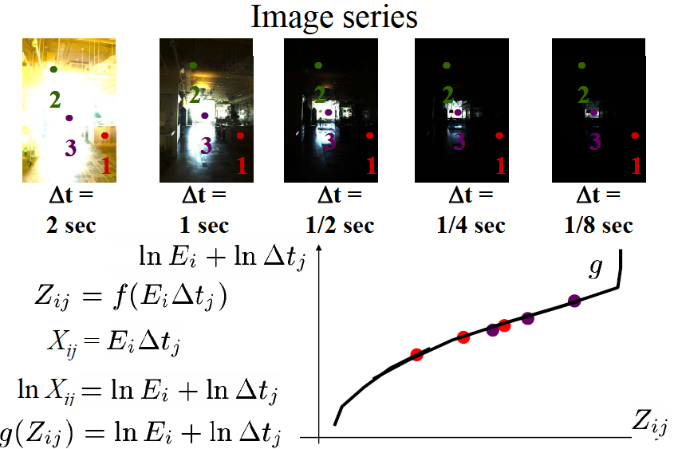
Debevec’s HDR imaging

Slide 12
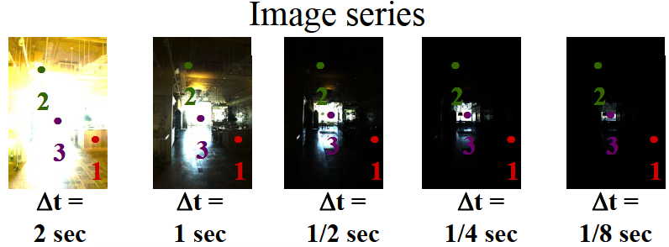
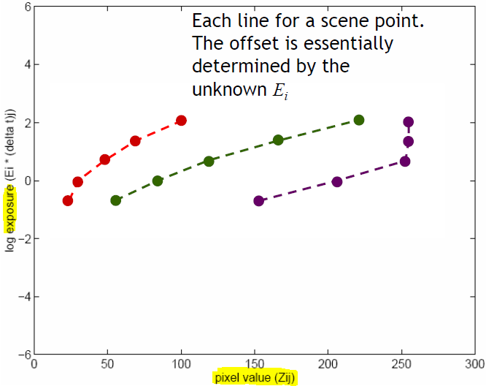

Slide 13
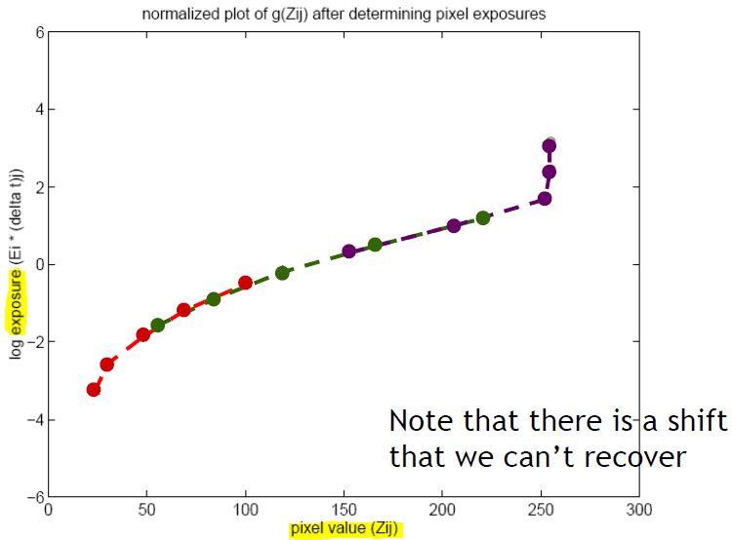

Slide 14
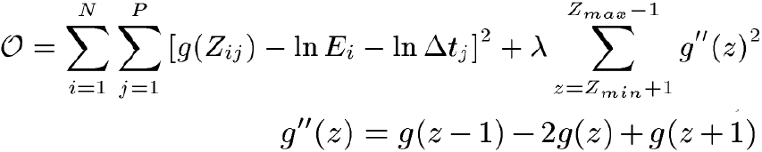
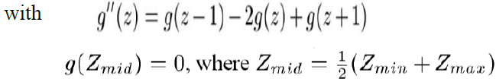

Debevec’s HDR imaging
Camera response curve reconstruction
$Z_{ij}$=$f(E_{i}{∙∆t}_{j})$
$g\left(Z_{ij}\right)=\ln\left(E∙∆t\right)=\ln\left(E_{i}\right)+ln⁡(∆t_{j})$
pixel value (Z) from multiple exposures images,
radiance (E) and Shutter speed ($∆t$)
Optimizing the following objective function

Slide 15
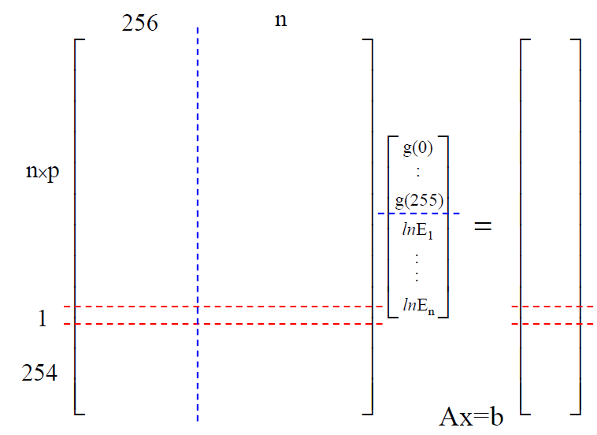
Least Square Optimization

Slide 16
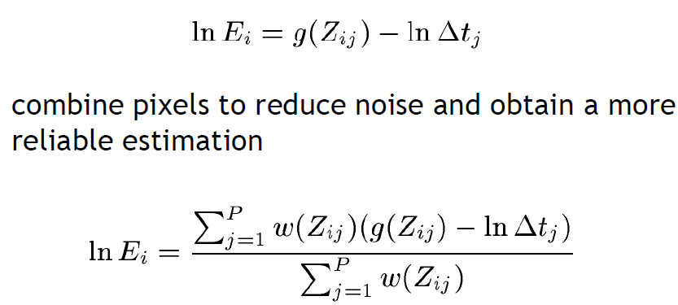
Debevec’s HDR imaging

Slide 17
Outline
Introduction
Theorems and Algorithms
  Singular Value Decomposition
  S.V.D on Least Square Optimization
  Applications of Least Square Optimization
    Debevec’s HDR imaging
    Edge-Preserving Filtering based on Local Extrema
    Several Edge-preserving Filtering Methods Comparisonms
Simulation Results
Conclusion
Reference

Slide 18
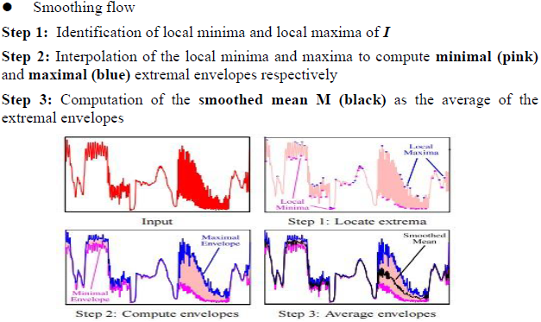
Edge-Preserving Filtering based on Local Extrema
Smoothing the texture and Preserving the structure edges
Capture the oscillations between local extrema to distinguish textures from individual edges.
Envelope Computing
Notes:
這個方法就是利用取出local extrema(區域極值)的準則，來達到區別texture(紋理)和individual edges
Step 1: 找出Image I的最大值和最小值
Step 2: 用interpolation的方式，找出兩個極值的envelope
Step 3: 求出兩個極值envelope的mean，就能有效去除Image的Texture

Slide 19
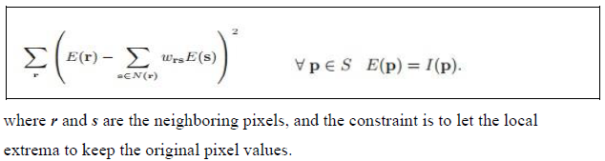

Edge-Preserving Filtering based on Local Extrema
─ Envelope Computing
Express the cost function to be a sparse linear system (Least Square problem) and apply S.V.D

Slide 20
Outline
Introduction
Theorems and Algorithms
  Singular Value Decomposition
  S.V.D on Least Square Optimization
  Applications of Least Square Optimization
    Debevec’s HDR imaging
    Edge-Preserving Filtering based on Local Extrema
    Several Edge-preserving Filtering Methods Comparisonms
Simulation Results
Conclusion
Reference

Slide 21
Several Edge-Preserving Filtering methods Comparisons
To emphasize the shortage of S.V.D-based Edge Preserving
Bilateral Texture Filtering (SIGGRAPH 2014)
Two-level joint local Laplacian texture filtering
(International Journal of Computer Graphics 2015)
Better processing efficiency
Better details-preserving & definition of edges

Slide 22
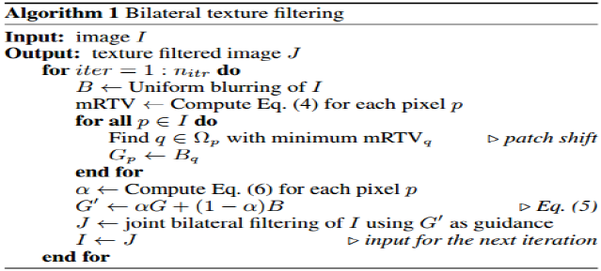
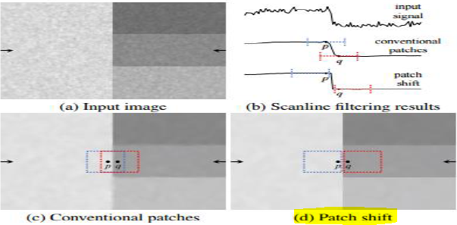

Bilateral Texture Filtering
Capture the texture information from the most representative texture patch clear of prominent structure edges via Patch shift

Slide 23
Two-level joint local Laplacian texture filtering
Introduce local Laplacian filters into the joint filtering
Preserve structure edges better

Slide 24
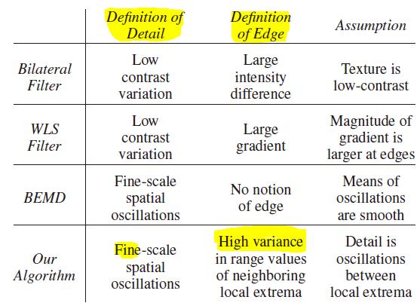
Performance Comparison
Edge-Preserving Filtering based on Local Extrema

Slide 25
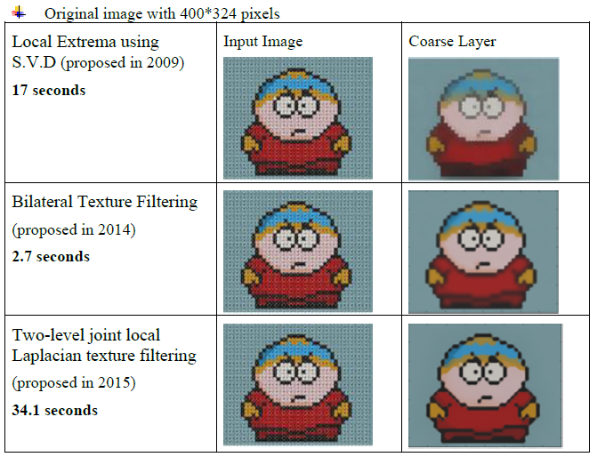
Performance Comparison
When S.V.D method is compared with others
Processing Time
Details-preserving
Definition of Edges

Slide 26
Outline
Introduction
Theorems and Algorithms
  Singular Value Decomposition
  S.V.D on Least Square Optimization
  Applications of Least Square Optimization
Simulation Results
Conclusion
Reference

Slide 27
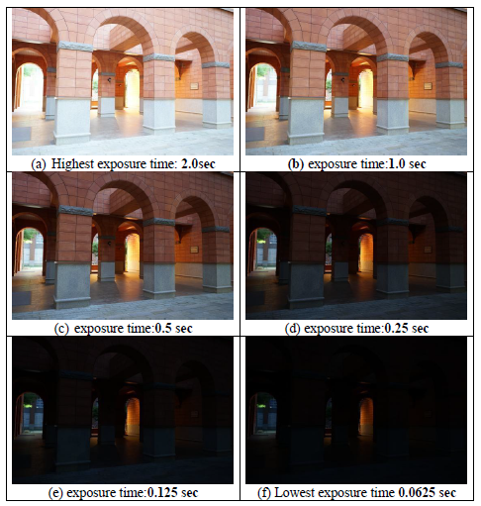
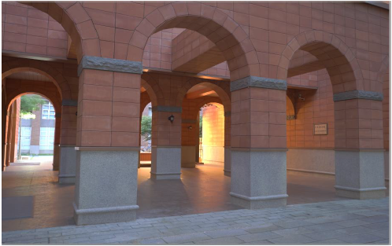
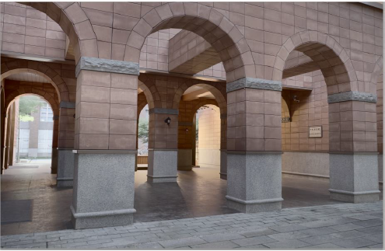

Slide 28
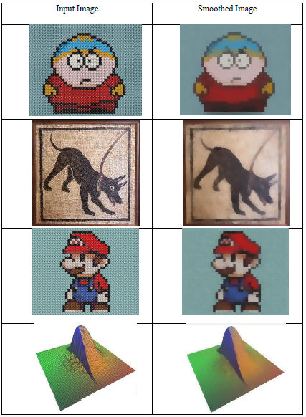
Edge-Preserving Filtering based on Local Extrema

Slide 29
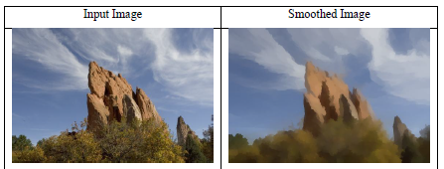
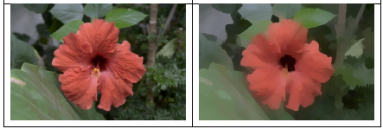
Edge-Preserving Filtering based on Local Extrema

Slide 30
Outline
Introduction
Theorems and Algorithms
Simulation Results
Conclusion
Reference

Slide 31
Conclusion
S.V.D performs well on least square optimization problem
High Dynamic Range Imaging
Edge-Preserving Filtering
Processing time is too much
Performance (the details-preserving and definition of edges) is not enough

Slide 32
Outline
Introduction
Theorems and Algorithms
Simulation Results
Conclusion
Reference

Slide 33
Reference
[1] Paul E. Debevec, Jitendra Malik, “Recovering High Dynamic Range Radiance Maps from Photographs”, SIGGRAPH 1997.
[2] Kartic Subr, Cyril Soler, Fredo Durand, “Edge-preserving multiscale image decomposition based on local extrema”, ACM Transactions on Graphics (TOG). Vol. 28. No. 5. ACM, 2009.
[3] Hojin Cho, Hyunjoon Lee, Henry Kang and Seungyong Lee, “Bilateral Texture Filtering”, Volume 33 Issue 4, July 2014 , Article No. 128
[4] Hui Du, Xiaogang Jin and Philip J. Willis, “Two-level joint local laplacian texture filtering”, International Journal of Computer Graphics, 2015
[5] https://ccjou.wordpress.com/ (Website Resource: 線代啟示錄)
[6] VFX Chapter 03 H.D.R

