Slide 1
Group Meeting Contactless Sleep Stage on Smartphones
Advisor : Jian-Jiun Ding
Student : Chang-Fu Hong
2023.12.05
Digital Image & Signal Processing Lab

Slide 2
Outline(1/2)
Introduction
What is Sleep Stage ?
Why Contactless ?
How to Contactless ?
Paper Survey
Sleep Sound Analysis
Method 1
Sonar Detection
Method 1
Method 2
Motivation
Digital Image & Signal Processing Lab

Slide 3
Outline(2/2)
Method Proposed
Sleep Sound Part
Sonar Part
Conclusion
References
Digital Image & Signal Processing Lab

Slide 4
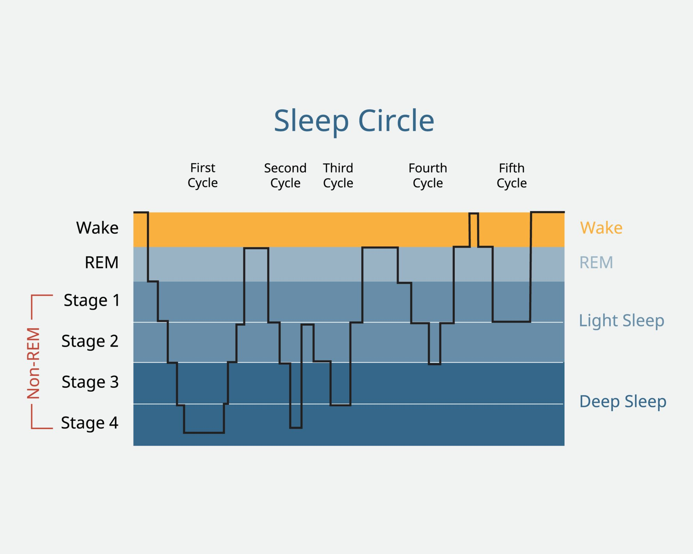
Introduction(1/3)
What is Sleep Stage ?
The human body cycles through two phases of sleep:
Rapid Eye Movement (REM) .
(2) Non-Rapid Eye Movement (NREM), which is divided into three stages N1, N2, N3.
The body cycles through all of these stages approximately 4 to 6 times each night, averaging 90 minutes for each cycle.
Sleep
NREM
REM
Wake
N1
N2
N3
Digital Image & Signal Processing Lab

Slide 5
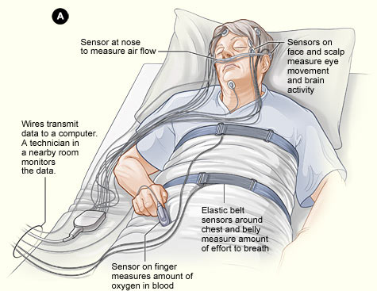
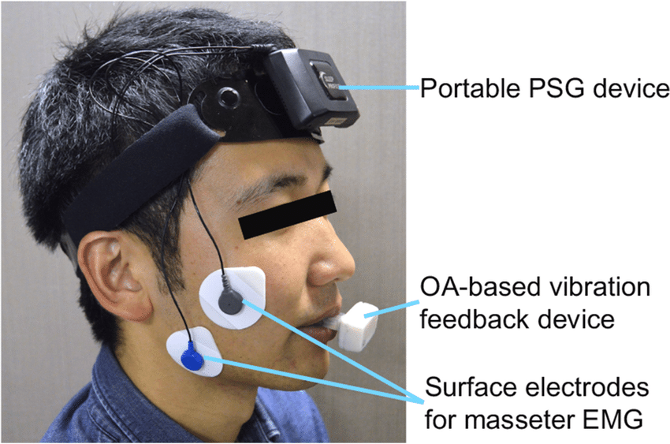
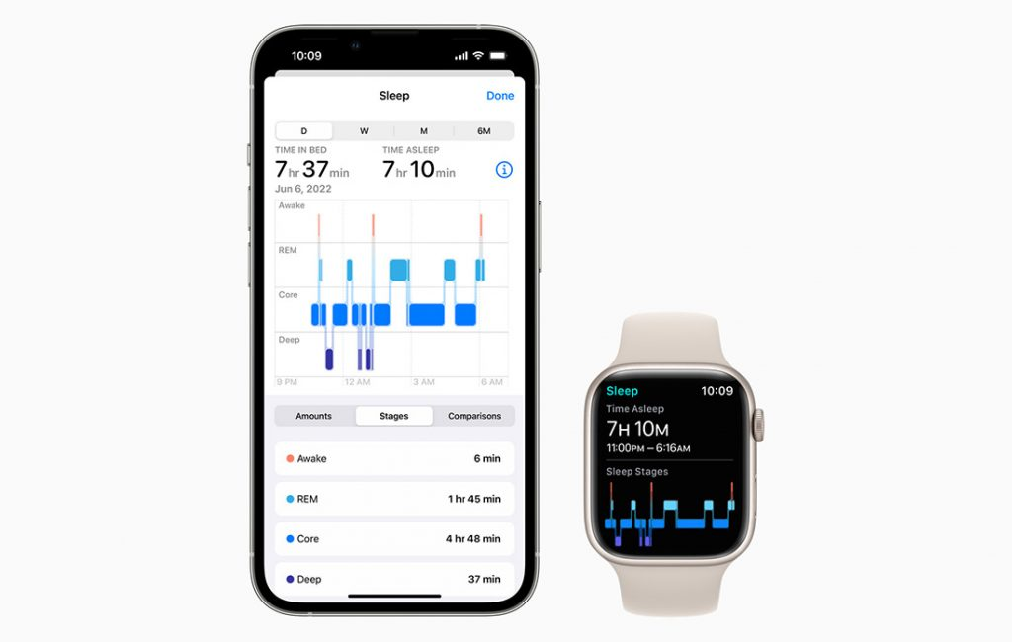
Introduction(2/3)
Why Contactless ?
PSG | Portable PSG | SmartWatchs | Contactless
Expensive Inconvenient Uncomfortable | Inconvenient Uncomfortable | Contact | Convenient Contactless Low Cost
Digital Image & Signal Processing Lab

Slide 6
Introduction(3/3)
How to Contactless ?
By Acoustic Analysis (Passive)
By Sonar Detection (Active)
Phone Audio
Record
Audio Signal Analysis
Sleep Stage Prediction
Sonar Signal Trasmitted
Reflect Sonar Signal Receive
Sleep Stage Prediction
Sonar Signal Analysis
Digital Image & Signal Processing Lab

Slide 7
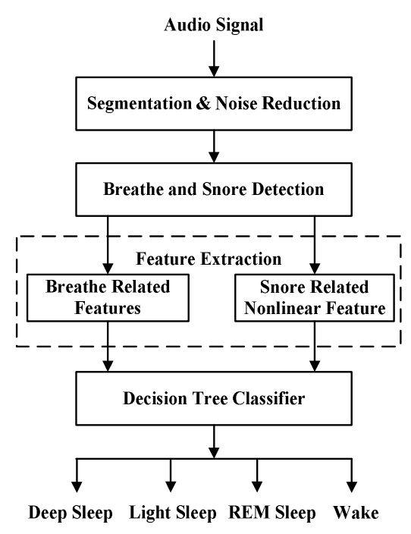
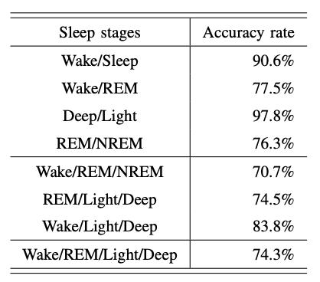
Paper Survey(1/3)
Sleep Sound Analysis
Paper 1 : Decision Tree based Sleep Stage Estimation from Nocturnal Audio Signals
Digital Image & Signal Processing Lab

Slide 8
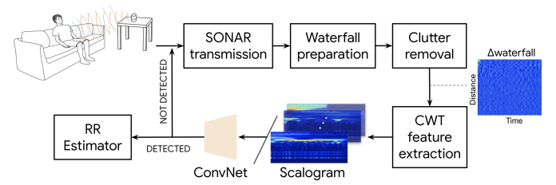
Paper Survey(2/3)
Sonar Detection
Paper 1 : LuckyChirp : Opportunistic Respiration Sensing using Cascaded Sonar on Commodity Devices
0.50 BPM
Digital Image & Signal Processing Lab

Slide 9
Paper Survey(3/3)
Sonar Detection
Paper 3 : C-FMCW Based Contactless Respiration Detection using Acoustic Signal
Digital Image & Signal Processing Lab

Slide 10
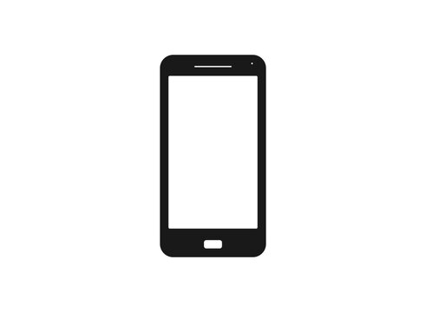
Motivation(1/1)
Sonar Signal Transmitted
Sound Record
Sonar Signal Analysis
Decision
Algorithm
Noise Reduction
Breathing Inform.
Sleep Stage
Prediction
Sonar Signal and Sleep Sound Separation
Sleep Sound Analysis
Humming
Inform.
Parameters can be added freely !
Digital Image & Signal Processing Lab

Slide 11
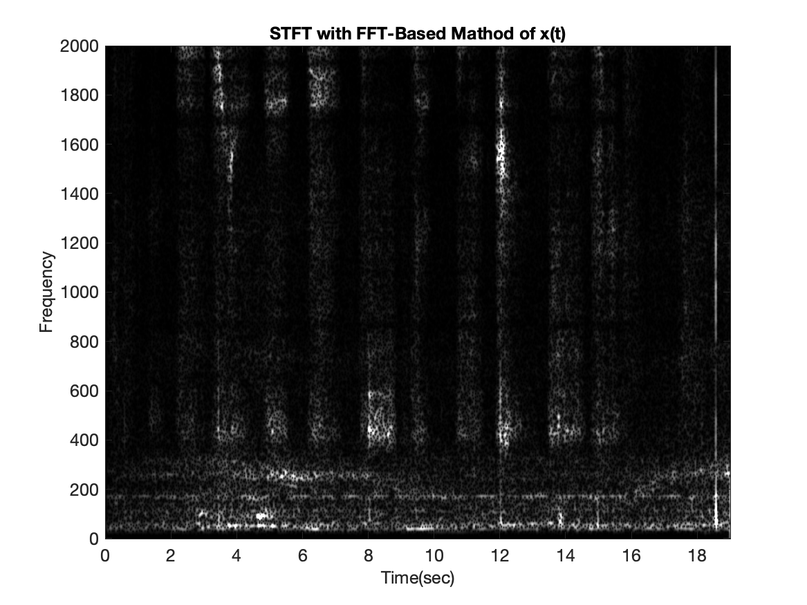
Method Proposed(1/3)
Sleep Sound Part (Main)
Due to the absence of Ground Truth, traditional algorithms are required to substitute for ML/DL.
Sleep Sound
Sleep Stage Prediction
Humming Detect
Power
Time Duration
Periodic
Frequecy Feature
Digital Image & Signal Processing Lab

Slide 12
Method Proposed(2/3)
Sleep Sound Part (Main)
Initiating sound emissions without disrupting sleep, actively testing participant’s responses, and estimating Sleep Stages based on reactions, which may include sound and movement.
Active Sound
Object Reaction
Sound Reaction Detection
Sleep Stage Prediction
Movement Reaction Detection
Digital Image & Signal Processing Lab

Slide 13
Method Proposed(3/3)
Sonar Part (Respiratory rate reference)
Employing Beamforming to focus the microphone's sound capture specifically on the subject's chest.
Participants voluntarily inform the mobile phone about their chest location.
Beamforming on Hand Position
Raise Hand
Sleep Stage Prediction
Sonar Detect

Slide 14
Conclusion(1/1)
If incorporating ML/DL, acquiring Ground Truth is a critical step.
The simulation of Sonar effects on a mobile phone has limitations, and there is a need for improved algorithms to enhance performance.
Usage might be restricted in the presence of a bed partner.
Incorporating additional reference information can significantly enhance performance.
The use of distance might pose a limitation.
There aren't very direct physiological responses for estimating the REM stage.
Digital Image & Signal Processing Lab

Slide 15
Thanks for Listening
Digital Image & Signal Processing Lab

Slide 16
Reference(1/2)
Aakash K. Patel; Vamsi Reddy; Karlie R. Shumway; John F. Araujo. ”Physiology, Sleep Stages”. StatPearls,2022, https://www.ncbi.nlm.nih.gov/books/NBK526132/
Wang, Tianben, et al. "C-FMCW based contactless respiration detection using acoustic signal." Proceedings of the ACM on Interactive, Mobile, Wearable and Ubiquitous Technologies 1.4 (2018): 1-20.
Xue, Qiuyue Shirley, et al. "LuckyChirp: Opportunistic Respiration Sensing Using Cascaded Sonar on Commodity Devices." 2022 IEEE International Conference on Pervasive Computing and Communications (PerCom). IEEE, 2022.
Nandakumar, Rajalakshmi, Shyamnath Gollakota, and Nathaniel Watson. "Contactless sleep apnea detection on smartphones." Proceedings of the 13th annual international conference on mobile systems, applications, and services. 2015.
Wang, Xuyu, Runze Huang, and Shiwen Mao. "SonarBeat: Sonar phase for breathing beat monitoring with smartphones." 2017 26th International Conference on Computer Communication and Networks (ICCCN). IEEE, 2017.
Digital Image & Signal Processing Lab

Slide 17
Reference(2/2)
Dafna, Eliran, Ariel Tarasiuk, and Yaniv Zigel. "Sleep-wake evaluation from whole-night non-contact audio recordings of breathing sounds." PloS one 10.2 (2015): e0117382.
Dafna, Eliran, Ariel Tarasiuk, and Yaniv Zigel. "Sleep staging using nocturnal sound analysis." Scientific reports 8.1 (2018): 13474.
Deng, Boya, et al. "Decision tree based sleep stage estimation from nocturnal audio signals." 2017 22nd International Conference on Digital Signal Processing (DSP). IEEE, 2017.
Digital Image & Signal Processing Lab

