Slide 1
Presentation:
Recent developments of signal and image processing – on Sparsity and Statistical Machine Learning
Cho-Ying Wu
Disp Lab
Graduate Institute of Communication Engineering
National Taiwan University
r04942049@ntu.edu.tw
December 30, 2015
1 / 70

Slide 2
So far, signal processing is a old but lifelong research field that is vital and strong connected to other fields
Motivation
Communication
Image processing
Computer vision
Audio signal processing
Natural language processing(NLP)
Medical , Geological , …… etc.
2 / 70

Slide 3
Roadmap
1 Sparsity
Lasso problem and Lagrange theory
Basics of Optimization
Fast algorithms of Lasso problem
2 Application of Sparsity
Compressive Sensing
Sparse classification
3 Statistical Machine Learning
Mixture Model and Clustering Similarity Learning
Active Learning Semi-supervised Learning
Online Learning Auto-encoder
Multitask Learning Deep Boltzmann Machine
3 / 70

Slide 4
Roadmap
Sparse representation basics Lasso problem
Lagrange theory
Fast algorithms of Lasso problem
Application Compressive Sensing
2
Sparse classification
Statistical Machine Learning
Modeling Mixture Model and Clustering
Training Design Active Learning
Similarity Learning
Semi-supervised Learning
Online Learning
Multitask Learning
Recurrent Neural Network Auto-encoder
Deep Boltzmann Machine
4 / 70

Slide 5
1 Sparsity
Lasso problem and Lagrange theory
Basics of Optimization
Fast algorithms of Lasso problem
5 / 70
Cho-Ying Wu
Disp Lab

Slide 6

Sparsity Model
Simple concept – if we can represent a high dimensional signal through transformation to a sparse matrix (i.e. only few entry is nonzero), we can represent the signal in an effective way.
Example: Vocabulary abandon
Decompose in alphabets:
a: 2 b:1 n:2 d:1 o:1
Or we have a dictionary
at abandon entry : 1
Sentence: Easy come easy go
Easy:2 come:1 go:1
1
6 / 70
Cho-Ying Wu
Disp Lab

Slide 7
Sparsity Model
Simple linear transform model :
Dictionary is denoted as A, vocabulary entries in dictionary are basis a_{i} , column vectors of A.
Now signal y can be construct as linear combination of dictionary basis
Add sparsity constraint:
So we can get a sparse vector x to represent y
1
7 / 70
Cho-Ying Wu
Disp Lab

Slide 8
Sparsity Model
Forming objective function:
We can introduce a coefficient connecting model and constraint
The first term is estimate how reconstructed signal is closed to reference signal y, the fidelity term
The second term is how sparse x is, sparsity term
is called Lagrange multiplier
1
8 / 70
Cho-Ying Wu
Disp Lab

Slide 9
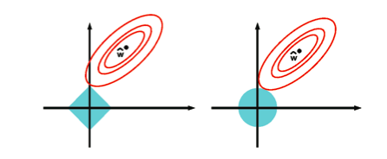
Sparsity Model
However optimizing L₀ norm is a NP-hard counting problem
It’s been proven L₁ norm can replace L₀ norm resulting good sparsity
Ex. L₁ norm v.s.L₂ norm
1
9 / 70
Cho-Ying Wu
Disp Lab

Slide 10
Sparsity Model
Deﬁnition (Lagrangian form of lasso problem)
Replacing L₀ norm with L₁ norm we can get a solvable objective function called lasso problem
Remark: If we impose L₂ norm constraint, it’s called rigid regression.
Just like least squared regression, rigid regression can easily be solved by differentiation
10 / 70
Cho-Ying Wu
Disp Lab

Slide 11
Basics of Optimization
Before we try to solve lasso problem, we need to know some basics of optimization
1
Definition (convex sets and convex function)
A set C is convex if the line segments between any two points in C lies in C
A function is convex if domain of f is a convex set and if for all x, and for
Remark: if function –f is convex then f is concave
11 / 70
Cho-Ying Wu
Disp Lab

Slide 12
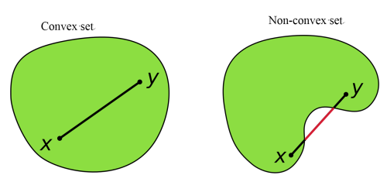
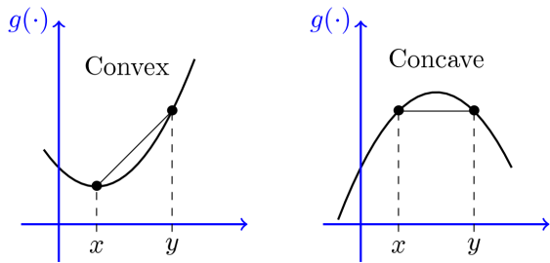
Basics of Optimization
Example of convex sets and convex function
1
It’s desirable to make objective function convex, why?
Avoid local optimal !!!
12 / 70
Cho-Ying Wu
Disp Lab

Slide 13
Basics of Optimization
Which are convex functions?
1
Exponential
Power
L₀ norm
L₁ norm
Logarithm
Remark: We can see that L₁ norm is convex, but L₀ norm not, so it’s suitable replacing L₀ norm with L₁ norm in lasso problem
13 / 70
Cho-Ying Wu
Disp Lab

Slide 14
Basics of Optimization
1
Definition (conjugate function)
Let function . The function is conjugate of f defined as
Remark: sup(.) means supremum. The upper bound of a set or simpy max(.), and the counterpart is denoted as inf(.)
Conjugate of conjugate is function itself.
14 / 70
Cho-Ying Wu
Disp Lab

Slide 15
Basics of Optimization
Constrained Programming:
1
Lagrange function
Lagrange dual function is
Importance: Lagrange dual function provide lower bound of optimal value p* for constrained problem
Remark: Sometimes the original problem is hard to solve, we can change the original problem (primal problem) into dual problem
15 / 70
Cho-Ying Wu
Disp Lab

Slide 16
Basics of Optimization
1
Weak duality : solution of dual problem u*≤p* ( p* optimal solution)
Strong duality : solution of dual problem u*=p*
Condition of Strong duality : Karush-Kuhn-Tucker (KKT) conditions
Remark: KKT conditions are extensively used in machine learning optimizing problem, any machine learning classes may refer to it.
16 / 70
Cho-Ying Wu
Disp Lab

Slide 17
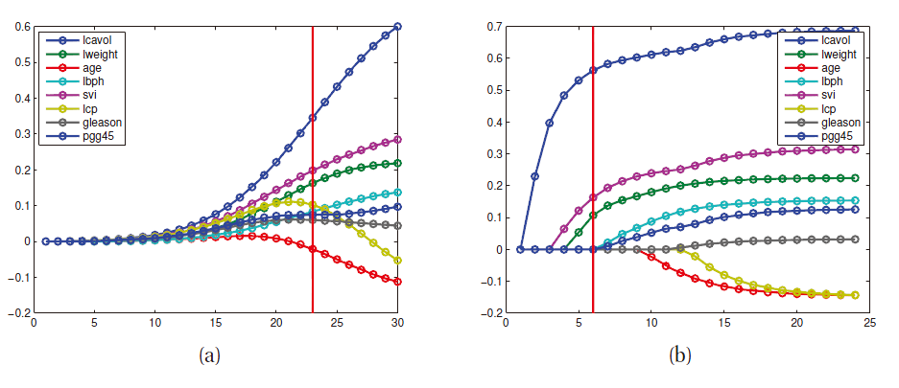
Fast algorithms of Lasso problem
1
Regularization Path : (a) is lasso problem (b) is ridge problem
LARS: start from large λ , selecting the most correlated attribute, computing the residuals , and re-compute the correlation
Homotopy: we can easily compute ,by continuously decreasing λ_{k}
17 / 70
Cho-Ying Wu
Disp Lab

Slide 18
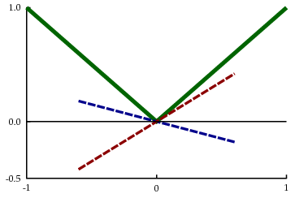
Fast algorithms of Lasso problem
1
2. Coordinate descent: simple method, just like other descent methods that iteratively compute the differential of λ fixed objective function
However, the L₁ norm is not smooth, we introduce soft thresholding
Or in operator form
Using soft operator
18 / 70
Cho-Ying Wu
Disp Lab

Slide 19
Fast algorithms of Lasso problem
1
Primal-dual interior point algorithm (PRIDA): Interior point is a classical method that formulate inequality constrained problem as an equality constrained problem by Newton’s method.
Complexity: O(n³) The most inefficient way
Other methods :
First order method (using soft operator):Proximal-Point Methods, Parallel Coordinate Descent, Approximate Message Passing, Templates for Convex Cone Solvers (TFOCS), Nesterov’s method……
Augmented Lagrangian Methods: Primal ALM, Dual ALM
Remark: Complexity of these solvers can approx. attain complexity O(n²),and it’s in progress problem on many famous computer vision conference such as CVPR,ICCV,ECCV……
19 / 70
Cho-Ying Wu
Disp Lab

Slide 20
Fast algorithms of Lasso problem
1
1. Early research find the sparsity with greedy search, called basis pursuit, without formulating the problem in the Lagrangian way.
2. L1 solver toolkit: (from UC berkeley)
http://www.eecs.berkeley.edu/~yang/software/l1benchmark/l1benchmark.zip
3. What we didn’t cover of lasso problem: Group lasso , Fused lasso, elastic net……
4. Courses on Optimization
數值優化 (數學系) 機器學習特論(資工系)
20 / 70
Cho-Ying Wu
Disp Lab

Slide 21
2 Application of Sparsity
Compressive Sensing
Sparse representation
21 / 70
Cho-Ying Wu
Disp Lab

Slide 22
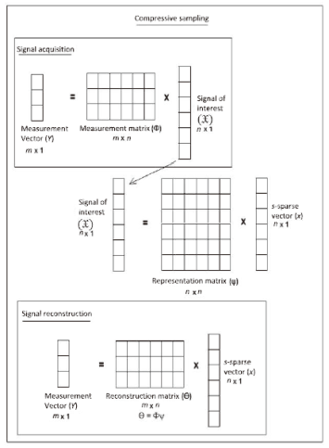
Compressive Sensing
Compressive sensing (CS) is simply representing signals in sparse way, so that sampling rate needed to reconstruct signals is far lower than Nyquist rate
1
Core concept:
Represent original signal y of sparse signal x
by transforming with sensing matrix A that is
usually be overcomplete and incoherence
Basis for image: wavelet
Basis for music: sinusoids
Just thinking that column vector of
Are many wavelets or sinusoids.
22 / 70
Cho-Ying Wu
Disp Lab

Slide 23
Compressive Sensing
Application of CS:
1
Image Processing
Biological Applications
Compressive Radio Detecting and Ranging (RADAR)
Analog-to-Information Converters (AIC)
Sparse Channel Estimation
Spectrum Sensing in CR Networks
Ultra Wideband (UWB) Systems
Wireless Sensor Networks (WSNs)
Erasure Coding
Multimedia Coding and Communication
CS based Localization
……
However, someone may think that due to reconstruction algorithm complexity, it’s infeasible to fulfill
23 / 70
Cho-Ying Wu
Disp Lab

Slide 24
Sparse representation based classification
The most attractive application of sparse representation is classification !!!
If we substitute basis in dictionary (matrix A) with sample of every class, we can represent a unknown class sample y with sparse vector x, the nonzero entry of x is its class.
1
Advantage:
1.robustness to noise and outliers
2.very high accuracy
24 / 70
Cho-Ying Wu
Disp Lab

Slide 25
Sparse representation based classification
The pioneer work[5] first introduce the sparse representation based classification (SRC) on Computer Vision problem, and further prove by experiment that
For the classification problem, it’s not important on how we extract feature (like PCA,LDA)of images, SRC is a far better way of classification accuracy.
Sparse representation is extended to many computer vision problem and have good performance
1
25 / 70
Cho-Ying Wu
Disp Lab

Slide 26
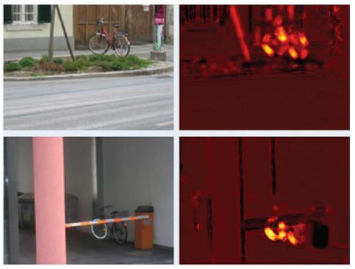
Sparse representation based classification
Object classification [6] Image denoising [6]
1
26 / 70
Cho-Ying Wu
Disp Lab

Slide 27
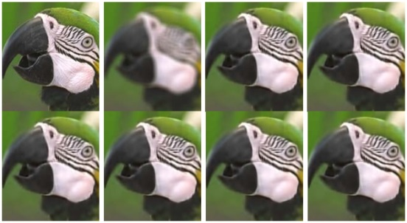
Sparse representation based classifiation
Super-resolution[7] Image deblurring [8]
1
27 / 70
Cho-Ying Wu
Disp Lab

Slide 28

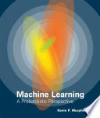
Sparsity Reference
1
Reference
[1] S. Mallat, A Wavelet Tour of Signal Processing: The Sparse Way, Academic Press, 3rd edition, 2009.
[2] Kevin P. Murphy, Machine Learning: A Probabilistic Perspective,MIT Press, 2012.
[3] Boyd, Stephen P.,Vandenberghe, Lieven: Convex Optimization Cambridge University Press, 2011.
[4] A. Yang, A. Ganesh, S. Sastry and Y. Ma, Fast l1-Minimization Algorithms and an Application in Robust Face Recognition: A Review,Technical Report UCB/EECS-2010-13, 2010.
[5] J. Wright, A. Y. Yang, A. Ganesh, S. S. Sastry, and Y. Ma, “Robust face recognition via sparse representation,” IEEE Trans. Pattern Analysis and Machine Intelligence, vol. 31, no. 2, pp. 210-227, Feb. 2009.
28 / 70
Cho-Ying Wu
Disp Lab

Slide 29
Sparsity Reference
1
[6] J. Wright, Y. Ma, J. Mairal, G. Sapiro, T. Huang, and S. Yan. Sparse representation for computer vision and pattern recognition. Proceedings of IEEE, Special Issue on Applications of Compressive Sensing & Sparse Representation, 98(6):1031-1044, 2010.
[7] J. Yang, J. Wright, T. Huang, and Y. Ma, Image superresolution as sparse representation of raw patches, in Proc. IEEE Int. Conf. Comput. Vis. Pattern Recognit., 2008.
[8] W. Dong, L. Zhang, G. Shi, and X. Wu, “Image deblurring and superresolution by adaptive sparse domain selection and adaptive regularization,” IEEE Trans. Image Process., vol. 20, no. 7, pp. 1838–1857, Jul. 2011.
29 / 70
Cho-Ying Wu
Disp Lab

Slide 30
3 Statistical Machine Learning
Mixture Model and Clustering Similarity Learning
Active Learning Semi-supervised Learning
Online Learning Auto-encoder
Multitask Learning Deep Boltzmann Machine
30 / 70
Cho-Ying Wu
Disp Lab

Slide 31
Mixture Model
Simple concept – latent factor or latent variable behind observation :
In data analysis or pattern recognition problem, some latent variables control what we observed.
Example [1]
z2
z1
z3
z4
31 / 70
Cho-Ying Wu
Disp Lab

Slide 32
Mixture Model
Deﬁnition (Mixture of Gaussians, GMM)
The base mixture model is a multivariate Gaussian with mean and covariance matrix . If we have K base model, and that
Remark: In clustering problem, every Gaussian can be considered as basic model. Such as image foreground-background classification problem, easily we can set k=1 as foreground, k=2 as background ……
32 / 70
Cho-Ying Wu
Disp Lab

Slide 33
Mixture Model
Deﬁnition (Mixture of multinoullis)
If our data consists of bit vectors, we can define Mixture of multinoullis
33 / 70
Cho-Ying Wu
Disp Lab

Slide 34
Mixture model
Two application of mixture model :
Black-box density: useful of data compression, outlier detection, creating generative classifiers
as each class-conditional density
Clustering: fitting mixture model to compute
representing posterior probability that point i and latent variable z belong to cluster k
Defining responsibility of cluster k for point i
This is called soft clustering
34 / 70
Cho-Ying Wu
Disp Lab

Slide 35
Factor Analysis
Mixture model only use single latent variable to generate an observations,
but Factor Analysis uses multiple latent variables generating an observation
If we set and , this model reduces to classical PCA
If we set and , this model reduces to probabilistic PCA
(PPCA)
35 / 70
Cho-Ying Wu
Disp Lab

Slide 36
Bayesian Nonparametric model
How many latent variables to use is in mixture model or factor analysis is a problem
Observation x, cluster assignments y , cluster parameter
joint distribution over observation can be written
We focus on observation belongs to which cluster
36 / 70
Cho-Ying Wu
Disp Lab

Slide 37
Bayesian Nonparametric model
Deﬁnition (Chinese restaurant process, CRP)
y_{n} is table assignment of n-th customer. We can sequentially assigning observation to cluster k with probability
Remark: CRP analysis we form approximation of joint posterior over all latent variables. By using it, we can decide how many cluster of model to use, or make prediction!
37 / 70
Cho-Ying Wu
Disp Lab

Slide 38
Bayesian Nonparametric model
Deﬁnition (Indian buffet process, IBP)
38 / 70
Cho-Ying Wu
Disp Lab

Slide 39
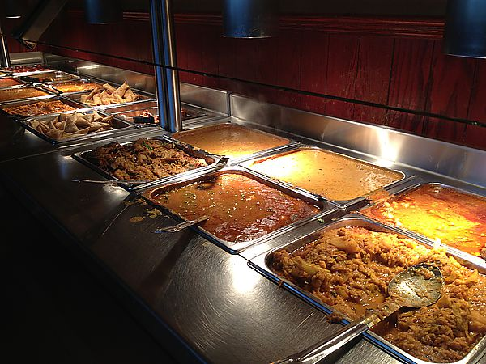
Bayesian Nonparametric model
Comparison of two models : CRP is related to mixture model, IBP is related to factor analysis
39 / 70
Cho-Ying Wu
Disp Lab

Slide 40
Bayesian Nonparametric model
Posterior inference : using Markov Chain Monte Carlo (MCMC)
Defining a Markov Chain on the latent variables, and using simply Gibbs sampling to approximate the posterior, Monte Carlo states that if sample times go to infinity, it will converge to posterior
Simply put, by sampling posterior from Chinese Restaurant Process or Indian Buffer Process, we can get how many cluster we need!
Remark: In cluster-based image segmentation, we can use CRP to decide how many super-pixel we should choose.
40 / 70
Cho-Ying Wu
Disp Lab

Slide 41
Active Learning
Usually, training sets are very large and redundant
Large : such as very high resolution images (VHR) in remote sensing problem
Redundant : usually classifiers focus on few data deciding margin
e.g.
41 / 70
Cho-Ying Wu
Disp Lab

Slide 42
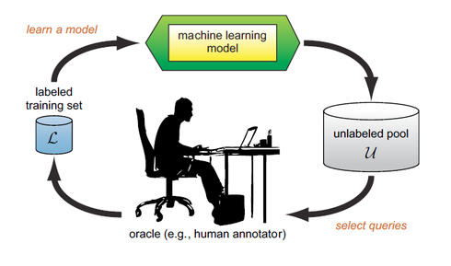
Active Learning
Initial training sets
Pool of candidates
We want to take most informative samples from pool of candidates to join the training sets through user-machine interactive
[Joan Fragaszy Troyano,Pressword.org]
42 / 70
Cho-Ying Wu
Disp Lab

Slide 43
Active Learning
How to rank the candidates? Heuristics to rank the uncertainty
Committee-Based heuristics [2]
Large-margin-based heuristics [2]
Posterior probability-based heuristics [2]
43 / 70
Cho-Ying Wu
Disp Lab

Slide 44
Active Learning
Definition (Committee-Based Heuristics)
Quantify the uncertainty by the most disagreement of classifiers
Disagreement : normalized entropy query-by-bagging
is the prediction of data x
44 / 70
Cho-Ying Wu
Disp Lab

Slide 45
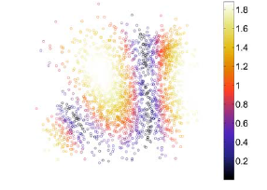
Active Learning
Definition (Large-margin-Based Heuristics)
If we defined the i-th class boundary hyperplane, we can calculate distance, the sample the closet sample to the boundary hyperplane
45 / 70
Cho-Ying Wu
Disp Lab

Slide 46
Active Learning
Definition (Posterior Probability-Based Heuristics)
Use the estimation of posterior probabilities of class (i.e. p(y|x) )
Simply, use Kullbach-Leiber divergence to compare the posterior distribution
Sample the data that maximize the divergence
46 / 70
Cho-Ying Wu
Disp Lab

Slide 47
Active Learning
Hyperspectral imaging problem : too much data to perform classification
[10]
47 / 70
Cho-Ying Wu
Disp Lab

Slide 48
Online Learning
Online Learning is contrast to offline learning (batch learning) whose data are used for training altogether ; however, online learning use training data sequentially , advantage is quick convergence
First, an observation occurs, and classifier try to predict the label
After making the prediction, the true label reveals, letting classifier correct its training algorithm.
Correct
classifier
Incorrect : correct the classifier instantly
48 / 70
Cho-Ying Wu
Disp Lab

Slide 49
Online Learning
Stochastic gradient descent (SGD) is the most common online algorithm
Definition (Stochastic Gradient Descent, SGD)
Defining f(.) is a loss function. θ is the parameter estimate, η is the learning rate, at each step we can write the update θ as
(projection only needed when some constraints on parameter space Θ)
Remark I: Tuning η is a drawback of SGD.
Remark II: SGD above set all the same step
size. We can adaptively set the step
size as adagrad
49 / 70
Cho-Ying Wu
Disp Lab

Slide 50
Online Learning
Simple online learning : margin-based binary classification
Given the observation , we want to find the boundary fitting the largest margin of , but keeping classification, or finding a support vector machine based on single observation.
Definition (Passive-Aggressive algorithm,PA )
Hinge loss
is the signed margin comparing the prediction and the
true label.
Here we set 1 as threshold, this algorithms try to let margin> 1 as possible
50 / 70
Cho-Ying Wu
Disp Lab

Slide 51
Online Learning
Definition (Passive-Aggressive algorithm,PA )
After defining the hinge loss, we can update the weight θ as above.
If the loss at iteration n is 0 then (i.e. passive) , otherwise it will force (i.e. aggressive)
Remark: obviously the optimization above can be done by Lagrange theory
51 / 70
Cho-Ying Wu
Disp Lab

Slide 52
Online Learning
Application of online learning : [3]
Large datasets that are infeasible using batch learning
Sequential data such as video tracking or background subtraction
52 / 70
Cho-Ying Wu
Disp Lab

Slide 53

Multitask Learning
Multitask Learning is an idea that use the shared representation within parallel training [7]
53 / 70
Cho-Ying Wu
Disp Lab

Slide 54
Multitask Learning
Application of multitask learning : recently it apply to robust visual tracking
Each particle in video tracking can be modeled as sparse representation of dictionary, we can solve each L₁ minimization problem using multitask learning for saving calculating time [4]
54 / 70
Cho-Ying Wu
Disp Lab

Slide 55
Similarity Learning
Given two object , we want to find a metric d(.) so that if
are from the same class, is small; otherwise, this distance is large. This is called similarity learning or metric learning
Definition (Mahalanobis distance)
Consider the generalized distance metric as above, M is a positive-definite matrix. If M=I , it’s Euclidean distance.
If we use eigenvalue decomposition on M = AA^{T}
55 / 70
Cho-Ying Wu
Disp Lab

Slide 56
Similarity Learning
A simple way of similarity learning is neighborhood component analysis
Definition (Neighborhood Component Analysis, NCA )
We can simply consider any pairs of object i,j. is the probability
that i,j are actually in the same class by softmax
Adding all the j in the same class with i we can have
the objective function as the expected number of correct classification
Simply differentiate the f(A) we can solve matrix A
56 / 70
Cho-Ying Wu
Disp Lab

Slide 57
Similarity Learning
OASIS is the most efficient algorithm in online learning fashion.
The similarity function . OASIS learns the matrix W by large margin-based online learning
Loss function
At each step:
Forming the constraint with Lagrange multiplier, and then differentiate it we can get updated W
57 / 70
Cho-Ying Wu
Disp Lab

Slide 58
Similarity Learning
Application of similarity learning: image retrieval [6]
58 / 70
Cho-Ying Wu
Disp Lab

Slide 59
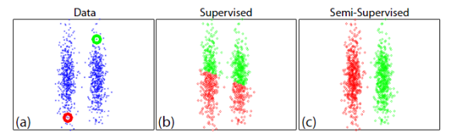
Semi-supervised Learning
In training sets, some data are labeled and the others are unlabeled, due to the complexity of labeling.
Directly classify the unlabeled data to the nearest neighbor is in supervised way, but semi-supervised also consider the density of the unlabeled data
Simple example: [5]
Application of semi-supervised learning: Gigantic image classification
59 / 70
Cho-Ying Wu
Disp Lab

Slide 60
From now on, we will go through Neural Network associated methods, especially recurrent neural network (RNN)
60 / 70
Cho-Ying Wu
Disp Lab

Slide 61
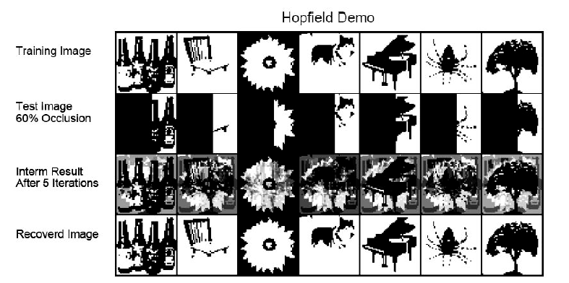
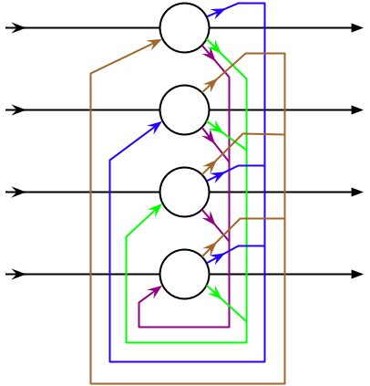
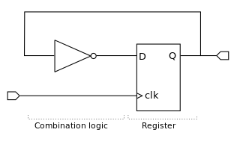
Hopfield network
Hopfield is the simplest RNN, depositing associative memory
61 / 70
Cho-Ying Wu
Disp Lab

Slide 62
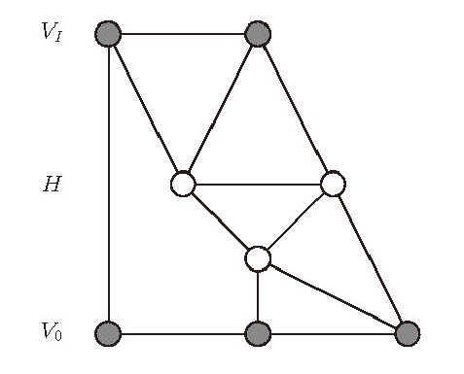
Boltzmann machine
Definition (Boltzmann Machine)
Boltzmann machine is a pairwise Markov Random Field (undirected graph) with hidden node h, visible node v
Remark: problem is the exact inference is intractable and sampling is also slow
62 / 70
Cho-Ying Wu
Disp Lab

Slide 63
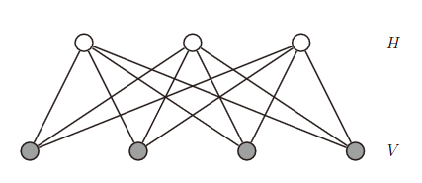
Restricted Boltzmann machine
Definition (Restricted Boltzmann machine, RBM)
Restricted Boltzmann machine, nodes are arranged in layers without connection
Hidden nodes are conditionally independent if visible nodes are specified
Remark: If we assume hidden nodes with binary distribution, each node is “on” or “off” representing the feature. (coding methods)
63 / 70
Cho-Ying Wu
Disp Lab

Slide 64
Restricted Boltzmann machine
Conventional optimizer: stochastic gradient descent
Faster one : Contrastive divergence (CD), difference of two KL-divergence
Application : Language modeling, document retrieval
64 / 70
Cho-Ying Wu
Disp Lab

Slide 65
Deep Boltzmann machine
Definition (Deep Boltzmann machine, DBM)
It’s the stacked RBMs.
If we have 3 hidden layers, the model can be written
Hidden nodes are also conditionally independent if visible nodes are specified -> simplify the weights
65 / 70
Cho-Ying Wu
Disp Lab

Slide 66
Auto-encoder
Auto-encoder is an unsupervised neural networks learning the low dimensional signal representation
Simple auto-encoder. It tries to learn a identity function with hidden layers small than dimension of signals.
It’s proven that linear activation function is the same with PCA
[11]
66 / 70
Cho-Ying Wu
Disp Lab

Slide 67
Auto-encoder
It’s straightforward to let hidden layers’ units small (good compression)
However, we can use large hidden layers, imposing sparsity constraint !
It causes sparse representation of input signal
Another method is to add noise to the inputs, causing a denoising auto-encoder that trying to learn the missing data.
Deep Auto-encoder can be constructed initializing with RBMs
67 / 70
Cho-Ying Wu
Disp Lab

Slide 68
Deep Auto-encoder
Application of deep auto-encoder : image retrieval (semantic hashing)
For example, if we use a 20-bit code, we can precompute the binary representation for all the images, creating a hash-table mapping codewords to documents.
The binary representation of semantically similar documents will be close in Hamming distance.
68 / 70
Cho-Ying Wu
Disp Lab

Slide 69
Statistical Machine Learning
Courses for Machine Learning
Famous online course: Andrew Ng, Machine Learning, Stanford Cousera, available from Coursera. (Not recommend......)
Full context of Andrew Ng, Machine Learning, Stanford http://cs229.stanford.edu/materials.html
(More suitable for introduction to researchers)
3. Larry Wasserman,Statistical Machine Learning (Advanced class)
http://www.stat.cmu.edu/~larry/=sml/
4. In NTU, 機器學習(資工系),機器學習深層及結構化(電信所)
Textbooks:
1.Christopher M. Bishop, Pattern Recognition and Machine Learning, Springer-Verlag New York, 2006 (very classical book)
2.Kevin P. Murphy, Machine Learning: A Probabilistic Perspective,MIT Press, 2012.
(Miscellaneous topics, beneficial for research)
69 / 70
Cho-Ying Wu
Disp Lab

Slide 70
Statistical Machine Learning
Reference:
[1] S. Gershman and D. Blei. A tutorial on Bayesian nonparametric models. Journal of Mathematical Psychology, 56:1-12, 2012.
[2] D. Tuia , M. Volpi , L. Copa , M. Kanevski and J. Munoz-Mari , "A survey of active learning algorithms for supervised remote sensing image classification" , IEEE J. Sel. Topics Signal Process. , vol. 5 , no. 3 , pp.606 -617 , 2011
[3] G. Chechik, V. Sharma, U. Shalit, and S. Bengio. Large scale online learning of image similarity through ranking. Pattern Recognition and Image Analysis, 2009
[4] Narendra Ahuja, Robust visual tracking via multi-task sparse learning, Proceedings of the 2012 IEEE Conference on Computer Vision and Pattern Recognition (CVPR), 2012
[5] R. Fergus, Y. Weiss, and A. Torralba. Semi-supervised learning in gigantic image collections. In NIPS, 2009.
[6] Ji Wan , Dayong Wang , Steven Chu Hong Hoi , Pengcheng Wu , Jianke Zhu , Yongdong Zhang , Jintao Li, Deep Learning for Content-Based Image Retrieval: A Comprehensive Study, 2014
70 / 70
Cho-Ying Wu
Disp Lab

Slide 71
Statistical Machine Learning
Reference:
[7] R. Caruana, Multitask Learning. Machine Learning, vol. 28, no. 1, pp. 41-75, 1997.
[8] J. Goldberger , S. Roweis , G. Hinton and R. Salakhutdinov , Neighborhood component analysis , Proc. Advances Neural Inform. Process. , pp.571 -577 , 2005
[9] K. Crammer, O. Dekel, S. Shalev-Shwartz, and Y. Singer, Online passive aggressive algorithms. In Proc. NIPS., 2003.
[10] Introduction to hyperspectral imaging, MicroImages, Inc., 2012.
[11] Andrew Ng,CS294A/CS294W Deep Learning and Unsupervised Feature Learning lecture notes, 2011.
[12] Kevin P. Murphy, Machine Learning: A Probabilistic Perspective,MIT Press, 2012.
71 / 70
Cho-Ying Wu
Disp Lab

