Slide 1
Group Meeting Stereo Matching
Advisor : Jian-Jiun Ding
Student : Chang-Fu Hong
2024.09.24
Digital Image & Signal Processing Lab

Slide 2
Outline(1/1)
Introduction
What is Stereo Matching
What is Disparity
Stereo Matching Algorithm
Paper Survey
Pyramid Stereo Matching Network
Reference
Digital Image & Signal Processing Lab

Slide 3
Introduction(1/4)
What is Stereo Matching
Is the reconstruction of the three-dimensional coordinates of points for depth estimation.
The two images captured simultaneously by these cameras are then processed for the recovery of visual depth information.
The goal of depth estimation is to compute the disparity $d$ for each pixel in the reference image.
Digital Image & Signal Processing Lab

Slide 4
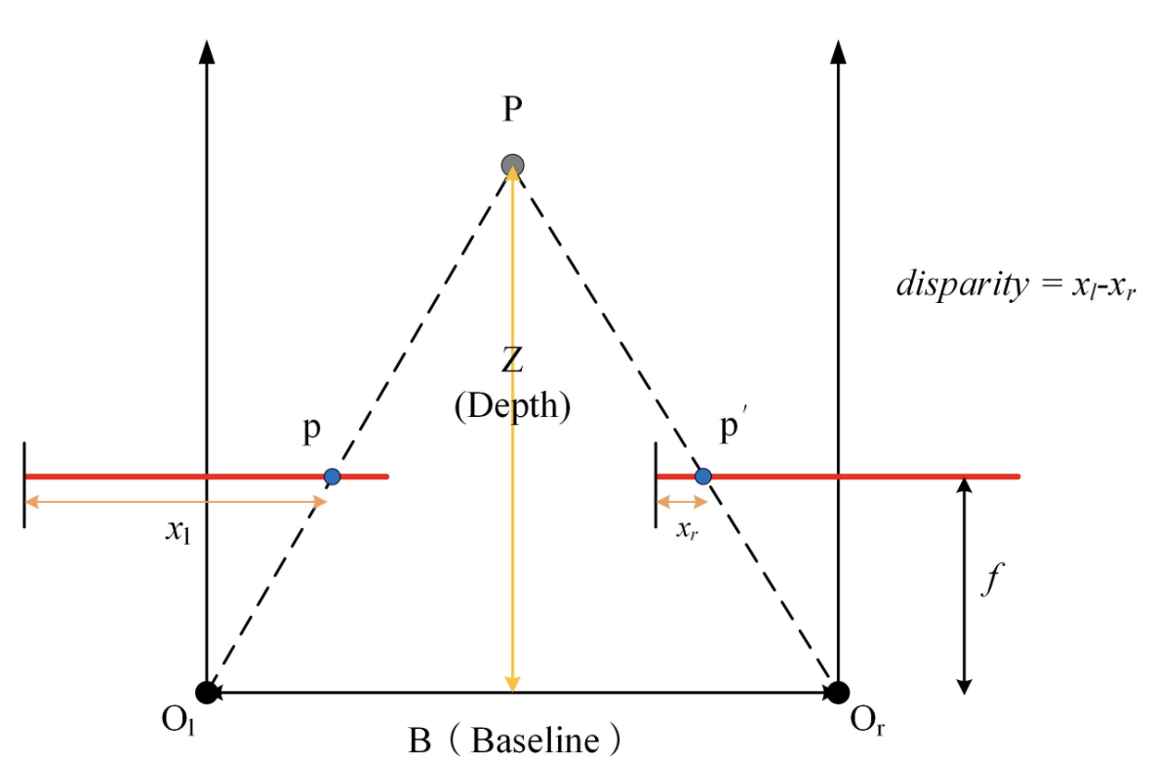
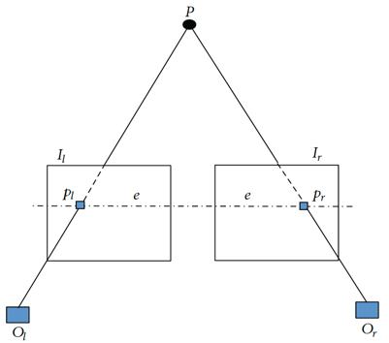
Introduction(2/4)
What is disparity
Disparity refers to the horizontal displacement between a pair of corresponding pixels on the left and right images.
The matching points must lie on Epipolar Line, this matching can be performed via a 1D horizontal search if the stereo pairs are accurately calibrated.
$$Disparity= \left|Pl\left(xl, y\right)−Pr⁡(xr, y)\right|$$
$$Depth= \frac{f×Baseline}{Disparity}$$
Digital Image & Signal Processing Lab

Slide 5
Introduction(3/4)
Stereo Matching Algorithm
In general stereo vision disparity map algorithms can be classified into :
Local Method
The disparity computation at a given point depends only on the intensity values within a predefined support window.
Global Method (include Semi-Global Method)
Treats disparity assignment as a problem of minimizing a global energy function for all disparity values.
Skip Step 2.
A framework of a stereo vision algorithm :
Digital Image & Signal Processing Lab

Slide 6
Introduction(4/4)
Step1. Matching Cost Computation
The matching cost computation is the stage in which whether the values of two pixels correspond to the same point in a scene is determined.
Like SSD, SAD, NCC…
Step2. Cost Aggregation
Cost aggregation is the most important stage for stereo vision, the purpose is to minimize matching uncertainties, that because matching cost from single pixel is not sufficient for precise matching.
Step3. Disparity Selection
Like WTA…
Step4. Disparity Refinement
The purpose is to reduce noise and improve the disparity maps.
Digital Image & Signal Processing Lab

Slide 7
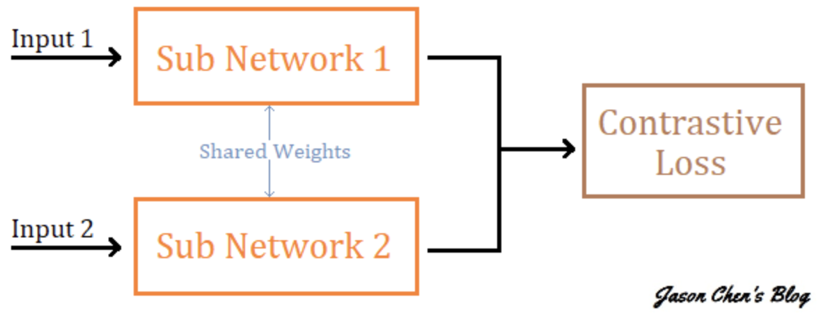
Paper Survey(1/4)
Learning Based Stereo
Depth estimation from a stereo pair of images can be formulated as a supervised learning task to be resolved with CNN, and current architectures rely on patch-based Siamese networks.
Compare with conventional method, CNN has good accuracy and speed, but in inherently ill-posed regions (occlusion areas, repeated patterns, textureless regions, reflective surfaces) CNN still difficult to find accurate corresponding points, so regional support from global context information must be incorporated into stereo matching.
Lacking the context information for finding correspondence in ill-posed regions.
Digital Image & Signal Processing Lab

Slide 8
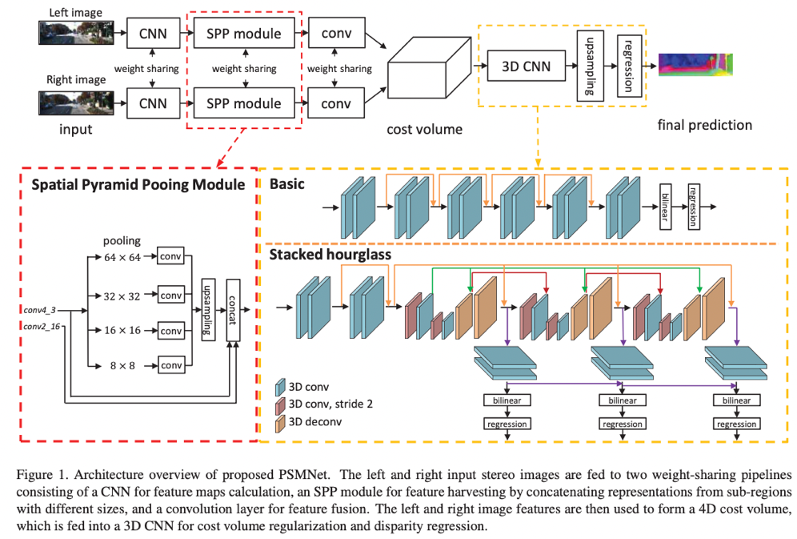
Paper Survey(2/4)
PSM-Net
PSM-Net is a pyramid stereo matching network consisting of two main modules :
Spatial pyramid pooling
3D CNN.
Digital Image & Signal Processing Lab

Slide 9
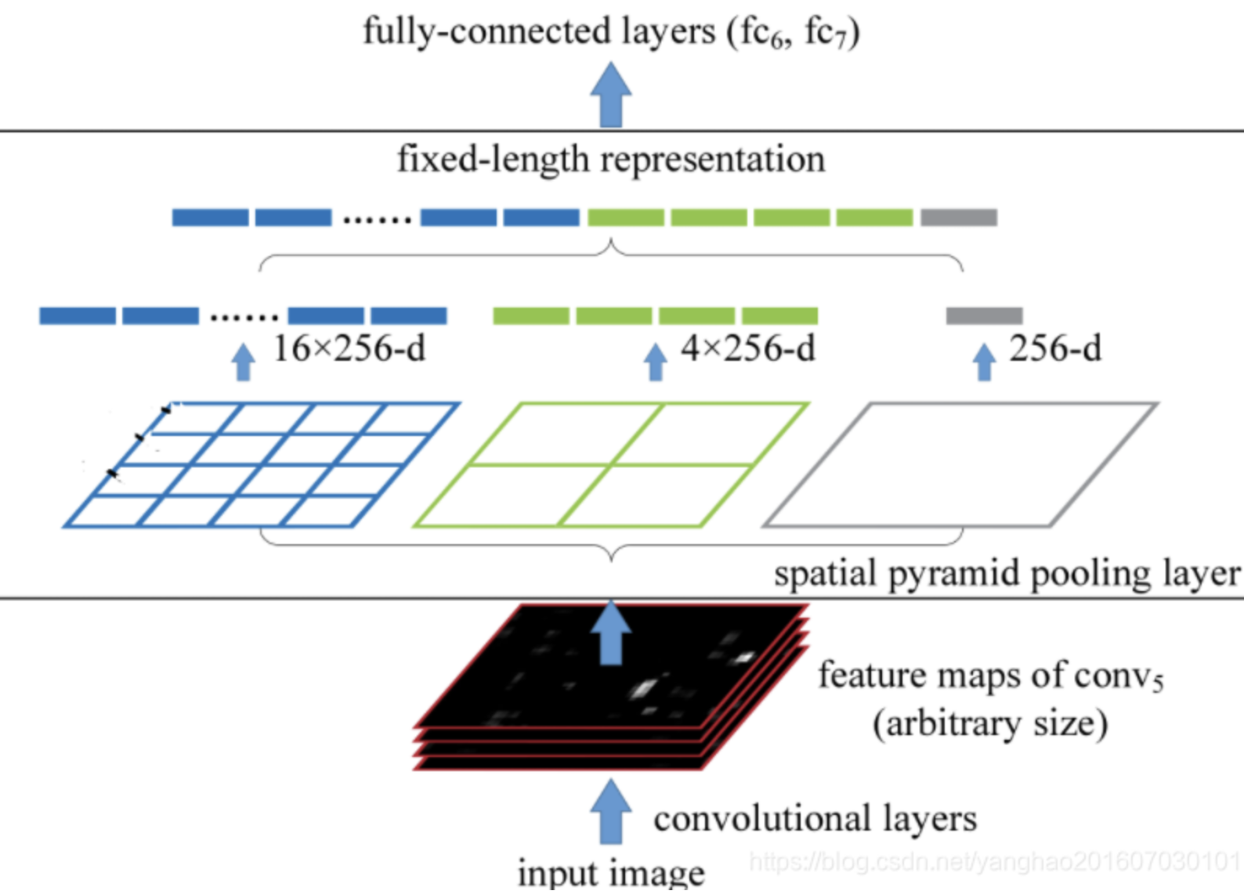
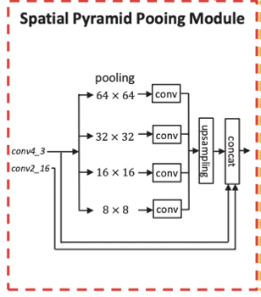
Paper Survey(3/4)
PSM-Net
Spatial Pyramid Pooling Module
The spatial pyramid pooling module takes advantage of the capacity of global context information by aggregating context in different scales and locations to form a cost volume.
Digital Image & Signal Processing Lab

Slide 10
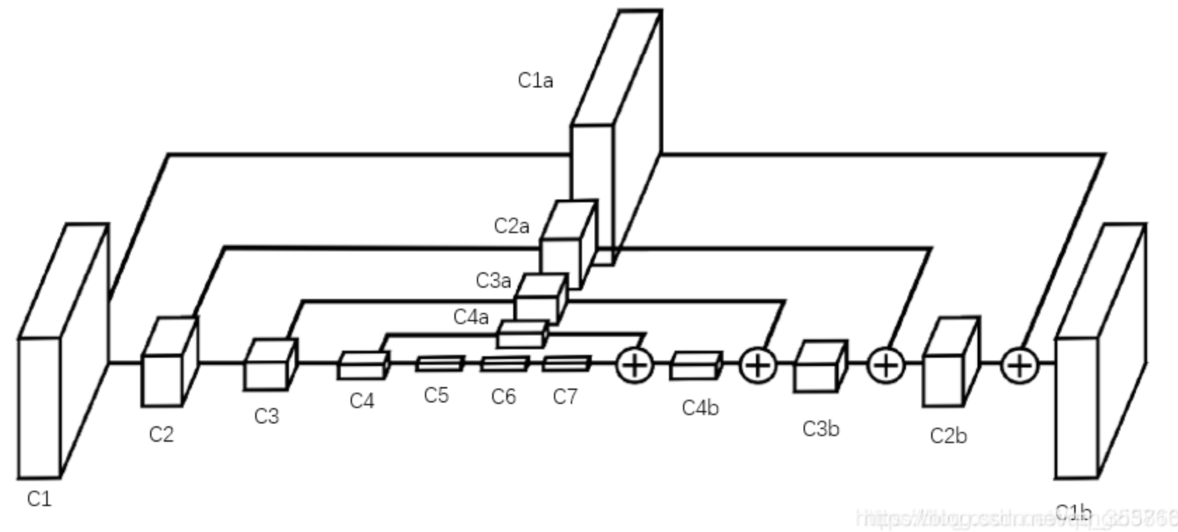
Paper Survey(4/4)
PSM-Net
3D CNN
The 3D CNN learns to regularize cost volume using stacked multiple hourglass networks in conjunction with intermediate supervision, this method repeatedly processes the cost volume in a top-down/bottom-up manner to further improve the utilization of global context information.
Digital Image & Signal Processing Lab

Slide 11
Thanks for Listening
Digital Image & Signal Processing Lab

Slide 12
Reference(1/1)
Scharstein, Daniel, and Richard Szeliski. "A taxonomy and evaluation of dense two-frame stereo correspondence algorithms." International journal of computer vision 47 (2002): 7-42.
Liu, Ce, et al. "Stereo risk: A continuous modeling approach to stereo matching." arXiv preprint arXiv:2407.03152 (2024).
Hamzah, Rostam Affendi, and Haidi Ibrahim. "Literature survey on stereo vision disparity map algorithms." Journal of Sensors 2016.1 (2016): 8742920.
Chang, Jia-Ren, and Yong-Sheng Chen. "Pyramid stereo matching network." Proceedings of the IEEE conference on computer vision and pattern recognition. 2018.
https://blog.csdn.net/qq_35586657/article/details/96843565
https://jason-chen-1992.weebly.com/home/siamese-network
https://blog.csdn.net/yanghao201607030101/article/details/109203705
Digital Image & Signal Processing Lab

