Slide 1
Recent Developments on Super-Resolution
Yi-Wen Chen
2018.12.28

Slide 2
Super-Resolution
Goal
Reconstruct a high-resolution (HR) image from a low-resolution (LR) input image
Application
Video surveillance
Medical diagnosis
Remote sensing

Slide 3
CNN-based SR
SRCNN [Dong et al. ECCV’14]
first CNN-based SR
VDSR [Kim et al. CVPR’16]
increase the network depth
ESPCN [Shi et al. CVPR’16]
bicubic upsampling → sub-pixel convolution
FSRCNN [Dong et al. ECCV’16]
bicubic upsampling → transposed convolution

Slide 4
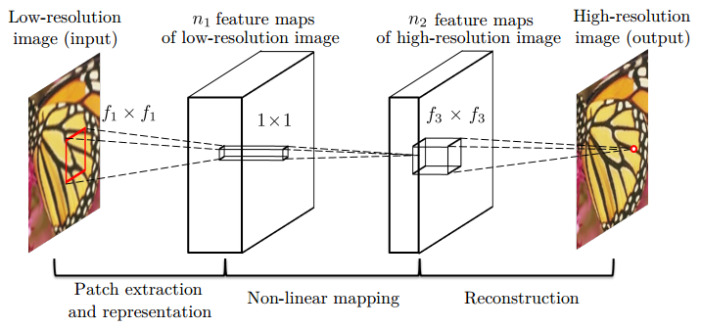
SRCNN
Ground Truth
Bicubic interpolation
Convolutional layer
C. Dong, C. C. Loy, K. He, and X. Tang. Learning a deep convolutional network for image super-resolution. In ECCV, 2014.

Slide 5
SRCNN → VDSR
Context
deeper network (3 layers → 20 layers) → larger receptive field
Convergence
higher learning rate enabled by residual-learning and gradient clipping (training time: 3 days → 4 hours)
Scale Factor
cope with multiscale SR problem in a single network

Slide 6
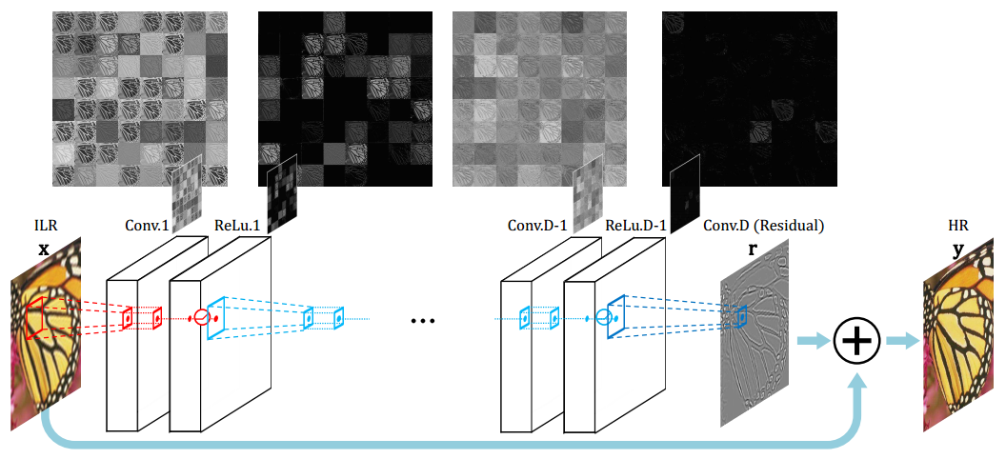
VDSR
Bicubic interpolation
J. Kim, J. K. Lee, and K. M. Lee. Accurate image super-resolution using very deep convolutional networks. In CVPR, 2016.

Slide 7
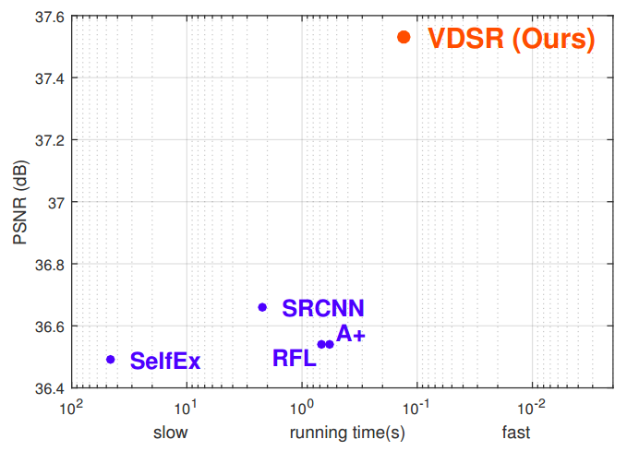
VDSR
J. Kim, J. K. Lee, and K. M. Lee. Accurate image super-resolution using very deep convolutional networks. In CVPR, 2016.

Slide 8
ESPCN
W. Shi, J. Caballero, F. Huszar, J. Totz, A. Aitken, R. Bishop, D. Rueckert, and Z. Wang. Real-time single image and video super-resolution using an efficient sub-pixel convolutional neural network. In CVPR, 2016.

Slide 9
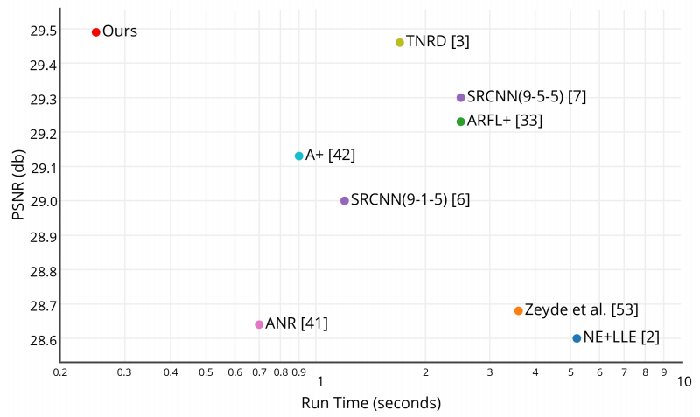
ESPCN
W. Shi, J. Caballero, F. Huszar, J. Totz, A. Aitken, R. Bishop, D. Rueckert, and Z. Wang. Real-time single image and video super-resolution using an efficient sub-pixel convolutional neural network. In CVPR, 2016.

Slide 10
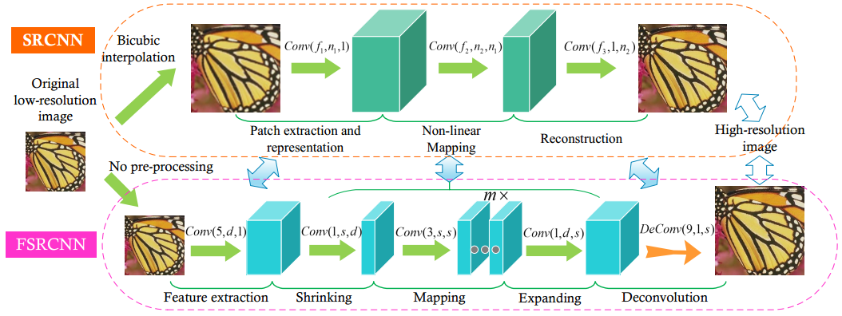
FSRCNN
C. Dong, C. C. Loy, and X. Tang. Accelerating the super-resolution convolutional neural network. In ECCV, 2016.

Slide 11
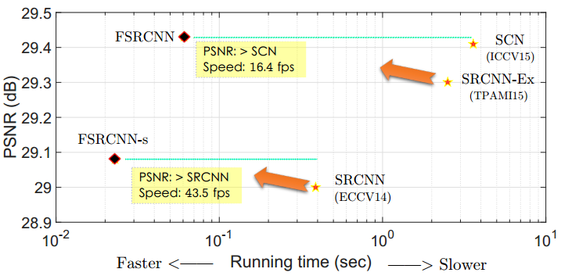
FSRCNN
C. Dong, C. C. Loy, and X. Tang. Accelerating the super-resolution convolutional neural network. In ECCV, 2016.

Slide 12
References
C. Dong, C. C. Loy, K. He, and X. Tang. Learning a deep convolutional network for image super-resolution. In ECCV, 2014.
J. Kim, J. K. Lee, and K. M. Lee. Accurate image super-resolution using very deep convolutional networks. In CVPR, 2016.
W. Shi, J. Caballero, F. Huszar, J. Totz, A. Aitken, R. Bishop, D. Rueckert, and Z. Wang. Real-time single image and video super-resolution using an efficient sub-pixel convolutional neural network. In CVPR, 2016.
C. Dong, C. C. Loy, and X. Tang. Accelerating the super-resolution convolutional neural network. In ECCV, 2016.

