Slide 1
Paper Survey : Attention is all you need
Advisor : Jian-Jiun Ding
Student : Chang-Fu Hong
2025.03.03
Digital Image & Signal Processing Lab

Slide 2
Outline
Introduction
Recurrent Neural Networks
Transformer
Model
Model Architecture
Attention
Position Encoding
Result
Conclusion
Reference
Digital Image & Signal Processing Lab

Slide 3
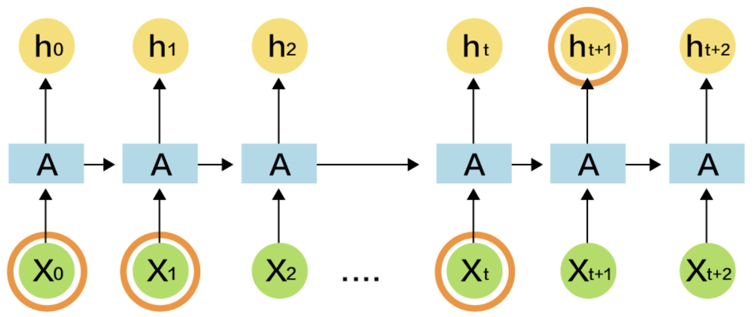
Introduction
Recurrent Neural Networks
Unable to process in parallel: When computing the t-th output, the previous t-1 outputs must be completed first.
Unfriendly to long sequences: When sequences are too long, historical information is lost, and gradient explosion or vanishing issues arise.
https://blog.tibame.com/?p=19075
Digital Image & Signal Processing Lab

Slide 4
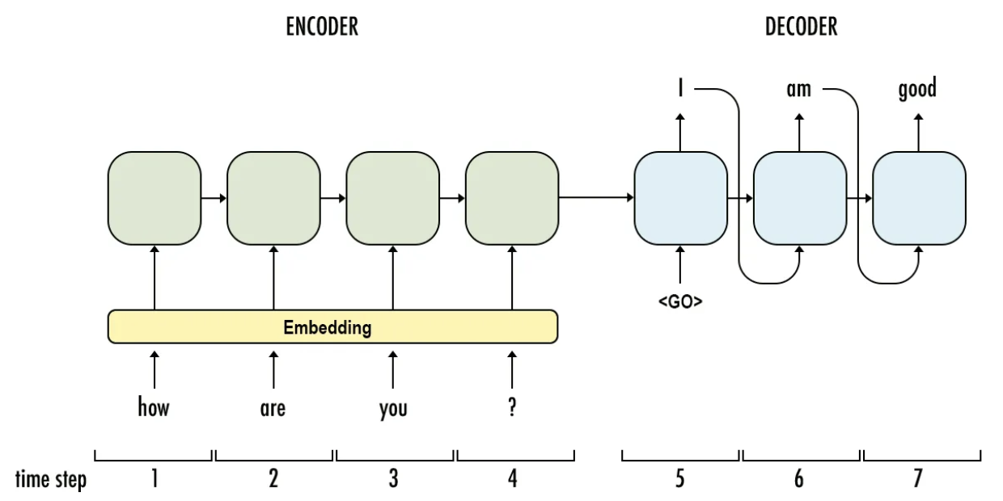
Introduction
Transformer
What is sequence transduction models : Input a sequence, generate a sequence.
Before Transformer, the attention mechanism was already proposed, mainly to address the issue of long sequences forgetting distant information.
Transformer is a sequence transduction model that uses only attention, replacing all recurrent models with multi-headed self-attention.
https://medium.com/towards-data-science/sequence-to-sequence-model-introduction-and-concepts-44d9b41cd42d
Digital Image & Signal Processing Lab

Slide 5
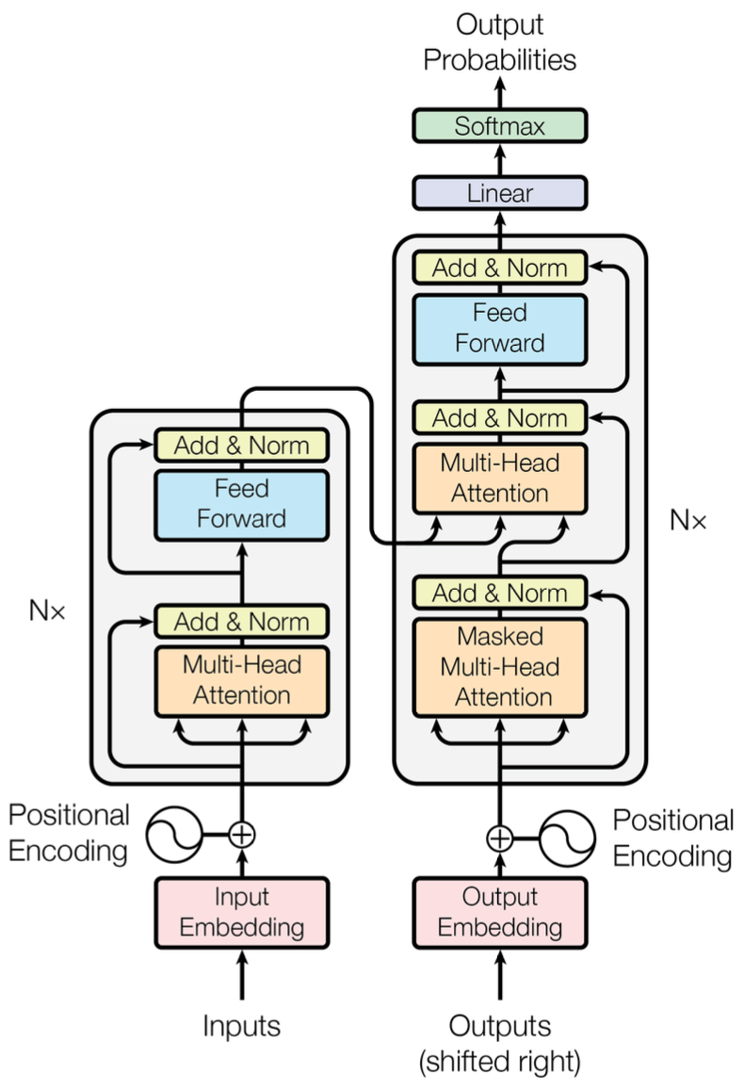
Model
Model Architecture
Encoder :
Composed of 6 identical layers stacked together.
Each layer contains two sub-layers.
Each sub-layer is connected using a residual connection.
Layer Norm.
Decoder :
Composed of 6 identical layers stacked together.
Each layer contains two sub-layers.
Each sub-layer is connected using a residual connection.
Layer Norm.
Masked multi-head attention.
Digital Image & Signal Processing Lab

Slide 6
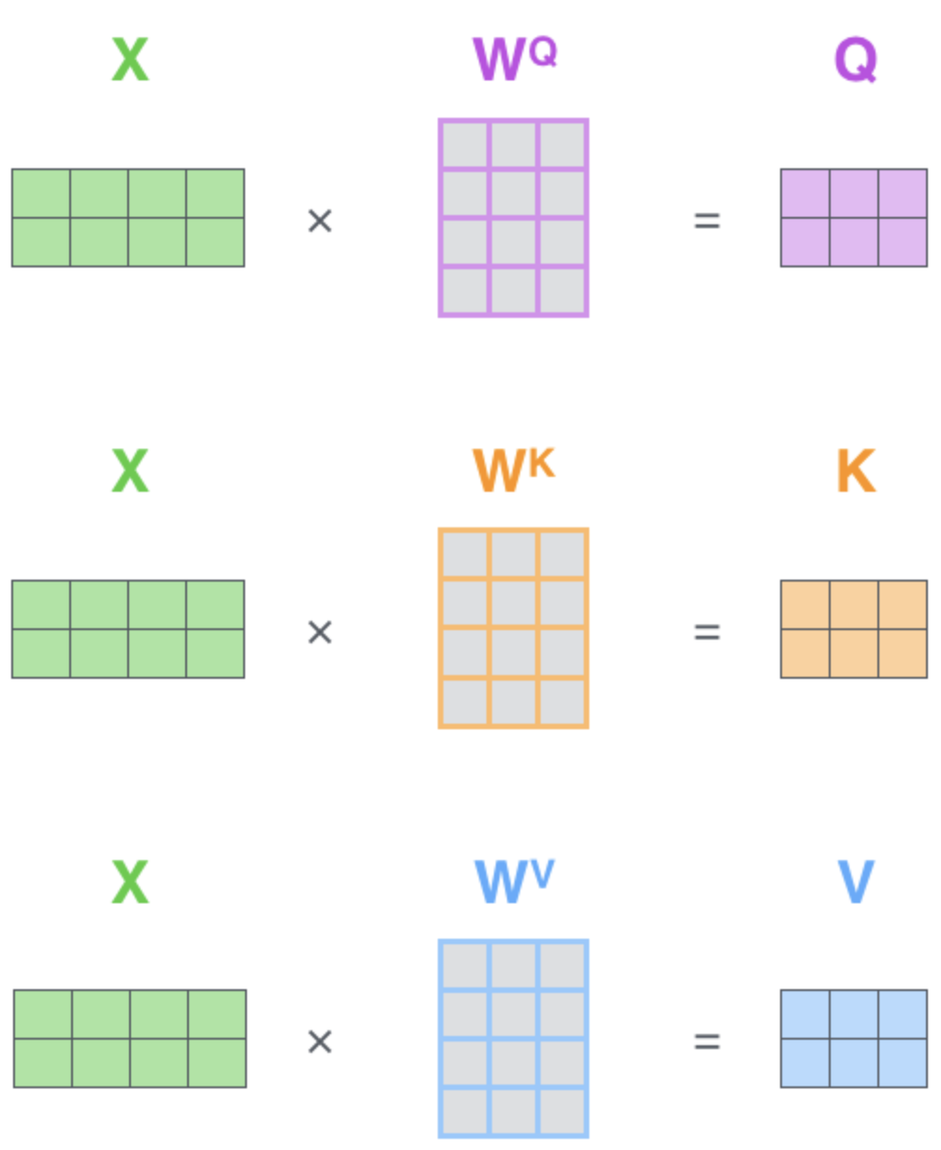
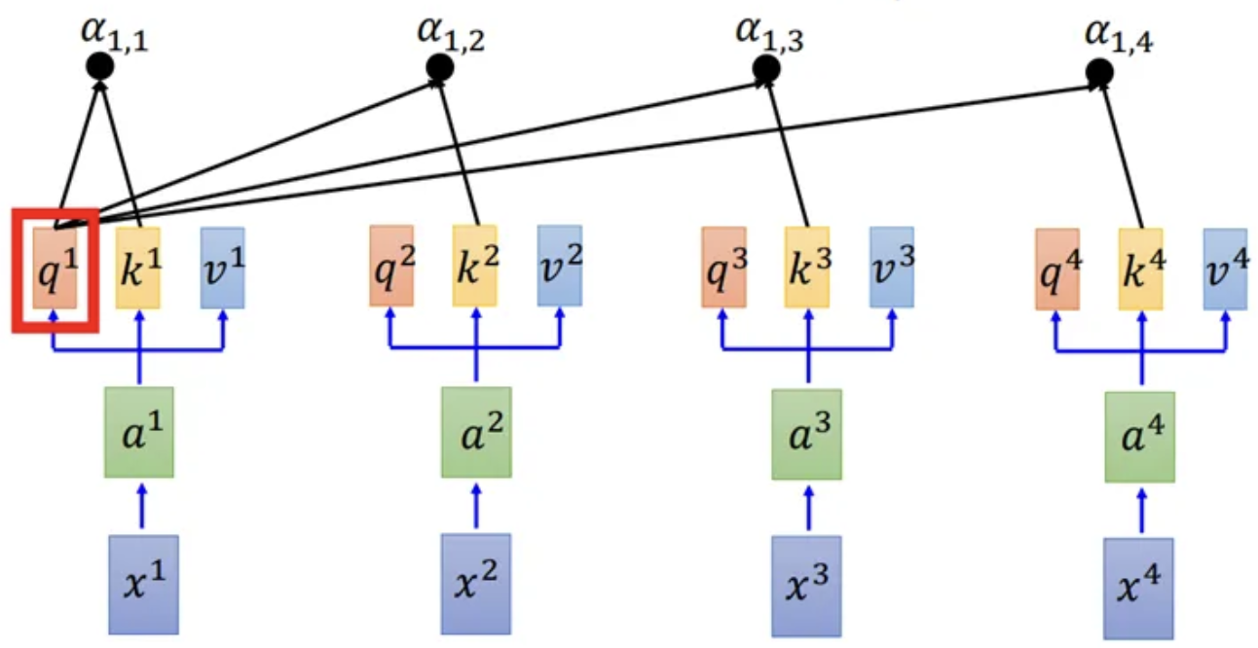
Model
Attention
Scaled Dot-Product Attention
https://medium.com/ching-i/transformer-attention-is-all-you-need-c7967f38af14
https://blog.csdn.net/weixin_45303602/article/details/134188049
Digital Image & Signal Processing Lab

Slide 7
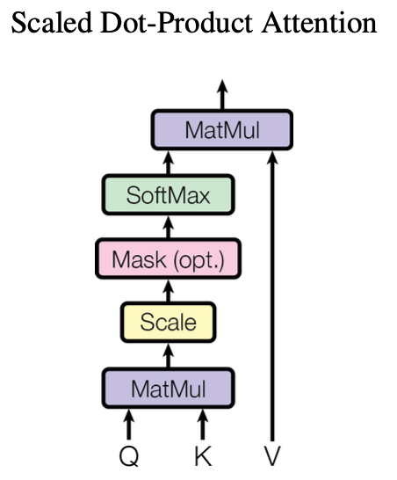
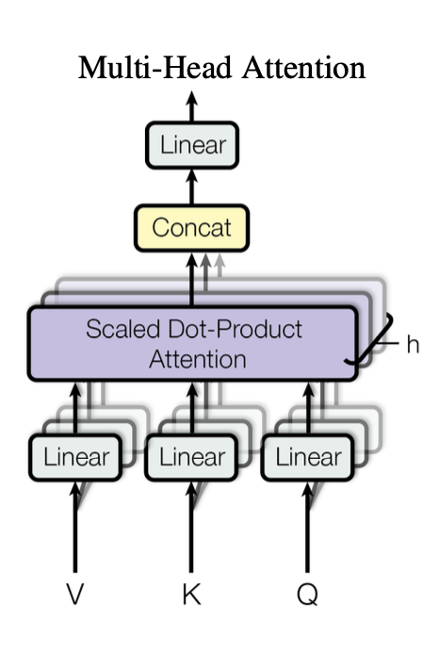
Model
Attention
Scaled Dot-Product Attention (Masked)
Multi-Head Attention
https://zhuanlan.zhihu.com/p/338817680
Digital Image & Signal Processing Lab

Slide 8
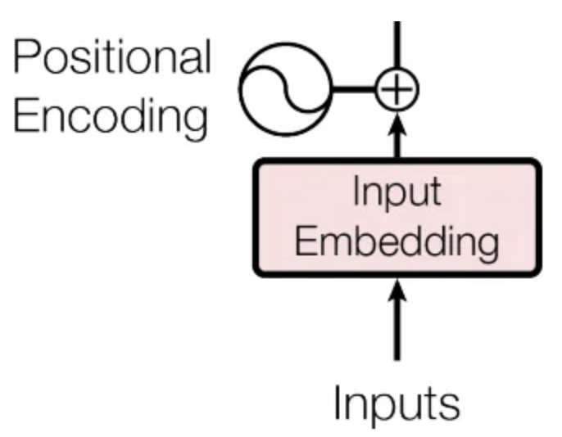
Model
Attention
Encoder :
Multi-Head Attention (Q K V from Encoder input)
Decoder :
Multi-Head Attention (K and V from Encoder output, Q from Masked output)
Masked Multi-Head Attention (Q K V from Decoder input)
Position Encoding
Digital Image & Signal Processing Lab

Slide 9
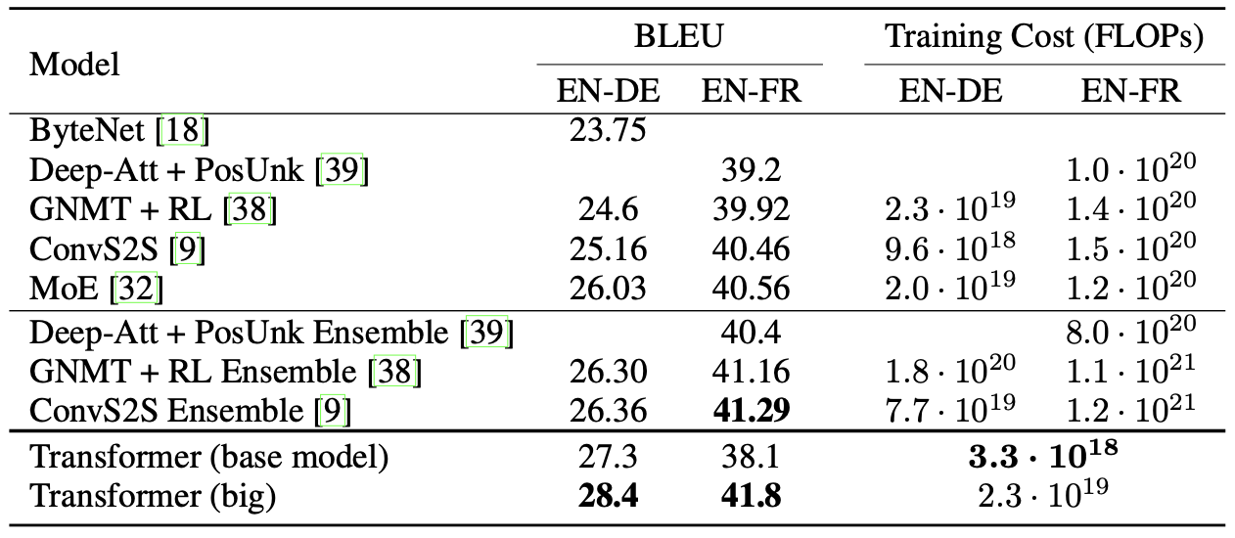
Result
BLEU score measures translation quality by comparing machine output to human references, scoring precision of word matches, with higher scores indicating better accuracy.
Training cost, measured in FLOPS, estimates computational effort as floating-point operations, reflecting time and resources needed to train a model.
Digital Image & Signal Processing Lab

Slide 10
Conclusion
Why Self Attention ?
Complexity per Layer : Measures total computations per layer, lower means faster processing.
Sequential Operations : Counts steps that must run in order, fewer means more parallelism.
Maximum Path Length : Distance signals travel for dependencies, shorter is better for learning.
Transformer is the first sequence transduction model to rely solely on attention.
Address the issue of RNNs being unable to handle long sequences effectively.
In addition to NLP problems, the Transformer can also effectively handle large-scale inputs and outputs (such as images, audio, and video).
Attention has fewer assumptions about the model, so Transformer requires more training data and computation to achieve better performance.
Digital Image & Signal Processing Lab

Slide 11
Thanks for Listening
Digital Image & Signal Processing Lab

Slide 12
Reference
Vaswani, Ashish, et al. "Attention is all you need." Advances in neural information processing systems 30 (2017).
Digital Image & Signal Processing Lab

