Slide 1
成群結隊的董事們

Slide 2
董事成群結隊
董事成群結隊: 兩位董事同時擔任相同兩家或更多公司的董事或者是多位董事同時擔任相同兩家或更多公司的董事。
傳統上又稱此現象為多重連結(multiple interlock)
董事多重連結，普遍存在於各國的公司中

Slide 3
Why?
1. Resource Dependency: overcome environmental uncertainty
Ex: multiple interlocks among competing companies, inviting firm banks into the board
2. Class Hegemony: control the economies and benefit the directors who involved in the interlocks

Slide 4
Questions
Q1: 董事多重連結是巧合，還是有意識的行為?
Q2: 若董事多重連結是有意識行為，參與多重連結的董事會和董事有何特徵?
Q3: 董事多重連結對公司的績效表現，是正面或負面?

Slide 5
3 graph structure to describe director multiple-interlock
Affliation Network
Board Network
Director Network

Slide 6
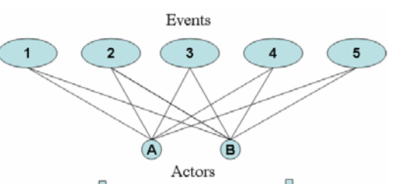
Affliation Network
Board
Director

Slide 7
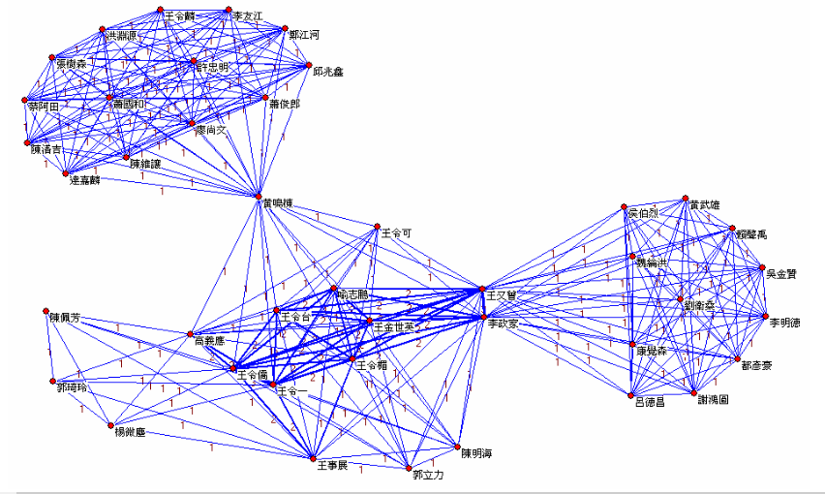
Director Network
director
Sharing board

Slide 8
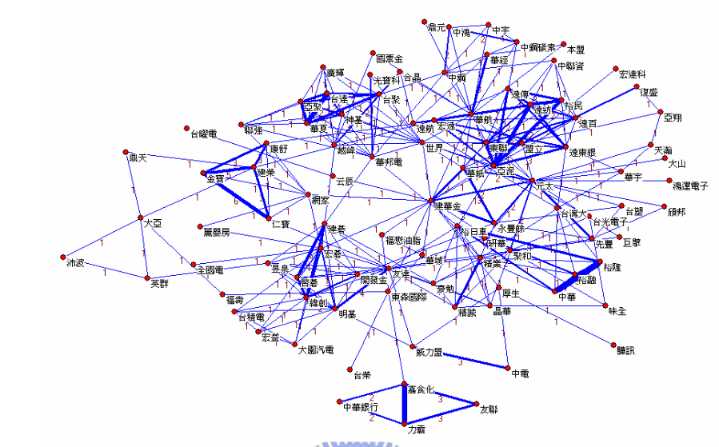
Board Network
Common director
Company

Slide 9
Herding Measures
percentage of multiple links in “board network” and “director network”
average multiplicity of multiple links in board network
Bipartite Clustering Coefficient
Social Inertia
Redundancy

Slide 10
Percentage of multiple links in “board network” and “director network”

Slide 11
Average Multiplicity of Multiple Links in a board network
Multiplicity of a node: how many edges connects a node
Multiplicity of Multiple Links of a node: how many multiple links connects a node

Slide 12
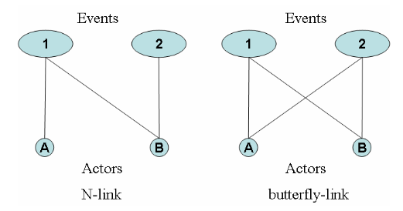
Bipartite Clustering Coefficients
BCC = #C4 / (#L3 * 0.25)

Slide 13
Social Inertia
Social Inertia of node i = sum(w_ik) / #k, where k is every neighbor of I

Slide 14
Redundancy
One director can be a communication channel of two board, other directors are redundant.

Slide 15
Q1: Coincidence or Intended?
Method:
1. Building a random network similar to the real-world network
2. Calculating the herding measure
3. Compare with real-world network
Result: Intended

Slide 16
Q2: pattern ?
1. 控制國內大量公司資產的董事
2. 擁有一家公司多數股份的公司
3. 內部董事

Slide 17
Q3:對公司績效正面或負面?
ROA = 淨利 / 資產
Regression Result: Negatively Related

Slide 18
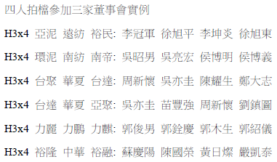
Multiple-interlock examples in Taiwan

Slide 19
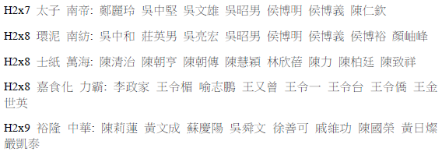
Multiple-interlock examples in Taiwan

Slide 20
References
劉顯仲. 成群結隊的董事們. 2006.

