Slide 1
Face Detection
蔡宇軒

Slide 2
Outline
Techniques for face detection
Knowledge based
Feature invariant
Template matching
Machine learning
Adaboost
Application
Conclusion
Reference
Notes:
前兩種方法有很多重疊部分所以比較難區分，後兩種方法有點類似的地方。
根據這四種方法給一個example。
但要達到人臉偵測通常需要這四種技術的搭配效果較好。
主要介紹現今相機偵測人臉的技術adaboost。

Slide 3
Outline
Techniques for face detection
Knowledge based
Feature invariant
Template matching
Machine learning
Adaboost
Application
Conclusion
Reference

Slide 4
Flow chart
(i) Face image is acquired, enhanced and segmented.
(ii) face boundary and facial features are detected.
(iii) the extracted facial features are matched against the features
stored in the database.
(iv) the classification of the face image into one or more persons is
achieved.
Notes:
先得到張含有人臉的圖片，可以先做前處理，像是equalizer消除光線問題或是增加對比度。
想辦法找到人臉的地方，去擷取需要的特徵。
根據特徵去和已知訓練好的model做比對。
讓classifier做判斷。

Slide 5
Knowledge based
Main idea : capture our knowledge of faces, and translate them into a set of rules
Suitable : Frontal faces in not complicated scene
Weaknesses : difficulty in translating human knowledge into well- defined rules
Notes:
1. 基於人類的知識判斷，最初始看到一張人臉的照片時，如何形容這是個人臉？
For example, a face often appears in an image with two eyes that are symmetric to each other, a nose, and a mouth.
將這些認知轉為一層一層的規則
2. One problem with this approach is the difficulty in translating human knowledge into well-defined rules
Another problem of such techniques is that they do not work very well under varying pose or head orientations.

Slide 6
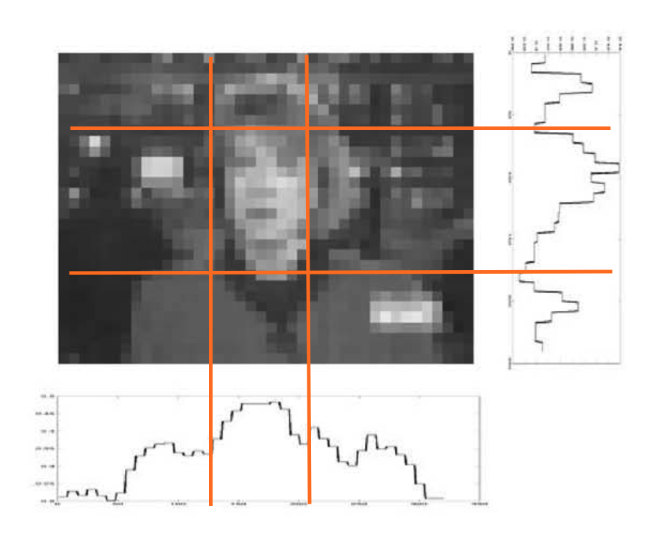
Knowledge based
Ming-Hsuan Yang. Detecting Faces in Images: A Survey.
Notes:
當我們看到左邊的照片時，要如何找到人臉，
Ex : 臉是對稱的，
如果都是這種只有一個臉的且照片相似情況可能就行得通，但對於其他可能就不適用。
所以通常會搭配hierarchical階層判斷，慢慢縮小範圍
但要是描述得過於仔細或廣泛的條件，將不利於判斷

Slide 7
Feature invariant
Main idea : find structural features or statistical models that exist, even when the viewpoint or lighting conditions vary.
Strengths : Improved invariance for different poses and lighting conditions
Weaknesses : Corruption of individual due to illumination, noise, or occlusion…
Notes:
Skin color is a powerful cue for detection, because color scene segmentation is computationally fast , while being robust to changes in viewpoint, scale…
There are also techniques that combine several features to improve the detection accuracy.
通常先使用質地，形狀，顏色來大範圍的搜尋face candidate，接者在用局部器官特徵來做確認。
Usually, they use features such as texture, shape and skin color to find face candidates and then use local facial features such as eyes, nose and mouth to verify the existence of a face.

Slide 8
Feature invariant
R>95 AND G>40 AND B<20 AND
Max{R,G,B} – Min{R,G,B}>15 AND
| R-G |>15 AND
R>G AND R>B
Deepak Ghimire and Joonwhoan Lee. A Robust Face Detection Method Based on Skin Color and Edges.
Notes:
Skin based segmentation has several advantages over other face detection techniques like this method is almost invariant against the changes of size of face, orientation of face.

Slide 9
Template matching
Main Idea : Given an input image, the correlation values with the standard patterns are computed for the face contour, eyes, nose, and mouth independently
Strengths: Simple to implement.
Weaknesses: Cannot achieve good results with variations in pose and shape.
Notes:
Fixed correlation templates work like matched filters, the cross-correlation is used as a similarity measure.
Ex. 拿100張人臉疊起來取膚色平均當作template，去對整張圖片或是特定區域做相似度計算，超過threshold即判斷為人臉。
Multiresolution, multiscale, subtemplates, and deformable templates have subsequently been proposed to achieve scale and shape invariance.
通常拿來做嫌疑犯或犯人的比對，拿自己的template和自己做比對有較高的相似程度。
The purpose of these sub-feature detectors has mainly been one of registering mugshot faces with model faces for recognition, rather than as a preprocessor for face detection.

Slide 10
Machine Learning
Neural networks
Omaima N. A. AL-Allaf. Review of face detection system based artificial neural networks algorithms
Notes:
和template不一樣的地方為：拿一堆data讓機器自己去學去統計出他認為可以分辨的特徵，而不是我們自己去定義設計template，
所以一般我們很難知道機器到底學了什麼為什麼他能達到分辨的功能。
While template matching methods rely on a predefined template or model, appearance-based methods use large numbers of depicting different variations

Slide 11
Machine Learning
Neural networks
Advantages：
1. Training neural Network is automatic
2. Capture the complex class conditional density of face patterns
Disadvantage：
1. Time consuming for training
2. Training set will be an important role to the performance.
3. Architecture has to be extensively tuned (number of layers,
number of nodes, learning rates… ) to get exceptional performance.

Slide 12
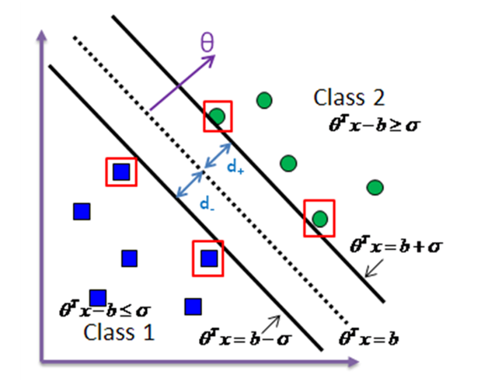
Machine Learning
Support vector machine
Edgar Osuna, Robert Freund and Federico Girosi. Training vector machine: application to face detection.
Notes:
使用線性分割來解決非線性分割，當在某一個維度不能使用線性的方式來進行分類時，SVM就會進行升維，然後在繼續嘗試使用線性方式來進行分類，

Slide 13
Machine Learning
Support vector machine
skin color

Slide 14
Machine Learning
Support vector machine
Advantages：
1. Evaluation is fast
2. Less training time than the neural networks
Disadvantage：
1. Training set will be an important role to the performance.

Slide 15
Outline
Techniques for face detection
Knowledge based
Feature invariant
Template matching
Machine learning
Adaboost
Application
Conclusion
Reference

Slide 16
ADABOOST
Adaptive boosting = weak classifiers + linear aggregation
https://www.google.com.tw/url?sa=i&rct=j&q=&esrc=s&source=images&cd=&cad=rja&uact=8&ved=0ahUKEwixr86t9vLAhUEJZQKHQHODQsQjRwIBw&url=http%3A%2F%2Fvgl-ait.org%2Fcvwiki%2Fdoku.php%3Fid%3Dopencv%3Atutorial%3Ahaartraining&psig=AFQjCNEy0_CsJjDCazcn0JTM0ipp-porRQ&ust=1458999639214602
Notes:
中文叫做皮將法：三個臭皮將勝過一個諸葛亮的概念
Train set = haar feature
Weak classifier = decision stump
在投票時得到過低的分數時就及時淘汰不用再算下去

Slide 17
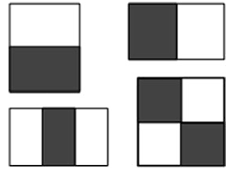
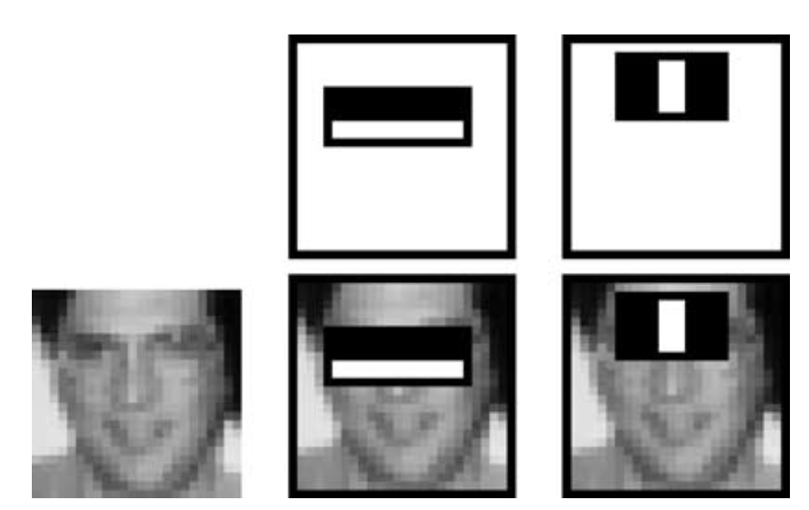
ADABOOST
Haar Feature (training set)
P. Viola and M. Jones. Robust Real-time Object Detection.
Notes:
特徵差異值計算方式為深色區與淺色區的灰階差值，對於人臉上不同區塊的灰階差值會有不同程度的結果，例如一般而言眼球區域的灰階總和會大於眼皮的灰階總和。

Slide 18
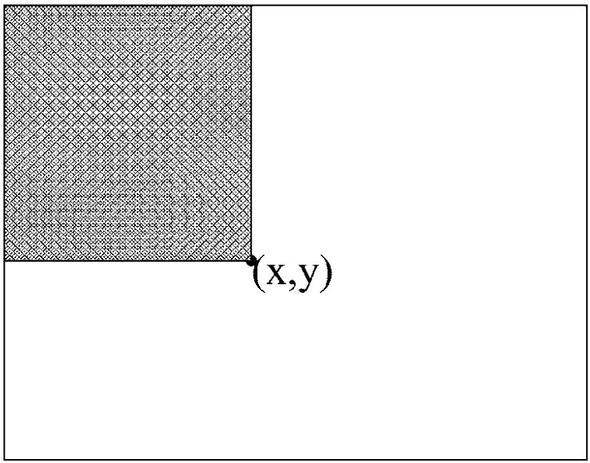
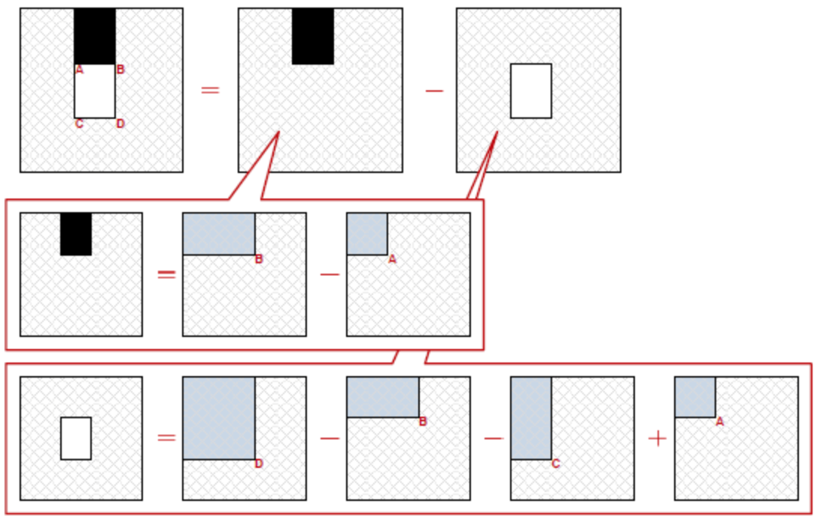
ADABOOST
Integral image
http://cg2010studio.com/2012/04/24/積分影像-integral-image/#more-5384
Notes:
積分圖，加速haar feature的計算。
（x,y）這點的直就是將灰色範圍的灰階值全部加起來。
所以現在training set有了。

Slide 19
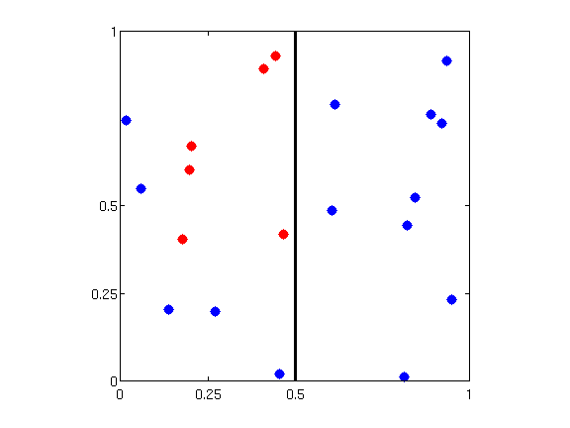
ADABOOST
Weak classifier : P(correct) => ½
Decision stump : $h_{s,i,θ}\left(x\right)=s ∙sign \left(x_{i }− θ\right)$
(feature i, threshold θ, direction s)
https://www.google.com.tw/url?sa=i&rct=j&q=&esrc=s&source=images&cd=&cad=rja&uact=8&ved=0ahUKEwiCobKN_tvLAhWFHpQKHbunDZsQjRwIBw&url=http%3A%2F%2Fsli.ics.uci.edu%2FClasses-CS178-Notes%2FDecisionTrees&psig=AFQjCNEXdJRLRrNH44sC-_2i39dMQNVm-Q&ust=1458999940453742
Notes:
什麼叫做weak：判斷正確的機率大於一半就可以 （丟銅板）
以2D來看就是切一刀。

Slide 20
ADABOOST
Hsuan-Tien Lin “machine learning techniques”
Notes:
輸入為一堆的haar feature，起始給每個feature一個uniform的weighted 1/N
根據這些sample找一個最好error最小的weak classifier A
重要核心：re-weighting。將分類錯的samples放大分對的縮小，專心在處理錯誤的samples上面，$∈t$ 為錯誤率 ，♦t 為設計過的變數，當$∈t$ <1/2時 ♦t>1
給這個classifier一個weighted（最後要做linear aggregation），ln(♦t )設計的想法為，$∈t$ =1/2 ♦t=1 $αt$ = 0，$∈t$ =0 ♦t=無限大 $αt$ = 無限大，給好的分類器大的權重，
4. 重複以上步驟

Slide 21
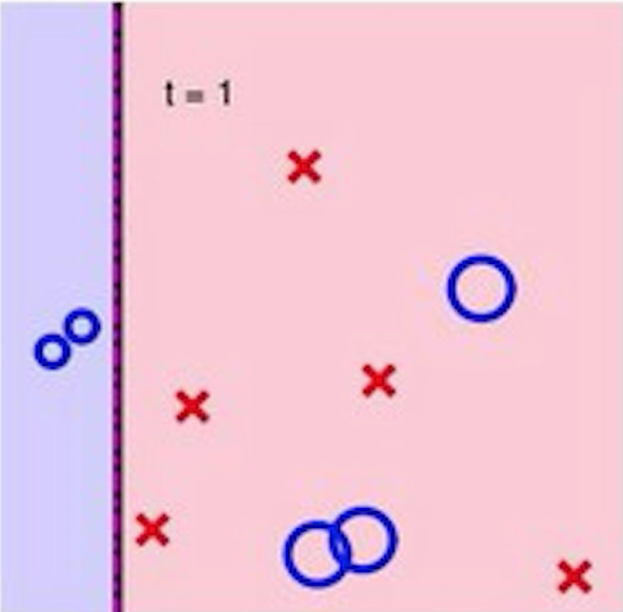
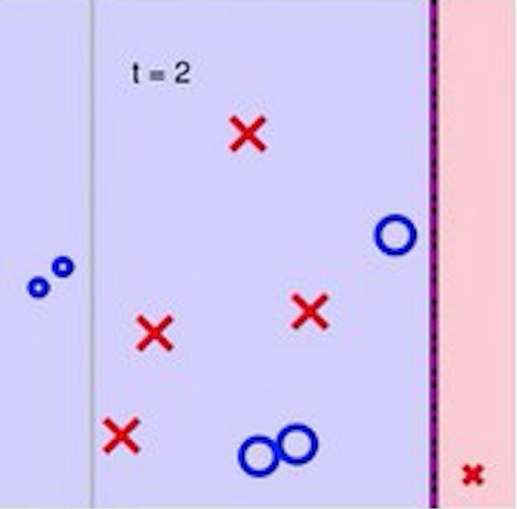
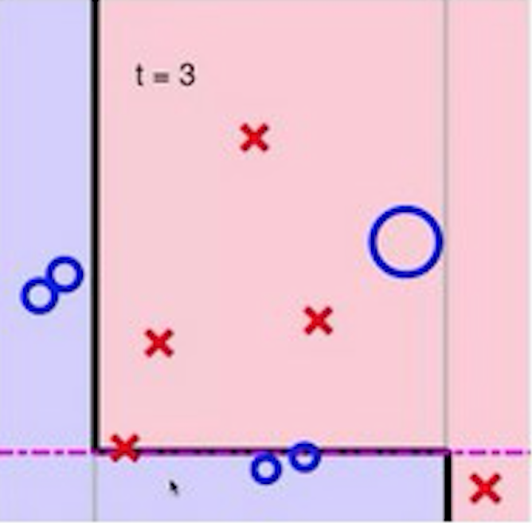
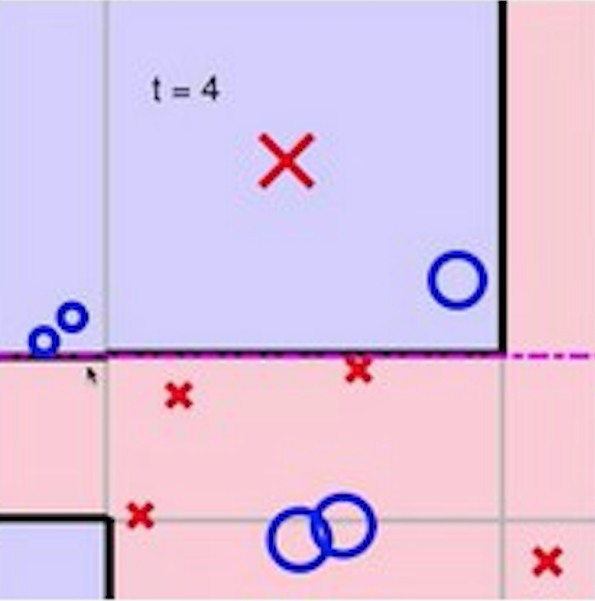
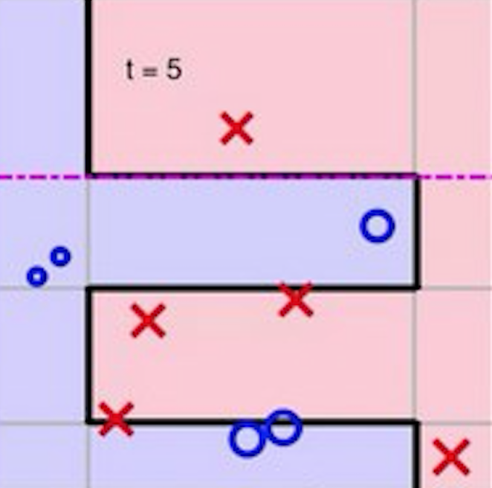
ADABOOST
Hsuan-Tien Lin “machine learning techniques”
Notes:
Example

Slide 22
ADABOOST
‪Haar Cascade Visualization‬ demo :
https://www.youtube.com/watch?v=hPCTwxF0qf4
Notes:
1:08 找到人臉
The set of detections are first partitioned into disjoint subsets. Two detections are in the same subset if their bounding regions overlap. Each partition yields a single final detection. The corners of the final bounding region are the average of the corners of all detections in the set.

Slide 23
Outline
Techniques for face detection
Knowledge based
Feature invariant
Template matching
Machine learning
Adaboost
Application
Conclusion
Reference

Slide 24
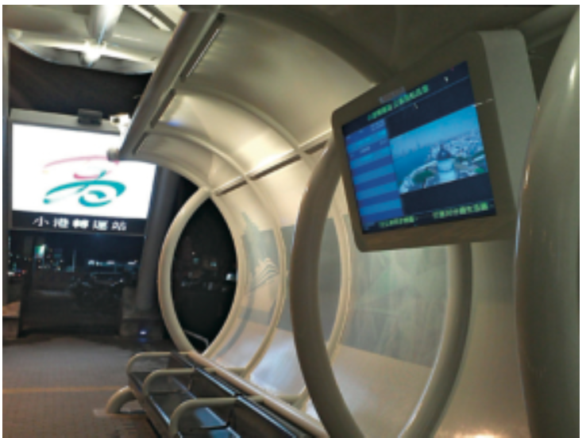
Application
Advertisement system
曾婉菁 人臉偵測及辨識方法探究
Notes:
高雄捷運上的數位看板，利用人臉偵測系統根據人臉位置、
注意力、眨眼、搖頭、點頭、停留的時間, 來判定廣告的吸引力及喜好度,計量出人流及廣告效益評估。
統計每個人的觀看行為,並透過統計資料讓廣告商更精準地投放內容。

Slide 25
Outline
Techniques for face detection
Knowledge based
Feature invariant
Template matching
Machine learning
Adaboost
Application
Conclusion
Reference

Slide 26
CONCLUSION
Face detection are still limited by some unconstrained conditions, e.g. variant pose, illumination, skin color..
A good face detection system may need to use more than one method.
It is the first step in many applications such as face recognition, facial expression analysis, surveillance, security systems and human computer interface.

Slide 27
references
[1] P. Viola and M. Jones. Robust Real-time Object Detection. International Journal of Computer Vision 57(2), 137–154, 2004
[2] Ming-Hsuan Yang, David J. Kriegman and Narendra Ahuja . Detecting Faces in Images: A Survey . Ieee transitions pattern analysis and machine intelligence, vol. 24, no. 1, january 2002
[3] Rashmi Gupta and Anil Kishore Saxena. Survey of Advanced Face Detection Techniques in Image Processing. International Journal of Computer Science and Management Research Vol. 1 Issue 2 September 2012
[4] Deepak Ghimire and Joonwhoan Lee. A Robust Face Detection Method Based on Skin Color and Edges. J Inf Process Syst, Vol.9, No.1, March 2013
[5] Hsuan-Tien Lin “machine learning techniques” , Coursera, Lecture note.
[6] http://cg2010studio.com/tag/haar-feature/
[7] http://mark-jo-prog.blogspot.tw/2012/08/face-detection-opencv-242.html
[8] http://courses.cs.tamu.edu/rgutier/cpsc689_s07/yang2002faceDetectionSurveySLIDES.pdf
[9] http://www.cepp.gov.tw/TheFiles/publication/97607698-36ce-48b3-973f-a7cd47d3b0ad.pdf

Slide 28
Thank you for your attention

