Slide 1
Introduction to
Image Quality Assessment
FR-IQA · NR-IQA Methods · VLM-based Quality Reasoning
張致恆 2026 / 05 / 26
FR-IQA
Traditional NR
Deep NR-IQA
VLM-based
PSNR / SSIM / LPIPS
BRISQUE / NIQE
HyperIQA / MUSIQ
CLIP-IQA
Q-Align / DeQA-Score
DepictQA / Q-Insight VisualQuality-R1 EvoQuality
p.6
p.9
p.12
p.16

Slide 2

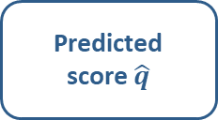
What is IQA (Image Quality Assessment) ?
The IQA Paradigm
IQA Model
Predicted score $\hat{q}$
MOS (human rating)
Input image
Reference image (optional)
f(image, ref) → $\hat{q}$
correlate
The IQA Dataset
MOS (human rating)
Input image
pairs
*MOS = Mean Opinion Score

Slide 3
IQA Taxonomy
Reference availability defines the problem setting
FR-IQA · Full Reference
NR-IQA · No Reference
Reference image
Required
Reference image
Not required
Task
Compare distorted vs. reference directly
Task
Predict perceived quality from a single image alone
Methods
PSNR, SSIM, LPIPS
vs
Methods
BRISQUE, NIQE, DBCNN, MUSIQ, VLM-based
Strength
Well-defined, stable, reproducible
Strength
Works in the wild — cameras, streaming, generated content
Limitation
Needs pristine reference — unavailable in real deployments
Limitation
Harder problem; must rely on learned or statistical priors

Slide 4
IQA Taxonomy: Key Axes
Four design dimensions that define every IQA method
General-Purpose
Scores any image regardless of distortion type.
Distortion-Specific
Tuned for one distortion type (JPEG, blur, noise…).
vs.
Synthetic Distortions
Lab-generated: JPEG, Gaussian blur, white noise, etc. Controlled, repeatable.
Authentic / In-the-Wild
Real capture degradations: camera noise, motion blur, over-/under-exposure.
Harder to model.
vs.
Opinion-Aware
Trained directly on human MOS labels. Predicts perceived quality as people experience it.
Opinion-Unaware
No MOS labels; exploits natural-scene statistics (NSS) or self-supervised signals instead.
vs.
Score-Only
Outputs a single quality scalar. Efficient, easy to compare, standard for ranking.
Explainable / Descriptive
Generates natural-language rationale.
Richer but more expensive.
vs.

Slide 5
Presentation Roadmap
1
FR-IQA Background
2
Traditional NR-IQA
3
Deep Learning NR-IQA
4
VLM-based NR-IQA
PSNR
SSIM
LPIPS
BRISQUE
NIQE
HyperIQA
MUSIQ
CLIP-IQA
Q-Align
DeQA-Score
DepictQA-V2
Q-Insight
VisualQuality-R1
EvoQuality

Slide 6
In this section
01
1
PSNR
Classical dB-scale pixel error — fast, universal, but perceptually weak
2
SSIM
FR-IQA
Background
Structural similarity: luminance, contrast, and structure decomposition
3
LPIPS
Measuring quality with a reference image:
pixel distances, structural similarity, and deep perceptual metrics
Deep feature distance — the first metric to closely match human perception

Slide 7
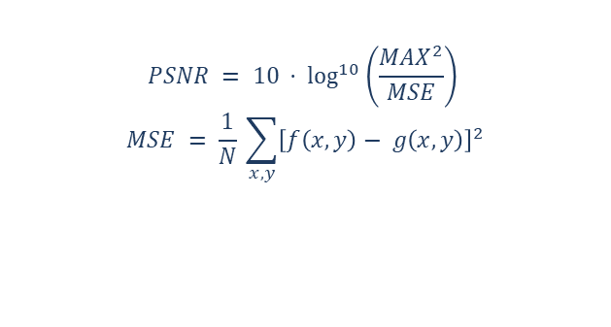
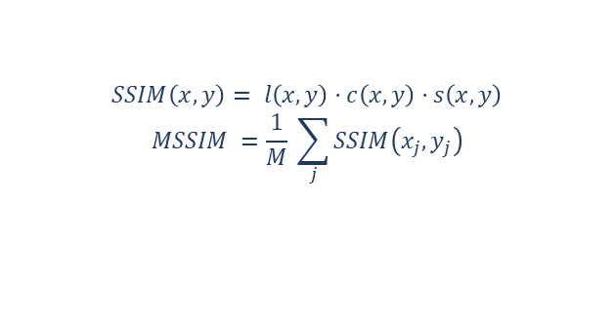
PSNR & SSIM
FR-IQA
Classical (PSNR) · IEEE TIP 2004 (SSIM)
PSNR — Peak Signal-to-Noise Ratio
SSIM — Structural Similarity Index
Pixel-level error measured as Mean Squared Error, expressed in dB
Higher = better; typical range 20–50 dB for images
General-purpose: applies to any distortion, but ignores visual saliency
Limitation: same PSNR can look very different to humans
Decomposes similarity into Luminance (μ), Contrast (σ), and Structure
Sliding window → local SSIMs averaged into a global score
Closer to human perception than PSNR — structure matters more than pixel error
General-purpose in design; strongest on synthetic distortions (blur, JPEG, noise)
$$PSNR = 10 · \log^{10}\left(\frac{MAX^{2}}{MSE}\right)$$
$$MSE = \frac{1}{N} \sum_{x,y}{{\left[f\left(x,y\right)− g\left(x,y\right)\right]}^{2}}$$
$$SSIM\left(x,y\right)= l\left(x,y\right)·c\left(x,y\right)·s\left(x,y\right)$$
$$MSSIM =\frac{1}{M} \sum_{j}{SSIM\left(x_{j},y_{j}\right)}$$

Slide 8
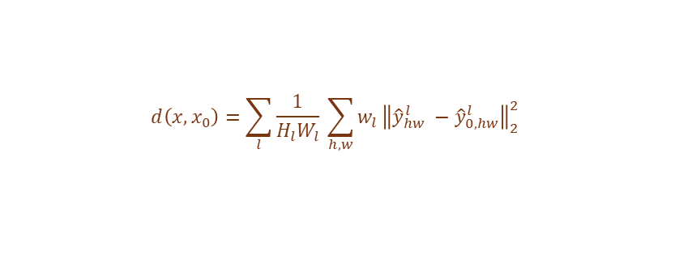
LPIPS
FR-IQA
CVPR 2018 · The unreasonable effectiveness of deep features as a perceptual metric
Uses deep network features, not raw pixels, to measure perceptual distance
Both images pass through AlexNet/VGG; L2 distance computed per layer, then weighted
General-purpose: robust across JPEG, blur, noise, and adversarial distortions
Trained on human 2AFC judgments — much closer to perceptual ground truth than PSNR/SSIM
Differentiable — widely used as a perceptual loss in image generation and restoration
Reference Image
Distorted Image
▼
▼
AlexNet / VGG Backbone
AlexNet / VGG Backbone
Frozen or fine-tuned
Frozen or fine-tuned
▼
▼
Multi-layer Features
(L1, L2, L3, …)
Multi-layer Features
(L1, L2, L3, …)
▼
▼
Normalize + L2 Distance per Layer → Weighted Sum
Perceptual Distance Score
$$d\left(x,x_{0}\right)=\sum_{l}{\frac{1}{H_{l}W_{l}} \sum_{h,w}{w_{l}}{\left\|{\hat{y}}_{hw}^{l} −{\hat{y}}_{0,hw}^{l}\right\|}_{2}^{2}}$$
(${\hat{y}}^{l}$ is channel-normalized activations)

Slide 9
In this section
02
1
BRISQUE
NSS statistics + Generalized Gaussian fitting + SVM regression
2
NIQE
Traditional
NR-IQA
Opinion-unaware: distance from a pristine multivariate Gaussian model
No reference, no labels — detecting quality degradation from natural scene statistics alone

Slide 10
BRISQUE
Traditional NR
IEEE TIP 2012 · No-Reference Image Quality Assessment in the Spatial Domain
No reference image needed — quality inferred entirely from natural scene statistics
MSCN coefficients: locally normalized luminance, sensitive to any statistical deviation
GGD/AGGD fitting over MSCN values → 36-dim feature vector (2 scales) → SVM → MOS
General-purpose scope (MOS-trained), but weakens on complex authentic distortions
Distortion-specific strength: highest accuracy on JPEG, blur, and white noise
Input Image
▼
MSCN Normalization
$$\hat{I}=(I−μ)/(σ+C)$$
▼
GGD Fit
(MSCN)
AGGD Fit
(neighbor pairs)
▼
▼
36-dim Feature Vector (2 scales)
▼
SVM Regressor → MOS Score
MSCN Normalization:
$$\hat{I}\left(i,j\right)=\frac{I\left(i,j\right)−μ\left(i,j\right)}{σ(i,j)+C}$$

Slide 11

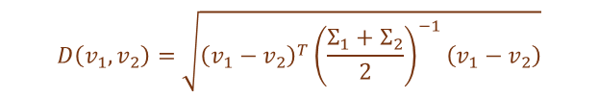

NIQE
Traditional NR
IEEE SPL 2013 · Making a ‘Completely Blind’ Image Quality Analyzer
Opinion-unaware: never trained on distorted images or MOS labels
Fits a Multivariate Gaussian (MVG) to NSS features of pristine natural images
Quality score = statistical distance between test image MVG and pristine MVG
Most general-purpose traditional method — works on any distortion without labels
Limitation: 'natural' ≠ 'high quality'; stylized or intentionally grained images may score poorly
High-Quality Natural Images
Test Image
▼
▼
Extract NSS Features
(MSCN etc.)
Extract NSS Features
(MSCN etc.)
▼
▼
Fit MVG
Pristine ($μ_{1}$,$Σ_{1}$)
Fit MVG
Test ($μ_{2}$,$Σ_{2}$)
▼
▼
Statistical Distance D($v_{1},ν_{2}$) = Quality Score
Lower distance = more natural = better
NIQE score:
$$D\left(v_{1},v_{2}\right)=\sqrt{{\left(v_{1}−v_{2}\right)}^{T}{\left(\frac{Σ_{1}+Σ_{2}}{2}\right)}^{−1}\left(v_{1}−v_{2}\right)}$$
(Generalized MVG distance)

Slide 12
In this section
03
1
HyperIQA
Hypernetwork to generate content-adaptive IQA predictors
2
MUSIQ
Deep Learning
NR-IQA
Multi-scale transformer handling arbitrary resolution inputs without quality loss
3
CLIP-IQA
Learned quality-aware features replace handcrafted statistics, enabling robust general-purpose quality prediction on real-world images
Antonymic prompt pairs unlock zero-shot quality scoring from CLIP

Slide 13
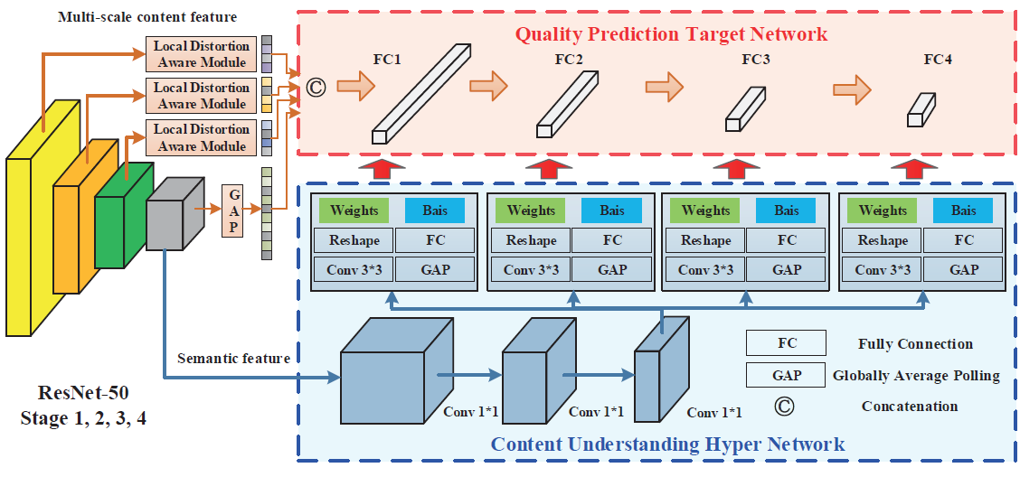
HyperIQA
Deep NR-IQA
CVPR 2020 · Blindly Assess Image Quality in the Wild Guided by a Self-Adaptive Hyper Network
Quality depends on content — a single shared FC scorer cannot judge a portrait the same way it judges a landscape
ResNet50 backbone (drop avgpool + FC), tap conv2/conv3/conv4 outputs as multi-scale features
Local-Distortion-Aware module: each tapped feature passes through 1×1 conv + avgpool, then is flattened
Hyper Network reads the deepest semantic feature and generates the weights and biases for the target FC layers
Target Network (4-layer FC, params injected) consumes the multi-scale vector and outputs the final quality score
Trained end-to-end with L1 loss against ground-truth MOS
Image source: [5]

Slide 14
MUSIQ
Deep NR-IQA
ICCV 2021 · MUSIQ: Multi-Scale Image Quality Transformer
Fixed-resolution CNNs destroy resolution-dependent quality cues — MUSIQ solves this
Processes image at multiple scales simultaneously via a shared Transformer encoder
Hash-based 2D positional + scale embeddings handle any resolution without a fixed grid
Trained on AVA, KonIQ, SPAQ — explicitly general-purpose across aesthetic and distortion quality
Key insight: general-purpose IQA must handle arbitrary resolution and aspect ratio
Input Image (any size)
▼
Scale 1
(full res)
Scale 2
(½ res)
Scale 3
(¼ res)
▼
▼
▼
Patch Tokens + Hash 2D Pos. Emb. + Scale Emb.
Spatial + scale identity per patch
▼
Transformer Encoder (Self-Attention)
▼
[CLS] Token → MLP Head → Quality Score

Slide 15

CLIP-IQA
Deep NR-IQA
AAAI 2023 · Exploring CLIP for Assessing the Look and Feel of Images
First to use CLIP vision-language priors for image quality assessment
Antonymic prompts ('Good photo.' vs. 'Bad photo.') give a relative quality score via softmax
CLIP-IQA+: soft prompt tokens (CoOp) learned to fit MOS — no architecture changes needed
One model covers holistic quality, sharpness, color, and aesthetics — just swap the prompt
Limitation: CLIP conflates quality with image content; prompt wording affects results
"Good photo."
(Positive)
Input Image
"Bad photo."
(Negative)
▼
▼
▼
CLIP Text
Encoder
CLIP Image Encoder
(ResNet/ViT)
CLIP Text
Encoder
▼
▼
▼
T₊ features
V features
T₋ features
▼
▼
▼
Cosine Sim + Softmax → Quality Score
softmax([cos(V,T₊), cos(V,T₋)])[0]
$$score =\frac{e^{\cos\left(V,T^{+}\right)}}{e^{\cos\left(V,T^{+}\right)}+e^{\cos\left(V,T^{−}\right)}}$$

Slide 16
In this section
1
Q-Align & DeQA-Score
04
LMM scoring via discrete text levels and score distribution regression
2
DepictQA-V2
GT-informed VLM unifying NR/FR, single/dual image, score/description
VLM-based
NR-IQA
3
Q-Insight
GRPO reinforcement learning — explicit chain-of-thought reasoning
Vision-language priors, descriptive reasoning, and reinforcement learning converge to redefine general-purpose quality evaluation
4
VisualQuality-R1
Reasoning-induced IQA via reinforcement learning to rank
5
EvoQuality
Fully self-supervised: self-evolving ranking via fidelity reward and GRPO

Slide 17
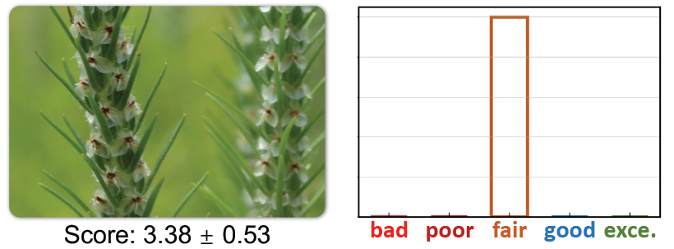
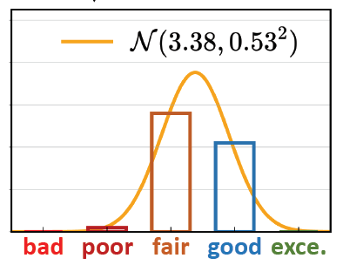
Q-Align & DeQA-Score
VLM-based
ICML 2024 · Q-Align: Teaching LMMs for Visual Scoring via Discrete Text-Defined Levels
CVPR 2025 · Teaching Large Language Models to Regress Accurate Image Quality Scores Using Score Distribution
Q-Align
DeQA-Score
Built on mPLUG-Owl2 LMM (LLaMA2 backbone); SFT-trained on visual quality data
Converts continuous MOS → 5 discrete text levels: bad / poor / fair / good / excellent
Visual abstractor compresses each image to 64 tokens, enabling up to 30-frame video as multi-image input
+10% accuracy gain over direct numeric regression on OOD benchmarks
Argues Q-Align's one-hot label loses MOS uncertainty and breaks inter-image ranking
Builds soft label from MOS Gaussian: integrate N(μ, σ²) over the 5 level bins to get probability vector
Linear correction (α, β) preserves expectation under truncation
Multi-dataset joint training via Thurstone-based Fidelity loss to align disparate score scales
Image source: [9]

Slide 18
DepictQA-V2
VLM-based
ECCV 2024 · Descriptive Image Quality Assessment in the Wild
One model covers NR/FR, single/dual image, and short answer/detailed reasoning
DQ-495K: 495K (image, question, answer) triplets across diverse distortion types
GT-informed generation: ground-truth distortion labels guide GPT-4V to write precise annotations
Trained jointly across all IQA subtasks — generalizes across distortion families by design
Preserves original resolution; CLIP ViT-L/14 + Vicuna-7B with LoRA fine-tuning
Image(s) (original res.)
Task Prompt
(eval / compare)
▼
▼
CLIP ViT-L/14 + Bicubic Pos.Emb. Interp.
▼
Image Projector (visual → LLM token dim)
▼
Vicuna-v1.5-7B (LoRA) + Multi-task tuning
▼
▼
Short Answer
(score / distortion)
Detailed Reasoning
(content + quality)

Slide 19
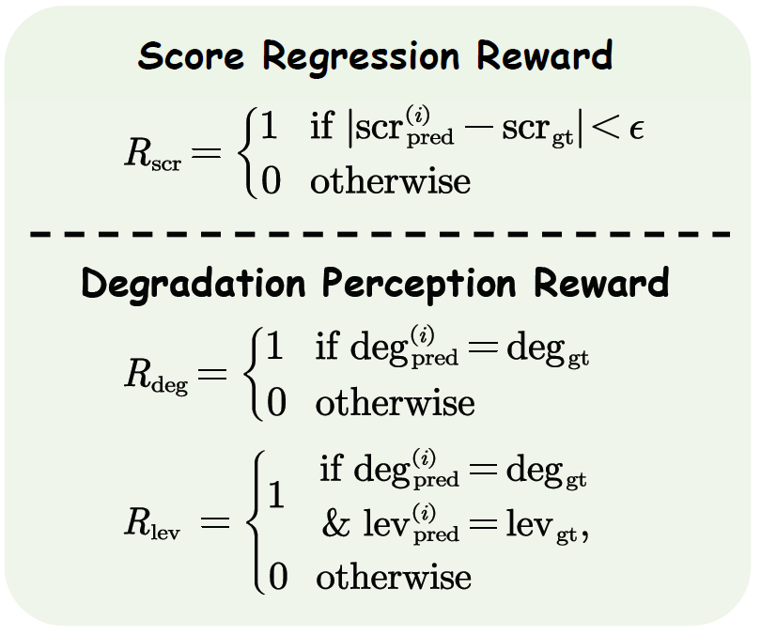
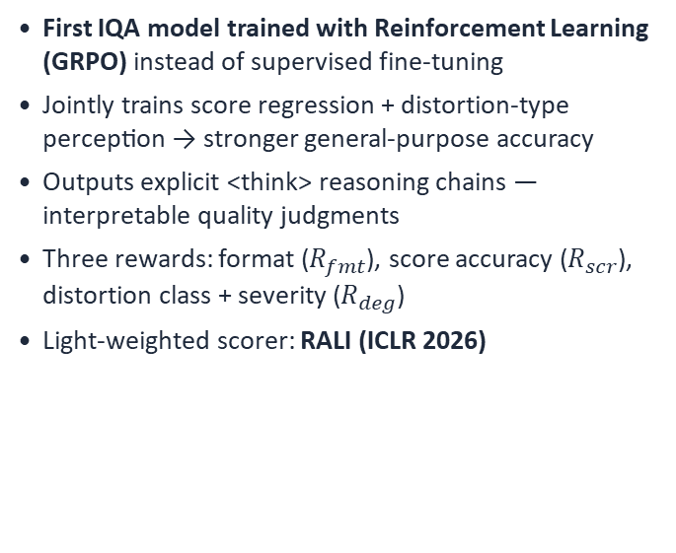



Q-Insight
VLM-based
NeurIPS 2025 · Q-Insight: Understanding Image Quality via Visual Reinforcement Learning
First IQA model trained with Reinforcement Learning (GRPO) instead of supervised fine-tuning
Jointly trains score regression + distortion-type perception → stronger general-purpose accuracy
Outputs explicit <think> reasoning chains — interpretable quality judgments
Three rewards: format ($R_{fmt}$), score accuracy ($R_{scr}$), distortion class + severity ($R_{deg}$)
Light-weighted scorer: RALI (ICLR 2026)
Input Image + Prompt
▼
Qwen2.5-VL-7B (Policy $π_{θ}$)
Generates N responses
▼
$$R_{fmt}$$
(Format)
$$R_{scr}$$
(Score±ε)
$$R_{deg}$$
(Distortion)
▼
▼
▼
GRPO: Advantage Weighting + KL Penalty vs $π_{ref}$
Policy update toward high-reward chains
▼
<think>…</think> <answer>{score,type}</answer>
Image source: [11]

Slide 20
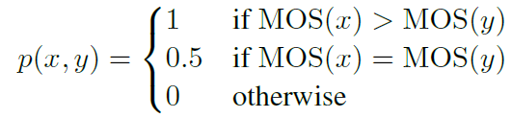
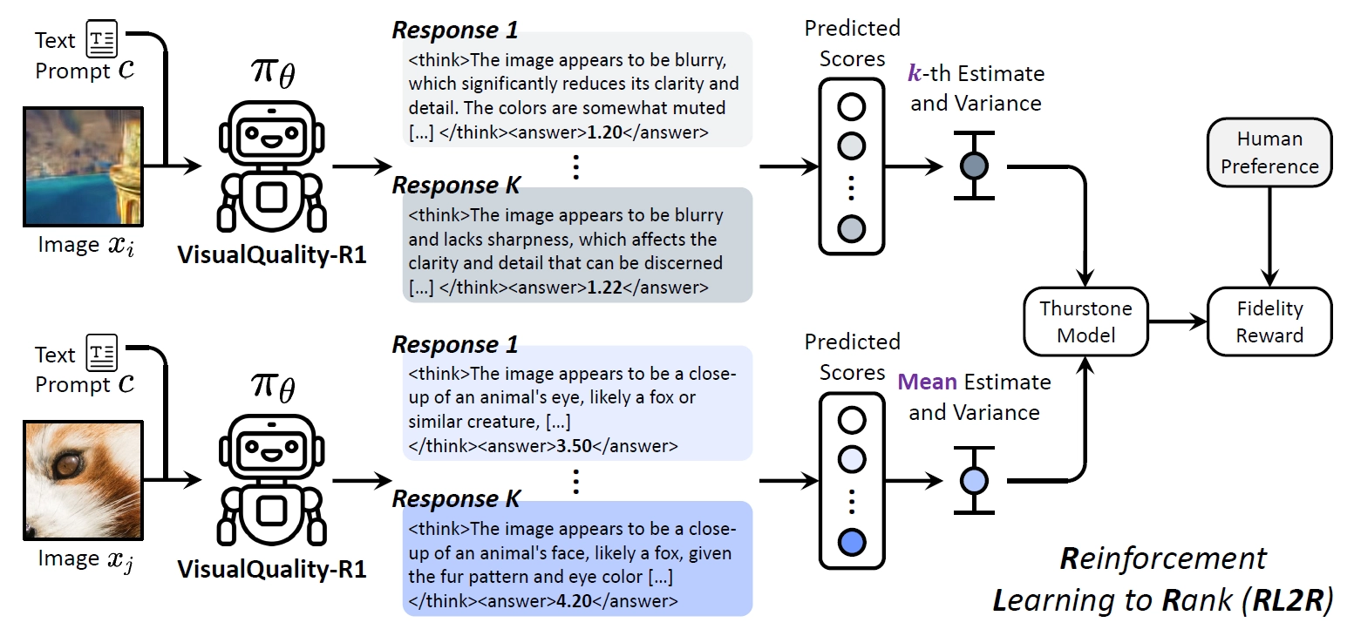
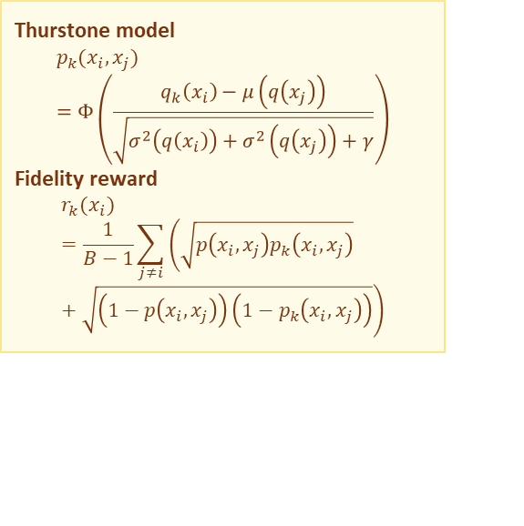
VisualQuality-R1
VLM-based
NeurIPS 2025 · VisualQuality-R1: Reasoning-Induced Image Quality Assessment via Reinforcement Learning to Rank
Image quality is intrinsically relative — absolute regression on a single dataset overfits and forgets pretraining
Frames NR-IQA as ranking: per image, sample K reasoning + score outputs to capture predictive uncertainty
Thurstone model converts paired scores into a comparative probability between two images
Fidelity reward against human MOS preference replaces brittle binary 0/1 rewards
GRPO updates the policy from grouped advantages — no separate value network needed
Thurstone model
$$p_{k}(x_{i},x_{j})=Φ\left(\frac{q_{k}\left(x_{i}\right)−μ\left(q\left(x_{j}\right)\right)}{\sqrt{σ^{2}\left(q\left(x_{i}\right)\right)+σ^{2}\left(q\left(x_{j}\right)\right)+γ}}\right)$$
Fidelity reward
$$r_{k}(x_{i})=\frac{1}{B−1}\sum_{j≠i}{\left(\sqrt{p\left(x_{i},x_{j}\right)p_{k}\left(x_{i},x_{j}\right)}+\sqrt{\left(1−p\left(x_{i},x_{j}\right)\right)\left(1−p_{k}\left(x_{i},x_{j}\right)\right)}\right)}$$
Image source: [12]

Slide 21
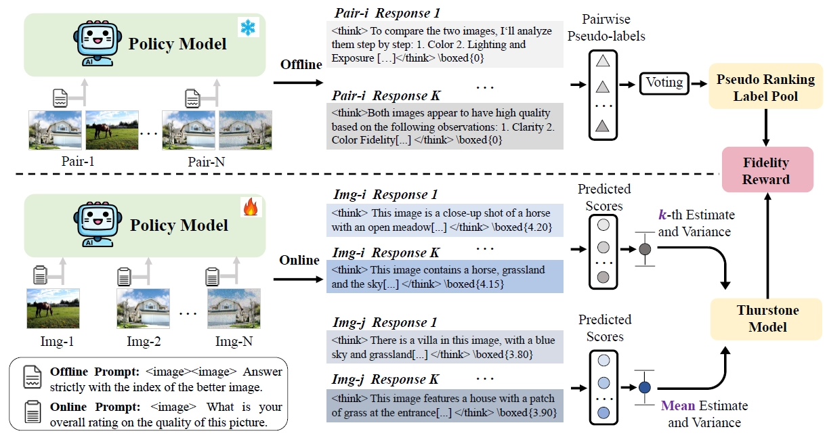
EvoQuality
VLM-based
ICLR 2026 · Self-Evolving Vision-Language Models for Image Quality Assessment via Voting and Ranking
Fully self-supervised — zero MOS labels, zero distortion annotations
Offline: repeated pairwise comparisons + majority voting → pseudo pairwise rankings
Online: scalar scores → Thurstone model → P(A>B); aligned to pseudo-rankings via fidelity reward
GRPO evolves the policy using fidelity reward — distortion-agnostic, no human labels
Key insight: relative ranking is a more stable self-supervision signal than score regression
Image source: [13]

Slide 22
Method Comparison
From handcrafted statistics to VLM-based reasoning
Family | Methods | Scope | Key Strength | Key Limitation
FR-IQA | PSNR / SSIM / LPIPS | GP with reference | Well-defined, stable, reproducible | Requires pristine reference image
Traditional NR | BRISQUE / NIQE | GP in design; strongest on synthetic | Fast, interpretable, no MOS needed | Fails on complex authentic distortions
Deep CNN / ViT | DBCNN / HyperIQA MUSIQ / CLIP-IQA | General-purpose (MOS-trained) | Handles mixed real-world distortions | Relies on large MOS datasets; dataset bias
VLM-based | Q-Align / DeQA-Score DepictQA /Q-Insight VisualQuality-R1 EvoQuality | Most GP; distortion-agnostic | Generalization, explainability, reasoning | High inference cost; prompt/reward bias

Slide 23

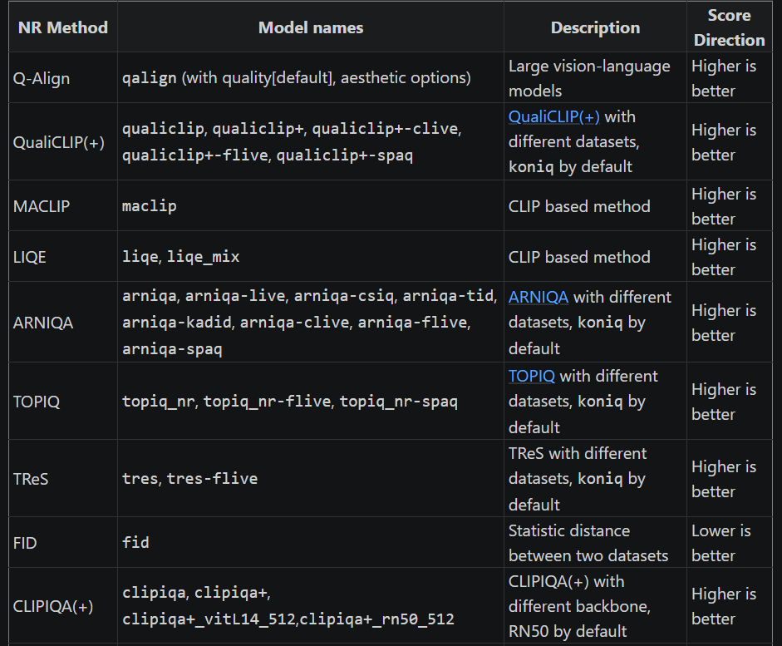
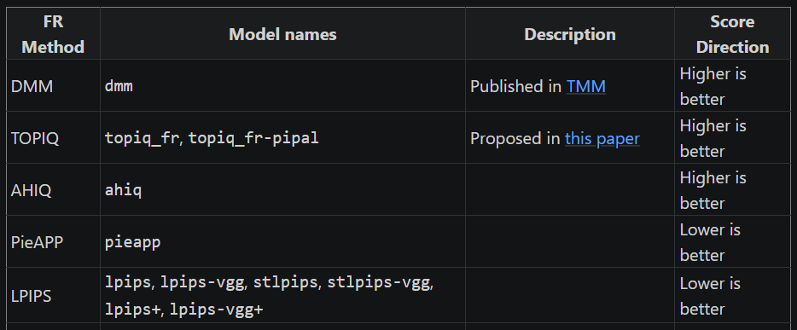
If you want to use IQA models
There is a IQA toolbox written in python: pyiqa
Supports most of NR-IQA and FR-IQA models / methods
Download: pip install pyiqa
Github link: https://github.com/chaofengc/IQA-PyTorch.git
Documentation: https://iqa-pytorch.readthedocs.io/en/latest/
Image source: [14,15]

Slide 24
References
Wang, Z., Bovik, A. C., Sheikh, H. R., and Simoncelli, E. P. “Image Quality Assessment: From Error Visibility to Structural Similarity.” IEEE Transactions on Image Processing, 13(4):600–612, 2004.
Zhang, R., Isola, P., Efros, A. A., Shechtman, E., and Wang, O. “The Unreasonable Effectiveness of Deep Features as a Perceptual Metric.” Proceedings of the IEEE/CVF Conference on Computer Vision and Pattern Recognition (CVPR), 2018.
Mittal, A., Moorthy, A. K., and Bovik, A. C. “No-Reference Image Quality Assessment in the Spatial Domain.” IEEE Transactions on Image Processing, 21(12):4695–4708, 2012.
Mittal, A., Soundararajan, R., and Bovik, A. C. “Making a ‘Completely Blind’ Image Quality Analyzer.” IEEE Signal Processing Letters, 20(3):209–212, 2013.
Su, S., Yan, Q., Zhu, Y., Zhang, C., Ge, X., Sun, J., and Zhang, Y. “Blindly Assess Image Quality in the Wild Guided by a Self-Adaptive Hyper Network.” Proceedings of the IEEE/CVF Conference on Computer Vision and Pattern Recognition (CVPR), 2020.
Ke, J., Wang, Q., Wang, Y., Milanfar, P., and Yang, F. “MUSIQ: Multi-Scale Image Quality Transformer.” Proceedings of the IEEE/CVF International Conference on Computer Vision (ICCV), 2021.
Wang, J., Chan, K. C. K., and Loy, C. C. “Exploring CLIP for Assessing the Look and Feel of Images.” Proceedings of the AAAI Conference on Artificial Intelligence (AAAI), 2023.
Wu, H., Zhang, Z., Zhang, W., Chen, C., Li, C., Liao, L., Wang, A., Zhang, E., Sun, W., Yan, Q., Min, X., Zhai, G., and Lin, W. “Q-Align: Teaching LMMs for Visual Scoring via Discrete Text-Defined Levels.” Proceedings of the International Conference on Machine Learning (ICML), 2024.
You, Z., Cai, X., Gu, J., Xue, T., and Dong, C. “Teaching Large Language Models to Regress Accurate Image Quality Scores Using Score Distribution.” Proceedings of the IEEE/CVF Conference on Computer Vision and Pattern Recognition (CVPR), 2025.
You, Z., Gu, J., Li, Z., Cai, X., Zhu, K., Dong, C., and Xue, T. “Descriptive Image Quality Assessment in the Wild.” arXiv preprint arXiv:2405.18842, 2024.
Li, W., Zhang, X., Zhao, S., Zhang, Y., Li, J., Zhang, L., and Zhang, J. “Q-Insight: Understanding Image Quality via Visual Reinforcement Learning.” Advances in Neural Information Processing Systems (NeurIPS), 2025.
Wu, T., Zou, J., Liang, J., Zhang, L., and Ma, K. “VisualQuality-R1: Reasoning-Induced Image Quality Assessment via Reinforcement Learning to Rank.” Advances in Neural Information Processing Systems (NeurIPS), 2025.
Wen, W., Zhi, T., Fan, K., Li, Y., Peng, X., Zhang, Y., Liao, Y., Li, J., and Zhang, L. “Self-Evolving Vision-Language Models for Image Quality Assessment via Voting and Ranking.” International Conference on Learning Representations (ICLR), 2026.
https://iqa-pytorch.readthedocs.io/en/latest/
Chen, C. and Mo, J. “IQA-PyTorch: PyTorch Toolbox for Image Quality Assessment.” GitHub repository, 2022. Available: https://github.com/chaofengc/IQA-PyTorch.
ZHAO, Shijie, et al. Reasoning as Representation: Rethinking Visual Reinforcement Learning in Image Quality Assessment. arXiv preprint arXiv:2510.11369, 2025.

Slide 25
Thanks for listening

