Slide 1
Integer-valued Zero Autocorrelation Sequences
Presenter : Shiang-Chih Hua
Advisor : Prof. Jian-jiun Ding

Slide 2
Outline
Introduction
Zero Autocorrelation
Integer-valued
Combination Method
Recursive Method

Slide 3
Introduction
$x={\left[\begin{matrix}6 & 6 & −6 & 3 & 2\end{matrix}\right]}^{T}$
$x^{\left(1\right)}={\left[\begin{matrix}6 & −6 & 3 & 2 & 6\end{matrix}\right]}^{T}$
$x^{\left(2\right)}={\left[\begin{matrix}−6 & 3 & 2 & 6 & 6\end{matrix}\right]}^{T}$
$\left\langle x,x^{\left(1\right)}\right\rangle =0, \left\langle x,x^{\left(2\right)}\right\rangle =0$

Slide 4
Zero Autocorrelation
periodic sequence $x\left[k\right]$
period = N
$\sum_{k=0}^{N−1}{x\left[k\right]x^{∗}\left[k+s\right]}=0, ∀s=1, 2, …, N−1$
$\sum_{k=0}^{N−1}{x\left[k\right]x^{∗}\left[k+s\right]}=Eδ_{N}\left[s\right]$
$δ_{N}\left[s\right]=\left\{\begin{aligned}1, s=0,±N,±2N,… \\ 0, otherwise\end{aligned}\right.$

Slide 5
Frequency domain
$W_{N}=e^{j\frac{2π}{N}}$
$\hat{x}\left[n\right]=DFT\left(x\left[k\right]\right)=\sum_{k=0}^{N−1}{x\left[k\right]{W_{N}}^{−nk}}$
$x\left[k\right]=IDFT\left(\hat{x}\left[n\right]\right)=\frac{1}{N}\sum_{n=0}^{N−1}{\hat{x}\left[n\right]{W_{N}}^{nk}}$

Slide 6
Constant Amplitude
$\left|\hat{x}\left[n\right]\right|=C, ∀n=0, 1, …, N−1$

Slide 7
ZAC $⇔$ CA
ZAC $⇒$ CA
${\left|\hat{x}\left[n\right]\right|}^{2}=\hat{x}\left[n\right]{\hat{x}}^{∗}\left[n\right]=\left(\sum_{k=0}^{N−1}{x\left[k\right]{W_{N}}^{−nk}}\right)\left(\sum_{k+s=0}^{N−1}{x^{∗}\left[k\right]{W_{N}}^{+n\left(k+s\right)}}\right)$
$=\sum_{s=0}^{N−1}{\left(\sum_{k=0}^{N−1}{x\left[k\right]x^{∗}\left[k+s\right]}\right){W_{N}}^{ns}}=\sum_{s=0}^{N−1}{\left(Eδ_{N}\left[s\right]\right){W_{N}}^{ns}}=E=C^{2}$

Slide 8
ZAC $⇔$ CA
ZAC $⇐$ CA
$\sum_{k=0}^{N−1}{x\left[k\right]x^{∗}\left[k+s\right]}=\sum_{k=0}^{N−1}{\left(\frac{1}{N}\sum_{n=0}^{N−1}{\hat{x}\left[n\right]{W_{N}}^{nk}}\right)\left(\frac{1}{N}\sum_{m=0}^{N−1}{{\hat{x}}^{∗}\left[m\right]{W_{N}}^{−m\left(k+s\right)}}\right)}$
$=\frac{1}{N^{2}}\sum_{n=0}^{N−1}{\sum_{m=0}^{N−1}{\hat{x}\left[n\right]{\hat{x}}^{∗}\left[m\right]{W_{N}}^{−ms}\left(\sum_{k=0}^{N−1}{{W_{N}}^{\left(n−m\right)k}}\right)}}$
$=\frac{1}{N^{2}}\sum_{n=0}^{N−1}{\sum_{m=0}^{N−1}{\hat{x}\left[n\right]{\hat{x}}^{∗}\left[m\right]{W_{N}}^{−ms}\left(Nδ_{N}\left[n−m\right]\right)}}$
$=\frac{1}{N}\sum_{n=0}^{N−1}{{\left|\hat{x}\left[n\right]\right|}^{2}{W_{N}}^{−ns}}=C^{2}δ_{N}\left[s\right]=Eδ_{N}\left[s\right]$

Slide 9
Integer-valued
$x\left[k\right]=\frac{1}{N}\sum_{n=0}^{N−1}{\hat{x}\left[n\right]{W_{N}}^{nk}}∈ℚ, ∀k=0, 1, …, N−1, \left(A1\right)$
$C=\left|\hat{x}\left[0\right]\right|=\left|\sum_{k=0}^{N−1}{x\left[k\right]}\right|∈ℚ$
$\frac{N}{C}x\left[k\right]=\sum_{n=0}^{N−1}{\left(\frac{1}{C}\hat{x}\left[n\right]\right){W_{N}}^{nk}}∈ℚ, ∀k=0, 1, …, N−1, \left(A2\right)$

Slide 10
Integer-valued
$y\left(d,k\right)≜\sum_{d|n}{\hat{x}\left[n\right]{W_{N}}^{nk}}∈ℚ, ∀d|N, ∀k=0, 1, …, N−1, \left(A3\right)$
$z\left(d,k\right)≜\sum_{gcd\left(N,n\right)=d}{\hat{x}\left[n\right]{W_{N}}^{nk}}∈ℚ, ∀d|N, ∀k=0, 1, …, N−1, \left(A4\right)$

Slide 11
Example
$\left[\begin{matrix}1 & 1 & 1 & 1 & 1 & 1 \\ 1 & \frac{1+\sqrt{3}i}{2} & \frac{−1+\sqrt{3}i}{2} & −1 & \frac{−1−\sqrt{3}i}{2} & \frac{1−\sqrt{3}i}{2} \\ 1 & \frac{−1+\sqrt{3}i}{2} & \frac{−1−\sqrt{3}i}{2} & 1 & \frac{−1+\sqrt{3}i}{2} & \frac{−1−\sqrt{3}i}{2} \\ 1 & −1 & 1 & −1 & 1 & −1 \\ 1 & \frac{−1−\sqrt{3}i}{2} & \frac{−1+\sqrt{3}i}{2} & 1 & \frac{−1−\sqrt{3}i}{2} & \frac{−1+\sqrt{3}i}{2} \\ 1 & \frac{1−\sqrt{3}i}{2} & \frac{−1−\sqrt{3}i}{2} & −1 & \frac{−1+\sqrt{3}i}{2} & \frac{1+\sqrt{3}i}{2}\end{matrix}\right]\left[\begin{matrix}\hat{x}\left[0\right] \\ \hat{x}\left[1\right] \\ \hat{x}\left[2\right] \\ \hat{x}\left[3\right] \\ \hat{x}\left[4\right] \\ \hat{x}\left[5\right]\end{matrix}\right]$ $∈ℚ^{6}$

Slide 12
Example
$\left[\begin{matrix}1 \\ 1 \\ 1 \\ 1 \\ 1 \\ 1\end{matrix}\right]\hat{x}\left[0\right], \left[\begin{matrix}1 & 1 \\ 1 & −1 \\ 1 & 1 \\ 1 & −1 \\ 1 & 1 \\ 1 & −1\end{matrix}\right]\left[\begin{matrix}\hat{x}\left[0\right] \\ \hat{x}\left[3\right]\end{matrix}\right],$ $\left[\begin{matrix}1 & 1 & 1 \\ 1 & \frac{−1+\sqrt{3}i}{2} & \frac{−1−\sqrt{3}i}{2} \\ 1 & \frac{−1−\sqrt{3}i}{2} & \frac{−1+\sqrt{3}i}{2} \\ 1 & 1 & 1 \\ 1 & \frac{−1+\sqrt{3}i}{2} & \frac{−1−\sqrt{3}i}{2} \\ 1 & \frac{−1−\sqrt{3}i}{2} & \frac{−1+\sqrt{3}i}{2}\end{matrix}\right]\left[\begin{matrix}\hat{x}\left[0\right] \\ \hat{x}\left[2\right] \\ \hat{x}\left[4\right]\end{matrix}\right]∈ℚ^{6}$

Slide 13
Example
$\left[\begin{matrix}1 \\ 1 \\ 1 \\ 1 \\ 1 \\ 1\end{matrix}\right]\hat{x}\left[0\right],\left[\begin{matrix}1 \\ −1 \\ 1 \\ −1 \\ 1 \\ −1\end{matrix}\right]\hat{x}\left[3\right],\left[\begin{matrix}1 & 1 \\ \frac{−1+\sqrt{3}i}{2} & \frac{−1−\sqrt{3}i}{2} \\ \frac{−1−\sqrt{3}i}{2} & \frac{−1+\sqrt{3}i}{2} \\ 1 & 1 \\ \frac{−1+\sqrt{3}i}{2} & \frac{−1−\sqrt{3}i}{2} \\ \frac{−1−\sqrt{3}i}{2} & \frac{−1+\sqrt{3}i}{2}\end{matrix}\right]\left[\begin{matrix}\hat{x}\left[2\right] \\ \hat{x}\left[4\right]\end{matrix}\right], \left[\begin{matrix}1 & 1 \\ \frac{1+\sqrt{3}i}{2} & \frac{1−\sqrt{3}i}{2} \\ \frac{−1+\sqrt{3}i}{2} & \frac{−1−\sqrt{3}i}{2} \\ −1 & −1 \\ \frac{−1−\sqrt{3}i}{2} & \frac{−1+\sqrt{3}i}{2} \\ \frac{1−\sqrt{3}i}{2} & \frac{1+\sqrt{3}i}{2}\end{matrix}\right]\left[\begin{matrix}\hat{x}\left[1\right] \\ \hat{x}\left[5\right]\end{matrix}\right]$ $∈ℚ^{6}$

Slide 14
$$\left(A4\right)⇒\left(A2\right)⇒\left(A3\right)⇒\left(A4\right)$$
直接加起來
$\sum_{n=0}^{N−1}{\hat{x}\left[n\right]{W_{N}}^{nk}}=\sum_{d|N}{\sum_{gcd\left(N,n\right)=d}{\hat{x}\left[n\right]{W_{N}}^{nk}}}=\sum_{d|N}{z\left(d,k\right)}∈ℚ$

Slide 15
$$\left(A4\right)⇒\left(A2\right)⇒\left(A3\right)⇒\left(A4\right)$$
$\sum_{m=0}^{d−1}{x\left[k+m\frac{N}{d}\right]}=\sum_{m=0}^{d−1}{\sum_{n=0}^{N−1}{\hat{x}\left[n\right]{W_{N}}^{n\left(k+m\frac{N}{d}\right)}}}$
$=\sum_{n=0}^{N−1}{\hat{x}\left[n\right]{W_{N}}^{nk}\left(\sum_{m=0}^{d−1}{{W_{d}}^{nm}}\right)}=\sum_{n=0}^{N−1}{\hat{x}\left[n\right]{W_{N}}^{nk}\left(dδ_{d}\left[n\right]\right)}$
$=d\sum_{d|n}{\hat{x}\left[n\right]{W_{N}}^{nk}}=dy\left(d,k\right)$
$y\left(d,k\right)=\frac{1}{d}\sum_{m=0}^{d−1}{x\left[k+m\frac{N}{d}\right]}∈ℚ$

Slide 16
$$\left(A4\right)⇒\left(A2\right)⇒\left(A3\right)⇒\left(A4\right)$$
$y\left(d,k\right)=\sum_{d|n}{\hat{x}\left[n\right]{W_{N}}^{nk}}=\sum_{d|m|N}{\left(\sum_{gcd\left(N,n\right)=m}{\hat{x}\left[n\right]{W_{N}}^{nk}}\right)}$
$=\sum_{d|m|N}{z\left(m,k\right)}=\sum_{\frac{N}{m}|\frac{N}{d}}{z\left(m,k\right)}$
$M\ddot{o}bius inversion formula$
$z\left(m,k\right)=\sum_{\frac{N}{d}|\frac{N}{m}}{μ\left(\frac{d}{m}\right)y\left(d,k\right)}=\sum_{m|d|N}{μ\left(\frac{d}{m}\right)y\left(d,k\right)}∈ℚ$

Slide 17
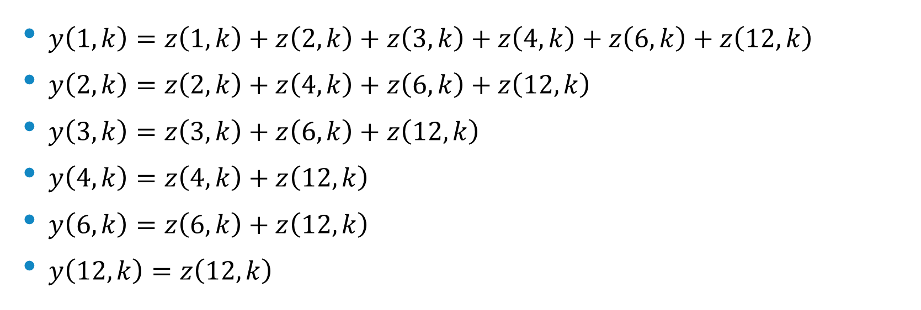
$$N=12$$
$y\left(1,k\right)=z\left(1,k\right)+z\left(2,k\right)+z\left(3,k\right)+z\left(4,k\right)+z\left(6,k\right)+z\left(12,k\right)$
$y\left(2,k\right)=z\left(2,k\right)+z\left(4,k\right)+z\left(6,k\right)+z\left(12,k\right)$
$y\left(3,k\right)=z\left(3,k\right)+z\left(6,k\right)+z\left(12,k\right)$
$y\left(4,k\right)=z\left(4,k\right)+z\left(12,k\right)$
$y\left(6,k\right)=z\left(6,k\right)+z\left(12,k\right)$
$y\left(12,k\right)=z\left(12,k\right)$

Slide 18
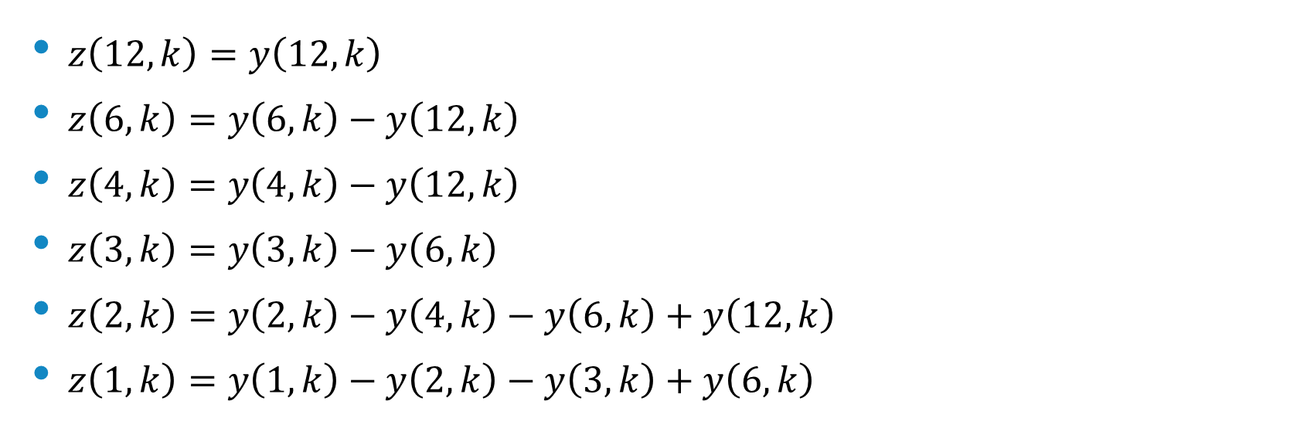
$$N=12$$
$z\left(12,k\right)=y\left(12,k\right)$
$z\left(6,k\right)=y\left(6,k\right)−y\left(12,k\right)$
$z\left(4,k\right)=y\left(4,k\right)−y\left(12,k\right)$
$z\left(3,k\right)=y\left(3,k\right)−y\left(6,k\right)$
$z\left(2,k\right)=y\left(2,k\right)−y\left(4,k\right)−y\left(6,k\right)+y\left(12,k\right)$
$z\left(1,k\right)=y\left(1,k\right)−y\left(2,k\right)−y\left(3,k\right)+y\left(6,k\right)$

Slide 19
Example
$\left[\begin{matrix}1 \\ 1 \\ 1 \\ 1 \\ 1 \\ 1\end{matrix}\right]\hat{x}\left[0\right],\left[\begin{matrix}1 \\ −1 \\ 1 \\ −1 \\ 1 \\ −1\end{matrix}\right]\hat{x}\left[3\right],\left[\begin{matrix}1 & 1 \\ \frac{−1+\sqrt{3}i}{2} & \frac{−1−\sqrt{3}i}{2} \\ \frac{−1−\sqrt{3}i}{2} & \frac{−1+\sqrt{3}i}{2} \\ 1 & 1 \\ \frac{−1+\sqrt{3}i}{2} & \frac{−1−\sqrt{3}i}{2} \\ \frac{−1−\sqrt{3}i}{2} & \frac{−1+\sqrt{3}i}{2}\end{matrix}\right]\left[\begin{matrix}\hat{x}\left[2\right] \\ \hat{x}\left[4\right]\end{matrix}\right], \left[\begin{matrix}1 & 1 \\ \frac{1+\sqrt{3}i}{2} & \frac{1−\sqrt{3}i}{2} \\ \frac{−1+\sqrt{3}i}{2} & \frac{−1−\sqrt{3}i}{2} \\ −1 & −1 \\ \frac{−1−\sqrt{3}i}{2} & \frac{−1+\sqrt{3}i}{2} \\ \frac{1−\sqrt{3}i}{2} & \frac{1+\sqrt{3}i}{2}\end{matrix}\right]\left[\begin{matrix}\hat{x}\left[1\right] \\ \hat{x}\left[5\right]\end{matrix}\right]$ $∈ℚ^{6}$

Slide 20
Example
$\hat{x}\left[0\right],\hat{x}\left[3\right],\left[\begin{matrix}1 & 1 \\ \sqrt{3}i & −\sqrt{3}i\end{matrix}\right]\left[\begin{matrix}\hat{x}\left[2\right] \\ \hat{x}\left[4\right]\end{matrix}\right],\left[\begin{matrix}1 & 1 \\ \sqrt{3}i & −\sqrt{3}i\end{matrix}\right]\left[\begin{matrix}\hat{x}\left[1\right] \\ \hat{x}\left[5\right]\end{matrix}\right]∈ℚ$
$\hat{x}\left[0\right]=±1, \hat{x}\left[2\right]=a+\frac{1}{\sqrt{3}}bi, \hat{x}\left[4\right]=a−\frac{1}{\sqrt{3}}bi,$
$\hat{x}\left[3\right]=±1, \hat{x}\left[1\right]=c+\frac{1}{\sqrt{3}}di, \hat{x}\left[5\right]=c−\frac{1}{\sqrt{3}}di$
$a,b,c,d∈ℚ, a^{2}+\frac{1}{3}b^{2}=1, c^{2}+\frac{1}{3}d^{2}=1$

Slide 21
Example
$6x=±\left[\begin{matrix}1 \\ 1 \\ 1 \\ 1 \\ 1 \\ 1\end{matrix}\right]±\left[\begin{matrix}1 \\ −1 \\ 1 \\ −1 \\ 1 \\ −1\end{matrix}\right]+\left[\begin{matrix}2a \\ a−b \\ −a−b \\ 2a \\ −a+b \\ a+b\end{matrix}\right]+\left[\begin{matrix}2c \\ −c−d \\ −c+d \\ 2c \\ −c−d \\ −c+d\end{matrix}\right]$
$a,b,c,d∈ℚ, a^{2}+\frac{1}{3}b^{2}=1, c^{2}+\frac{1}{3}d^{2}=1$

Slide 22
Initial solution → General solution
$a^{2}+\frac{1}{3}b^{2}=1, initial solution \left(a,b\right)=\left(1,0\right)$
$a=1+r_{1}t, b=0+r_{2}t$
$1+2r_{1}t+{r_{1}}^{2}{t }^{2}+\frac{1}{3}{r_{2}}^{2}{t }^{2}=1⇒t=\frac{−2r_{1}}{{r_{1}}^{2}+\frac{1}{3}{r_{2}}^{2}}$
$a=\frac{−{r_{1}}^{2}+\frac{1}{3}{r_{2}}^{2}}{{r_{1}}^{2}+\frac{1}{3}{r_{2}}^{2}}, b=\frac{−2r_{1}r_{2}}{{r_{1}}^{2}+\frac{1}{3}{r_{2}}^{2}}$

Slide 23
Combination
$DFT\left(p\right)={\left[\begin{matrix}\hat{p}\left[0\right] & \hat{p}\left[1\right] & \hat{p}\left[2\right] & \hat{p}\left[3\right] & \hat{p}\left[4\right] & \hat{p}\left[5\right]\end{matrix}\right]}^{T}$
$DFT\left(q\right)={\left[\begin{matrix}\hat{q}\left[0\right] & \hat{q}\left[1\right] & \hat{q}\left[2\right] & \hat{q}\left[3\right] & \hat{q}\left[4\right] & \hat{q}\left[5\right]\end{matrix}\right]}^{T}$
$DFT\left(u\right)={\left[\begin{matrix}\hat{u}\left[0\right] & \hat{u}\left[1\right] & \hat{u}\left[2\right] & \hat{u}\left[3\right] & \hat{u}\left[4\right] & \hat{u}\left[5\right]\end{matrix}\right]}^{T}$
$DFT\left(v\right)={\left[\begin{matrix}\hat{v}\left[0\right] & \hat{v}\left[1\right] & \hat{v}\left[2\right] & \hat{v}\left[3\right] & \hat{v}\left[4\right] & \hat{v}\left[5\right]\end{matrix}\right]}^{T}$
$x=IDFT\left({\left[\begin{matrix}\hat{p}\left[0\right] & \hat{v}\left[1\right] & \hat{u}\left[2\right] & \hat{q}\left[3\right] & \hat{u}\left[4\right] & \hat{v}\left[5\right]\end{matrix}\right]}^{T}\right)$

Slide 24
Example
$DFT\left({\left[\begin{matrix}1 & 0 & 0 & 0 & 0 & 0\end{matrix}\right]}^{T}\right)={\left[\begin{matrix}1 & 1 & 1 & 1 & 1 & 1\end{matrix}\right]}^{T}$
$DFT\left({\left[\begin{matrix}−1 & 0 & 0 & 0 & 0 & 0\end{matrix}\right]}^{T}\right)={\left[\begin{matrix}−1 & −1 & −1 & −1 & −1 & −1\end{matrix}\right]}^{T}$
$DFT\left({\left[\begin{matrix}0 & 0 & 0 & 0 & 0 & −1\end{matrix}\right]}^{T}\right)={\left[\begin{matrix}−1 & −{W_{6}}^{1} & −{W_{6}}^{2} & 1 & −{W_{6}}^{4} & −{W_{6}}^{5}\end{matrix}\right]}^{T}$
$DFT\left({\left[\begin{matrix}0 & 1 & 0 & 0 & 0 & 0\end{matrix}\right]}^{T}\right)={\left[\begin{matrix}1 & {W_{6}}^{5} & {W_{6}}^{4} & −1 & {W_{6}}^{2} & {W_{6}}^{1}\end{matrix}\right]}^{T}$
${x=\frac{1}{6}\left[\begin{matrix}2 & −1 & −1 & 2 & −1 & 5\end{matrix}\right]}^{T}$

Slide 25
$$N=prime$$
$p$ 的因數只有 $1,p$
$\hat{x}\left[0\right]=±1, \left(\hat{x}\left[1\right],…,\hat{x}\left[p−1\right]\right)$ 的關係依然很複雜
取 $\hat{x}\left[0\right]=−1, \hat{x}\left[1\right],…,\hat{x}\left[p−1\right]=1$
$⇒x=\frac{1}{p}{\left[\begin{matrix}\left(p−2\right) & −2 & −2 & … & −2 & −2\end{matrix}\right]}^{T}$

Slide 26
$$N=6$$
$6x=±\left[\begin{matrix}1 \\ 1 \\ 1 \\ 1 \\ 1 \\ 1\end{matrix}\right]±\left[\begin{matrix}1 \\ −1 \\ 1 \\ −1 \\ 1 \\ −1\end{matrix}\right]+\left[\begin{matrix}2a \\ a−b \\ −a−b \\ 2a \\ −a+b \\ a+b\end{matrix}\right]+\left[\begin{matrix}2c \\ −c−d \\ −c+d \\ 2c \\ −c−d \\ −c+d\end{matrix}\right]$
$a,b,c,d∈ℚ, a^{2}+\frac{1}{3}b^{2}=1, c^{2}+\frac{1}{3}d^{2}=1$

Slide 27
$$N=5$$
$5x=±\left[\begin{matrix}1 \\ 1 \\ 1 \\ 1 \\ 1\end{matrix}\right]+\left[\begin{matrix}4a \\ −a+5b+10c \\ −a−5b+10d \\ −a−5b−10d \\ −a+5b−10c\end{matrix}\right]$
$a,b,c,d∈ℚ, a^{2}+5b^{2}+10c^{2}+10d^{2}=1, ab+4cd+c^{2}−d^{2}=0$

Slide 28
$$N=5$$
$a,b,c,d∈ℚ, a^{2}+5b^{2}+10c^{2}+10d^{2}=1, ab+4cd+c^{2}−d^{2}=0$
$if b=0⇒c,d=0⇒a=±1$
$a=1+r_{1}t, b=t, c=r_{3}t, d=r_{4}t$
$t=\frac{−2r_{1}}{{r_{1}}^{2}+5+10{r_{3}}^{2}+10{r_{4}}^{2}}=\frac{−1}{r_{1}+4r_{3}r_{4}+{r_{3}}^{2}−{r_{4}}^{2}}$

Slide 29
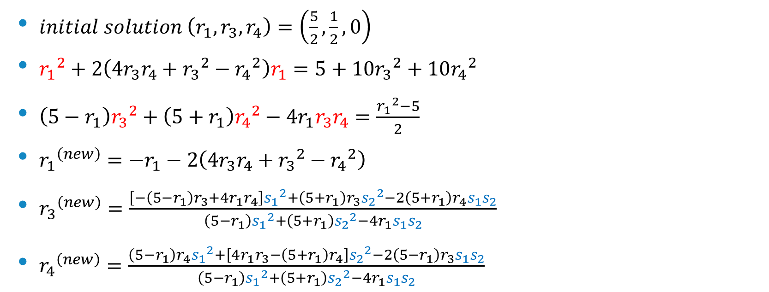
$$N=5$$
$initial solution \left(r_{1},r_{3},r_{4}\right)=\left(\frac{5}{2},\frac{1}{2},0\right)$
${r_{1}}^{2}+2\left(4r_{3}r_{4}+{r_{3}}^{2}−{r_{4}}^{2}\right)r_{1}=5+10{r_{3}}^{2}+10{r_{4}}^{2}$
$\left(5−r_{1}\right){r_{3}}^{2}+\left(5+r_{1}\right){r_{4}}^{2}−4r_{1}r_{3}r_{4}=\frac{{r_{1}}^{2}−5}{2}$
${r_{1}}^{\left(new\right)}=−r_{1}−2\left(4r_{3}r_{4}+{r_{3}}^{2}−{r_{4}}^{2}\right)$
${r_{3}}^{\left(new\right)}=\frac{\left[−\left(5−r_{1}\right)r_{3}+4r_{1}r_{4}\right]{s_{1}}^{2}+\left(5+r_{1}\right)r_{3}{s_{2}}^{2}−2\left(5+r_{1}\right)r_{4}s_{1}s_{2}}{\left(5−r_{1}\right){s_{1}}^{2}+\left(5+r_{1}\right){s_{2}}^{2}−4r_{1}s_{1}s_{2}}$
${r_{4}}^{\left(new\right)}=\frac{\left(5−r_{1}\right)r_{4}{s_{1}}^{2}+\left[4r_{1}r_{3}−\left(5+r_{1}\right)r_{4}\right]{s_{2}}^{2}−2\left(5−r_{1}\right)r_{3}s_{1}s_{2}}{\left(5−r_{1}\right){s_{1}}^{2}+\left(5+r_{1}\right){s_{2}}^{2}−4r_{1}s_{1}s_{2}}$

Slide 30
Result
$\left(1/11\right){\left[\begin{matrix}6 & 6 & −6 & 3 & 2\end{matrix}\right]}^{T}$
${\left(1/31\right)\left[\begin{matrix}22 & 18 & −6 & 6 & 9\end{matrix}\right]}^{T}$
${\left(1/41\right)\left[\begin{matrix}36 & 12 & −12 & 9 & −4\end{matrix}\right]}^{T}$
$\left(1/61\right){\left[\begin{matrix}48 & 24 & −24 & 16 & −3\end{matrix}\right]}^{T}$
$\left(1/101\right){\left[\begin{matrix}69 & 36 & 36 & 12 & −52\end{matrix}\right]}^{T}$
${\left(1/121\right)\left[\begin{matrix}96 & −24 & 24 & −32 & 57\end{matrix}\right]}^{T}$
${\left(1/121\right)\left[\begin{matrix}108 & 36 & 12 & 4 & −39\end{matrix}\right]}^{T}$

Slide 31
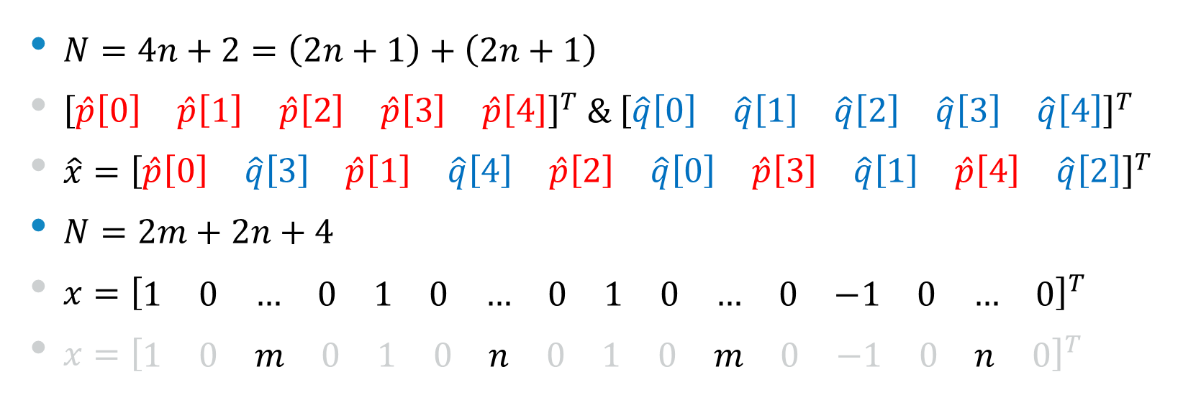
Special cases
$N=4n+2=\left(2n+1\right)+\left(2n+1\right)$
${\left[\begin{matrix}\hat{p}\left[0\right] & \hat{p}\left[1\right] & \hat{p}\left[2\right] & \hat{p}\left[3\right] & \hat{p}\left[4\right]\end{matrix}\right]}^{T} \& {\left[\begin{matrix}\hat{q}\left[0\right] & \hat{q}\left[1\right] & \hat{q}\left[2\right] & \hat{q}\left[3\right] & \hat{q}\left[4\right]\end{matrix}\right]}^{T}$
$\hat{x}={\left[\begin{matrix}\hat{p}\left[0\right] & \hat{q}\left[3\right] & \hat{p}\left[1\right] & \hat{q}\left[4\right] & \hat{p}\left[2\right] & \hat{q}\left[0\right] & \hat{p}\left[3\right] & \hat{q}\left[1\right] & \hat{p}\left[4\right] & \hat{q}\left[2\right]\end{matrix}\right]}^{T}$
$N=2m+2n+4$
$x={\left[\begin{matrix}1 & 0 & … & 0 & 1 & 0 & … & 0 & 1 & 0 & … & 0 & −1 & 0 & … & 0\end{matrix}\right]}^{T}$
$x={\left[\begin{matrix}1 & 0 & m & 0 & 1 & 0 & n & 0 & 1 & 0 & m & 0 & −1 & 0 & n & 0\end{matrix}\right]}^{T}$

Slide 32
Reference
[1] Pei, Soo-Chang, and Kuo-Wei Chang. "On integer-valued zero autocorrelation sequences." Signal and Information Processing Association Annual Summit and Conference (APSIPA), 2013 Asia-Pacific. IEEE, 2013.
[2] Carni, E., and Spalvieri, A. “Synchronous CDMA based on the cyclical translations of a CAZAC sequence”, IEEE Transactions on Wireless Communications, 2005
[3] Hu, Wei-Wen and Wang, Sen-Hung and Li, Chih-Peng, “Gaussian Integer Sequences with Ideal Periodic Autocorrelation Functions”, 2011 IEEE International Conference on Communications ICC, pp. 1-5

