Slide 1
Video Frame Interpolation DISP Lab Group Meeting 2023/12/05
Presenter: 顏子鈞
r11942161@ntu.edu.tw
Graduate Institute of Communication Engineering

Slide 2
Outline
Introduction
VFI methodology overview
Flow-based VFI
Kernel-based VFI
Hybrid flow-kernel-based VFI
Further Reading
Loss Function for Training Image Synthesis Task

Slide 3
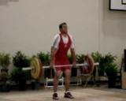
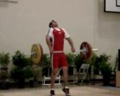
Introduction
Video Frame Interpolation (VFI):
Generate frame(s) between existing frames in a video sequence.
Metric to evaluate generate frame(s):
Smooth temporal motion, i.e. Interpolation Error(IE)↓, Normalized Interpolation Error(NIE) ↓
Visually appealing, i.e. PSNR↑, SSIM↑
the corresponding motion
?
…
?
Image source: Soomro, Khurram et al. “UCF101: A Dataset of 101 Human Actions Classes From Videos in The Wild.” ArXiv abs/1212.0402 (2012): n. pag.

Slide 4
Introduction
Other computer vision task related to VFI:
Video frame prediction (Video frame extrapolation)
Video generation
prediction
generation
?
…
…
?
?
…
future
a whole content based on input frame’s semantic
Image source: Soomro, Khurram et al. “UCF101: A Dataset of 101 Human Actions Classes From Videos in The Wild.” ArXiv abs/1212.0402 (2012): n. pag.

Slide 5
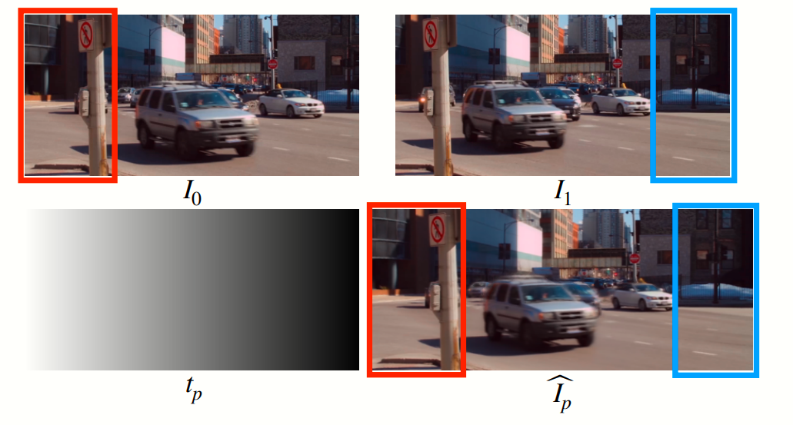
Introduction
Application:
Increase video frame rate
Generate slow-motion content
Frame recovery in video streaming
Video compression
Dynamic scene stitching
Dynamic scene stitching
Reference: Huang, Zhewei et al. “Real-Time Intermediate Flow Estimation for Video Frame Interpolation.” European Conference on Computer Vision (2020).

Slide 6
VFI Methodology Overview
3 mainstream methodology:
Flow-based method
Kernel-based method
Hybrid flow-kernel-based method

Slide 7
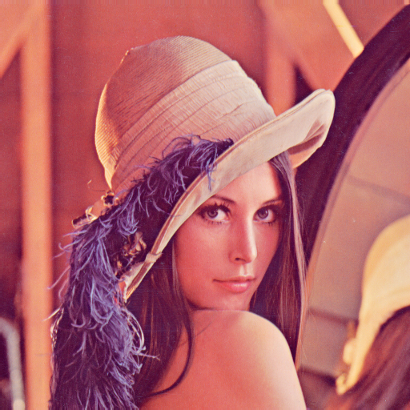
VFI Methodology Overview
3 mainstream methodology:
Flow-based method
Relies on optical flow* to generate intermediate frame.
Remark: optical flow is the dense motion vector of every pixel in image1 to image2.
?
?
?
?
?
?
?
?
Frame 1
F_{1→2}
Frame 2

Slide 8
VFI Methodology Overview
3 mainstream methodology:
Flow-based method
Relies on optical flow* to generate intermediate frame.
Halve the magnitude of optical flow, then warp frame to obtain the intermediate frame.
?
Warped by
?
0.5 x
=
?
?
?
?
?
?
Frame 1
F_{1→2}
Frame 1.5
Frame 2

Slide 9
VFI Methodology Overview
3 mainstream methodology:
Kernel-based method
Relies on local adaptive convolution kernel to interpolate every pixel between frame 1 and frame 2, i.e. using Convolutional neural network / Vision Transformer.
CNN
or
ViT
Frame 1
Frame 1.5
Frame 2

Slide 10
VFI Methodology Overview
3 mainstream methodology:
Hybrid flow-kernel-based method
Kernel-based method argues that flow-based approach is unreliable, due to the incorrect flow estimation caused by dynamic changing of lighting and texture in between frame transitions.
Flow-based method argues that kernel-based approach is unreliable, due to not explicitly perform motion estimation and compensation between frame transitions.
Thus, the hybrid-based method proposed to combine kernel-based and flow-based method.

Slide 11
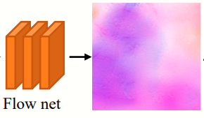
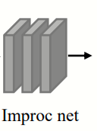
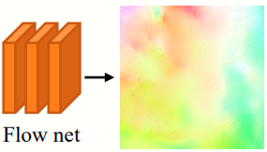
Flow-based VFI
Remark: STN: Spatial Transformer Network
concat: concatenate tensors along channel axis
Classic SOTA: TOFlow: Video Enhancement with Task-Oriented Flow (IJCV 2019).
Proposed a task-oriented optical flow, using input frame 0 and frame 1:
$F_{t→0}$ and $F_{t→1} ,$ where $t=0.5$
The optical flow models the motion vector required for backward warping from frame 0 to frame 0.5, as well as frame 1 to frame 0.5.
STN
Frame 0
$$F_{t→0}$$
concat
Frame 1
STN
Frame 0.5
$$F_{t→1}$$
Reference: Xue, Tianfan et al. “Video Enhancement with Task-Oriented Flow.” International Journal of Computer Vision (2017): 1-20.

Slide 12
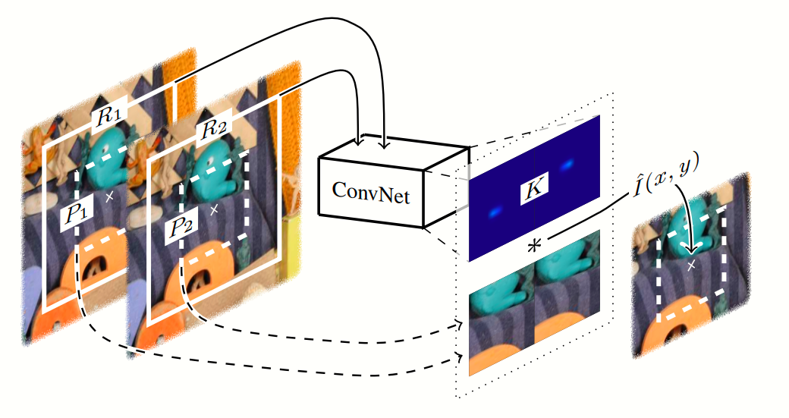
Kernel-based VFI
Classic SOTA: Video Frame Interpolation via Adaptive Convolution (CVPR 2017).
For each pixel $(x,y)$of the intermediate frame, estimate a convolutional kernel $K$ to convolve with patches $P1$ (from frame 1) and $P2$ (from frame 2) centered at $(x,y).$
Reference: Niklaus, Simon et al. “Video Frame Interpolation via Adaptive Convolution.” 2017 IEEE Conference on Computer Vision and Pattern Recognition (CVPR) (2017).

Slide 13
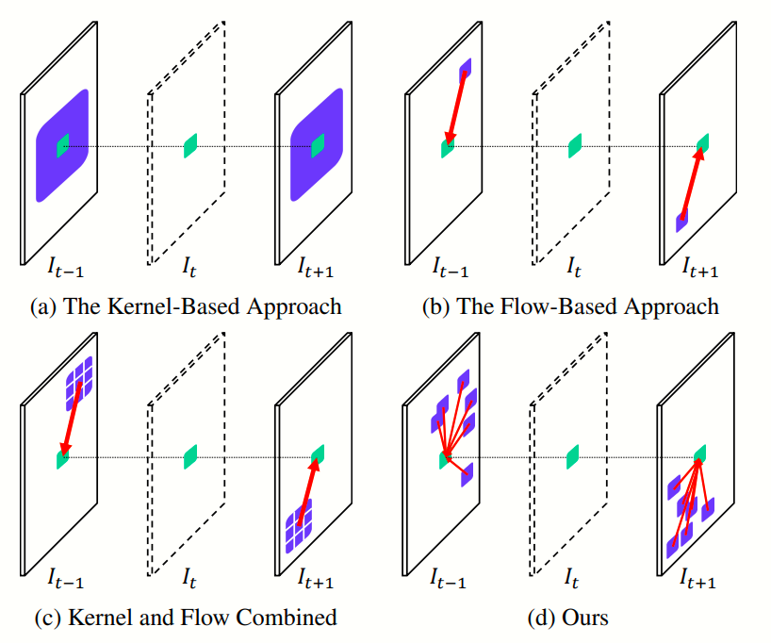
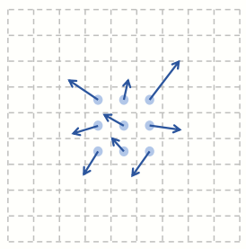
Hybrid Flow-kernel-based VFI
Classic SOTA: AdaCoF: Adaptive Collaboration of Flows for Video Frame Interpolation (CVPR 2020).
Task-oriented flow + Deformable convolution
A 3x3 convolution kernel, each entries having 3 attribute: $x$ offset, $y$ offset, weight
Reference: Lee, Hyeongmin et al. “AdaCoF: Adaptive Collaboration of Flows for Video Frame Interpolation.” 2020 IEEE/CVF Conference on Computer Vision and Pattern Recognition (CVPR) (2019).

Slide 14
Further Reading
Flow-based method
Video frame synthesis using deep voxel flow (ICCV 2017)
Super Slomo (CVPR 2018)
ABME (ICCV 2021)
RIFE (ECCV 2022)
Kernel-based method
Video frame interpolation via adaptive separable convolution (ICCV 2017)
CAIN (AAAI 2020)
Multiple video frame interpolation via enhanced deformable separable convolution (IEEE Trans. Pattern Anal. Mach. 2021)
Hybrid flow-kernel-based method
DAIN (CVPR 2019)
FILM (ECCV 2022)
VFIformer (CVPR 2022)

Slide 15
Loss Function for Training Image Synthesis Task
(1) For optimizing image quality:
$ℓ1$ loss (reconstruction loss): $ℓ1={\left\|{\hat{I}}_{0.5}−I_{0.5}\right\|}_{1}$
Using L2 loss leads to blurry results.
Most paper utilize Charbonnier Function to further optimizing $ℓ1$ loss.
$Φ\left(x\right)={(x^{2}+ε^{2})}^{1/2}$, where $ε=0.001$ and $x=$ $ℓ1$ loss
VGG perceptual loss: $l_{vgg}=\frac{1}{N}\sum{{\left\|φ{(\hat{I}}_{0.5})−φ(I_{0.5})\right\|}_{2}}$
Where $φ(x)$ is the feature from pretrained VGG network of Imagenet.
Good-old-classic ways to improve perceptual quality.
Gram matrix loss (Style loss): $l_{gram}=\frac{1}{N}\sum{{\left\|M{(\hat{I}}_{0.5})−M(I_{0.5})\right\|}_{2}}$
Also known as the L2 norm of auto-correlation of VGG network feature, where $M\left(x\right)$ is the Gram matrix:
$$M\left(x\right)=({φ(x))}^{T}φ(x)$$
Effective in synthesizing sharp details when inpainting large disocclusion regions.

Slide 16
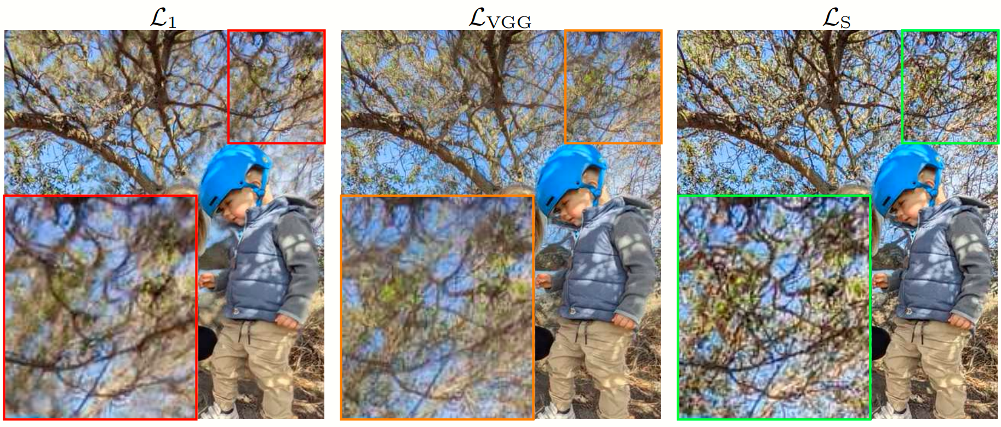
Ablation Study: Image quality w/ different loss
(w/ $ℒ1$ loss)
(w/ $ℒ1$ & $ℒ_{VGG}$loss)
Reference: Reda, Fitsum A. et al. “FILM: Frame Interpolation for Large Motion.” Europe Conference on Computer Vision (ECCV) 2022.

Slide 17
Loss Function for Training Image Synthesis Task
(2) For optimizing optical flow:
Distillation loss: $ℓ_{dis}={\left\|{\hat{F}}_{t→0}−F_{t→0}\right\|}_{1}+{\left\|{\hat{F}}_{t→1}−F_{t→1}\right\|}_{1}$
To explicitly supervise the estimated flow with ground truth flow.
Proposed by RIFE (ECCV 2022)
Warping loss: $ℓ_{w}={\left\|I_{t}−warp(I_{0},F_{t→0})\right\|}_{1}+{\left\|I_{t}−warp(I_{1},F_{t→1})\right\|}_{1}$
To model the quality of estimated optical flow, from the perspective of warped image.
Proposed by Super SloMo (CVPR 2018)
Smoothness loss: $ℓ_{s}={\left\|∇F_{0→1}\right\|}_{1}+{\left\|∇F_{1→0}\right\|}_{1}$
To encourage neighboring pixels to have similar flow.
Proposed by Video frame synthesis using deep voxel flow (ICCV 2017)
Reference: (1) Huang, Zhewei et al. “Real-Time Intermediate Flow Estimation for Video Frame Interpolation.” European Conference on Computer Vision (2020).
(2) Jiang, Huaizu et al. “Super SloMo: High Quality Estimation of Multiple Intermediate Frames for Video Interpolation.” 2018 IEEE/CVF Conference on Computer Vision and Pattern Recognition (2017).
(3) Liu, Ziwei et al. “Video Frame Synthesis Using Deep Voxel Flow.” 2017 IEEE International Conference on Computer Vision (ICCV) (2017): 4473-4481.

Slide 18
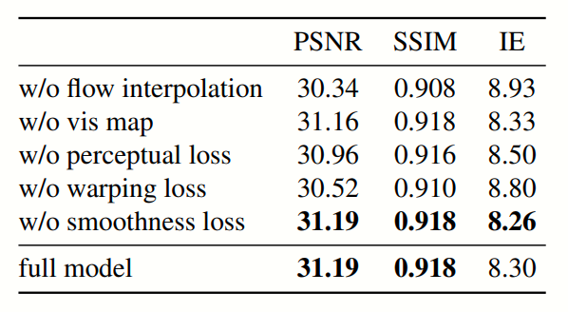
Ablation Study: Interpolation quality w/ different loss
Reference: (1) Huang, Zhewei et al. “Real-Time Intermediate Flow Estimation for Video Frame Interpolation.” European Conference on Computer Vision (2020).
(2) Jiang, Huaizu et al. “Super SloMo: High Quality Estimation of Multiple Intermediate Frames for Video Interpolation.” 2018 IEEE/CVF Conference on Computer Vision and Pattern Recognition (2017).

Slide 19
Thanks for listening.
Questions are welcome!

