Slide 1
Read and Write Audio, Image, and Video Files (by Python)
Chang-Ting Tsai, Jian-Jiun Ding
Graduate Institute of Communication Engineering, National Taiwan University

Slide 2
I. Read and Write Audio Files
First, install the following modules:
pip install numpy
pip install scipy
pip install matplotlib # plot
pip install pipwin
pipwin install simpleaudio # vocal files
pipwin install pyaudio
We then illustrate how to read, play, record, and construct audio files by Python. We also illustrate the way to plot the spectrum by Python.

Slide 3
I-A. Read Audio Files
First, import the related module: import wave
Example to read an audio file :
wavefile = wave.open('C:/WINDOWS/Media/Alarm01.wav', 'rb‘)
To acquire the sampling frequency and the length of the audio file:
fs =wavefile.getframerate() # sampling frequency
num_frame = wavefile.getnframes() # length of the vocal signal
>>> fs
22050
>>> num_frame
122868
3

Slide 4
Acquire the Waveform and the Related Parameters
First, import the related module: import numpy as np
After performing the commands on the previous page, we then perform
str_data = wavefile.readframes(num_frame)
wave_data = np.frombuffer(str_data, dtype=np.int16)
# convert into the integer format
wave_data = wave_data / max(abs(wave_data)) # normalization
n_channel = 2
wave_data = np.reshape(wave_data, (num_frame, n_channel))
# This step is required if the audio file is a two-channel (stereo) one.
4

Slide 5
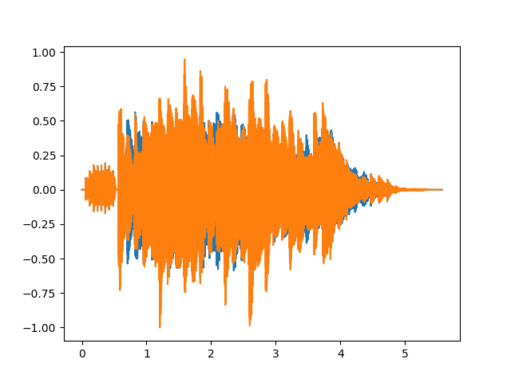
Plot the Waveform of Audio Files
Frist, import the related module: import matplotlib.pyplot as plt
time = np.arange(0, num_frame)*1/fs
plt.plot(time, wave_data)
plt.show()
5

Slide 6
I-B. Plot the Spectrum
First, import the related module: from scipy.fftpack import fft
fft_data = abs(fft(wave_data[:,1]))/fs # only choose the 1st channel
# Note: The multiplication of 1/fs is necessary
n0=int(np.ceil(num_frame/2))
fft_data1=np.concatenate([fft_data[n0:num_frame],fft_data[0:n0]])
# Move the right half of the spectrum to the left side.
freq=np.concatenate([range(n0-num_frame,0), range(0,n0)]) *fs/num_frame
# Adjust the frequency axis.
plt.plot(freq,fft_data1)
plt.xlim(-1000,1000) # Limit the range of the horizontal axis of the figure.
plt.show() # As the example on the next page.
6

Slide 7
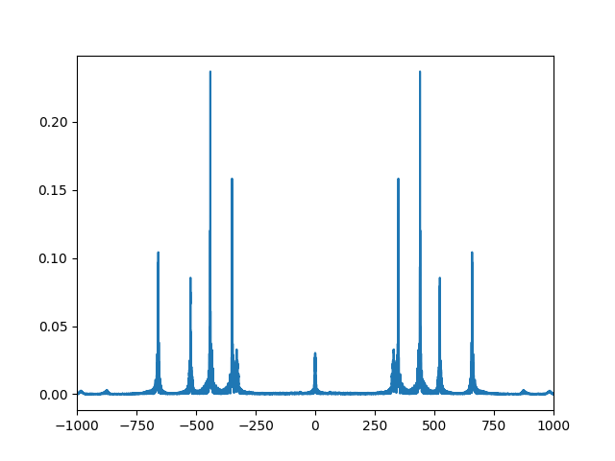
The result of “plt.show()”
7

Slide 8
I-C. Play Audio Files
First, import the related module: import simpleaudio as sa
n_bytes =2 # using two bytes to record a data
wave_data = (2**15-1)* wave_data
# change the range to -2¹⁵ ~ 2¹⁵
wave_data = wave_data.astype(np.int16)
play_obj = sa.play_buffer(wave_data, n_channel, n_bytes, fs)
play_obj.wait_done()
8

Slide 9
I-D. Construct Audio Files
f = wave.open('testing.wav', 'wb')
f.setnchannels(2) # Set the number of channels
f.setsampwidth(2) # Set the number of bytes for each sample
f.setframerate(fs) # Set sampling frequency
f.writeframes(wave_data.tobytes())
f.close()
9

Slide 10
1-E. Recording
First, import the related module : import pyaudio
[Sample Code]
import pyaudio
pa=pyaudio.PyAudio()
fs = 44100
chunk = 1024
stream = pa.open(format=pyaudio.paInt16, channels=1, rate=fs, input=True, frames_per_buffer=chunk)
vocal=[]
count=0
10

Slide 11
while count<200: # Control the recording time
audio = stream.read(chunk)
vocal.append(audio)
count +=1
save_wave_file('testrecord.wav',vocal)
stream.close()
Reference
https://codertw.com/%E7%A8%8B%E5%BC%8F%E8%AA%9E%E8%A8%80/491427/
11

Slide 12
II. Read and Write of Image Files
First, import the related modules:
pip install numpy
pip install matplotlib
We then illustrate how to read, plot, and generate image files by Python.

Slide 13
II-A Read Image Files
import cv2
image = cv2.imread('D:/Pic/peppers.bmp’)
or
import matplotlib.pyplot as plt
image = plt.imread(‘D:/Pic/peppers.bmp’)
13

Slide 14
Note:
(1) If the image is a colorful one, after applying cv2.imread, the order of the 3 channels are BGR.
image[:, :, 0] => B, image[:, :, 1] => G, image[:, :, 2] => R
(2) However, if we apply plt.imread to read a color image, the order is still RGB.
image[:, :, 0] => R, image[:, :, 1] => G, image[:, :, 2] => B
(3) If the file cannot be read, change \ into / in the path.
(4) The size of the image can be seen from image.shape
>>> image.shape
(512, 512, 3)
(5) cv2.imread can read *.jpg, *.bmp, *.png files. However, *.gif files cannot be read.
14

Slide 15
II-B Show Images
Case 1: If the format of the image is int
The following commands should be used together (for both color and gray-level images)
cv2.imshow('test', image) # ‘test’ is the title of the image
cv2.waitKey(0)
cv2.destroyAllWindows()
The following commands can also be applied to show images
import matplotlib.pyplot as plt
plt.imshow(image)
plt.show()
15

Slide 16
If we read color images by cv.imread and want to show color images by plt.imshow, we should change the order of BGR into RGB and modify the 2nd line as:
plt.imshow(image[:,:,[2,1,0]])
16

Slide 17
Case 2: If the format of the image is not integer
In this case, we should divide the image by 255 before showing it, no matter using cv2.imshow or plt.imshow.
[Example 1]:
import cv2
image = cv2.imread('D:/Pic/peppers.bmp’)
image1 = image*0.5 + 127.5 # lighten the image
cv2.imshow(‘test’, image)
# it is unnecessary to divide the image by 255 for the integer case
cv2.waitKey(0)
cv2.destroyAllWindows()
cv2.imshow(‘test’, image1/255)
# For the non-integer case, one should divide the image by 255
cv2.waitKey(0)
cv2.destroyAllWindows()
17

Slide 18
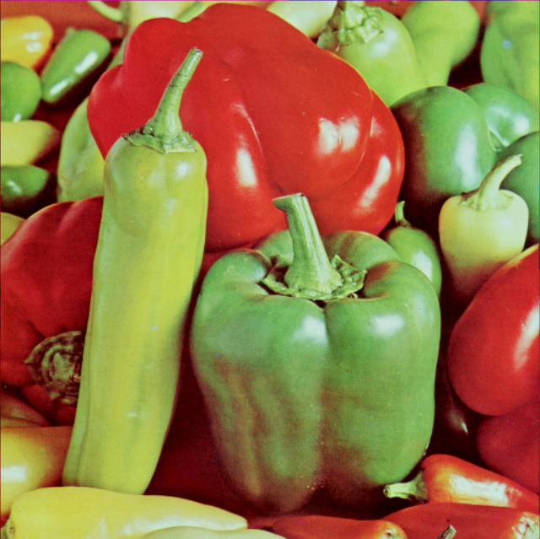
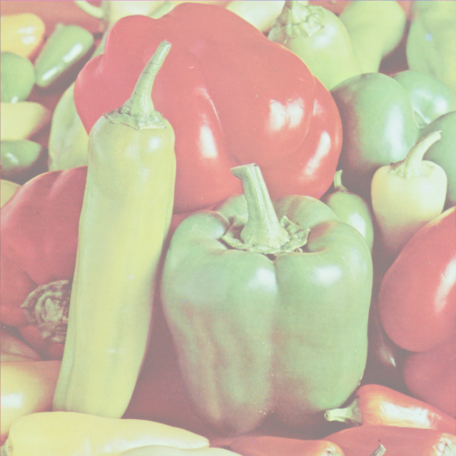
the result of the sample code on the previous page
18

Slide 19
Example 2:
import matplotlib.pyplot as plt
image = plt.imread('D:/Pic/peppers.bmp’)
image1 = image*0.5 + 127.5 # lighten the image
plt.imshow(image)
# it is unnecessary to divide the image by 255 for the integer case
plt.show()
plt.imshow(image1/255)
# For the non-integer case, one should divide the image by 255
plt.show()
19

Slide 20
II-C Construct Image Files
cv2.imwrite('D:/Pic/jpg', image)
or
plt.imsave('D:/Pic/jpg', image)
Note:
(1) To construct a color image file by cv.imwrite, one should note that
image[:, :, 0] => B, image[:, :, 1] => G, image[:, :, 2] => R
If we use plt.save to construct a color image file, the order is still RGB:
image[:, :, 0] => R, image[:, :, 1] => G, image[:, :, 2] => B
(2) The command cv2.imwrite(‘D:\Pic\jpg’, image) may not work. We should change \ into /.
(3) When we use plt.imshow or plot.show() to show an image，we can also use the bottom “save the figure” at the right-down button to save the image as a file.

Slide 21
III. Read and Write Video Files
First, install the following modules:
pip install numpy
pip install matplotlib
We then illustrate the ways to read and write video files by Python.

Slide 22
III-A Read and Play Video Files
Sample Code (Read and Play)
import cv2
cap = cv2.VideoCapture(‘test.avi')
while cap.isOpened(): # continued to read video files
ret, frame = cap.read() # the current frame information
# if frame is read correctly ret is True
if not ret:
print("Can't receive frame (stream end?). Exiting ...")
break
cv2.imshow('frame', frame)
cv2.waitKey(1) # adjust the rate of playing; a large number means playing slowly
if cv2.waitKey(1) == ord('q'): # press ‘q’ to quit
break
cap.release()
cv2.destroyAllWindows()
Reference: https://www.kancloud.cn/aollo/aolloopencv/260405

Slide 23
Sample Code (Read and Save Each Frame)
import cv2
import matplotlib.pyplot as plt
cap = cv2.VideoCapture(‘test.avi')
while cap.isOpened():
ret, frame = cap.read()
# if frame is read correctly ret is True
if not ret:
print("Can't receive frame (stream end?). Exiting ...")
break
plt.imshow(frame)
plt.show() # We can press the button “save the figure” to save each frame.
cap.release()
cv2.destroyAllWindows()

Slide 24
III-B Construct Video Files
Sample Code
(This example is to read a video file, reverse its content, and save it as another video file.)
import numpy as np
import cv2
cap = cv2.VideoCapture('test.mp4')
# Define the codec and create VideoWriter object
fourcc = cv2.VideoWriter_fourcc(*'XVID') # Set the coding format
width = int(cap.get(cv2.CAP_PROP_FRAME_WIDTH))
height = int(cap.get(cv2.CAP_PROP_FRAME_HEIGHT))
out = cv2.VideoWriter('output1.mp4', fourcc, 20.0, (width,height))
# The parameters are (i) output file name, (ii) the coding format, (iii) frame per second (fps), and width and height
(Continued)

Slide 25
while(cap.isOpened()):
ret, frame = cap.read()
if ret==True:
frame = cv2.flip(frame,0) # reverse the frame
# write the flipped frame
out.write(frame)
cv2.imshow('frame',frame)
if cv2.waitKey(1) == ord('q’):
break
else:
break
cap.release()
out.release()
cv2.destroyAllWindows()
Reference：https://www.kancloud.cn/aollo/aolloopencv/260405

