Slide 1
Group Report
2017/12/22 By Yu-Hao Chin

Slide 2
Outline
Predicting the Probability Density Function of Music Emotion using Emotion Space
鴻海語音助理

Slide 3
Affective Computing
Affective computing (AC) is a hot topic in machine learning.
Modeling the affective content of various sources.
e.g. music, face, body language, and speech.
Recognize the affect of various sources!

Slide 4
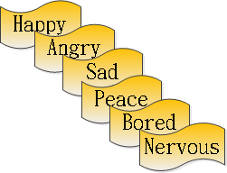
Emotion Definition
There are two ways to present affect:
Emotional model, e.g. Thayer's valence-arousal (VA) plane
Emotional label

Slide 5
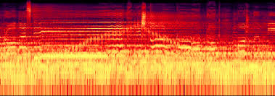
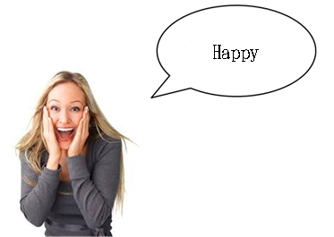
Difficulty and Challenge
Three major issues in affective computing of audio:
Subjectivity issue: labeling the emotions can be highly inconsistent.
Feature issue: the relation between the audio feature and affect is vague.
Definition issue: human emotions lacked precise definitions.
Notes:
That is, different persons might perceive different emotions in the same music piece because the emotion perception can depend on various personal and situational factors, such as the listening mood, personality, and cultural background

Slide 6
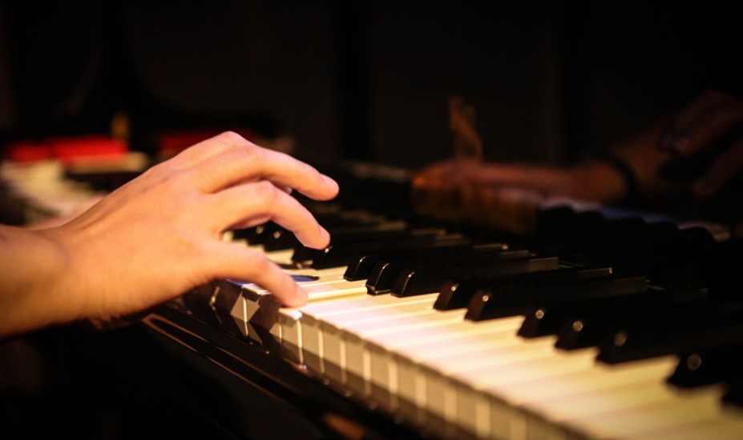
Emotion Recognition of Music
Perceived emotion: the emotional state perceived as being expressed by a song by human.
Feel: people actually feel in response to the music.
Time domain feature, frequency domain feature, cepstral features…
EEG, RSP, EMG, skin conductance…

Slide 7
Previous Works
Dimensional Approach
Valence/Arousal
SVR, lasso regression
Emotion distribution
Gaussian distribution, probability density
Dynamic emotion recognition
Recurrent neural network
Categorical Approach
Single label
SVM, emotion profile
Multi-label
Arousal
Emotion
Valence
Time

Slide 8
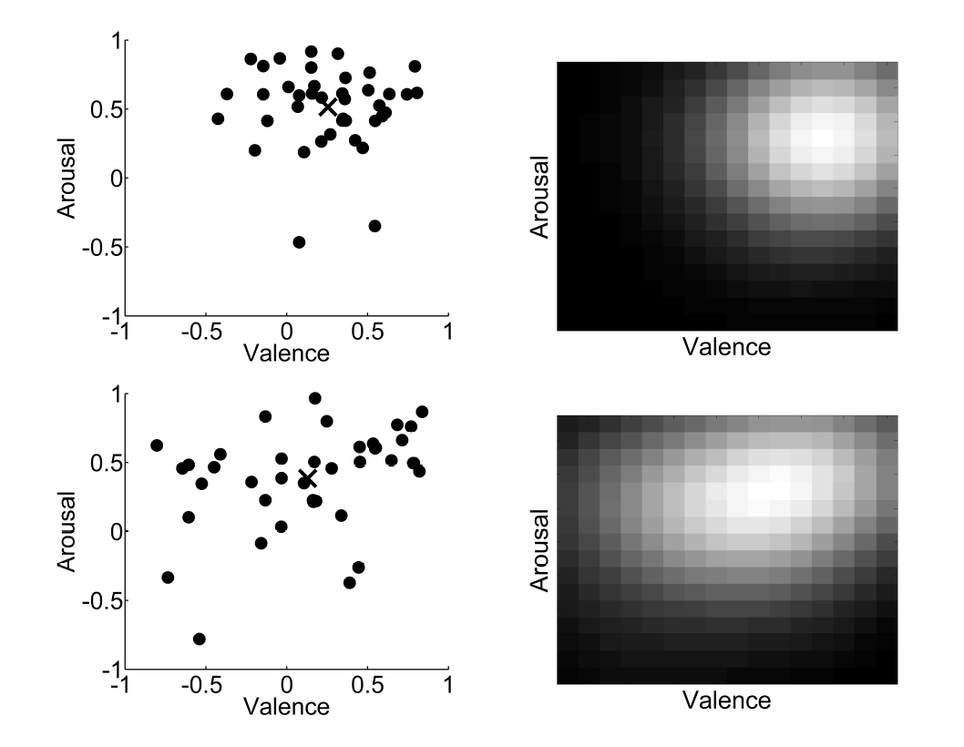
Emotion Distribution
Subjectivity issue in VA plane
The left column shows multiple annotations of the VAs entered by a few annotators for two music pieces.
The right column presents the two corresponding probability density function (PDF) generated from the annotations.
Mean
Notes:
The left column shows multiple annotations of the valence and arousal values entered by a few annotators for two music pieces; the right column presents the two corresponding probability density functions generated (by kernel density estimation) from the annotations. The symbol “x” indicates to the mean of the annotated VA values.

Slide 9
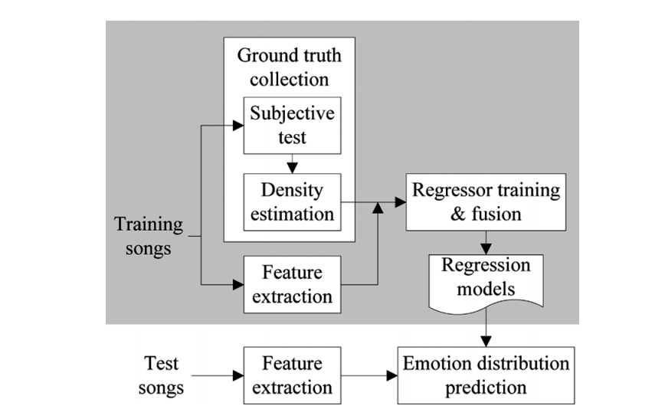
PDF Prediction
Machine learning algorithms can be employed to predict the PDF from audio features.
Yang and Chen [1]:
[1] Y. H. Yang and H. H. Chen, “Prediction of the distribution of perceived music emotions using discrete samples,” IEEE Trans. Audio, Speech & Language Processing, vol. 19, no. 7, pp. 2184–2196, 2011

Slide 10
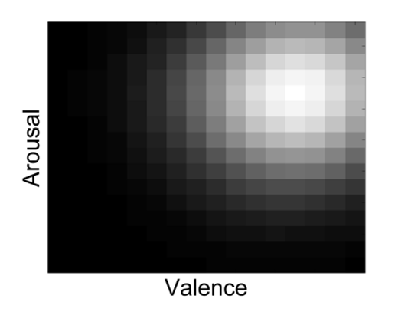
Motivation (1/2)
Potential problems of the work of [1]:
Spatial relationship among the cells is not exploited.
SVR approach does not guarantee that the predicted density value is non-negative.
Predicted VA Distribution
SVR₁
SVR₂
SVR₃
SVR₄
.
.
.

Slide 11
Motivation (2/2)
Goal of the Solution
Keep the spatial relationship among the cells.
Guarantee that the predicted density value is non-negative.
Assumption 1: The PDF of a music piece can be modeled as a linear combination of the PDFs of other existing music pieces.
Assumption 2: The music pieces, which are close to one another in the audio feature space, would have similar PDFs in the VA space [2].
[2] J. C. Wang, Y. H. Yang, H. M. Wang, and S. K. Jeng, “Modeling the affective content of music with a Gaussian mixture model,” IEEE Trans. Affective Computing, vol. 6, no. 1, pp. 56–68, 2015.

Slide 12
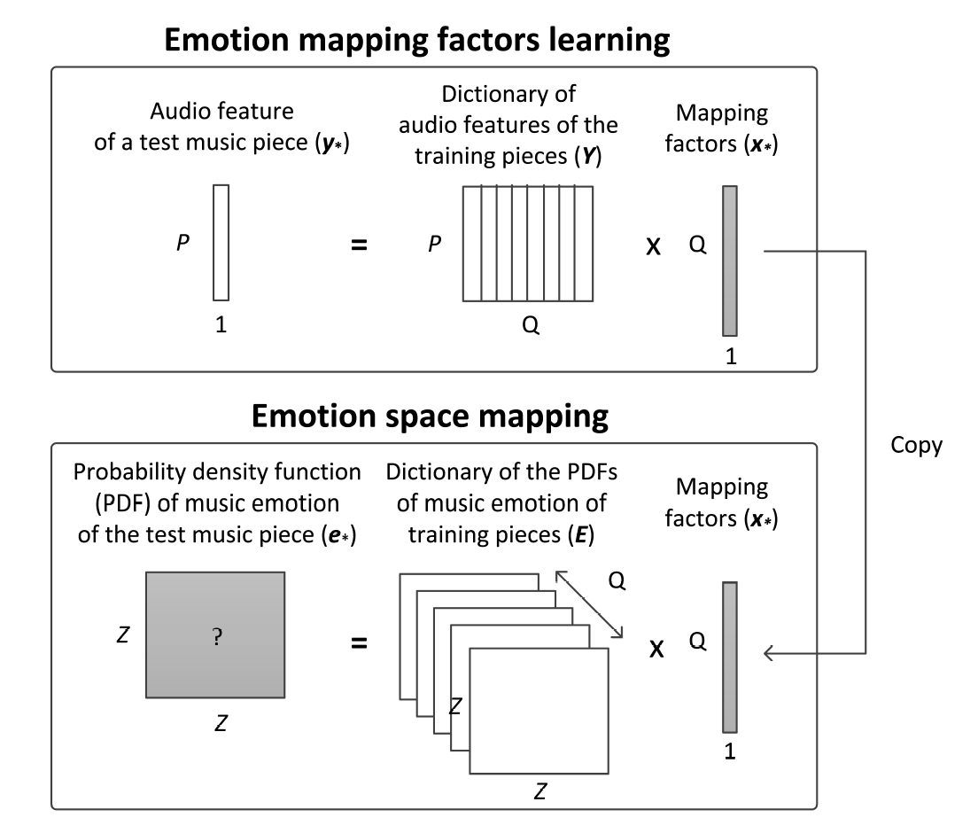
Prediction Process (1/2)
Step 1
Learning the mapping factors x_{*r} that approximates the test piece y* by a linear combination of the training pieces Y in the audio space.
Acoustic space

Slide 13
Prediction Process (2/2)
Acoustic space
Step 2
Using the learned factor coefficients x* along with the training emotion dictionary E to predict the test piece's PDF e*
VA space

Slide 14
Mapping Factors Learning
Formulating the problem as minimizing the reconstruction error of y* over the dictionary Y:
Least absolute residual (LAR) sets and .
Least square (LS) sets and .
Sparse representation (SR) uses and . This form leads to sparsity in the coefficients (i.e. only few elements of x* were non-zero) due to the l₁ norm.

Slide 15
Mapping Factors Learning
Non-negative least absolute residual (LAR+) uses and requires the non-negative constraint, i.e., .
Non-negative least square (LS+) takes and requires .
Non-negative sparse representation (SR+) takes and requires .
K-nearest neighbor (kNN) finds the k nearest neighbors of the test piece among the training pieces according to Euclidean distance in the audio space, and then we set the corresponding elements in to 1 and the rest to 0

Slide 16
Datasets & Audio Features
Name | Sample space per music piece | #pieces | #annotations per piece | Audio features
NTUMIR [1] | The VA annotations from different subjects | 60 | 40 | MIRtoolbox features [4]
MediaEval-2013 [3] | The averaged VA annotations from different seconds | 744 | 61 | openSMILE features [5]
[3] M. Soleymani, M. N. Caro, E. M. Schmidt, C. Y. Sha, and Y. H. Yang, “1000 songs for emotional analysis of music,” in Proc. ACM Int. Workshop. Crowdsourcing for Multimedia, 2013, pp. 1–6.
[4] O. Lartillot and P. Toiviainen, “MIR in Matlab (II): A toolbox for musical feature extraction from audio,” in Proc. Int. Soc. Music Info. Retrieval Conf., 2007, pp. 127–130, [Online] http://users.jyu.fi/lartillo/mirtoolbox/
[5] F. Eyben, F. Weninger, F. Gross, and B. Schuller, “Recent developments in openSMILE, the Munich open-source multimedia feature extractor,” in Proc. ACM Int. Conf. Multimedia, 2013, pp. 835–838, [Online] http://www.audeering.com/research/opensmile.

Slide 17
Result on Music Emotion Recognition
Proposed emotion space mapping approach
KPCA Feature → Mapping factors learning → Predicted PDF
Simple SVR
KPCA Feature → SVR → Predicted PDF
Enssemble SVRs [1]
Feature → Multiple SVR → Fusion → Predicted PDF
MER performance on NTUMIR.
Performance was shown by mean ± standard deviation
Approach | R² | JS
Proposed(kNN) + KPCA features | 0.622 ± 0.288 | 0.069 ± 0.066
Simple SVR + KPCA features | 0.584 ± 0.265 | 0.085 ± 0.059
Ensemble SVRs [1] | 0.531 ± 0.244 | 0.102 ± 0.073
MER performance on MediaEval 2013.
Performance was shown by mean ± standard deviation
Approach | R² | JS
Simple SVR + KPCA features | 0.334 ± 0.034 | 0.130 ± 0.009
Proposed(kNN) + KPCA features | 0.554 ± 0.044 | 0.108 ± 0.013

Slide 18
Performance comparison on MediaEval2013 with different Z
The MER performance comparison on MediaEval2013 with different Z values
Metric | Method | Z = 4 | Z = 8 | Z = 16 | Z = 32 | Z = 64
JS | 8-NN | 0.109 | 0.108 | 0.120 | 0.111 | 0.107
 | SVR | 0.182 | 0.170 | 0.161 | 0.157 | 0.124
R² | 8-NN | 0.546 | 0.554 | 0.482 | 0.509 | 0.519
 | SVR | 0.321 | 0.334 | 0.339 | 0.341 | 0.342
The retrieval performance (Gamma statistic) comparison on MediaEval2013 with different Z values
Method | Z = 4 | Z = 8 | Z = 16 | Z = 32 | Z = 64
R²-based ranking criterion
8-NN | 0.235 | 0.216 | 0.205 | 0.168 | 0.207
SVR | 0.258 | 0.196 | 0.136 | 0.098 | 0.077
JS-based ranking criterion
8-NN | 0.286 | 0.311 | 0.327 | 0.303 | 0.346
SVR | 0.531 | 0.293 | 0.223 | 0.187 | 0.169

Slide 19
Evaluation of Different Mapping Factors Learning Methods
Method | Z = 4 | Z = 8 | Z = 16 | Z = 32 | Z = 64
LAR | 0.487 | 0.463 | 0.462 | 0.460 | 0.456
LS | 0.487 | 0.463 | 0.462 | 0.461 | 0.456
SR | 0.415 | 0.403 | 0.399 | 0.397 | 0.389
LAR+ | 0.356 | 0.304 | 0.288 | 0.280 | 0.253
LS+ | 0.354 | 0.302 | 0.286 | 0.279 | 0.251
SR+ | 0.341 | 0.303 | 0.297 | 0.271 | 0.252
4-NN | 0.681 | 0.655 | 0.645 | 0.640 | 0.638
8-NN | 0.656 | 0.622 | 0.606 | 0.592 | 0.587
12-NN | 0.629 | 0.605 | 0.596 | 0.593 | 0.591
R² on NTUMIR with different mapping factors learning methods and Z values
Method | Z = 4 | Z = 8 | Z = 16 | Z = 32 | Z = 64
LAR | 0.123 | 0.125 | 0.121 | 0.120 | 0.119
LS | 0.195 | 0.151 | 0.158 | 0.161 | 0.162
SR | 0.041 | 0.038 | 0.037 | 0.037 | 0.036
LAR+ | 0.613 | 0.574 | 0.549 | 0.536 | 0.513
LS+ | 0.613 | 0.574 | 0.550 | 0.536 | 0.513
SR+ | 0.613 | 0.582 | 0.564 | 0.553 | 0.534
4-NN | 0.537 | 0.562 | 0.569 | 0.578 | 0.571
8-NN | 0.546 | 0.554 | 0.482 | 0.509 | 0.519
12-NN | 0.487 | 0.497 | 0.500 | 0.502 | 0.512
R² on MediaEval2013 with different mapping factors learning methods and Z values

Slide 20
Outline
Predicting the Probability Density Function of Music Emotion using Emotion Space
鴻海語音助理

Slide 21
鴻海語音助理-小派
Intent Understanding
Multi-Domain Joint Semantic Frame Parsing using Bi-directional RNN-LSTM, Dilek Hakkani-Tür, Gokhan Tur, Asli Celikyilmaz, Yun-Nung Vivian Chen, Jianfeng Gao, Li Deng, Ye-Yi Wang, in Proceedings of The 17th Annual Meeting of the International Speech Communication Association (INTERSPEECH 2016), ISCA, June 24, 2016
Neural-Dialogue-Generation
A Diversity-Promoting Objective Function for Neural Conversation Models, J.Li, M.Galley, C.Brockett, J.Gao and B.Dolan. NAACL2016.
Input text
Model
Response

Slide 22
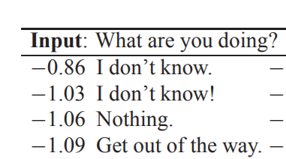
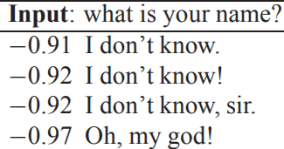
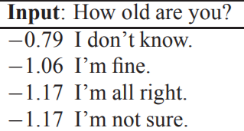
Issues
The neural-dialogue-generation technique has not been well-developed.
From: A Diversity-Promoting Objective Function for Neural Conversation Models, J.Li, M.Galley, C.Brockett, J.Gao and B.Dolan. NAACL2016.

Slide 23
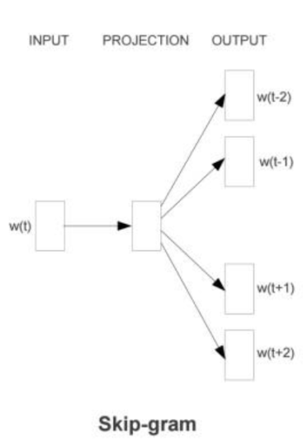
Implementation
Class 1
Keyword Spotting + If-Else
Class 2
Input text
Slot Filling Model
From: https://kknews.cc/zh-tw/news/3j6yj2g.html

Slide 24
System flowchart
Speech Recognition by 出門問問
(on Android)
Our model
(Python)
TTS by
出門問問
(On Android)
Code cannot be released
From the official sites of 出門問問, 圖靈機器人

Slide 25
Web api
Library of Web API: Flask-RESTful
Issue of multiple web requests of the Keras model:
“have a global_model and one main tensorflow session. But inside each thread I am creating a local_model which copies parameters from the global_model” Get Error!!
Solution:

