Slide 1
Image Deblurring - text image deblurring
r11942060 廖駿林
Notes:
拍投影片 黑板

Slide 2
大綱
non-blind image deblurring
blind image deblurring
text image deblurring(non-DL)
text image deblurring(DL)
Notes:
分階段 介紹 牽涉到比較多數學的細節 根據 survey 比較容易理解 學長做過

Slide 3
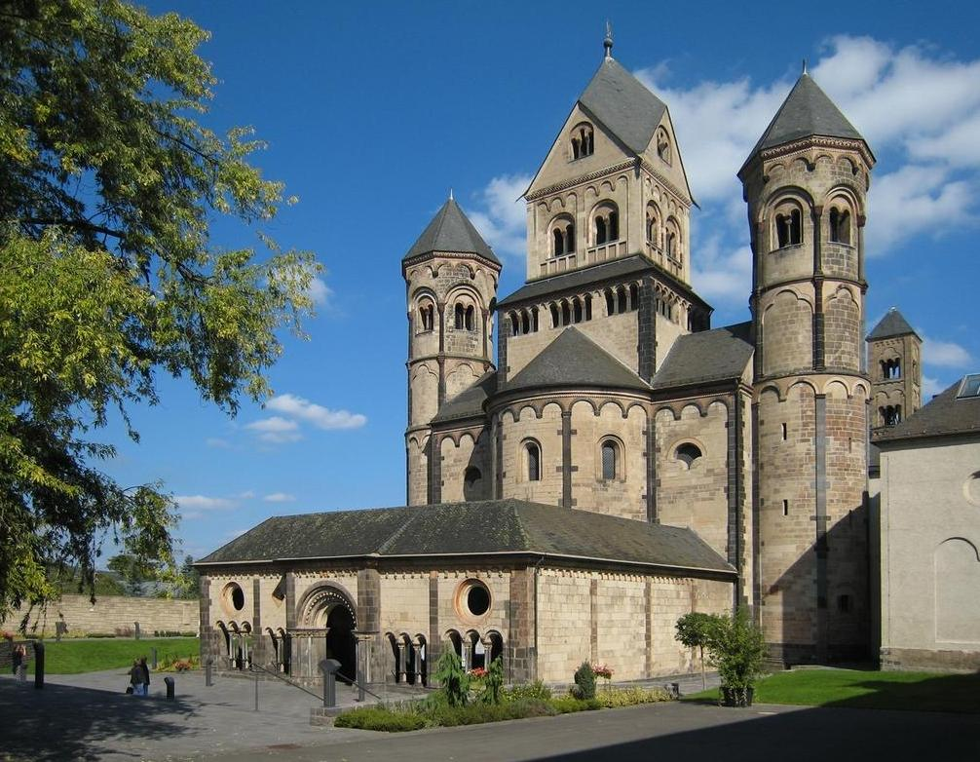
original image
kernel
noise(Gaussian)
blurred image
$$＊$$
$$+$$
$$=$$
2D convolution
image deblurring

Slide 4
non-blind deblurring
$$＊$$
$$+$$
$$=$$
2D convolution
blind deblurring
$$＊$$
$$+$$
$$=$$
2D convolution
Notes:
noise estimation power spectral density

Slide 5
Non-blind image deblurring
Fast Image Deconvolution using Hyper-Laplacian Priors
$$=$$
$$＊$$
$$+$$
y
x
k
n
y = x$＊k$ + n
Reference:
D. Krishnan and R. Fergus. Fast image deconvolution using hyper-laplacian priors. In Y. Bengio, D. Schuurmans, J. Lafferty, C. Williams, and A. Culotta, editors, Advances in Neural Information Processing Systems, volume 22. Curran Associates, Inc., 2009.
Notes:
時間較快 在知道 g f w 分布的情形下 找出結果 g

Slide 6
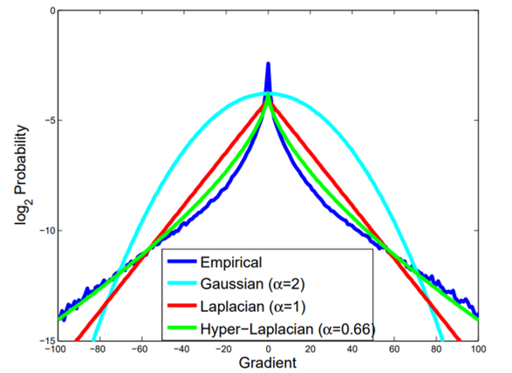
Non-blind image deblurring
Fast Image Deconvolution using Hyper-Laplacian Priors
y = x$＊k$ + n
Main concept: using Bayes' theorem
p(x|y, k) ∝ p(y|x, k)p(x)
minimize − log p(y|x, k) − log p(x)
$$\min_{x}{\sum_{i=1}^{N}{({\frac{λ}{2}\left(\text{x}＊k \text{−}\text{y}\right)}_{i}^{2}+\sum_{j=1}^{J}{{|\left.​{\left(\text{x}＊f_{j}\right)}_{i}\right|}^{α})})}}$$
Notes:
時間較快 在知道 g f w 分布的情形下 找出結果 g

Slide 7
Non-blind image deblurring
Fast Image Deconvolution using Hyper-Laplacian Priors
$$\min_{x}{\sum_{i=1}^{N}{({\frac{λ}{2}\left(\text{x}＊k\text{ −}\text{y}\right)}_{i}^{2}+\sum_{j=1}^{J}{{|\left.​{\left(\text{x}＊f_{j}\right)}_{i}\right|}^{α})})}}$$
$$β→∞$$
$$\min_{x,w}{\sum_{i=1}^{N}{({\frac{λ}{2}\left(\text{x}＊k\text{ −}\text{y}\right)}_{i}^{2}+\frac{β}{2}\left({\left|\left|F_{i}^{1}x −w_{i}^{1}\right|\right|}_{2}^{2}+{\left|\left|F_{i}^{2}x −w_{i}^{2}\right|\right|}_{2}^{2}\right)+{\left|w_{i}^{1}\right|}^{α} +{\left|w_{i}^{2}\right|}^{α})}}$$
x subproblem
w subproblem
Notes:
時間較快 在知道 g f w 分布的情形下 找出結果 g

Slide 8
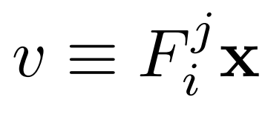
Non-blind image deblurring
Fast Image Deconvolution using Hyper-Laplacian Priors
$$\min_{x,w}{\sum_{i=1}^{N}{({\frac{λ}{2}\left(\text{x}＊k\text{ −}\text{y}\right)}_{i}^{2}+\frac{β}{2}\left({\left|\left|F_{i}^{1}x −w_{i}^{1}\right|\right|}_{2}^{2}+{\left|\left|F_{i}^{2}x −w_{i}^{2}\right|\right|}_{2}^{2}\right)+{\left|w_{i}^{1}\right|}^{α} +{\left|w_{i}^{2}\right|}^{α})}}$$
x subproblem
w subproblem
Parseval‘s theorem $↓$
polynomial
$→$look up table, Newton-Raphson(牛頓法)
Notes:
有推導出 不管alpha是多少 最後都會化剪成polynomial

Slide 9
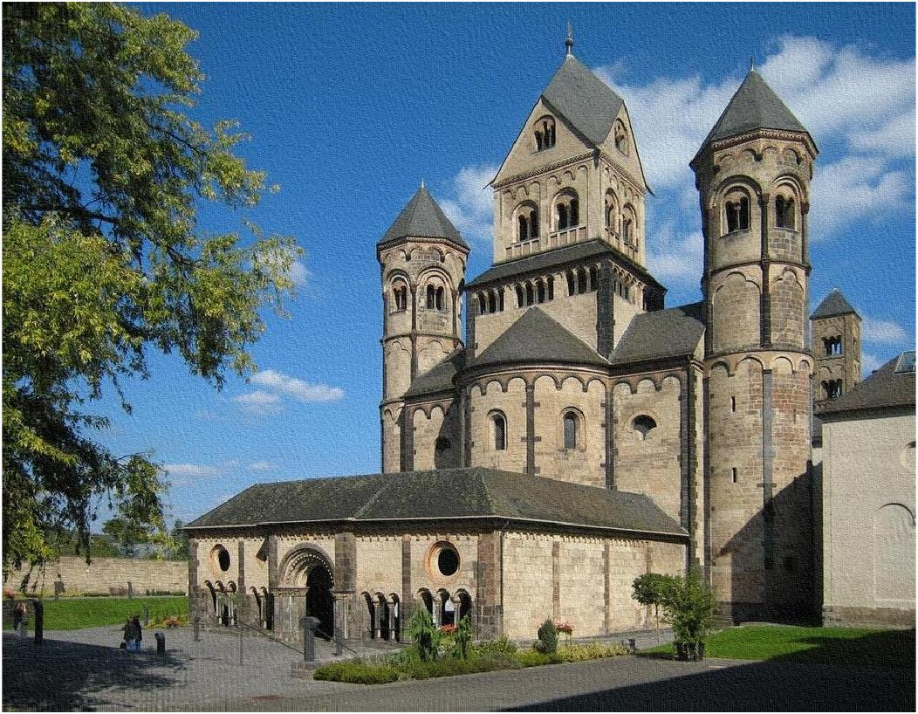
Non-blind image deblurring
Fast Image Deconvolution using Hyper-Laplacian Priors
Result:
pros: run time(< 5s)
cons: either higher noise in smooth area or bad deblurring in edge area.
Notes:
時間較快 在知道 g f w 分布的情形下 找出結果 g

Slide 10
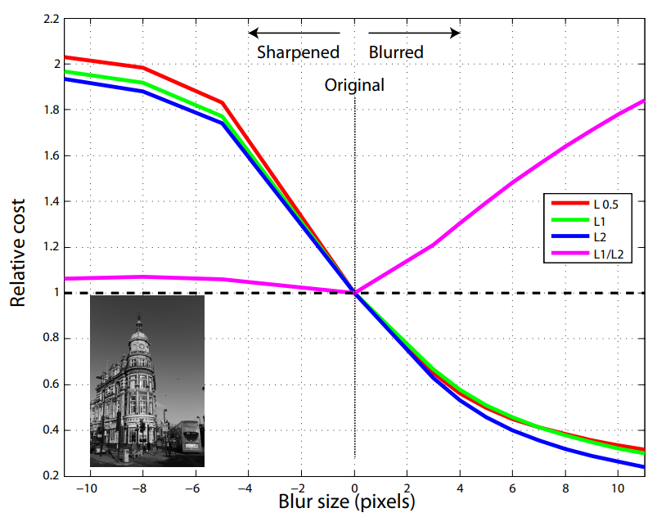
blind image deblurring
Blind Deconvolution Using a Normalized Sparsity Measure
*here x, y are high frequency latent image and blurred image(gradient)
Reference:
D. Krishnan, T. Tay, and R. Fergus. Blind deconvolution using a normalized sparsity measure. In CVPR 2011. IEEE, June 2011.

Slide 11
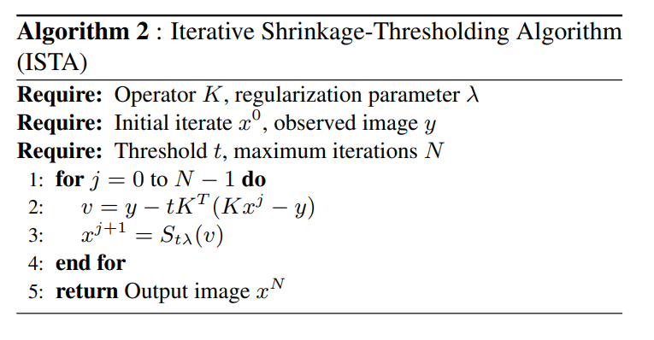
blind image deblurring
Blind Deconvolution Using a Normalized Sparsity Measure
x update(latent gradient)
k update(kernel)
itrative re-weighted least squares(IRLS)
itrative shrinkage-thresholding algorithm(ISTA)
Notes:
實作k 加起來是1 k大於等於0

Slide 12
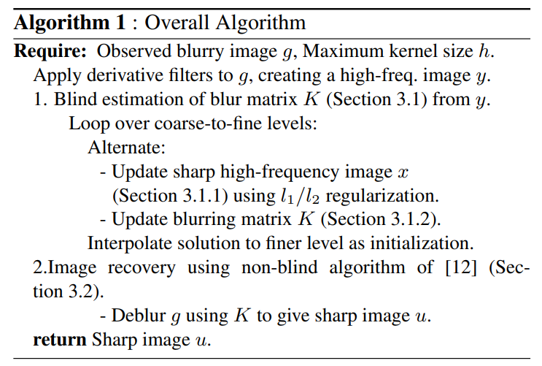
blind image deblurring
Blind Deconvolution Using a Normalized Sparsity Measure
x update(latent gradient)
k update(kernel)
Notes:
實作k 加起來是1 k大於等於0

Slide 13
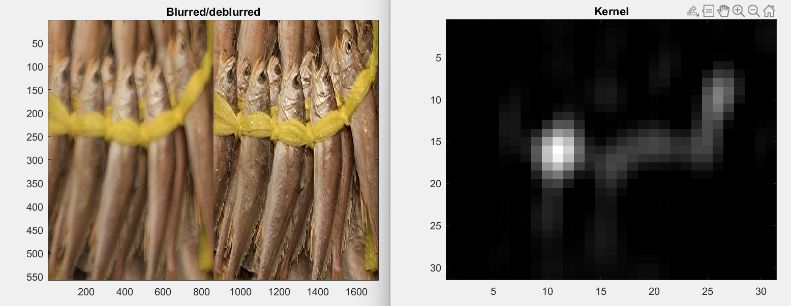
blind image deblurring
Blind Deconvolution Using a Normalized Sparsity Measure
Result :
Notes:
實作k 加起來是1 k大於等於0

Slide 14
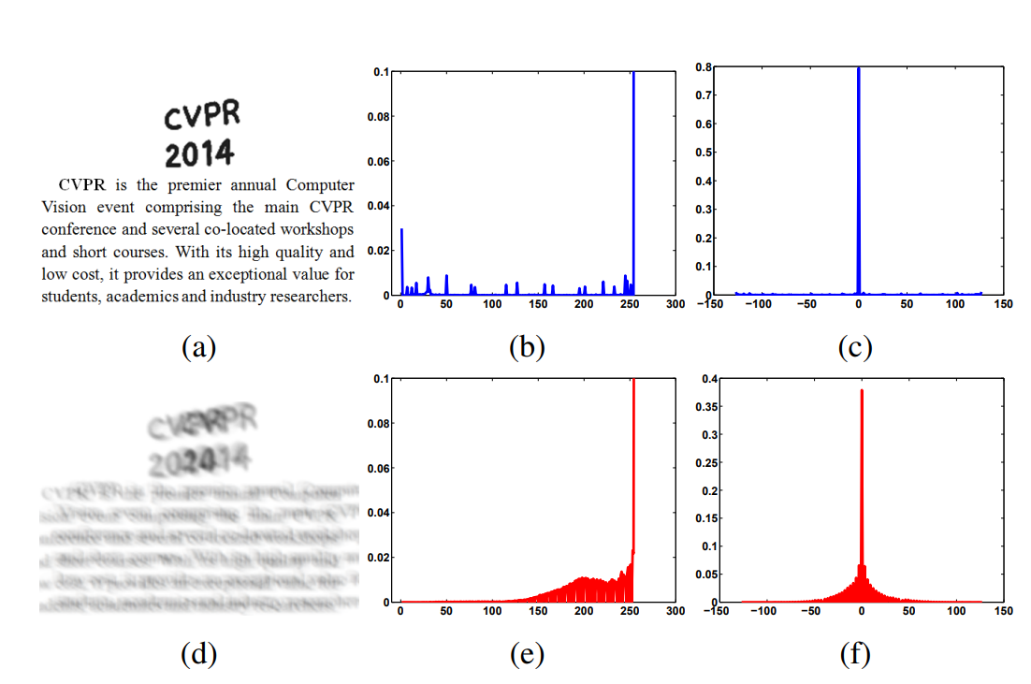
text image deblurring (non-DL)
Deblurring Text Images via L0-Regularized Intensity and Gradient Prior
*here x, y are latent image and blurred image(gradient)
L0-regularized prior( $|{\left.​∙\right|}_{0}$)
Reference:
J. Pan, Z. Hu, Z. Su, and M.-H. Yang. Deblurring text images via l0-regularized intensity and gradient prior. In 2014 IEEE Conference on Computer Vision and Pattern Recognition. IEEE, June 2014.

Slide 15
text image deblurring (non-DL)
Deblurring Text Images via L0-Regularized Intensity and Gradient Prior
x update(latent gradient)
k update(kernel)
*apply Parseval’s theorem, direct FFT
*non blind part …recall p7

Slide 16
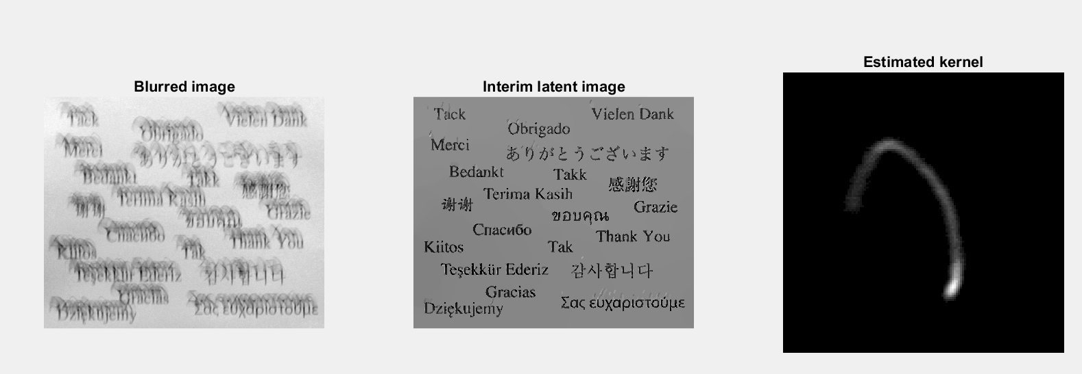
text image deblurring (non-DL)
Deblurring Text Images via L0-Regularized Intensity and Gradient Prior
Result:

Slide 17
text image deblurring(non-DL)
Deblurring Text Images via L0-Regularized Intensity and Gradient Prior
possible weakness:
low contrast image, long run time
blurred
result

Slide 18
text image deblurring (DL)
Convolutional Neural Networks for Direct Text Deblurring
multi layers combined with element-wise ReLU and loss function
*Pytorch: weight decay
Reference:
M. Hradiˇs, J. Kotera, P. Zemˇc´ık, and F. Sroubek. Convolutional neural networks for direct text deblurring. In Procedings of the British Machine Vision Conference 2015. British Machine Vision Association, 2015.

Slide 19
text image deblurring (DL)
Convolutional Neural Networks for Direct Text Deblurring
Result: the result dependends on the training data

