Slide 1
Green Learning
Presenter : De-Yan Lu
Advisor : Prof. Jian-Jiun Ding
Department : Graduate Institute of Communication Engineering, NTU
10 / 03 / 2023

Slide 2
Reference
C.-C. Jay Kuo, The CNN as a guided multilayer RECOS transform [lecture notes], IEEE Signal Process. Mag. 34 (3) (2017) 81–89.
C.-C. Jay Kuo, Yueru Chen, On data-driven saak transform, J. Vis. Commun. Image Represent. 50 (2018) 237–246.
C-C Jay Kuo, Min Zhang, Siyang Li, Jiali Duan, Yueru Chen, Interpretable convolutional neural networks via feedforward design, J. Vis. Commun. Image Represent. 60 (2019) 346–359.
Min Zhang, Yifan Wang, Pranav Kadam, Shan Liu, C-C Jay Kuo, PointHop++: A lightweight learning model on point sets for 3D classification, 2020, arXiv preprint.
Yijing Yang, Wei Wang, Hongyu Fu, C.-C. Jay Kuo, On supervised feature selection from high dimensional feature spaces, 2022, arXiv preprint.
Hongyu Fu, Yijing Yang, Vinod K. Mishra, C.-C. Jay Kuo, Subspace learning machine (SLM): Methodology and performance, 2022, arXiv preprint.
C.-C. Jay Kuo, Azad M. Madni, “Green learning: Introduction, examples and outlook,” J. Vis. Commun. Image R. 90(2023)

Slide 3
Outline
Overview of Green Learning ---- p.4 $\sim$ p.11
Unsupervised Representation Learning---- p.12 $\sim$ p.31
2017 - Rectified-correlations on a sphere (RECOS) transform
2018 - Saak transform (Subspace approximation via augmented kernels transform)
2019 - Saab transform (Subspace approximation via adjusted bias transform)
2020 – Multi-stage Saab transform
Supervised Feature Learning ---- p.32 $\sim$ p.36
2022 - Discriminant feature test (DFT)
2022 - Relevant feature test (RFT)
Supervised Decision Learning---- p.37 $\sim$ p.41
2022- Subspace Learning Machine (SLM)
Demonstrations and applications--- p.42 $\sim$ p.66
Multi-stage Saab transform for MNIST data
Deep-fake face detection
Graph node classification
Cloud data augmentation
Blind image quality assessment

Slide 4
01
Overview of Green Learning

Slide 5
Overview field of AI
Artificial intelligence (AI)
The simulation of human intelligence processes
by machines, especially computer systems.
Machine learning (ML)
A branch of artificial intelligence and computer
science which focuses on the use of data and
algorithms to imitate the way that human learn,
gradually improving its accuracy.
Deep learning (DL)
A part of broader family of machine learning methods, which is based on artificial neural
networks with representation learning.
Green learning (GL)
Characterized by low carbon footprints, lightweight
model, low computational complexity, and logical
transparency from the viewpoint of deep learning.
AI
ML
DL
GL

Slide 6
Overview field of AI
Machine
Learning
Edge, Texture
Deep
Learning
<Ref>:Tommy Huang, 什麼是人工智慧、機器學習和深度學習?
https://chih-sheng-huang821.medium.com/%E4%BB%80%E9%BA%BC%E6%98%AF%E4%BA%BA%E5%B7%A5%E6%99%BA%E6%85%A7-%E6%A9%9F%E5%99%A8%E5%AD%B8%E7%BF%92%E5%92%8C%E6%B7%B1%E5%BA%A6%E5%AD%B8%E7%BF%92-587e6a0dc72a

Slide 7
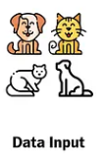
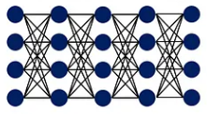
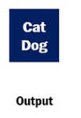
Overview field of AI
Feed-forward
Deep
Learning
Back-forward
Feature Extraction + Classifier
Feed-forward
Green
Learning
Feature Extraction + Classifier

Slide 8
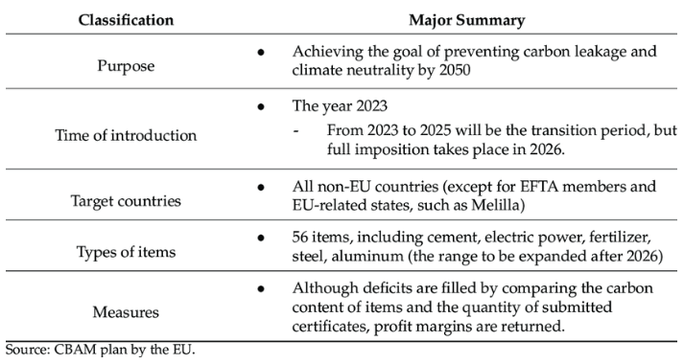
Carbon Taxes
Carbon pricing
Increasing prices of electricity coming from fossil fuels that emit carbon dioxide when burner
Carbon taxes offer the most efficient (lowest cost) way to tackle climate change
77 countries and over 100 cities have committed to achieving net zero emissions by 2050
As of 2019, carbon taxes have been implemented or scheduled for implementation in 25 countries

Slide 9
Green learning field
Deep learning (DL) concerns
Mathematically intractable
No clear logical reasoning
Demanding heavy supervision
With high carbon footprint
Vulnerable to adversarial attacks
Green learning (GL) v.s. Deep learning (DL)
GL has smaller sizes than DL
GL had lower computational complexity than DL
GL has logical reasoning (Interpretable AI)
Without computational neurons as its basic units
Without a network architecture

Slide 10
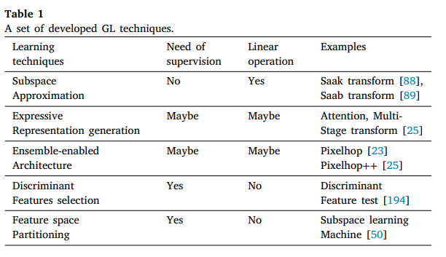
GL techniques
Overview of a generic GL system
Module 1
Module 2
Module 3
Module 1
Module 2
Module 3

Slide 11
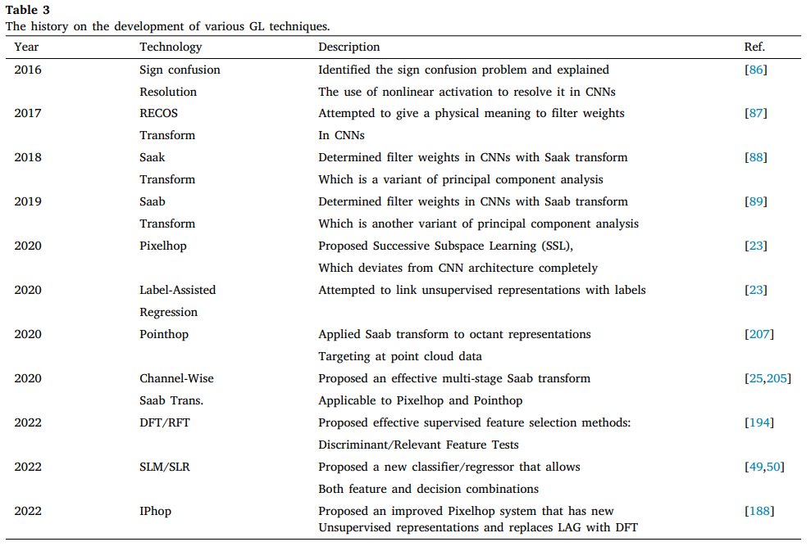
Content History
<Ref> : C.-C. Jay Kuo, Azad M. Madni, “Green learning: Introduction, examples and outlook,”
J. Vis. Commun. Image R. 90(2023)
Module 1
Module 2
Module 3

Slide 12
02
Unsupervised Representation Learning

Slide 13
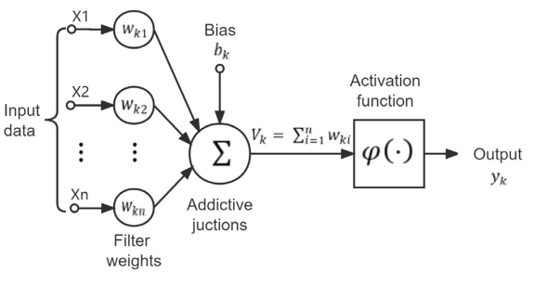
Green learning field
Illustration of a computational neuron : At k-th neuron
$$V_{k}=\sum_{i=1}^{n}{w_{ki}x_{i}}+b_{k}$$
$$φ\left({w_{k}}^{T}x+b_{k}\right)$$
How to determine the weight vector $w_{k}$ ?
How to simulate activation function ?
$${w_{k}}^{T}x+b_{k}=\left\langle w_{k},x\right\rangle +b_{k}$$

Slide 14
Unsupervised Representation Learning
Kernel and coefficients : $y=Wx$
$W$ : Kernel
$w_{i}$ : Basis of new space , $i=1,2,…,N$
$x$ : Coefficients of original space
$y$ : Coefficients of new space
$$W=\left[\begin{matrix}w_{1} & w_{2} & ⋯ & w_{N}\end{matrix}\right]$$
$$x$$
error
$$w_{1}$$
$$w_{N}$$
$$w_{2}$$
$$y$$
Data independent transform : kernel is predefined
1978-Discrete cosine transform (DCT)
1992-Wavelet transform (WT)
Data-driven (Data dependent) transform : kernel is not predefined
1981-Karhunen–Loéve transform (KLT) or Principle component analysis (PCA)
2017-Rectified-correlations on a sphere (RECOS) transform
2018-Saak transform (Subspace approximation via augmented kernels transform)
2019-Saab transform (Subspace approximation via adjusted bias transform)

Slide 15
Unsupervised Representation Learning
1978-Discrete cosine transform (DCT) : Extract the low-frequency component
$X=Dx$ , where the input $x∈ℝ^{N}$, transformation matrix $D∈ℝ^{N×N}$, and the output $X∈ℝ^{N}$
$D=\left[\begin{matrix}1 & 1 & ⋯ & 1 \\ cos\left(\frac{π}{N}∙\frac{1}{2}\right) & cos\left(\frac{π}{N}∙\frac{3}{2}\right) & ⋯ & cos\left(\frac{π}{N}∙\left(N−\frac{1}{2}\right)\right) \\ ⋮ & ⋮ & ⋱ & ⋮ \\ cos\left(\frac{π}{N}∙\frac{1}{2}∙\left(N−1\right)\right) & cos\left(\frac{π}{N}∙\frac{3}{2}∙\left(N−1\right)\right) & ⋯ & cos\left(\frac{π}{N}∙\left(N−\frac{1}{2}\right)\left(N−1\right)\right)\end{matrix}\right]$
1981-Karhunen–Loéve transform (KLT) : Doing decorrelation
$z=Kx$ , where the input $x∈ℝ^{N}$, transformation matrix $K∈ℝ^{N×N}$, and the output $z∈ℝ^{N}$
Correlation matrix : $R_{z}$ is a diagonal matrix, which means decorrelation, i.e. $𝔼\left[z_{i}{z_{j}}^{H}\right]=0$ , $i≠j$
$R_{z}=𝔼\left[zz^{H}\right]=K𝔼\left[xx^{H}\right]K^{H}=KR_{x}K^{H}$
$K$ is an orthonormal matrix whose column vectors are composed of the eigenvectors of $R_{x}$

Slide 16
Unsupervised Representation Learning
Loss function
$$f$$
$$\hat{f }$$
$$f′$$
Neuron layer
Activation function
ReLU
Backpropagation for updating weight to minimize loss
Total loss : ${\left\|f −f^{′}\right\|}^{2}$
$$f$$
$$\hat{f }$$
$$f′$$
Kernel 1
Kernel 2
Appox. loss
$${\left\|f −\hat{f}\right\|}^{2}$$
Rectifier loss
$${\left\|\hat{f}−f^{′}\right\|}^{2}$$

Slide 17
Unsupervised Representation Learning
2017-Rectified-correlations on a sphere (RECOS) transform
Forward RECOS transform
$K+1$ anchor vectors (basis): $a_{k}$ , $k=0,1,2,…,K$ , where $a_{0}=\frac{1}{\sqrt{N}}1^{T}$ (DC term)
Coefficient from new space : $p_{k}={a_{k}}^{T}f$ , $k=0,1,2,…,K$ , $f∈ℝ^{N}$
Projection vector $p$ of input $f$ : $p={\left[\begin{matrix}p_{0} & p_{1} & p_{2} & ⋯ & p_{K}\end{matrix}\right]}^{T}∈ℝ^{K+1}$
DC term : $p_{0}$ ; AC term : $p_{1}$, $p_{2}$, …, $p_{K}$
Output $g$ is passed through activation function : $g={\left[\begin{matrix}g_{0} & g_{1} & g_{2} & ⋯ & g_{K}\end{matrix}\right]}^{T}∈ℝ^{K+1}$
$g_{0}=p_{0}$
$g_{k}=\left\{\begin{aligned}p_{k}, if p_{k}>0 \\ &0 , if p_{k}≤0\end{aligned}\right.$ , $k=1,2,…,K$
Inverse RECOS transform
Approximation :$f≈\hat{f}=\sum_{k=0}^{K}{α_{k}}a_{k}$ , when $K+1<N$
$p_{k}≈{a_{k}}^{T}\hat{f}={a_{k}}^{T}\sum_{m=0}^{K}{α_{m}}a_{m}=\sum_{m=0}^{K}{{a_{k}}^{T}a_{m}α_{m}}$ , $k=0,1,2,…,K$
Rectifier approximation : $f≈f′=\sum_{q=0}^{Q}{β_{q}}{a′}_{q}$
Reorder output $g$ : $g^{′}=\left[\begin{matrix}{g′}_{0} & g_{1}^{′} & g_{2}^{′} & ,⋯ & g_{Q}^{′} & 0 & ⋯ & 0\end{matrix}\right]∈ℝ^{K+1}$ corresponding to the anchor vector ${a′}_{0}$, ${a′}_{1}$,…, ${a′}_{Q}$
$g_{q}^{′}≈{a_{q}}^{T}f^{′}=\sum_{q′=0}^{Q}{β_{q′}}{a_{q}}^{T}{a′}_{q′}$
Loss : $E\left(f,f^{′}\right)={\left\|f −\hat{f}\right\|}^{2}+{\left\|\hat{f}−f^{′}\right\|}^{2}+2{\left(f −\hat{f}\right)}^{T}\left(\hat{f}−f^{′}\right)$
A
$$f$$
$$a_{1}$$
$$f^{′}$$
$$a_{0}$$
B
$$⋮$$
$$⋮$$
O
$$a_{K}$$
$$\hat{f}$$
C
C
$${\left\|f −\hat{f}\right\|}^{2}$$
$${\left\|\hat{f}−f^{′}\right\|}^{2}$$
Approximation
loss
Rectifier
loss
A
B
$$E\left(f,f^{′}\right)$$

Slide 18
Unsupervised Representation Learning
A
1st module of Saak transform : KLT
Loss of RECOS transform : $E\left(f,f^{′}\right)={\left\|f −\hat{f}\right\|}^{2}+{\left\|\hat{f}−f^{′}\right\|}^{2}+2{\left(f −\hat{f}\right)}^{T}\left(\hat{f}−f^{′}\right)$
Approximation loss : $E_{a}\left(f,\hat{f}\right)={\left\|f −\hat{f}\right\|}^{2}$
Rectifier loss : $E_{r}\left(\hat{f},f^{′}\right)={\left\|\hat{f}−f^{′}\right\|}^{2}$
Orthonormal anchor vectors : ${a_{i}}^{T}a_{j}=δ_{i,j}=\left\{\begin{aligned}1, i=j \\ &0, i≠j\end{aligned}\right.$ ; $i,j=0,1,2,…,K$
Projection
Coefficient from new space : $p_{k}={a_{k}}^{T}f$ , $k=0,1,2,…,K$ , $f∈ℝ^{N}$
Approximation : $\hat{f}=\sum_{k=0}^{K}{p_{k}}a_{k}$
Rectifier approximation : $f′=\sum_{q=0}^{Q}{p_{q}}{a′}_{q}$
Minimum of approximation loss $E_{a}\left(f,\hat{f}\right)$
Solution : Orthonormal projection such as KLT (or PCA)
Step :
Mean-removed : $\tilde{f}=f−p_{0}a_{0}∈ℝ^{N}$
Compute correlation matrix : $R_{\tilde{f}}=𝔼\left[\tilde{f}{\tilde{f}}^{H}\right]∈ℝ^{N×N}$
Reorder the eigenvalues from the largest to the smallest : $λ_{1}≥λ_{2}≥…≥λ_{N}≥0$
Choose the first $M (M≤N)$ orthonormal basis $ℝ^{M}$ in $ℝ^{N}$ to provide the minimum approximation loss. (PCA or truncated KLT)
The final loss by orthonormal projection :
$E\left(f,f^{′}\right)=\min\left[E_{a}\left(f,\hat{f}\right)\right]+E_{r}\left(\hat{f},f^{′}\right)$
${\left(f −\hat{f}\right)}^{T}\left(\hat{f}−f^{′}\right)=0$ (Because of orthogonality)
$$E\left(f,f^{′}\right)$$
$${\left\|f −\hat{f}\right\|}^{2}$$
C
B
$${\left\|\hat{f}−f^{′}\right\|}^{2}$$
A
$$f$$
$$a_{1}$$
B
$$a_{0}$$
$$f^{′}$$
$$⋮$$
$$⋮$$
O
C
$$a_{K}$$
$$\hat{f}$$

Slide 19
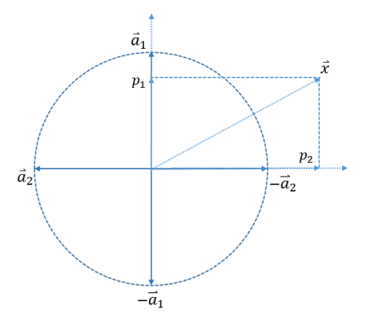
Unsupervised Representation Learning
A
$$f$$
2nd module of Saak transform : S/P Conversion (Sign to position)
The loss by orthonormal projection :
$E\left(f,f^{′}\right)=\min\left[E_{a}\left(f,\hat{f}\right)\right]+E_{r}\left(\hat{f},f^{′}\right)$
Approximation loss : $E_{a}\left(f,\hat{f}\right)={\left\|f −\hat{f}\right\|}^{2}$
Rectifier loss : $E_{r}\left(\hat{f},f^{′}\right)={\left\|\hat{f}−f^{′}\right\|}^{2}$
Minimum of rectifier loss $E_{r}\left(\hat{f},f^{′}\right)$
Why is there rectifier loss ?
Negative coefficients is clipped to $0$ passing through non-linear activation
Solution : Augment each kernel vector with its negative vector to
preserve negative coefficients
If $a_{k}$ is a kernel vector, choose ${−a}_{k}$ to be another kernel vector
Ideas :
The projection of input $f$ onto two AC anchor vectors $a_{1}, a_{2}$ with $p_{1}>0 and p_{2}<0$
ReLU will preserve $p_{1}$ but clip $p_{2}$ to 0
Augment two AC anchor vectors with two more anchor vectors ${−a}_{1}, {−a}_{2}$ with ${−p}_{1}<0 and−p_{2}>0$
ReLU will preserve $−p_{2}$ but clip ${−p}_{1}$ to 0
The final loss by S/P conversion
$E\left(f,f^{′}\right)=\min\left[E_{a}\left(f,\hat{f}\right)\right]+\min\left[E_{r}\left(\hat{f},f^{′}\right)\right]$
$$a_{1}$$
$$f^{′}$$
B
$$a_{0}$$
$$⋮$$
$$⋮$$
O
$$\hat{f}$$
C
$$a_{K}$$
A
$${\left\|f −\hat{f}\right\|}^{2}$$
$$E\left(f,f^{′}\right)$$
C
$${\left\|\hat{f}−f^{′}\right\|}^{2}$$
B

Slide 20
Unsupervised Representation Learning
2018-Saak transform (Subspace approximation via augmented kernels transform)
Forward Saak transform
Input $f∈ℝ^{N}$ $→$ determine its KLT basis function $b_{k}$ , $k=0,1,2,…,N−1$
After KLT, the projection vector is $g_{s}={\left[\begin{matrix}g_{s,0} & g_{s,1} & ⋯ & g_{s,N−1}\end{matrix}\right]}^{T}∈ℝ^{N}$
Component : $g_{s,k}={b_{k}}^{T}f$ , $k=0,1,…,N−1$
Kernel selection and augmentation
DC kernel vector : ${a_{0}=b}_{0}=\frac{1}{\sqrt{N}}1^{T}$ (Because the eigenvalue is equal 0)
AC kernel vector : $a_{2k−1}=b_{k}$ ; $a_{2k}=−b_{k}$ , $k=1,2,…,N−1$
Projection onto the augmented kernel set
Projection component of input $f$ : $p_{k}={a_{k}}^{T}f$ , $k=0,1,2,…,2\left(N−1\right)$
Projection vector of input $f$ : $p={\left[\begin{matrix}p_{0} & p_{1} & ⋯ & p_{2\left(N−1\right)}\end{matrix}\right]}^{T}∈ℝ^{2N−1}$
Apply the ReLU to the projection vector except the first element to yield the final output $g$
$g={\left[\begin{matrix}g_{0} & g_{1} & ⋯ & g_{2\left(N−1\right)}\end{matrix}\right]}^{T}∈ℝ^{2N−1}$
$g_{0}=p_{0}$ ;
$g_{2k−1}=p_{2k−1}$ and $g_{2k}=0$ if $p_{2k−1}>0$ , $k=1,2,…,N−1$ ;
$g_{2k−1}=0$ and $g_{2k}=p_{2k}$ if $p_{2k}>0$ , $k=1,2,…,N−1$
# of DC kernels : $1$
# of AC kernels : $2\left(N−1\right)$
Pays the price of
doubled spectral dimensions
Saab transform
(Subspace Approximation of
adjusted bias)
Input : $f$
AC term : $g_{s}$
Output : $g$
$$f∈ℝ^{N}$$
KLT
$${\left[\begin{matrix}5 & −3\end{matrix}\right]}^{T}$$
S/P conversion
$${\left[\begin{matrix}5 & 0 & 0 & 3\end{matrix}\right]}^{T}$$
$$b_{1}$$
$$b_{2}$$
$$b_{1}$$
$${−b}_{1}$$
$$b_{2}$$
$${−b}_{2}$$

Slide 21
Unsupervised Representation Learning
2018-Saak transform (Subspace approximation via augmented kernels transform)
Inverse Saak transform
KLT basis : $b_{k}$ , $k=0,1,…,N−1$
Projection vector after KLT : $g_{s}={\left[\begin{matrix}g_{s,0} & g_{s,1} & ⋯ & g_{s,N−1}\end{matrix}\right]}^{T}∈ℝ^{N}$
Reconstruction
$f=\sum_{k=0}^{N−1}{g_{s,k}}b_{k}$
Output $f$
AC term : $g_{s}$
Input : $g$
Inverse
KLT
$${\left[\begin{matrix}5 & −3\end{matrix}\right]}^{T}$$
$${\left[\begin{matrix}5 & 0 & 0 & 3\end{matrix}\right]}^{T}$$
$$f∈ℝ^{N}$$
P/S conversion
$$b_{1}$$
$$b_{2}$$
$$b_{1}$$
$${−b}_{1}$$
$$b_{2}$$
$${−b}_{2}$$
Stability of Saak transform : Bounded input bounded output (BIBO) system
Stability of forward Saak transform : ${\left\|g_{1}−g_{2}\right\|}_{2}≤{\left\|g_{s,1}−g_{s,2}\right\|}_{2}={\left\|f_{1}−f_{2}\right\|}_{2}$
Stability of inverse Saak transform : ${\left\|f_{1}−f_{2}\right\|}_{2}={\left\|g_{s,1}−g_{s,2}\right\|}_{2}≤{\left\|g_{s,1}−g_{s,2}\right\|}_{1}={\left\|g_{1}−g_{2}\right\|}_{1}$
Lemma:
If $A$ is an orthonormal matrix, then ${\left\|Ax\right\|}_{p}={\left\|x\right\|}_{p}$
If $x$is a vector, then ${\left\|x\right\|}_{2}≤{\left\|x\right\|}_{1}$

Slide 22
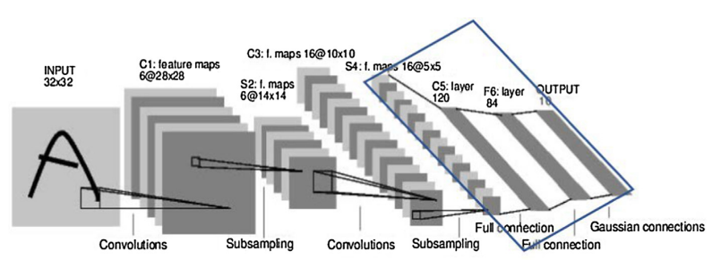
Unsupervised Representation Learning
2019- Saab transform (Subspace approximation via adjusted bias transform)
Affine transformation
$y_{k}=\sum_{n=0}^{N−1}{a_{k,n}x_{n}+b_{k}}=a_{k}^{T}x+b_{k}$ , $k=0,1,2,…,K−1$, $x∈ℝ^{N}$, $a_{k}∈ℝ^{N}$
Kernel vector $a_{k}$ selection : Using KLT
$S=S_{DC}⊕S_{AC}$
$S_{DC}$ : One DC term: $a_{0}=\frac{1}{\sqrt{N}}1^{T}∈ℝ^{N}$
$S_{AC} : \left(K−1\right)$ AC term: $a_{k}∈ℝ^{N}$, $k=1,2,…,K−1$
Bias selection:
Positive response constraint
$y_{k}=\sum_{n=0}^{N−1}{a_{k,n}x_{n}+b_{k}}=a_{k}^{T}x+b_{k}≥0$ , $∀x$
Constant bias constraint
$b_{0}=b_{1}=⋯=b_{K−1}=d\sqrt{K}$ , $d$: bias value
$y={\left[a_{0},a_{1},…,a_{K−1}\right]}^{T}x+d\sqrt{K}1∈ℝ^{K}$, , $1=\frac{1}{\sqrt{K}}{\left(1,1,…,1\right)}^{T}∈ℝ^{K}$
All biases are lied in the DC subspace $S_{DC}$
Bias selection rule :
$b_{0}=b_{1}=⋯=b_{K−1}=d\sqrt{K}$ , $d$: bias value
$b_{k}≥\max_{x}\left\|x\right\|$ , $k=0,1,…,K−1$ , $x∈ℝ^{N}$ , $y∈ℝ^{K}$

Slide 23
Unsupervised Representation Learning
Multi-Saab transform : 1st stage
$$\left(\# of training data, height, width, channel\right)$$
Conv. layer
Transformed matrix : $6×25$
$$60000×32×32×1$$
$$60000×28×28×25$$
Do PCA with 5 AC filters
And adding 1 DC filter
Patches with kernel size
$5×5$ with stride=1
DC filter vector :$a_{0}=\frac{1}{\sqrt{N}}1^{T}$
$N$ is the number of channels
$$60000×28×28×6$$
$$60000×14×14×6$$
2nd stage Saab transform
Max pooling
with $2×2$
1981-Karhunen–Loéve transform (KLT or PCA) : Doing decorrelation
$z=Kx$ , where the input $x∈ℝ^{N}$, transformation matrix $K∈ℝ^{N×N}$, and the output $z∈ℝ^{N}$
Correlation matrix : $R_{z}$ is a diagonal matrix, which means decorrelation, i.e. $𝔼\left[z_{i}{z_{j}}^{H}\right]=0$ , $i≠j$
$R_{z}=𝔼\left[zz^{H}\right]=K𝔼\left[xx^{H}\right]K^{H}=KR_{x}K^{H}$
$K$ is an orthonormal matrix whose column vectors are composed of the eigenvectors of $R_{x}$

Slide 24
Unsupervised Representation Learning
Multi-Saab transform : 2nd stage
Conv. layer
$$60000×14×14×6$$
$$60000×14×14×6$$
$$60000×10×10×150$$
Bias addition
Patches with kernel size
$5×5$ with stride=1
Transformed matrix : $16×150$
$$60000×5×5×16$$
$$60000×10×10×16$$
$$60000×10×10×16$$
Do PCA with 15 AC filters
and adding 1 DC filter
Max pooling
with $2×2$
Remove bias
DC filter vector :$a_{0}=\frac{1}{\sqrt{N}}1^{T}$
$N$ is the number of channels

Slide 25
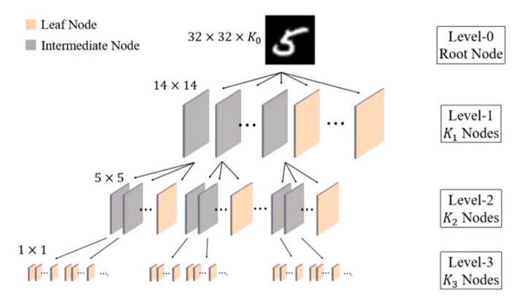
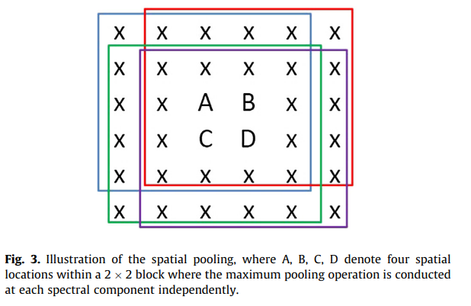
Unsupervised Representation Learning
2019- Saab transform (Subspace approximation via adjusted bias transform)
Max-pooling
Kernel size (window size) : $5×5$
Stride = 1
Lower correlation
Higher correlation
A patch of size $6×6$
$5×5$ window
Projection values : $A,B,C,D$
Max pooing: $\max\left(A,B,C,D\right)$
Multi-stage Saab transform (Conv. + Max Pooling)

Slide 26
Unsupervised Representation Learning
2019- Saab transform (Subspace approximation via adjusted bias transform)
Least-square regressor (LSR): $y_{k}=a_{k}^{T}x+b_{k}$ , $k=1,2,…,c$ (Affine transformation)
$c:$ clusters
Input feature : $x^{i}={\left[x_{1},x_{2},…,x_{D}\right]}^{T}∈ℝ^{D}$ , $i=1,2,…,N$ (N : Numbers of training data)
Output label : $y^{i}={\left[y_{1},y_{2},…,y_{c}\right]}^{T}∈ℝ^{c}$ , $i=1,2,…,N$ (N : Numbers of training data)
${\left[\begin{matrix}1 & x_{1,1} & ⋯ & x_{1,D} \\ 1 & x_{2,1} & ⋯ & x_{2,D} \\ ⋮ & ⋮ & ⋱ & ⋮ \\ 1 & x_{N,1} & ⋯ & x_{N,D}\end{matrix}\right]}_{N×\left(D+1\right)}{\left[\begin{matrix}b_{1} & b_{2} & ⋯ & b_{c} \\ a_{1,1} & a_{1,2} & ⋯ & a_{1,c} \\ ⋮ & ⋮ & ⋱ & ⋮ \\ a_{D,1} & a_{D,2} & ⋯ & a_{D,c}\end{matrix}\right]}_{\left(D+1\right)×c}={\left[\begin{matrix}y_{1,1} & y_{1,2} & ⋯ & y_{1,c} \\ y_{2,1} & y_{2,2} & ⋯ & y_{2,c} \\ ⋮ & ⋮ & ⋱ & ⋮ \\ y_{N,1} & y_{N,2} & ⋯ & y_{N,c}\end{matrix}\right]}_{N×c}$
Fully connection layer of LeNet (Multi-Stage LSR):
Stage $Ι$ : $n_{1}=400+1 , m_{1}=120$
Stage $ΙΙ$ : $n_{2}=120+1 , m_{1}=84$
Stage $ΙΙΙ$: $n_{3}=84+1 , m_{1}=10$
Output : $10$ one-hot vectors
${\left[1,0,…,0\right]}_{10×1}^{T},{\left[0,1,…,0\right]}_{10×1}^{T},{\left[0,0,…,1\right]}_{10×1}^{T}$
Pseudo-labels generation:
K-means cluster :
10 labels expand to 120 labels
with dividing same digit into 12 cluster
<Note>: Pseudo inverse
$Ax=b$ $→x=A^{†}b$
$$400=16×5×5$$

Slide 27
Unsupervised Representation Learning
(60000,400)$→$ (60000,120) $→$ (60000,84) $→$ (60000,10)
Number of training data : 60000
Training label : $y=\left[\begin{matrix}y_{1} \\ y_{2} \\ ⋮ \\ y_{60000}\end{matrix}\right]∈ℝ^{60000}\text{,}$ $y_{i}=1,2,…,10$
1
Predicted label
Input feature
(# of training data, feature dimension)
$\hat{y}=\left[\begin{matrix}{\hat{y}}_{1} \\ {\hat{y}}_{2} \\ ⋮ \\ {\hat{y}}_{60000}\end{matrix}\right]∈ℝ^{60000}$, ${\hat{y}}_{i}=1,2,…,120$
2
K-Means
120 clusters
c
$$\left(60000, 400\right)$$
$for$ $j=1,2,…,60000$ :
If predicted label $\hat{y}\left[j\right]=i$ , i=1,2,…,120 (clusters) and training label $y\left[j\right]=t$ , t=1,2,…,10 (classes)
$num class\left[i,t\right]+=1$ $\left(num class size : 120×10\right)$
Cluster_labels $y_{c}$= np.argmax($num class$, axis = 1) $∈ℝ^{120}$ , $y_{c,i}=1,2,,,,10$ (classes)
If $y_{c}\left[\hat{y}\left[j\right]\right]=y\left[j\right]$ $→$ Built label matrix $L\left[j,\hat{y}\left[j\right]\right]=1$ $\left(Label matrix size :60000×120\right)$
3

Slide 28
Green learning for speech processing model
Modularized : Bilateral LSTM (BLSTM)
Deep learning model
Input
image
Output
feature
BLSTM
Linear mapping
RELU
Green learning model
Input
image
Green
learning
model
Output
feature
LSR
Bias

Slide 29
Demonstrated examples : Deepfake-hop

Slide 30
Demonstrated examples : Green BQA

Slide 31
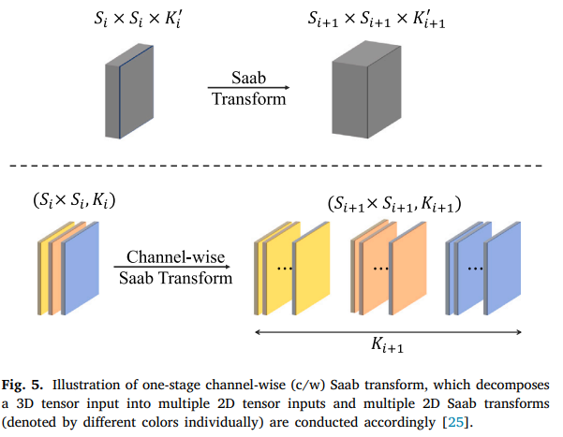
Unsupervised Representation Learning
2019- Saab transform (Subspace approximation via adjusted bias transform)
Standard Saab transform:
The dimensions of the inputs : ${S_{i}}^{2}K_{i}$
Output size : ${S_{i}}^{4}{K_{i}}^{2}$
Channel-wise Saab transform:
The dimensions of the inputs of each channel : ${S_{i}}^{2}K_{i}$
Output size : ${S_{i}}^{4}K_{i}$
${S_{i}}^{4}K_{i}≪{S_{i}}^{4}{K_{i}}^{2}$
Standard Saab transform
Channel-wise Saab transform

Slide 32
03
Supervised Feature Learning

Slide 33
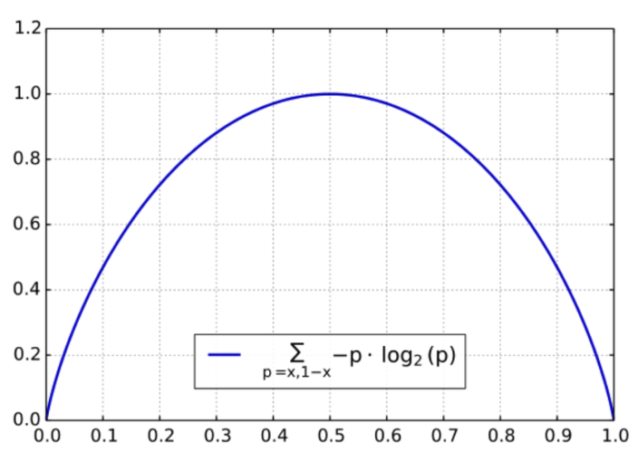
Supervised Feature Learning
Binary classification problem
Case 1:
$p_{1}=1$ ; $p_{2}=0$
Cross entropy: $L=0$
Discriminant feature (Perfect !!)
Case 2:
$p_{1}=0.5$ ; $p_{2}=0.5$
Cross entropy: $L=1$
Not discriminant feature

Slide 34
Supervised Feature Learning
Main purpose using supervised feature learning
Lower computational and modeling costs with little performance degradation because of a high dimensional feature space yielded from image and video.
Dimension reduction avoiding curse of dimensionality
Techniques
2022- Discriminant feature test (DFT) : for classification problem (Using entropy)
2022- Relevant feature test (RFT) : for regression problem (Using MSE)

Slide 35
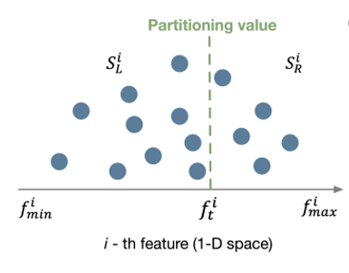
Supervised Feature Learning
2022-Discriminant feature test (DFT)
A classification problem
$N$ data samples, $P$ features, and $C$ classes
$f_{i}$ : feature dimension with $1≤i≤P$
Weighted entropy loss at the $i$-th feature
Left entropy loss : $H_{L,t}^{i}=−\sum_{c=1}^{C}{p_{L,c}^{i}\log\left(p_{L,c}^{i}\right)}$
Right entropy loss : $H_{R,t}^{i}=−\sum_{c=1}^{C}{p_{R,c}^{i}\log\left(p_{R,c}^{i}\right)}$
Weighted entropy loss : $H_{t}^{i}=\frac{N_{L,t}^{i}H_{L,t}^{i}+N_{R,t}^{i}H_{R,t}^{i}}{N}$ , where $N=N_{L,t}^{i}+N_{R,t}^{i}$
Optimized entropy loss for the $i$-th feature
$H_{OP}^{i}=\min_{t∈T}{H_{t}^{i}}$ , $i=1,2,…,P$
Choose $K$ $\left(K<P\right)$features with the lowest entropy values as discriminant features
If $H_{OP}^{1}≤H_{OP}^{2}≤…≤H_{OP}^{K}≤…≤H_{OP}^{P}$, then we use the first $K$ $\left(K<P\right)$features
<Case>: two clusters

Slide 36
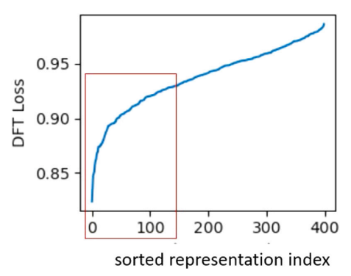
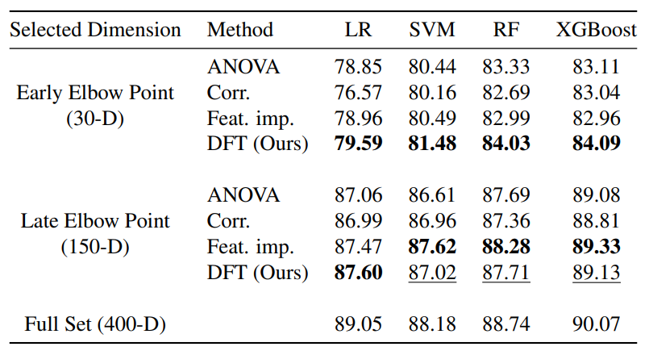
Supervised Feature Learning
2022-Discriminant feature test (DFT)
Choose $K$ $\left(K<P\right)$features with the lowest entropy values as discriminant features
If $H_{OP}^{1}≤H_{OP}^{2}≤…≤H_{OP}^{K}≤…≤H_{OP}^{P}$, then we use the first $K$ $\left(K<P\right)$features
Table. Comparison of classification performance(%) on Clean Fashion
MNIST between different feature selection methods
$$K$$

Slide 37
04
Supervised Decision Learning

Slide 38
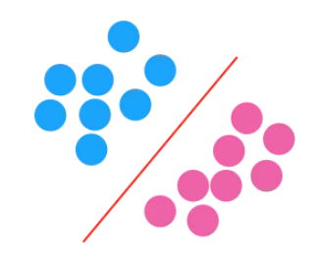
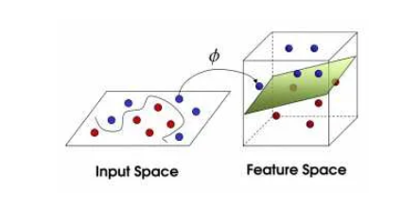
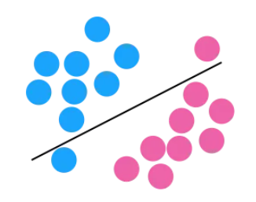
Supervised Decision Learning
Support Vector Machine (SVM)
$$R_{+}$$
$$w^{T}f−φ$$
$$R_{−}$$
(a)
(b)
Non-linear SVM : High complexity
Sensitive to data distribution

Slide 39
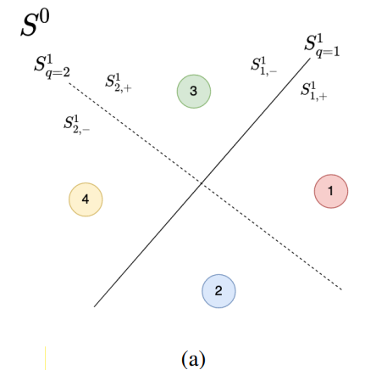
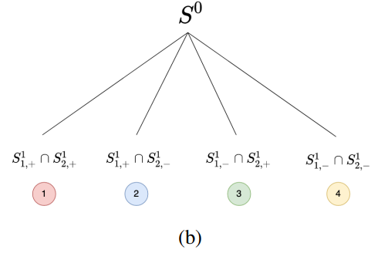
Supervised Decision Learning
2022-Subspace Learning Machine (SLM)

Slide 40
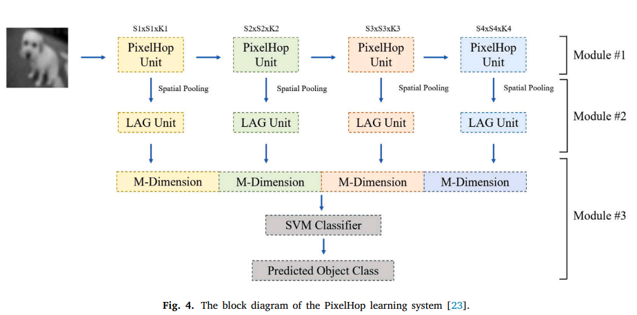
Overall Green Learning Architecture

Slide 41
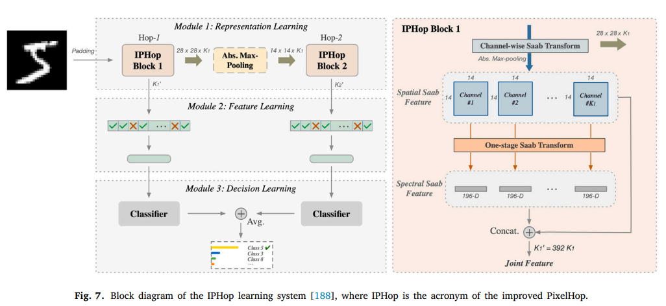
Overall Green Learning Architecture

Slide 42
05
Demonstrated examples and Applications

Slide 43
Multi-stage Saab transform for MNIST data
10 / 03 / 2023

Slide 44
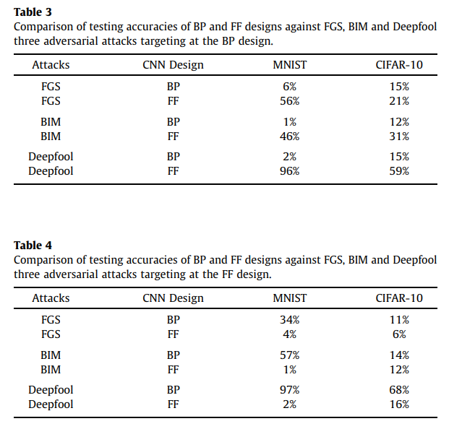
Multi-Saab transform on MNIST and CIFAR10

Slide 45
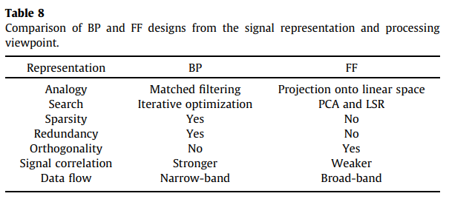
Multi-Saab transform on MNIST and CIFAR10
At viewpoint of signal processing

Slide 46
Demonstrated examples
Deepfake detection
Blind image/video quality assessment
Point clouds registration
Graph node classification
Knowledge graph completion

Slide 47
Deep fake detection
10 / 03 / 2023

Slide 48
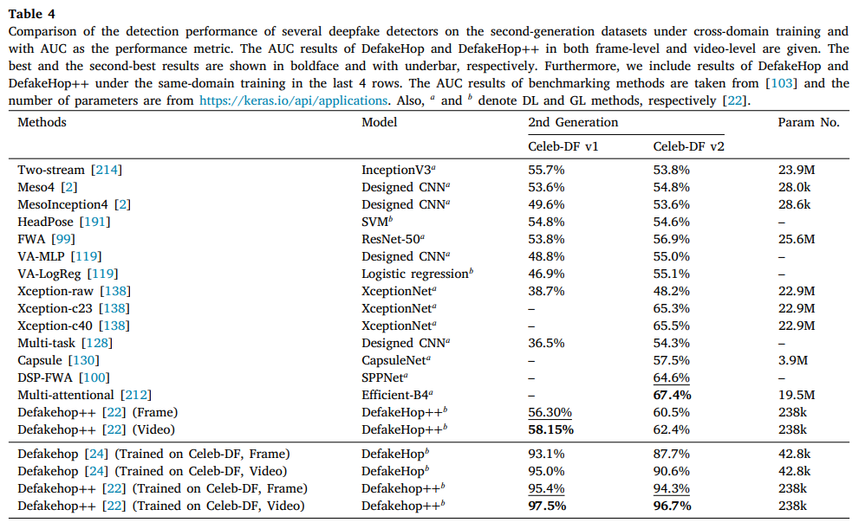
Demonstrated examples
Deepfake detection

Slide 49
Demonstrated examples : Deepfake-hop

Slide 50
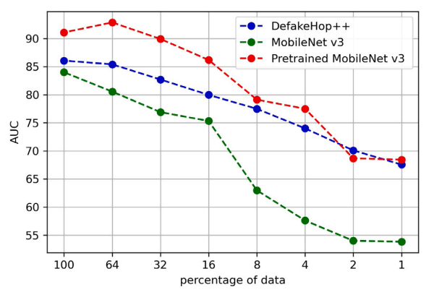
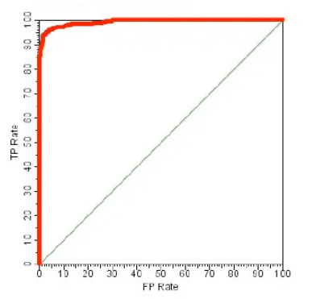
Demonstrated examples
Deepfake detection

Slide 51
Graph node classification
10 / 03 / 2023

Slide 52
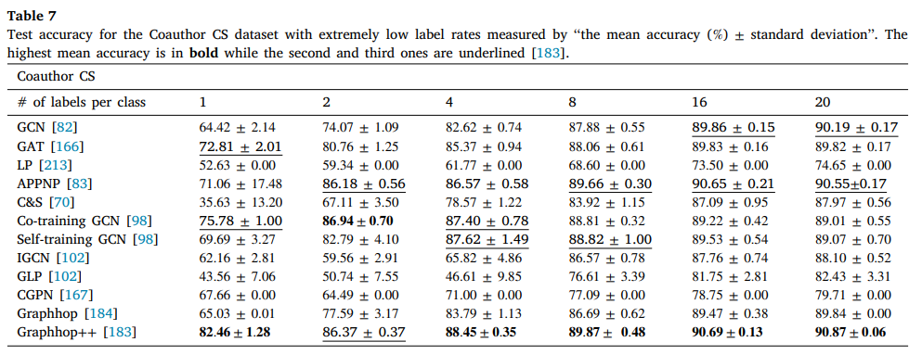
Demonstrated examples
Graph node classification

Slide 53
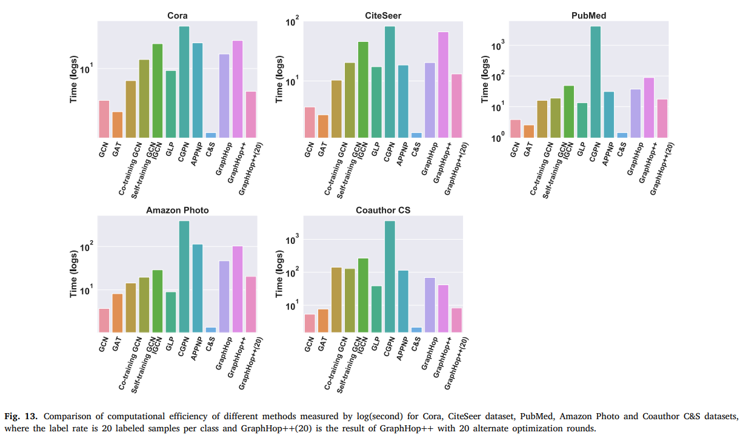
Demonstrated examples
Graph node classification

Slide 54
Cloud data augmentation
10 / 03 / 2023

Slide 55
Cloud data augmentation

Slide 56
Cloud data augmentation

Slide 57
Cloud data augmentation

Slide 58
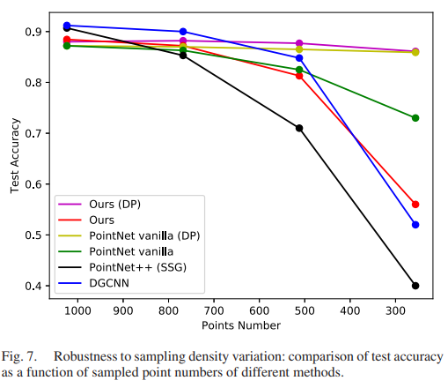
Cloud data augmentation

Slide 59
Cloud data augmentation

Slide 60
Cloud data augmentation

Slide 61
Quality Assessment
10 / 03 / 2023

Slide 62
Quality assessment
Demonstrated examples : Green BQA

Slide 63
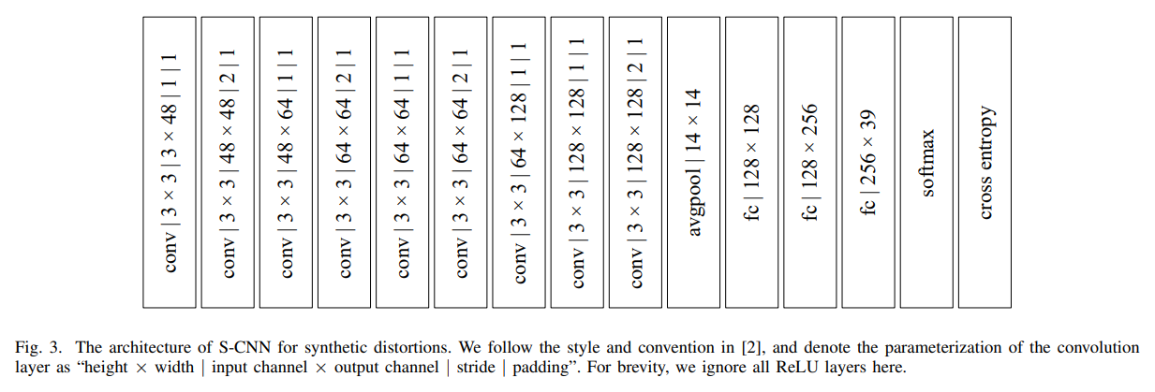
Quality assessment

Slide 64
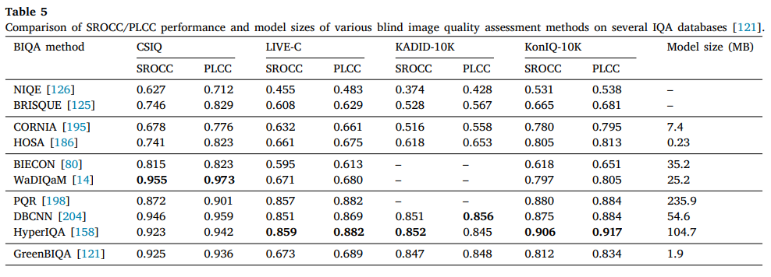
Demonstrated examples
Blind image/video quality assessment

Slide 65
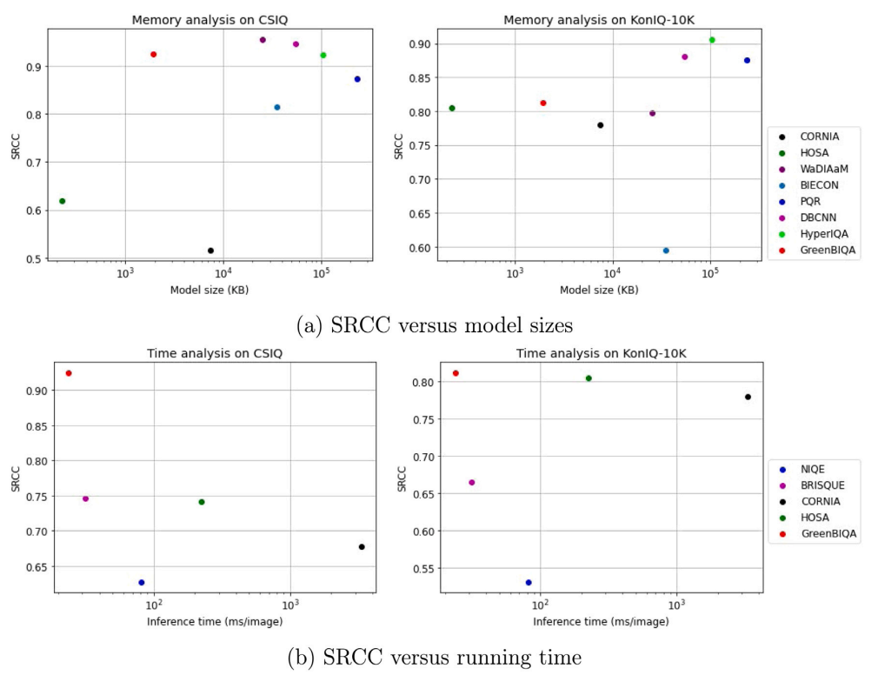
Demonstrated examples
Blind image/video quality assessment

Slide 66
Future Outlook
Robustness
Related to statistics of training data against adversarial attacks
Ensemble technique for GL
However, if the distributions of sampled training and test data are sufficiently different,
the trained GL systems will not predict well
Trust and risk assessment
Relationship between cognition and explainable AI/ML
Generative models
Structures of high-dimensional representation space
Object detection, classification and semantic segmentation
Multi-domain data integration
Lightweight DL versus GL

