Slide 1
TFA-Net: A deep learning based time-frequency analysis tool
Presenter : De-Yan Lu
Advisor : Prof. Jian-Jiun Ding
Department : Graduate Institute of Communication Engineering, NTU
<Ref>:
Pingping Pan, Yunjian Zhang, Zhenmiao Deng, Shaocan Fan, and Xiaohong Huang, “TFA-Net: A deep learning based time-frequency analysis tool,” IEEE Trans. Neural Netw. Learn. Syst., Vol. 34, No. 11, pp. 9274-pp. 9286, Nov, 2023.

Slide 2
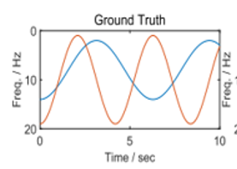
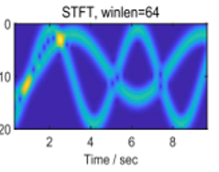
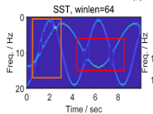
Problem statement
Problem statement :
How to obtain ideal time-frequency representation ?
How to obtain the optimal time-frequency representation without the exhaustive adjustment of hyper-parameters ?
Features selection :
Input signal
$$x\left(t\right)$$
Features
$$X\left(t,f\right)$$
T-F Transform
Deep Learning model
Post-processing
$$✔️ :Good$$

Slide 3
Common time-frequency methods
Common time-frequency methods :
Short-time Fourier transform (STFT, 1977):
Input signal : $x\left(t\right)$
Window function : $g\left(t\right)$ , even function
STFT : $G\left(t,ω\right)=\int_{−∞}^{∞}{x\left(u\right)g\left(u−t\right)e^{−jωu}du}$
Disadvantage : Limited to Heisenberg principle.
Wigner-Ville distribution (WVD, 1980):
$W_{x}\left(t,ω\right)=\int_{−∞}^{∞}{x\left(t+\frac{τ}{2}\right)x^{∗}\left(t−\frac{τ}{2}\right)e^{−jωτ}dτ}$
Disadvantage : Cross terms.

Slide 4
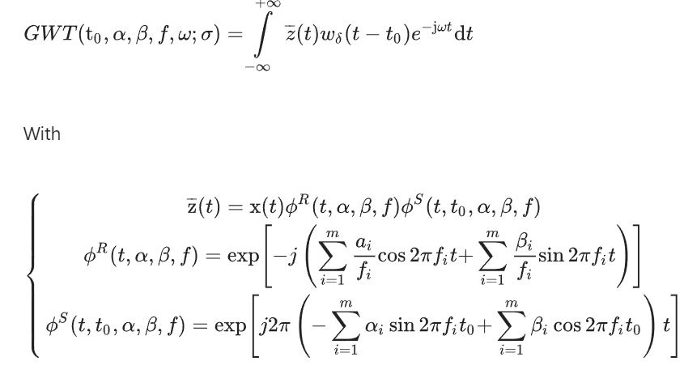
Common time-frequency methods
Common time-frequency methods:
Generalized Warblet transform (GWarblet, 2012):
Yang, Y., Peng, Z. K. , Meng, G, and Zhang, W. M, "Characterize highly oscillating frequency modulation using generalized Warblet transform". Mechanical Systems and Signal Processing, Vol. 26, pp. 128-140..Jan. 2012.

Slide 5
Common time-frequency methods
Common time-frequency methods:
Synchrosqueezing transform (SST, 2010):
Harmonic frequency : $ω_{0}\left(t,ω\right)=−j\frac{∂_{t}G\left(t,ω\right)}{G\left(t,ω\right)}$
SST : ${TF}_{SST}\left(t,η\right)=\int_{−∞}^{∞}{G\left(t,ω\right)δ\left(η−ω_{0}\left(t,ω\right)\right)dω}$
G. Thakur and H.-T. Wu, “Synchrosqueezing-based recovery of instantaneous frequency from non-uniform samples,” SIAM J. Math. Anal., vol. 43, pp. 2078–2095, Jun. 2010
Synchroextracting transform (SET, 2017):
SET : ${TF}_{SET}\left(t,η\right)=G\left(t,ω\right)δ\left(η−ω_{0}\left(t,ω\right)\right)$
G. Yu, M. Yu, and C. Xu, “Synchroextracting transform,” IEEE Trans. Ind. Electron., vol. 64, no. 10, pp. 8042–8054, Oct. 2017.
Multi-synchrosqueezing transform (MSST, 2019):
${\hat{ω}}^{\left[N\right]}\left(t,ω\right)=φ^{′}\left(t\right)+{\left(\frac{φ^{′′}\left(t\right)}{1+{φ^{′′}\left(t\right)}^{2}}\right)}^{N}\left(ω−φ^{′}\left(t\right)\right)$ , $N≥1$
MSST : ${{TF}^{\left[N\right]}}_{MSST}\left(t,η\right)=\int_{−∞}^{∞}{G\left(t,ω\right)δ\left(η−{\hat{ω}}^{\left[N\right]}\left(t,ω\right)\right)dω}$
G. Yu, Z. Wang, and P. Zhao, “Multisynchrosqueezing transform,” IEEE Trans. Ind. Electron., vol. 66, no. 7, pp. 5441–5455, Jul. 2019.

Slide 6
Good time-frequency representation
A good time-frequency representation satisfies the followings
Energy concentration close to the trajectories of IF
Time-resolution
Frequency resolution
No cross terms
Real time and fewer hardware resources
The drawbacks of Synchrosqueezing transform (SST) :
The instantaneous frequencies (IFs) of multi-component signals are closely adjacent or intersected.
The exhaustive adjustment of window length is required for SST-based methods to obtain the optimal TFR.
Deep-learning based method : TFA-Net
End-to-end model
Data-driven architecture
Strong generalization capacity

Slide 7
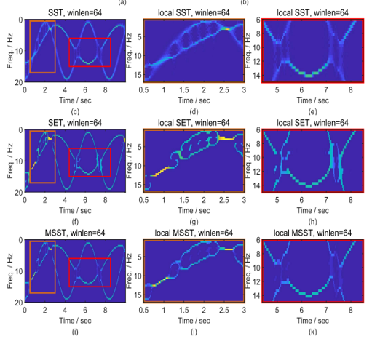
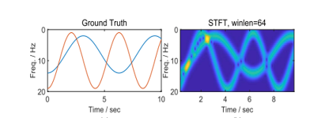
Examples 1
Input signal: 2 component
$x\left(t\right)=\exp\left(j2π\left(8t+6\sin\left(t\right)\right)\right)+\exp\left(j2π\left(10t+6\sin\left(1.5t\right)\right)\right)$
${IF}_{1}\left(t\right)=8+6\cos\left(t\right)$
${IF}_{2}\left(t\right)=10+9\cos\left(1.5t\right)$

Slide 8
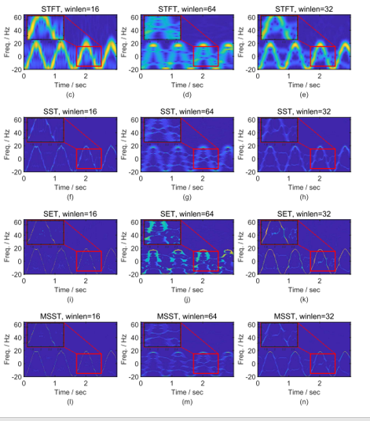
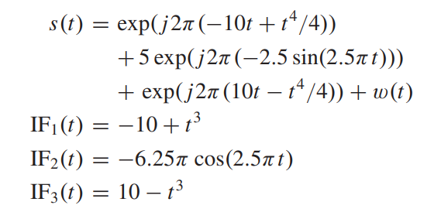
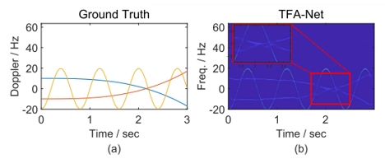
Examples 2
Input signal: 3 component

Slide 9
Dataset
Dataset:
30,000 training data
1000 test data
All data are mixed with the additive white Gaussian noise (AWGN), and the SNRs vary from −5 to 40 dB.
Generating steps:
Data : $s\left(n\right)=\sum_{p=0}^{P−1}{A_{p}\exp\left(j2πd_{p}n\right)\exp\left(j2π×B_{p}\cos\left(2π\left(a_{p}n^{2}+b_{p}n+θ_{p}\right)\right)\right)}$
Random variables :
Number of component : $P∈𝒰\left(1, 5\right)$
Amplitude of the p-th component : $A_{p}=0.1+5\left|v_{p}\right|$ , $v_{p}∈𝒩\left(0 , 1\right)$
Doppler shift : $d_{p}∈𝒰\left(−150, 150\right)$
Vibration amplitude of the p-th component : $B_{p}∈𝒰\left(0.01, 6\right)$
Polynomial coefficients : $a_{p}∈\left[−6, 6\right)$ ; $b_{p}∈\left[−4, 4\right)$ ; $θ_{p}∈𝒰\left(0, 2π\right)$
Ground truth : $gt\left(k,n\right)=\left\{\begin{aligned}{\overline{A}}_{p} , if ∃p, s.t. k∆f≤\tilde{{IF}_{p}}\left(n\right)≤\left(k+1\right)∆f \\ 0 ,otherwise\end{aligned}\right.$
Logarithm magnitude : ${\overline{A}}_{p}=20\log_{10}\left(1+A_{p}\right)$
Time index : $n=0,1,…, L−1$ ; frequency index : $k=0,1,…,2N_{f}−1$ ; frequency interval : $∆f=\frac{f_{s}}{2N_{f}}$
$\tilde{{IF}_{p}}\left(n\right)=mod\left({IF}_{p}\left(n\right),f_{s}\right)$
${IF}_{p}\left(n\right)=d_{p}−2πB_{p}\left(2a_{p}n+b_{p}\right)\sin\left(2π\left(a_{p}n^{2}+b_{p}n+θ_{p}\right)\right)$

Slide 10
Loss function
Loss function:
$L=\sum_{k}{\sum_{n}{{\left({\hat{TF}}_{est}−gt\left(k,n\right)\right)}^{2}w_{k,n}}}$
Penalty factors:
$w_{k,n}=\left\{\begin{aligned}\max_{κ}{{{{\overline{A}}_{κ}}^{2}}/{{{\overline{A}}_{p}}^{2}}}, if ∃p, s.t. k∆f≤\tilde{{IF}_{p}}\left(n\right)≤\left(k+1\right)∆f \\ 1, otherwise\end{aligned}\right.$
Logarithm magnitude : ${\overline{A}}_{p}=20\log_{10}\left(1+A_{p}\right)$

Slide 11
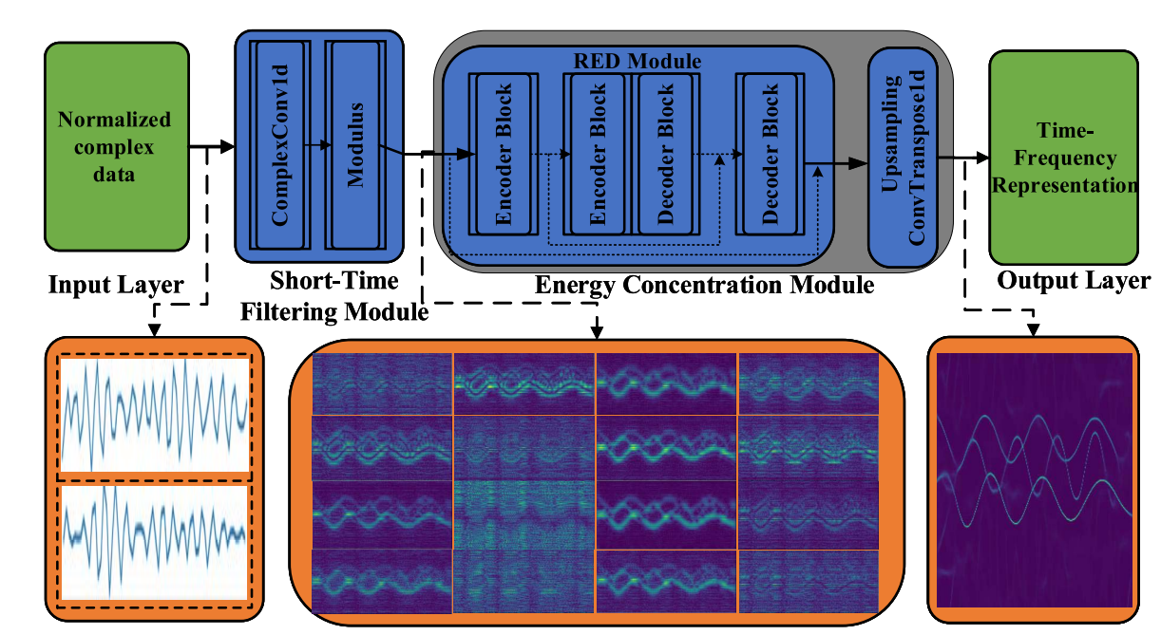
Overall Architecture: TFA-Net
Overall Architecture: TFA-Net

Slide 12
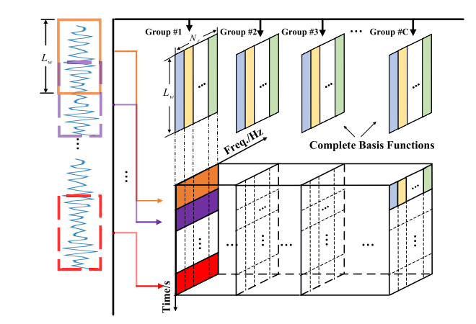
1st module: Short-time filtering
1st module: Short-time filtering
Short-time Fourier transform (STFT):
Input signal : $x\left(t\right)$
Window function : $g\left(t\right)$ , even function
STFT : $G\left(t,ω\right)=\int_{−∞}^{∞}{x\left(u\right)g\left(u−t\right)e^{−jωu}du}$
$cTFR\left(m,k\right)=\sum_{n=0}^{L_{w}−1}{g\left(n−m\right)s\left(n\right)W\left(n,k\right)}$
Input signal : $s\left(n\right)=s_{R}\left(n\right)+js_{I}\left(n\right)$
Weight matrix : $W\left(n,k\right)=W_{R}\left(n,k\right)+jW_{I}\left(n,k\right)$
$cTFR\left(m,k\right)=\sum_{n=0}^{L_{w}−1}{g\left(n−m\right)s\left(n\right)W\left(n,k\right)}$
$$=\left[\sum_{n=0}^{L_{w}−1}{\left(g\left(n−m\right)s_{R}\left(n\right),W_{R}\left(n,k\right)\right)}−\sum_{n=0}^{L_{w}−1}{\left(g\left(n−m\right)s_{I}\left(n\right),W_{I}\left(n,k\right)\right)}\right]+j\left[\sum_{n=0}^{L_{w}−1}{\left(g\left(n−m\right)s_{I}\left(n\right),W_{R}\left(n,k\right)\right)}+\sum_{n=0}^{L_{w}−1}{\left(g\left(n−m\right)s_{R}\left(n\right),W_{I}\left(n,k\right)\right)}\right]$$
$$≜\left[Conv\left(g\left(n−m\right)s_{R}\left(n\right),W_{R}\right)−Conv\left(g\left(n−m\right)s_{I}\left(n\right),W_{I}\right)\right]+j\left[Conv\left(g\left(n−m\right)s_{I}\left(n\right),W_{R}\right)+Conv\left(g\left(n−m\right)s_{R}\left(n\right),W_{I}\right)\right]$$

Slide 13
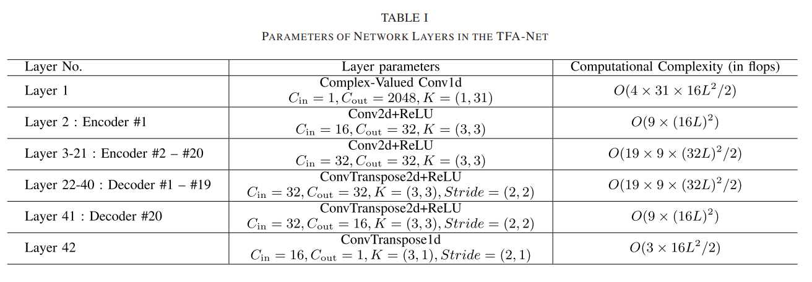
2nd module: Energy concentration
2nd module: Energy concentration
$$C_{out}=16$$

Slide 14
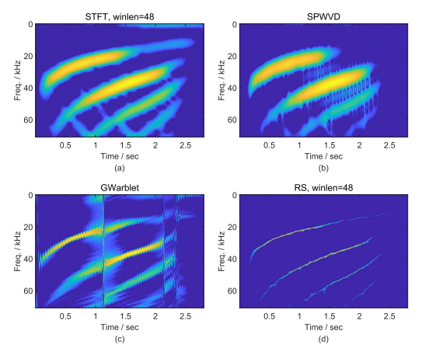
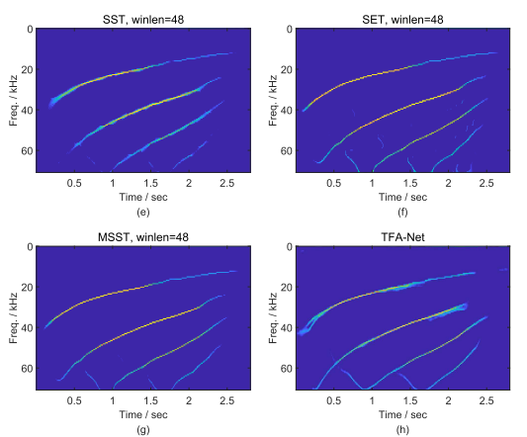
Real world signals
Real world signals:
Bat signals :

Slide 15
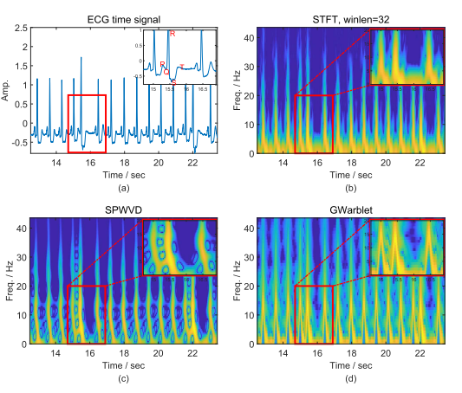
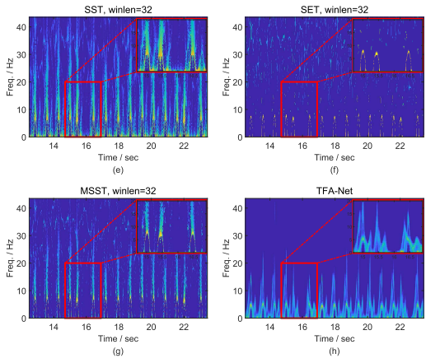
Real world signals
Real world signals:
ECG signals :

Slide 16
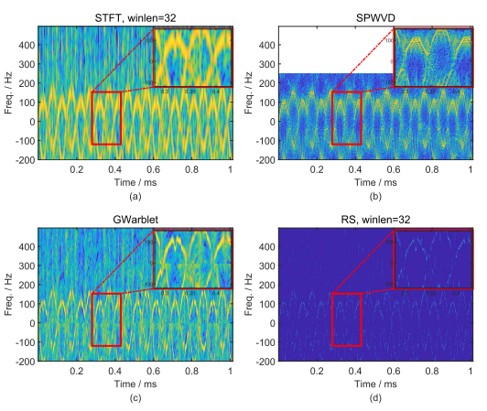
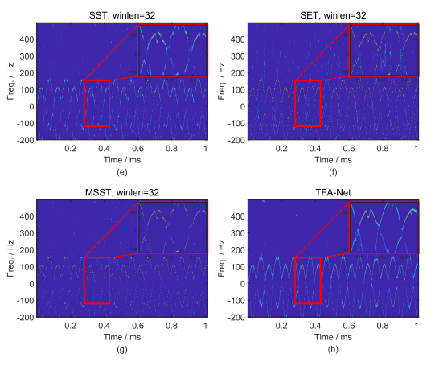
Real world signals
Real world signals:
Micro Doppler on Radar signals :

Slide 17
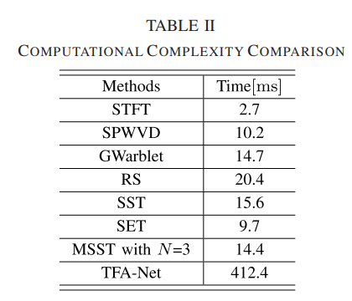
Complexity
Complexity:
Times of experiment : 1000
The length of input signal : $L$
The length of window : $L_{w}$
STFT : $𝒪\left(\left(L−L_{w}\right){∙L}_{w}\log\left(L_{w}\right)\right)$
SST : $𝒪\left(L^{2}\right)$
TFA-Net :$𝒪\left(710×{\left(16L\right)}^{2}\right)$

Slide 18
Conclusion
TFA-Net :
End-to-end model
Avoid exhaustive search of hyper-parameters for optimal time-frequency representations
High generalization capability and can be directly applied to the time-frequency analysis of real-world signals.

