Slide 1
網站開發架構與工具
張耀仁

Slide 2
Motivation
網頁的必要性
經驗分享

Slide 3
Content
HTML, CSS, JavaScript, SQL
Ruby on Rails
Reference

Slide 4
HTML, CSS, JavaScript
HTML : 內容
CSS : 外觀
JavaScript : 行為
Resource : http://www.w3schools.com/

Slide 5
HTML
HTML stands for Hyper Text Markup Language
HTML documents are described by HTML tags
Each HTML tag describes different document content
Notes:
HTML的全名是HyperText Markup Language，是編寫網頁的基本語言，而它並不是一個程式， 只是一些插在普通文件內的碼( code )，這些碼可以控制我們的瀏覽器要怎樣把文件顯示出來, 就是你現在所看到的頁面就是用HTML來控制的，它可控制字體的大小，也可以插入連結或圖像。

Slide 6
HTML
HTML elements are written with a start tag, with an end tag, with the content in between:

Slide 7
HTML
http://www.w3schools.com/html/tryit.asp?filename=tryhtml_basic_document

Slide 8
HTML
Other tags : <div>, <span>, <table>, <br>, <script>, <section>, <blockquote> ……….
HTML Attributes : provide additional information about an element
id
class
src
href
……

Slide 9
CSS
CSS stands for Cascading Style Sheets
CSS describes how HTML elements are to be displayed on screen, paper, or in other media

Slide 10
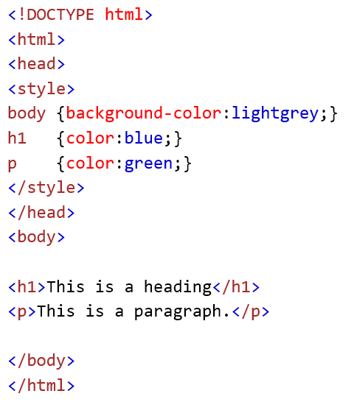
CSS
In HTML

Slide 11
CSS
In HTML
In mystyle.css

Slide 12
CSS

Slide 13
CSS
font, background, colors, height, width, position…………..
What can pure CSS do ? https://codepen.io/rachel_web/pen/pjzowB

Slide 14
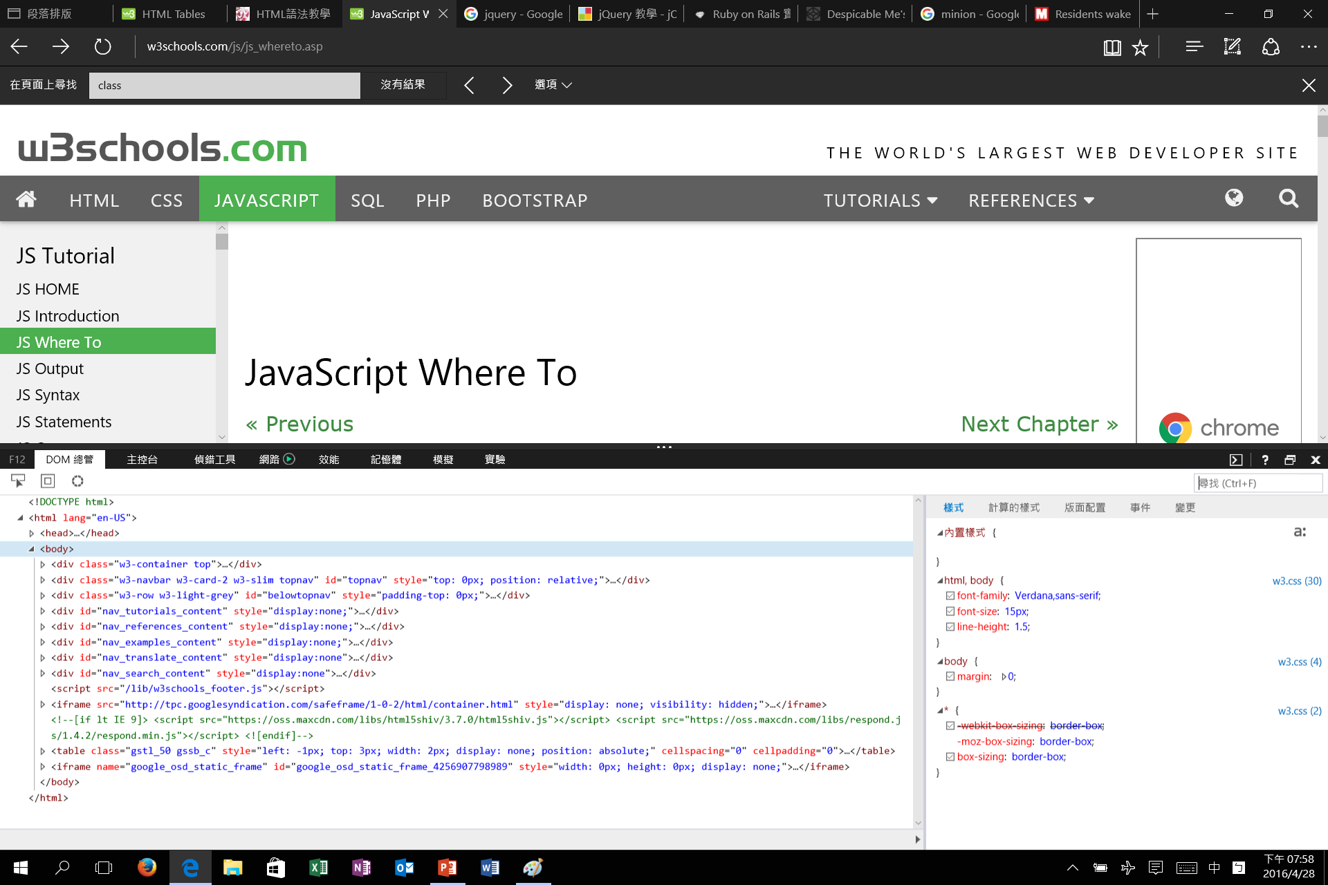
CSS
Practice
F12

Slide 15
JavaScript
JavaScript is the programming language of HTML and the Web
Node.js
Notes:
瀏覽器只是提供了一個上下文，它定義了使用JavaScript可以做什麼，但並沒有 "說" 太多關於JavaScript語言本身可以做什麼。事實上，JavaScript是一門 "完整" 的語言： 它可以使用在不同的上下文中，其能力與其他同類語言相比有過之而無不及。

Slide 16
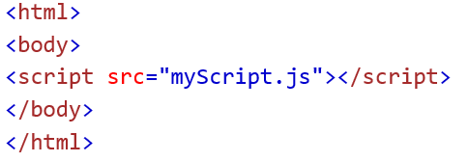
JavaScript
In HTML
External

Slide 17
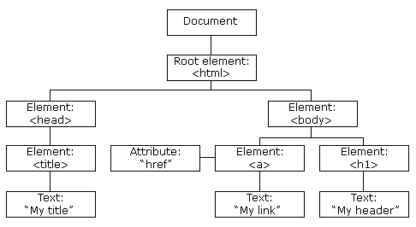
What can JavaScript do?
Change all the HTML elements
Change all the HTML attributes
Change all the CSS
Remove existing HTML elements and attributes
Add new HTML elements and attributes
React to all existing HTML events
Create new HTML events

Slide 18
HTML DOM
The HTML DOM is a standard for how to get, change, add, or delete HTML elements.
all HTML elements are defined as objects.
A property is a value that you can get or set
A method is an action you can do

Slide 19
HTML DOM
Example : http://www.w3schools.com/js/js_htmldom_methods.asp
Notes:
In the example above, getElementById is a method, while innerHTML is a property

Slide 20
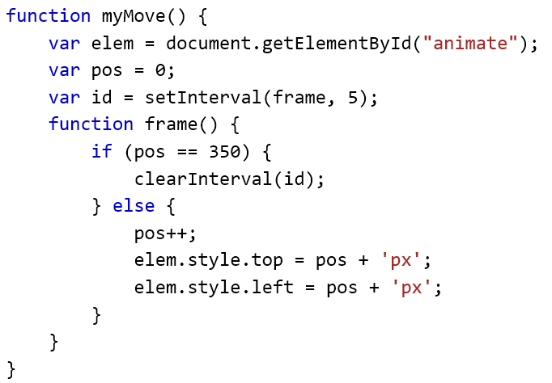
JavaScript
Animation
Example : http://www.w3schools.com/js/tryit.asp?filename=tryjs_dom_animate_3

Slide 21
JavaScript&CSS library
jQuery https://jquery.com/
Bootstrap http://getbootstrap.com/

Slide 22
SQL
SQL stands for Structured Query Language
SQL is a standard language for accessing and manipulating databases

Slide 23
SQL
build a web site that shows data from a database, you will need
A database program (MySQL)

Slide 24
SQL
Some of The Most Important SQL Commands
SELECT - extracts data from a database
UPDATE - updates data in a database
DELETE - deletes data from a database
INSERT INTO - inserts new data into a database
CREATE DATABASE - creates a new database

Slide 25
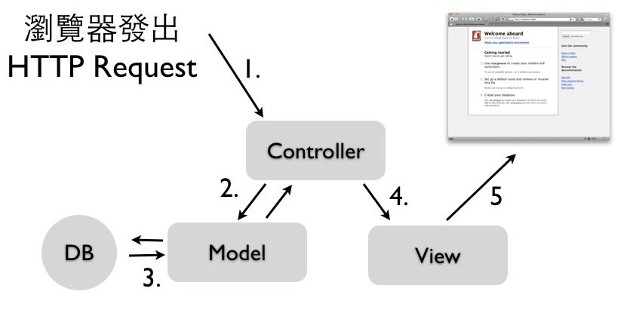
Ruby on Rails
A Web Framework
MVC
MVC是一個巨大誤會 : http://blog.turn.tw/?p=1539

Slide 26
Ruby on Rails
Don't Repeat Yourself
Convention Over Configuration

Slide 27
Ruby on Rails
URL路由
指定任意URL對應到任一個Controller的動作，跟檔案位置是無關
config/routes.rb
get “welcome/say” => “welcome#say” ( “say “ method in “welcome” controller)
match ':controller(/:action(/:id(.:format)))', :via => :all
ORM(Object-relational mapping)
不用寫SQL語法

Slide 28
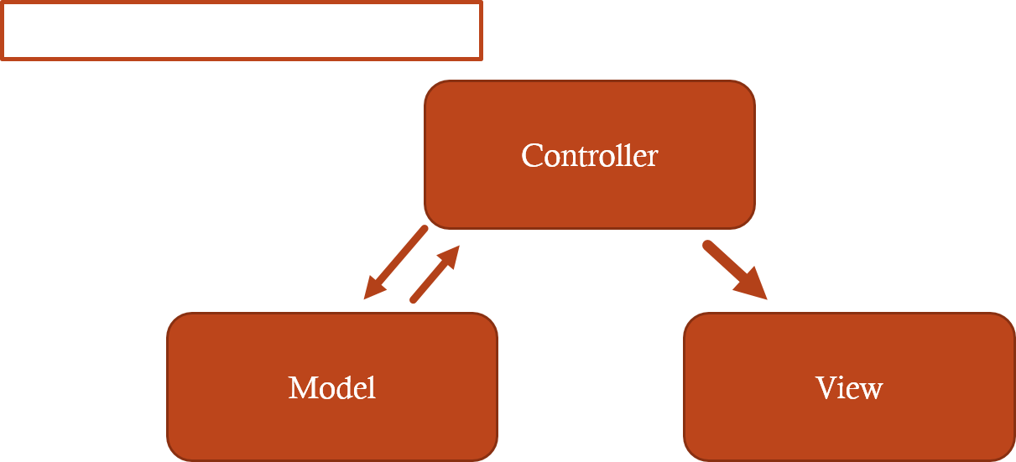
Ruby on Rails

Slide 29
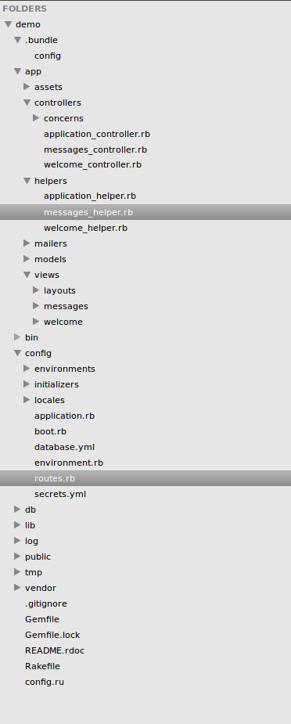
Ruby on Rails
New project
rails new demo

Slide 30
Ruby on Rails-Request
config/routes.rb
get “welcome/say” => “welcome#say” ( “say “ method in “welcome” controller)
match ':controller(/:action(/:id(.:format)))', :via => :all

Slide 31
Ruby on Rails-controller
rails g controller welcome
controllers/welcome_controller.rb

Slide 32
Ruby on Rails-model
Create model “User”
rails g model user name:string
rake db:migrate
rails c
u1 = User.new
u1.name = ‘MD531’
u1.save

Slide 33
Ruby on Rails-model
Migration
rails g migration add_status_to_users
# db/migrate/XXXXXXXXXXX_add_status_to_users.rb
class AddStatusToUsers < ActiveRecord::Migration
def change
add_column :users, :status, :string
end
end
Rake db:migrate

Slide 34
Ruby on Rails-View
view/say.html.erb
<%= %>

Slide 35
Ruby on Rails

Slide 36
Ruby on Rails
RubyGem
Bootstrap, jQuery
帳號系統
The Ruby Toolbox
開發快速
demo(if have time)

Slide 37
Should I use Ruby on Rails?
Is Ruby On Rails Dying
適合ROR:
透過存取資料庫，動態產生內容的網站
不適用於CMS(Content Management System)的
一個全新的應用
Note
如果你只需要靜態的HTML，那是絕不需要用到Rails的 -- ihower

Slide 38
Summary
HTML, CSS, Javascript
SQL
Ruby on Rails

Slide 39
Reference
http://www.w3schools.com/
https://ihower.tw/rails4/intro.html
https://codepen.io/rachel_web/pen/pjzowB
http://ilikekillnerds.com/2015/02/is-ruby-on-rails-dying/

