Slide 1
GoldWave 音樂編輯軟體
-演算法與技巧-
學生: 冼達
指導教授: 丁建均

Slide 2
Example: 去除人聲
如果遇到人聲和音樂合在一起的，可以透過效果==>立體聲==>減少人聲，不過這個方法效果有限，可能會連音效的聲音也被減少。

Slide 3
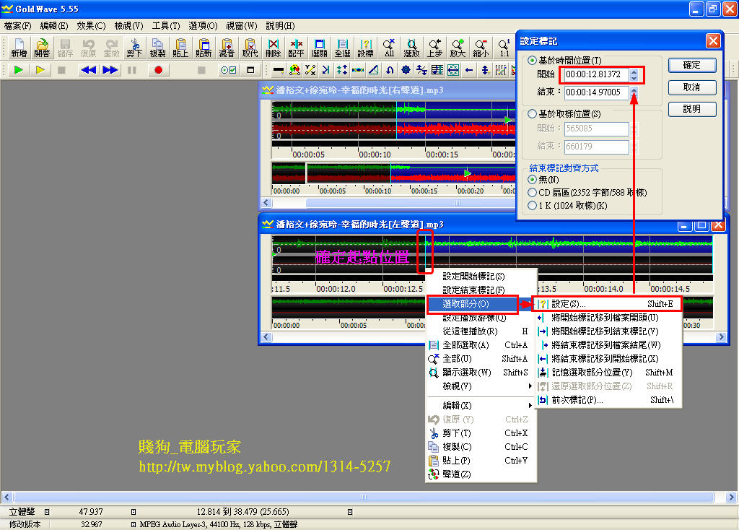
基本操作: 音樂剪接與編輯合成
為了準確知道要接的起始點，可以按滑鼠右鍵透過【選取部分】==>【設定】得知要連接的起始點，也可以透過【設定】直接設定要修改的位置，才不會接錯點讓音樂聽起來怪怪的。

Slide 4
Censor- 人工合成聲音
Effect -> Censor 可以選擇多種效果的人工合成音樂(High tone, ding, ding dong, …etc.)

Slide 5
Censor :the math model.
High/medium tone: 純音
Ding:
Ding Dong:
Buzz:
Siren(Doppler):
$$\left.y(t)=cos(2πf_{c}t\right)$$
$$\left.y(t)=a(t)×cos(2πf_{c}t\right)$$
$$y(t)=\frac{\left.sin((t×tan(400t)+sin(600t)×sin(N×t^{2})\right)}{1.5}$$
$$\left.y(t)=A(\sum_{n}{\left.U(t−nT\right)}−\frac{1}{2}\right)$$
$$y(t)=Acos(2πft), f=(\frac{v+v_{r}}{v+v_{s}})f_{0}$$

Slide 6
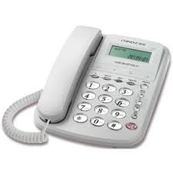
Other censors
#: (sin(5912*t)+sin(9280*t))/2 * : (sin(5912*t)+sin(7596*t))/2 0: (sin(5912*t)+sin(8394*t))/2 1: (sin(4379*t)+sin(7596*t))/2 2: (sin(4379*t)+sin(8394*t))/2 3: (sin(4379*t)+sin(9280*t))/2 4: (sin(4838*t)+sin(7596*t))/2 5: (sin(4838*t)+sin(8394*t))/2 6: (sin(4838*t)+sin(9280*t))/2 7: (sin(5353*t)+sin(7596*t))/2 8: (sin(5353*t)+sin(8394*t))/2 9: (sin(5353*t)+sin(9280*t))/2
Bender(弯音): wave(n+(1/T/16)*(sin(2*pi*t)+1)) Echoes, x=delay, y=volume(回声，x=延迟，y=音量): wave(n)+wave(n-(1/T)*x)*y Envelope detector(包络检测): (wave(n)>wave(n-1))*(wave(n)*0.1+wave(n-1)*0.9)+(1-(wave(n)>wave(n-1)))*(wave(n-1)*0.99) Frequency modulation(频率调制): cos(2*pi*f*t + y*wave(n)) Tremolo(震音): wave(n) * (0.6 + 0.4 * sin(2*pi*f*t))

Slide 7
迴音(echo)特效
$$\left.y(t)=x(t)+Ax(t−N\right)$$

Slide 8
Filter: Digital bandpass filter
$$\left.y(t)=IFFT(FFT(x(t))×rect(\frac{f−E}{BW})\right)$$

Slide 9
Filter: Manual Equalizer
$$\left.y(t)=IFFT(FFT(x(t))×W(f)\right)$$

Slide 10
Filter: Noise Reduction
Analysis the spectrum at the specific moment in green signal, and the desired or manual filter would be applied for the entire signal.

Slide 11
Silence reduction

Slide 12
Amplitude smoother
$$\left.y(t)=x(t)×f(x(t)\right)$$

Slide 13
Reverse and Invert
Reverse:
$$\left.y(t)=x(−t\right)$$
Invert:
$$\left.y(t)=−x(t\right)$$

Slide 14
Pitch: Offset the spectrum
$$\left.y(t)=FFT^{−1}(X(f_{1}×k)\right)$$

Slide 15
Time Warp: Do interpolation in the waveform.
$$\left.y(t)=x(t/N\right)$$

